Slide 1
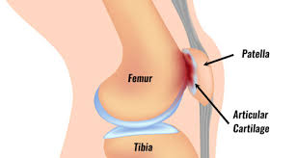
PATELLOFEMORAL SYNDROME
Fiona Rattray & Linda Ludwig Pg.537

Slide 2
PATELLOFEMORAL SYNDROME
Patellofemoral syndrome also called patellofemoral tracking disorder, describes various painful degenerative changes to the articular cartilage on the underside of the patella.
65% of patellofemoral P is due to tracking or instability problems.
Several predisposing factors to this condition, including abnormal biomechanics, soft tissue dysfunction, and previous injury.

Slide 3
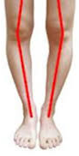
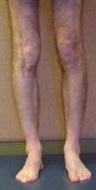
CONTRIBUTING FACTORS
Abnormal biomechanics: increased foot pronation, internal tibial rotation, internal femoral rotation.

Slide 4
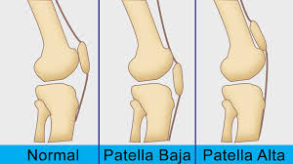
CONTRIBUTING FACTORS
A small high riding patella: called patella alta.
Less stable due to it lies in the shallower superior portions of the femoral groove.

Slide 5
CONTRIBUTING FACTORS
Tight lateral structures: vastus lateralis, IT band, and TFL. This will pull the patella laterally.
Tight posterior and anterior structures: hamstrings, gastrocs, rectus femoris, any of these structures can cause abnormal movement of the knee.
Weakness: Vastus medialis, glute medius.
Knee injury: Patellar subluxation, knee surgery. These can injure the articular surfaces and result in weakness.
Arthroscopic structures: Can cause iatrogenic lesions of the cartilage.
Repeated knee stress: Overuse

Slide 6
MEDICAL TX
NSAIDS
Remedial exercise, such as straight leg raises and knee extensions for 8-12 weeks.
Taping in specific positions to correct the abnormal position and decrease pressure on the articulating surfaces.
Surgery is used in minor cases.
Knee supports or braces to relieve the P.

Slide 7
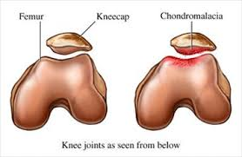
ASSOCIATED CONDITIONS
Chondromalacia patella: softening of the cartilage.
Often asymptomatic and is part of the aging process.
It may develop secondary to patellar tracking disorders.
Develops in the deep layers of the cartilage.

Slide 8
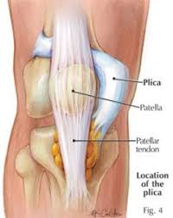
ASSOCIATED SYMPTOMS
Plica syndrome: Synovial folds at the knee also called plica.
These folds are usually asymptomatic unless repeated overuse and injury to the knee results in fibrosing of the plica.
The knee is painful and may mimic patellofemoral P.
Clicking or swelling may also result.
A taut palpable band is noted just medial to the patella.

Slide 9
SYMPTOM PICTURE
Peripatella and subpatellar P.
Client has difficulty sitting for long periods of time due to P.
Activities such as walking down stairs, squatting, and running downhill are painful, the knee may give way.
P on patellar compression.
**Please read observation and palpation Pg.540-541

Slide 10
TESTING
AF ROM: May reveal excessive lateral motion of the patella in the first 45 degrees of flexion.
The patella is lightly palpated for snapping of soft tissue over medial or lateral retinaculum when the client flexes and extends the knee.
PR ROM: Is palpated for crepitus, and to check if the patella tracks in the lateral manner.
Tightness in the lateral retinaculum is present when the patella is medially mobilized.
AR strength test: Glute medius may be reduced.
Length tests: Hamstrings reveal reduced knee extension, when the hip is flexed to 90 degrees.

Slide 11
TESTING
Gastrocnemius may be shortened.
Waldron’s, McConnells, Clarks patellofemoral grind test. Patellar apprehension test.
Obers: Positive for IT band tightness.
Differential assessment for patellar tendinitis: P when palpated at the patellar tendon inferior to the patella, P also with a knee squat.

Slide 12
TREATMENT
Positioning: Prone, supine, or side lying are all indicated.
Hydro: Deep moist heat.
GSM on low back, and gluteals in prone position.
Fascial techniques are used on IT band and hamstrings. Fascial spreading, skin rolling to lateral knee and retinaculum.
Patella is mobilized in a medial direction.
Petrissage is done to TFL, glute medius, hams, and gastroc.
Supine position: adductors and quads are treated with effleurage, petrissage.
TP’s are tx’d, with mm stripping and ischemic compressions.

Slide 13
TREATMENT
PF ROM of the knee.
Passive stretching is indicated.
Joint play at the hip and ankle.
Tx to distal leg and foot.

Slide 14
SELF-CARE
Home care should be directed at the whole limb, not just the condition itself.
Strengthening such as quadriceps setting.
Straight leg raises 10-15 reps/3 sets/3rd day
Knee extensions over a towel roll.
Strengthening to hip abductors, client is side lying on the unaffected side and abducts against gravity.
Self-mobilization of the patella.
Self massage to the IT band.
Flexibility exercises.

Slide 15
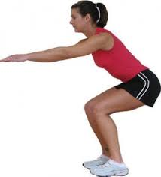
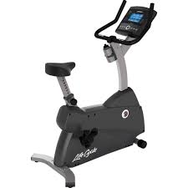
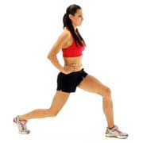
SELF-CARE
Hamstring and gastrocnemius stretches to be specific.
Closed kinetic chain exercises: Step downs with the leg to be strengthened remaining on the top step while the other leg steps back up.
Partial squats: Leaning against the wall.
Partial lunges.
Stationary bike as they progress and resistance set to low.

Slide 16
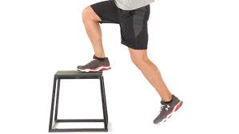
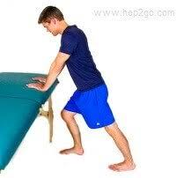
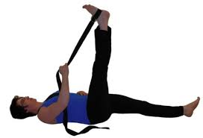
SELF-CARE

