Slide 1
Inflammatory arthritides
Pg 963

Slide 2
What is it?
A group of inflammatory diseases affecting connective tissue including the joints.
These include but are not limited to:
      Ankylosing spondylitis
      Gout
      Infectious arthritis
      Lyme disease
      Reiter’s syndrome
      Rheumatoid arthritis
      Scleroderma
      Still’s disease and juvenile RA
      Systemic lupus erythematosus
    *bold is what we will cover.

Slide 3
Ankylosing spondylitis
Pg 963

Slide 4
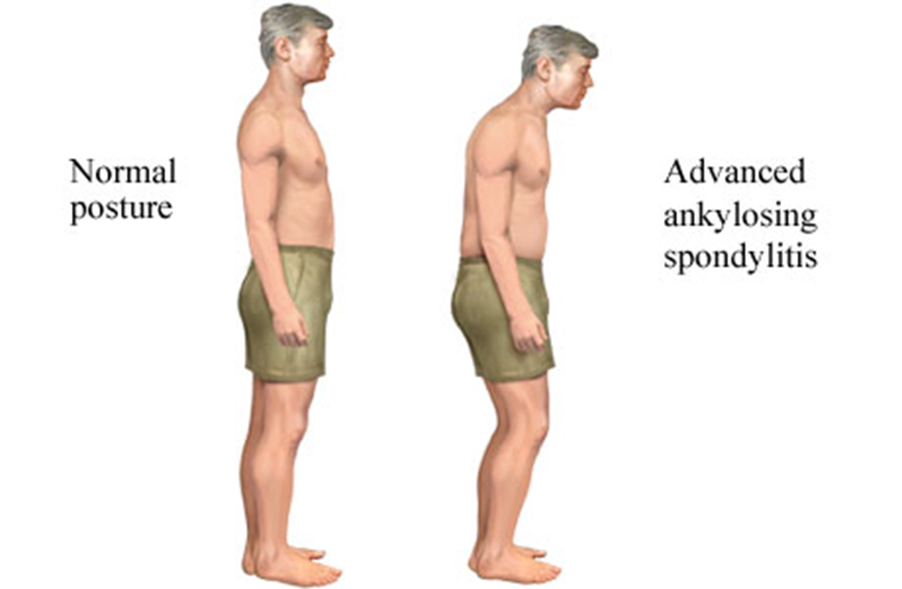
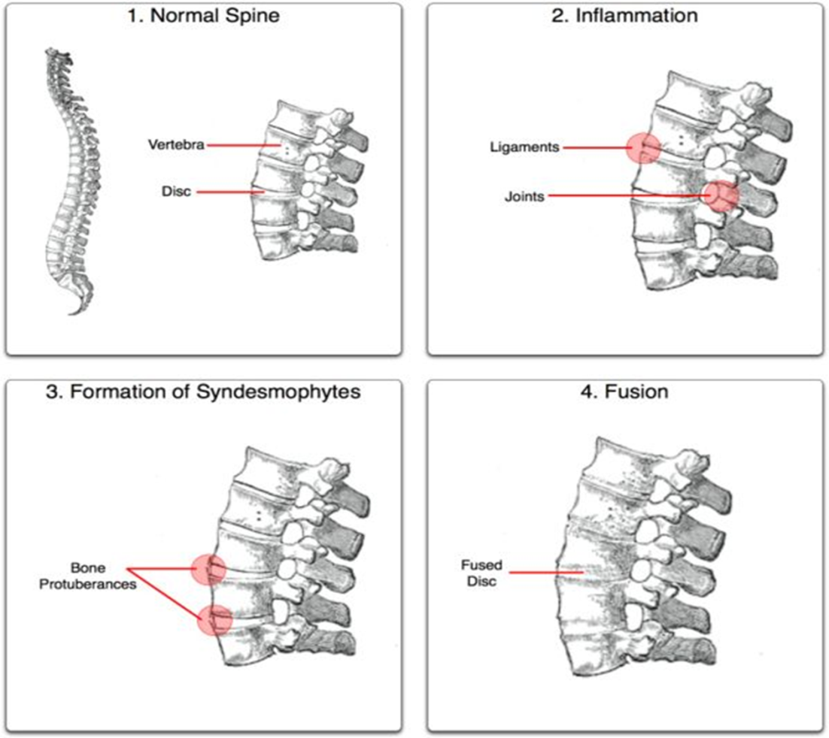
What is it?
AS is a chronic, systemic inflammatory disorder that involves specific areas of the body, primarily the spine.
Cause is idiopathic
Group read 963

Slide 5
gout
Group read Pg 965

Slide 6
What is it?
A group of disorders in which crystals of monosodium urate are deposited in the tissues, accompanied by attacks of acute arthritis
Cause: malfunction of the normal chemical process that breaks
The metatarsophalangeal joint of the big toe is the area most commonly attacked by gout, with the tarsal area and ankle also frequently involved. The other joints are less commonly affected.
Pseudogout, a similar condition, is caused by calcium pyrophospate dihydrate crystals. Joints attacked are usually, ankles, knee, shoulders and wrists, big toe rarely.
90% are men usually between 40 and 50
Women usually post-menopausal, children rarely affected.

Slide 7
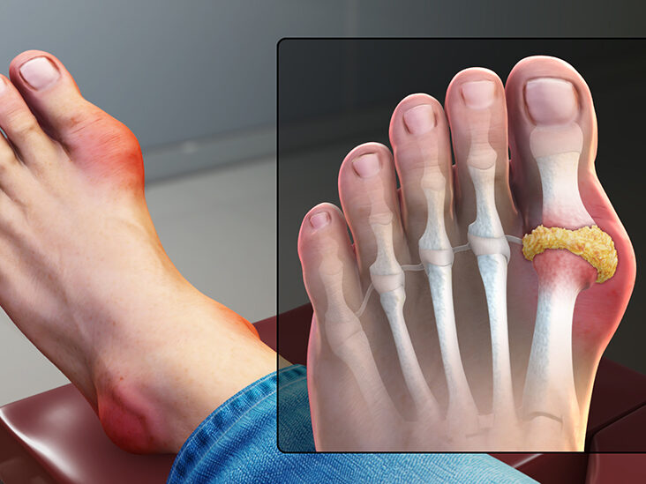
medically
Diagnosed through identification of urate crystals in synovial fluid
Acute attack Inflammation and pain treated with NSAIDS and colchicine.
Uric acid production reduced with allopurinol
Dietary changes- liver, sardines and alcohol (until medication stabilizes)
Obese may be placed on physician-directed weight-reduction plan.

Slide 8
Rheumatoid arthritis
Pg 969

Slide 9
An inflammatory, destructive, chronic autoimmune disease of multiple joints and connective tissue throughout the body
Cause is unknown
RA affects 1% of the population, women affected more than men with a 3:1 ratio.
Can affect people of all ages, prevalence increases with age, 25-50 most commonly affected.
Often has a gradual onset over several months, w symptom-free periods following for several months or years. There are flare-up and remission periods. There may be complete remission periods within the first few years but is less likely in later stages.
Prognosis is uncertain.

Slide 10
Group read
Pg 970-972

Slide 11
Ci’s and Treatment
Pg 975

Slide 12
Ci’s
Testing, except for AROM, is contraindicated on acute inflamed joints
Hot hyrdo during acute inflammation
General massage fever over 38.5°C or 101.5°F
Lymph drainage proximal to affected joint are avoided w acute infection
Local massage on acute inflamed joints or open lesions. Avoid distal techniques that will painfully increase circulation through the joint.
Do not fatigue the pt, avoid prolonged or overly vigorous tx
Joint play; acute inflamed joints (prevent aggravation)
-Gentle progressive grades of joint play may be cautiously used between flare-ups.
-Forceful techniques may rupture connective tissue and joint capsule creating instability.
*Severe RA creates C1/C2 instability- tractioning and ROM of C/S CI’d
In tx or home care, PROM and AROM are avoided as remedial exercises
Deep, vigorous techniques may provoke inflammation in come pt between flare-ups
Stretching techniques are used with caution, vigorous passive stretching may also cause inflammation.
Strengthening should not be painful and should not fatigue the muscles

Slide 13
Health history questions
Read pg 975-976

Slide 14
Further assessment: Ankylosing Spondylitis
Additional HH questions: has onset of the low back pain been insidious and has stiffness occurred for more than 3 months?
Is there family history of AS?
Are symptoms worse with rest and better with exercise?
Observation:
- Gait: rigid gait with some knee flexion due to hips flexed
- Posture: lateral- decreased lordotic curve, increased hyperkyphosis and HFP. With increasing severity of the condition, the hyperkyphosis worsens, rib movement is reduced or absent with breathing, the abdomen may protrude.
Testing:
- AROM: hips and SIJ and L/S, T/S and C/S may be reduced due to stiffness and pain. All ranges may be affected, most commonly trunk flexion.
- PROM: reduced range and either muscle spasm or leathery end feel

Slide 15
Massage (A.S.)
Goal is to decrease pain, hypertonicity and TRP, maintain thoracolumbar mobility and respiratory function, prevent or reducing postural changes and educating the pt about correct posture and exercises.
Positioning: prone and supine
Hot hydro is used on affected areas between flare ups
Massage is a combination of stres reduction and hyperkyphosis. Fascial techniques are used on ant thorax, (intercostals and pecs) GSM used on hip flexors, pec major and minor, SCM, intercostals and rot cuff. Back extensors, QL, scap retractors. Work compensating structures (hams and ER of hip)
PIR used to lengthen shortened muscles (hip flexors and pecs)
Joint Plays: hips, SIJ, vertebrae, ribs, scapulothoracic articulations, sternoclavicular joints

Slide 16
Self Care (A.s.)
Exercise to maintain mobility and strength of hips, entire spine and shoulders.
Active free back muscle extension and rotation, stretches for hip flexors, pecs, scalenes and SCM
Posterior pelvic tilt exercises and strengthening for the back extensors and scap retractors. Swimming is excellent for joints.
Diaphragmatic breathing exercises with focus on lateral rib motion and sternal lifting with thoracic mobility
Several 15 min rest periods throughout the day are recommended, where the pt can lie prone with arms above the head to prevent hyperkyphosis. A pillow can be placed under the thorax and a rolled towel under the head.
Sleeping on a firm mattress w/o a pillow, supine instead of side lying.
Movement therapy may be beneficial for retraining and monitoring the pt’s posture. May be referred to the arthritis society

Slide 17
Further assessment: RA and others
Group read pg 977-978

Slide 18
Massage during flare-up
Goal: depends whether pt is in remission or flare up, stress reduction and relaxation, decrease pain, edema and spasm, maintaining joint mobility, maintain and increase joint strength and prevent or reducing postural changes and joint deformities.
Initial visit: a gentle conservative treatment of shorter duration is prudent.
massage, if tolerated, is to the unaffected areas. Tx is 30 mins in duration to avoid exhausting the pt. Focus of relaxation w unforced DDB.
Hydro: cold to affected joint
Position: prone/ supine/ side lying comfortable for pt
TX: HNF for relaxtation, storking, mm squeezing, light circular kneading and static kneading.
AAROM of the affected joints, or AFROM if symptoms are controlled by medication and gentle isometric contractions may be interspersed throughout tx.

Slide 19
Massage between flare-ups
Goal: depends whether pt is in remission or flare up, stress reduction and relaxation, decrease pain, edema and spasm, maintaining joint mobility, maintain and increase joint strength and prevent or reducing postural changes and joint deformities.
Initial visit: a gentle conservative treatment of shorter duration is prudent.
Tx is initially 30 mins, increasing to 45 mins according to the pt tolerance.
Tx is relaxation based including DB. Positioning is again for pt comfort.
Hot hydro may be used w chronically arthritic joints, as it controls pain and spasm, providing releif for 1 -2 hrs. A warm room is especially important if pt has active Raynauds associated w scleroderma.
Pure essential: sandalwood is an emollient (skin moisturizer). Lavender can help reduce P and roman chamomile has anti-inflammatory properties. 1:2 essential oil to carrier

Slide 20
Specific tx
Pain free rhythmic techniques, rocking an shaking. Contralateral and compensatory structures are treated to reduce hypertonicity and TRP’s, especially in mm’s that cross the joint.
Working proximal to distal on the affected limb, soothing GSM to reduce hypertonicity.
TRP’s are tx
Gentle fascial techniques to soft tissue contractures
Gout, R/A: gentle passive movement of the affected joints interspersed throughout tx
Passive and active movements may help to keep joints flexible, maintain circulation and prevent contractures.
Gentle jp may be used with caution o the affected joints to reduce adhesions present w gout and R/A
Address postural dysfunctions
Treatments are of an ongoing nature

Slide 21
Self care
Read pg 980

