Slide 1
Peripheral Nerve Lesions

Slide 2
What we will cover
Crush and severance injuries
Radial, ulnar and median nerve lesions.
Sciatic nerve lesion
Bell’s paralysis

Slide 3
What are peripheral nerve lesions?

Slide 4
A peripheral nerve lesion is an injury to a peripheral nerve which, depending on the severity, results in motor loss or weakness, sensory loss, sensory imparement or pain, as well as autonomic dysfunction.

Slide 5
The causes
Compression either internally or externally
Trauma such as crushing or severance wounds
Systemic disorders
Systemic edematous conditions

Slide 6
Classifying nerve injuries
Neuropraxia (first degree) is the compression of a nerve causing a local conduction block, with no structural damage to the axon or the tissue distal to the lesion.
Axonotmesis (second degree) is the prolonged, severe compression of a nerve. This causes a lesion at the site of the compression followed by degeneration of the axons distal to the injury.
Neurotmesis (3rd to 5th degree) is an injury to the nerve as a result of severance of part or all of the nerve trunk, including endoneurial tube.
Nerve lesions may be complete or partial.
In terms of the healing process, the lesion may be regenerating or permenant.

Slide 7
Peripheral nerve pain
Can be due to:
  Neuritis
  Neuralgia
  Causalgia
  Reflex sympathetic dystrophy
  neuromas

Slide 8
Crush and severance injuries

Slide 9
Group read
Pg 761-763

Slide 10
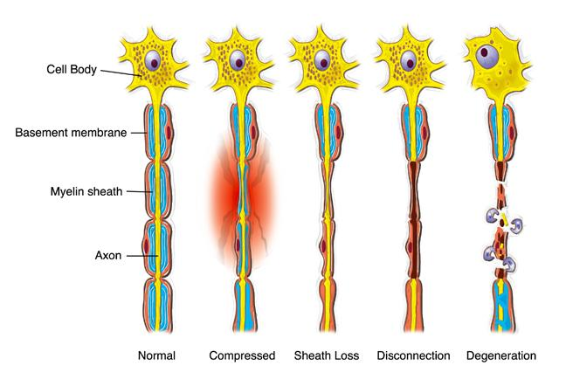

Slide 11
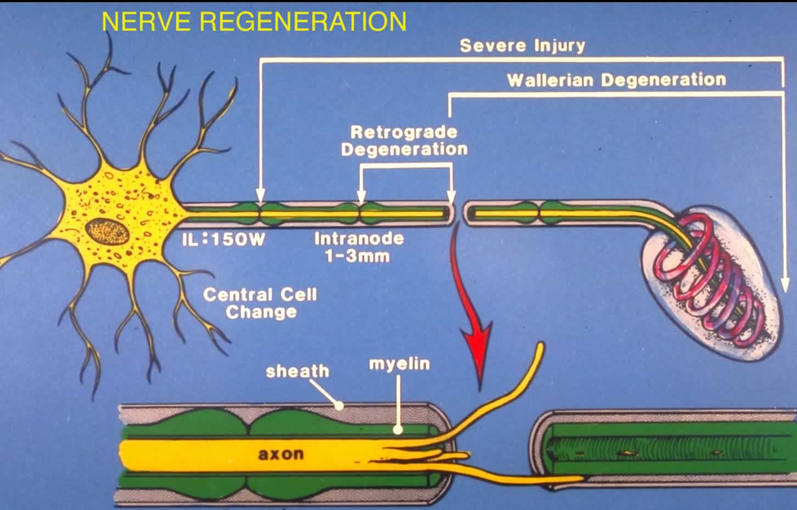

Slide 12
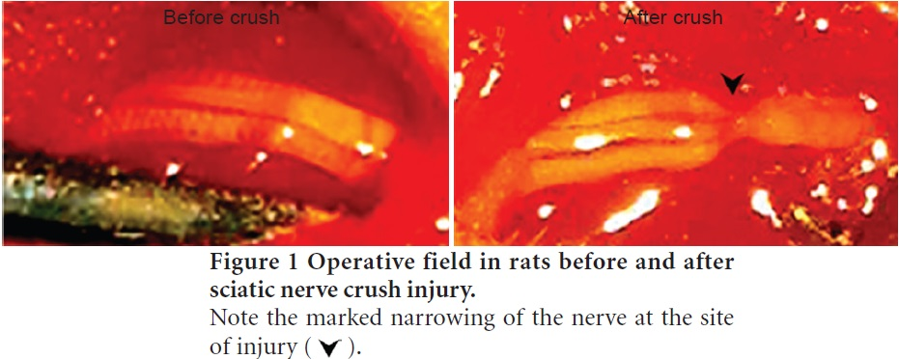

Slide 13
Symptom Picture

Slide 14
Regenerating lesions
Traumatic injuries resulting in nerve damage will frequently cause damage to other structures such as skin, bones, muscles and their tendons. Repair and subsequent healing of fractures, severed tendons ect., is also necessary for recovery of function.
A complete lesion is a nerve injury which results in damage to all the fibres within the nerve. A partial lesion results in damage to some of the fibres within the nerve. Where fascicles are well organized some end organs will suffer more damage than others depending on which fibres are affected and how severely. Only specific test will give a clear picture.
Edema is present
There is altered tissue health
Motor function is affected
Holding patterns are observed
Contractures may develop in the unopposed antagonists
Pain may be present
Scar tissue is present at the lesion site

Slide 15
Permanent lesions
If regeneration does not occur, the original functional, sensory and autonomic losses of a complete lesion, or dysfunctions of a partial lesion will remain.
Edema will remain.
Trophic changes and muscle wasting will become more marked with time.
Holding patterns will remain.
Scar tissue develops at the lesion site. A neuroma may also develop.
Pain may be present, especially with a partial permanent lesion.
Compensatory changes are present with a permanent nerve lesion as other muscles are used to perform lost or weak actions. Secondary conditions, such as tendonitis, may result.
With a permanent peripheral nerve lesion, the client must adjust to permanent functional and sensory losses. Also, disfigurement of a limb may be noticeable.

Slide 16
Subjective information
As mentioned earlier, to enable the therapist to develop a safe treatment plan, contact with the neurologist with the client’s permission is important. Nerve regeneration can be observed by improvement in muscle bulk and function as well as sensory perception.
The neurologist has access to testing procedures that the massage therapist does not and is able to determine when early muscle contractions, which are not palpable to a therapist, are present.

Slide 17
Observations
Holding patterns typical to the lesion may be evident.
Functional losses can be noted as the therapist observes the client before treatment.
Altered gait may result from nerve lesions in the lower limb.
An antalgic fascial expression or posture may be observed if a pain syndrome is present.
A decrease in muscle bulk will be evident. The muscle bulk is measured with a measuring tape at regular intervals so the therapist may chart changes. As reinnervation occurs, muscle bulk increases.
Edema may be present. Median and tibial nerves have additional autonomic fibres and in turn, will likely have increased edema, due to a lack of vasomotor control in the blood vessels previously innervated by the fibres.
Trophic changes of the skin, hair and nails often occur.
Inflammation or bruising is likely present in acute and subacute stages of healing. If surgery was performed, the condition of the scar is observed
Supportive splints or braces may be used to support the affected limb in a balanced position to allow safe use of the limb while regeneration occurs.
  Casting of the affected limb may occur in the first few weeks after surgery to promote successful regeneration of a nerve across the lesion.
  Skin irritation at splint pressure points can occur if the splint is not properly fitted.

Slide 18
Testing
Actions that traction the affected nerve are to be avoided until the nerve has regenerated past the lesion site.
AF ROM
PR ROM
AR testing

Slide 19
Special testing
Sensory testing: deep and light touch, pain and two-point discrimination, proprioception and piloerector response.
Tinel’s sign
Deep tendon reflex testing
Upper limb tension, slump and straight leg raise test

Slide 20
Regenerating lesion; early healing stages
Do not disrupt the healing process of the regenerating nerve
Cold compress can be used in acute stages
Decrease SNS firing
Do not traction the nerve or interfere with the healing process
Decrease edema
Decrease hypertonicity and trigger points of unaffected proximal muscles
Promote health of denervated tissue
Prevent contracture formation of the unopposed antagonist muscles
Maintain health in all joints of affected limb
Encourage motor re-education of affected muscles
Maintain the strength of the weak muscles

Slide 21
Later stages of healing of regenerating nerves
Positioning: do not let affected limb hang
Mild contrast wash
Decrease SNS firing
Address compensatory changes
Take care with tissue that is not yet fully innervated
Reduce edema
Promote tissue health of unaffected and newly innervated tissue
Reduce scar tissue formation
Maintain and improve joint health and ROM
Encourage motor re-education of the affected muscles
Perform sensory awareness re-education

Slide 22
Permanent lesions
Positioning includes any position that are suitable, provided the limb is secure.
Hydrotherapy restrictions must be maintained. Weight, duration and temp.
Decrease SNS firing
Treat compensatory changes
Decrease edema
Maintain tissue health
Limit contracture of the unopposed antagonist muscles
Reduce scar tissue
Maintain joint health
Maintain awareness of the affected limb

Slide 23
Self care regenerating lesions early stages
Encourage relaxation
Educate the client about tissue health
Encourage motor re-education
Maintain strength and ROM
Refer the client

Slide 24
Self-care later stages of healing
Educate the client
Encourage motor re-education
Maintain then increase strength and ROM
Encourage re-education of sensory awareness
Refer the client

Slide 25
Self-care permanent nerve lesion
Encourage relaxation
Educate the client
Maintain strength and ROM of the affected limb

Slide 26
Treatment frequency and expected outcome
Self read 780
Group discussion

Slide 27
Radial Nerve Lesion

Slide 28
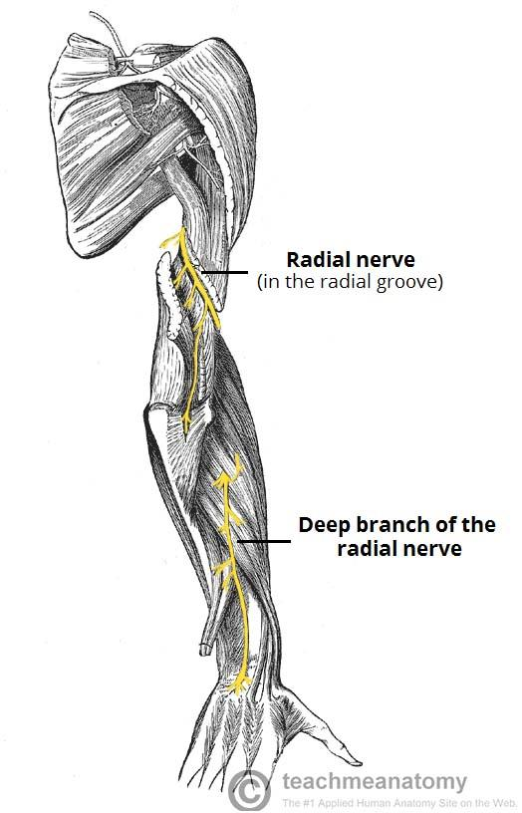
The Path
The radial nerve is a continuation of the posterior cord of the brachial plexus. From the posterior axillary wall between the long and medial heads of the triceps, the nerve continue to the spiral groove of the humerus, deep to the lateral head of the triceps.
It winds around the humerus to the lateral side where it travels to the anterior arm. The radial nerve is relatively superficial at this point before it travels between the brachialis and the brachioradialis, passing the extensor carpi radialis longus and extensor carpi radialis brevis .

Slide 29
The path cont…
The nerve crosses the elbow joint to the supinator. At this point, the radial nerve divides into 2 branches. The posterior motor branch enters the supinator muscles, then travels down the lateral aspect of the radius, innervating extensor digitorum, extensor carpi ulnaris, extensor pollicus longus and brevis, abductor pollicus longus, extensor indicis and extensor digit minimi. This branch terminates at the wrist.

Slide 30
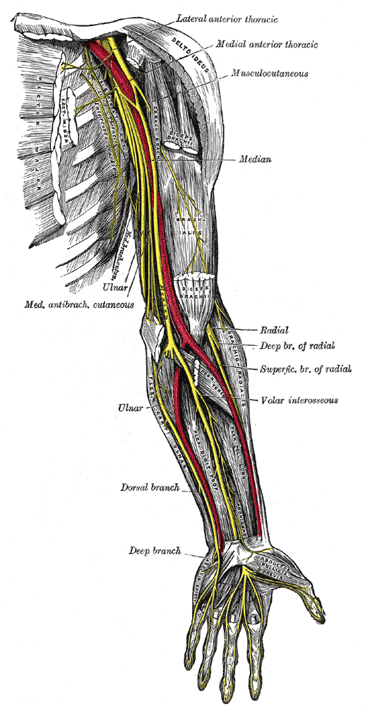
The path
The superficial branch continues down the arm under the brachioradialis, crossing supinator, pronator teres and the radila attachments of the flexor digitorum superficialis and flexor pollicis longus. The radial artery travels on the nerve’s medial side. The nerve continues on the dorsal surface of the arm, becoming superficial to the abductor pollicis longus and extensor pollicis brevis. After crossing the extensor rectinaculum, it divides into more branches. These innervate the dorsal surface of the hand, lateral to a line midway through the fourth digit, including the radial aspect of the thenar eminence distal to the middle phalanx.

Slide 31
The muscles
Make a list of al the muscles innervated by the radial nerve.

Slide 32
Causes of lesions of the radial nerve
Fractures
Dislocation
Post-surgical complications
Compression
Supinator syndrome
Generally, the half to lower third of the upper arm is 3 times as common an injury site as the proximal third.

Slide 33
Symptom picture
Presentation of a complete radial nerve lesion is also known as wrist drop.
When the injury is proximal to the elbow, before the radial nerve branches, both sensory and motor function is affected.
When the injury is distal to the elbow, often only one branch is affected, with impairment being either sensory or motor.
Muscle wasting is possible depending on the lesion site.
There may be swelling on the dorsum of the hand, thought the etiology is unknown.

Slide 34
Sensory dysfunction
Altered sensation is experienced at the posterior arm, forearm and hand, specifically in the thumb, index, middle and one-half of the ring finger, excluding the fingertips.
Anesthesia occurs at the web between the thumb and second digit.

Slide 35
Chart on page 784 + 785
Remake the chart.

Slide 36
Ulnar nerve lesion

Slide 37
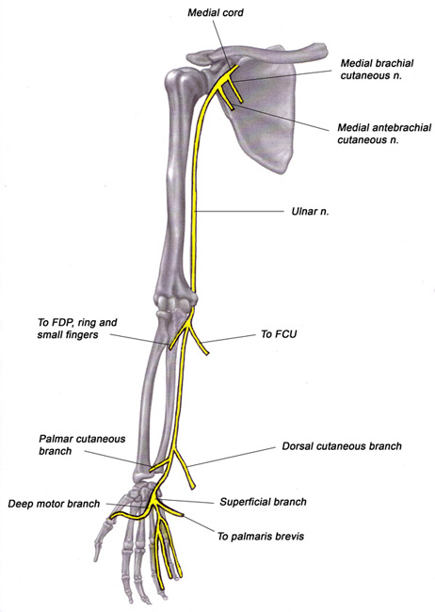
The path
Originates from the medial cord of the brachial plexus. It follows along the posterior wall of the axilla, under the pec minor.
In the upper arm, it shares a common neurovascular bundle with the median nerve until it reaches the insertion of coracobrachilalis in the mid-upper arm. The ulnar nerve then travels along the medial triceps. Generally it follows a relatively superficial course in the upper arm.

Slide 38
The path cont…
At the elbow, the nerve goes posterior to the medial epicondyle of the humerus and medial to the olecranon process. The ulnar collateral ligament supports the nerve. There are additional ligamentous fibres which connect the medial epicondyle to the olecranon and under which the ulnar nerve passes. It then follows a path between and deep to the head of the flexor carpi ulnaris muscle.
Continuing to the wrist, the ulnar nerve lies with the flexor carpi ulnaris above it and flexor digitorum profundus below it. The nerve is joined midway by the ulnar artery.
There are 2 main sensory branches: the dorsal branch and the palmaris branch. Midway down the forearm, the dorsal branch emerges. It supplies the extensor surface of the 4th digit to the interphalangeal joint.

Slide 39
The path cont….
At the wrist, the nerve travels over the flexor retinaculum, between the pisiform and the hook of the hamate bone and beneath the volar carpal ligament and the palmaris brevis muscle. This passage is also called the Guyon’s canal or the ulnar tunnel.
Here, the ulnar nerve divides into superficial and deep divisions. The superficial branch is primarily sensory and the deep branch is primary motor. The superficial branch travels deep to the palmaris brevis and then divides further into the palmaris digital branch, which supplies the ulnar side of the little finger, and another branch for the radial side of the little finger and the ulnar side of the ring finger.
The deep division travels with the ulnar artery, going deep between the adbuctor and flexor digiti minimi. It then pierces the opponens digiti minimi before continuing radially beneath the tendons of the finger flexors to the adductor pollicis.

Slide 40
The muscles
Make a list of the muscles innervated by the ulnar nerve

Slide 41
Causes
Fractures
Dislocation of elbow
Post-surgical complications
Pathology such as leprosy
Prolonged compression
Repetitive action
Direct trauma
The ulnar nerve is most vulnerable where it is superficial; specifically at the superior posterior elbow. Also where it emerges at the pisiform under the flexor carpi ulnaris tendon.

Slide 42
Symptoms
Presentation of a complete ulnar nerve lesion is also known as claw hand
Hyperextension
Muscle wasting
Froment’s sign is positive
Altered sensation

Slide 43
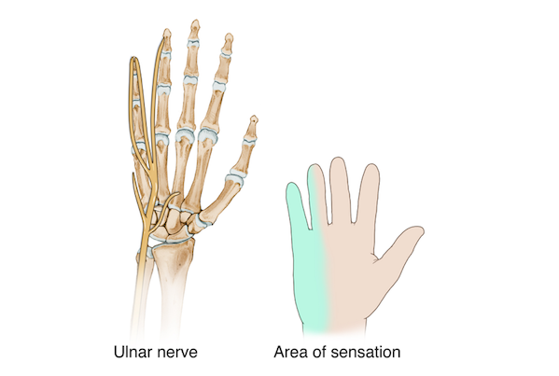
Sensory dysfunction
Altered sensation is experienced on the ulnar side of the hand
Anesthesia occurs along the little finger to the wrist.

Slide 44
Chart 792 + 793

Slide 45
Median nerve lesion

Slide 46
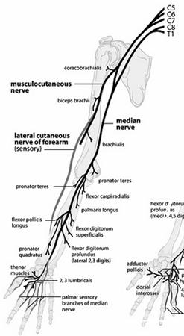
The path
Innervates primarily the flexor muscles in the forearm and hand.
Originates from the medial cord and the lateral cord of the brachial plexus.
Travelling as a neurovascular bundle with the axillary-brachial artery, the median nerve follows a path down the radial aspect of the arm from the axilla to the cubital fossa. The median nerve travels with the axillary artery on its radial side and the musculocutaneous nerve and the coracobrachialis muscle on its ulnar side.

Slide 47
The path cont…
The nerve leaves the cubital fossa and runs between the heads of the pronator teres muscle. From here it penetrates deeper, lying beneath the superficial finger flexors. In the forearm, the median nerve is well protected from traumatic injury, though it is susceptible to compression by pronator teres, flexor carpi radialis and flexor digitorum superficialis.
Approaching the wrist, the nerve becomes more superficial and is positioned between the tendons of the flexor carpi radialis (median side) and the palmaris longus. Before it reaches the carpal tunnel at the wrist, the median nerve gives off the palmar cutaneous branch. This branch travels superior to the carpal tunnel, turns radially and supplies sensory innervation to the skin of the thenar area.

Slide 48
The path cont…
The nerve becomes increasingly flat as it enters the carpal tunnel along with the tendons of the flexor pollicis longus, flexor digitorum superficialis and digitorum profundus muscles.
Upon leaving the tunnel, the median nerve passes under the palmar fascia and branches into the hand.

Slide 49
The muscles
List all muscles that are innervated by the median nerve

Slide 50
Causes of a median nerve lesion
Fractures
Dislocation
Compression
Trauma
The nerve is most easily injured where it is most superficial, at the elbow and wrist.

Slide 51
Symptom picture
Ape hand or oath hand
Flaccidity in the opponents pollicis muscle
Vasomotor and trophic changes
Atrophy of the forearm flexors and thenar muscles depending on the location
Risk of causalgia

Slide 52
Sensory dysfunction
Altered sensation is experienced on the thumb, index, middle and one-half of the ring finger on the flexor surface and distal 2/3 pf the palm
Anesthesia occurs at the distal interphalangeal joint of the index and middle fingers

Slide 53
Chart on pg 800-801

Slide 54
Sciatic nerve lesion

Slide 55
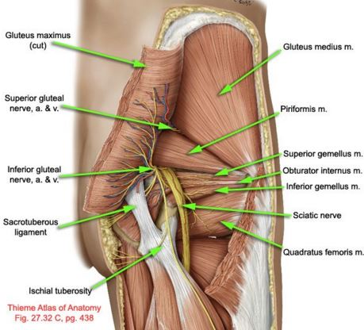
The path

Slide 56
The path cont…
The sciatic nerve is the strongest and longest of the peripheral nerves. It primarily provides motor supply to the hamstrings, lower leg and foot.
Consists of 2 independent nerves (the tibial and peroneal divisions) which travel together down the posterior leg as the sciatic nerve until reaching just proximal to the popliteal fossa.
The nerve leaves the sacral plexus, passing through the greater sciatic foramen and usually under the piriformis muscle.
It travels mid-way to 1/3 of the way between the ischial tuberosity and the greater trochanter. The nerve then goes deep, following along the adductor magnus down the leg.

Slide 57
The path cont…
At the popliteal fossa, the nerve splits into two branches.
The tibial nerve is the larger of the 2 nerves. As it continues through the popliteal fossa, it is joined by the tibial vein and artery. They travel as a neurovascular bundle between the heads of gastrocnemius, supplying motor function to this muscle as well as soleus, plantaris and popliteus, with branches to tibialis posterior, hallucis longus and flexor digitorum longus.
At the ankle, the nerve is situated superficially between the medial malleolus and the achilles tendon. It passes around the malleolus and travels deep to the flexor retinaculum.

Slide 58
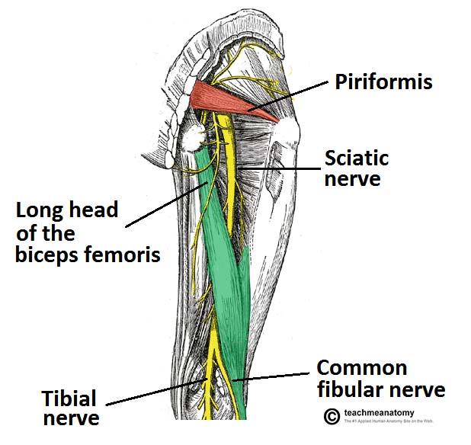
The path cont…
The tibial nerve divides into the medial and lateral plantar nerves. These supply motor functions to the intrinsic foot muscles. Sensory supply is to the heel of the foot. As well, the cutaneous branches from both the tibial nerve and the common peroneal nerve which form the sural nerve. This nerve supplies the skin of the lateral and posterior part of the inferior 3rd of the leg and lateral side of the foot.

Slide 59
The path cont…
The second branch of the sciatic nerve is the common peroneal nerve. After passing through the popliteal fossa, it travels around and below the head of the fibula. The nerve is flattened and superficial at this point. It then splits into 2 divisions: the superficial and deep peroneal nerves.
The deep branch travels deep to the extensor digitorum longus and continues down to the malleoli, supplying motor function to the extensors of the lower leg.
In the foot, the nerve is on the dorsal surface. The superficial division is found between peroneus longus and extensor digitorum longus. It provides motor supply to the peroneus longus and brevis. The superficial branch of the common peroneal nerve supplies the skin on the distal anterior surface of the leg, most of the dorsum of the foot and the toes.

Slide 60
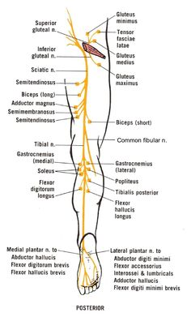

Slide 61
Make a list of all the muscles innervated by the sciatic nerve

Slide 62
Causes
Foot drop
Steppage gait
Claw toe
Muscle wasting
Injuries that can lead to infection and pressure sores
Severe trophic changes and edema in the sole of the foot and toes
causalgia

Slide 63
Differential assessment
L4 to L5 radicular lesion due to a prolapsed disc results in weak inversion of the foot from a weak tibialis posterior.
Sensory dysfunction is experiences high on the outer aspect of the leg in the L5 dermatome.
A peroneal nerve lesion results in weak tibialis anterior, extensor hallucis longus and foot evertors, causing foot drop.
Sensory dysfunction is experienced over the entire aspect of the outer lower leg and most of the dorsum of the foot.

Slide 64
Sensory dysfunction
Tibial division
  Altered sensation is experienced on the posterior leg, heel and sole of the foot including the toes
Peroneal division
  Altered sensation is experienced on the lateral and anterior surface of the lower leg and foot, not including the toes, as well as on the area medial to the medial malleolus and a thin strip at the edge of the foot.
  Anesthesia is experienced on the dorsal surface of the foot, at the web space between the greater toe and 2nd digit

Slide 65
Bell’s palsy

Slide 66
What is it
A condition involving a lesion on the facial nerve (CNVII).
Results in flaccid paralysis of the muscles of the facial expression on the same side as the lesion.
Affects at least 25/100,000 each year.

Slide 67
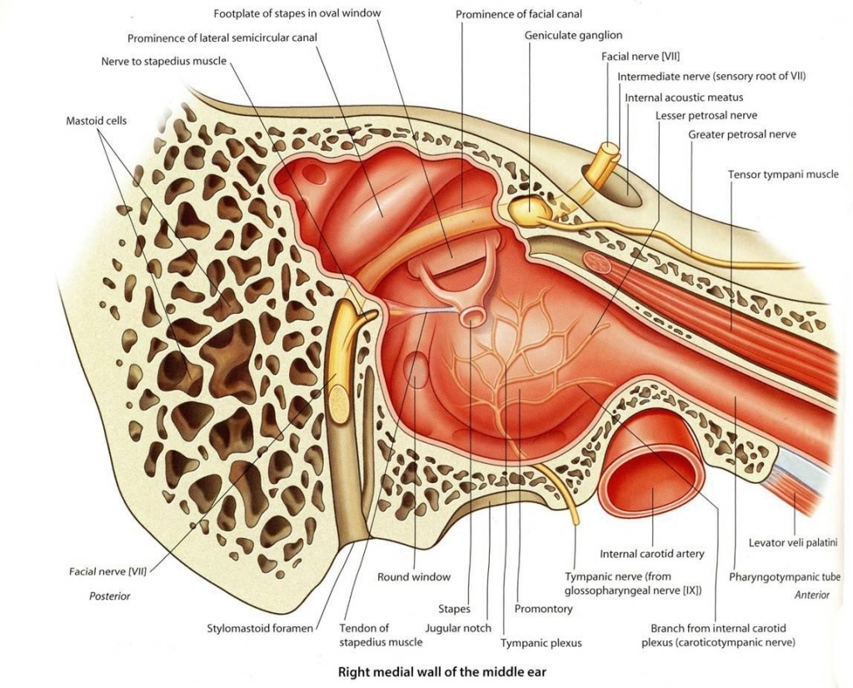
The path
The facial nerve leaves the brain stem and passes through the genticulate ganglion before it separates into 2 divisions.
One division is the motor nerve. It travels through the petrous canal of the temporal bone before exiting at the stylomastoid foramen. Here is travels through the partoid gland where it then gives off 5 branches to supply motor function to the muscles of facial expression.

Slide 68
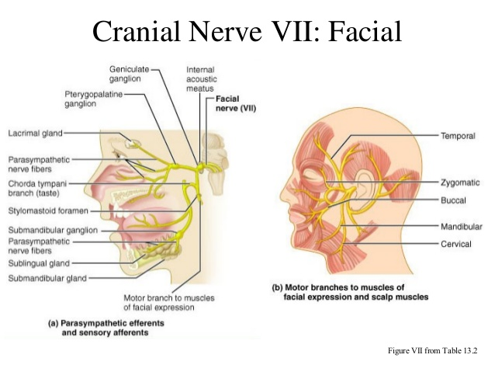
Motor nerve division
Temporal branch: the orbital and forehead muscles except the levator palpebrae superioris (opens the eye)
Zygomatic branch: muscles of the zygoma, orbital and intraorbital area
Buccal branch: buccinator and upper lip muscles
Mandibular branch: lower lip and chin muscles
Cervical branch: platysma, stylohiod and posterior digastric muscles

Slide 69
The other division
This division has mixed autonomic and sensory fibers.
Enables taste in the anterior 2/3 of the tongue. It also controls the submandibular and sublingual salivary glands, the lacrimal glands and the small sensory area of the soft palate and around the external auditory meatus.

Slide 70
Causes
Compression from edema
Conditions affecting the parotid gland
Compression from inflammation secondary to trauma
Exposure to chill or draft
A familiar tendency has not been clearly established but is a possibility.

Slide 71
Read page 813

Slide 72
Symptoms
For most people, Bell's palsy is temporary. Symptoms usually start to improve within a few weeks, with complete recovery in about six months. A small number of people continue to have some Bell's palsy symptoms for life. Rarely, Bell's palsy can recur.

Slide 73
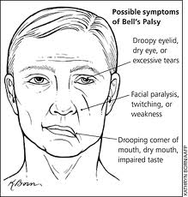
Symptoms cont…
Unilateral weakness followed by flaccid paralysis of muscles of facial expression. The person experiences:
inability to raise eyebrows
incomplete closure of the eye
inability to actively flare nostrils
loss of the blinking reflex
inability to raise the corners of the mouth, whisper or pucker
difficulty eating food
difficulty articulating some sound
difficulty holding the lower lip to a glass

Slide 74
Symptoms cont…
If sensory and autonomics are involved there is:
  Loss of control of larcimation and usually decreased salivation
  Loss of taste to anterior 2/3 of tongue
  hyperacusis
Sagging of face and eyelid
Facial expressions are distorted
Pain is usually not a primary symptom
Unaffected side may feel tense.

Slide 75
Testing
AF ROM
AR strength testing of orbicularis oculi muscles

Slide 76
Treatment
Ensure that fragile tissue is not compressed
Hydro applications consist of cool washes on the affected tissues.

Slide 77
General treament
Decrease SNS firing
Diaphragmatic breathing is encouraged
Provide emotional support

Slide 78
Specific treatment
Treat compensatory changes and holding patterns
Decrease hypertonicity and trigger points in compensatory muscles of the neck and shoulder.
Reduce edema, if present
Maintain tissue health
Prevent contracture formation as much as possible
Decrease pain if present
Encourage motor re-education
Maintain client awareness of the affected tissue
Maintain ROM
Promote whole body integration

Slide 79
Self-care Goals
Encourage relaxation
Recommend self-massage
  5-10 mins 2-3 times a day
Improve functional ability

Slide 80
Treatment frequency and expected outcomes
In early stages, shorter, more frequent treatments are appropriate, such as ½ hour tx 2-3x a week
Once recovery begins, tx frequency is reduced to once a week
Recovery depends on the severity of the lesion
  Stats show full recovery to 70-85%
  The remaining 15-30% of people will have some residual functional loss

Slide 81
Contraindications
There is a concern about eye infection if the eye can not close and especially if tearing is diminished
Pressure applied during massage is modified on the flaccid tissue
Long dragging strokes and fascial techniques are contraindicated on the affected side

