Slide 1
Systemic Conditions

Slide 2
Arterial Disease

Slide 3
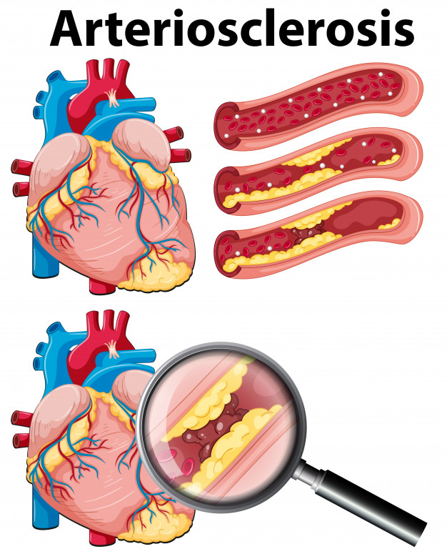
Arteriosclerosis:
Definition: A group of diseases characterized by thickening and loss of elasticity of the arterial walls. Aka- hardening of the arteries.
Types:
1: Atherosclerosis (most common form)
2: Monckeberg’s Arteriosclerosis
3: Arteriolosclerosis
All 3 maybe present in same person but
in different blood vessels.

Slide 4
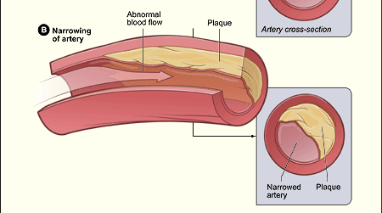
Atherosclerosis:
Definition: Thickening of arterial wall through accumulation of lipids, macrophages, T-lymphocytes, smooth muscle cells, extracellular matrix, calcium and necrotic debris. It can affect any of the arteries.
In arteries of the heart= Coronary artery disease (CAD) or Coronary heart disease (CHD)
In brain = Cerebrovascular disease
In other blood vessels to other part of the body= peripheral vascular disease (PVD), aneurysm and intestinal infarction.

Slide 5
Risk factors: (studied in America only)
Non-modifiable:
Age: women>55, men >45
Gender: men > women
Family history/genetics
Ethnicity (African American or Mexican women, African American men)
Infection (viral or bacterial)

Slide 6
Risk factors: (studied in America only)
Modifiable:
Smoking
Cholesterol levels, high LDL and low HDL (some debate still exists about this)
Hypertension
Obesity
Physical inactivity
Diabetes or impaired glucose tolerance
Hormonal status (contraceptives, hysterectomy, menopause without HRT)
Thrombogenic factor
Stress
Meds
Excess alcohol consumption or possibly complete abstinence
High triglycerides
Sleep disordered-breathing
Poor nutrition

Slide 7
Pathogenesis: (most recent theory)
Wall damage permits infiltration of macromolecules (cholesterol). The naked collagen acts like flypaper for platelets, causing them to aggregate at the site of injury and plug the wound.
Can take decades to form, sitting in artery wall for years.
Keep in mind that prevention is the best way to “treat” this condition. Atherosclerosis is NOT a disease of old age, it often begins in adolescence and young adulthood and develops slowly but progressively through the body.

Slide 8
Symptoms:
Initially asymptomatic
Only when a critical deficit in blood supply to affected structures do the signs start appearing. Ex: In CAD, no symptoms until 75% of the lumen is obstructed, then pain and dysfunction occur.
Angina pectoris
MI or heart attack
Sudden death

Slide 9
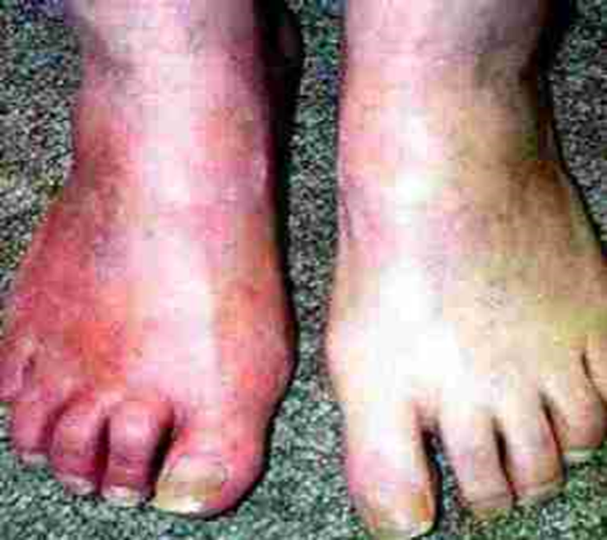
Thromboangiitis Obliterans (AKA. Buerger’s Disease)
Definition: Vasculitis (inflammatory and thrombotic process) of peripheral blood system, arteries and veins, primarily affecting the extremities.
Causes are unknown
Affects men <40 years who smoke
Recent (last 10 years) studies show an increase in occurrence with women

Slide 10
Symptoms:
Pain and tenderness of affected area
Episodic and segmental, i.e. come and go intermittently over time and appears in different asymmetric anatomical locations.
Pulse loss, most commonly posterior tibial and dorsal pedis
Intermittent claudication in arch of the foot and palm of hand
Pain at rest
Persistent ischemia of digits
Edema
Cold sensitivity
Rubor
Cyanosis with thin, shiny hairless skin
All leading to painful ulceration and eventual gangrene

Slide 11
Raynaud’s Disease and Phenomenon
(65% of cases fall under the disease category)
Definition: Intermittent episodes of small artery or arteriole constriction of the extremities causing temporary pallor and cyanosis of the digits with a change of temperature. Usually occur in response to cold temperature or strong emotions such as anxiety or excitement.

Slide 12
Raynaud’s Disease:
Primary vasospastic disorder
80% are women 20>49 years old
Unknown etiology
May be caused by hypersensitivity of digital arteries to cold and release of serotonin
Considered more of an annoying condition then medically serious

Slide 13
Raynaud’s Phenomenon:
Secondary to disease or underlying cause
10 to 20% of general population
Women 20 times more common than men
Risk factors differ from men to women:
  Men: age and smoking
  Women: marital status and alcohol consumption
Often associated with Buerger’s or connective tissue disorder (e.g. Scleroderma)
Occurs with difference in temperature, ex. going from warm outdoors to air conditioned room
TOS
Injuries to small vessels of the hand. Ex: use of sledgehammer.

Slide 14
Most cases the skin progresses from blue to white to red in color (Tabers states “white to blue to red”), but individual cases vary
1st there is ischemia from vasospastic attacks cause cyanosis, numbness and the sensation of cold in the digits (thumb is usually unaffected)
Tissues then become numb or painful
Unknown mechanism cause the vessels to relax and blood flow returns
Skin becomes white then red, warm and flushed
Throbbing, paresthesia and slight swelling can be present during this last phase

Slide 15
Complications:
In severe chronic Raynaud’s phenomenon, scars can occur in the vessels, reducing the vessels diameter and therefore blood flow.
Attacks often become more severe and prolonged loss of blood flow to fingers and toes can produce ulcers and, rarely, gangrene can develop.
Bilateral, progressing distally to proximally along digits
When unilateral, involving only 1 or 2 fingers, please refer back to MD, can be a possible sign of cancer.

Slide 16
Assessment:

Slide 17
Pulses of the arms and legs
  Brachial, radial, ulnar, femoral, popliteal, posterior tibial, dorsal pedis
Palpate for temperature
Observe skin integrity, hair loss, ulcerations, dryness
Palpate muscle tone, tenderness
If there is parasthesia, check dermatomes, myotomes

Slide 18
Special Tests:
The therapist is reminded of the importance of taking blood pressure and pulse with every initial patient. Continue to take BP and pulse with patients who have cardiovascular dysfunction, diabetes, pregnancy and those who are elderly or obese.
  Allen test
  Capillary refill test or digit blood flow
  Buerger’s test (Rubor test)

Slide 19
Specific Treatment Goals:

Slide 20
Determine triggers/aggravating factors and remove if possible
Increase general circulation
Increase local circulation
Prevent tissue damage, ulcers, gangrene
Decrease fascial adhesions and hypertonicity proximal to occlusion in order to prevent compression syndromes
Increase or maintain ROM of affected joints
Patient education
Increase exercise tolerance

Slide 21
Specific Techniques to Achieve Tx Goals:

Slide 22
Warm hydrotherapy to trunk or proximal limb (reflex heating)
Encourage ingestion of warm beverages if cold is a triggering factor
Swedish massage to neck, shoulders, trunk, hip, thighs
Local work to hands and feet if not contraindicated
AROM, PROM of all joints of affected region
Attachment release, trigger point release
Myofascial release proximal to occlusion
Passive stretching, contract-relax stretching
Joint mobilizations
Diaphragmatic breathing
Graded ambulatory exercises

Slide 23
Precautions & Contraindications:

Slide 24
Do not work locally if acute (proximal work only)
Gentle work, no drag if tissue fragility is present
Do not use extremes of temperature, especially cold
Avoid heavy, compressive techniques
Elevation of limbs will further hinder circulation
Do not work distal to line of demarcation with Buerger’s disease
Local, direct heat is contraindicated

Slide 25
Venous Disease

Slide 26
Thrombophlebitis:
A partial or complete occlusion of a vein by a thrombus, with a secondary inflammatory reaction in the wall of the vein. Occurs most often in the lower extremities. There are two forms of venous thrombosis:
Superficial: most commonly of the saphenous vein in the lower extremity, usually the result of varicose veins and is self-limiting (not a serious condition). In the upper extremity this condition does not generally cause pulmonary embolism as the blood flow to deeper veins is via small perforating venous channels. This can be secondary to prolonged IV catheter use.
Deep: usually of the femoral, iliac veins of the lower extremity, calf veins or more proximally from the trifurcation of the popliteal vein caudally. Calf vein thromboses are usually clinically silent and benign without complications, although in 30% of the cases they can extend into more proximal veins. Proximal DVTs are much more likely to result in Pulmonary Embolus
Superficial venous thrombosis of the upper extremity can occur, although it is much less common and is usually seen in people with systemic illness in the presence of an indwelling catheter, such as in the treatment of cancer, malignancy, or hemodialysis.

Slide 27
Deep Vein Thrombosis:
3rd most common cardiovascular disease, up to 2 million of Americans annually.
Trauma to endothelium of the vein wall exposes sub-endothelial tissues to platelets and clotting factors, initializing thrombosis.
Adhered platelets the attract fibrin, leukocytes and erythrocytes forming a thrombus.
Two types of thrombus:
  Mural: attached to the wall of the vein and does not occlude the lumen
  Occlusive: begins by attachment to vessel wall and progresses to completely occlude the lumen.

Slide 28
Evolution/resolution:
Lysis, dissolution or recanalization: thrombus is dissolved and away and blood flow through vein returns
Organization, potential for removal of thrombus and vein
Extension: thrombus enlarges either proximally or distally.
Release of thrombus to form a pulmonary embolism
(Embolus travels through the enlarging vessels and through the right side of the heart to the progressively narrowing pulmonary artery, where it may become lodged and occlude pulmonary circulation.)
If thrombus occludes major vein, the venous pressure and volume rise distally. However, if it occludes a deep small vein, collateral vessels develop and relieve the increased pressure and volume

Slide 29
Risk Factors:
Immobility: bed rest, air travel, neurological disorders, cardiac failure, absence of ankle muscle pump
Trauma: varicose veins, surgery, local trauma, IV, fractures or dislocations, childbirth and delivery, sclerosing agent
Lifestyle: oral contraceptives, HRT, hormonal medications, pregnancy, IVF, smoking
Hypercoagulation: hereditary thrombotic factor, neoplasm, other: diabetes, genetics, obesity, previous DVT, Buerger’s disease, age >60

Slide 30
Symptoms:
Early stages are asymptomatic
90% are in the lower extremity
Upper extremity DVTs present with edema of the involved extremity and pain.
Dull pain and local tenderness
Superficial induration (firm or hard cord)
Redness
Lower extremity presents with dull ache, tight feeling or pain, often misdiagnosed.
Signs are often absent, and when present and taken alone, they may be variable and unreliable.
Leg or calf swelling
Pain or tenderness
Dilation of superficial veins
Pitting edema
Skin may be warmer than the unaffected side
If obstruction is severe, skin may be cyanotic
(Any of these symptoms can occur without DVTs, possibly associated with other vascular, inflammatory, musculoskeletal or lymphatic conditions.)

Slide 31
Pulmonary embolism: most devastating complication of DVTs and can occur without apparent warning, signs and symptoms depend on the size and location and may include:
    Possible sudden death
    Pleuritic chest pain
    Diffuse chest discomfort
    Tachypnea
    Tachycardia
    Hemoptysis
    Anxiety, restlessness, apprehension
    Dyspnea
    Persistent cough

Slide 32
Varicose veins:
Abnormal dilation of vein, usually the saphenous veins, leading to tortuosity (twisting and turning) of the vessels, incompetence of the valves and a propensity to thrombosis. Women are more affected then men, often secondary to pregnancy. As of age 70, the occurrence in men and women is closer to equal.
41 % of women ages 40 to 50 and 72% of women ages 60 to 70 have varicose veins.
(Spider veins, or telangiectasia, are a separate but similar condition in which broken capillaries result in fine-lined networks of red, blue or purple veins, usually on the thighs, calves and ankles. Can also appear as short, unconnected or parallel lines.)

Slide 33
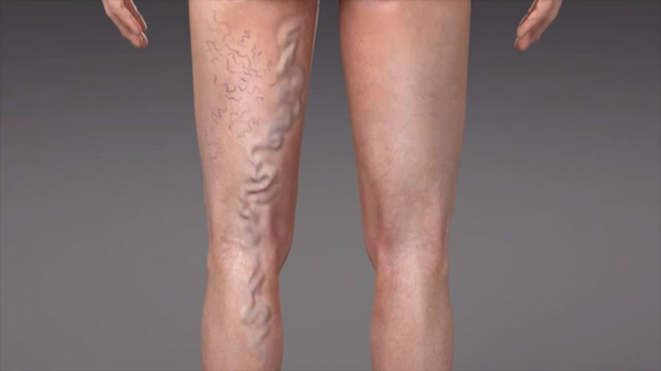
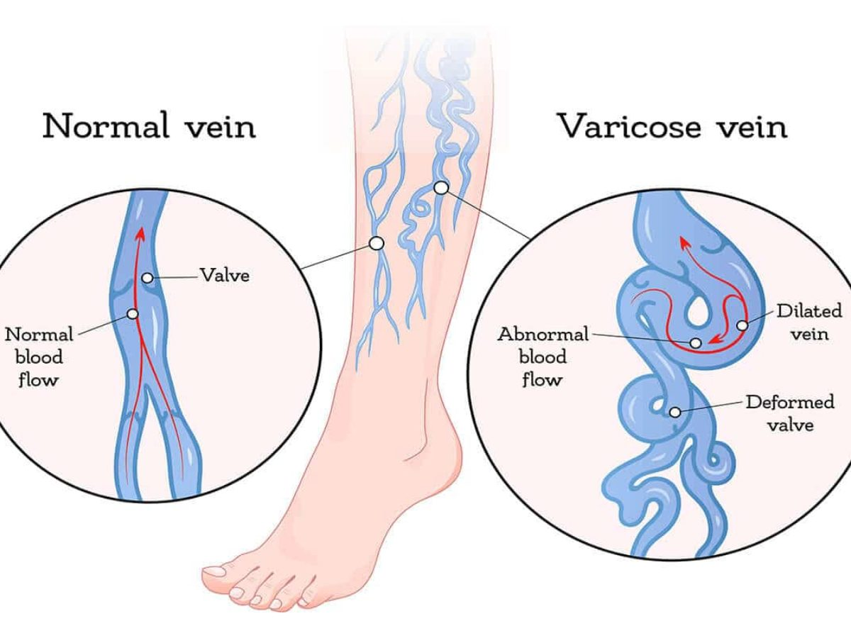
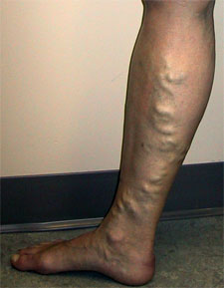

Slide 34
Vessels most commonly affected are located just beneath the skin superficial to the deep fascia.
One-way valves become incompetent or the veins become more elastic, the veins engorge with stagnant blood and become pooled.
Any condition causing pressure changes place a strain on the veins
Lack of pumping action of the lower leg muscles causes blood to pool
Weight of the blood pressing down on the closed valves, causes the veins to distend and eventually lose their elasticity.
As more and more valves lose their ability to function properly, veins become more distended and swollen

Slide 35
Risk factors:
Maybe inherited
High venous pressure associated with heavy lifting
Prolonged sitting or standing
Hormonal changes, pregnancy, menopause, HRT
Obesity
Heart failure
Haemorrhoids
Constipation
Esophageal varices
Hepatic cirrhosis

Slide 36
Signs and symptoms:
Dull, aching heaviness, tension or fatigue brought on by periods of standing.
Cramps in lower leg, especially at night, elevation of leg provides relief
Itching from associated dermatitis may occur above the ankle
Dilated, tortuous, elongated veins, readily visible when person standing
Long standing varicosities may be accompanied by secondary tissue changes, i.e.: brownish pigmentation, thinning of skin
Swelling around ankle
Untreated veins become thick and hard
Impaired circulation and skin changes may lead to ulcers in lower leg
May result in thrombosis and phlebitis or venous insufficiency ulcers

Slide 37
Treatment:
Elevation of the limb may be indicated depending on systemic health of patient.
Encouraging circulatory return to the heart with all massage strokes
Reducing any restrictions or tightness in structures that could compromise the path of blood flow
Reducing edema via lymphatic drainage techniques when the systemic circulatory system is NOT compromised
Decreasing pain in order to return the client to graded activity. This will improve circulation far more effectively than any modality.

Slide 38
Hydrotherapy:
Based on client presentation and treatment environment.
Heat or possibly contrasts used if sensation and tissue health is appropriate.
Paraffin wax could be applied as a more aggressive modality if client responds well to deep moist heat.
AROM is used after hydro modalities to encourage residual edema to return to the circulatory system.

Slide 39
Remex:
Based on client presentation and treatment environment.
Progressively increasing activity from AAROM to AROM to RROM to cardiovascular activities to dynamic activities.
Swimming is suggested as the hydrostatic pressure of the water environment helps gently mobilize edema back into the circulatory system.

Slide 40
Chronic venous insufficiency:
Inadequate venous return over a long period of time follows most severe cases of DVT. Also may occur as a result of leg trauma, varicose veins and neoplastic obstruction of the pelvic veins.
Damage or destroyed valves in the veins result in ↓ venous return, thereby ↑venous pressure and producing venous stasis
Inadequate valve function and absence of calf muscle pump, blood flows bidirectional, causing venous hypertension.
Superficial veins and capillaries dilate
Red blood cells and fluids leak out into interstitial spaces
Edema and reddish brown pigmentation
Chronic pooling of blood prevents adequate cellular oxygenation and removal of waste products
Cell death occurs, necrotic tissue develops into venous stasis ulcer
Delayed healing and persistent ulceration
Poor circulation impairs immune and inflammatory responses, leaving venous stasis ulcers susceptible to infection

Slide 41
Risk Factors:
Leg trauma
Varicose veins
Neoplastic obstruction of the pelvic veins
Poor nutrition
Immobility
Local trauma (past or present)
Previous history of burns requiring skin graft

Slide 42
Signs and symptoms:
Progressive edema of the leg
Thickening, coarsening and brownish pigmentation of skin around ankles
Venous stasis ulceration (approximately 80% of all lower extremity ulcers, most often above medial malleolus, where venous hypertension is greatest)
In long standing CVI, edema becomes hardened to a dense woody like texture
Skin is think, shiny, dry and cyanotic
Dermatitis and cellulitis may develop later in this condition

Slide 43
Case History Questions for all preivious vein conditions
Do you have a history of cardiovascular disease?
Any recent surgeries, illness, bed rest, trauma?
Medications (anticoagulants)
Are you pregnant? Taking oral contraceptives?
Do you smoke?
History of varicose veins in the family?
Occupation?
Activity level?
Associated Structures:
All muscles, ligaments, tendons, skin of primarily the lower extremity. Greater saphenous vein is most often affected (varicose veins).

Slide 44
Special Tests:
Girth Measurements: take circumference measurements every 8-10cm along the entire length of the affected limb to establish a baseline. Compare over time, as well as comparing with the correlating measurements of the unaffected limb to detect edema and/or atrophy.
Greater Saphenous Vein Competency Test (Percussion Test):
Homan’s Sign: For Deep Vein Thrombosis
Retrograde filling (Trendelenburg) Test

Slide 45
Specific Treatment Goals:
Prevention
Relieve pain if present
Assist with venous return
Regain functional mobility
Prevent venous stasis
Prevent skin ulcerations and wound infections
Assist muscle pump activity
Maintain muscle and joint health

Slide 46
Specific Treatment Techniques:
MD referral is necessary for treating patients with thrombophlebitis / DVT
Elevate limbs to 30-45°
Begin ambulation a.s.a.p. after surgery
Ankle pumps, AROM/PROM of lower extremity
Compression stockings
Elevate limbs when sitting for prolonged periods
Swedish massage

Slide 47
Precautions & Contraindications:
Thrombosis is a local/regional CI
MD referral necessary if thrombus suspected
Do not work distal to a thrombus
Do not use heat distal to a thrombus
Do not use AROM/PROM distal to a thrombus
Do not work directly over a varicose vein
No aggressive or deep techniques if patient is on blood thinners
No use of heat if patient is on blood thinners

Slide 48
Therapeutic Exercise:
Active ankle pumps done throughout the day while immobilized
Isometric exercises
AROM/PROM of all the joints of the extremities
A graded exercise program with support stockings

Slide 49
Hydrotherapy:
No deep heat to involved extremity unless with MD consultation
Mild contrast foot baths (VV)
Mild contrast affusions (VV)

