Slide 1
Systemic conditions

Slide 2
What we will cover
Fibromyalgia and chronic fatigue syndrome
Dupuytren’s contracture
Osteoporosis
Diabetes
Cancer

Slide 3
Fibromyalgia

Slide 4
What is it?
A painful non-articular rheumatic condition of at least 3 months duration
Characterized by widespread muscular achiness and specifically the palpation of tender points at 11 to 18 prescribed locations on the body
2/3 of those diagnosed state they “hurt all over”.
There is no obvious origin of the pain.

Slide 5
Affected points
Low back
Shoulders (including; traps)
Neck
Posterior of head
Upper chest
Arms
Hands
Thighs
Legs
Other areas
Temporomandibular region
Anterior chest
These points distinguish from other conditions such as chronic fatigue syndrome, myofascial pain syndrome, myalgic encephalomyelitis or various forms of arthritis and lupus

Slide 6
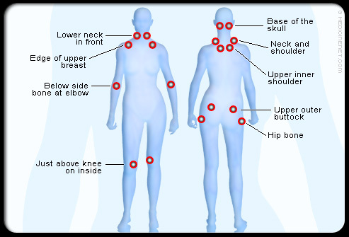

Slide 7
causes
The causes are not clear
There seem to be some connection with immune abnormalities and a genetic predisposition which causes neuroendocrine dysfunction
Some evidence of a deficiency of serotonin due to abnormalities of serotonin binding platelets
Symptoms can be triggered
Some sources suggest there are 2 types

Slide 8
triggers
Overexertion
Lack of exercise
Stress
Anxiety
Depression
Lack or poor quality of sleep
Trauma
Extreme temp or humidity
Infectious illness

Slide 9
types
Post-traumatic
  Thought to develop after a fall, whiplash or back strain
Primary
  Has an uncertain origin

Slide 10
Treatment is focused on finding ways to manage the disorder so that the patient may lead a normal life

Slide 11
chronic fatigue syndrome

Slide 12
What is it?
Condition distinguished by persistent fatigue that does not resolve and severly reduces activity levels for at least 6 months
Often misdiagnosed as a flu or viral infection, hypochondria or depression

Slide 13
The cause
The cause is not well understood
  It was linked to the Epstein-bar virus but is now thought to be linked to some other viral or infective source
  There is a deficiency of T-lymphocytes or natural killer cells
  There is a link to fibromyalgia, which is frequently found in people with CFS; but how the 2 are connected is unclear

Slide 14
symptoms
The syndrome may be chronic or recurrent
Primary symptom is disabling fatigue
Up to 90% of those affected complain of persistent daily headaches or migraines
3 times more common in women than men, generally occurring between 20-40 years of age
Not life threatening but has no cure

Slide 15
Other symptoms
Aching muscles and joints
Spasm
Weakness
Fever
Sore throat
Swollen lymph nodes
Recurrent upper respiratory tract infections
Loss of appetite
Intestinal problems
Jaundice
Memory loss
Inability to concentrate
Confusion
Anxiety and depression
Mood swings
Sensitivity to light and heat
Sleep disturbances

Slide 16
Massage and CFS
30 persons with CFS who were treated with massage therapy revealed that their total hours of sleep increased while anxiety and depression were reduced
Massage can help to relieve muscular pain and reduce stress levels but care must be taken to not fatigue the client
Treatments are usually shorter in duration and not vigorous in nature with a relaxation focus

Slide 17
Self- care
Read pg 989 -990
http://abcnews.go.com/Health/study-sheds-light-chronic-fatigue-syndrome/story?id=48959336

Slide 18
Dupuytren’s contracture

Slide 19
What is it?
Contracture of the palmer fascia resulting in a flexion deformity of the fingers
The metacarpophalangeal and interphalangeal joints of the 4th and 5th digits are the most frequently affected
A client with this condition is unable to extend the affected digits voluntarily or by force

Slide 20
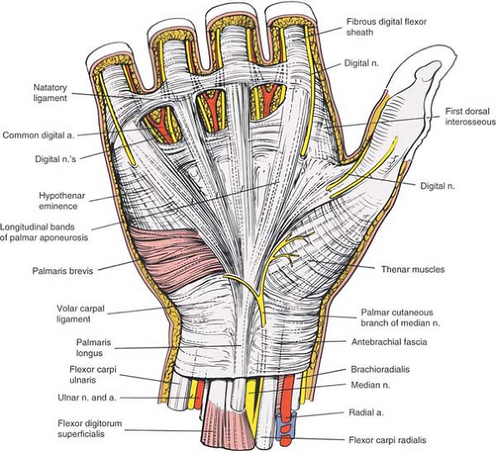

Slide 21
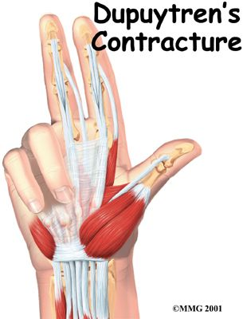

Slide 22
Group read
991.5-994

Slide 23
contraindications
Friction techniques are contraindicated if the client is taking anti-inflammatory medication
Following surgery, the clients physician and physiotherapist should be contacted before specific treatment to the wrist and hand occurs.
  The incision site must be completely healed prior to massage, fascial work or stretching of the tissue.

Slide 24
Osteoporosis

Slide 25
What is it?
Osteoporosis is a disease characterized by low bone mass and deterioration of bone tissue. This leads to increased bone fragility and risk of fracture (broken bones), particularly of the hip, spine, wrist and shoulder. Osteoporosis is often known as “the silent thief” because bone loss occurs without symptoms. Osteoporosis is sometimes confused with osteoarthritis, because the names are similar. Osteoporosis is a bone disease; osteoarthritis is a disease of the joints and surrounding tissue.

Slide 26
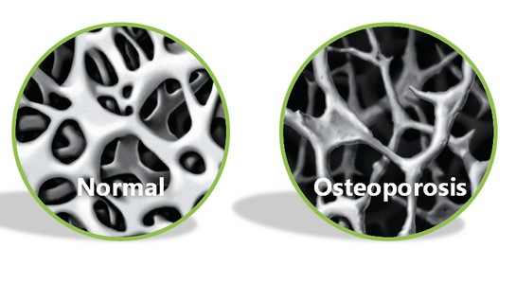

Slide 27
cause
The cause is not related to any one problem, but certain risk factors have been identified

Slide 28
Risk factors
age
Sex
vertebral compression fracture
fragility fracture after age 40
either parent has had a hip fracture
>3 months use of glucocorticoid drugs
medical conditions that inhibit absorption of nutrients
other medical conditions or medications that contribute to bone loss

Slide 29
Symptom picture
Many women with osteoporosis do not experience any symptoms for years
Periodic acute low thoracic or high lumbar pain may be present
Often women only become aware of the problem when a minor injury results in a fracture of a wrist or hip
  Even a strong cough or hug could cause a rib to crack or break
Vertebrae start to wedge or fracture; this causes compression of the nerves and a loss of height of more than an inch. It can also result in hyperkyphosis and the ‘dowager’s hump” often seen in women as they age

Slide 30
contraindications
Overpressure testing procedures are best avoided
Any mobilization technique that creates stress on the bone
Avoid giving flexion exercises
High impact exercises are used with extreme caution
Immobilization should be avoided if possible

Slide 31
massage
The client may not be aware that they are developing this condition, unless it has been diagnosed by a physician
Therapist may want to contact physician to obtain more information
Positioning is for the clients comfort.
Massage is performed in the context of a relaxation treatment with use of diaphragmatic breathing
Hyperkyphosis treatment may be performed with modifications to the pressure and the intensity of the techniques
Passive movement of the joints is incorporated throughout the massage to facilitate joint health

Slide 32
Diabetes

Slide 33
What is it?
Diabetes is a chronic, often debilitating and sometimes fatal disease, in which the body either cannot produce insulin or cannot properly use the insulin it produces. Insulin is a hormone that controls the amount of glucose (sugar) in the blood. Diabetes leads to high blood sugar levels, which can damage organs, blood vessels and nerves. The body needs insulin to use sugar as an energy source.
The pancreas is an organ that sits behind the stomach and releases hormones into the digestive system. In the healthy body, when blood sugar levels get too high, special cells in the pancreas (called beta cells) release insulin. Insulin is a hormone and it causes cells to take in sugar to use as energy or to store as fat. This causes blood sugar levels to go back down.

Slide 34
Type 1
Type 1 diabetes occurs when the immune system mistakenly attacks and kills the beta cells of the pancreas. No, or very little, insulin is released into the body. As a result, sugar builds up in the blood instead of being used as energy. About five to 10 per cent of people with diabetes have type 1 diabetes. Type 1 diabetes generally develops in childhood or adolescence, but can develop in adulthood.
Type 1 diabetes is always treated with insulin. Meal planning also helps with keeping blood sugar at the right levels.
Type 1 diabetes also includes latent autoimmune diabetes in adults (LADA), the term used to describe the small number of people with apparent type 2 diabetes who appear to have immune-mediated loss of pancreatic beta cells.

Slide 35
Type 2
Type 2 diabetes occurs when the body can’t properly use the insulin that is released (called insulin insensitivity) or does not make enough insulin. As a result, sugar builds up in the blood instead of being used as energy. About 90 per cent of people with diabetes have type 2 diabetes. Type 2 diabetes more often develops in adults, but children can be affected.
Depending on the severity of type 2 diabetes, it may be managed through physical activity and meal planning, or may also require medications and/or insulin to control blood sugar more effectively.

Slide 36
What is gestational diabetes?
A third type of diabetes, gestational diabetes, is a temporary condition that occurs during pregnancy. It affects approximately two to four per cent of all pregnancies (in the non-Aboriginal population) and involves an increased risk of developing diabetes for both mother and child.

Slide 37
What are the complications of diabetes?
Having high blood sugar can cause diabetes-related complications, like chronic kidney disease, foot problems, non-traumatic lower limb (leg, foot, toe, etc.) amputation, eye disease (retinopathy) that can lead to blindness, heart attack, stroke, anxiety, nerve damage, and erectile dysfunction (men).
Diabetes-related complications can be very serious and even life-threatening. Properly managing blood sugar levels reduces the risk of developing these complications

Slide 38
Risk factors type 1
Researchers continue to work hard to find out what causes type 1 diabetes. It is known that having a family member (parent, sibling) with type 1 diabetes slightly increases the risk; however, definite risk factors are currently not known

Slide 39
Risk factors type 2
Anyone over the age of 40 should be tested for diabetes every three years. Anyone who has one or more risk factors should be tested more frequently. Risk factors are:
Having a parent, brother, or sister with diabetes;
Being a member of a high-risk group (Aboriginal, Hispanic, South Asian, Asian, or African descent);
Having health complications that are associated with diabetes;
Having given birth to a baby that weighed more than four kilograms (nine pounds) at birth or having had gestational diabetes (diabetes during pregnancy);
Having been diagnosed with prediabetes (impaired glucose tolerance or impaired fasting glucose);
Having high blood pressure;
Having high cholesterol or other fats in the blood;
Being overweight, especially if that weight is mostly carried around the tummy;
Having been diagnosed with polycystic ovary syndrome;
Having been diagnosed with Acanthosis nigricans (darkened patches of skin);
Having been diagnosed with psychiatric disorders: schizophrenia, depression, bipolar disorder;
Having been diagnosed with obstructive sleep apnea;
Having been prescribed a glucocorticoid medication by a doctor.

Slide 40
complications
Ketoacidosis
Hyperglycemia
Hyperosmolar nonketotic coma
Hypoglycemia

Slide 41
Group read
Long-term complications in other body systems pg1011-1012
Diabetes exercise and massage pg1012-1013
Contraindications pg 1013

Slide 42
Group work
Massage and self-care

Slide 43
cancer

Slide 44
What is it?
Cancer is a general term used for abnormal, uncontrolled growth of cells.
Cancer cells do not respond to the normal restraints on proliferation.
Once growth has commenced, these cells divide in an uncontrolled way. The terms “tumour” and “neoplasm” are used to describe these new growths.
Neoplasms fuel their growth by using the nutrients and blood supply of their hosts.
Benign tumours are not considered serious unless they compress vital structures.
Malignant tumour is a type that can destroy other tissues. Malignant tumours have 2 important qualities: they are invasive and they are able to move to new sites.
The movement of cancer cells is referred to as metastasizing, this happens though the circulatory system or the lymphatic system.

Slide 45
The naming
The suffix “oma” is used to designate a tumour and is added to the name of the tissue type from which the tumour originated: a benign tumour such as osteoma or a malignant tumour such as a glioma
Carcinoma is a term used for a malignant tumour that originates in epithelial tissue
Sarcoma is the term used for a tumour that develops in connective tissue such as cartilage, bone, muscle and fat.

Slide 46
causes
Many cancers the cause is not known and for any specific cancer there is not one single cause
Recently it has been discovered that genes in healthy cells can be transformed into genes that promote cancer growth. These genes are called “oncogenes”. If the body’s suppressor genes are missing or fail to stop the transformation, cancerous growth occurs.
Cancer development is the result of a cumulative process with many different effects on the cells that interact over many years.
This disease primarily affects older people. Over 70% of new cases and over 80%of deaths from cancer occur in those 60 yrs or older.
It is thought that cancerous growth results if the genes are changed in at least 2 different ways.
Chronic irritation from exposure to carcinogens results in these cell changes.

Slide 47
Carcinogens
Carcinogens are chemical and environmental agents known to cause cancer.
These include:
  Cigarette smoke
  Radiation from UV rays of sunlight
  Certain drugs and hormones
  Industrial agents or toxic substances

Slide 48
Causes cont…
Heredity plays a role with some types of cancers.
Some contributing factors are:
  Weakness of the immune system secondary to excessive or chronic stress, disease or immunosuppressor drugs can contribute to the development of cancer.
  Alcohol plays a role in 4% of cancers in the head, neck and liver.

Slide 49
Medical treatment
The main types of medical treatment for cancer are surgery, radiation and chemotherapy.
A relatively new way of treating cancer is through biological therapy.
Treatment often involves a combination of therapies for the best effect.

Slide 50
Medical treatment cont…
Surgery
  Surgery is primarily used to excise localized tumours. To optimize success in removing the cancer, other forms of treatment are frequently used in conjunction with surgery.
Chemotherapy
  Chemo is the use of chemical agents to destroy the cancer cells. This therapy differs from radiation therapy or surgery because the chemo drugs travel through the bloodstream and affect the entire body.
Radiation therapy
  Radiation therapy is used with approximately half of those who develop cancer. It is frequently used to destroy localized cancer.
Biological therapy
  Biological therapy destroys cancer cells by exploiting the immune system and its ability to eliminate and destroy foreign substances in the body. It involves highly purified proteins that help activate or generally enhance the immune system.

Slide 51
Group read
Massage and cancer pg 1021
Warning signs of cancer pg 1021-1022
Contraindications pg 1022-1023
Health history questions pg 1023-1024

Slide 52
treatment
Group work

Slide 53
Common types of cancer
On your own, go through the book and write out the common types of cancer.
Make sure to include:
  Who is affected
  Causes and contributing factors
  Symptoms
  Medical treatment
  Post-treatment complications
  massage

