Slide 1
Venous insufficiency

Slide 2
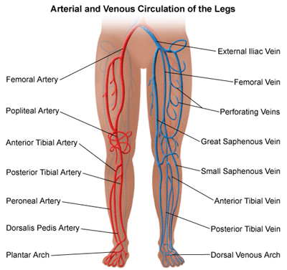
Review of Vessels of the Legs

Slide 3
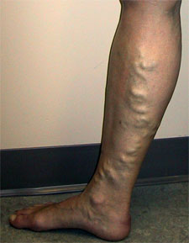
Varicose veins

Slide 4
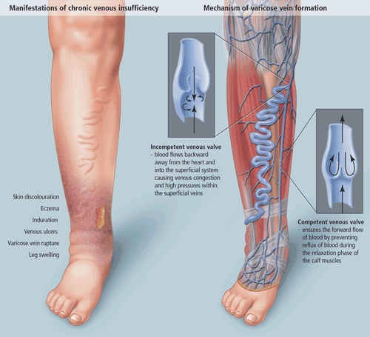
VARICOSE VEINS

Slide 5
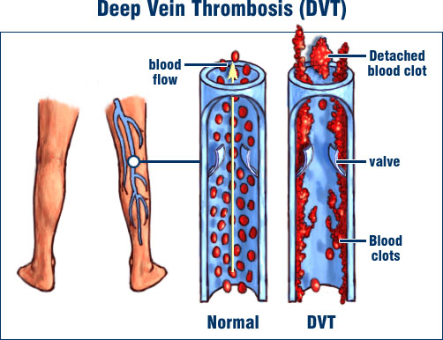
Notes:
CAUSE IS VENOUS STASIS, Or any increase in venous stasis. Thrombus is fibrin based enmeshed with rbc. Will present with localized redness and warmth and a cord like swelling along the course of the vein. pain is experienced at rest and worsens with movement.

Slide 6
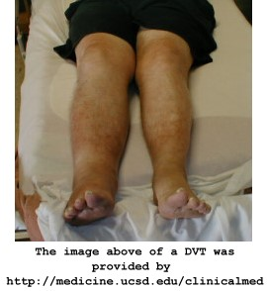
DVT

Slide 7
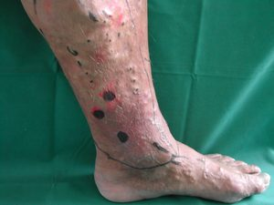
Chronic Venous Insufficiency

Slide 8
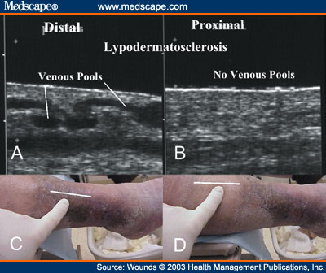
Chronic Venous Insufficiency

Slide 9
ASSESSMENT
GIRTH MEASUREMENT
Take and record measurements proximal to distal along both extremities
To test for edema or venous stasis
+ test = one side larger than the other
SAPHENOUS VEIN COMPETENCY TEST
Palpating distal to knee, and one hand inner thigh. At least 20 cm higher.
Compress vein at thigh, feel for an impulse in lower hand
+ test = back flow palpable at distal point
In competent veins will feel nothing, in severe V.V. will feel back flow

Slide 10
ASSESSMENT
Retrograde filling (Trendelenburg) Test
Raise legs to 90 degrees to empty venous blood
Occlude great saphaneous in upper thigh, compress with hand
Patient stands with occlusion
Watch for filling, fills from below
Normal takes about 35 seconds
After 20 seconds remove occlusion, watch for sudden filling, rapid filling is a sign of incompetent valves.

Slide 11
ASSESSMENT
Homan’s Sign For Deep Vein Thrombosis
Combine dorsiflexion of the ankle with squeezing into the belly of muscles gastrocnemius/soleus
+ test = severe pain on pressure
- test = doesn’t mean that it isn’t present!
Frequently this test results in false positive and false negative results.

Slide 12
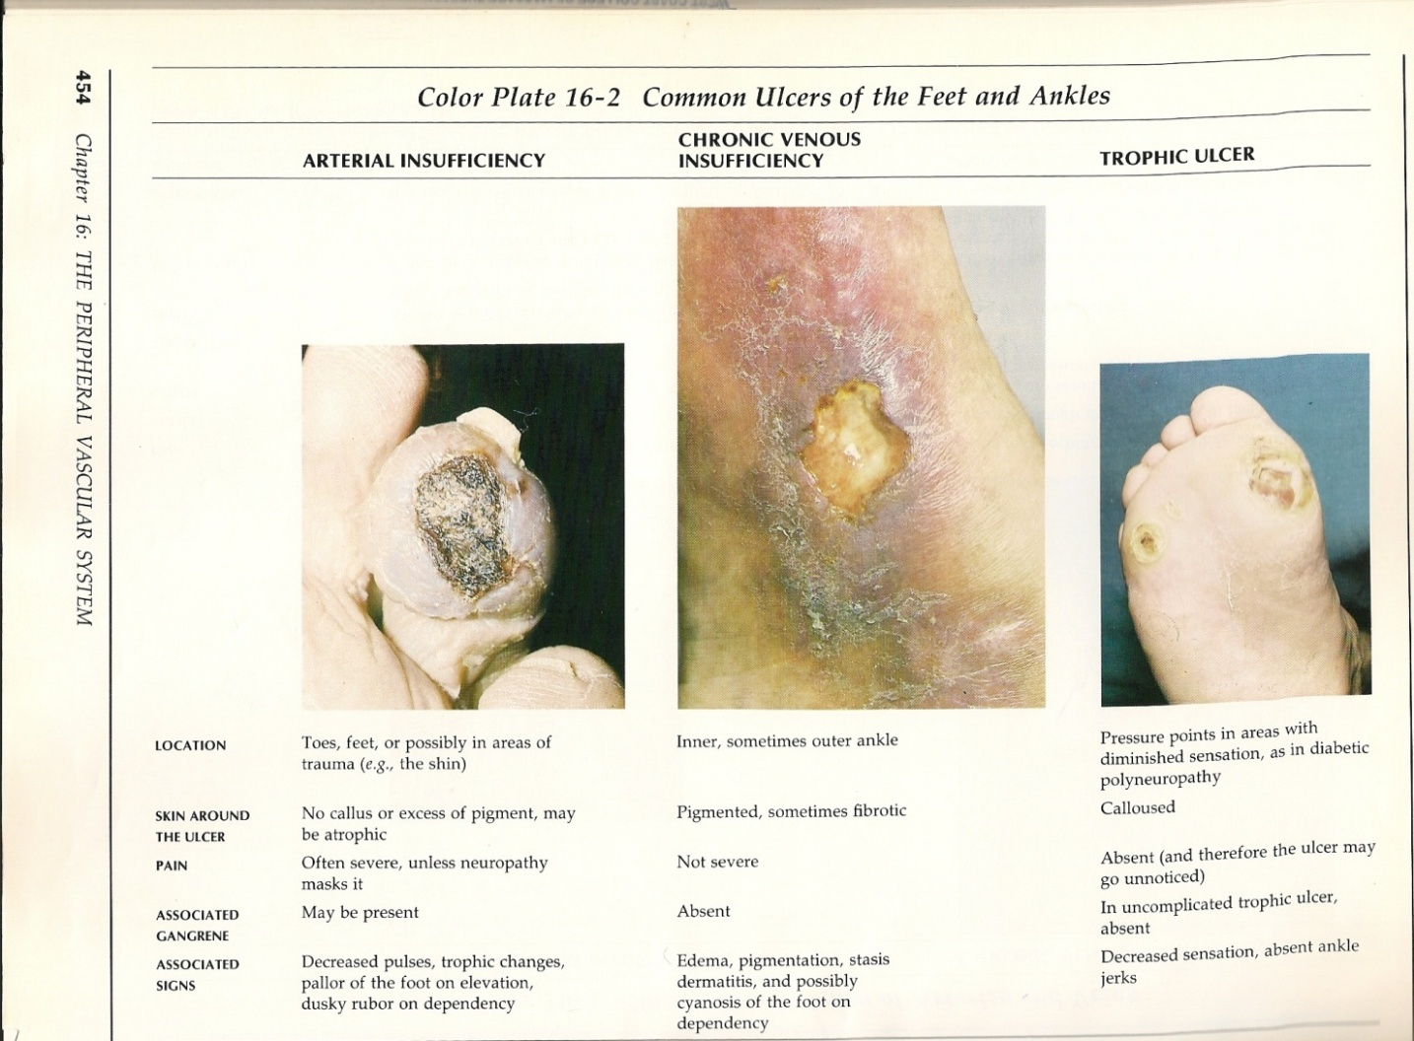

Slide 13
