Slide 1
ARTERIAL
INSUFFICIENCY

Slide 2
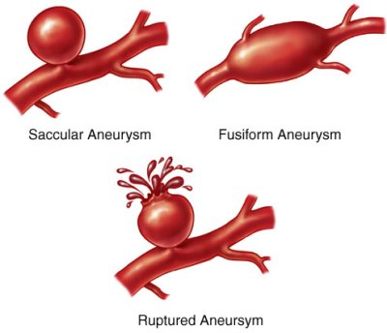
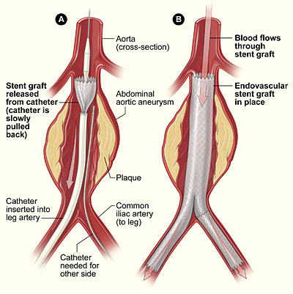
aneurysm

Slide 3
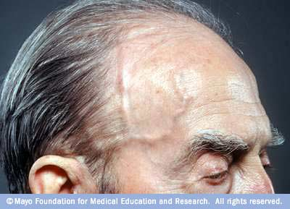
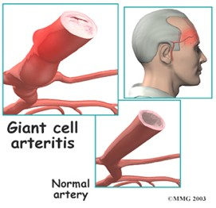
Arteritis

Slide 4
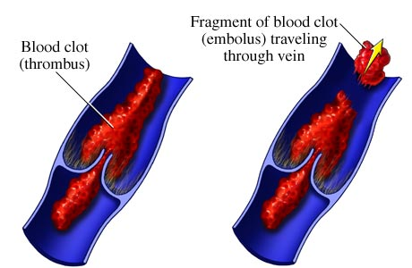
Thrombus

Slide 5
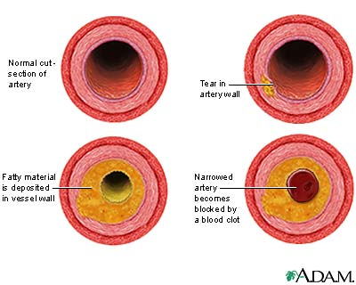
arteriosclerosis

Slide 6
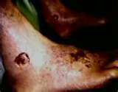
CHRONIC ARTERIAL INSUFFICIENCY

Slide 7
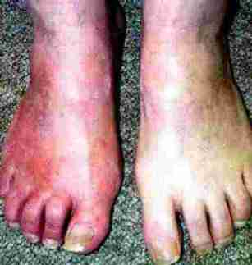
Buergers disease:

Slide 8
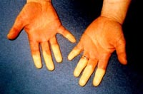
RAYNAUDS

Slide 9
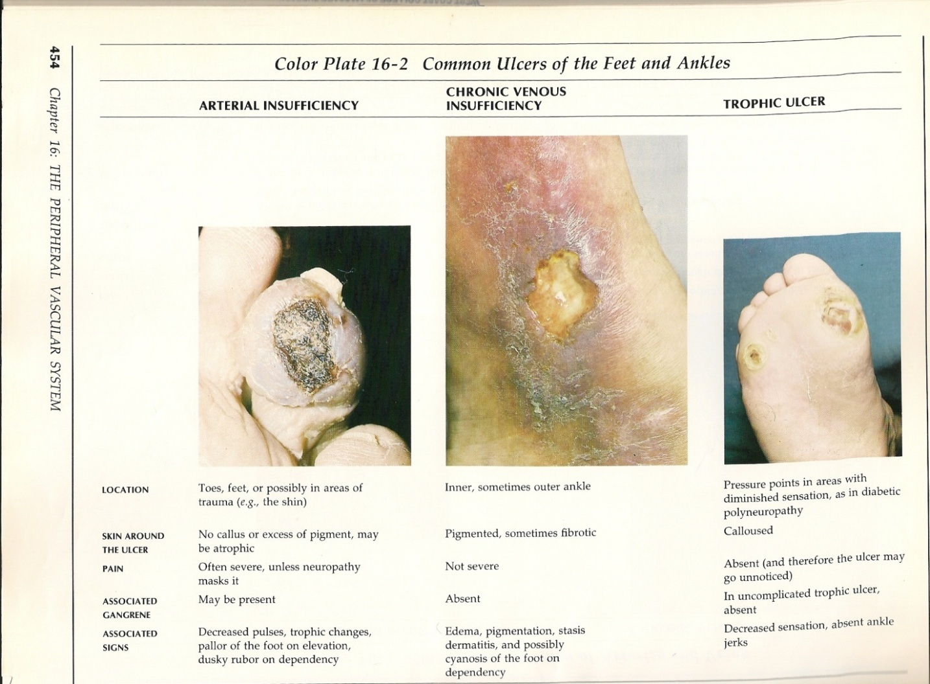

Slide 10
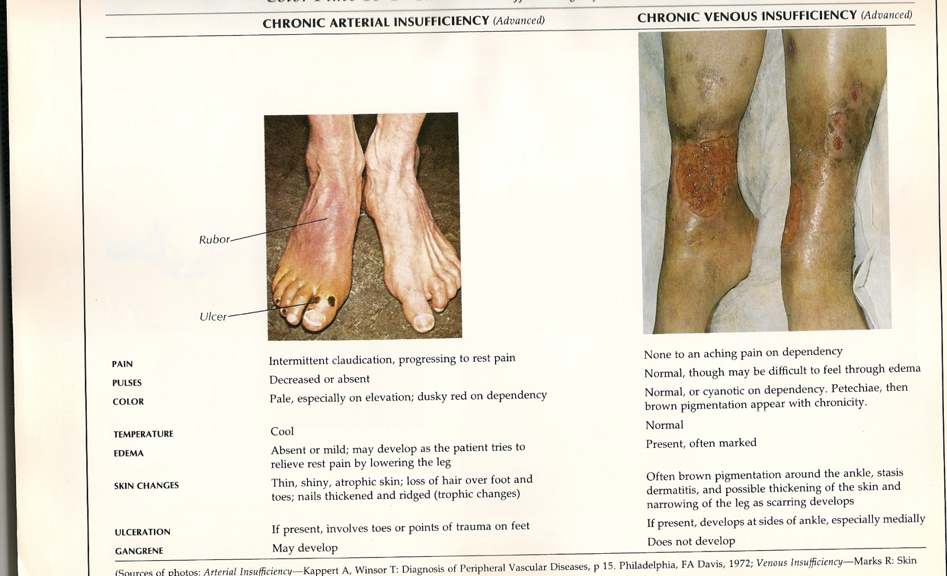

Slide 11
ALLEN TEST:

Slide 12
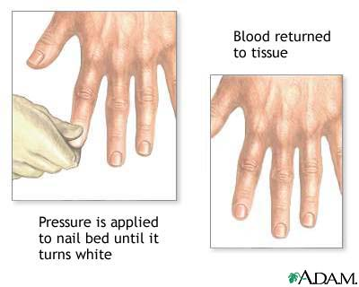
CAPILLARY REFILL TEST:

