Slide 1
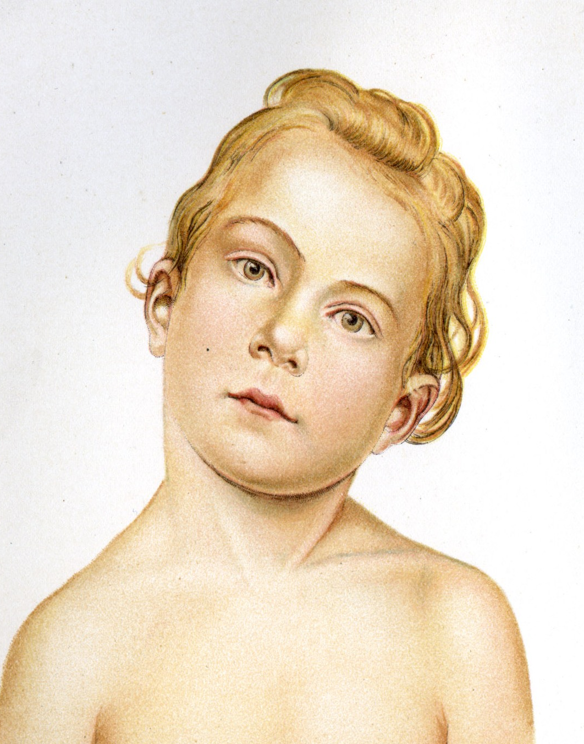
TORTICOLLIS
Fiona Rattray Pg.477

Slide 2
Torticollis
An abnormal positioning of the head and neck relative to the body
The typical presentation of torticollis has the head and neck side bent towards the affected side, the face turned away from the affected side and the shoulder on the affected side raised
The head could be in flexion (if SCM is involved) or extension (if levator scapula is involved)
Management of torticollis can pose a challenge to the physician owing to the fact that the condition can be acute or chronic, congenital or acquired, and idiopathic or secondary to trauma or disease. Moreover, the onset of torticollis can occur at any age.
In addition, laboratory studies are not particularly helpful and are dependent on the underlying disorder, although they are useful if infection is suspected.

Slide 3
ACUTE AQUIRED TORTICOLLIS
Is a painful unilateral shortening or spasm of the neck resulting in an abnormal head posture
Shortening can be due to latent TP’s that have been activated by holding the muscle in a shortened position for an extended period of time (telephone to ear)

Slide 4
CAUSES OF ACUTE ACQUIRED TORTICOLLIS
Activation of latent TP’s in cervical muscles
Subluxation of C1 on C2 due to trauma
Facet joint irritation
Infection, inflammation of the throat or cervical lymph nodes
Disc related pain

Slide 5
ACQUIRED TORTICOLLIS
SIGNS & SYMPTOMS
Breathing is rapid due to pain
If TP’s in SCM are affected, tinnitus, nausea or tearing of the eye on affected side may be present
Pain referral may be present
With facet joint irritation, pain can be sudden after abrupt neck movement. Pain may also be felt between the scapulae. Position is side bending is away from the affected side
If cervical DDD is the cause, the pain has a gradual onset, usually after sleeping in a awkward position
Onset is usually sudden (Client wakes up with it)
The head and neck are in typical torticollis position
Affected muscles are shortened and in spasm
Pain is present, especially with movement
Range of movement in drastically decreased due to pain

Slide 6
CONGENITAL TORTICOLLIS
Is a contracture of one SCM resulting in abnormal head posture
Present from infancy, and can continue to childhood unless treated with stretching or surgery

Slide 7
CAUSES
Idiopathic
Not clearly understood but thought to be associated with trauma in the birth process, causing inflammation and later fibrosing of the affected SCM (forceps delivery, caesarean, breech birth)
Tissue ischemia may be a contributing factor
Cranial bone torsion changes the angulation of the occiput

Slide 8
SYMPTOMS
May develop over days or 2-3 weeks after birth
Present with typical torticollis position
Contracture, thickening and shortening of one SCM muscle and scalene and fascia associated with that area
Possibly a palpable mass in the muscle
Unable to move neck normally due to contracture
Other postural dysfunctions such as scoliosis may be present

Slide 9
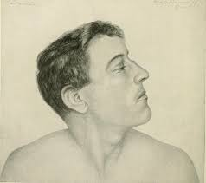
SPASMODIC TORTICOLLIS
Is a localized dystonia (abnormal tonicity of muscle, characterized by prolonged, repetitive muscle contractions that may cause twisting or jerking movements of the body or a body part) resulting in an involuntary spasm of cervical muscles and an abnormal head position
This uncontrollable rhythmic spasm of the neck muscles often worse when a person is stressed

Slide 10
CAUSES OF SPASMODIC TORTICOLLIS
Idiopathic
Linked to depression, severe stress and occupational positioning of the head
CNS lesions
Postural dysfunction such as scoliosis
Trauma of the head and neck

Slide 11
SYMPTOM PICTURE
Has an adult onset
Presents with typical torticollis position
The affected muscles of the neck jerk and twitch, and the affected shoulder shrugs uncontrollably
Can be intermittent or permanent

Slide 12
CONTRAINDICATIONS
Caution with clients receiving botulinum injection therapy. Get clearance from the physician prior to local treatment to injection site.
For any torticollis avoid full stretch to the SCM if the vertebral artery test is positive or if the client experiences dizziness with the stretch
Avoid direct pressure over the carotid artery
For Acute Acquired Torticollis do not passively stretch the shortened muscles
For Congenital Torticollis, if working with infants, use appropriate pressure when treating contractures
For Spasmodic Torticollis, painful techniques are contraindicated as they may increase CNS activation and increase muscle tone

Slide 13
ASSESSMENT
Observations:
Full posture assessment
Palpation:
Locate acutely spasmodic muscle
Heat, point tenderness, firmness and increased tone
Contracture may be tender and cool due to ischemia, or hard and fibrosed
AROM/PROM on the neck, thorax, shoulder joints
With Acute Acquired and Spasmodic Torticollis AROM is painful and very restricted, PROM is restricted when trying move neck out of the torticollis position
With Congenital Torticollis AROM and PROM away from affected side is restricted
RROM testing with acquired torticollis, is performed once the spasm has reduced, congenital torticollis may reveal weakness of the contralateral neck muscles as well as ipsilateral extensors

Slide 14
ASSESSMENT
Neurological:
Assess dermatomes/myotomes/reflexes
Nerve compression highly likely. Assess for nerve integrity to locate areas of compression
Referred Pain:
Assess for both latent and active TP’s
Special Tests:
Cervical depression and distraction tests are used to differentiate a cervical nerve root compression
Vertebral artery test rules out cerebral vascular insufficiencies one the spasm has reduced
Spurling’s test is performed after the spasm is reduced. May initiate facet joint irritation

Slide 15
MASSAGE FOR ACUTE ACQUIRED TORTICOLLIS
Positioning: supine
Decrease SNS firing (diaphragmatic breathing)
Decrease pain, spasm and abnormal positioning while working within the client’s pain tolerance
Start with the unaffected side while supporting the affected side, starting with MFR techniques, both indirect and direct. Follow with slow gentle effleurage and petrissage to gain the clients trust
Affected side – techniques that apply direct pressure may be too painful for muscles that are spasmodic. Possibly work with a gentle form of pin and stretch for SCM if within client’s pain levels.
Indirect techniques may be more effective
  Reciprocal Inhibition techniques for affected SCM
  GTO release and O&I technique are performed on the SCM attachments
  Repetition of techniques may be necessary to reduce the spasm

Slide 16
CONT.
Be sure to massage the surrounding muscles as well (levator scapula, Scalenes, upper traps)
Once the spasm has decreased or is less painful gentle on-site work such as vibrations, stroking, light fingertip kneading to affected muscles
TP’s in SCM can be treated with light pincer grasp technique
All other muscles of the neck are assessed for TP’s and hypertonicity and addressed within the client’s pain tolerance
Pain free PROM is also indicated

Slide 17
CONT.
GTO to sub occipitals and long axis traction of the occiput are performed
Joint play to any hypomobile vertebra is applied in pain free manner
Passive stretch to SCM can be performed only is the spasm is completely reduced and client is willing
Treatment is finished with soothing stroking, petrissage to muscles of mastication and scalp

Slide 18
SELF-CARE
Diaphragmatic breathing
Self massage
Gentle stretch of shortened structures with no pain for the client
Address contributing factors of the abnormal posture
Strengthen weak structures
Hydrotherapy:
Hydro depends on the type of spasm or shortening that is present. Local cold is used for an analgesic effect, while heat is used with TP to increase local circulation

Slide 19
MASSAGE FOR CONGENITAL TORTICOLLIS
Treatment may only last 5 – 10 minutes, but will likely extend as the treatment progresses
Positioning is supine
Hydrotherapy heat to affected structures
Goals of treatment are:
  Lengthen contractured structures
  Reduce abnormal posture
  Increase range of motion
  Strengthen weakened structures
Fascial glide to SCM in a segmental manner
Gentle stretching of affected muscles
General Swedish techniques to surrounding areas

Slide 20
SELF-CARE
Parents of infant clients are instructed on how to stretch and reposition the head
Range of motion exercises (use a toy to guide the eyes and head of the baby)
Referral to other practitioners who are trained in Neuromuscular therapy & craniosacral techniques

Slide 21
TREATMENT for SPASMODIC TORTICOLLIS
Supine positioning, or side lying on the unaffected side with support of pillowing under the head.
DDB to decrease SNS firing and spasm
Hydro: Heat to reduced hypertonicity
Full body relaxation massage, techniques used are gentle and soothing
Treating compensatory structures first, diaphragm, intercostals, and pectoral muscles.
Direct massage on the neck is CI’d.
Subsequent treatments: Cervical traction is introduced

Slide 22
SELF-CARE
DDB to help with spasm control
PF AROM of the neck
Agonist contraction

