Slide 1
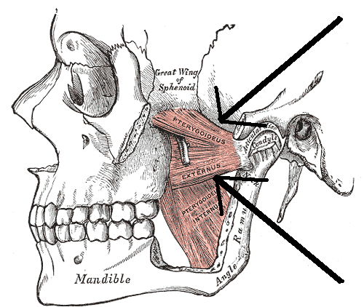
TEMPOMANDIBULAR JOINT DYSFUNCTION
Fiona Rattray & Linda Ludwig
Pg.597

Slide 2
TMJ
TMJ is a disorder of the muscles of mastication, the temporomandibular joints and associated structures.
Terminology used by Dentists and DR’s to describe the jaw positions used in evaluating proper mandibular motion is not clear.
A combination of jaw, head and ear pain has been describe clinically.
DR. J. Costen (1934) described HA’s and ear P in 11 people who were missing molars, theory was the height of posterior teeth helped maintain proper space at the TMJ, P than resulted. Psychosocial factors such as stress, lead to TMJ dysfunction.

Slide 3
TMJ ANATOMY & FUNCTION
2 tempomandibular joints are the most superior synovial joints in the body.
TMJ joints have 2 components: Rotation & Glide
Inferior portion which is the condyle: allows for rotation.
Superior portion which is the temporal bone: allows for gliding
Between the 2 bones: meniscus or articular disc

Slide 4
FACTORS CONTRIBUTING TO TMJ DYSFUNCTION
3 components must be present: Predisposition, tissue alteration, and stress
Predisposition: Can be intrinsic (genetic development of mm’s, ligaments and bones) or extrinsic (trauma to the neck, face or jaw)
Tissue alteration: malocclusion, tooth loss, cranial bone misalignment, hypermobility, postural dysfunction, spasms, ischemia, and TP’s.
Stress: increase mm tone due to jaw clenching, bruxism, or chewing gum, popping or clicking.

Slide 5
FACTORS CONTRIBUTING TO TMJ DYSFUNCTION
Opening Lock or subluxation occurs when the condyle is anterior to the articular eminence; the condyle is unable to return posteriorly and the jaw cannot close.
Closing Lock occurs when the disc is displaced anteriorly and the condyle cannot reduce over the posterior portion of the disk into the disc depression; the jaw cannot open more than 10 mm and often there is premature dental contact on the same side as the disc displacement.
Other factors are: incorrect swallowing patterns, mouth breathing and incorrect respiration

Slide 6
CAUSES OF TMJ
Imbalances in the mm’s of mastication-H+, spasms, TP’s
MM overuse-chewing gum BL or one sided
Malocclusion-loosing a tooth misaligns the whole jaw structure
Cranial bone misalignment-Temporal bone most common
Postural dysfunction
Increased stress
Trauma
Sinus blockage or infection
Joint pathology- hypermobility, capsulitis or synovitis

Slide 7
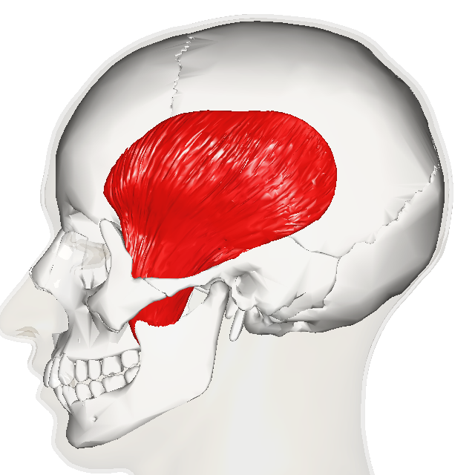
MUSCLES OF MASTICATION
TEMPORALIS
O: Temporal fossa
I: Coronoid process of the mandible
A: Elevates the mandible (closes the jaw)
To palpate, ask the client to gently clench their jaw

Slide 8
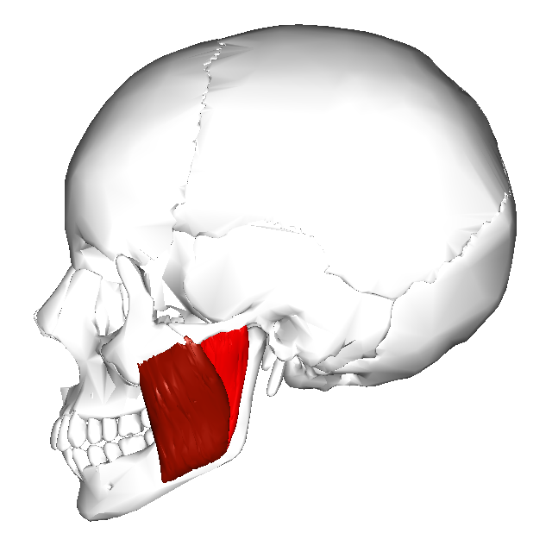
MUSCLES OF MASTICATION
MASSETER
Superficial and deep layers
O: Zygomatic arch
I: to the angle of the mandible
A: Elevates the mandible
To palpate externally, ask the client to clench their jaw.
To palpate intra orally, therapist places gloved finger into the client’s mouth between the cheek and molars, ask the client to gently clench.

Slide 9
MUSCLES OF MASTICATION
MEDIAL PTERYGOID
O: Runs from the lateral pterygoid plate of the sphenoid bone
I: To the inner aspect of the angle of the mandible
A: BL, elevates the mandible, Unilaterally one muscle moves the mandible to the opposite side
To palpate mm externally, first side bend the clients head to the side being palpated, palpate along the inner surface of the mandible at the angle while the client is asked to clench the jaw
Intra-orally, using gloves finger is first placed on the last lower molar, than slid around to the medial surface and inferiorly past the gum towards the floor. Keeping the pad of the finger against the inner surface of the mandible, the finger is than slid posteriorly to medial pterygoid.
To contract the muscle isometrically, the therapist hooks two fingers of the non-palpating hand over the lower front teeth, the client is than asked to close the jaw.

Slide 10
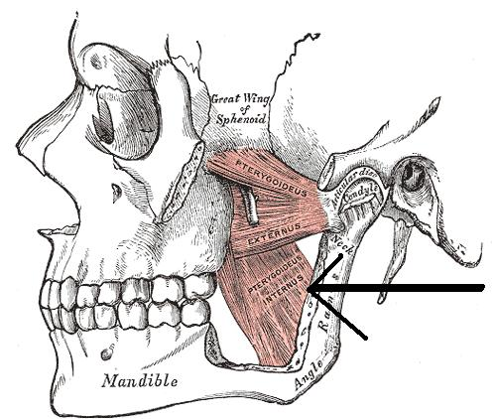
MEDIAL PTERYGOID

Slide 11
LATERAL PTERYGOID
LATERAL PTERYGOID
O: Superior and interior portions. Superior runs from the sphenoid bone posteriorly. Inferior runs from the lateral pterygoid plate
I: Superior inserts the tempomandibular joint capsule and articular disc. Inferior inserts on the neck of the mandible.
A: Superior pulls the disc anteriorly when the mandible opens. Inferior depresses and protrudes the mandible BL, pulls the jaw to the opposite side when acting unilaterally.
To palpate externally, first open the jaw 2 cm. It is found 2cms anterior to the external auditory meatus, inferior to the zygomatic arch and through the mandibular notch. The mm is palpated through the masseter mm. To isolate lateral pterygoid, ask the client to resist depression of the mandible.
To palpate intra-orally, using gloves placing between the cheek and the teeth, with your fingernail against the last upper molars. Ask the client to open the jaw and move it to the side being palpated to allow the next movement

Slide 12
LATERAL PTERYGOID
The finger is slid superiorly and posteriorly between the maxilla and the coronoid process of the mandible, into the hollow at the roof of the cheek. Ask the client to resist depression.

Slide 13
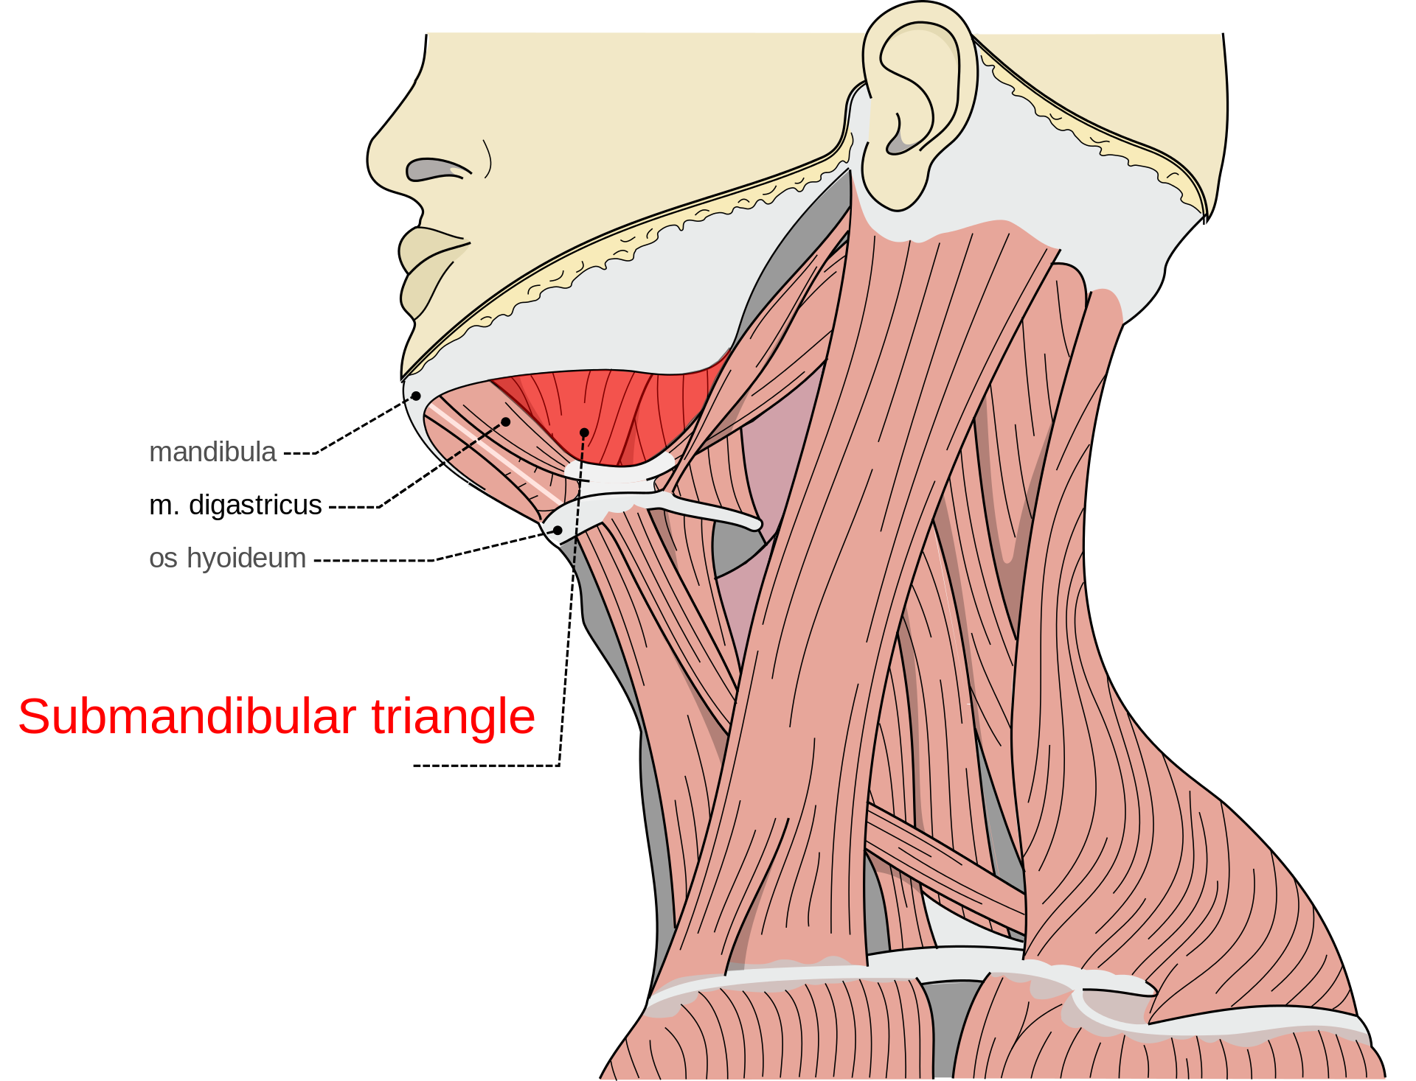
DIGASTRIC
Digastric has 2 bellies
O: Posterior belly attaches to mastoid notch and common tendon attaching to the hyoid bone, than continues as the anterior belly.
I: Attaches to the inside of the mandible at the symphysis.
A:BL Depresses and retracts the mandible; unilaterally, moves the mandible to the same side.
To palpate, ask the client to open their jaw against resistance, posterior belly is located between the angle of the mandible and mastoid process, anterior is close to the midline of the hyoid and mandible.

Slide 14
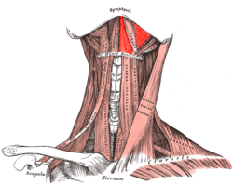
MYLOHYOID
O: Attaches inside of the entire mandible
I: Runs to the hyoid bone, covers the entire floor of the mouth
A: Depresses the mandible when the hyoid is fixed and tightens the floor of the mouth.
To palpate, ask the client to depress the mandible against resistance. Externally palpate on the inner aspect of the mandible, from the ramus to the angle.
Intra-orally, using gloves, place finger between the lower teeth and tongue. Using your finger pad slid down the inner surface of the mandible to the floor of the mouth. Palpation is as far as the last molar when mylohyoid ends.

Slide 15
MEDICAL TREATMENT OF TMJ
Medication-NSAIDS to reduce P and inflammation, mm relaxants for spasms
Dental splints
Physiotherapy
Behavioural therapy
Surgery has been used but not successful

Slide 16
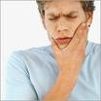
SYMPTOM PICTURE
TMJ may be unilateral or BL
Most common in ages 15-45 and more common in women 5:1
Predisposition, tissue alteration, and stress
Postural dysfunction
Other pathologies such as Fibromyalgia, OA, RA

Slide 17
SYMPTOM PICTURE
EARLY STAGE
Muscular incoordination and subluxation
TMJ joints sounds, clicking and popping sounds with jaw movement
Jaw P with movement or jaw clenching, P more worse in the morning, tenderness with muscles of mastication and joint capsule
HA usually frontal or temporal
Spasms, TP’s and H+ may occur in the mm’s of mastication
Shoulder and neck tightness
Decrease ROM of the jaw, especially when opening
Ear stuffiness, hearing loss
Trauma: which than will produce edema, inflammation, adhesions

Slide 18
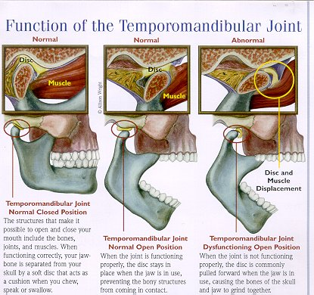
SYMPTOM PICTURE
LATER STAGE
If not corrected, mm’s of mastication may develop contractures, limiting ROM
Degeneration of the disc, condylar hear and articular eminence may occur.
Please read Pg’s 607-608 on Postural Assessment and Palpation

Slide 19
TESTING
AF ROM of the mandible is reduced due to P
Tempomandibular joint AF ROM test is done. If the therapist see’s a C-wobble, indicating a capsular source on the side of the jaw deviates towards, or an S-wobble, indicating a muscular source such as TP’s.
Reduced mandibular depression= BL TP’s in masseter
AF ROM of the C/sp may be reduced
PR ROM: Painful end feel may be present, clicking and springy block end feel are present; PR ROM of the C/sp may be reduced
AR Isometric testing, reveals weakness or P

Slide 20
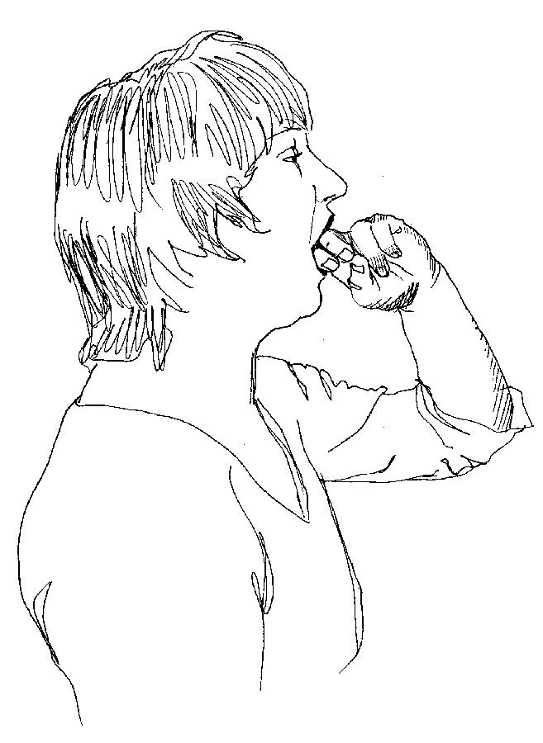
SPECIAL TESTS
Three Knuckle Test
Positive with TP’s in the muscles that elevate the jaw

Slide 21
CONTRAINDICATIONS
When treating anterior C/sp, do not compress the carotid artery
Do not treat the SCM at the same time, client may feel choked
Avoid deep work over the styloid process of the temporal bone, potentially fragile
Frictions are CI’d with anti inflammatories and blood thinners
Do not use latex gloves for intra-oral work if the client has a latex allergy
Avoid using heavy or deep pressure when working intra-orally, mm’s may be delicate or tender
TMJ may be a result of abuse or history of abuse, work within the clients tolerance while working intra-orally

Slide 22
TREATMENT
Mm stripping in short strokes for adhesions
PF AROM is used to normalize proprioception: in between working orally get the client to open and close within P tolerance
Joint play for hypomobile joints: Traction of the mandible
Once intra-oral work is done, remove your gloves and continue with suboccipital work GTO
Passive stretching, long axis traction of C/sp, Inferior traction of the mandible
PR ROM of C/sp
Treatment is finished with effleurage to shoulders, neck and scalp.

Slide 23
TREATMENT
TREATMENT GOALS
Reduced P, decrease SNS firing
Maintain local circulation
Reduce inflammation and edema if present
Reduce fascial restrictions, stretch shortened mm’s
Reduce H+, and TP’s
Mobilize hypomobile jts
Positioning: Prone, side lying and supine are all indicated
Hydro: Heat to shoulder girdle, neck and jaw.
If inflammation is present, apply cold
Tx compensatory structures first, DDB
If edema is present, start direct treatment with lymphatic drainage, beginning with nodal pumping at the terminus.

Slide 24
TREATMENT
Effleurage and general Swedish techniques proximal to the affected joint
If no edema is present, fascial glide to assess, than fascial techniques are used at neck and jaw. Skin rolling, cross hands and finger tip kneading.
Passive stretching: Tight pectoral muscles
Effleurage and petrissage at C/sp, being specific to anterior Scalenes, pec major, minor and subclavius.
SCM treated unilaterally: Pincer grasp or O & I technique
Joint play techniques for C/sp, shoulder girdle and thorax
Muscles of mastication are now treated outside the mouth, temporalis, masseter, medial pterygoid/lateral pterygoid are treated using fingertip kneading, mm stripping, and ischemic compressions. Gentle fascial spreading can also be used within clients P tolerance on temporalis and masseter.

Slide 25
TREATMENT
Temporalis and masseter: direction of strokes is from superior to inferior. O & I technique is used on temporalis attachments, zygomatic and mandibular attachments of masseter.
TP’s in temporalis are tx’d
Intra-orally masseter, medial and lateral pterygoid and mylohyoid are tx’d.
Specific consent are required, a signal should be arranged so tx can be stopped if necessary.
Vinyl or latex gloves must be worn by the therapist, wash prior to putting the gloves on. MAKE SURE YOUR CLIENT IS NOT ALLERGIC TO LATEX.
Pressure here is gentle, O & I techniques are used, gentle mm stripping, cross fibre work, ischemic compressions.

Slide 26
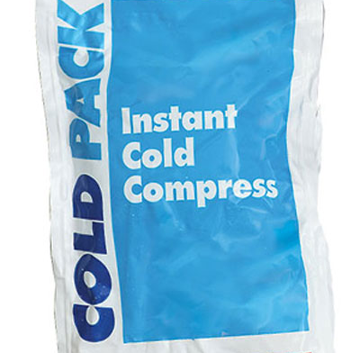
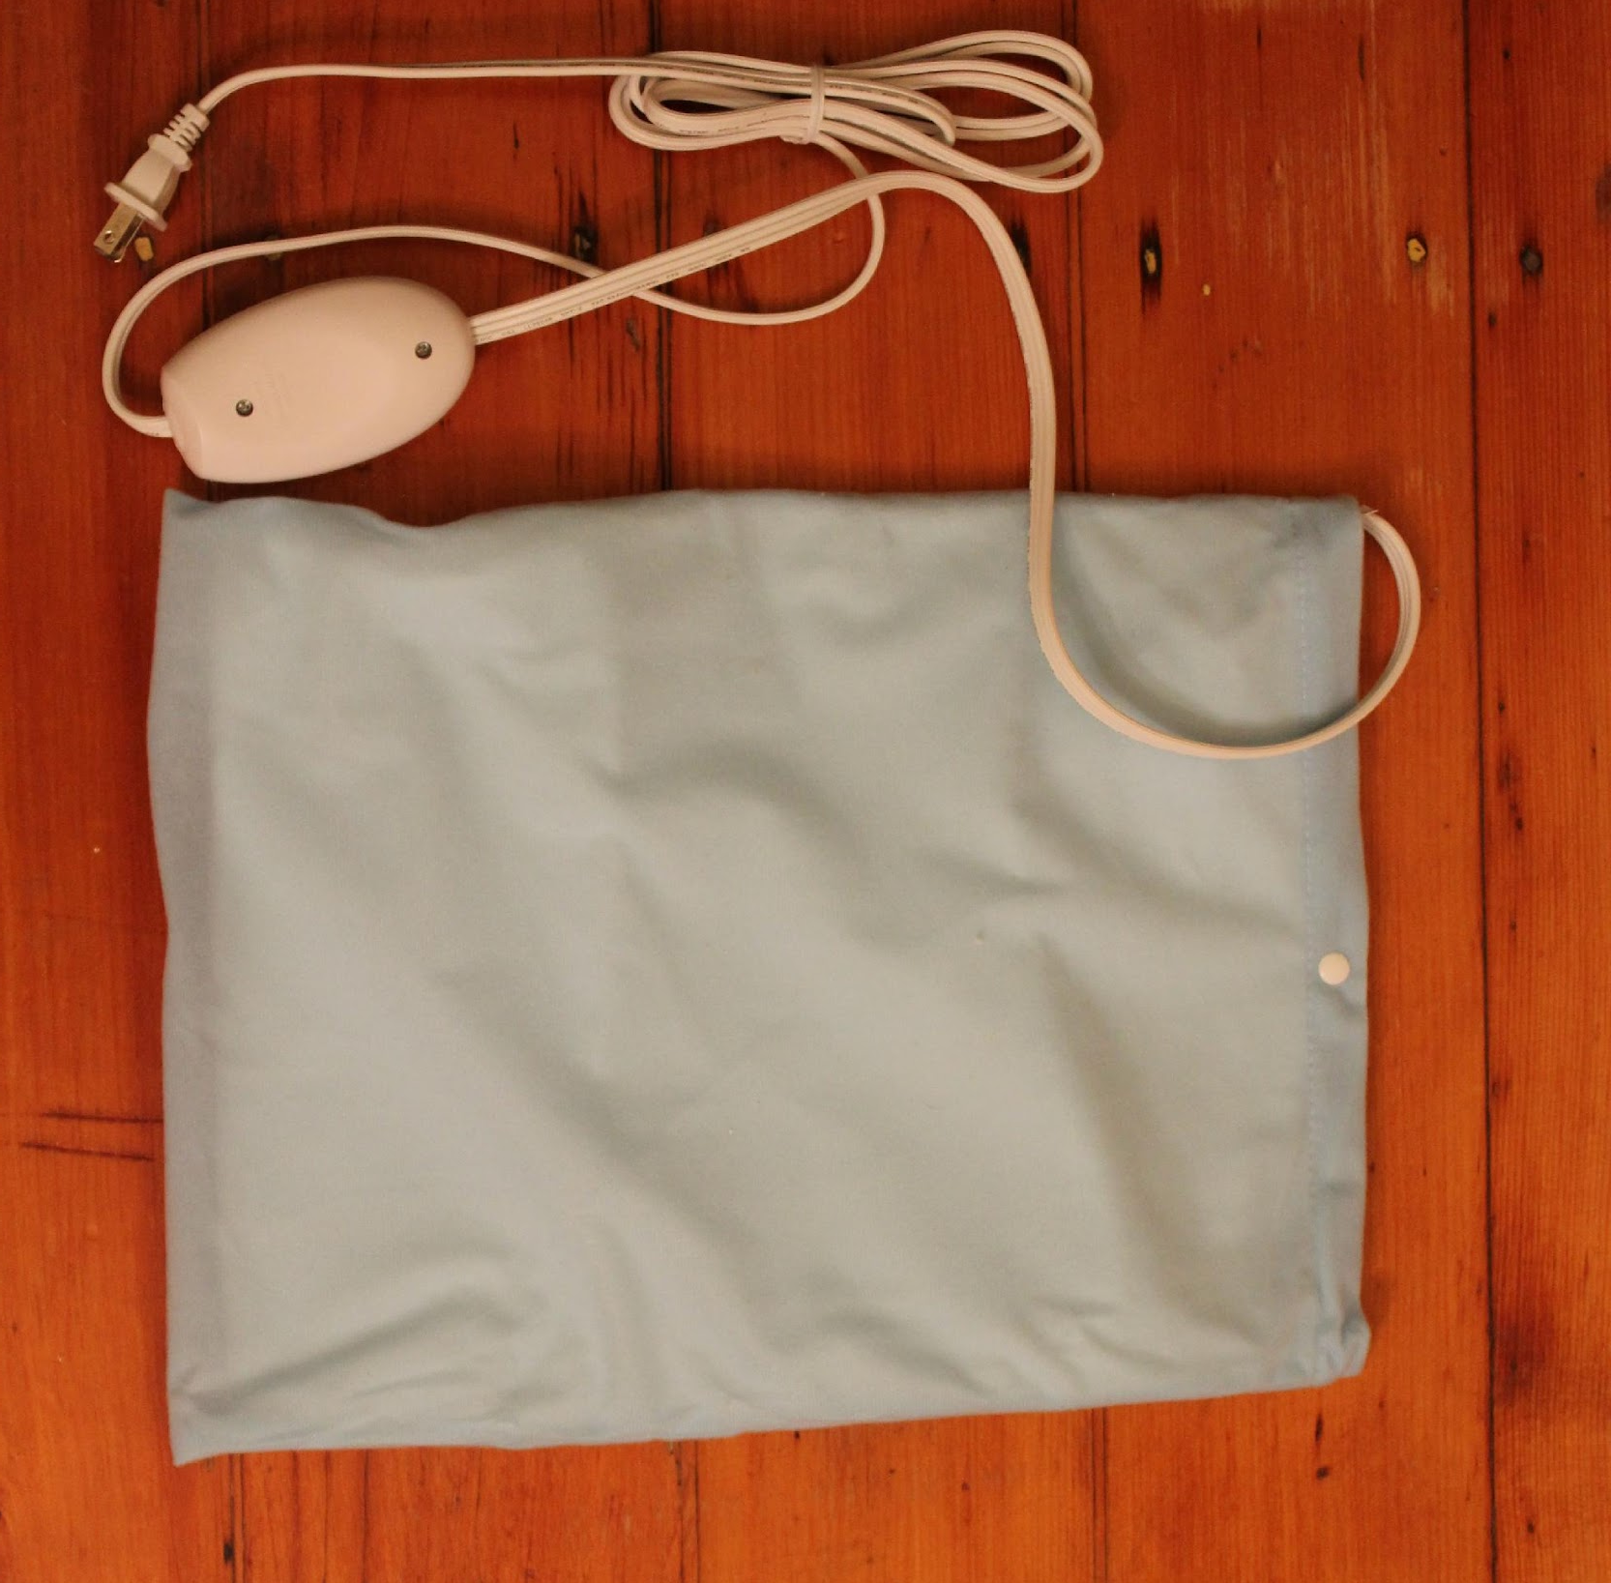
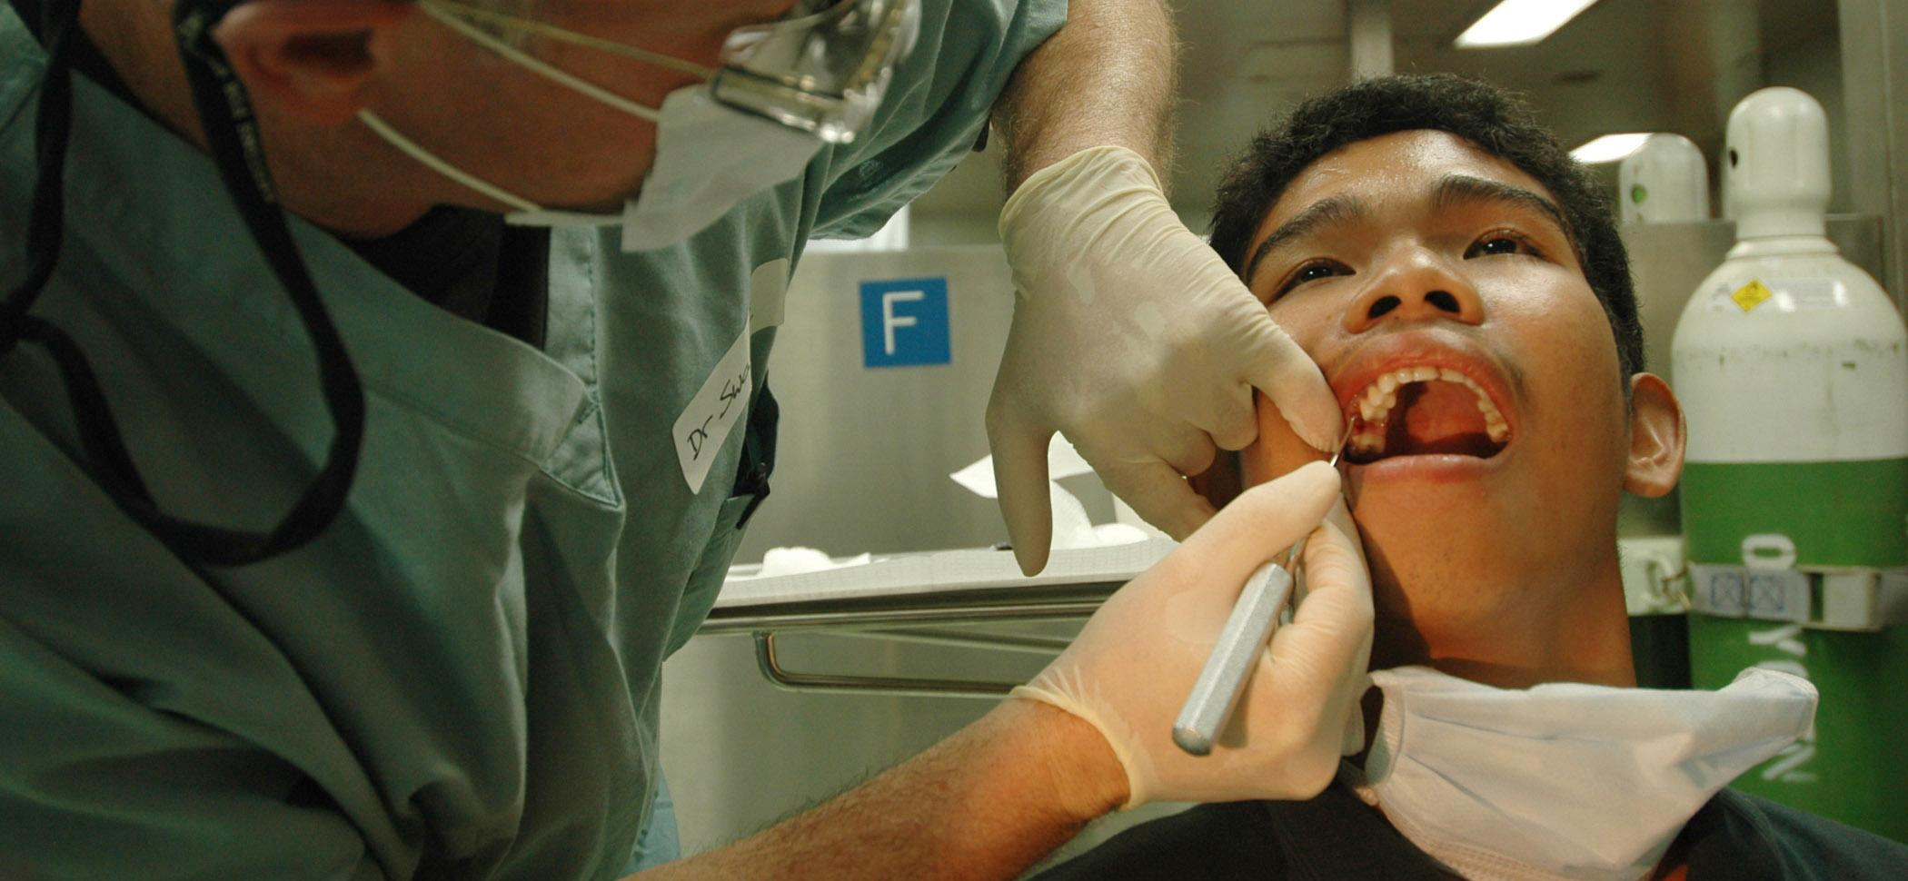
SELF-CARE
Self-massage: To affected muscles, mm stripping and gentle ischemic compressions
Hydro: Heat, Ice if inflammation is present
Sub occipitals are stretched using chin tuck 30-3-3
Relaxation exercises DDB
Isometric active resisted exercise for all muscles involved
Refer out to Physiotherapy, or a Dentist
Tx plan: 2x/week for 2 weeks, than RE-AX, than 1x/week for several months based on prognosis.

