Slide 1
Pathophysiology 1

Slide 2
Course Outline
Section 1
  Definitions of Health
  The Study of Pathophysiology
  Medical and Pathological Terms
  Cellular Adaptation
  Factors Affecting Adaptation to Stressors
  Aspects of the Disease Process
  Levels of Disease Prevention
  Cell Injury

Slide 3
Section 2
Blood Cells and the Hematopoietic System
Blood Elements
Hematopoiesis
Anemia
Hemostasis
Blood Groups
Polycythemia
Infectious Mononucleosis
Hodgkin Disease and Non-Hodgkin Disease
Leukemia
Test 1 after Section 1 & 2

Slide 4
Section 3
Source of infection
Patterns and Defenses against Infections
Spread of infections
Pathogenesis of Bacterial Infections
MRSA, H-PYLORI, VRSA-VISA, VRE
The Lymphatic System

Slide 5
Section 4
The Immune System
Innate immunity
Adaptive Immunity
Immune Response
Acquired immunodeficiency syndrome (AIDS)
Inflammation
Hypersensitivity Disorders
Test after section 3 and 4

Slide 6
Section 5
  Mental Health
Stress
Insomnia
Sleep Disorders
Anxiety Disorders
Phobias
OCD
Mood Disorders
Depression
Bipolar Disorder
Eating Disorders
Schizophrenia
Test
FINAL EXAM

Slide 7
Definition of Health
“Health is a state of complete physical, mental, and social well-being and not merely the absence of disease and infirmity.”
Definition from the WHO in 1948 and has not been amended since

Slide 8
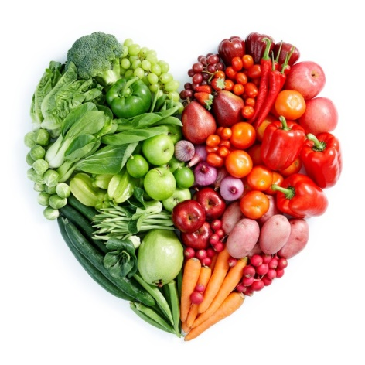
Determinants of Health
For many people attaining health based on
the true definition is an unrealistic goal.
The US Department of Health and Human Services in “Healthy People 2020” describe the determinants of health to as
Attain lives free of preventable disease, disability, injury and premature death
Achieve Health equity and eliminate disparities
Promote good health for all
Promote healthy behaviors across the lifespan

Slide 9
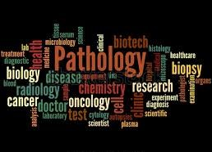
Medical and Pathological Terminology

Slide 10
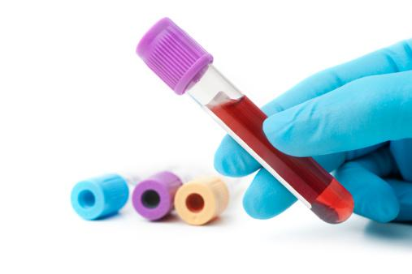
Study of Pathology
study of the body’s response to dysfunction or disease

Slide 11
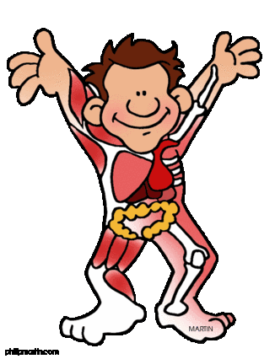
Study of Physiology
Branch of biology that deals with the functions and activities of life or of living matter (such as organs, tissues, or cells) and of the physical and chemical phenomena involved

Slide 12
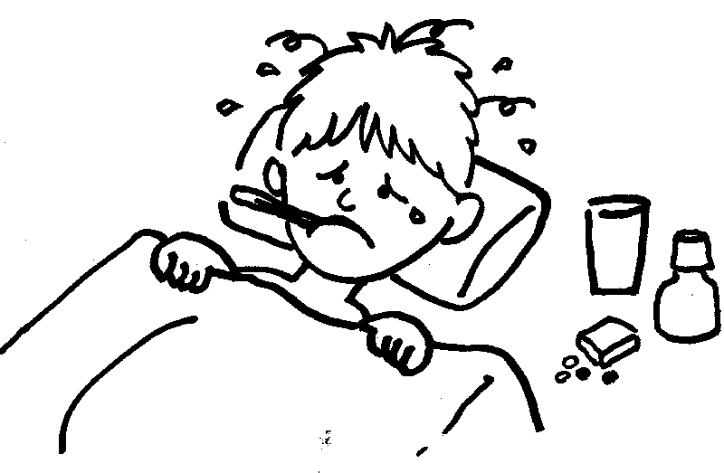
Pathophysiology
The study of the physiology of altered health
www.

Slide 13
Pathology Types
Pathology - Underlying processes and changes in an organ or tissue, related to disease. At the cellular level it is called Histopathology & at the tissue level, it is called Gross Pathology
Forensic Pathology - determination of a cause of death through examining human remains at the gross & cellular levels.

Slide 14
Definitions
Disease: The interruption, cessation, or disorder of a body system or organ structure.
Etiology: Cause or causes of the disease
Pathogenesis: Step by step development of the disease
Symptoms: Subjective manifestation of the disease such as pain
Signs: Objective (measurable) manifestations of the disease such as heart rate, BP, Size of swelling etc
Diagnosis: Designation of the nature or cause of a health problem
Prognosis: A prediction of the outcome of the pathological process or disease.

Slide 15
Disease Progression
Remission: Decrease or complete disappearance of the disease
Exacerbation: Disease gets worse
Autoimmune conditions such as rheumatoid arthritis, MS, & fibromyalgia often have periods of remission and exacerbation (AKA “flare ups).
Complications: Secondary problem due to the initial problem ex. My friend with diabetes has now developed peripheral neuropathy as a complication
Healing: Process by which damaged tissues are restored towards normal
Resolution: Perfect healing

Slide 16
Disease Classifications - Congenital
Congenital disease: When the individual is born with the disease. This could be due to:
a genetic or inherited problem of the DNA such as in Down Syndrome or Cystic fibrosis
problems in the uterine environment such as congenital birth defects from exposure to the rubella virus or taking the drug Thalidomide
problems during birth, such as cerebral palsy due to a lack of oxygen during the birth process.

Slide 17
Disease Classifications - Acquired
Any disease that is NOT present at birth is said to be an acquired disease.
Diseases can be acquired in different ways:
Infection: Disease due to a pathogenic organism such as a virus, bacteria, fungi or parasite. These diseases can be further classified into contagious and non-contagious.
Degenerative disease: Disease caused by the structure or function of the tissues changing for the worse over time. Common examples are osteoarthritis, osteoporosis and coronary artery disease which are all very common findings in elderly people.

Slide 18
Disease Classifications - Acquired
Traumatic disease: Disease caused by injury
Neoplastic disease: Uncontrolled growth of cells AKA Cancers
Deficiency Disease: caused by lack of a certain nutrient eg Scurvy from lack of Vit C, anemia from lack of iron
Autoimmune disease: a malfunction of the body’s immune system that causes it to attack components of our body ex. Rheumatoid arthritis, Multiple Sclerosis
Idiopathic disease: The medical professional does not know the cause of the disease
Iatrogenic disease: A disease caused by a medical intervention or mistake, such as paralysis after surgery or kidney disease caused by a toxic medication

Slide 19
Testing for Diseases
Predictive value: Extent to which an observation or test result is able to predict the presence of a given disease or condition.
Sensitivity: The sensitivity of a test refers to how well the test is able to find people with the disease. A highly sensitive test has very few false negatives and so is very good at identifying those with the condition.
Specificity: The specificity of a test refers to how well the test can rule OUT healthy people, with very few false positives.
https://youtu.be/UsOv0DcXk6w?feature=shared

Slide 20
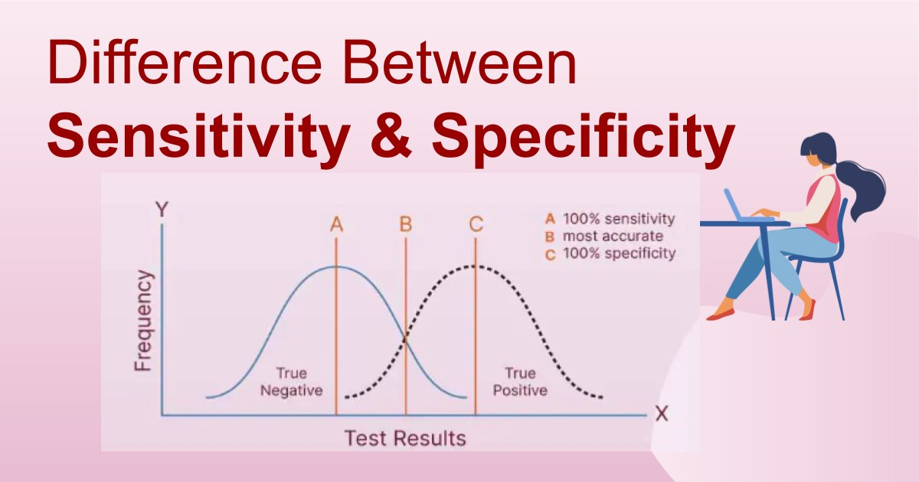
Sensitivity vs Specificity
SPPIN - A highly specific test, when positive, rules in a disease
SNNOUT - A highly sensitive test, when negative, rules out a disease

Slide 21
Epidemiology
Epidemiology is the study of how a disease affects a population of people.
Morbidity: The number of diseased persons in a given locality, nation etc. describes the effects of an illness on a person’s life
  Concerned with the incidence, persistence, and long-term consequences of disease
Prevalence: The number of people affected by the disease currently in any defined population.
Incidence: The number of new cases arising in a population at risk during a specified time
Mortality: The number of deaths that have occurred in any defined population due to a specific disease or cause.

Slide 22
Problems with Blood Oxygenation
Anemia: A condition in which a person doesn’t have enough healthy red blood cells or hemoglobin to carry adequate oxygen to his/her tissues.
Hypoxia: Inadequate oxygen supply
Ischemia: Loss of blood supply resulting in damaged tissues
Cyanosis: A bluish discoloration of the skin and mucous membranes due to an excessive concentration of reduced (deoxygenated) hemoglobin in the blood

Slide 23
Terms related to blood
Embolus: A clot, usually part or all of a thrombus, carried by a larger vessel and forced into a smaller vessel, thus obstructing blood flow.
Embolism: The sudden blocking of an artery by a clot of material (embolus). The process of the formation of an embolus.
Hematemesis: Vomiting blood.
Hemoptysis: Coughing-up blood.
Hematoma: A localized collection of extravasated blood, usually clotted.
Hemorrhage: Discharge of blood.
Syncope: A temporary loss of consciousness due to insufficient cerebral blood flow; fainting.

Slide 24
Definitions
Abscess: A localized collection of pus in a cavity formed by the disintegration of tissue.
Cyst: An abnormal sac filled with gas, fluid, or semi-solid material that is lined by a membrane.
Polyp: A spheroidal mass that protrudes upwards or outwards from a normal surface. Polyps may be hyperplastic, inflammatory, or neoplastic.
Edema: An abnormal accumulation of fluid in the cavities and intercellular spaces of the body.
Ulcerated: Having a local defect or excavation of the epithelium of an organ or tissue through the basement membrane.

Slide 25
Continued
Dyspnea: Difficult breathing.
Fistula: An abnormal, tube-like passage from a hollow organ to the surface or from one organ to another
Gastroenteritis: Inflammation of the lining of the stomach and intestine.
Jaundice: Yellow staining of the skin and sclera (the whites of the eyes) by abnormally high blood levels of the bile pigment (bilirubin).
Necrosis: The morphologic changes indicative of cell death, indicated by characteristic nuclear and cytoplasmic changes.

Slide 26
Continued
Imperforate: Closed (when it should be open), ex. imperforate anus
Infarct: A localized area of ischemic necrosis produced by the occlusion of the blood vessels - either arterial supply or venous drainage.
Lesion: An alteration or abnormality in a tissue or cell; a pathological change.
Metastatic: A tumor that has transferred from one organ (or part) to another not directly connected to it
Malignant: Having the properties of anaplasia, invasiveness and metastasis; tending to become progressively worse and to result in death
Patent: Open (when it should be closed), exposed or unobstructed. e.g. patent ductus arteriosus - an abnormal persistence after birth of an open lumen in the ductus arteriosus, between the pulmonary artery and the aorta.

Slide 27
Continued
Splenomegaly: Enlargement of the spleen.
Hepatomegaly: Enlargement of the liver.
Cardiomegaly: Enlargement of the heart.
Hemiplegia: Weakness/paralysis on one side of the body
Hemiparesis: Weakness/partial paralysis on one side of the body
Quadriplegia: Weakness/paralysis bilateral upper & lower extremities
Paraplegia: Weakness/ paralysis bilateral lower extremities

Slide 28
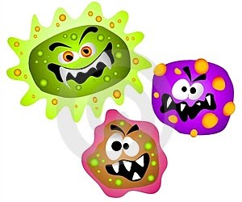
Suffixes
-algia: Pain
-itis: Inflammation
-pathy: Disease
-paresis: Partial paralysis
-lysis: Destruction, separation
-oma: Tumor
-penia: Deficiency

Slide 29

STRESS & HEALTH
Factors Affecting Adaptation to Stressors

Slide 30
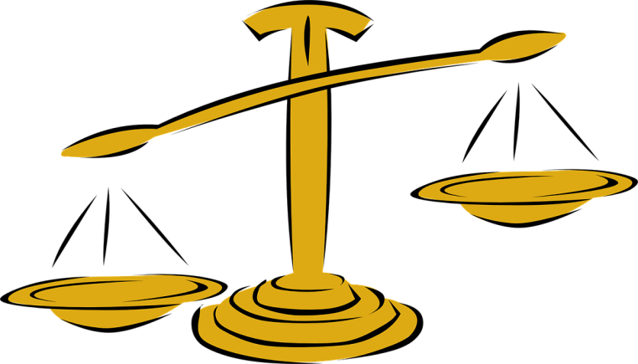
A few more definitions
Homeostasis - tendency of organisms to auto-regulate and maintain their internal environment in a stable state
Stress - is a condition in which the human system responds to changes in its normal balanced state.
Stressor - anything that is perceived as challenging, threatening or demanding
Adaptation - is the change that takes place as a result of the response to a stressor

Slide 31
Stress Response
A Control System
The Stress response
  A collection of control systems in the brain that serve to control nerve activity, regulate information flow that ultimately control behavior. They mediate the physical, emotional and behavioral reactions to stressors
Parts of a control System
  Sensor – Detects change
  Integrator – compares incoming data with normal
  Effector – Tries to reverse the change
More complex Stressor invoke more complex control systems and sometimes the stress response cannot restore balance or homeostasis
https://youtu.be/BIfK0L8xDP0 (Page 205 Porth’s)

Slide 32
Stress & Adaptation
Humans usually have alternative mechanisms for adapting and have the ability to control many aspects of the environment
Many of the bodies physiologic disturbances are controlled by moment by moment feedback mechanisms that limit their application and duration of action
Systems that control physiologic responses are specific, where as psychological disturbances are not regulated with same degree of specificity and feedback control
General Adaptation Syndrome HPA Axis

Slide 33
HPA Axis & General Adaptation Response
Discovered by Dr. Hans Selye
Response to a perceived stressor,, physical or mental/emotional, causes a response by the HPA Axis:
Hypothalamus -> Pituitary gland -> Adrenal Gland
ultimately resulting in the production of more cortisol hormone and an increased sympathetic nervous system response
-General Adaptation Syndrome has 3 phases: alarm, resistance, & exhaustion
- If the stressor persists & the General Adaptation response cannot restore homeostasis, that is when the exhaustion phase sets in. Symptoms include: fatigue, burnout, decreased tolerance of stressors & more frequent illness.

Slide 34
Factors that affect Adaptation
Adaptation implies and individual has created a new balance between the stressor and ability to deal with it
How we cope with stressful events depends on how we perceive and interpret the event
Factors that affect our ability to adapt include
  Physiologic and Anatomic Reserve
  Time
  Genetics
  Age
  Gender
  Health Status
  Nutrition
  Sleep-wake cycles
  Resilience
  Psychosocial Factors

Slide 35
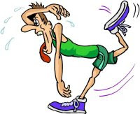
Physiologic & Anatomic Reserve
The ability of body systems to increase their function given the need to adapt is Physiologic Reserve
Many body organs are paired which provide an anatomic reserve (kidneys)

Slide 36

Time
Adaptation is most efficient when changes occur gradually rather than quickly
Ex – losing blood over a week with a GI bleed will likely not manifest signs of shock, where as happening suddenly it would

Slide 37
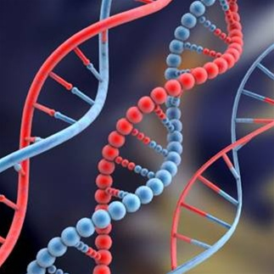
Genetics
Adaptation is further affected by availability of adaptive responses and flexibility to select the appropriate one
Genetics can ensure that systems for adaptation function adequately

Slide 38
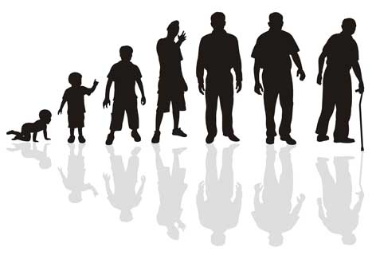
Age
Capacity to adapt is decreased at extremes of age
Ability in infants is impaired by immaturity of body etc.
Ability in elders due to decline in functional reserve

Slide 39

Gender
Premenopausal women tend to have a lower activation of their sympathetic nervous system than men in response to stressors
This may account for differences in susceptibilities to diseases which the stress response plays a causal role

Slide 40
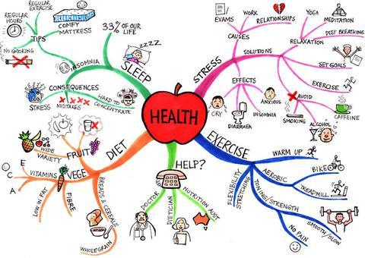
Health Status
Strong Determinant of the ability to adapt
Has an effect on physiologic and anatomical reserves
Ex – heart disease less able to deal with stresses that require cardiovascular responses

Slide 41
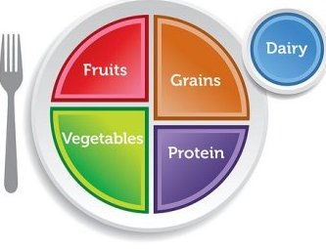
Nutrition
Lack of or excesses in any essential nutrient can impair the body's ability to adapt

Slide 42
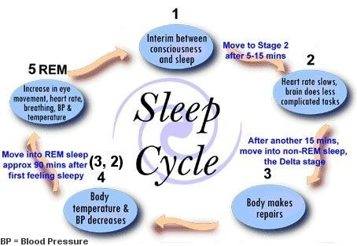
Sleep-Wake Cycles
Sleep is restorative in which energy is restored and tissues are regenerated
Sleep deprivation has been shown to alter immune responses, hormone secretion, physical and physiological functioning
Lack of Sleep affects health

Slide 43

Resilience or Hardiness
Personality characteristic that includes: Sense of control over one’s life, sense of purpose, ability to look at stressors as challenges rather than a threat. Studies suggest that hardiness is related to positive health outcomes
Can be improved through many exercises including mindfulness meditation
Building Resilience in Healthcare

Slide 44
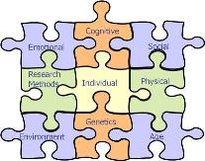
Psychosocial Factors
People who can mobilize strong supportive resources from within their social relationships are better able to withstand negative effects of stress on their health

Slide 45
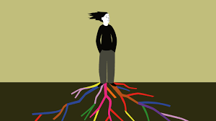
REVIEW OF FACTORS THAT AFFECT ADAPTATIONS TO STRESSORS
Physiologic & Anatomic Reserve
Time 3. Age
Genetics 5. Gender
6. Nutrition
7. Health Status
Psychosocial Factors
Sleep-Wake Cycles
10. Resilience
.Berkeley Greater Good in Action

Slide 46

ASPECTS OF THE DISEASE PROCESS

Slide 47
Aspects of the disease process
Etiology
Pathogenesis
Morphologic changes(morphology of the tissue changes)
Clinical manifestations
Diagnosis
Clinical course

Slide 48
Etiology
Causes of disease known as Etiologic factors
Recognized etiologic agents
  Biologic Agents (bacteria, viruses)
  Physical Forces (Burns, Trauma, radiation)
  Chemical Agents (Poisons, Alcohol)
  Genetic Inheritance
  Nutritional excesses or deficits
Many different agents can cause disease of a single organ
A single agent can cause disease to a number of organs or systems (cystic Fibrous)
Most diseases are multifactorial in nature (cancer, heart disease)

Slide 49
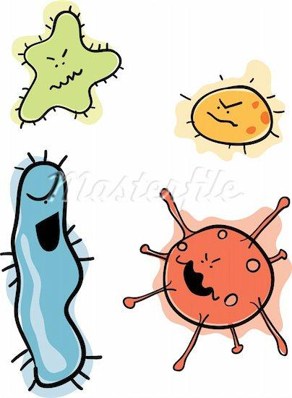
Etiology Continued
Diseases can be grouped as either congenital (present at birth)or acquired

Slide 50
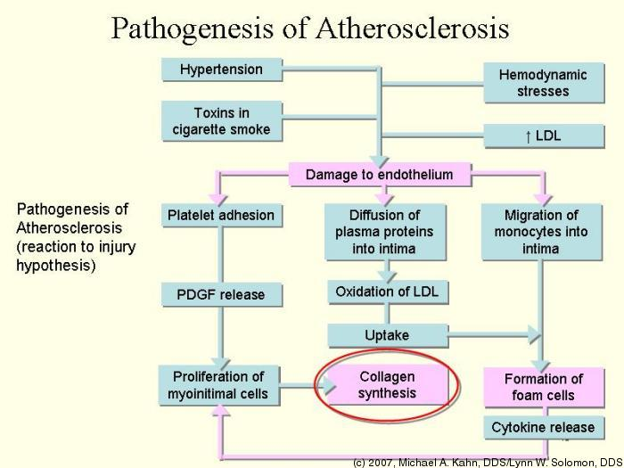
Pathogenesis
Explains how the disease process evolves
Sequence of cellular and tissue events that take place from time of initial contact of the etiologic agent until expression of the disease

Slide 51
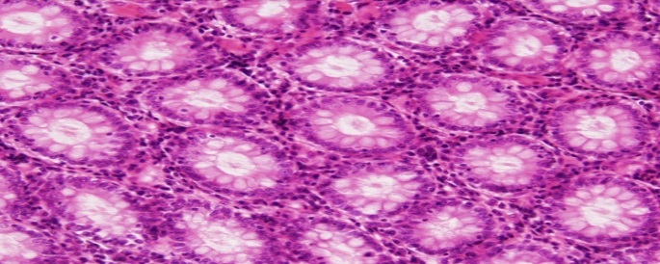
Morphologic Changes
Refers to the fundamental structure or form of cells or tissues
concerned with both gross anatomic and microscopic changes that are characteristic of a disease
Histology – Study of cells, extracellular matrix of body tissues
Plays an important role in diagnosing many types of cancers

Slide 52

Clinical Manifestations
Disease can Manifest in many different ways
  Some processes manifest quickly and display signs quickly like fever
  Some are silent at onset and usually diagnosed when examining for other reasons or when disease are far advanced
        Signs (objective, observable, often measurable)
        Symptoms (subjective, hard to measure) used to describe the changes that accompany disease

Slide 53
Diagnosis
Designation as to nature of the health problem
Involves
  Physical exam
  Health History
  Diagnostic Tests
Development of diagnoses involves competing possibilities and selecting the most likely one from among the conditions that might be responsible for the persons clinical presentation.
This is referred to as Differential Diagnosis.
ddx video
Dr House

Slide 54
Clinical Course
Describes evolution of disease
Acute, Subacute and chronic course possibilities
Chronic can have stages of remission or aggravation
Infectious diseases can run a course from preclinical to persistent chronic infection (HepB)
Possible to transmit to others in preclinical stage
Subclinical not clinically apparent and not always destined to become clinical. Diagnosed with antibodies or cultures
Clinical stage manifested by signs and symptoms
Persistent chronic infection can last years or a lifetime. Carrier has organism but is not infected but can pass an infection to others

Slide 55
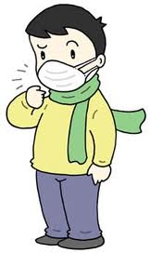
LEVELS OF DISEASE PREVENTION

Slide 56
Three levels of Prevention
Leading a healthy life contributes to the prevention of disease. The three fundamentals of prevention include:
  Primary Prevention (e.g., immunizations, using seatbelt): removing risk factors so disease does not occur, we use primary prevention methods before the person gets the disease. Primary prevention aims to prevent the disease from occurring. So primary prevention reduces both the incidence and prevalence of a disease
  Secondary Prevention (e.g., Pap smears): detecting disease while it is still curable, Secondary prevention is used after the disease has occurred, but before the person notices that anything is wrong.
  Tertiary Prevention (e.g., antibiotic use): preventing further deterioration or reducing complications of disease, Tertiary prevention targets the person who already has symptoms of the disease.

Slide 57
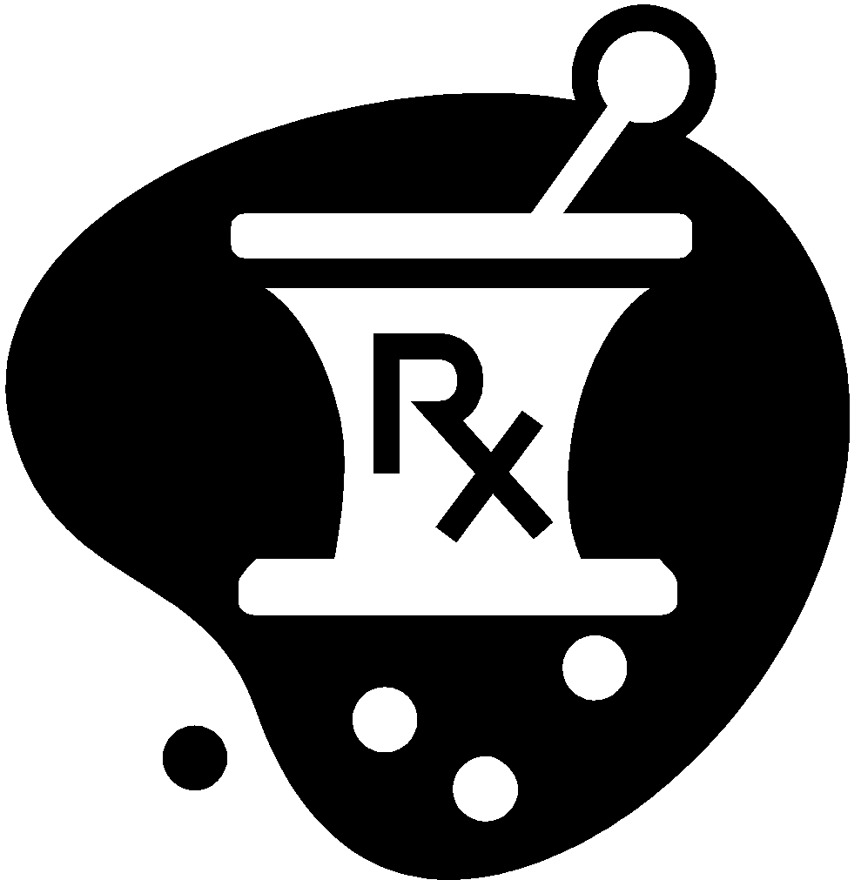
Goals of Tertiary Prevention
Prevent damage and pain from the disease
Slow down the disease
Prevent the disease from causing complications
Give better care to people with the disease
Return the person to health again and return them to their normal activities of living

Slide 58
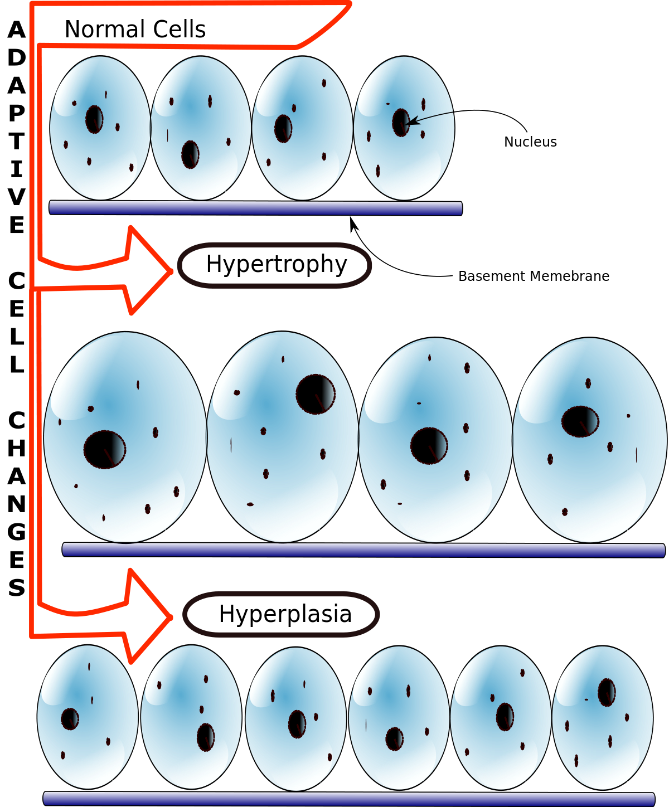
CELLULAR ADAPTATION

Slide 59
Cellular Adaptation
Occurs when cells are confronted with stresses that endanger its normal structure and function
These changes permit survival and maintenance of function
Cell injury and death occur when stress is overwhelming or adaptation is ineffective
Cells adapt to changes in the internal environment

Slide 60
How Cells Adapt
Cells may adapt by undergoing changes in size, number, and type
These changes occur singly or in combination, may lead to
  Atrophy
  Hypertrophy
  Hyperplasia
  Metaplasia
  Dysplasia
Adaptive cellular responses also include intracellular accumulations and storage of products in abnormal amounts

Slide 61
Dysplasia
Characterized by deranged cell growth of a specific tissue that results in cells that vary in shape, size and organization
Dysplasia is abnormal
Can be potentially reversible as it is an adaptive response to chronic inflammation or irritation

Slide 62
Atrophy
Reverting to a smaller size is known as atrophy
An adaptation to decrease in work demands or adverse environmental condition
Cell functions more efficiently
General causes
  Disuse
  Denervation
  Loss of endocrine stimulation
  Inadequate nutrition
  Ischemia or decreased blood flow

Slide 63
Hypertrophy
Increase in cell size , increase in the amount of functioning tissue mass
Results from an increased workload imposed on a organ or body part
Commonly found in skeletal and cardiac muscle, which cannot adapt by formation of new cells
May result as normal physiologic or abnormal pathologic conditions (skeletal, myocardial hypertrophy)

Slide 64
Hyperplasia
Increase number of cells in an organ or tissue
Occurs in epidermis, intestinal epithelium, glandular tissue – cells that do a lot of mitotic division
Rarely seen in neurons because of their slow & low rate of mitosis
2 types of physiologic (normal) hyperplasia
  Hormonal – breast enlargement during pregnancy
  Compensatory – regeneration of liver after surgery
Non physiologic, pathological hyperplasia
  Mostly due to excessive hormonal stimulation
  Can be caused by effects of growth factors on target tissues
Hypertrophy and hyperplasia often work together

Slide 65
Metaplasia
A reversible change in cells in which one adult (epithelial or mesenchymal) is replaced by another cell type
Thought to involve reprogramming of undifferentiated stem cells that are present in the tissue undergoing the metaplastic changes
Usually results from chronic irritation or inflammation
Never oversteps boundaries of original cell type – epithelium – epithelium
Ex. Squamous epithelial to columnar-lined epithelium for those suffering GERD. Becomes a risk factor for adenocarcinoma ( *classic example of metaplasia - know this)
Review of Cellular Adaptations

Slide 66
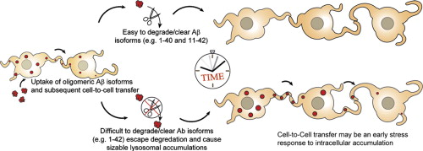
INTRACELLULAR ACCUMULATIONS

Slide 67
Intracellular Accumulations
Build up of substances that cells cannot immediately use or eliminate
May accumulate transiently or permanently, harmless or toxic
Grouped into three categories
  Normal body substances
    Lipids, proteins, carbohydrates, melanin, etc.
  Abnormal endogenous products
    Those resulting from inborn errors of metabolism
  Exogenous products
    Environmental agents and pigments not broken down by the cell
    https://youtu.be/0GnTCuJt74o

Slide 68
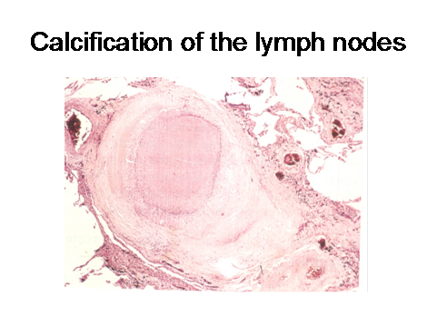
PATHOLOGIC CALCIFICATION

Slide 69
Pathologic Calcifications
Occurs when Calcium salts are deposited in tissues where it is not supposed to be. Eg arteries, lung, kidney tubules, lymph node
Contrast with Physiologic Calcification in which Calcium is deposited where it is supposed to be ie. Teeth, bone
Abnormal tissue deposits of calcium salts, together with smaller amounts or iron, magnesium and other minerals.
Dystrophic calcification – when occurs in injured, dying or dead tissue. Eg atherosclerosis, damaged heart valves
Metastatic Calcification – occurs in normal tissues as a result of high serum calcium (hypercalcemia). Eg calcifications in lung, kidney and blood vessels as a result of hyperparathyroidism, Paget disease etc

Slide 70

CELL INJURY

Slide 71
Causes of Cell Injury
Damage can occur in many ways
Grouped into five categories
Injury from physical agents
  Mechanical forces
  Extremes of temperature
  Electrical forces
Radiation injury
  Ionizing radiation
  Ultraviolet radiation
  Nonionizing radiation
Chemical agents
  Drugs
  Carbon tetrachloride
  Lead toxicity
  Mercury

Slide 72
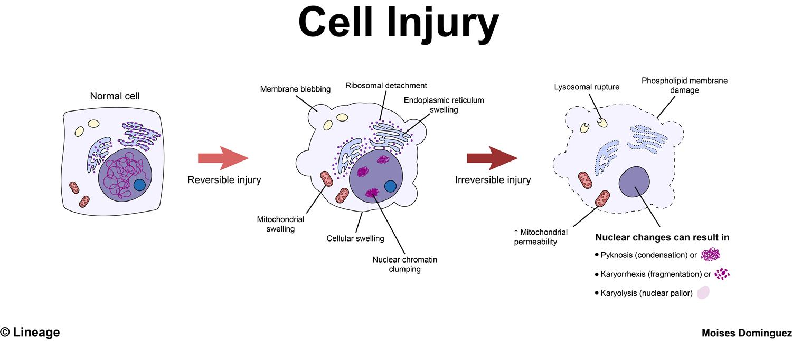
Continued
Injury from biologic agents
  Viruses, parasites, bacteria
Injury from nutritional imbalances
  Excesses and shortnesses

Slide 73
Mechanisms of Cell Injury
The cellular response to injurious stimuli depends on the type of injury, its duration, and its severity. Thus, low doses of toxins or a brief duration of ischemia may lead to reversible cell injury, whereas larger toxin doses or longer ischemic intervals may result in irreversible injury and cell death.

Slide 74
Hypoxic Cell Injury
Deprives the cell of oxygen and interrupts oxidative metabolism and the generation of ATP
  Acute cellular swelling (edema)
  The longer the tissue is hypoxic, the greater chance of irreversible cellular injury.
Causes of hypoxia:
  Inadequate amount of oxygen in the air
  Respiratory disease
  Inability of the cells to use oxygen
  Edema
  Ischemia

Slide 75
Reversible Cell Injury
Impairs cell function but does not result in cell death
Two patterns of reversible cell injury occur:
  Cellular swelling: impairment of the energy-dependent Na+/K+ ATPase membrane pump, usually as the result of hypoxic cell injury.
  fatty change: linked to intracellular accumulation of fat

Slide 76
Cell Death
Apoptosis (programmed Cell Death)
This process eliminates cells that are:
  Worn out – natural life cycle of cell
  Have been produced in excess
  Have developed improperly
  Have genetic damage
Necrosis:
  Refers to cell death in an organ or in tissues that are still part of a living person
  Often interferes with cell replacement and tissue regeneration
  Gangrene occurs when a considerable mass of tissue undergoes necrosis
  https://youtu.be/1vaEVcMfa1E

Slide 77
Gangrene
The term gangrene is applied when a considerable mass of tissue undergoes necrosis due to a lack of blood flow or a bacterial infection. Gangrene most commonly affects the extremities, including toes, fingers and limbs, but it can also occur in muscles and internal organs. Treatments for gangrene include surgery to remove dead tissue, antibiotics and other approaches. The prognosis for recovery is better if gangrene is identified early and treated quickly.

Slide 78
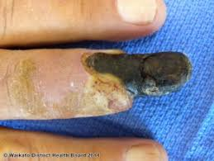
Dry Gangrene
begins at the distal part of the limb due to ischemia, and often occurs in the toes and feet of elderly patients due to arteriosclerosis
  The affected tissue becomes dry and shrinks, the skin wrinkles, and its color changes to dark brown or black. The spread of dry gangrene is slow.

Slide 79
Wet Gangrene
occurs in naturally moist tissue and organs such as the mouth, bowel, lungs, cervix, and vulva. This condition is characterized by thriving bacteria and has a poor prognosis (compared to dry gangrene) due to septicemia resulting from the free communication between infected fluid and circulatory fluid.
  The affected area is cold, swollen, and pulseless. The skin is moist, black, and under tension. Blebs form on the surface, liquefaction occurs, and a foul odor is caused by bacterial action.
  The spread of tissue damage is rapid.

Slide 80
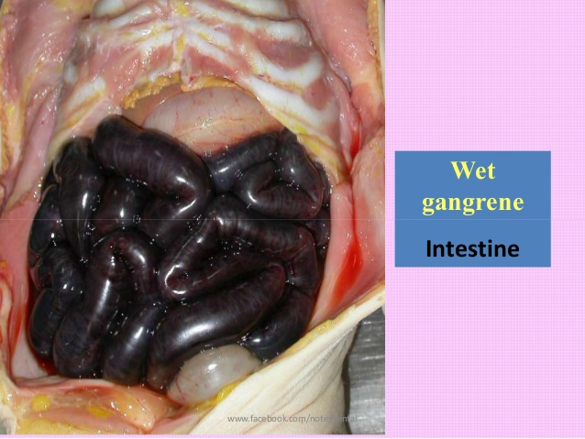

Slide 81
References
Lippincott Williams & Wilkins
http://www.who.int/about/definition/en/print.html
http://undp.by/en/who/healthforall
www.cdc.gov
http://kidshealth.org
onlinelibrary.wiley.com
www.merckmanuals.com
www.princeton.edu
www.cliffsnotes.com
http://biology.about.com
https://youtu.be/1vaEVcMfa1E
https://www.proprofs.com/quiz-school/quizshow.php?title=pathophysiology-practice-test-i&q=1

Slide 82
Hematology
Section 2
Study of the pathophysiology of Blood
Porth’s Chapter 25 pg 638

Slide 83
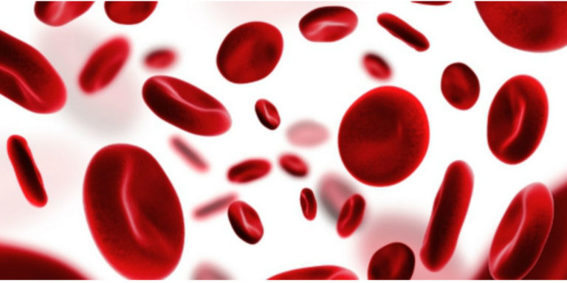

Slide 84
Outline
Blood Cells and the Hematopoietic System
Blood Elements
Hematopoiesis
Anemia
Hemostasis
Blood Groups
Polycythemia
Infectious Mononucleosis
Hodgkin Disease and Non-Hodgkin Disease
Leukemia

Slide 85
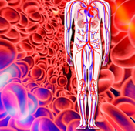
BLOOD CELLS AND THE HEMATOPOIETIC SYSTEM

Slide 86
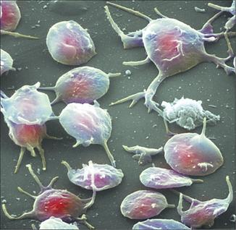
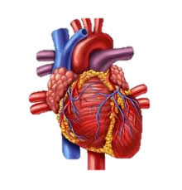
Cardiovascular System
The cardiovascular system consists of three interrelated components: the blood, the heart, and blood vessels.
Blood contributes to homeostasis by transporting respiratory gasses, nutrients, and hormones to and from your body’s cells. It helps regulate body pH and temperature, and provides protection through its clotting mechanisms and immune defenses

Slide 87
Blood
A connective tissue composed of liquid extracellular matrix called blood plasma that dissolves and suspends various cells (Erythrocytes, Leukocytes) and cell fragments (Platelets)
Interstitial fluid is the fluid that bathes the body cells and is constantly renewed by the blood.
Blood transports oxygen from the lungs and nutrients from the gastrointestinal tract, which diffuse from the blood into the interstitial fluid and then into the body cells. Carbon dioxide and other wastes move in the reverse direction, from body cells to interstitial fluid to blood. Blood then transports the wastes to various organs-the lungs, kidneys, and skin-for elimination from the body.

Slide 88
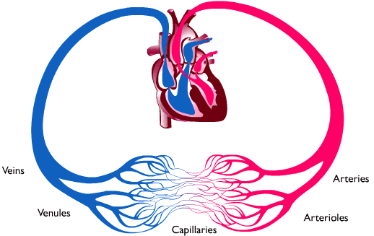
Blood Continued
The colour of blood varies with its oxygen content. When it has high oxygen content it is bright red. When it has low oxygen content it is dark red. Blood is approximately 8% of the total body mass, and totals between 4-6 litres.

Slide 89
Functions of the Blood
Blood has 3 functions:
1. Transportation-oxygen, nutrients, heat, waste products
2. Regulation-pH, body temperature, and the water content of cells
3. Protection-clotting after injury, white blood cells (WBC) through phagocytosis, antibodies, interferons, and complement protect against disease
https://youtu.be/UIvU-OuZHww

Slide 90
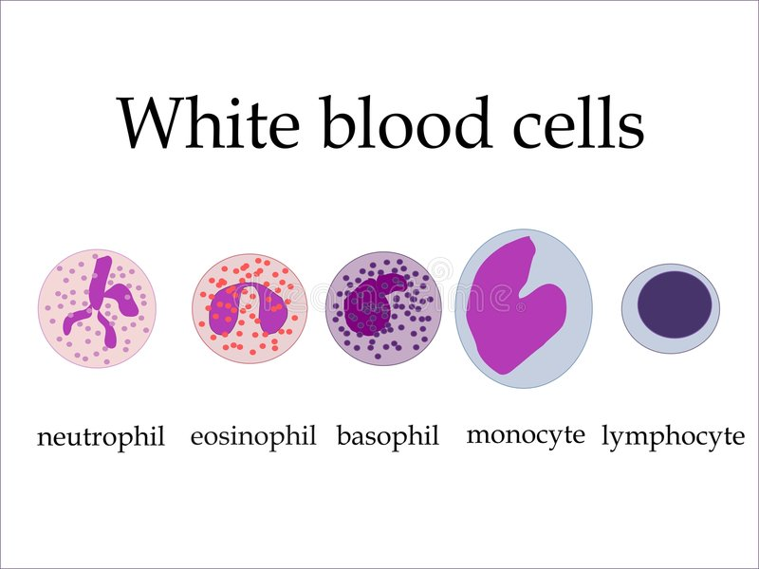
Components of Blood
Blood has two components: about 55% blood plasma and about 45% formed elements.
  Plasma is a straw-coloured watery liquid extracellular matrix that contains 91.5% water and 8.5% solutes, most of which are plasma proteins.
  Formed Elements are cells and cell fragments. More than 99% are red blood cells (RBCs), and less than 1% are platelets and white blood cells (WBCs)

Slide 91
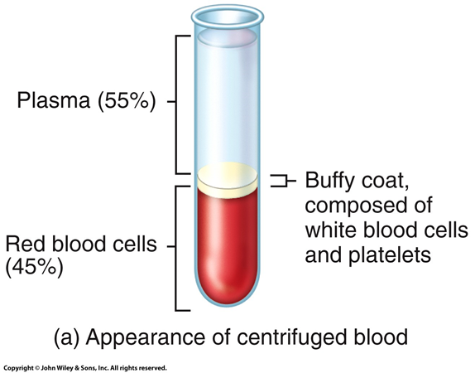

Slide 92
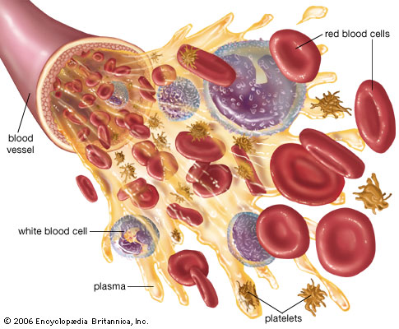
Functions of Plasma
Carries the cells that transport gases
Aids in body defenses
Prevents blood loss

Slide 93
Plasma Proteins
Some of the proteins in blood plasma are found elsewhere in the body, but those confined to blood are called Blood proteins
Hepatocytes synthesize most of the plasma proteins.
Plasma proteins include
  Albumins
  Globulins
  Fibrinogen
Other solutes include electrolytes, nutrients, regulatory substances (enzymes, hormones), gases, waste products (urea, uric acid, creatinine, ammonia & bilirubin)
https://youtu.be/stmYYdpdV-E

Slide 94
Continued
Albumin
  Comprises approximately 54% of the plasma proteins
  Contributes to plasma osmotic pressure and the maintenance of blood volume
  Serves as a carrier for certain substances
Globulins
  Comprise approximately 38% of plasma proteins
  Alpha globulins transport bilirubin and steroids.
  Beta globulins transport iron and copper.
  Gamma globulins constitute the antibodies (immunoglobulins) of the immune system.
Fibrinogen
  Make up approximately 7% of the plasma proteins
  Converted to fibrin in the clotting process

Slide 95
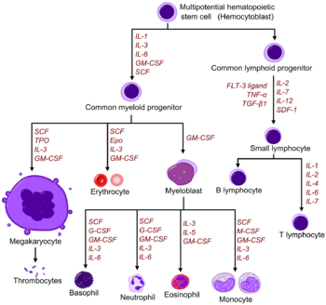
HEMATOPOIESIS/HEMOPOIESIS
HTTPS://YOUTU.BE/CM8IK24RRVA

Slide 96
Hematopoiesis
The process by which the formed elements of blood develop is called Hematopoiesis.
Before birth, hematopoiesis occurs in the spleen & liver.
After birth & throughout life, Red bone marrow is the source of blood cells.
Red bone marrow is a highly vascularized connective tissue located in the microscopic spaces between trabeculae of spongy bone tissue. It is chiefly found in the axial skeleton, pectoral, and pelvic girdles, and the proximal epiphyses of the humerus and femur. Once blood cells are produced they enter the bloodstream through sinusoids (sinuses)-enlarged and leaky capillaries that surround red bone marrow cells and fibers.

Slide 97
Continued
Blood cells originate from pluripotent stem cells in the bone marrow
The proliferation, differentiation, and functional abilities of the various blood cells are controlled by cytokines
Cytokines are hormone-like growth factors
Hematopoietic Growth Factors
  Increase peripheral stem cells for transplantation
  Accelerate cell proliferation after bone marrow engraftment
https://youtu.be/0deCbmh7PHs

Slide 98
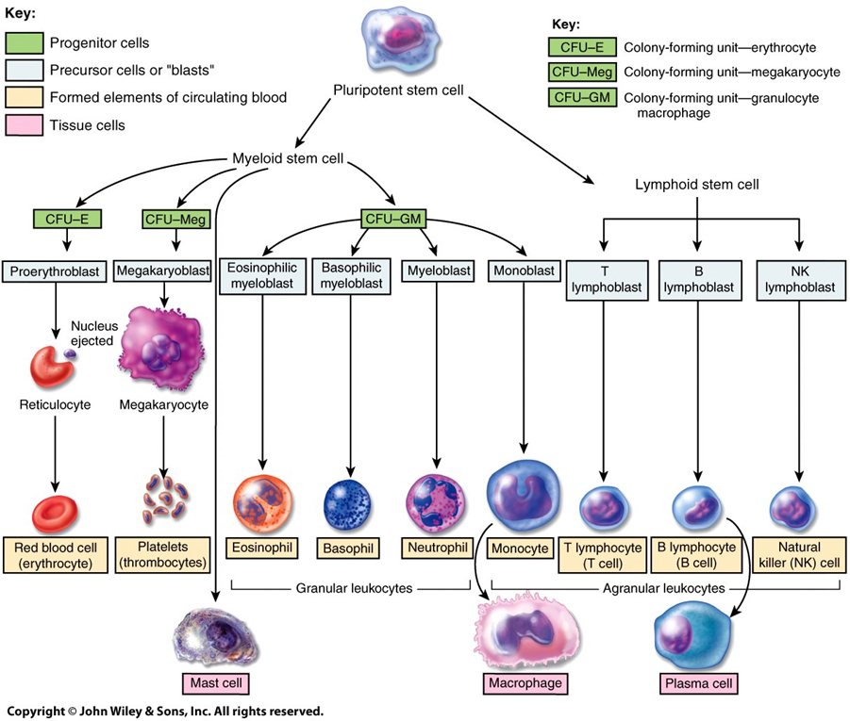

Slide 99
Red Blood Cells
RBCs contain the oxygen carrying protein hemoglobin, which is a pigment that gives whole blood its red colour. To maintain normal numbers of RBCs, new mature cells must enter the circulation at the astonishing rate of at least 2 million per second, a pace that balances the equally high rate of RBC destruction.
                RBC Anatomy
RBCs are biconcave discs without nuclei that contain hemoglobin . Their plasma membrane is both strong and flexible, which allows them to deform without rupturing as they squeeze through narrow capillaries. RBCs lack of a nucleus means it can neither reproduce nor carry on extensive metabolic activities.
The cytosol of RBCs contains hemoglobin molecules; these important molecules are synthesized before loss of the nucleus during RBC production and constitute about 33% of the cell’s weight.

Slide 100
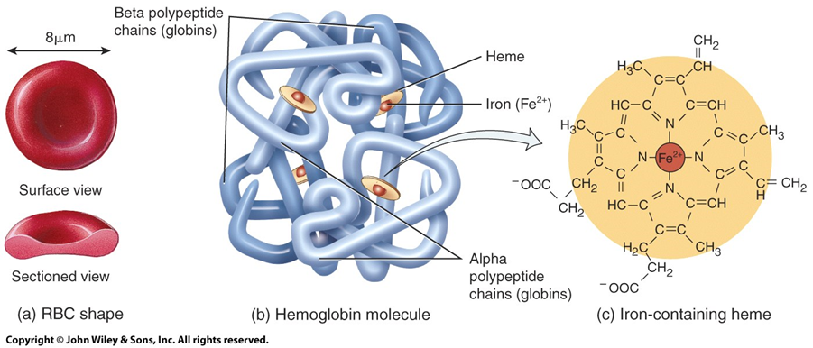

Slide 101
RBC Physiology
specialized for their oxygen transportation function because they have no nucleus, all their internal space is available for oxygen transport
lack mitochondria so they cannot generate ATP aerobically, they do not use up any of the oxygen they transport. (they create ATP through glycolysis only)
Contains 280 million hemoglobin molecules.
A hemoglobin consists of a protein called a globin, composed of 4 polypeptide chains, and a heme, composed of a ringlike non protein pigment. At the center of each heme ring is an iron ion that can combine reversibly with one oxygen molecule, allowing each hemoglobin to combine with 4 oxygen molecules

Slide 102
Hemoglobin, Nitric Oxide & Blood Pressure
Hemoglobin also functions in blood pressure regulation.
The gaseous hormone nitric oxide (NO), produced by endothelial cells that line the blood vessels, binds to hemoglobin. Under some circumstances, hemoglobin releases the NO, which then causes vasodilation. Vasodilation improves blood flow and enhances oxygen delivery to cells near the site of the NO release.
https://youtu.be/-EnL3bDG5J0
FYI- Foods that boost NO: beets, garlic, dark chocolate, leafy green vegetables (lettuce, spinach, spinach), celery, citrus fruits

Slide 103
RBC Life Cycle
Red blood cells only live about 120 days
Worn out RBCs are removed from circulation and destroyed by fixed phagocytic macrophages in the spleen and liver, and the products are recycled.
  1. Phagocytosis of worn out RBCs
  2. The globin portion is split from the heme
  3. Globin is broken down into amino acids, which can be reused for protein synthesis
  4. The iron in the heme portion travels to the liver where it is stored as Ferritin. The rest of the heme molecule becomes a component of bile which is produced in the liver.

Slide 104
Iron Overload
Under normal conditions plasma contains almost no free iron. Iron should be bound to hemoglobin in the RBCs or stored in the liver as ferritin.
If the amount of iron present in the body builds up, iron overload results which causes diseases of the liver, heart, pancreatic islets, and gonads. Iron overload also permits iron dependent microbes to flourish. Such microbes are normally not pathogenic, but they multiply rapidly and can cause lethal effects in a short time when free iron is present.
Primary Iron Overload - Genetic inheritance, most commonly Hereditary Hemochromatosis
Secondary Iron Overload - Excessive intake of Iron, transfusion, hemolysis
Iron overload is more likely to occur in men because female menses is protective against iron buildup.
Treatment is primarily blood donation.

Slide 105
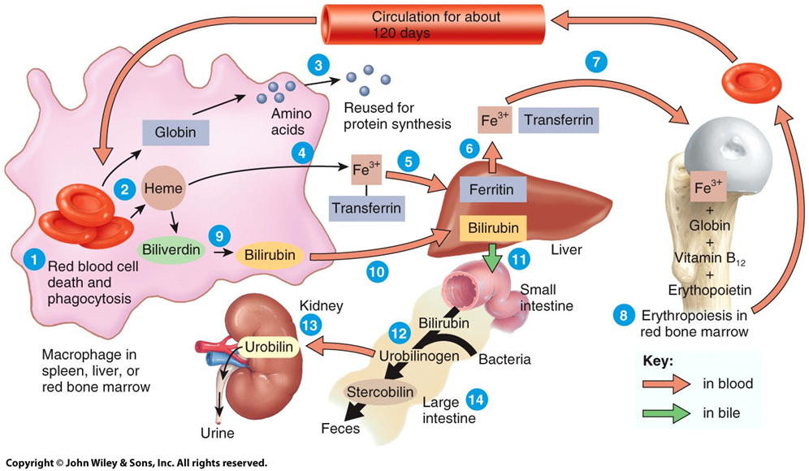

Slide 106
Erythropoiesis: Production of RBCs
Erythrocyte formation, called erythropoiesis, occurs in adult red bone marrow of certain bones. Ultimately a cell near the end of the development sequence ejects its nucleus and becomes a reticulocyte. Loss of the nucleus causes the center of the cell to indent, producing the RBCs distinctive biconcave shape. Reticulocytes mature into RBCs within 1 to 2 days after their release from red bone marrow.
Normally creation and destruction of RBCs proceed at roughly the same pace. If the oxygen carrying capacity of the blood falls because erythropoiesis is not keeping up with RBC destruction, a negative feedback system steps up RBC production
.https://youtu.be/8cCgBp8DAb8

Slide 107
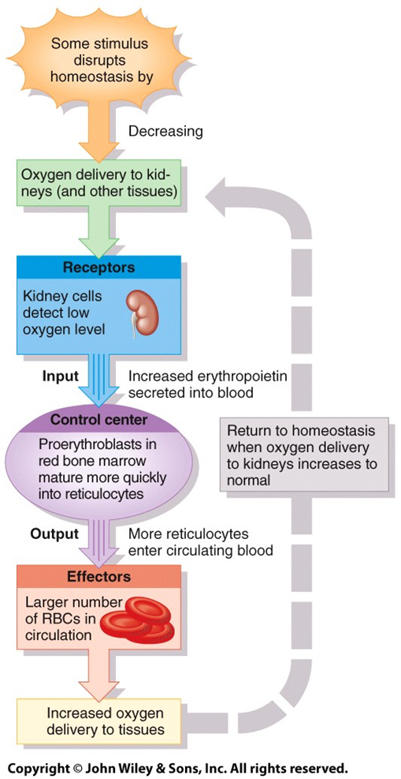

Slide 108
Leukocytes (White Blood Cells)
Leukocytes (white blood cells or WBCs) are nucleated cells and do not contain hemoglobin.
These cells are classified as either granular (neutrophils, eosinophils, basophils) or agranular (lymphocytes and monocytes), based on the straining of the granules under the microscope.
Agranular leukocytes do not have cytoplasmic granules and include the lymphocytes and monocytes, which differentiate into macrophages (fixed and wandering). Leukocytes have surface proteins, as do erythrocytes. They are called major histocompatibility antigens (MHC), are unique for each person (except for identical siblings), and can be used to identify a tissue.

Slide 109
Functions of White Blood Cells
White blood cells can live for several months or years but usually live for only a few hours or a few days.
Normal blood contains 5,000-10,000 leukocytes/mm3, they are outnumbered by RBCs about 700:1.
Leukocytosis refers to an increase in the number of WBCs.
Leukopenia refers to an abnormally low number of WBCs.
The general function of leukocytes is to combat inflammation and infection.
Once pathogens enter the body, WBCs leave the bloodstream by the process of diapedesis, and collect at the site of invasion.
Some WBCs, particularly neutrophils and macrophages, are active in phagocytosis and can ingest bacteria and dispose of dead matter. The chemical attraction of WBCs to a disease or injury site is termed chemotaxis.

Slide 110
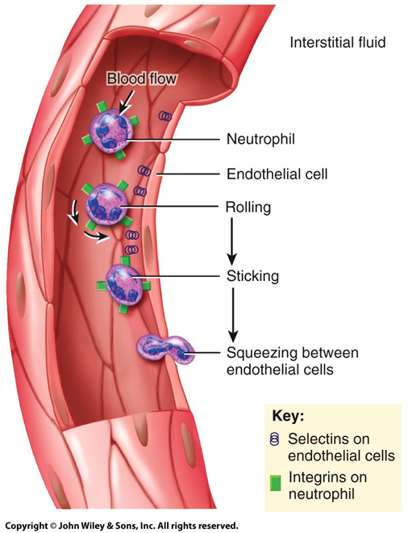
Diapedesis

Slide 111
Continued
Different WBCs combat inflammation and infection in different ways:
A) Granular Leukocytes
1. Neutrophils do so through phagocytosis.
2. Eosinophils combat the effects of histamine in allergic reactions, phagocytize antigen-antibody complexes, and combat parasitic worms.
3. Basophils develop into mast cells that liberate heparin, histamine, and serotonin in allergic reactions that intensify the inflammatory response e.g allergic and hypersensitivity reactions.
B) Agranular Leukocytes
4. B lymphocytes, in response to the presence of foreign substances called antigens, differentiate into tissue plasma cells that produce antibodies.
5. T lymphocytes destroy foreign invaders directly.
6. Monocytes – Phagocytic action
https://youtu.be/p5Ovu2uBYvc

Slide 112
Platelets
Besides the immature cells that develop into RBCs and WBCs, hematopoietic stem cells also differentiate into cells called megakaryocytes that produce platelets by breaking apart.
Normal blood contains 250,000 to 400,000 platelets/mm3.
Platelets have a lifespan of 5 to 9 days;
Aged and dead platelets are removed by fixed macrophages in the spleen and liver.
Platelets help stop blood loss from damaged vessels by forming a platelet plug. Their granules also contain chemicals that promote blood clotting.
https://youtu.be/gZnjCT17bHM

Slide 113
Hemostasis
Hemostasis refers to the stoppage of bleeding. When blood vessels are damaged or ruptured, the hemostatic response must be quick, localized to the region of damage, and carefully controlled. When successful, hemostasis prevents hemorrhage.
Hemostasis (a sequence of responses that stops bleeding), requires: platelets, calcium, vitamin K and Clotting factors.
Three mechanisms reduce blood loss:
1) vascular spasm -the smooth muscle of a blood vessel wall contracts to stop bleeding.
2) platelet plug formation-clumping of platelets around the damage to stop the bleeding.
3) blood coagulation (clotting)

Slide 114
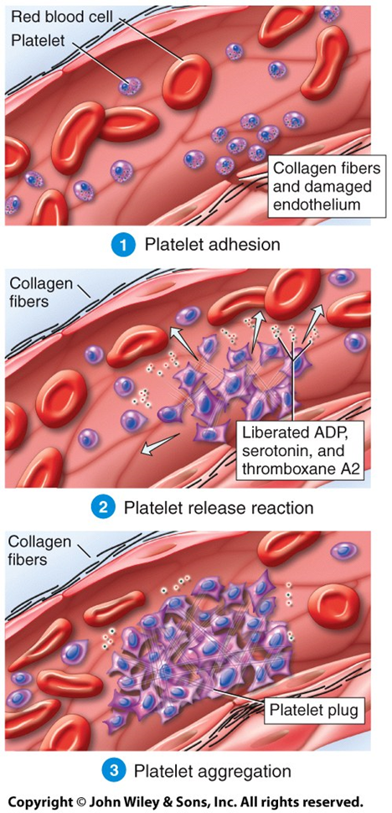

Slide 115
Clotting
A clot is a gel consisting of a network of insoluble protein fibers (fibrin) in which formed elements of blood are trapped .The chemicals involved in clotting are known as coagulation (clotting) factors; most are in blood plasma, some are released by platelets, and one is released from damaged tissue cells. Blood clotting involves a complex cascade of reactions that may be divided into three stages:
formation of prothrombinase (prothrombin activator)
conversion of prothrombin into thrombin
conversion of soluble fibrinogen into insoluble fibrin.

Slide 116
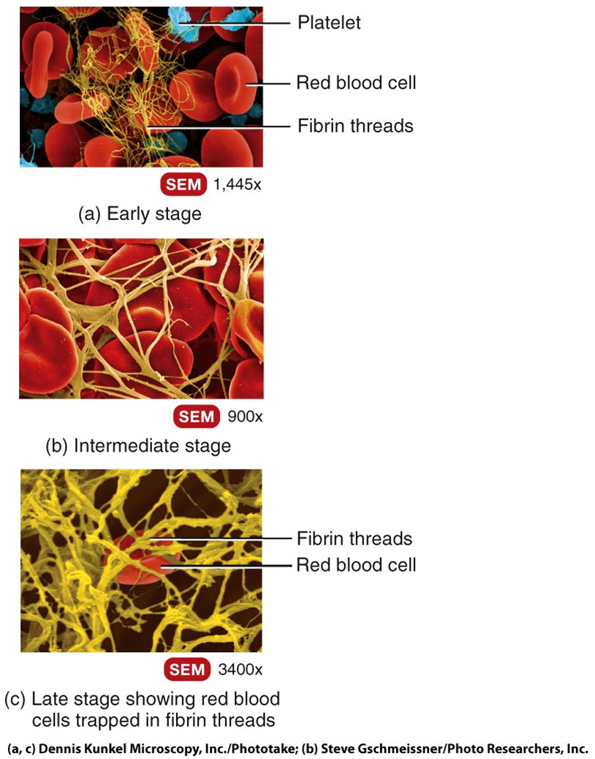

Slide 117
Clotting Pathway
Either the extrinsic pathway or the intrinsic pathway can initiate the clotting cascade.
Extrinsic or primary hemostasis begins with the release of Tissue factor from external trauma
-Intrinsic or secondary hemostasis begins with exposure of collagen & von Willebrand factor from the damaged lining of a blood vessel.
Both types of hemostasis still require platelets, Vitamin K, Calcium & clotting factors.

Slide 118
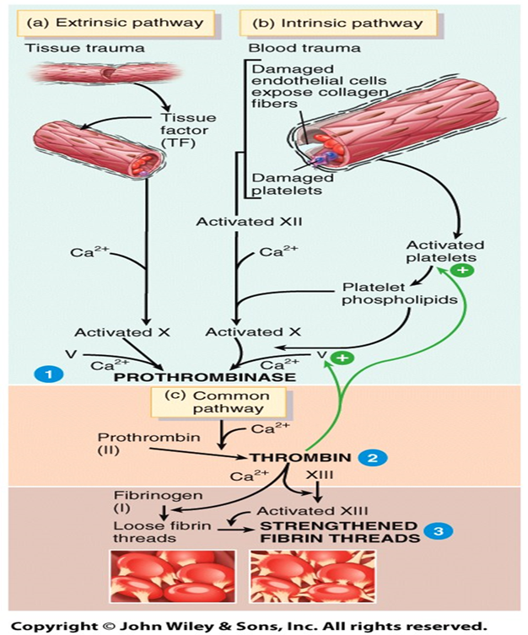
https://youtu.be/GfjtBUwOdYU

Slide 119
Clotting Retraction/Healing
Clot retraction is a consolidation or tightening of the fibrin clot. The fibrin threads attached to the damaged surfaces of the blood vessels gradually contract as platelets pull on them. As the clot retracts it pulls the edges of the damaged vessel closer together, decreasing the risk of further damage.
During contraction some serum can escape between the fibrin threads, but the formed elements in blood cannot.
In time, fibroblasts form connective tissue in the ruptured area, and new endothelial cells repair the vessel lining.
https:youtu.be/DKFSH5MMPLM

Slide 120
Normal coagulation requires vitamin K. It is required for the synthesis of 4 of the clotting factors. Normally produced by bacteria that inhabit the large intestine, vitamin K is a fat-soluble vitamin that can be absorbed through the lining of the intestine and into the blood if absorption of lipids is normal.
Many times a day little clots start to form, often at a site of minor roughness or at a developing atherosclerotic plaque inside a blood vessel. The fibrinolytic system dissolves small, inappropriate clots and clots at a site of damage once the damage is repaired.
Plasmin (fibrinolysin) can dissolve a clot by digesting fibrin threads and inactivating substances such as fibrinogen, prothrombin, and factors V, VIII, and XII.

Slide 121
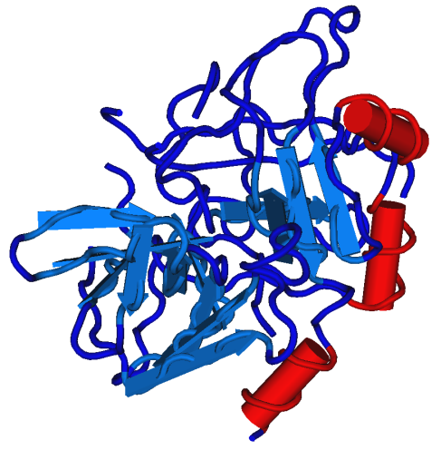
Homeostatic Control Mechanisms in Clotting
Clots are generally localized due to fibrin absorbing thrombin into the clot, clotting factors diffusing through blood, and the production of prostacyclin, a powerful inhibitor of platelet adhesion and release.
Substances that inhibit coagulation, called anticoagulants, are also present in blood. An example is heparin.
Patients who are at increased risk of forming blood clots may receive an anticoagulant drug such as heparin or warfarin

Slide 122
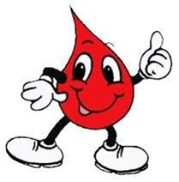
Continued
Despite the anticoagulating and fibrinolytic mechanisms, blood clots sometimes form within the cardiovascular system. Clotting in an unbroken blood vessel is called thrombosis.
A thrombus (clot), bubble of air, fat from broken bones, or piece of debris transported by the bloodstream that moves from its site of origin is called an embolus.
If the embolus blocks the blood supply to on organ or area of tissue, it is called an embolism. Eg a pulmonary embolism is a blockage in the circulation of the lungs.
At low doses aspirin inhibits vasoconstriction and platelet aggregation thereby reducing the chance of thrombus formation. Thrombolytic agents are injected into the body to dissolve clots that have already formed. https://youtu.be/gExUCrpAKyQ

Slide 123
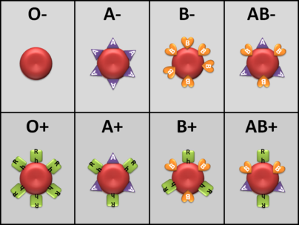
BLOOD GROUPS AND TYPES

Slide 124
Blood Groups and Types
https://youtu.be/ttjn1jVACk8
The surfaces of red blood cells contain genetically determined blood group antigens, called agglutinogens.
Blood is categorized into different blood groups based on the presence or absence of various antigens.
Within a blood group there may be two or more different blood types. Major blood groups are the ABO and Rh groups. Other blood groups include the Lewis, Kell, Kidd, and Duffy systems.
ABO Group
  In the ABO system, agglutinogens (antigens) A and B determine blood types.
  Plasma contains agglutinins (antibodies), designated as A and B, that react with agglutinogens that are foreign to the individual.

Slide 125
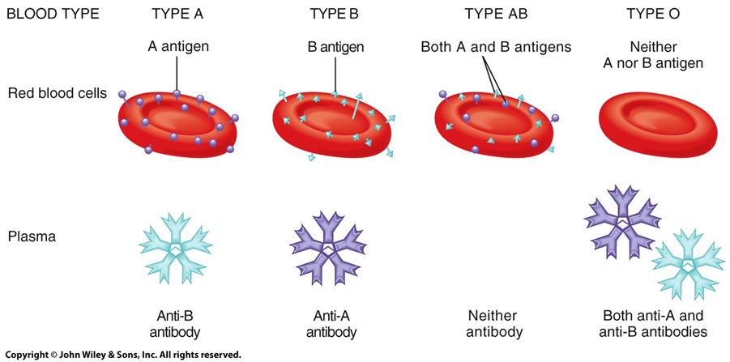
Type AB individuals are “universal recipients” because they has neither anti-A nor anti-B antibodies in their serum that would destroy transfused RBCs.
Type O individuals are “universal donors” because their RBCs have no antigens on the cell surface that can potentially react with the recipients serum.

Slide 126
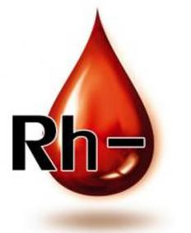
RH Blood Group
In the Rh system, individuals whose erythrocytes have Rh proteins are classified as Rh+. Those who lack the protein are Rh-.
Normally, blood plasma does not contain anti-Rh antibodies; individuals whose RBCs have the Rh antigen are said to be Rh+ while those who lack the Rh antigen are Rh-

Slide 127
Rh Continued
Rh incompatibility can cause problems with any blood transfusion, so it is screened just as carefully as the ABO group.
biggest problem with Rh incompatibility, however, involves mother and child in pregnancy.
If blood from an Rh+ fetus sensitizes an Rh- mother during birth, anti-Rh antibodies will form in the blood of that woman.
During her next pregnancy those antibodies can cross the placenta to affect the next baby.
Hemolytic disease of the newborn (HDN) results when an Rh+ fetus develops in the womb of an Rh- woman, To prevent HDN, mothers who are Rh- are given an injection of RhoGAM - a commercially produced anti-Rh antibody – at 28 weeks pregnancy or within 72 hours of birth.

Slide 128
BLOOD TESTING
Obtaining Blood Specimens
  Skin puncture (capillary blood)
  Venipuncture
  Arterial puncture
  Bone marrow aspiration
Diagnostic Tests
  Blood count – CBC measures # of RBCs, diff. Leukocytes, and platelets. Also includes RBC indices & hemoglobin also included.
  Erythrocyte sedimentation rate- + inflammation = + cytokines= + rate of fall of RBCs in 1 hour = high ESR. Normal is < 15 (men) or 20 (women)
  Bone marrow aspiration and biopsy- For very sick people – investigate possible cancers, unexplained anemia, genetic disorders.
  Aspiration examines fluid component & cell morphology. Biopsy removes a solid chunk of innermost bone for microscopic examination.

Slide 129
Transfusions
Blood transfusion is the process of transferring blood or blood products from one person to another. Donated blood can be separated into its various components to make better use of it.
History of transfusions: https://youtu.be/qcZKbjYyOfE
Types of Transfusions:
Whole blood - most common
Red blood cells - for anemia
Platelet - for thrombocytopenia
Plasma - used for severe burns, infections and liver failure
Leukocyte-reduced blood cells - most blood products have the WBCs filtered out to reduce adverse immune reactions
Frozen red blood cells - used to increase the storage time for rare types of RBCs
Immunoglobulins- Gamma globulin(aka antibody) transfusions to help support the immune system

Slide 130
Transfusion Reactions
In a blood transfusion, if the recipient receives the wrong blood type, antigen-antibody reactions will cause a rapid destruction (hemolysis) of the donor red blood cells
Giving the wrong type blood can cause the patient to develop a fever, develop serious renal failure, or go into shock.
Signs and Symptoms of Transfusion Reactions:
  Sensation of heat along the vein where the blood is being infused
  Flushing of the face
  Urticaria, headache, pain in the lumbar area
  Chills, fever, constricting pain in the chest
  Cramping pain in the abdomen
  Nausea, vomiting
  Tachycardia, hypotension, and dyspnea

Slide 131
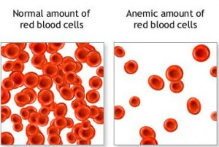



DISORDERS OF THE BLOOD

Slide 132
Conditions that increase Coagulability
Genetic Conditions
  - Factor V Leiden https://youtu.be/jr5aJi2a-3M
  Acquired Hypercoagulability
  Long Periods of Inactivity- bed rest,
  extended travel
  - Older Age
  Cancers
  Cancer treatments
  Drugs that help increase red blood cells such as Epoetin
  -Long term IV Catheter or port use
  -Congestive Heart Failure
  - Atrial Fibrillation
  -Diabetes
  -HIV
  -Vasculitis

Slide 133

Conditions that cause temporarily Accelerated Coagulation
Smoking
Obesity
Pregnancy
Use of oral contraceptives
Post-surgical state
Dehydration
DVT - Deep Vein Thrombosis
Unilateral Pain, Swelling
https://youtu.be/SqR8EJVOMQE

Slide 134

Coagulation and Vitamin K
Vitamin K is an essential cofactor for synthesis of clotting factors.
  It is Fat-soluble vitamin synthesized by intestinal bacteria
  In vitamin K deficiency, the liver produces inactive clotting factor, resulting in abnormal bleeding.

Slide 135
Disorders of Bleeding - less Coagulability
Failure of blood to clot in response to appropriate stimulus.
Thrombocytopenia
  Decrease in the number of circulating platelets
Depletion of platelets must be relatively severe before hemorrhagic tendencies of spontaneous bleeding occur.
  Impaired platelet function
Bleeding resulting from platelet deficiency commonly occurs in small vessels and is characterized by petechiae and purpura.
  petechiae - red or purple spot on the skin, caused by a minor bleed from broken capillary blood vessels. <4 mm in diameter
  Purpura - is a condition of red or purple discolored spots on the skin that do not blanch on applying pressure. The spots are caused by bleeding underneath the skin > 4mm in diameter

Slide 136



Slide 137

Platelets Defects - Thrombocytopenia
https://youtu.be/VLdhfsM5RHc
Results from a decrease in platelet production, increased sequestration of platelets in the spleen, or decreased platelet survival
Types:
  Drug-induced thrombocytopenia
  Idiopathic thrombocytopenic purpura
  Thrombotic thrombocytopenic purpura

Slide 138
Coagulation Defects
Deficiencies can arise because of defective synthesis, inherited disease, or increased consumption of the clotting factors.
Hereditary disorders: https://youtu.be/BoXBuJSURTI
  Hemophilia A, people with this are at risk for severe bleeding.
    an X-linked, recessive disorder caused by deficiency of functional plasma clotting factor VIII (FVIII), which may be inherited or arise from spontaneous mutation. Several members of European royal families were sufferers.
  Hemophilia B
    disorder causing easy bruising and bleeding due to an inherited mutation of the gene for factor IX, and resulting in a deficiency of factor IX. It is less common than factor VIII deficiency (haemophilia A).
  Von Willebrand disease https://youtu.be/I-uYvkTVwiM
    There are various types of VWD. All the different types are caused by a problem with the von Willebrand factor (VWF). This is a protein in blood which is necessary for proper blood coagulation, or clotting.
    When there is not enough VWF in the blood, or when it does not work the way it should, the blood takes longer to clot
Any other genetic disruption of the production of clotting factor

Slide 139


Slide 140
Vascular disorders that cause bleeding
Hemorrhagic telangiectasia
  An uncommon autosomal-dominant disorder characterized by thin-walled, dilated capillaries and arterioles
Vitamin C deficiency (scurvy)
  Results in poor collagen synthesis and failure of the endothelial cells to adhere to one another properly, causing a fragile wall
Cushing disease
  Causes protein wasting and loss of vessel tissue support because of excess cortisol
Senile purpura (bruising in elderly persons)
  Caused by the aging process. Collagen becomes less abundant & less organized with advanced age, resulting in stiffer, weaker blood vessel walls

Slide 141
Polycythemia
Definition
  A condition in which the red blood cell mass is increased
Types
  Relative polycythemia: results from a loss of vascular fluid (ie. dehydration) and is corrected by replacing the fluid
  Primary polycythemia(Polycythemia Vera): a proliferative disease of the bone marrow with an absolute increase in total red blood cell mass accompanied by elevated white cell and platelet counts. Can progress to myelofibrosis where scar tissue in bone marrow prevents hematopoiesis.
  https://youtu.be/jFxCZ91sDpl
  Secondary polycythemia: results from increased erythropoietin levels caused by hypoxic conditions such as chronic heart and lung disease

Slide 142
Clinical Manifestations
Variable and related to an increase in RBCs, hemoglobin level, and hematocrit with increased blood volume and viscosity
  Splenomegaly
  Depletion of iron
  Disrupted cardiac output
  Hypertension
  Decreased cerebral blood flow
  Venous stasis
  Thromboembolism and hemorrhage

Slide 143
Decreased Red Blood Cells (Anemia)
https://youtu.be/hJsH9VRjBQk
-Low red Blood Cells
RBCs may be Normal, Microcytic, or Macrocytic
Common causes: Iron deficiency, B12 Deficiency, excessive bleeding, cancers, genetic conditions such as thalassemia
Peripheral blood smear and a reticulocyte count and index
  Studies to rule out comorbid conditions such as malignancy, gastrointestinal conditions that cause bleeding, and pernicious anemia
OR Age-associated decline in the hematopoietic reserve
  Reduction in hematopoietic progenitors
  Reduced production of hematopoietic growth factors
  Inhibition of erythropoietin
  Inflammatory cytokines interfere with interaction of erythropoietin with its receptors.

Slide 144
Infectious Mononucleosis
https://youtu.be/U-LHnufQK4Q
Definition
  Self-limited lymphoproliferative disorder
Causes and characteristics
  Caused by the B-lymphocytotropic Epstein-Barr virus, a member of the herpes virus family; transmitted in saliva
  Characterized by fever, generalized lymphadenopathy, sore throat, and the appearance in the blood of atypical lymphocytes and several antibodies
  Highest incidence in adolescents and young adults
  Treatment is symptomatic and supportive

Slide 145

Neoplastic Disorders of Hematopoietic and Lymphoid Origin
Represent the most important pathology of the white cell disorders
Include somewhat overlapping categories
  Lymphomas (Hodgkin disease and non-Hodgkin lymphoma)
  Leukemias
  Plasma cell dyscrasias (multiple myeloma)

Slide 146
Hodgkin & Non-Hodgkin
Hodgkin disease
  Lymphoma arises in a single node or chain of nodes, usually upper body
  Can spread through nodes quickly
  Reed-Sternberg cells ARE present
  Young Adults
  Better Prognosis
Non-Hodgkin disease
  Lymphoma originates at any lymph tissue-
  Any node & extranodal sites. Spread less likely.
  Reed-Sternberg cells are NOT present,(Reed-Sternberg cells are derived from B lymphocytes)
  Affects typically 50+ adults
  Hepatosplenomegaly
  -Leukemic phase

Slide 147

Reed-Sternberg Cells
Reed–Sternberg cells
Large, multi-nucleated cell that is characteristic of Hodgkin’s disease.
Derive from a B lymphocyte precursor that escapes apoptosis
The number of Reed-Sternberg cells increases as the disease worsens
Seen against a sea of B cells, they give the tissue a moth-eaten appearance

Slide 148
Symptoms of Hodgkin’s Disease
Stage A
  Lacks constitutional symptoms
  -Swollen glands, esp. at the throat or underarms
Stage B (40% of persons with Hodgkin disease)
  Significant weight loss, fevers, pruritus (itching), or night sweats
Advanced stages
  Fatigue and anemia
  Liver, lungs, digestive tract, and CNS may be involved
  https://youtu.be/qW3uP8D3mSs

Slide 149
Treatment of Hodgkin’s & Non-Hodgkin’s Disease
Depends on the histologic type, stage of the disease, and clinical status of the person
Types
  Radiation
  Combination chemotherapy
For NHL only
  Adjuvant radiation therapy
  Monoclonal antibodies

Slide 150
Leukemia
Definition
  Malignant neoplasms arising from the transformation of a single blood-cell line derived from hematopoietic stem cells
  Can be acute (affects immature, “blast” cells)
  or chronic (affects mature, fully differentiated cells)
Classification according to cell lineage
  Lymphoid (lymphocytes)
  Myeloid (granulocytes, monocytes)
https://youtu.be/6xdgRo97YZM

Slide 151
Leukemic Cells
Immature and poorly differentiated
Proliferate rapidly and have a long life span
Do not function normally
Interfere with the maturation of normal blood cells
Circulate in the bloodstream
Cross the blood–brain barrier
Infiltrate many body organs
Most common leukemia is CLL – chronic lymphocytic ( 5 yr survival rate 83%)
Worst prognosis is AML – acute myeloid (5 yr survival 26%)

Slide 152
Warning signs/complications of Acute Leukemia
Signs
Complications
Fatigue
Pallor
Weight loss
Repeated infections
Easy bruising
Nosebleeds
Other types of hemorrhage.
Leukostasis
Tumor lysis syndrome
Hyperuricemia
Blast crisis
https://youtu.be/hp9XfGk4DQ8

Slide 153
Multiple Myeloma
Definition: a plasma cell dysplasia characterized by expansion of a single clone of immunoglobulin-producing plasma cells and a resultant increase in serum levels of a single monoclonal immunoglobulin or its fragments
Remember – what is a plasma cell? https://youtu.be/vceJglmSuTI
Main sites involved: bones and bone marrow
Proliferation and activation of osteoclasts that leads to bone resorption and destruction (Pathologic fractures, Hypercalcemia)
Signs & symptoms: back pain, protein in urine, fractures, anemia
https://youtu.be/_XHsmJ8u-T4

