Slide 1
Nutrition profoundly affects health
Examples of chronic diseases connected to poor diet: heart disease, diabetes, some kinds of cancer, dental disease, adult bone loss
Less
nutrition
related
Down Syndrome
Hemophilia
Sickle cell anemia
Osteoporosis
Cancer
Infectious disease
Diabetes
Hypertension
Heart Disease
Iron deficiency
(anemia)
Vitamin deficiency
Mineral deficiency
Toxicities
Poor resistance
to disease
More nutrition
related
Nutrition has little influence on some diseases but strongly affects others

Slide 2
Nutritional Genomics
Choice of diet influences long-term health within a range set by genetic inheritance
Nutritional Genomics: integration of nutrition, genomic science and molecular biology
It studies how nutrients affect genes and vice versa
Pinpoints nutrient needs for growing children, healthy adults, chronic conditions, etc.

Slide 3
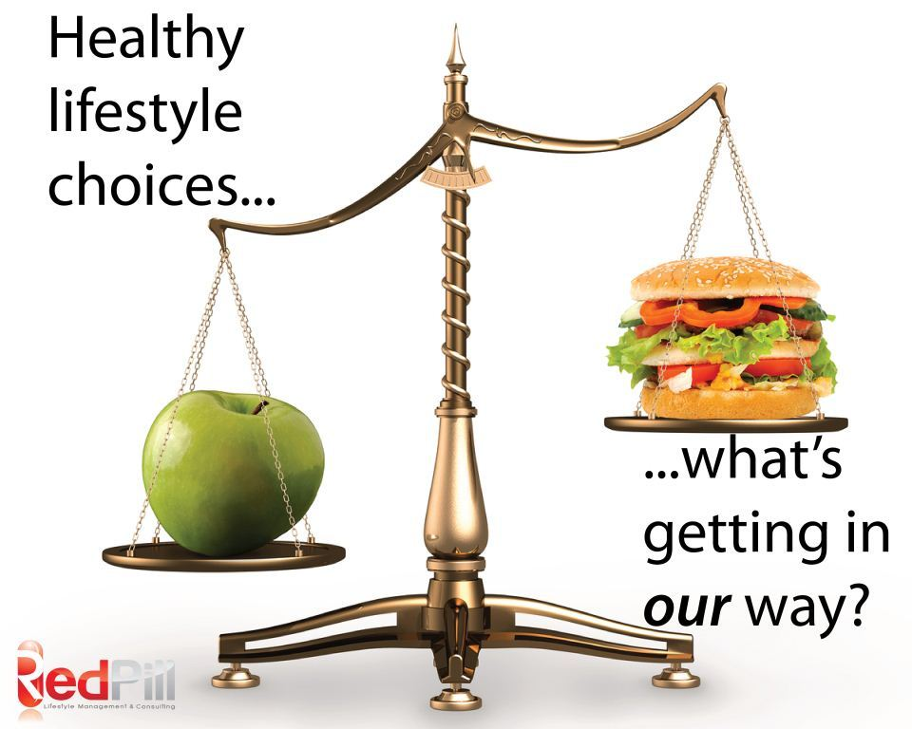
Other lifestyle choices
Tobacco, alcohol and other substance abuse can destroy health
Physical activity, sleep, low stress levels, improved conditions at home and work, quality of air and water, etc. can prevent/reduce severity of some diseases

Slide 4

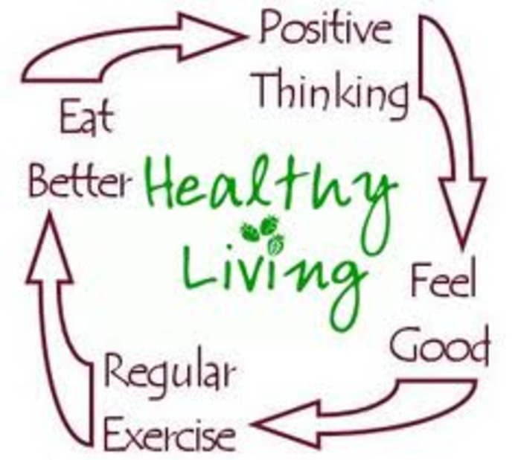
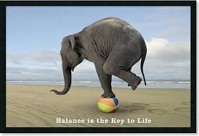
Other lifestyle choices

Slide 5
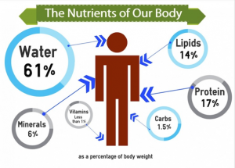
The Six Classes of Nutrients

Slide 6
Six kinds of indispensable molecules:
Water
Carbohydrates*
Lipids (fats)*
Proteins*
Vitamins*
Minerals
(*) organic compounds (contain Carbon)

Slide 7
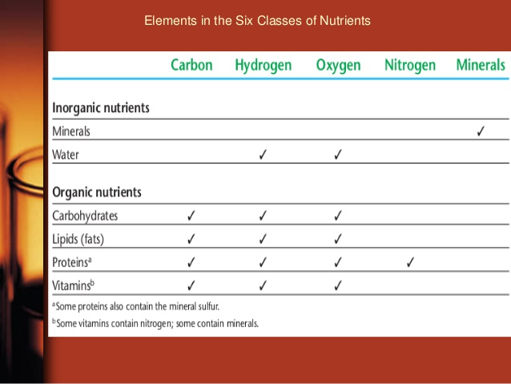
The 6 Classes of Nutrients
http://www.slideshare.net/ehab10f/clinical-nutrition-14806374

Slide 8
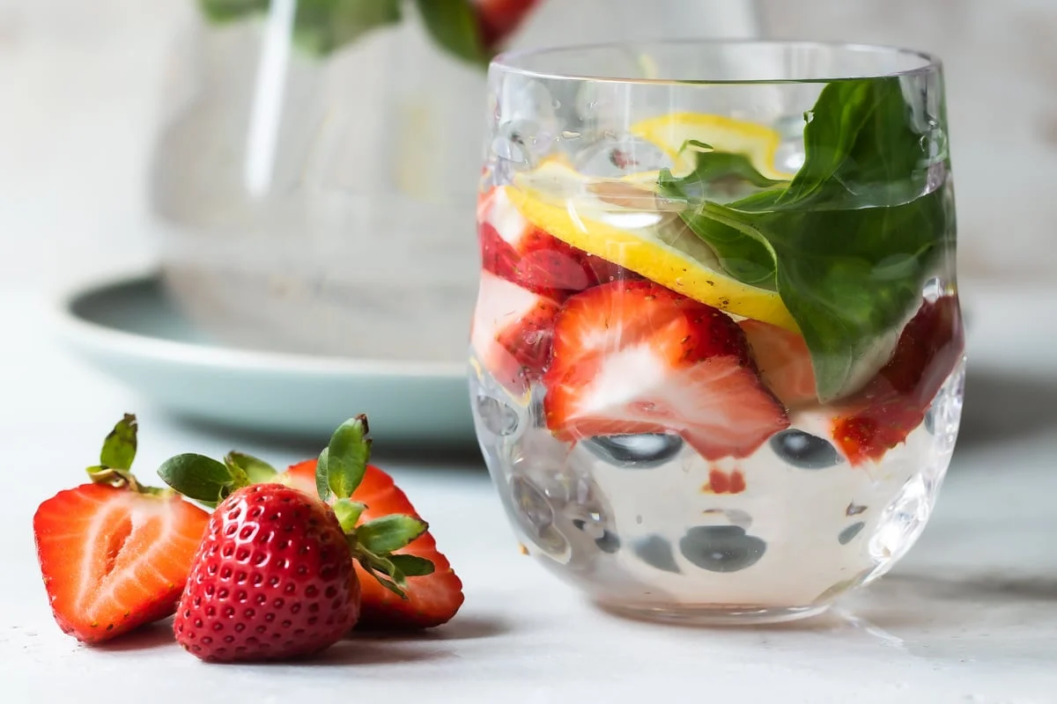
Nutrients in Food
Water: it must constantly be replaced
Energy-yielding nutrients (energy in C-C bonds):
- Carbohydrates (i.e., sugar, starch)
- Lipids (fats) (saturated and unsaturated)
- Proteins (chains of amino acids)
Regulators (assist in body processes):
- Vitamins (i.e. Vitamin C)
- Minerals (i.e. Calcium, Iron)

Slide 9
Nutrients (Cont.)
Essential Nutrient: your body can’t make them so if you don’t ingest them, you will develop deficiencies
Calorie/kilocalorie: unit of energy in food (amount of heat energy to raise the temp of 1 kg (a litre) of water by 1 ºC.
- Lipids (fats) (saturated and unsaturated)
- Proteins (chains of amino acids)
Regulators (assist in body processes):
- Vitamins (i.e. Vitamin C)
- Minerals (i.e. Calcium, Iron)

Slide 10
Energy-yielding nutrients
Body uses energy from C-C bonds from:
Carbohydrates – sugar, starch
Lipids (fats) – saturated and unsaturated
Proteins – (aa) produce energy and structure of body

Slide 11
Calorie values of energy-yielding nutrients
Energy Nutrient | Energy
Carbohydrate | 4 Cal/g
Lipid (fat) | 9 Cal/g
Protein | 4 Cal/g

Slide 12
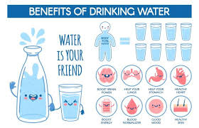
Water
~ 60% of body is water
Important for all the cellular functions
Will go over more in Minerals lecture
https://youtu.be/P8c9DIiAFz8?feature=shared

Slide 13
The challenge of choosing foods
Basic foods (whole foods): milk, milk products, meats, vegetables, grains, fruits
Enriched foods (fortified foods): nutrients have been added
Fast foods: avail within minutes after customers order them, such as hamburgers, French fries, milkshakes, salads (may or may not meet people’s needs)
Functional foods: foods known to possess nutrients or non-nutrients that might help protect against disease
Natural foods: it implies wholesomeness (no legal definition)

Slide 14
And more foods…
Organic foods: nutrients grown without synthetic pesticides or fertilizers. Growers conform to standards set by Canadian Organic Standards or USDA Organics or others.
Partitioned foods: Composed of parts of whole foods (butter, sugar, corn oil). Generally overused, they provide few nutrients with many calories
Processed foods: foods subjected to any process (milling, alteration of texture, addition of additives, etc.). It may or may not be nutritious
Staple foods: foods used frequently or daily (rice, potatoes).

Slide 15
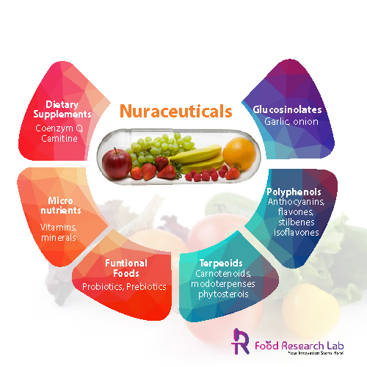
Nutraceuticals
Definition: Any substance that is a food or part of food that provides medical or health benefits.
Eg. Vitamin D, L- Carnitine, Probiotics, Curcumin etc.

Slide 16
Can I live on just supplements/nutraceuticals?
Forming pairs discuss arguments favoring and against the question above

Slide 17
Importance of real food
Elemental diets (precise chemical composition)
Aroma, taste
Digestive organs weaken and grow smaller
Hormones in response to food contribute to health
Physical and emotional comfort
Other chemicals in food may reduce disease risks

Slide 18
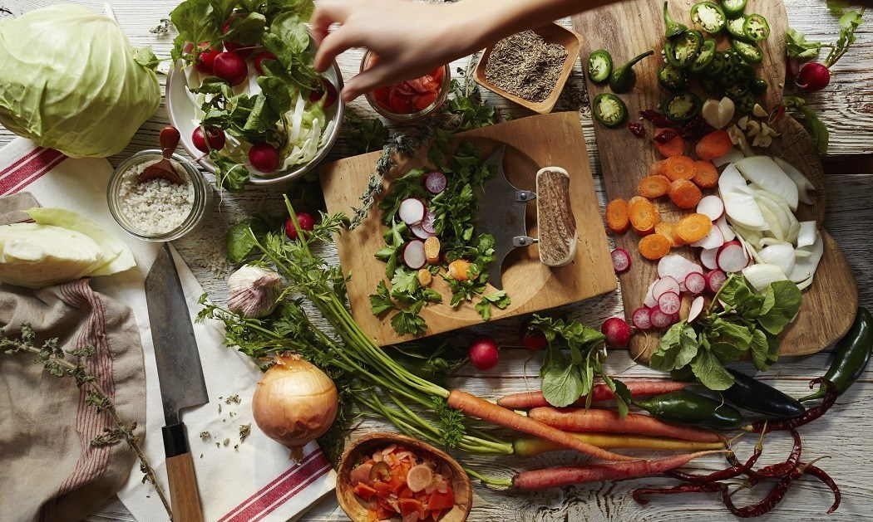
How can I recognize a nutritious diet?
http://daily.jstor.org/plan-get-poor-eat-healthy-food-1890s/

Slide 19
How can I recognize a nutritious diet?
SIX PRINCIPLES OF A HEALTHY & BALANCED DIET
Adequacy: food provides enough of each essential nutrient, fibre and energy
Balance: choices do not overemphasize one nutrient or food type at expense of another
Calorie control: provides amount of energy needed to maintain appropriate weight –not more, not less
Moderation: foods not provide excess fat, salt, sugar, or other unwanted constituents
Variety: foods chosen differ from one day to the next; meals should occur with regular timing throughout the day
Nutrient Density: Choose more foods that are high in nutrient content versus the amount of calories it contains

Slide 20
Key point
A well-planned diet is adequate in nutrients, balanced with regard to food types, offers food energy that matches energy expended in activity, is moderate in unwanted constituents and offers a variety of nutritious foods

Slide 21
Energy-yielding nutrients include all of the following EXCEPT:
Vitamins
Carbohydrates
Fat
Protein

Slide 22
Organic nutrients include all of the following EXCEPT:
minerals
fat
carbohydrates
protein

Slide 23
A characteristic of a nutritious diet is that the diet provides no constituent in excess. This principle of diet planning is called:
adequacy
balance
moderation
variety

Slide 24
Why people choose foods…
Many factors influence food-related choices:
Sharing ethnic food, cherish values and culture
Omnivores, carnivores, vegetarians, vegans
Convenience (time, budget)
Advertising, availability, emotional comfort, habit, personal preference and genetic inheritance, positive associations
Region of the country
Social pressure
Values or beliefs
Weight, nutritional value

Slide 25
Grocery shopping habits around the world
http://prohealthsys.com/site/treatments/nutrition/
Activity: recognize nutritious diet
Select a nutrition habit from the pictures and describe food items. Provide rough estimation of % of nutrients

Slide 26
Can I trust the media to deliver nutrition news?
Forming pairs discuss how you distinguish among dishonest scams, well-meaning but misinformed advice, and honest and helpful ideas and products
Provide an example (from the internet) of a nutrition/health fraud
Present to class

Slide 27
Phytochemicals: what do they promise?
Bioactive compounds found in plants
Provide taste, aroma, texture and colour to food
Examples: burning sensation of hot peppers, aromatic herbs, pungent flavour of onions, garlic, red color of tomatoes…
Antioxidants: protect against disease (heart disease, cancer)
Flavonoid: antioxidants in red wine, grapes, chocolate
Lignans: present in flaxseed, are converted to phytosterols by intestinal bacteria and has possible anticancer properties
Phytoestrogens (in soybeans): may alter women's monthly hormonal cycle in menopause, reducing symptoms

Slide 28
Phytochemicals activity – searching for answers…
Supplements with phytochemicals – benefits?
Scientific evidence concerning their effects?
Phytochemicals in:
chocolate, wine, tea, whole foods, soybeans, flaxseeds, tomatoes, garlic. What do they do?
Tips for consuming phytochemicals?

Slide 29
What is Sugar?
Generally refers to cane sugar, beet sugar, or other product made up of primarily glucose, fructose, sucrose, lactose, galactose, or maltose.
Foods that are high in sugar:
  Honey, tropical fruits, maple syrup, agave nectar, cane sugar, candy, breakfast cereals, jams, BBQ sauces, condiments
Look up a packaged food you eat regularly and check on the label to see how many grams of sugar that product contains

Slide 30
Carbohydrates
Indigestible carbohydrates add fibre to foods and help to keep the GI tract healthy
Complex carbohydrates – starch and fibre – long chains of sugar units arranged to form starch or fibre. Otherwise known as polysaccharides
Simple carbohydrates – sugars, including both single sugar units and linked pairs of sugar units
Carbohydrates – compounds composed of single or multiple sugars
Galactose
Fructose
Glucose
Sucrose
(fructose + glucose)
Maltose
(glucose + glucose)
Lactose
(glucose + galactose)

Slide 31
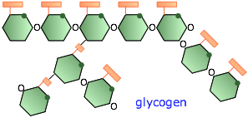
Polysaccharides
Starch – glucose units linked in long, occasionally branched chains
Glycogen – highly branched chains of glucose units
Cellulose – (a fibre) Glucose chains that are linked in such a way that human enzymes cannot digest them.

Slide 32
Carbohydrates
http://www.brightstorm.com/science/biology/chemical-basis-of-life/chemistry-carbohydrates/ (2:30 min)

Slide 33
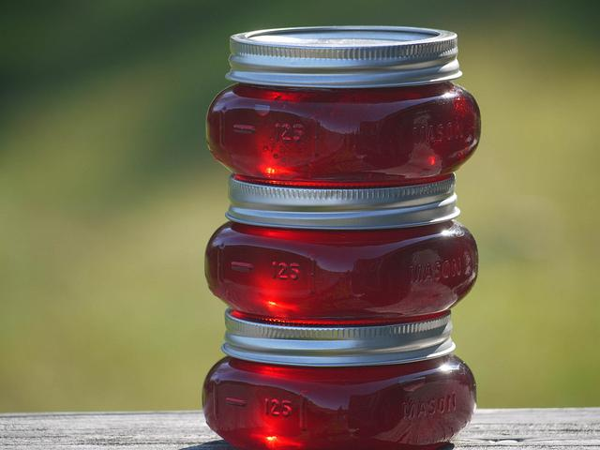
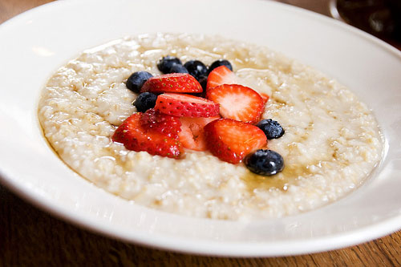
Soluble Fibre
Soluble, viscous, fermentable fibres
Add thickness to food
Readily dissolve in water
Cannot be digested by enzymes but may be broken down to absorbable products by bacteria in the digestive tract

Slide 34
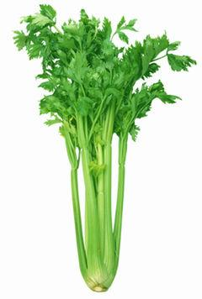
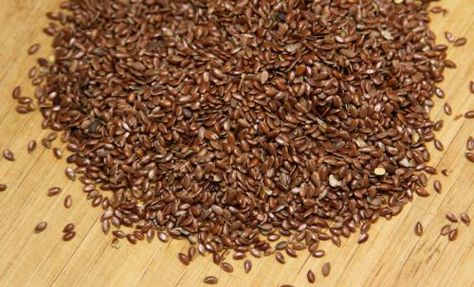
Insoluble Fibre
Tough, fibrous structures of fruits, vegetables, and grains
Do not dissolve in water
Indigestible
Aid in elimination through the bowels

Slide 35
Carbohydrate and Nutrition
45-65% of a persons daily caloric intake –recommended
4 calories per gram
Question: If an individual is consuming a 2000kcal/day diet and they want 65% of their diet to be carbohydrate, how many grams of carbohydrates will that person need to consume?
Notes:
325grams

Slide 36
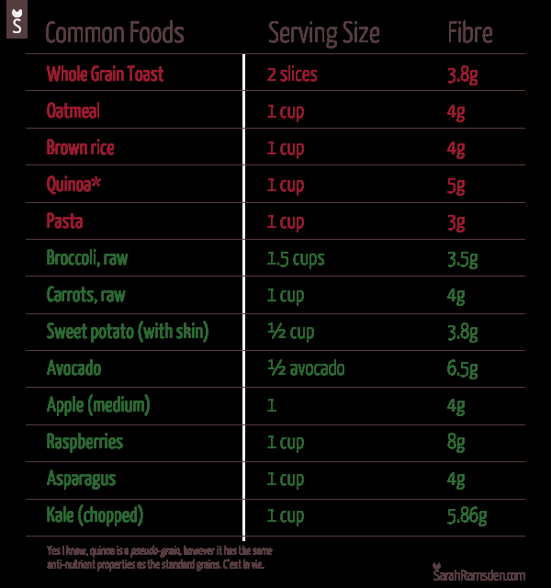
FIBRE
Numerous health benefits:
  Lower cholesterol
  Moderate blood sugar spikes
  Increase transit time in GI tract
  Soften stools
  Decrease transit time through colon
  Increase satiety

Slide 37
Lipids/Fats
Lipid – not soluble in water; an organic compound
Fat – a solid lipid (at room temperature) – in this course used interchangeably with the term lipid unless specified
Oil – a liquid lipid (at room temperature)
Main categories of dietary lipids:
  Triglyceride – made up of 3 fatty acids on a glycerol backbone
  Phospholipid – one of the 3 fatty acids on the triglyceride is replaced with a phosphorus containing acid. This switch allows it to be soluble in water and fat. Used as an emulsifier (mixes fat and water – eg. Lecithin). Present in all cell membranes.
  Sterol – structure similar to cholesterol
Lipoproteins – clusters of lipids that transport lipid in the blood and lymph
Chylomicrons – clusters of fatty acids and proteins used to transport lipids to the liver and other tissues

Slide 38
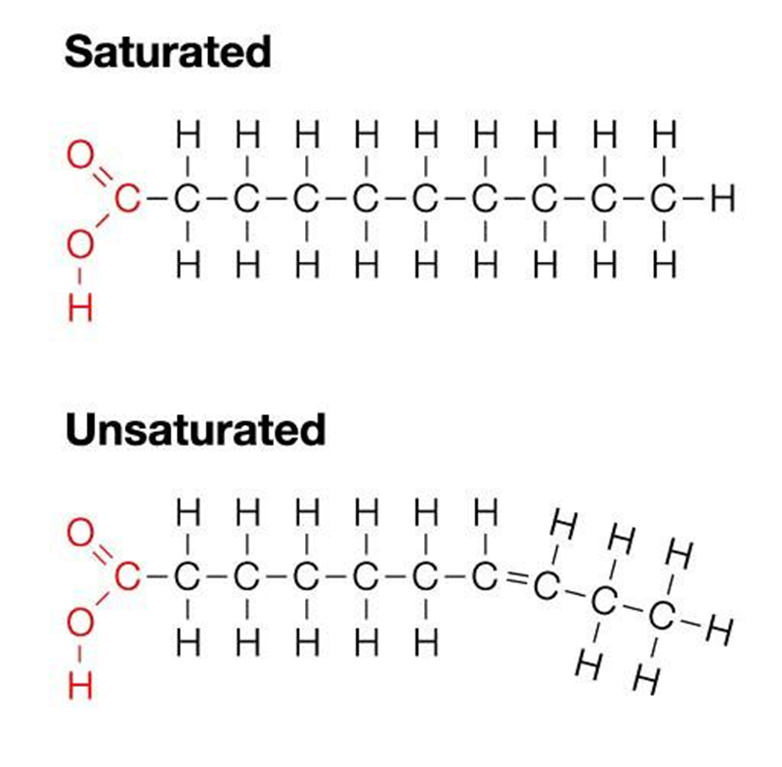
Fatty Acids
Saturated fatty acid:
It contains no unsaturated linkages between carbon (C) atoms
and hence cannot incorporate any more hydrogen (H) atoms.
Unsaturated fat or fatty acid contains at least one double bond
within the fatty acid chain.
It could be monounsaturated (containing one double bond)
or polyunsaturated if it contains more than one double bond.
Notes:
Monounsaturated = 1 double bond
Polyunsaturated = more than 1 double bond
The greater the number of double bonds, the greater the tendency for an oil to become rancid
In general plant based lipids contain less saturated fat (exceptions are coconut and palm oil)
The number of double bonds affects the temperature at which a lipid becomes liquid. (Eg. Olive oil is liquid at room temperature but butter is not)

Slide 39
 | Saturated Fats | Unsaturated Fats
Type of bonds | Consist of SINGLE bond | Consist of at least 1 DOUBLE bond
Recommended consumption | Not more than 10% of total cal/day | Not more than 30% of total cal/day
Health Effects | Excessive consumption is not good, increased risk of atherosclerosis and heart diseases | Good to eat if you are watching your cholesterol. Also high in antioxidants.
Cholesterol | Increase Low Density Lipoproteins (LDL or bad cholesterol) & Very Low Density Lipoproteins (VLDL's). These found in trans fatty acids, refined carbohydrates (i.e white sugar, flour). | Increase High-Density Lipoprotein (HDL or good cholesterol) and decrease LDL. Sources of HDL include onions and Omega-3 fatty acids (flax oil, fish, foods rich in fiber, grains).
Commonly found in | Butter, coconut oil, whole milk, meat, peanut, butter, margarine, cheese, vegetable oil, fried foods, frozen dinners, red meats | Avocado, soybean oil, canola oil and olive oil, sunflower oil, fish oils walnuts, flax
Shelf Life | Long lasting and do not spoil quickly | Spoil quickly
Melting Point | High | Low
Physical state at room temperature | Solid (Trans Fats & Saturated Fats) | Liquid (Monounsaturated & Polyunsaturated Fats- Omega 3's & 9's)
Rancidity | Low | High
Examples | Hydrogenated Oils, Butter, Processed Meats | Olive Oil, linoleic acid, alpha-linolenic acid

Slide 40
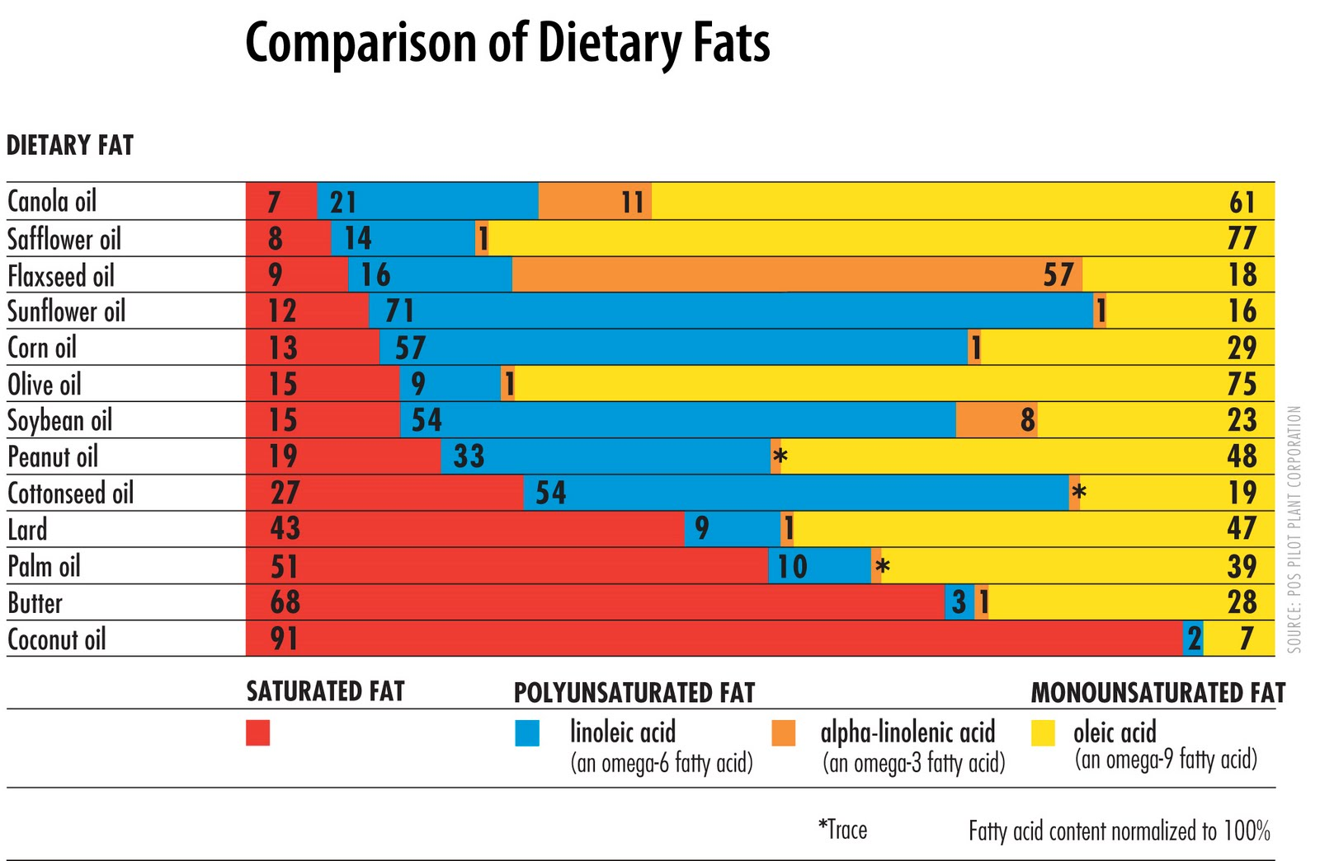
Dietary fatty acids
Notes:
In general plant based lipids contain less saturated fat (exceptions are coconut and palm oil)
The number of double bonds affects the temperature at which a lipid becomes liquid. (Eg. Olive oil is liquid at room temperature but butter is not)

Slide 41
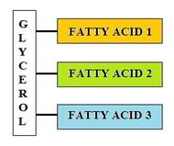
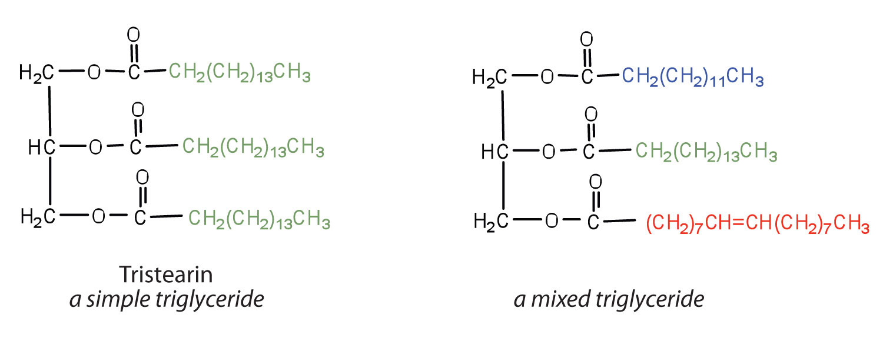
Triglycerides: storage of fat

Slide 42
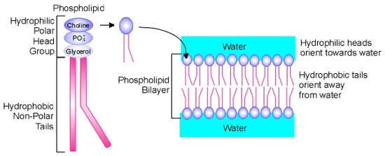
Phospholipids
Notes:
Phospholipids are major components of cell membranes. They form lipid bilayers

Slide 43
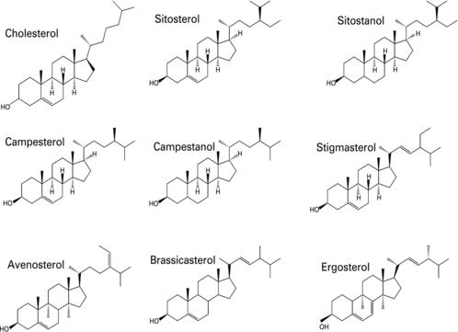
Sterols
Notes:
Sterols are organic compounds that play important functions in the body. They are derived from animals (zoosterols, such as cholesterol) or plants (phytosterols). Examples: cholesterol (form cell membranes affecting fluidity and cell signalling), corticosterols (cortisol) –important steroid hormone affecting metabolism and depressing immune responses

Slide 44
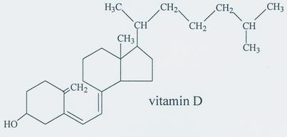
Sterols
Cholesterol is also an emulsifier – the key emulsifier in bile (secreted by the gallbladder)
Vitamin D is also an important sterol made from cholesterol in the body
Steroid hormones are also made from cholesterol

Slide 45
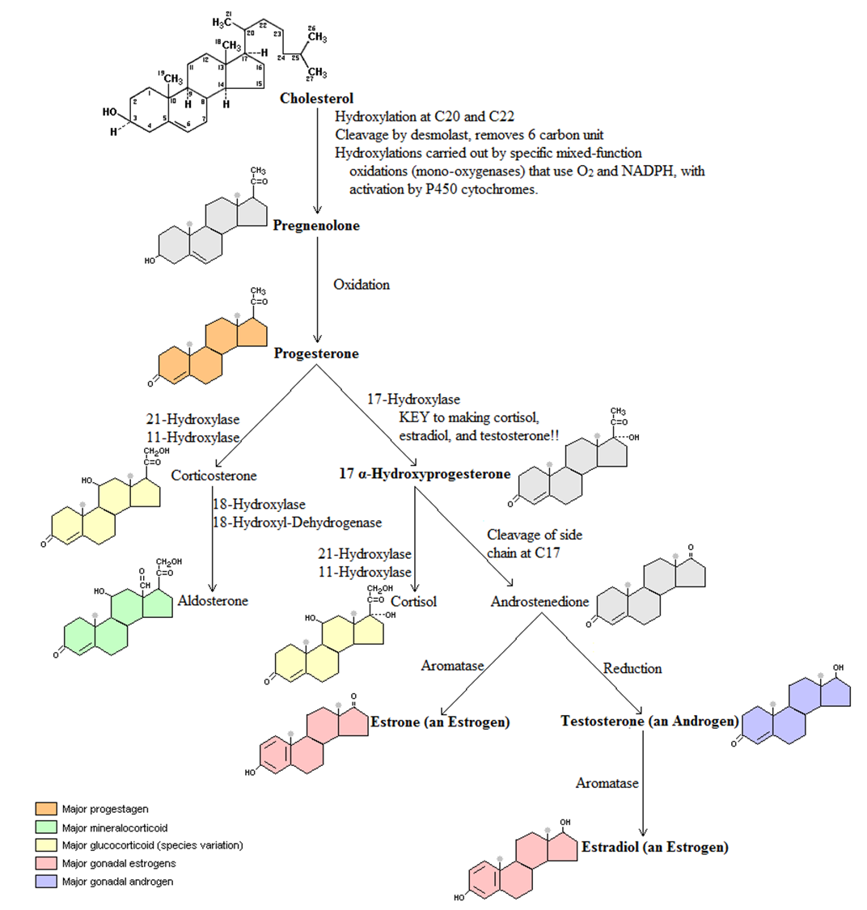

Slide 46
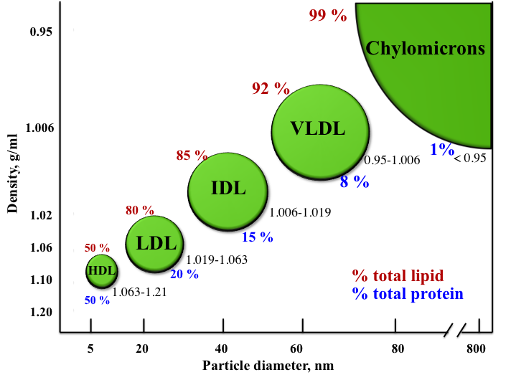
Lipoproteins
Notes:
Chylomicrons transport lipids from the intestine to the rest of the body
VLDL: transport endogenous products. They convert in bloodstream to LDL
Intermediate-density lipoproteins (IDLs) belong to the lipoprotein particle family and are formed from the degradation of very low-density lipoproteins. They are similar to LDL in that they can contribute to atherosclerosis
LDL (low-density lipoproteins, also known as “bad cholesterol”) particles pose a risk for cardiovascular disease
HDL (high-density lipoproteins) are also known as “good cholesterol” because they can transport fat molecules (including cholesterol, triglycerides, etc.) out of artery walls, reducing macrophage accumulation, and thus helping prevent, even regress atherosclerosis

Slide 47
End the war of fat
http://www.slate.com/articles/health_and_science/medical_examiner/2010/03/end_the_war_on_fat.2.html
http://www.medicinenet.com/cholesterol_levels_pictures_slideshow/article.htm

Slide 48
Digestion of Lipids
Fat does not mix well with saliva or stomach acid
Stomach – gastric lipase begins to digest triglycerides into fatty acids
Gallbladder secretes bile – emulsifies fats and helps them to dissolve in the small intestine
Pancreatic enzymes – pancreatic lipase breaks lipids into smaller particles for digestion (triglycerides → fatty acids, monoglycerides)

Slide 49
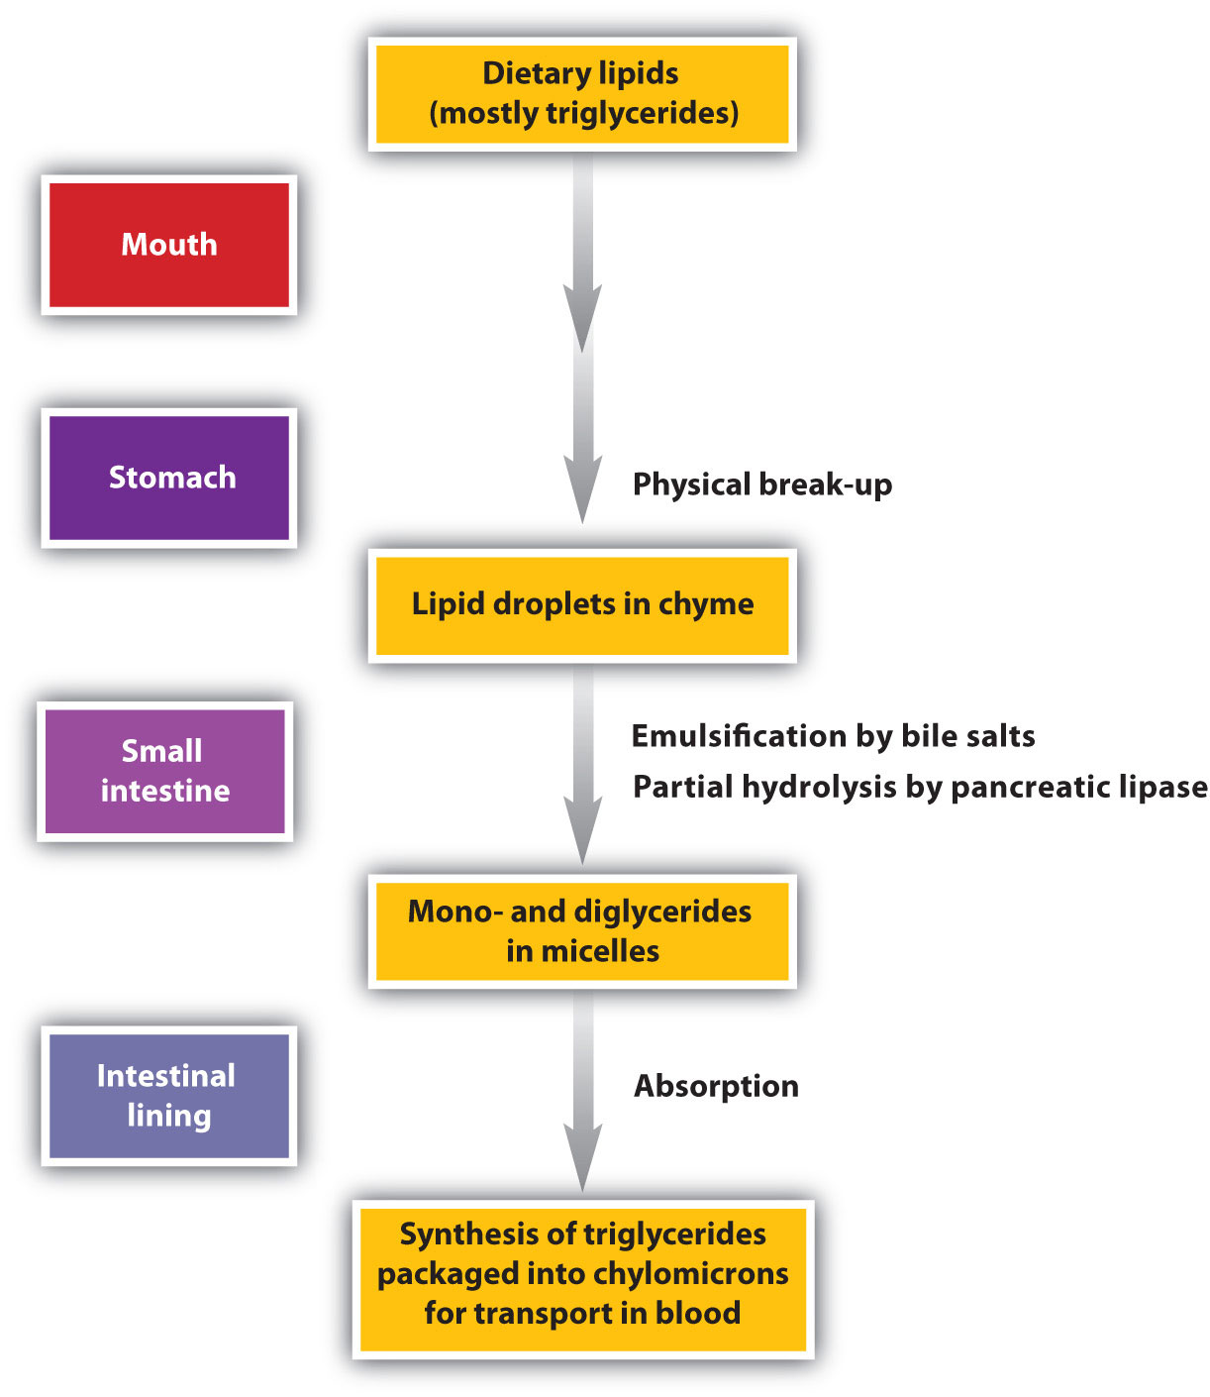

Slide 50
Protein
Proteins are arranged as strands or chains of amino acids
Amino acids – the building blocks of proteins – all types consist of the same basic structure however the side chain changes. 20 different kinds.
Essential amino acids – cannot be synthesized by the body or cannot be synthesized in quantities sufficient to meet body needs. Must be obtained through dietary sources. They are: phenylalanine, valine, threonine, tryptophan, methionine, isoleucine, lysine, and histidine
Peptide bonds – how amino acids are linked in order to create proteins
Collagen – a type of protein in the body – tendons, ligaments, scars, etc. Connective tissue
Notes:
An essential amino acid or indispensable amino acid is an amino acid that cannot be synthesized de novo (from scratch) by the organism being considered, and therefore must be supplied in its diet. The nine amino acids humans cannot synthesize are phenylalanine, valine, threonine, tryptophan, methionine, leucine, isoleucine, lysine, andhistidine

Slide 51
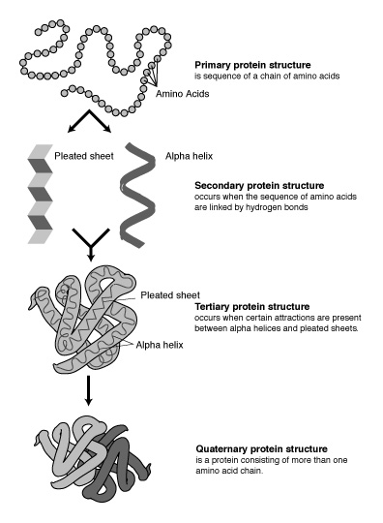
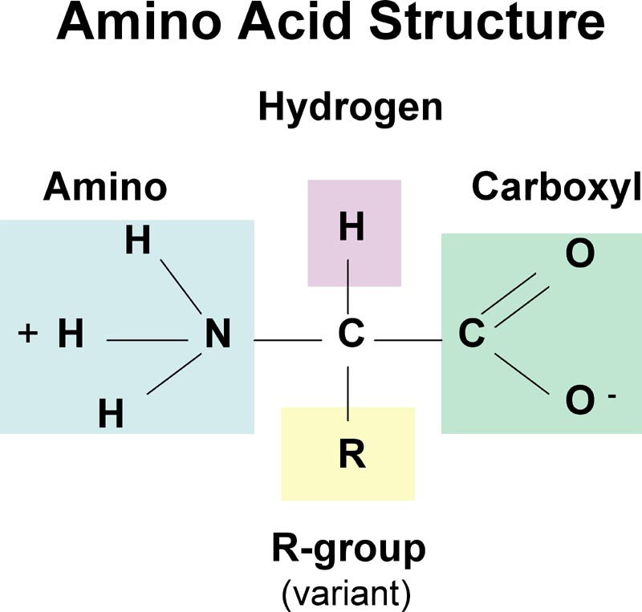
Protein Structure

Slide 52
Essential Amino Acids
PVT TIM HALL (acronym)
  Phenylalanine
  Valine
  Tryptophan
  Threonine
  Isoleucine
  Methionine
  Histidine
  Arginine
  Leucine
  Lysine

Slide 53
Non-Essential Amino Acids
Alanine
Asparagine
Aspartic Acid
Cysteine
Glutamic Acid
Glutamine
Glycine
Proline
Serine
Tyrosine

Slide 54
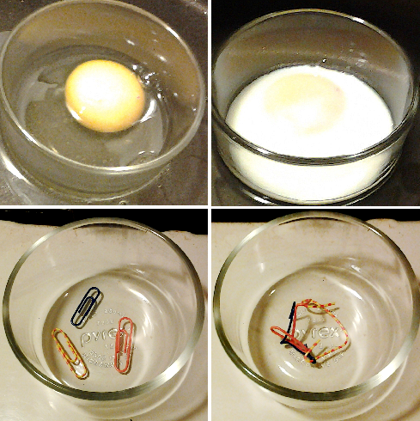
Protein Digestion
Proteins must be broken down into amino acids prior to absorption
Denaturation – the irreversible change in a protein’s shape brought about by heat, acids, bases, alcohol, salts of heavy metals, etc.
Acid-tolerant proteins (enzymes)
Stomach – hydrochloric acid, pepsin
Small intestine – proteases (from pancreas)
Brush Border – peptidases
From proteins → polypeptides
Polypeptides → di and tri-peptides
Di and Tri-peptides → amino acids
Notes:
Isn’t the stomach lining made of proteins too? Yes, but mucous protects these proteins from being denatured by acid. If the mucous barrier is disrupted, an ulcer can form.

Slide 55
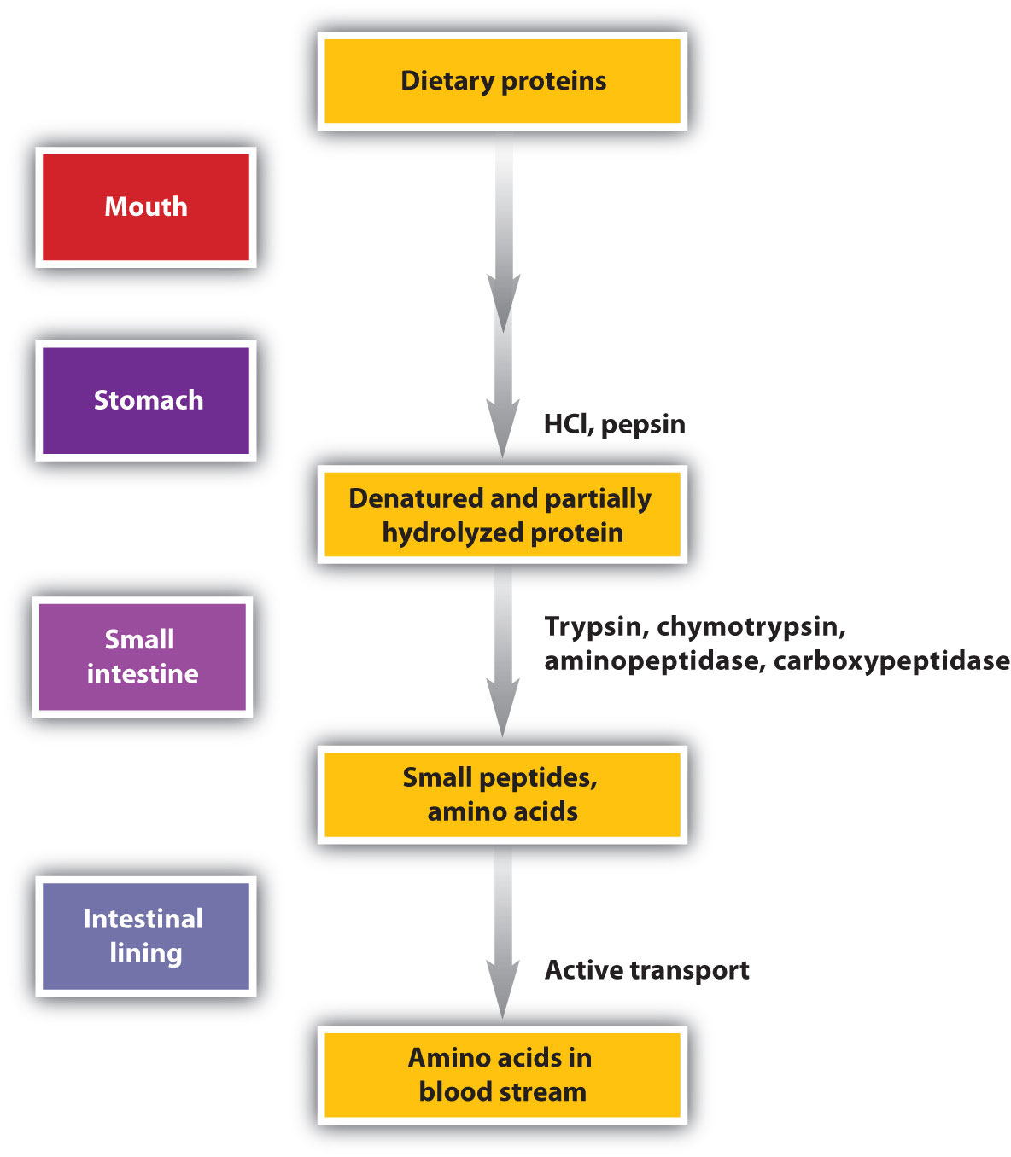

Slide 56
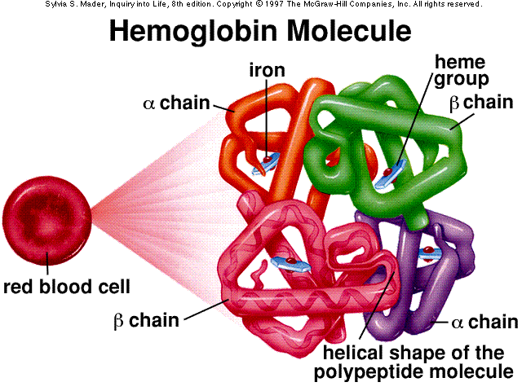
Important Body Proteins
Collagen
Enzymes
Hemoglobin
Insulin

Slide 57
Important Body Proteins
Growth and Maintenance
  Muscles
  Blood
  Embryo
  Growing child
  Scar tissue after injury or surgery
  Hair and nails
Protein turnover – the continuous breakdown and synthesis of body proteins involving the recycling of amino acids
  Daily approximately ¼ of all available amino acids are irretrievably used for other uses (eg. Fuel) – why we need proteins from food every day
Notes:
Every:
3 days – every cell in the gastrointestinal tract replaced
3-4 months – new red blood cells (5L of blood in body approximately)

Slide 58
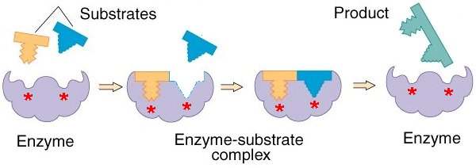
Important Body Proteins
Enzymes
Notes:
Every:
3 days – every cell in the gastrointestinal tract replaced
3-4 months – new red blood cells (5L of blood in body approximately)

Slide 59
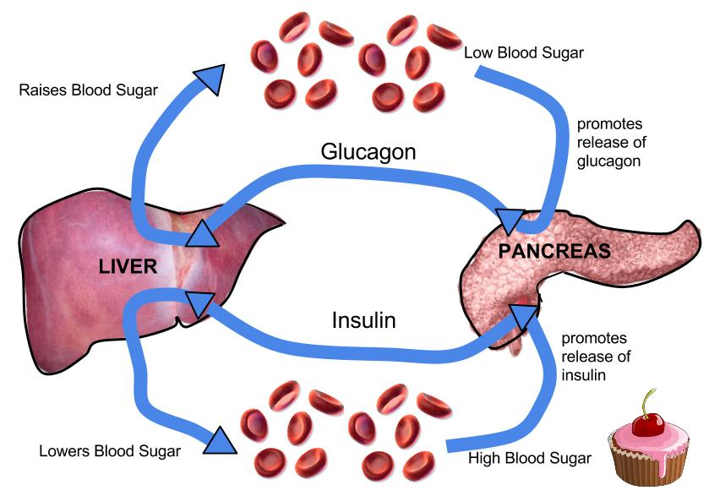
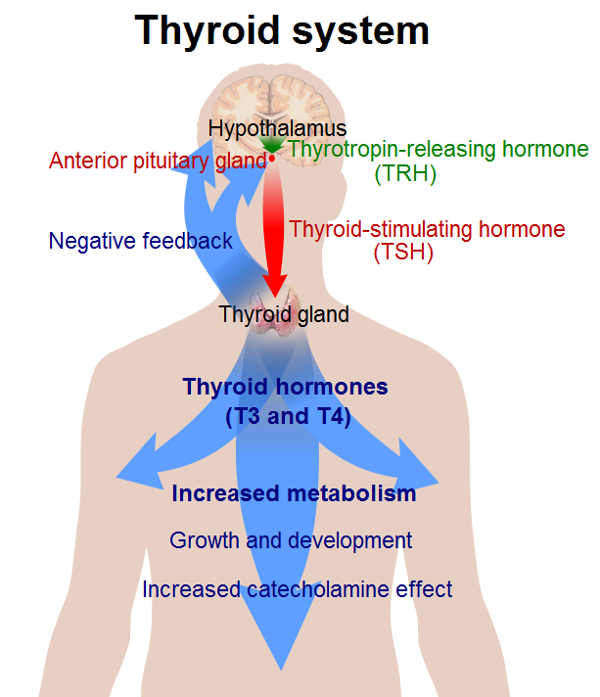
Hormones (recall some hormones are made from lipids)
  Eg: Thyroid hormone, insulin, glucagon
Notes:
Every:
3 days – every cell in the gastrointestinal tract replaced
3-4 months – new red blood cells (5L of blood in body approximately)

Slide 60
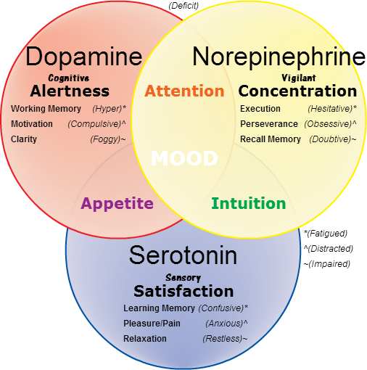
Important Body Proteins
Skin, hair, eye colour – melanin is a protein
Neurotransmitters
  Serotonin – “feel good” chemical in the brain – anti-depressant medications increase serotonin levels in the brain.
    Made from tryptophan
    Cashews also increase serotonin
Notes:
Every:
3 days – every cell in the gastrointestinal tract replaced
3-4 months – new red blood cells (5L of blood in body approximately)

Slide 61
Important Body Proteins
Antibodies
  Recognize every protein that belongs within the human body and leaves these alone
  Identifies foreign proteins that invade the body and attack them (bacteria, virus, toxin)
    Hyperactive response – allergies develop (trees, grasses, molds, dust, animals, foods)
    Autoimmune diseases – body begins to attack proteins that are “normal” within the body – this is an abnormal process
Notes:
Every:
3 days – every cell in the gastrointestinal tract replaced
3-4 months – new red blood cells (5L of blood in body approximately)

Slide 62
Food Sources of Protein
High quality protein – contains all of the necessary amino acids in ratios that humans require.
  Animal protein – also highly digestible (>90%)
Digestibility
  Animal protein is highest
  Legumes (beans/lentils) – 80-90%
  Grain and other plant sources – 70-90%
  Cooking with moist heat increases
  Dry heat decreases

Slide 63
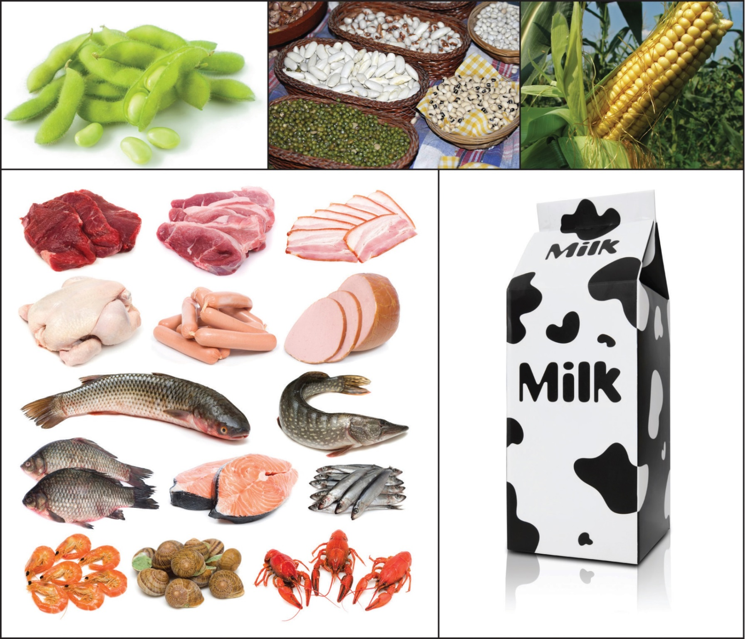

Slide 64
Regulator nutrients
Assist in all body processes, some in body structures
Vitamins (i.e. Vitamin C, D, etc.)
Minerals (Calcium, iron)
Food energy is measured in Calories; food and nutrient quantities measured in grams
Essential nutrients: need to ingest those as body doesn’t make them (vitamins, some aa, minerals)

Slide 65
Can we live on just supplements?
Elemental diets (precise chemical composition, meal replacements)
Advantages?
Disadvantages?
Importance of real food?

Slide 66
How to eat to live 100+
https://www.ted.com/talks/dan_buettner_how_to_live_to_be_100
(~20 min)

Slide 67
Digestion
https://www.youtube.com/watch?v=i5MH6ddyi74 (6 min)
https://www.youtube.com/watch?v=s1q2srfUU0g (3 min)
https://www.youtube.com/watch?v=08VyJOEcDos (2:33 min)

