Slide 1
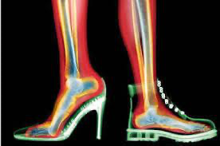
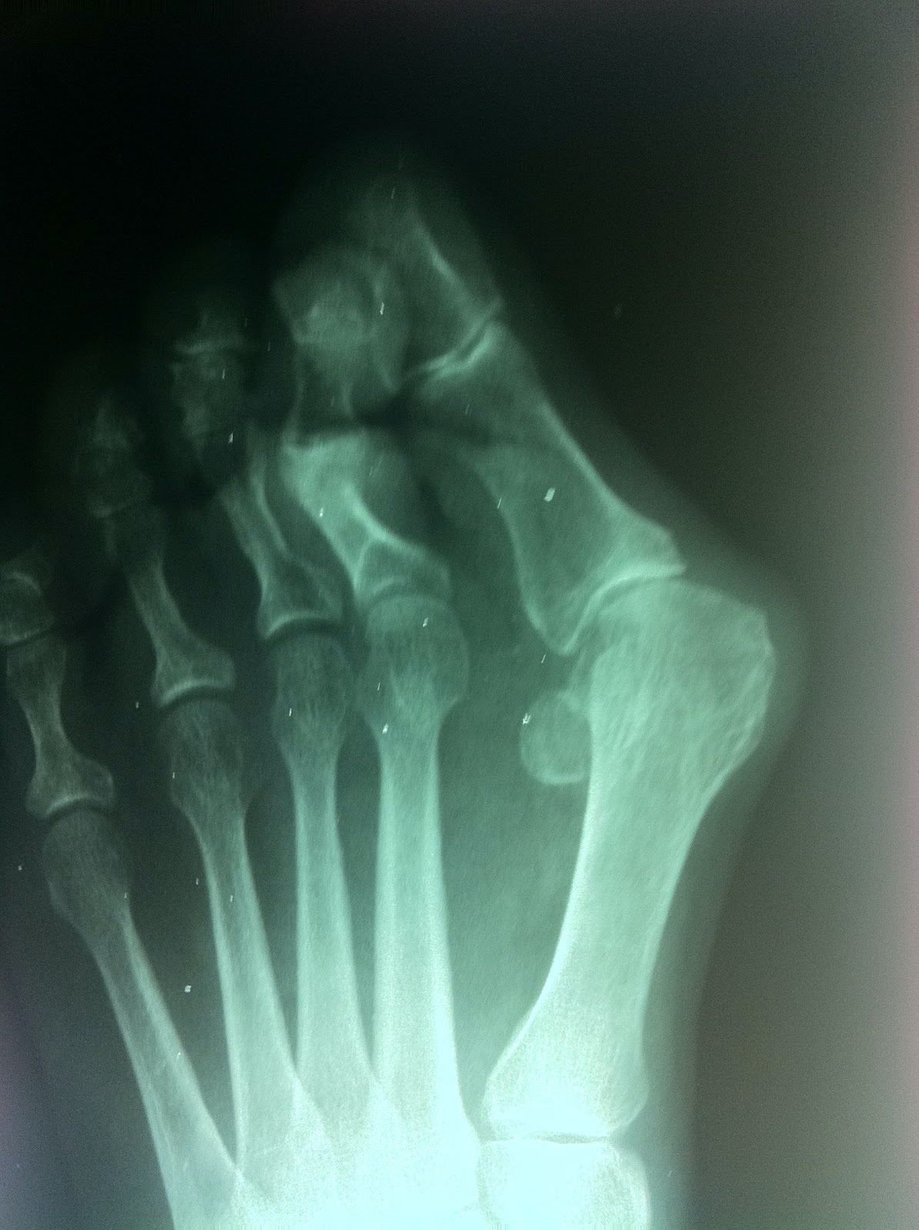
ANKLE AND FOOT

Slide 2
Why are the ankle and foot so important?
form the base of stability for the entire body
all its structures - joints, ligaments, bones, fascia, skin and muscles specialize in accepting great levels of force from body weight and ground forces
Has the ability to maintain contact with and adapting to variable surfaces.
What is the first step of understanding the ankle and foot?
Notes:
GAIT!

Slide 3
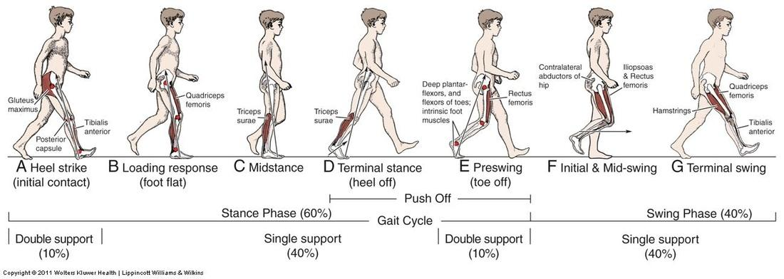
GAIT!

Slide 4
Overview
26 Irregular shaped bones (28 with sesamoids) (Def: a small nodular mass of bone or cartilage in a tendon, especially at a joint or bony prominence.-www.merriam-webster.com)
More than 100 ligaments
30 muscles
Provides propulsion and restraint for each step
Arches provide a complex spring-like structure which transmits forces upon heel strike and then propels the body forward. The arches essentially store up energy on the heel strike and release it on the forward propulsion.

Slide 5
3 Functional Areas
Hindfoot – Talocrural joint and Subtalar joint
Midfoot – Talonavicular, Calcaneocuboid, Cuneonavicular, Intercuneiform, Cuneocuboid and Cubonavicular joints
Forefoot – Tarsometatarsal, Metatarsophalangeal, Interphalangeal joints
Notes:
Talocrural - true ankle joint

Slide 6
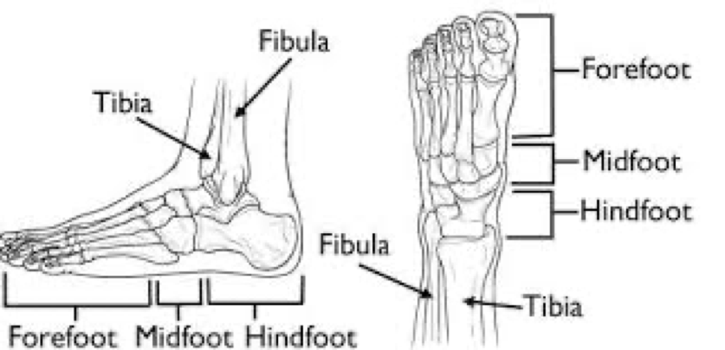

Slide 7
Hindfoot
Talocrural joint – plantar and dorsiflexion occur through the joint, either by the tibia moving on a fixed foot or the foot moving on a fixed tibia
Subtalar joint – Pronation and supination occur at this joint
Talocrural and Subtalar joints are a unit which act as torque converters and shock absorbers during the stance phase of gait

Slide 8
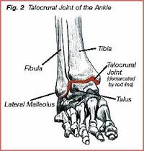
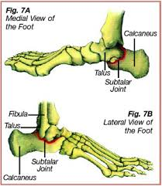

Slide 9
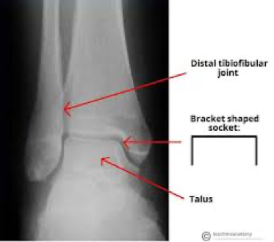

Slide 10
Midfoot
The Transverse Tarsal Joint is a combination of the talonavicular and calcaneocuboid joint
Pronation and Supination occur at this joint
  Adds to pronation and supination happening at subtalar joint therefore helping to absorb rotary force of lower leg
  Helps keep forefoot as flat as possible on the ground

Slide 11
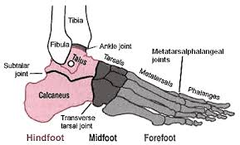
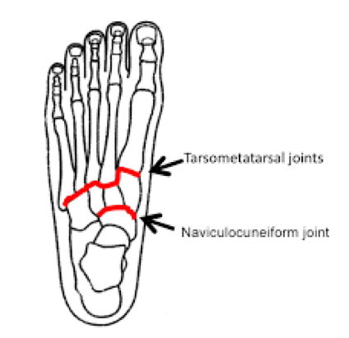

Slide 12
Midfoot
Cuneonavicular, Intercuneiform, Cubonavicular & Cuneocuboid Joints – allow small gliding movements which contribute to the flexibility of the foot
  Stability and mobility of this area is related directly to the hindfoot. Hence why proper biomechanics at the hindfoot are essential to avoid faulty mechanisms leading to injury of the entire foot.

Slide 13
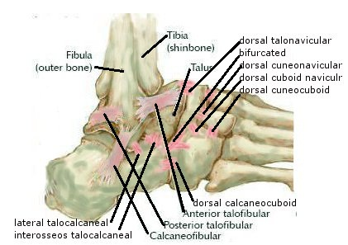
Midfoot Joints

Slide 14
Forefoot
  The metatarsals and phalanges
  Tarsometatarsals - independent joint movements at each of the TMT joints allows the entire foot to undergo a pronation or supination twisting action to counteract what happens in the hindfoot and keep as much contact with the floor as possible
  Metatarsophalangeal joints – allow flexion, extension & adduction, abduction. Extension is more free than flexion, which allows for the metatarsal break in the foot as the heel lifts when walking.

Slide 15
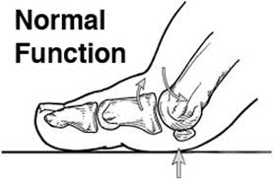
Metatarsophalangeal Joint

Slide 16
Forefoot
  Interphalangeal Joint – allows flexion/extension
    The toes smooth the transfer of weight onto the opposite foot during gait
    They help stabilize by pressing against the ground in standing
    The big toe takes the greatest load during the push-off portion of gait, with 40% of the body weight on the other 4 toes, making them important for stability

Slide 17
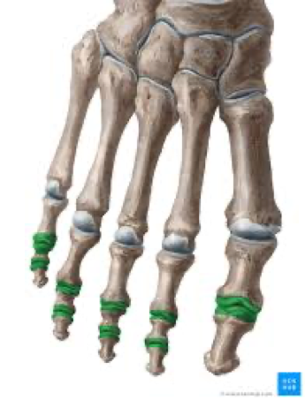

Slide 18
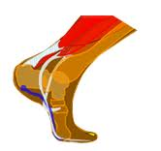
Push-off Portion of Gait

Slide 19
Arches of the Foot
Medial Longitudinal Arch – Highly elastic, contributes greatly to shock absorption
Lateral Longitudinal Arch – makes contact with ground during gait, supports during weightbearing
Transverse arch – provides significant support in weightbearing
Tibialis Posterior is the only extrinsic (Def: It’s origin is not close to the moving part-www.merriam-webster.com,) muscle that contributes significantly to arch support

Slide 20
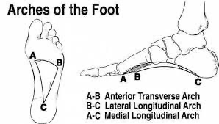

Slide 21
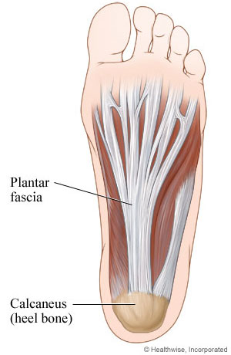
Plantar Fascia

Slide 22
Arches & Plantar Fascia
Although the shape of the bones provide some stability to the arches, by far the most important support structures are:
  The plantar ligaments
  The plantar musculature
  The plantar fascia - a spring-like structure which not only supports the arches, but protects other structures of the foot. It is most important in supporting the medial arch in the end part of the stance phase of gait

Slide 23
Ideal function of Foot and Ankle
Major source of propulsion
Must have ability to adjust to various ground surfaces and speeds of movement
Both flexibility and rigidity are important for optimal function
Notes:
Think of bones of the foot…. Lots of tiny bones to allow for adaptation.

Slide 24
Dysfunctions of the Ankle & Foot
Achilles Tendinopathy
Compartment Syndrome
Shin Splints (inflammation)
Plantar Fasciitis
Hallux Valgus (Bunions)
Bone Spurs
Notes:
Diff b/w compartment syndrome and shin splints?

Slide 25
Achilles Tendinopathy
The achilles tendon is the thickest & strongest tendon in the body. It is a combined tendon of the gastrocnemius, soleus and plantaris muscles.
Tendinopathy is an injury to the tendon causing pain and swelling, which makes it difficult to move. Tendinopathy can be either a:
  Tendonitis—inflammation of the tendon or a
  Tendinosis—tiny tears in the tendon with no significant inflammation

Slide 26
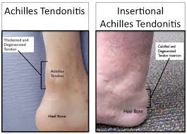
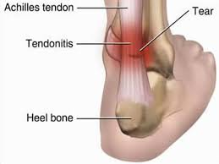

Slide 27
Achilles Tendinopathy
Causes: - improper training; too much too soon
      A single event involving a violent muscle action, such as a sprint
      improper footwear
      Excessive pronation
      Calf weakness or tightness causing restriction in dorsiflexion
      If not treated can result in full rupture of the tendon

Slide 28
Achilles Tendinopathy
Exercises
  Work on eccentric strengthening
  Emphasize heel drops with extended and bent knees
  Ankle exercises using a flex band
  Client may feel pain with exercises at first, avoid increasing load until previous exercise can be done pain-free
  Ensure all joints are moving throughout all exercises
Notes:
Why extended knee/flexed knee? Isolating what mms?

Slide 29
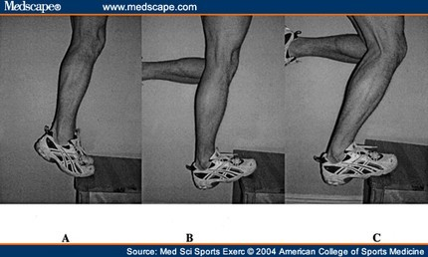
Heel Drops

Slide 30
Compartment Syndrome
Nerve and vascular compression occur as a result of hypertrophy in the muscle, causing an impingement of the nerves and blood vessels
  May be caused by a decrease in the elasticity of the fascia surrounding the muscle, resulting in an inability of the compartment to expand
  Can occur in either the anterior compartment (tibialis anterior, extensor digitorum longus, extensor hallucis longus, peroneus tertius) or the posterior compartment (flexor digitorum longus, flexor hallucis longus, tibialis posterior)

Slide 31
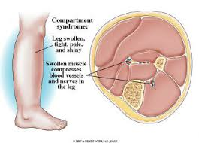

Slide 32
Compartment Syndrome
  Causes: - Typically an overuse injury resulting in inflammation and sometimes pain
      Recurrent exertional compartment syndrome due to overuse behaviors such as running or speed walking cause aching and painful shins. These systems often create a bursting feeling that increases with exertion and decreases with rest.
      Complication resulting from fracture or soft tissue injury

Slide 33
Compartment Syndrome
Exercises
  Begin all exercise in non-weightbearing
  Retrain all lumbopelvic and lower exetremity biomechanics and movement patterns
    aka…?
  May require surgery or extended rest

Slide 34
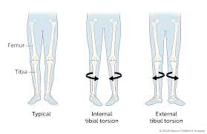
Tibial Torsion

Slide 35
Shin Splints
Typically associated with overuse or malalignment
May cause pain during the night or upon getting up
Common in athletes who jump with improper mechanics or who jump on unforgiving surfaces like cement regularly

Slide 36
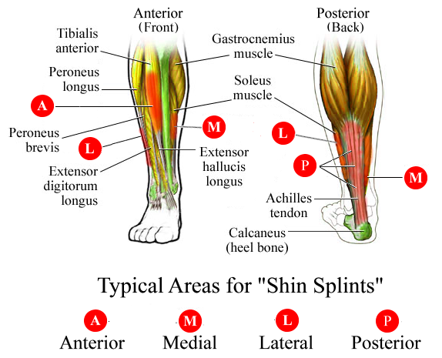
Shin Splints

Slide 37
Shin Splints
Causes: - Excessive training
      Improper mechanics
      Reduced bone density due to low estrogen levels in women
      Standing/jumping on cement or similar surfaces for extended periods

Slide 38
Shin Splints
Exercises:
  non-weightbearing
        Low load
        Work on correcting biomechanics
        Footwork with a flex band
        Ankle exercises with a band

Slide 39
Plantar Fasciitis
Inflammation of the Plantar Fascia on the underside of the foot
Irritation usually occurs at area of attachment to medial calcaneous
Prevalent in people with high arches

Slide 40
Plantar Fasciitis
Causes:
- HT Achilles tendon
      Leg length discrepency
      Poor biomechanics; excessive pronation or supination and maximal ankle plantar flexion and simultaneous dorsiflexion of metatarsophalangeal joints
      Footwear
Notes:
Footwear… seasonal, why?

Slide 41
Plantar Fasciitis
Exercises:
    avoid full range of plantar flexion
      Emphasize heel drop and eccentric lengthening of gastrocnemius and soleus
      Circumduction of ankle with a flex band
      Walking on a pool noodle
        Arches, balls, heels
        Roll out entire foot on noodle
        Stretch calf on noodle

Slide 42
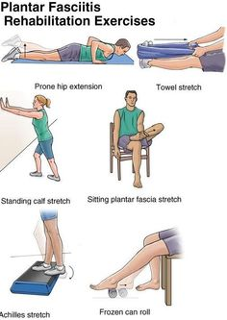
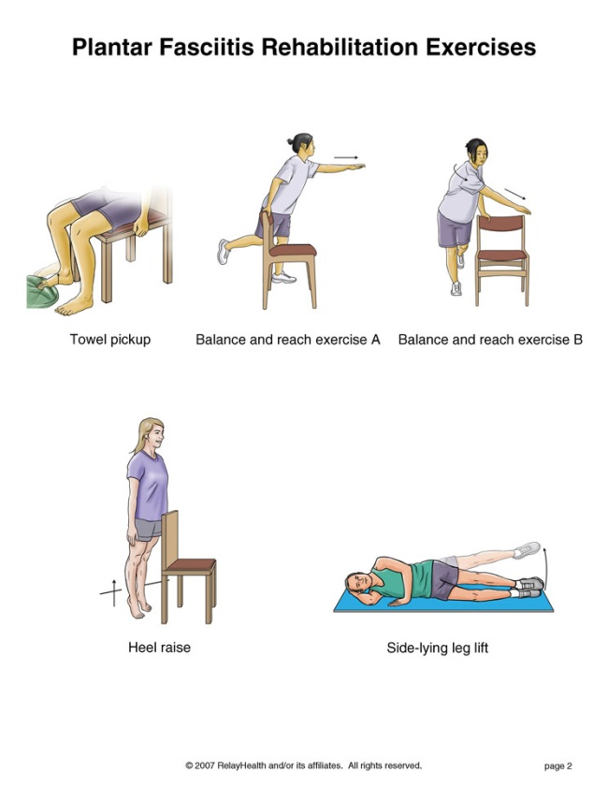

Slide 43
Bunions
Excessive bony protrusion develops around the base of the 1st metatarsal
Bursitis may develop over the area
In severe cases ROM is limited in 1st metatarsal
Painful with pressure
May have pain with loading of metatarsals due to inability to withstand load

Slide 44
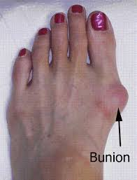
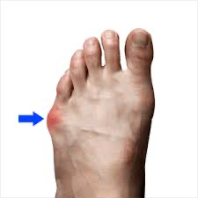
Bunions
Bunionette - 5th Metatarsal

Slide 45
Bunions
Causes:
  compression of the forefoot medially and laterally can lead to bunions
  Common with excessive pronation during propulsion stage of gait
  Improper or ill-fitting shoes (narrow-toed high heels, pointe shoes in ballet)
  Genetics

Slide 46
Bunions
Exercises:
      - avoid weightbearing until able
      Low load
      Correct biomechanics
      Toe extension
      Towel pick-up
      Calf raises
      Ankle eversion with band
      Ankle inversion with band
      Toe spacers - start non-weight bearing

Slide 47
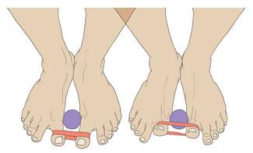
Bunions

Slide 48
Bone Spurs
Bone spurs are bony projections that develop along the edges of bones. Also called osteophytes, bone spurs often form where bones meet each other — in your joints. The main cause of bone spurs is the wear-and-tear damage associated with osteoarthritis.
www.mayoclinic.org/diseases.../bone-spurs/basics/definition/con-20024478

Slide 49
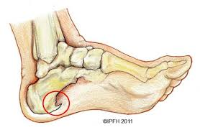
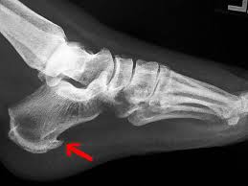
Bone Spurs

Slide 50
Bone Spurs
Causes: -osteoarthritis
      Extra bone build up due to excess pull of tense muscles/fascia
        Can result from overuse due to poor mechanics

Slide 51
Bone Spurs
Exercises:
      - Calf Raises
      Calf stretches
      Support back of ankle with heel pointing down and try to pull heel to the floor, release and repeat.
      Piano Toes
        Separate toes and try to tap or wiggle each one individually

Slide 52
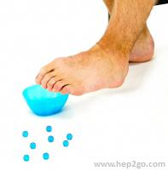
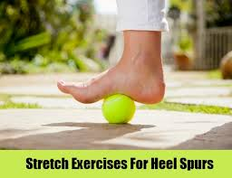
Heel Spurs

Slide 53
Deep Venous Thrombosis
Serious, possibly life-threatening condition
Can be mistaken for calf pain/injury/overuse
Can result from sitting too long with pressure on leg, ie. On an airplane
Presents as calf pain, tenderness, increased temperature and/or swelling of the calf and pain with passive ankle dorsiflexion

Slide 54
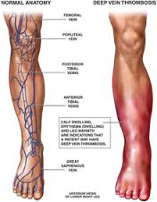
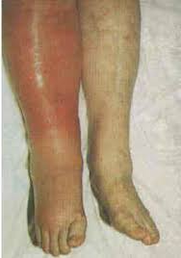
Deep Venous Thrombosis

Slide 55
Deep Venous Thrombosis
If you suspect a deep venous thrombosis, send your client for a physician consult immediately
Avoid massage or exercise until diagnosed

Slide 56
Ankle Sprains
Lateral ankle sprains most common
Involve the posterior tibiofibular ligament, posterior talofibular ligament or calcaneofibular ligament

Slide 57
Ankle sprains
Non weight bearing is typical in the acute stage
In a subacute stage ROM is encouraged
Muscle strength especially foot everters need to be stregthened
Balance needs to be regained
If they want to return to a specific sport dynamic (jumping) activities may be needed

Slide 58
Fractures
Any fracture in the ankle / foot that requires casting or immobilization will require a rehabilitation program once the fracture has healed

Slide 59
Fractures
Goals - Once casts have been removed
Re-establish ROM in non-weight bearing then weight bearing
Stretch shortened structures
Restore strength
Improve balance
Improve cardiovascular endurance

