Slide 1
Making Sense of Statistics
Lecture 7

Slide 2
What is Statistics?

Slide 3
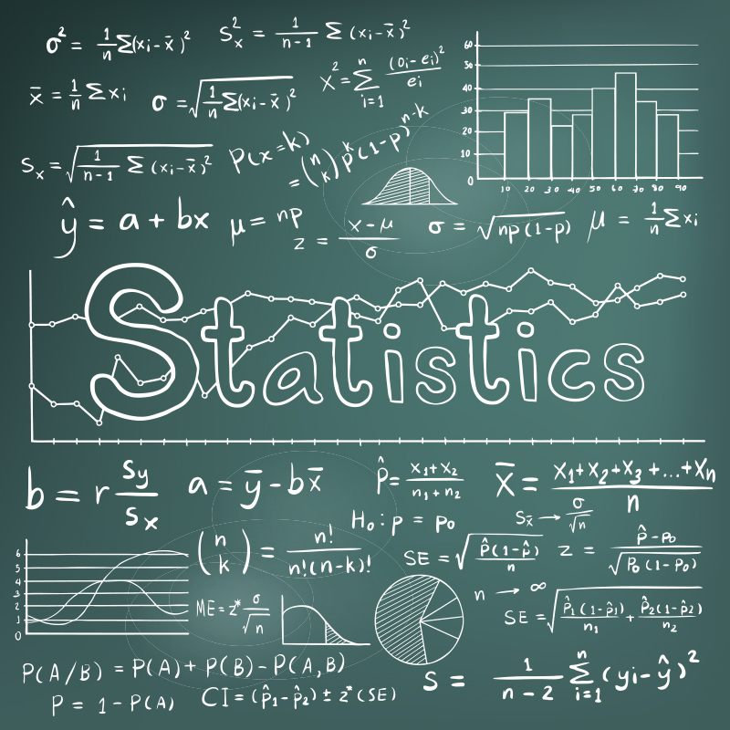
Definition:
Statistics is:
everything that deals with collecting, processing, interpreting & presenting data
Biostatistics:
Focuses on data related to living things

Slide 4
More than just numbers…
Statistics can be used to answer questions like:
What kind & how much data needs to be collected?
How should the data be organized & summarized?
How can we analyze the data & draw conclusions?
How can we assess the strength of the conclusions & evaluate any uncertainty?

Slide 5
Can you think of any day to day examples of statistics?

Slide 6

How do you pick your toothpaste?

Slide 7

How did you decide what to wear today?

Slide 8
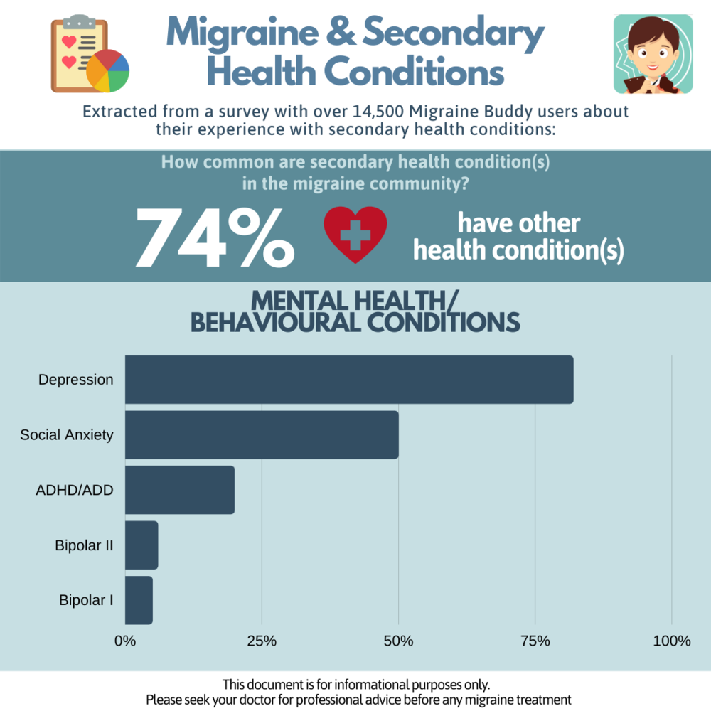
Can my headaches be impacting my mental health?

Slide 9
In Summary:
The goal of statistics is to make an inference of a population from the analysis of the data collected from a sample.

Slide 10
Statistics: Understanding Basic Concepts
Notes:
https://www.osmosis.org/notes/Introductory_Biostatistics#page-1

Slide 11
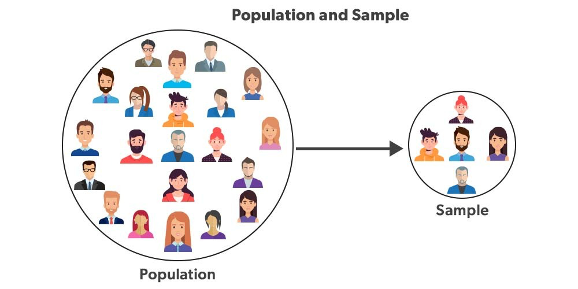
Population & Sample
Population:
the collection of all individuals or items under consideration in a statistical study
The selected group is defined by a certain set of criteria
  Ex: October - March emergency room visits
Sample:
a part of the population from which information of collected
  Ex: influenza related October - March emergency room visits
The population always identifies the target of the investigation & we learn about the population by taking a sample of the collection.

Slide 12
Parameters & Statistics
Parameter:
an unknown numerical summary of a population; every person/object is taken into consideration
  aka: the feature of a population under investigation
the research problem usually becomes an investigation of the parameter
provide a descriptive data of a particular population
Statistics:
a known numerical summary of the parameter
obtained from a sample (subset) of the population
data is used to make inferences about an entire population

Slide 13
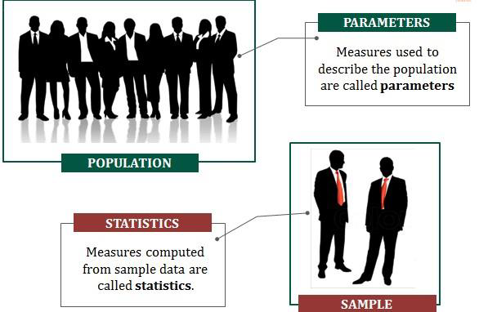

Slide 14

Types of Hypotheses
Null hypothesis
states that there is no relationship between variables
  any observed relationship due to chance
  ex: no relationship between BMI & hypertension
Alternative hypothesis
states expected relationship between variables
  ex: there is a relationship between BMI & hypertension

Slide 15
Hypothesis Testing
when statistics are used to determine relationship strength between variables
determines how much of the observed relationship is due to chance; determines the statistical significance
Statistical significance
when the relationship between variables is caused by something over than chance
  p-value of 5% (p = probability)

Slide 16
Errors of hypothesis testing
Type 1 Error
Probability of incorrecting rejecting the null hypothesis
  concluding a significant relationship between variables when there is not
Type 2 Error
Incorrectly accepting null hypothesis
  concluding there is no significant relationship between variables

Slide 17
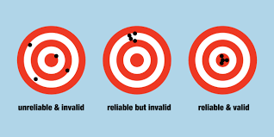
Reliability & Validity
measurement characteristics used to collect data
Reliability: repeatability
when the instrument consistently yields the same results with repeated measurements
doesn’t always mean there is validity
  ex: when urine dipstick detects proteinuria with each measurement
Validity: accuracy
when the instrument actually measures variable it is supposed to measure
  ex: urine dipstick accurately detects proteinuria

Slide 18
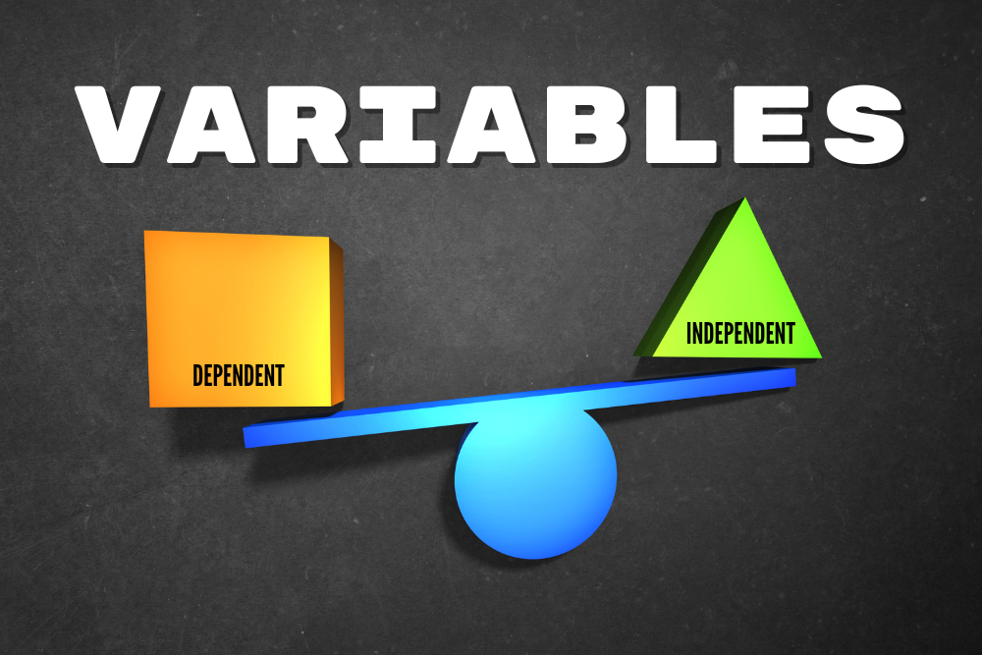
Variables
Definition:
any characteristic that varies from one person/object to another in a population
Independent variable (X)
manipulated variable (Treatment)
Dependent variable (Y)
outcome variable
influenced by the independent variable
Example: what is the effect of lipid-lowering drug (X) on an individual's cholesterol level (Y)

Slide 19
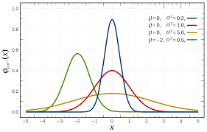
Graphic Description of Data
when values are plotted on a graph a variety of frequency distributions (curves) result
Two types:
Normal (Gaussian) curve
Non-Gaussian Curve

Slide 20
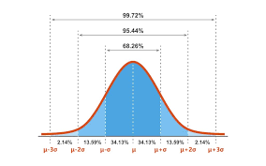
Gaussian Curve
Symmetrical distribution of scores
Forms a classic bell shape
Values lie within two standard deviations of the mean
Most natural phenomena show this type of distribution
Parametric tests utilized in research

Slide 21
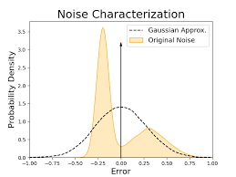
Non-Gaussian Curve
Skewed (negatively or positively)
Kurtotic (flat/peaked)
Nonparametric tests utilized in research

Slide 22
Types of Statistics

Slide 23
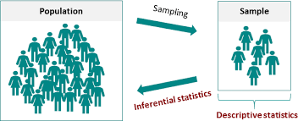
Two types of statistics:
Descriptive
creates methods for collecting & summarizing data
Inferential
creates methods for drawing & measuring the reliability of conclusions collected about a population based on information obtained from as sample

Slide 24
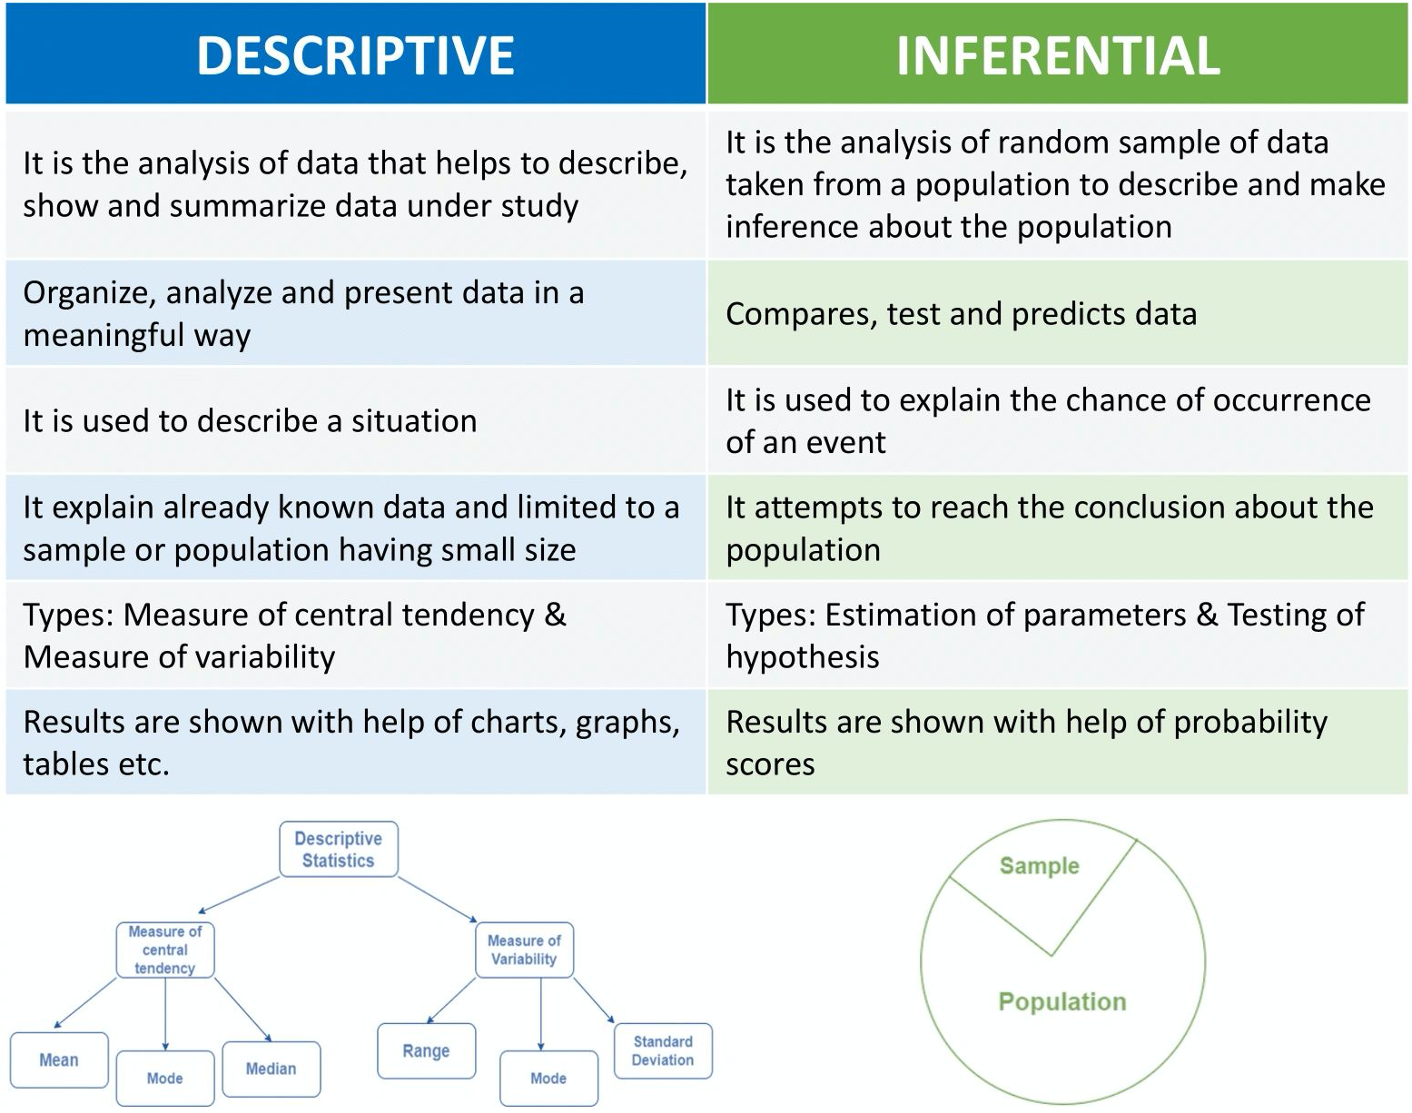
Differences between descriptive & inferential statistics
Notes:
https://arockialiborious.com/f/descriptive-vs-inferential-statistics

Slide 25
Notes on descriptive & inferential statistics
Almost always interrelated
typically descriptive statistics is used first to collect & organize data before inferential statistics can be applied to further analyze results of the subject under investigation
preliminary descriptive statistics can lead to the choice of an appropriate inferential method later
Example: Are dice fair?
Roll a dice 100 times and calculate how many times 1, 2, 3, 4, 5, 6 is rolled
Descriptive statistics
  How many times each number is rolled out of 100 (shown in a chart)
Inferential statistics
  Using probability scores from descriptive data to verify if the dice is fair or not

Slide 26
Types of Data

Slide 27
Qualitative Data
Qualitative/Categorical
small number of possible values that are in categories or classes
Nominal categories:
unordered categories that are mutually exclusive
  ex: male/female, smoker/non-smoker
Ordinal categories:
Ordered categories that are mutually exclusive
  ex: pain scales

Slide 28
Quantitative Data
Quantitative/Numerical
have numbers as values
Discrete
whole numerical values
  ex: number of visits to the dentist
Continuous
takes any infinite number of value
  ex: height in cm

Slide 29
Quantitative Data
Quantitative/Numerical
have numbers as values
Interval data
quantitative difference between two values; placed in clear, logical order
no meaningful zero; with decimal values
  ex: temperature scale (Celsius)
Ratio data
meaningful zero point, without decimal places
  ex: test scores

Slide 30
Measures of central tendency
descriptive statistics that attempt to represent a variable by its central value/most typical value
where is the middle of the data set?

Slide 31
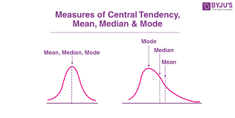
Mean, Median, Mode
Mean = “average”
adding the values of the numeric variable and divide by the count
Median = “middle”
the middle value in a sorted list of values of a numeric variable
Most commonly used measure of central tendency
Mode = “most often”
value with the highest count

Slide 32
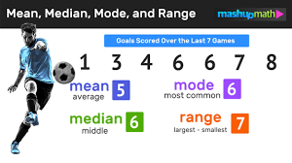
Examples:

Slide 33
What is the significance of central tendency?
more curve symmetry
=
more alike mean, median & mode

Slide 34
Measures of variability
descriptive statistics that represent how distant the typical values of a numeric variable are from the mean
how far away from the average is the data dispersed?

Slide 35
Variance, Standard Deviation, Range
Variance for a sample
the variability of the data set around the mean
helps to determine the size of the data spread
Standard deviation
a measure of how dispersed the data is in relation to the mean
helps to measure the absolute variability of the dispersion
Gaussian curve rule:
  68 - 95 - 99
    68% of data points lie within 1SD, 95% lie within 2 SD, 99% lie within 3 SD
Range
the largest difference between any two values of a numeric variable
range = maximum - minimum

Slide 36
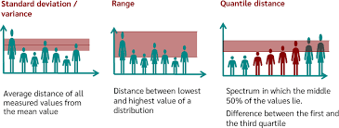

Slide 37
Probability

Slide 38
What is probability?
the likelihood that an event will/will not occur

Slide 39
How to find probability?
Divide the number of times the event happened by the number of times an event could have happened
Ex: Rolling a die and getting a three (event A)
a single die has six sides with six possible numbers therefore:
P (probability) of event A = ⅙, 0.167 (16.7%)

Slide 40
Probability Rules

Slide 41
Rule 1
Probability of event A can range anywhere from 0-100%
Notes:
Probability can be greater than or equal to 0 or lesser than or equal to 100
Die example = 16.7 percent

Slide 42
Rule 2
The sum of probabilities of all possible outcomes = 1
Notes:
Die example: 6 sides @ 0.167 = 1

Slide 43
Rule 3
Complement rule
The probability that event will not occur = 1 minus the probability that it does occur
Notes:
Essentially the difference
Die example P (of not rolling three)
1- P (3)
1- 0.167
=0.833

Slide 44
Rule 4
Probability of two disjoint (mutually exclusive) events = the sum of the first event + second event
Notes:
Example:
A: Rolling less than 2
B: Rolling an even number
P(A or B) = P (A) + P(B)
P (A) = ⅙
P (B) = 3/6

Slide 45
Rule 5
Probability for two not disjoint (not mutually exclusive) events = sum of the probability of event A and the probability of event B minus the probability of event A & B together
Notes:
Event A: rolling a number equal to or less than 2
Event B: rolling an even number

Slide 46
Rule 6
Multiplication Rule
Probability of two independent events = probability of the first even multiplied by the probability of the second event
Notes:
What is the probability of rolling a 5 then a 3 with a normal six sided die?
P(3) = ⅙
P(5) = ⅙
=1/36

Slide 47
Rule 7
Conditional probability
The probability of event A given what happens in event B = probability of event A & B divided by probability of event B
Notes:
P (A given B) = P(A&B)/P(B)
Probability that the roll of two dice adds up to seven (event A) given that he first die is either a five or six (event B)
P(A) = 6 combinations/36 options
P(B) = 2/6 = 0.33

