Slide 1
Learning Objectives
Define probability
Name common misconceptions about probability
Descriptive vs. inferential statistics
Define Mean, Median, Mode, Standard Deviation
Define the classes of variables
Parametric vs. non-parametric statistics

Slide 2
What is Probability?
Chances of particular outcome to occur based on
random process
Random process: varies in a random way, usually within certain limits
Individual outcome will vary between the total number of possible outcomes
Examples:
Tossed coin: 1 out of 2 of heads or tails
Dice cast to land in 1 out of 6 sides

Slide 3
What is Probability? (Cont.)
Can be expressed as:
A number between 0 and 1
As a percentage (fraction of 100)
Examples:
Coin: 1 out of 2 (1 divided by 2, or 50%)
Dice: 1 out of 6 (1 divided by 6, or 16.7%)

Slide 4
What is Probability? (Cont.)
Probability of “0” means event will never happen
Probability of “100%” means event will always happen
Sum of all probabilities of all possible outcomes is 1 (or 100%)

Slide 5
What is Probability? (Cont.)
Example: Chances of roll even number on single cast of a single die?
Die casts to land in 1 out of 6 sides (each side has a 1 out of 6 chances, or 1/6):
Number 1: 1/6, number 2: 1/6, number 3: 1/6, etc.
Probability of rolling a 2, 4 or 6:
1/6 + 1/6 + 1/6 = 3/6 = ½ = 50%

Slide 6
Facts to remember:
Probability effective on long-term behaviour but much less in short-term behaviour (event will occur but can’t predict exactly when, i.e. forecast)
No such thing as “being on a roll” (gambling): cards and dice have no memory, so probability is same for each repetition under same conditions
Tendency to rate probability of event differently, depending on if seen as ‘good’ or ‘bad’ (i.e. winning lottery vs. being struck by lightning in our house)

Slide 7
Planning a statistical study
Identify individuals or objects of interest
Specify variables as well as protocols for taking measurements or observations
Determine if you will use entire population or a representative sample (sampling method?)
Address issues of ethics, confidentiality, permissions
Collect data
Use descriptive statistics methods and make conclusions using appropriate inferential methods
Note any concerns about data collection and list recommendations for future studies

Slide 8
Measure of central tendency: where the middle of data set is?
Three ways to define it:
Mean ( X ): (average) sum all observations divided by the number of observations
Standard deviation (SD or sigma) or is how much the individual observations vary from the mean (the more the spread out are the values, the higher the SD)

Slide 9
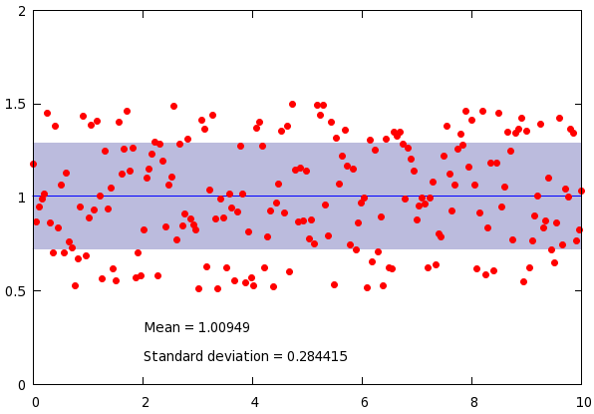
Mean and SD

Slide 10
Measure of central tendency: where the middle of data set is?
Median: point at which half data set is above and half below (interval or ratio data; i.e.: median home price)
Mode: score value with the highest frequency (categorical data, i.e. most frequent eye color is brown)

Slide 11
Measure of central tendency
Comparison of common averages of values { 1, 2, 2, 3, 4, 7, 9 }
Type | Description | Example | Result
Arithmetic mean | Sum of values of a data set divided by number of values: | (1+2+2+3+4+7+9) / 7 | 4
Median | Middle value separating the greater and lesser halves of a data set | 1, 2, 2, 3, 4, 7, 9 | 3
Mode | Most frequent value in a data set | 1, 2, 2, 3, 4, 7, 9 | 2

Slide 12
Measure of central tendency - examples
https://www.mathsisfun.com/median.html

Slide 13
Frequency Distribution
Grouped frequency distribution of data set: plotting
data on a graph
Normal distribution (Gaussian distribution):
bell-shaped curve; most scores are in the middle, very
high or very low scores to either side

Slide 14
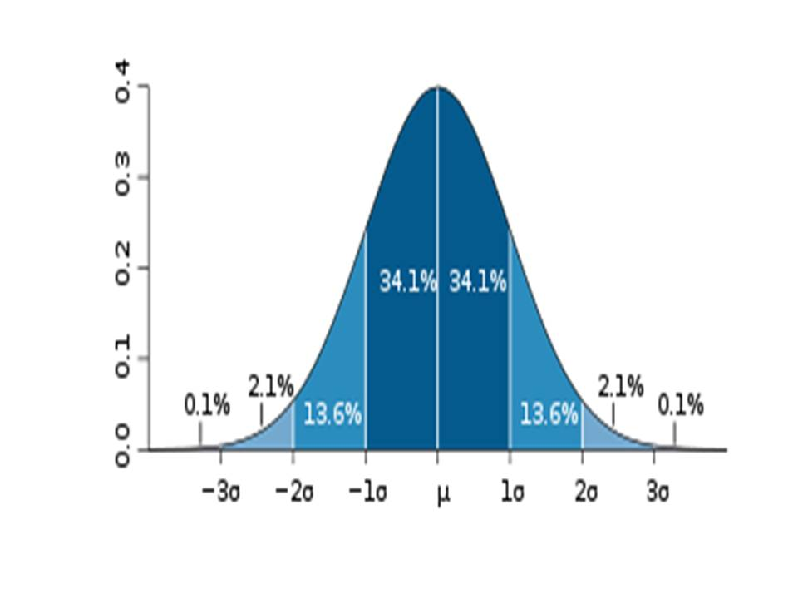
Gaussian distribution (Mean = Median = Mode)

Slide 15
Gaussian (normal) distribution: characteristics
(Mean = Median = Mode)
68% of data points are within 1 SD of the mean
95% of data points are contained within 2 SD
99.7% of data will be under 3 SD

Slide 16
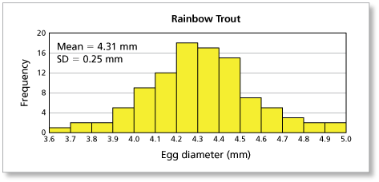
Gaussian distribution

Slide 17
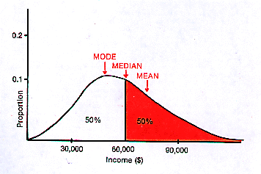

Slide 18
Inferential Statistics
Used to make inferences from population based on measuring a sample of that population
Useful to make estimations and to test hypotheses
Ex: voter survey
They select sample representative of population of interest. Based on sample, they estimate how the whole population will vote
Also tell amount of error (margin of error) within estimate
Confidence Interval (CI): how sure we are that our prediction is accurate

Slide 19
Inferential Statistics
Confidence Interval (CI): True score lies within the specified range 95% of the time
Null Hypothesis (H0): no difference between the means of groups compared in study (groups’ means are equal)
Alternate Hypothesis (H1): There is a difference between the means of the groups in study (means are not equal)

Slide 20
P – value (“p” stands for probability)
Probability that a result is due to chance
Smaller the p value, the more likely the results are not due to chance (i.e if we detect a difference between groups, this would be due to the treatment, not to chance)

Slide 21
Statistical Power
Power: Likelihood (probability) that a significant test will be able to detect an effect if present
Detection of small effects requires large sample sizes
Type 1 error (alpha error, or “false positive”): H0 is mistakenly rejected (conclude there is a difference between groups when in reality there is not)
Type 2 error (beta error, or “false negative:): does not reject H0 (concludes there is no difference when actually a difference exists)

Slide 22
Factors influencing Statistical Power
Total number of variables being measured (the larger the number of variables, the larger “n” or number of participants needed)
Confounding variables (associations)

Slide 23
Parametric vs. Non-parametric stats
Interval and ratio variables are assumed to be normally distributed (bell-shape) and therefore, analyzed using parametric statistics
Nominal and ordinal variables require counting number of individuals in each category. These data are analyzed using non-parametric statistics (distribution-free methods)

Slide 24
Types of Parametric tests
t-test: compares means of two groups relative to the average variability in each group:
Difference between group means
Variability of the groups
Analysis of Variance (ANOVA): compares means of multiple groups with same outcome measures
Variance between groups
Variance within groups

Slide 25
Types of Parametric tests (cont.)
Multiple Analysis of Variance (MANOVA): compares means of multiple groups with multiple outcome variables
Variance between groups
Variance within groups
ANOVA says that there is a difference somewhere between groups. It doesn’t say between which groups….

Slide 26
Post-hoc testing
Comparisons between 2 of the multiple groups
Bonferonni method
Tukey’s test
Scheffe’s test

Slide 27
Correlations
Methods to measure association between variables
No relationship: correlation = 0
Increasing linear relationship: correlation = 1
Decreasing linear relationship: correlation = -1
The closer the coefficient to 1 or -1, the stronger the association
Correlation coefficient: r

Slide 28
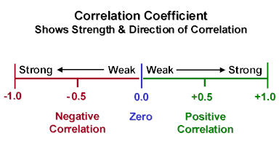
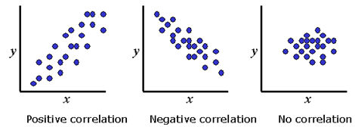
Correlations

Slide 29
Non-parametric tests
Comparisons between 2 of the multiple groups
Chi-square test
Fisher’s exact test
Mann-Whitney-U test
Wilcoxon rank sum test

