Slide 1
Pathophysiology 2
Skeletal System Conditions

Slide 2
Congenital Orthopedic Disorders & Diseases
Disorders that affect the musculoskeletal system
AKA orthopedic birth defects
Occur while the baby is still developing in the womb and appear at birth.
Caused by a wide range factors
  gene abnormalities
  toxin ingestion
  disease and illness during pregnancy
different types and may be characterized by different symptoms
may or may not require treatment

Slide 3
Topics Covered
Metatarsus Adductus
Clubfoot
Developmental Dysplasia of the Hip (DDH)
Congenital Limb Defects
Osteogenesis Imperfecta
Muscular Dystrophy

Slide 4
Metatarsal Adductus
(AKA metatarsus varus)
  common foot deformity noted at birth that causes the forefoot, deviate medially
2 Types
  "flexible" (the foot can manually be straightened to a degree)
  "nonflexible" (the foot cannot be straightened manually).

Slide 5
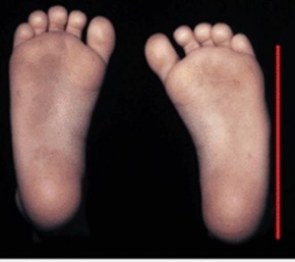

Slide 6
Cause & Statistics
Unknown etiology
Occurs in approximately 1 to 2 per 1,000 live births
More common in firstborn
Increased risk for developmental dysplasia of the hip (DDH)

Slide 7
Diagnosis & Treatment
Diagnosis of metatarsus adductus is made with a physical examination, complete birth history and family history of M.A.
X-rays often done in the case of nonflexible metatarsus adductus
An infant with metatarsus adductus has a high medial arch and the big toe has a wide separation from the second toe and deviates medially.
Specific treatment for metatarsus adductus will be determined based on:
  Age, overall health, and medical history
  extent of the condition

Slide 8
Goals of Treatment
Straighten the position of the forefoot and heel
Treatment options vary for infants and may include:
  Observation, for those with a supple, or flexible, forefoot
  Stretching or passive manipulation exercises (joint mobilizations)
  Casts
  Surgery
Studies have shown that metatarsus adductus may resolve spontaneously in the majority of affected children.
https://youtu.be/CpUR0ocGIKc

Slide 9
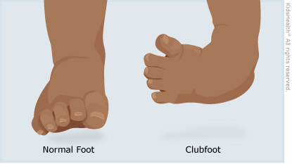
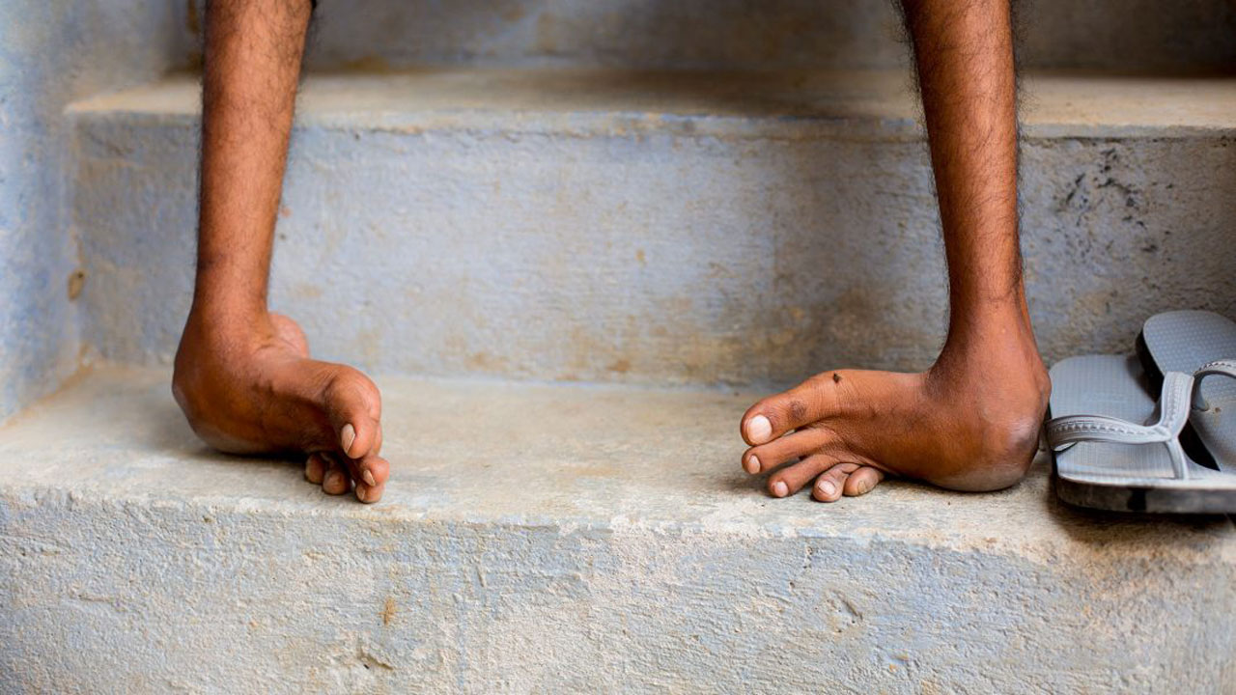
Club Foot

Slide 10
Club Foot
Congenital foot deformity
Affects bones, muscles, tendons, and blood vessels
one or both feet
Foot is usually short and broad in appearance and the heel points downward while the forefoot turns inward. Achilles tendon is tight
Painless condition

Slide 11
Causes
Clubfoot is considered a "multifactorial trait."
Factors are usually both genetic and environmental. Risk factors may include:
  Family history of clubfoot
  Multiple gestations (twins or triplets)
  Position of the baby in the uterus
  Increased occurrences in those children with neuromuscular disorders.
  decreased amount of amniotic fluid surrounding the fetus in the uterus during pregnancy
Babies born with clubfoot may also be at increased risk of DDH

Slide 12
Statistics
Clubfoot occurs in approximately 1 to 3 of every 1,000 births, with boys outnumbering girls 2 to 1
One or both feet may be affected.

Slide 13
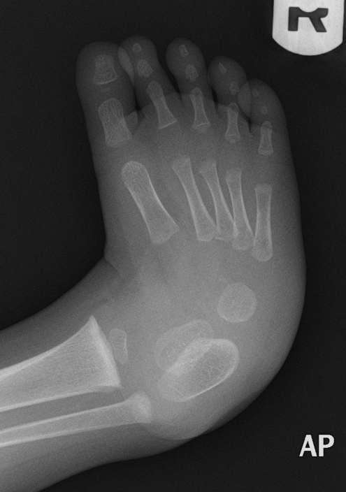
Diagnosis
Made with a physical examination
Doctor obtains a complete prenatal and birth history & any family history of clubfoot
X-ray of foot may be done

Slide 14
Treatment Options
The goal of treatment is to straighten the foot so that it can grow and develop normally.
Treatment options for infants include:
  Nonsurgical treatment:
    These methods include serial manipulation and casting, taping, physical therapy and splinting, and use of a machine that provides continuous passive motion.
  A nonsurgical treatment should be the first type of treatment for clubfoot,
  Surgery:
    Used when nonsurgical treatment fails, or when deformity recurs and does not respond to nonsurgical treatment.
    https://youtu.be/Z4errSBsD7M

Slide 15
Developmental Dysplasia of the Hip (DDH)
Congenital condition of the hip joint
The hip socket may be shallow, letting the femoral head, slip in and out of the socket. The "ball" may move partially or completely out of the hip socket.

Slide 16
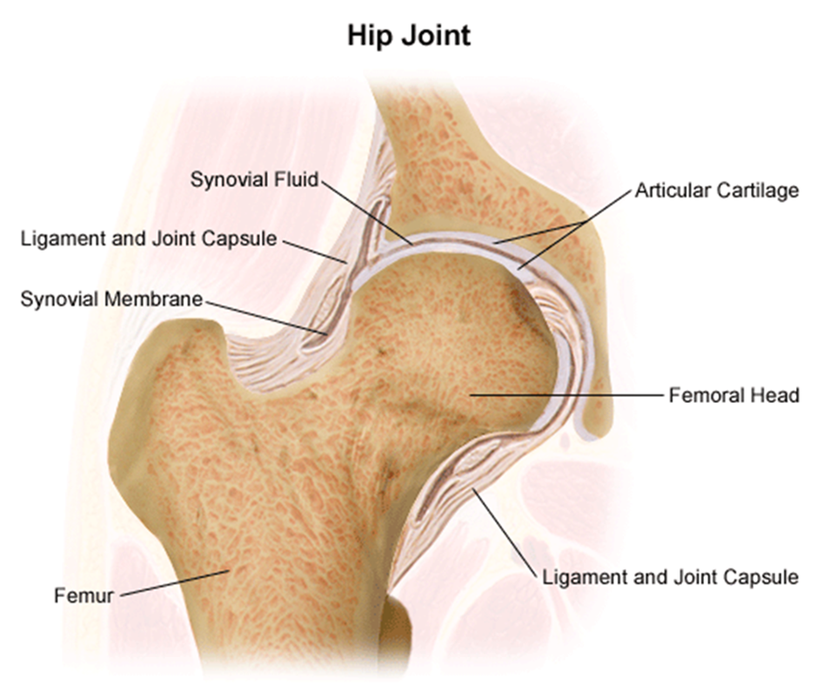

Slide 17
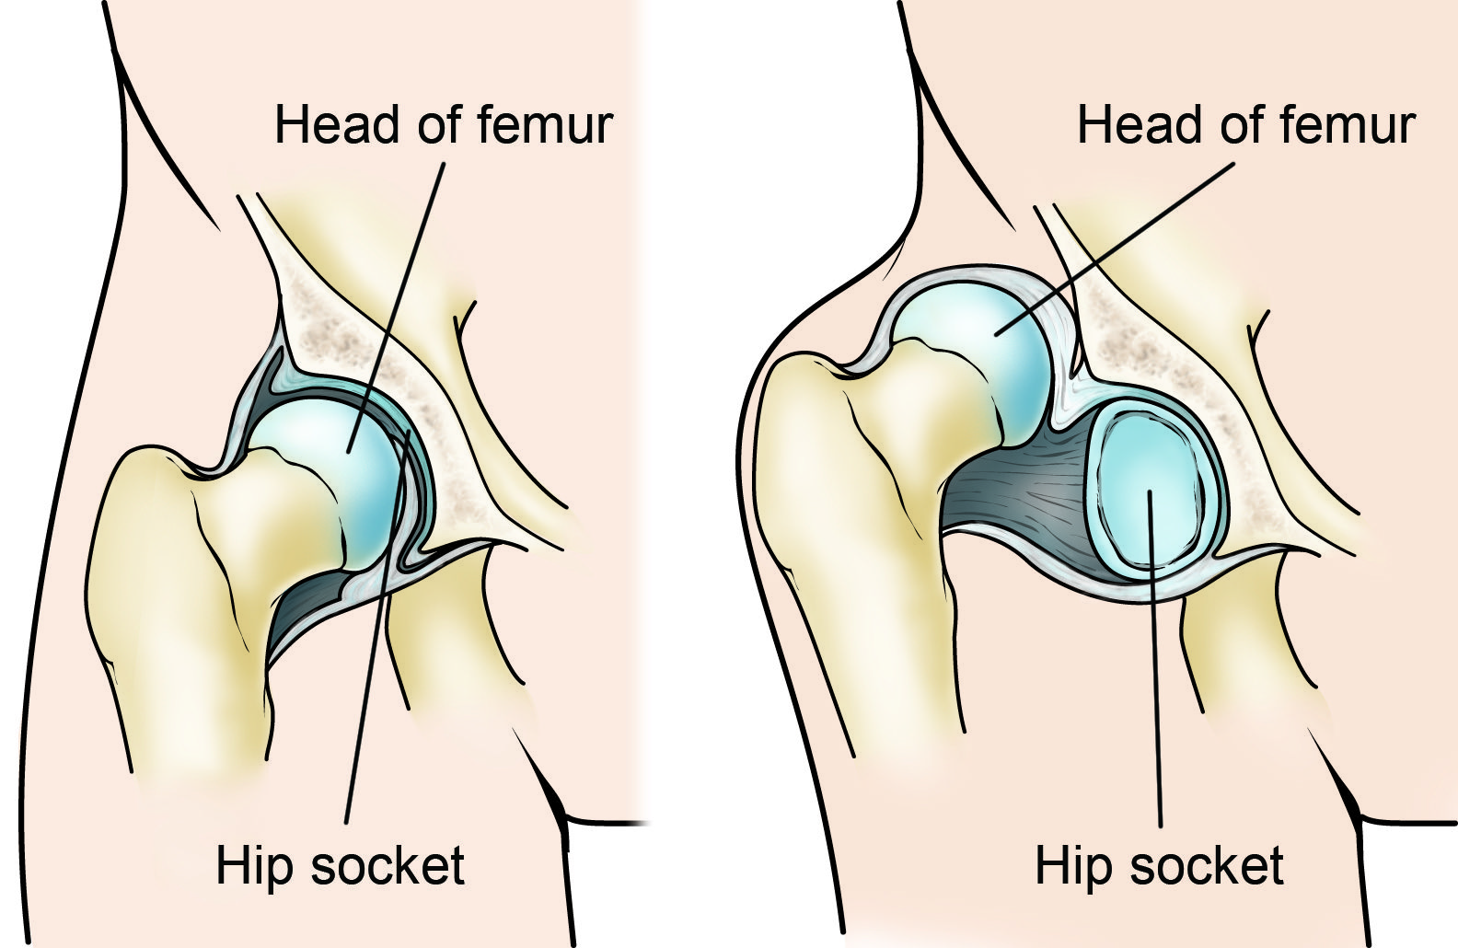
DDH

Slide 18
Causes
Considered a "multifactorial trait."
Environmental influences thought to contribute as the baby's response to the mother's hormones during pregnancy
Tight uterus that prevents fetal movement or a breech delivery. Left hip is involved more frequently than the right due to intrauterine positioning
First-born babies are at higher risk
Family history of developmental dysplasia of the hip
very flexible ligaments

Slide 19
Symptoms
Symptoms may include:
  The leg may appear shorter on the side of the dislocated hip
  The leg on the side of the dislocated hip may turn outward
  The folds in the skin of the thigh or buttocks may appear uneven
  The space between the legs may look wider than normal

Slide 20

Continued
May have a hip that is partially or completely dislocated
Sometimes noted at birth. However, DDH may not be discovered until later evaluations.

Slide 21
Statistics
The greatest incidence of DDH occurs in first-born females with a history of a close relative with the condition
occurs once in every 1,000 live births.

Slide 22
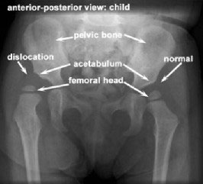
Diagnoses
Diagnostic procedures may include:
  X-ray.
  Ultrasound

Slide 23
Treatment
The goal of treatment is to put the femoral head back into the socket of the hip so that the hip can develop normally.
Treatment options:
  Nonsurgical positioning is used on babies up to 6 months of age to hold the hip in place, while allowing the legs to move a little.
  Casting- If the hip continues to be partially or completely dislocated, casting, or surgery may be required.
  Surgery- If the other methods are not successful, or if DDH is diagnosed at age 6 months to 2 years, surgery may be required.

Slide 24
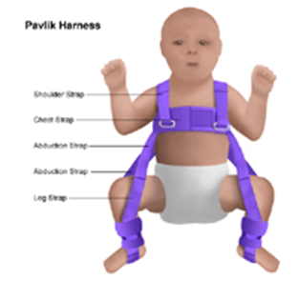
Pavlik Harness

Slide 25
Osteogenesis Imperfecta
AKA - brittle-bone disease
Genetic disorder characterized by bones that break easily without a specific cause.
Can affect males and females of all races
Believed to be because of a genetic defect that causes imperfectly formed or an inadequate amount of bone collagen
To date, no known treatment, medicine, or surgery will cure
The goal of treatment is to prevent deformities and fractures and allow the child to function as independently as possible.

Slide 26
Treatment
  Care of fractures
  Surgery
  Rodding, a procedure to insert a metal bar the length of a long bone to stabilize it and prevent deformity
  Dental procedures
  Physical therapy
  Assistive devices

Slide 27
Muscular Dystrophy
Causes the muscles in the body to become very weak
Muscles break down and are replaced with fatty deposits over time.
Most common forms of muscular dystrophy are Duchenne muscular dystrophy (DMD) and Becker muscular dystrophy.
Very similar, but Becker muscular dystrophy is less severe
Girls are rarely affected by either of these two forms of muscular dystrophy.
Muscular dystrophy is usually diagnosed in children between 3 and 6 years of age.

Slide 28
Signs & Symptoms
Early signs
  delay in walking, difficulty rising from a sitting or lying position, and frequent falling
  weakness typically affecting the shoulder and pelvic muscle are one of the initial symptoms

Slide 29
Other S & S
The following are the most common symptoms of muscular dystrophy
  Difficulty climbing stairs
  Frequent falls
  Unable to jump or hop normally
  toe walking
  Leg pain
  Facial weakness
  Inability to close eyes or whistle

Slide 30
Diagnoses
Diagnostic tests may include:
  Blood tests. These include genetic blood tests.
  Muscle biopsy. The primary test used to confirm diagnosis
  Electromyogram (EMG). A test to check if the muscle weakness is a result of destruction of muscle tissue rather than nerve damage.
  Electrocardiogram (ECG or EKG). A test that records the electrical activity of the heart, shows abnormal rhythms (arrhythmias or dysrhythmias), and detects heart muscle damage.

Slide 31
Treatment
To date, there is no known treatment, medicine, or surgery
Treatment is to prevent deformity and allow the child to function as independently as possible

Slide 32
Continued
Nonsurgical interventions may include:
  Physical therapy
  Positioning aids used to help the child sit, lie, or stand
  Braces and splints used to prevent deformity, promote support, or provide protection
  Medications
  Nutritional counseling
  Psychological counseling
  https://youtu.be/DGOmN6rnsNk
  https://youtu.be/ztg7hzVgQrw

Slide 33
Fractures
fracture is a broken bone
may be completely fractured or partially fractured in any number of ways (crosswise, lengthwise, in multiple pieces)
severity depends on the force
If bone fragments stick out through the skin, or a wound penetrates called an "open" fracture
once the skin is broken, infection in both the wound and the bone can occur

Slide 34
Types of Fractures
Stable fracture
  The broken ends of the bone line up and are barely out of place.
Open, compound fracture
  breaks the skin at the time of the fracture. The bone may or may not be visible in the wound
Transverse fracture
  horizontal fracture line
Oblique fracture
  angled pattern
Comminuted fracture
  bone shatters into three or more pieces

Slide 35
Pediatric fractures
The anatomy and biomechanics of pediatric bone differ from that of adult bone, leading to unique pediatric fracture patterns, healing mechanisms, and management
pediatric bone less dense, more porous and penetrated throughout by capillary channels
The mechanisms of fracture change as children age.
Younger children likely to sustain a fracture while playing and falling on an outstretched arm
Older children tend to injure themselves while playing sports, riding bicycles, and in motor vehicle accidents.
Child ligaments are stronger than those of an adult, forces which would tend to cause a sprain in an older individual will be transmitted to the bone and cause a fracture in a child.

Slide 36
Common Pediatric Fractures
Buckle fracture
  Compression failure of bone that usually occurs at the junction of the metaphysis and the diaphysis
  Commonly seen in distal radius.
  stable
  Heal in 3-4 weeks with simple immobilization.
Greenstick fracture
  Bone is bent and the tensile/convex side of the bone fails.
  Fracture line does not propagate to the concave side of the.

Slide 37
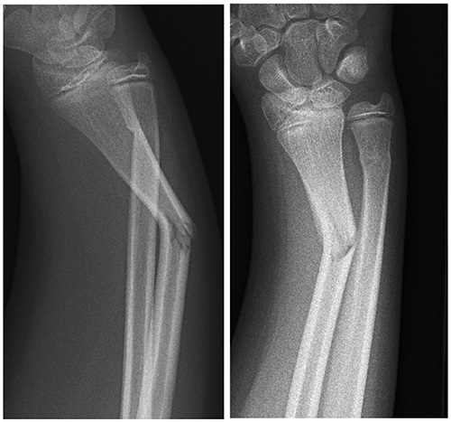

Slide 38
Complete Fractures
Fracture completely propagates through the bone
  spiral, transverse, or oblique, depending on the direction of the fracture line.
Spiral fractures:
  Created by a rotational force.
  Low-velocity injuries
  An intact periosteal hinge enables the orthopedic surgeon to reduce the fracture by reversing the rotational injury.
Oblique fractures:
  Unstable, therefore alignment is necessary.
  Fracture reduction is attempted by immobilizing the extremity while applying traction.]
Transverse fractures:
  Created by a 3-point bending force.
  Easily reduced by using the intact periosteum from the concave side of the fracture force.

Slide 39
Congenital Scoliosis
Lateral deviation of the spinal column that may or may not include rotation or deformity of the vertebrae
Disturbances in vertebral development during the sixth to eighth week development

Slide 40
Bone Tumors
Tumors occur when cells divide abnormally and uncontrollably.
Bone tumors form in your bones. As the tumor grows, abnormal tissue can displace healthy tissue
  Benign Tumors
    won’t spread to other parts of the body and are unlikely to cause death, they can still be dangerous and may require treatment
  Malignant Tumors
    can cause cancer to spread throughout the body.

Slide 41
Benign Bone Tumors
Osteochondromas
  most common
  Between 35 and 40% of all benign bone tumors
  Develop in adolescents and teenagers
  Formed of a combination of bone and cartilage
  considered to be an abnormality of growth
  may develop one or many

Slide 42
CONTINUED
Non-Ossifying Fibroma
  non-aggressive
  Consists mainly of fibrous tissue
  usually occurs in the Femur or Tibia
  usually produces no symptoms and resolves by itself

Slide 43
Contined
Giant Cell Tumors
  Aggressive but rare
  Grows at the ends of the body's long bones. Most often, the lower end of the femur or upper end of the tibia, close to the knee joint.
  typically occur in young adults, and are slightly more common in females
  can destroy the surrounding bone. Treatment for a giant cell tumor almost always involves surgery

Slide 44
Malignant Bone Tumors
Primary bone cancer = originated in the bones. Primary bone cancer accounts for less than one percent of all types of cancer. The three most common forms of primary bone cancers are:
  1) Osteosarcoma:
  occurs mostly in children and adolescents
  second most common type
  usually develops around the hip, shoulder, or knee near growth plates of bones
  Aggressive and likely to spread to other parts of the body
  AKA osteogenic sarcoma.

Slide 45
Primary bone cancers Continued
2) Ewing sarcoma
  Adolescents and young adults, but can sometimes affect children as young as 5 years old.
  Usually shows up in the legs, pelvis, Spine, ribs, and upper arms and in the skull. It begins in the medullary cavities
  African American children seldom develop Ewings sarcoma
  More common boys than girls
  Rapidly growing and spreading tumor.
3) Chondrosarcoma
  Middle-aged people and seniors
  Hips, shoulders, and pelvis are the usual areas for this type of bone cancer

Slide 46
Secondary Bone Cancers
cancer started somewhere else in the body and then spread to the bone. It usually affects older people. The types of cancer most likely to spread to your bones are:
  kidney
  breast
  prostate
  lung
  thyroid gland
Most common type of secondary bone cancer is multiple myeloma:
  Tumors in the bone marrow
  People between the ages of 50 and 70 are most commonly affected

Slide 47
Osteomyelitis
Infection in a bone
can reach a bone by traveling through the bloodstream ,spreading from nearby tissue or begin in the bone itself if an injury exposes the bone to germs
In children, most commonly affects the long bones of the legs and upper arm, while adults are more likely to develop osteomyelitis in the vertebra
Diabetics may develop osteomyelitis in their feet if they have foot ulcers
Once considered an incurable condition, it can be successfully treated today
  Treatment includes surgery to remove parts of the bone that have died, followed by strong antibiotics delivered intravenously for at least six weeks. Different types of bacteria typically affect the different age groups.

Slide 48
Signs & Symptoms
Fever or chills
Irritability or lethargy in young children
Pain in the area of the infection
Swelling, warmth and redness over the area of the infection
Sometimes causes no signs /symptoms or has signs /symptoms that are difficult to distinguish from other problems.

Slide 49
Causes
Most cases are caused by staphylococcus bacteria
Germs can enter a bone in a variety of ways, including:
  Via the bloodstream
    Germs in other parts of your body(ex – UTI) can travel through your bloodstream to a weakened spot in a bone. In children, osteomyelitis most commonly occurs in the growth plates
  From a nearby infection
    Severe puncture wounds can carry germs deep inside your body. If such an injury becomes infected, the germs can spread into a nearby bone.
  Direct contamination
    EX – open Fracture, during surgeries

Slide 50
Diagnoses and Treatment
Blood tests
Imaging tests: X-rays, CT, MRI
Bone biopsy
Most common Tx are
  Antibiotics
  surgery to remove portions of bone that are infected or dead
  Hospitalization is usually necessary

Slide 51
Growth Disorders
Any type of problem in infants, children, or teenagers that prevents normal growth, which depends upon several factors including:
  nutrition
  genetics
  hormones.
Hormones are necessary for normal growth and development, they regulate:
  body's growth
  Metabolism
  sexual development and function.

Slide 52
Continued
Hormonal causes of growth disorders include
  thyroid hormone deficiency (hypothyroidism)
  growth hormone deficiency
  hypopituitarism
  or other hormone disorders.
some growth problems are not necessarily growth disorders; normal variants of growth patterns include genetic short height and slow growth/delayed puberty
Growth hormone deficiency involves the pituitary gland.( produces GH and other hormones) GH is necessary for normal growth and development in children. In adults, growth hormone is needed to maintain the proper amounts of body fat, muscle, and bone.
Growth hormone deficiency can occur at any age. In children growth will be slower than normal.In adults, low or absent growth hormone can also cause emotional symptoms, such as tiredness and lack of motivation.
Hypopituitarism occurs if other pituitary hormones are absent or present in inadequate amounts

Slide 53
Cause
low or absent secretion of GH from the pituitary gland
May be present at birth
May develop after birth due to:
  trauma, infections, radiation to the head, or tumors
Adults with GH deficiency usually have a history of pituitary tumors treated with surgery or radiation
In some cases, no cause can be identified.

Slide 54
Metabolic Bone Disorders
Disorders of bone strength, usually caused by abnormalities of minerals vitamin D, bone mass or bone structure
Can affect people of all ages
Most common disorders include
  Osteoporosis (most common of all) untreated, it can lead to fragility fractures, bone deformities and serious disability. Those at high risk for osteoporosis include patients with old age, small body size, family history, steroid use, intestinal diseases, organ transplants, smoking, postmenopausal, and kidney disorders.
  Osteomalacia: Inadequate mineralization of bone results from a calcium or phosphate deficiency, or both.
  Rickets: disorder of vitamin D deficiency, inadequate calcium absorption, and impaired mineralization of bone in children.
  Paget Disease:
  progressive skeletal disorder that involves excessive bone destruction and repair, Characterized by increasing structural changes of the long bones, spine, pelvis, and cranium

Slide 55
Associated conditions
Metabolic and endocrine diseases associated with joint symptoms:
  Gout syndrome
  Osteogenesis imperfecta
  Diabetes mellitus
  Hyperparathyroidism
  Thyroid disease
  AIDS
  Hypermobility syndromes

Slide 56
Pagets Disease
Paget’s disease (PD) (osteitis deformans)
2nd most common metabolic bone disease
Characterised by a disturbance in bone modelling and remodelling due to an increase in osteoblastic and osteoclastic activity.
more common in people of Anglo Saxon origin
less common in individuals from the Far East, India, Middle East and Africa
The overall prevalence of PD is 3–3.7% and increases with age. By the age of 90 years, the prevalence increases to about 10%.
the etiology can variously classified as an infection, metabolic disorder or a neoplastic process. However, as the unaffected skeleton is metabolically normal, it does not fulfill the criteria for a true metabolic bone disorder.

Slide 57
Signs and Symptoms
Bone pain, deformity, fracture, and arthritis
  pain of Paget's disease is located in the affected bone, most commonly; spine, femur, pelvis, skull, clavicle, humerus.
The symptoms depend on the bones affected and the severity of the disease
  Enlarged bones can pinch adjacent nerves, causing tingling and numbness
  Bowing of the legs can occur
  Hip or knee involvement can lead to arthritis, limping, as well as pain and stiffness of the hip or knee
  Headache, loss of vision, and hearing loss can occur when the bones of the skull are affected.

Slide 58
Connective Tissue and Joint pathology
Arthritis
  Types of Arthritis:
    Osteoarthritis
    Rheumatoid arthritis
    Juvenile arthritis
    Psoriatic arthritis
    Gout

Slide 59
Osteoarthritis (OA)
AKA degenerative joint disease (DJD) or degenerative arthritis
most common chronic condition of the joints
affecting approximately 27 million Americans
Occurs in people of all ages, OA is most common in people older than 65.
Breakdown in the cartilage covering the ends of bones where they meet to form a joint. Bones become exposed and rub against each other
Deterioration of cartilage also affects the shape and makeup of the joint so that it no longer functions smoothly.
Other problems can occur inside the joint as cartilage breakdown affects the joint components. Fragments of bone or cartilage may float in joint fluid, causing irritation and pain. Spurs, or osteophytes, can develop on the ends of the bones, damaging surrounding tissues and causing pain. Fluid inside the joint may not have enough of a substance called hyaluronan, which may affect the joint’s ability to absorb shock. And although inflammation is not a main symptom of osteoarthritis, it can occur in the joint lining in response to the cartilage breakdown

Slide 60
Symptoms & Causes
vary, depending on which joints and how severely they are affected
most common symptoms are:
  Stiffness, particularly first thing in the morning or after resting, and pain.
most commonly affected joints are
  lower back,
  hips
  knees
  Feet
Other commonly affected joints are:
  neck and fingers, including the thumb base (making it difficult to grasp and hold objects, or to do delicate tasks
Has no single, specific cause.
Progressive and when it becomes severe it can severely affect an individuals day-to-day activities.

Slide 61
Risk Factors
Genetics/Age/Gender/Race
Childhood hip diseases including:
  DDH, Legg-Calve-Perthe’s Disease and slipped capital femoral epiphysis
Acquired conditions; ex: avascular necrosis can result in hip arthritis if left untreated or if treatment fails.
Variations in hip anatomy; ex: femoroacetabular impingement can cause the hip to become arthritic.
Severe trauma. Fractures or traumatic dislocations
Obesity

Slide 62
OA & the SI Joint
OA is the most common cause of SI joint dysfunction.
Pregnancy is a common cause of SI joint dysfunction. During pregnancy, hormones are released in the woman's body that allows ligaments to relax in order to prepare the body for childbirth. Relaxation of the ligaments holding the SI joints together allows for increased motion in the joints and can lead to increased stress and abnormal wear. The additional weight and altered gait associated with pregnancy also places additional stress on the SI joints.
Any condition that alters the normal walking pattern places increased stress on the SI joint, including:
  leg length discrepancy
  pain in the hip, knee, ankle, or foot
Patients with severe pain in the lower extremity often develop problems with either the lumbar spine or SI joints. In most cases, if the underlying problem is treated the associated lumbar spine or SI joint dysfunction will also improve.

Slide 63
Rheumatoid Arthritis (RA)
Though RA affects the joints; it’s a disease of the immune system. RA causes the immune system to go awry and mistakenly attack healthy cells such as the synovium. As a result, fluid builds up in the joints, causing pain and inflammation.
Over time this can wear away the cartilage and erode bone, causing a lack of function and mobility. In most people, the inflammation usually becomes systemic, affecting organs such as the skin, heart and lungs.
RA most commonly affects the hands, feet, wrists, elbows, knees and ankles.
Joint involvement is usually symmetrical
no cure - its symptoms often come and go
Affects an estimated 1.5 million Americans
  3 x more women than men
  Usual age for adult onset is between 40 and 60 years, can begin at any age

Slide 64
Diagnoses & Signs and Symptoms
Medical history
Physical examination:
  look for swelling, warmth, tenderness and limited motion in joints, or nodules under the skin.
Signs and symptoms:
  Regular morning joint stiffness
  Persistent joint pain that does not improve
  Joint pain that is getting worse over time
  Joints that are swollen, red, hot or tender to the touch
  Joint pain accompanied by fever
  Several affected joints
  Joint problems that affect ability to move or function
  The "rheumatoid factor" is an antibody that can be found in the blood of 80% of people with rheumatoid arthritis.

Slide 65
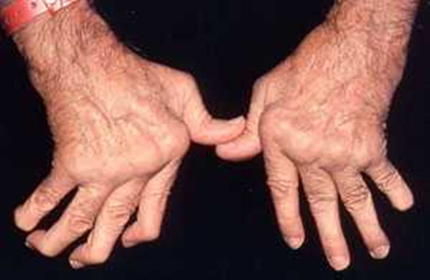
RA in the hands

Slide 66
Juvenile Idiopathic Arthritis (JIA)
Begins before age 16 and involves swelling in one or more joints lasting at least six weeks.
Symptoms include:
  muscle and soft tissue tightening
  bone erosion
  joint misalignment
  changes in growth patterns
Not all symptoms are shared by all children with the disease
Symptoms can change from day to day
Diagnosis of JIA is based on physical exam, lab tests and medical history. In addition to watching for symptoms for at least six weeks

Slide 67
Psoriatic Arthritis (PsA)
autoimmune disease
a form of inflammatory arthritis that can cause pain, swelling and sometimes damage to any joint in the body. It typically appears in people who have psoriasis, a chronic disease characterized by a scaly, reddish skin rash that usually appears on the elbows, knees and scalp
most commonly associated with joints, it is a systemic condition,over time it can affect multiple joints and even organs.

Slide 68
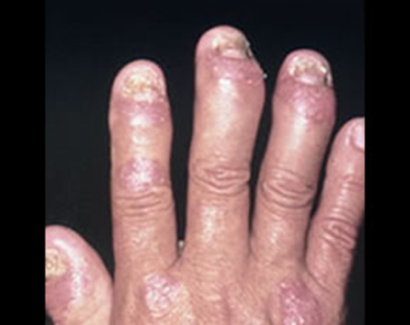
PsA

Slide 69
Gout
characterized by sudden, severe attacks of pain, redness and tenderness in joints, often the joint at the base of the big toe.
can affect anyone. Men are more likely but women become increasingly susceptible to gout after menopause
An acute attack of gout can wake the patient up in the middle of the night due to pain. The affected joint is hot, swollen and so tender that even the weight of the sheet on it may seem intolerable.
Treatable
Signs and symptoms include:
  intense joint pain most severe within first 12 -24 hours
  usually affects the joint of big toe, but it can occur in the feet, ankles, knees, hands and wrists
  Lingering discomfort. After the most severe pain subsides, some joint discomfort may last from a few days to a few weeks. Later attacks are likely to last longer and affect more joint
  Inflammation and redness

Slide 70
Causes Complications & Risk Factors
urate crystals accumulate in the joint, creating sharp, needle-like urate crystals in a joint or surrounding tissue that cause intense pain, inflammation and swelling. Urate crystals can form when there is high levels of uric acid in the blood. The body produces uric acid when it breaks down purines as well as in certain foods, such as organ meats, anchovies, herring, asparagus and mushrooms.
Urate crystals may collect causing kidney stones,
Factors that increase the uric acid level in the body include:
  Lifestyle factors. Excessive alcohol use — generally more than two drinks a day for men and more than one for women — increases the risk of gout.
  Medical conditions. Certain diseases and conditions. These include untreated hypertension, chronic conditions (diabetes), hyperlipidemia, arteriosclerosis
  Certain medications. The use of thiazide diuretics (treat hypertension , low-dose aspirin, anti-rejection drugs can increase uric acid
  Family history of gout.
  Age and sex

Slide 71
Rheumatic Fever
an inflammatory disease that can develop as a complication of inadequately treated streptococcal throat infection or scarlet fever, caused by group A streptococcus bacteria
most common in 5- to 15-year-old children
strep throat is common, rheumatic fever is rare in developed countries. but common in many developing nations
Can cause permanent damage to the heart, including damaged heart valves and heart failure
Tx can reduce tissue damage from inflammation, lessen pain and other symptoms, and prevent reoccurance
symptoms may vary. Some people may have several symptoms, others experience few. Symptoms may change during the course of the disease
onset of rheumatic fever usually occurs about two to four weeks after a strep throat infection

Slide 72
Signs and Symptoms
Fever
Painful and tender joints — most often the ankles, knees, elbows or wrists; less often the shoulders, hips, hands and feet
Pain in one joint that migrates to another joint
Red, hot or swollen joints
Small, painless nodules beneath the skin
Chest pain
Heart murmur
Fatigue
Flat or slightly raised, painless rash with a ragged edge
Jerky, uncontrollable body movements most often in the hands, feet and face

Slide 73
Risk Factors
Family history – may carry a gene or genes that make them more likely to develop rheumatic fever.
Type of strep bacteria
Environmental factors - overcrowding, poor sanitation and other conditions that result in the rapid transmission or multiple exposures to strep bacteria.

Slide 74
Complications of inflammation
Inflammation caused by rheumatic fever may last for a few weeks to several months. Inflammation may cause long-term complications. The damage may result in one of the following conditions:
  Valve stenosis
    narrowing of the valve, which results in decreased blood flow.
  Valve regurgitation.
    leak in the valve, which allows blood to flow in the wrong direction.
  Damage to heart muscle.
    weaken the heart muscle, resulting in poor pumping function.
Damage to the mitral valve, other heart valves or other heart tissues can cause problems with the heart later in life. Resulting conditions may include:
  Atrial fibrillation
    an irregular and chaotic beating of the atria
  Heart failure
    inability of the heart to pump enough blood to the body
Notes:
The exact link between strep infection and rheumatic fever isn't clear, but it appears that the bacterium "plays tricks" on the immune system. The strep bacterium contains a protein similar to one found in certain tissues of the body. Therefore, immune system cells that would normally target the bacterium may treat the body's own tissues as if they were infectious agents — particularly tissues of the heart, joints, skin and central nervous system. This immune system reaction results in inflammation.

Slide 75
Systemic Lupus Erythematosus
See Immunologic Dysfunctions' for description
No two cases of lupus are exactly alike
Signs and symptoms may come on suddenly or develop slowly, may be mild or severe, and may be temporary or permanent. Most people with lupus have mild disease characterized by flares.
The most common signs and symptoms include:
  Fatigue and fever
  Joint pain, stiffness and swelling
  Butterfly-shaped rash on the face that covers the cheeks and bridge of the nose
  Skin lesions that appear or worsen with sun exposure
  Raynaud's phenomenon
  Shortness of breath
  Chest pain
  Dry eyes
  Headaches, confusion, memory loss

Slide 76
Risk Factors
Sex - more common in women.
Age - most often diagnosed between the ages of 15 and 40
Race - more common in African Americans, Hispanics and Asians.

Slide 77
Complications
Kidneys -serious kidney damage, and kidney failure is one of the leading causes of death among people with lupus. S & S may include generalized itching, chest pain, nausea, vomiting and edema
Brain - causes headaches, dizziness, behavior changes, hallucinations, strokes or seizures, memory problems and may have difficulty expressing their thoughts.
Blood and blood vessels - blood problems, including anemia and increased risk of bleeding or blood clotting, vasculitis
Lungs - pleurisy
Heart.- inflammation of the heart muscle, arteries or pericarditis, cardiovascular disease and heart attacks increases
Infection - more vulnerable to infection because both the disease and its treatments weaken the immune system. Infections include urinary tract infections, respiratory infections, yeast infections, salmonella, herpes and shingles.
Bone tissue death - avascular necrosis, The hip joint is most commonly affected.
Pregnancy complications - increased risk of miscarriage, preeclampsia and preterm birth.

Slide 78
Scleroderma
A group of rare diseases that involve the hardening and tightening of the skin and connective tissues.
Caused by an overproduction and accumulation of collagen in body tissues.
In some scleroderma affects only the skin. But can also harm blood vessels, internal organs and the digestive tract
Affects women more often than men
most commonly occurs between the ages of 30 and 50
No cure for scleroderma, but treatments can ease symptoms and improve quality of life.

Slide 79
Signs & Symptoms
Skin -hardening and tightening of patches of skin, which may be shaped like ovals or straight lines. number, location and size of the patches vary by type. Skin can appear shiny and movement of the affected area may be restricted.
Fingers or toes - exaggerated response to cold temperatures or emotional distress, which can cause numbness, pain or color changes in the fingers or toes. Called Raynaud's phenomenon.
Digestive system - acid reflux, which can damage the section of esophagus nearest the stomach, some people with scleroderma may also have problems absorbing nutrients if their intestinal muscles aren't moving food properly through the intestines.
Heart, lungs or kidneys. Rarely, scleroderma can affect the function of the heart, lungs or kidneys. These problems can become life-threatening.

Slide 80
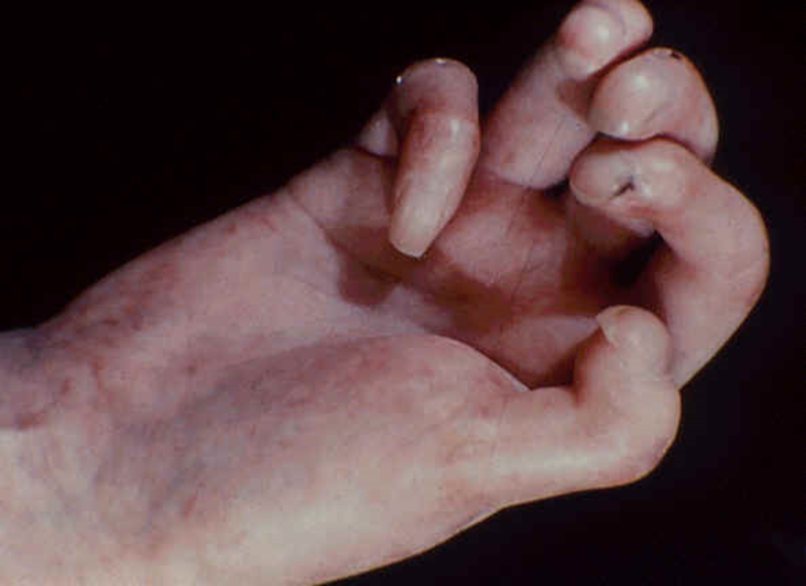
Scleroderma Hand

Slide 81
Acromegaly
hormonal disorder that develops when the pituitary gland produces too much growth hormone during adulthood causing the bones to increase in size, including those of the hands, feet and face. Acromegaly usually affects middle-aged adults.
In children who are still growing, too much growth hormone can cause a condition called gigantism. These children have exaggerated bone growth and an abnormal increase in height.
If not treated promptly, acromegaly can lead to serious illness and even become life-threatening.

Slide 82
Signs and Symptoms
One of the most common signs of acromegaly is enlarged hands and feet. People with this disorder often notice that they can no longer put on rings that used to fit and that their shoe size has progressively increased.
Acromegaly may also cause gradual changes in the shape of the face, such as a protruding lower jaw and brow, an enlarged nose, thickened lips. Acromegaly may produce the following signs and symptoms, which can vary from one person to another:
  Enlarged hands and feet
  Coarsened, enlarged facial features
  Coarse, oily, thickened skin
  Excessive sweating and body odor
  Small outgrowths of skin tissue (skin tags)
  Fatigue and muscle weakness
  A deepened, husky voice due to enlarged vocal cords and sinuses
  Severe snoring due to obstruction of the upper airway
  Impaired vision
  Headaches
  Enlarged tongue
  Pain and limited joint mobility
  Menstrual cycle irregularities in women
  Erectile dysfunction
  Enlarged liver, heart, kidneys, spleen and other organs
  Increased chest size (barrel chest)

Slide 83
Complications
Hypertension
Cardiovascular disease, particularly enlargement of the heart (cardiomyopathy)
Osteoarthritis
Diabetes mellitus
Polyps on the lining of the colon
Sleep apnea
Carpal tunnel syndrome
hypopituitarism
Uterine fibroids, benign tumors in the uterus
Spinal cord compression
Vision loss

Slide 84
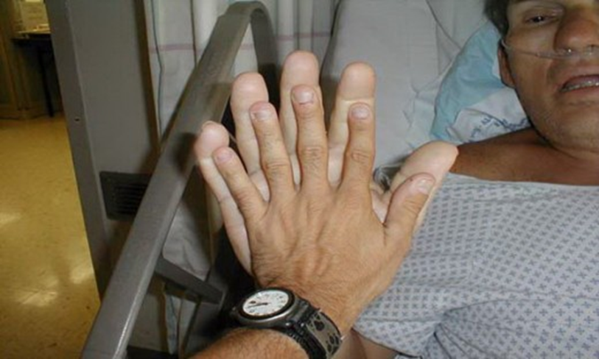
Acromegaly

Slide 85
Polymyositis
uncommon inflammatory disease that causes muscle weakness affecting both sides of the body.
can make it difficult to climb stairs, rise from a seated position, lift objects or reach overhead
most commonly affects adults in their 30s - 50s
more common in African Americans than in Caucasian's
women are affected more often than men
Develops gradually, over weeks or months
The muscle weakness involves the muscles closest to the trunk, such as those in hips, thighs, shoulders, upper arms and neck. The weakness affects both the left and right sides of the body
The exact cause is unknown, but the disease shares many characteristics with autoimmune disorders

Slide 86
Complications
Dysphagia - If the esophageal muscles are affected, which in turn may cause weight loss and malnutrition.
Aspiration pneumonia - Difficulty swallowing may also cause aspiration of food or liquids, including saliva, into the lungs, which can lead to pneumonia.
Breathing problems - If the chest muscles are affected by the disease, the patient may experience breathing problems, such as shortness of breath or, in severe cases, respiratory failure.
Calcium deposits - Late in the disease, deposits of calcium can occur in the muscles, skin and connective tissues (calcinosis).

Slide 87
Associated Conditions
Raynaud's phenomenon
Other connective tissue diseases such as lupus, rheumatoid arthritis, scleroderma and Sjogren's syndrome, can occur in combination with polymyositis.
Cardiovascular disease muscular walls of the heart to become inflamed (myocarditis). In a small number of people who have polymyositis, congestive heart failure and heart arrhythmias may develop.
Lung disease - A condition called interstitial lung disease may occur with polymyositis. Interstitial lung disease refers to a group of disorders that cause scarring (fibrosis) of lung tissue, making lungs stiff and inelastic. Signs and symptoms include a dry cough and shortness of breath.

Slide 88
Septic Arthritis
Intensely painful infection in a joint
Can become infected with germs that travel through the bloodstream from another part of the body
Also can occur when a penetrating injury brings germs directly into the joint
More common in Infants and older adults
Most common joints affected =knees & hips.
Can quickly and severely damage the cartilage and bone within the joint, so prompt treatment is crucial
Tx involves draining the joint with a needle or surgery. IV antibiotics may be necessary to stop the infection
Typically causes extreme discomfort and difficulty using the affected joint. The joint usually swollen, red and warm, and the patient may get fever.

Slide 89
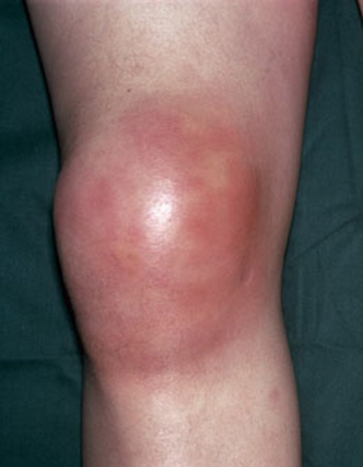
Causes
Can be caused by bacterial, viral or fungal infections
Bacterial infection with Staphylococcus aureus is most common

Slide 90
Neurogenic Arthropathy (Charcot Joints)
A rapidly destructive arthropathy due to impaired pain perception and position sense, which can result from various underlying disorders, most commonly diabetes and stroke
Symptoms include joint swelling, effusion, deformity, and instability. Pain may be disproportionately mild due to the underlying neuropathy.
Diagnosis requires x-ray
Tx consists of joint immobilization and sometimes surgery if the disease is advanced
Many conditions predispose to neurogenic arthropathy
Impaired deep pain sensation or proprioception affects the joint's normal protective reflexes, often allowing trauma (especially repeated minor episodes) and small periarticular fractures to go unrecognized. Increased blood flow to bone from reflex vasodilation, resulting in active bone resorption, contributes to bone and joint damage. Each new injury sustained by the joint causes more distortion as it heals. Hemorrhagic joint effusions and multiple small fractures can occur, accelerating disease progression. Ligamentous laxity, muscular hypotonia, and rapid destruction of joint cartilage are common, predisposing to joint dislocations, which also accelerate disease progression. Advanced neurogenic arthropathy can cause hypertrophic changes, destructive changes, or both.

Slide 91
Continued
Arthropathy does not usually develop until years after onset of the neurologic condition but can then progress rapidly and lead to complete joint disorganization in a few months. Pain is a common early symptom. However, because the ability to sense pain is commonly impaired, the degree of pain is often unexpectedly mild for the degree of joint damage. A prominent, often hemorrhagic, effusion and subluxation and instability of the joint are usually present during early stages. Acute joint dislocation sometimes occurs also.
During later stages, pain may be more severe if the disease has caused rapid joint destruction (eg, periarticular fractures or tense hematomas)
During advanced stages, the joint is swollen from bony overgrowth and massive synovial effusion. Deformity results from dislocations and displaced fractures. Fractures and bony healing may produce many loose pieces of cartilage or bone that can slough into the joint, causing a coarse, grating, often audible crepitus usually more unpleasant for the observer than for the patient. The joint may feel like a “bag of bones.”

Slide 92
Continued
knee and the ankle are most often affected
Distribution depends largely on the underlying disease.
  ex - diabetes mellitus affects the foot and ankle, Syringomyelia commonly affects the spine and upper limb joints, especially the elbow and shoulder
Frequently, only one joint is affected and usually no more than two or three (except for the small joints of the feet), in an asymmetric distribution.
Infectious arthritis may develop with or without systemic symptoms particularly with diabetes. Structures such as blood vessels, nerves, and the spinal cord can become compressed due to the tissue overgrowth.

Slide 93
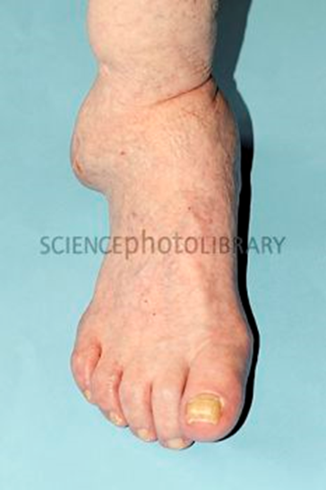

Slide 94
Hemarthrosis
Recurrent or chronic Hemarthrosis is the most common complication of a group of inheritable disorders of blood coagulation
Can be a complication of anticoagulant therapy or severe trauma to a normal joint
In hemophilia, joint bleeding usually begins before the age of five and tends to recur repeatedly during childhood in response to even minor injury. The most common sites are the knees, elbows, and ankles, but any joint can be involved.
Acute hemarthrosis usually results in marked local inflammation and joint symptoms that can last for days to weeks.
Approximately one half of patients with hemophilia develop chronic deformities in one or more joints. Some of them develop a chronic progressive synovitis, restricted to one or a few joints, which clinically resembles rheumatoid arthritis.
In chronic cases there is marked synovial membrane hyperplasia, destruction of articular cartilage, and erosions of subchondral bone. This chronic progressive pattern probably results from a low level of continuous or intermittent bleeding into involved joints. joint fluid, in chronic cases, usually contains blood and very high levels of leukocyte-derived proteases. Other musculoskeletal manifestations of hemophilia include bleeding into muscle and bone.

Slide 95
Continued
Symptoms of hemarthrosis are usually first noticed during infancy or childhood. milder forms of hemophilia may not have symptoms until later in life. Symptoms of bleeding into a joint include:
  Warmth and/or tingling in the joint during the early stages of hemarthrosis. This is called an aura. If bleeding is not treated, it can progress to severe pain.
  Swelling and inflammation in the joint, caused by repeated episodes of bleeding. If episodes continue, it may lead to chronic pain and destruction of the joint.
  An infant's or child's reluctance to move an arm or leg because of bleeding into an affected joint, often first noticed when a child begins to walk.
It usually follows injury but occurs mainly in patients with a predisposition to hemorrhage such as those being treated with warfarin and patients suffering from hemophilia. It can be associated with knee joint arthroplasty.

Slide 96
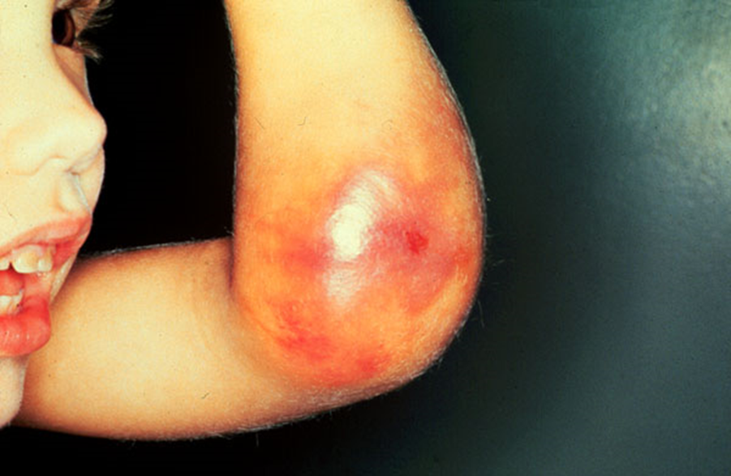

Slide 97
Hypermobility Syndrome
condition that features joints that easily move beyond the normal range expected for a particular joint. Tends to be inherited.
Often causes no symptoms and requires no treatment. Treatments are customized for each individual based on their particular manifestations.
It is felt that certain genes (that are responsible for production of collagen) predispose to the development of hypermobile joints
Joint hypermobility is also a feature of a rare, inherited, more significant medical condition called Ehlers-Danlos syndrome, which is characterized by weakness of the connective tissues of the body. Also commonly seen in people with Down syndrome and in people with Marfan's syndrome

Slide 98
References
Lippincott Williams & Wilkins
Pathology for Health Professions/ Ivan Damjanov
www.patient.co.uk http://learnpediatrics.com
www.medicinenet.com www.mayoclinic.org
www.seattlechildrens.org www.urmc.rochester.edu
www.inkling.com www.merckmanuals.com
www.arthritis-unplugged.com www.medicinenet.com
www.healthline.com

