Slide 1
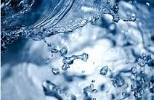
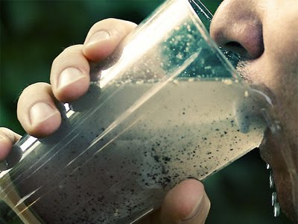
Lecture 8 – Water and Minerals

Slide 2
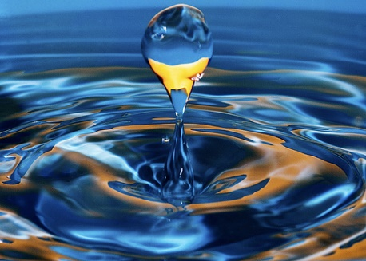
Overview
Water’s main functions
How water and minerals mingle to form the body’s fluids
How cells regulate distribution of those fluids
Roles of each of the minerals

Slide 3

Water
You begins as a single cell bathed in a nourishing fluid
As becoming air-breathing body of trillions of cells, each cell has to be close to water to survive
Water makes up ~60% of adult person’s weight
Human life begins in water

Slide 4
Why is water the most indispensable nutrient?
Carries nutrients throughout body (without water cells quickly die)
Solvent: it dissolves amino acids, glucose, minerals, etc. Fatty substances packaged with water-soluble proteins in blood and lymph
Necessary to remove waste (blood, urine)
Provides lubrication (joints) and shock protection (eyes, spinal cord, amniotic sac)
Aids in maintaining the body’s temperature

Slide 5
The body’s water balance
Imbalances between dehydration and overhydration can occur temporarily
Amount of water can vary by pounds at a time (i.e. water retention with a meal high in salt or with hormonal fluctuations such as menstrual cycle). This does not reflect change in body fat.
Fat weight takes days or weeks to change noticeably; water weight can change overnight.
Balance regulated by brain and kidneys
A 68-kg person contains 41 kg of water ( 68 kg x 0.6)
Water input:
Food (700 – 1,000 mL)
Liquid (550- 1,500 mL)
Water made by metabolism (200-300 mL)
Water output:
Kidneys (500 -1,400 mL)
Skin (450-900 mL)
Lungs (350 mL)
Feces (150 mL)

Slide 6
Are some waters better for health than others?
Hard water: high in calcium and magnesium
Soft water: high in sodium and dissolves cadmium and lead from pipes
Cadmium: can harm body, promotes bone fractures, kidney problems and hypertension
Lead (from old plumbing): toxic metal- affects nervous system
Filtered water: vary
Bottled water
Tap water: sediment is removed, chlorine added to remove hazards (microorganisms, heavy metals, chemicals), meets minimum standards
https://youtu.be/0_ZcCqqpS2o

Slide 7
Bottled water – better than tap water?
Taste?
Mineral content? Best choice in rich in calcium and magnesium but low in sodium
Fluoride?
Is it cleaner?
Cost?
Helps environment?
htps://youtu.be/Se12y9hSOM0

Slide 8
How to make filthy water drinkable
https://www.ted.com/talks/michael_pritchard_invents_a_water_filter?language=en
(~10 min)

Slide 9
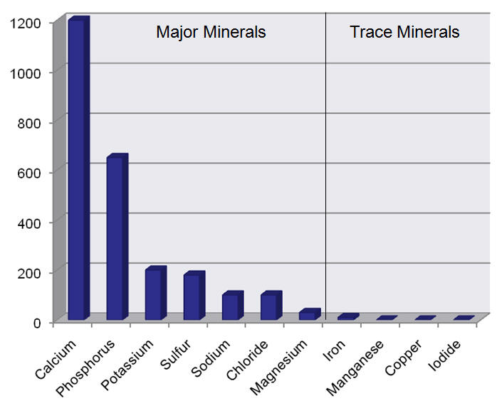
Major Minerals and Trace Minerals
Minerals: naturally occurring, inorganic, chemical elements
Major minerals: found in body in amounts larger than 5 g
Trace minerals: in small amounts (less than 5 g)
Both equally important

Slide 10
Body fluids and Minerals
Major minerals form salts that dissolve in body fluids
Salts are compounds: composed of charged particles (ions). Ex: K⁺Cl⁻
Ions: electrically charged particles. Ex: Na⁺ and Cl⁻
Electrolytes: compounds that dissociate in water to form ions. Ex: K⁺Cl⁻
Electrolytes help conduct electricity in the body
Cells direct where salts go, this determines where fluids flow (water follows salt)
Mineral salts help keep fluids in proper compartments in body

Slide 11
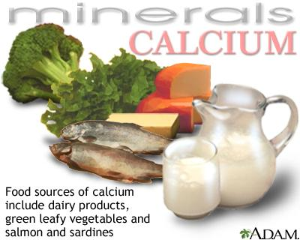
Calcium – 99% in bones and teeth
Function: makes structure of bone and tooth; role in nerve transmission, muscle contraction, blood clotting. Absorption rises when dietary deficiency or increased need (i.e. growth)
Most abundant mineral in body
RDA 1000 mg/day
1200 mg/day in women over 50
1300 mg/day in pregnancy & teens
NHASE Studies have shown many people
eat insufficient calcium to meet the RDA
Deficiency: leads to poor bone density and ultimately, osteoporosis. Very common around the world

Slide 12
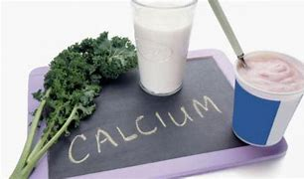
Calcium Cont.
Absorption is decreased by high phosphorus intake, caffeine, & low Vit D
Toxicity can occur starting at 2500 mg/day – nausea & vomiting, headache, thirst
Calcium levels in the blood do not reflect nut. status because of tight homeostatic control
Adequate Calcium intake seems to be protective against fractures, osteoporosis, cancers, heart disease, and weight management.
Supplements come in various forms – carbonate, citrate, bisglycinate, microcrystalline hydroxyapatite etc., with different pros & cons
Calcium should never be supplemented alone – linked to increased atherosclerosis & kidney stones. Always use with Mag, Vit D &/or K

Slide 13
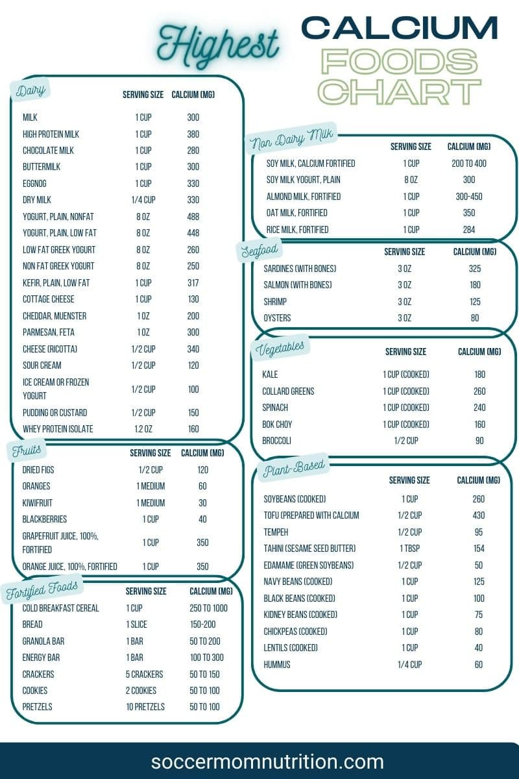
Calcium Sources - Not just Dairy products
High Calcium Foods are found in a few categories:
Dairy Foods, Dark Green Leafy Vegetables, Soy Foods like edamame and tofu, Beans and lentils, seeds, canned fish with the bones, and fortified foods.
Foods commonly fortified with calcium include: Orange & Grapefruit juice, plant milks, and cereals.

Slide 14
Osteoporosis- can lifestyle choices reduce the risks?
Insufficient Ca+ and vitamin D intake is a cause of osteoporosis but not the only one!
Physical activity (sedentary lifestyle increases risk) - Resistance training can prevent/reduce risk
Genetics
Estrogen deficiency
Being underweight/small frame
Use of tobacco and alcohol
Excess protein, sodium, caffeine, soft drinks
Long term corticosteroid use
Hyperthyroidism /Hyperparathyroidism

Slide 15
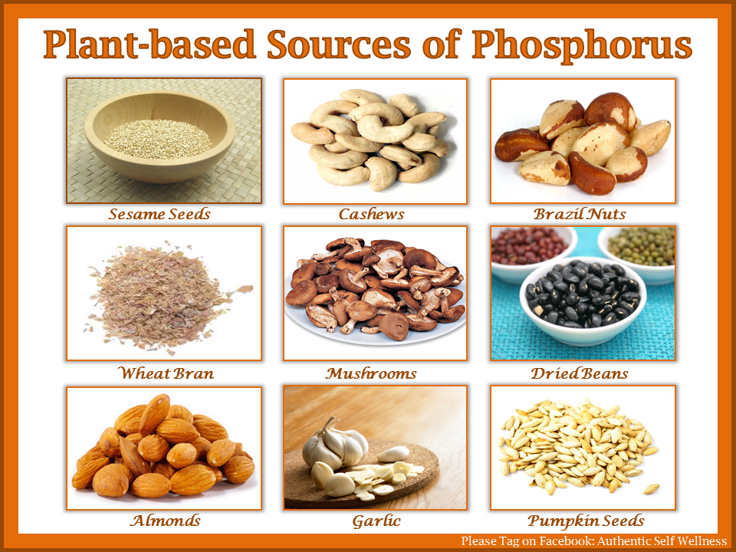
Phosphorus
Function: important for bones and teeth structure.
Helps maintain acid-base balance, part of DNA, energy metabolism, part of cell membranes (phospholipids)
RDA: Ages 9 -18 & in pregnancy 1250 mg/day
Ages 19+ 700 mg/day
Best sources: yogurt, milk, salmon, scallops,
Chicken, lentils, beef, cashews, potatoes
Deficiencies are rare in the developed world &
usually associated with kidney or parathyroid
Problems rather than insufficient intake

Slide 16
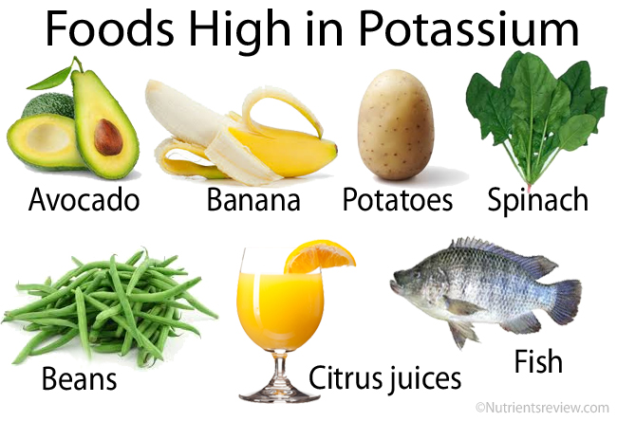
Potassium
Function: most abundant positive ion inside cells, is important in many metabolic functions. It has a strong relationship with sodium via the Na+/K+ pump
Assessing K+ in the body is difficult, because it is mostly intracellular. Abnormal blood potassium levels therefore reflect kidney disease, dehydration, or certain medication use, NOT dietary intake.
-Adequate intake (AI)
{insufficient evidence for RDA}
: Male 3000 – 3400 mg
Female 2300 – 2600 mg/day
NHANES study found that average daily
intake is below the recommended AI

Slide 17
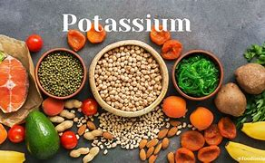
Potassium
Food Sources: Apricots, lentils, prunes, acorn squash, raisins, potato
Groups that are at risk of K deficiency: people with inflammatory bowel disease, those using thiazide diuretics or large doses of laxatives, people with pica (persistent eating of non-nutritious foods such as clay)
People with K deficiency are at risk of: high blood pressure, kidney stones, bone problems, blood sugar control & diabetes
Hyperkalemia:usually a result of kidney disease or medication overdoses can cause potentially fatal cardiac arrhythmias

Slide 18
Magnesium
Function: important to build protein and using energy. Magnesium is a cofactor in more than 300 enzyme systems. It plays a role in active transport of Ca & K ions across the cell membrane, which is important to nerve conduction, muscle contraction & normal heart rhythm.
Blood levels are kept under tight homeostatic control. Better testing option include Mg in the RBC, salivary or a magnesium loading test.
RDA: Males 400 – 420 mg
Females: 310 – 400 mg
NHANES study showed average intake was around 50-100 mg deficient of RDA

Slide 19
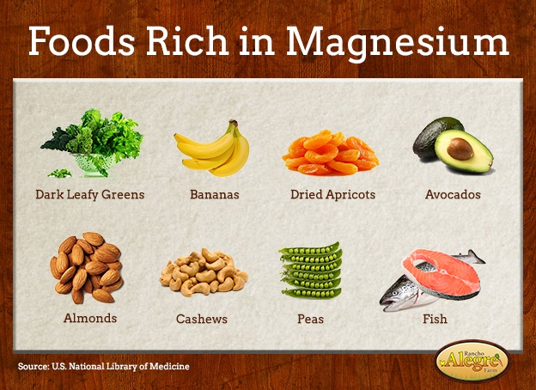
Magnesium
Food Sources: pumpkin seeds, chia seeds, almonds, spinach, cashews, peanuts
Black beans, edamame
Laxative effect: some forms of supplemental magnesium exert an osmotic laxative effect by drawing more water into the bowel
Milk of Magnesia (Mag. Hydroxide)
Magnesium Citrate
Rolaids contains mag. hydroxide

Slide 20
Magnesium
Deficiency can occur with chronic under intake. Symptoms include: fatigue, weakness, muscle contractions and cramps, numbness, tingling, heart palpitations, migraine headaches
Groups at greater risk of deficiency are: people with inflammatory GI diseases, Type 2 diabetics, older adults
Magnesium toxicity generally only occurs in cases of very large doses (>5000 mg/day) of Mag. Containing laxatives +/or antacids.
Medication interactions: PPI (Nexium, Prevacid) use for >1 year can result in hypomagnesemia
Loop diuretics (Lasix) & thiazide diuretics (hydrochlorothiazide) can cause hypomagnesium through increased excretion

Slide 21
Sodium
Function: main positively charged ion outside body’s cells. Sodium attracts water. Major role in keeping fluid and electrolyte balance. Too much sodium raises blood pressure and aggravates hypertension
BUT salt is not the only cause of hypertension…https://youtu.be/4QXmTqpqVJY
Recommended amounts:
1,300-1,500 mg/day
Tolerable Upper Limits: >2300 mg/day
A 2004 survey found that 60 -85% of Canadians were consuming more than the TUL for sodium.

Slide 22


Sodium
Foods to REDUCE/AVOID
Major dietary sources of sodium are in: Processed meats, packaged bread products, shrimp, soups, ham, instant pudding, salad dressings
Hypernatremia – high blood sodium. Can be caused by dehydration, loss of body fluids, certain medications such as steroids
Hyponatremia – low blood sodium. (Often caused by too much water) Usually caused by heart, lung, kidney or adrenal problems.
https://youtu.be/72Ncvlr6GQk

Slide 23
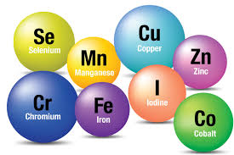
Trace Minerals

Slide 24
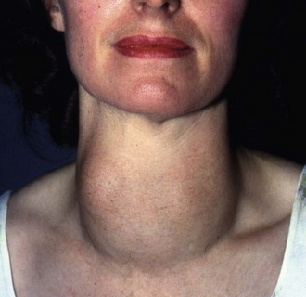
Iodine
Part of thyroid hormones, critical for metabolism
Causes goiter (enlargement of thyroid gland) if iodine is deficient (simple goitre) or in excess (toxic goiter)
Cretinism: mental and physical retardation
caused by iodine deficiency during pregnancy
https://youtu.be/keE_ed7xCm4
RDA 150 mcgs/day, 220 mcgs in pregnancy
Food sources: seaweeds, enriched breads, cod, yogurt,
Oysters, iodized salt

Slide 25
Iodine
Groups at risk of deficiency: People who live in the Goiter belt (poor soil iodine), vegans, pregnant women, people not using iodized salt, people eating a lot of goitrogenic foods
Goitrogens: foods that interfere with the body’s uptake of iodine. Includes soy, cassava, and cruciferous vegetables (cabbage, broccoli, cauliflower, brussel sprouts)
Insufficient iodine has also been linked to fibrocystic breast disease. Potassium iodide has been approved to reduce cancer risks from radiation exposure.
Tolerable upper limits: 900 – 1100 mcg/day
Toxicity symptoms are similar to deficiency: goiter, hypothyroidism but also thyroiditis & hyperthyroidism.

Slide 26
Iron
Present in all living cells
Most iron in hemoglobin (red blood cells)and myoglobin (muscle cells), helping hold and carry oxygen
Plants & Iron fortified foods contain Non-heme iron. Animal sources contain heme iron which has higher bioavailability.
Food sources: Oysters, white beans, chocolate, liver, lentils, tofu, sardines, beef
Iron levels can be measured in the blood through several tests: ferritin (Normal 30 mcg/L +) to measure iron stores, hemoglobin ( N 12 g/dL +) & hematocrit (N 36-50%) to identify Iron Deficiency anemia.
https://youtu.be/vXNhGmv8fXA

Slide 27
Iron
RDA Males 8 – 11 mg, Females 8 – 18 mg, in pregnancy 27 mg
Groups at risk of deficiency: pregnant women, young children (first suggested solid foods are those high in iron), women with heavy periods, people with GI diseases, People with cancer
Toxicity: supplementation can lead to stomach pain, constipation. Different forms can reduce that likelihood. Iron can interfere with Zinc absorption.
Severe overdose > 60 mg/kg can be fatal.
Hemochromatosis: excessive buildup of iron in the body due to a genetic mutation. Treatment is blood donation, monitoring iron & liver function.
Vitamin C increases Iron absorption.
Tea, coffee, calcium, phosphorous, tannins, phytates and fiber can affect iron absorption

Slide 28
Other Trace Minerals
Zinc: deficiencies cause growth retardation with sexual immaturity.
Selenium: protects from oxidation. Deficiency causes heart disease
Fluoride: stabilizes bones and makes teeth resistant to decay
Chromium: works with insulin to control blood glucose concentrations
Copper: needed to form hemoglobin and collagen
Boron : Affects body's use of bone building minerals such as calcium,magnesium & Phosphorus.
All trace elements play important roles in body. All trace minerals are toxic in excess.

Slide 29
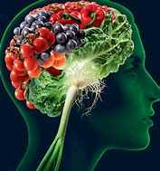
The surprisingly dramatic role of nutrition in mental health
https://www.youtu.be/3dqXHHCc5IA (17 min)

Slide 30
Reviewing Water and Mineral content…
1. Water balance is governed by the:
Liver
Kidneys
Brain
b and c
2. Which two minerals are major constituents of bone?
Calcium and zinc
Phosphorus and calcium
Sodium and magnesium
Magnesium and calcium

Slide 31
Reviewing water and minerals content… (cont.)
3. The best way to control salt intake is to cut down on processed and fast food
T
F
4. The most abundant mineral in the body is iron:
T
F

