Slide 1

Disorders of Psychology, Sleep & Substance Abuse
Path 1 PPT 5

Slide 2
Objectives
Lesson 15.1: Mental Disorders
Define mental health, mental disorders, and stress, and then describe appropriate massage considerations.
Identify sleep disorders and discuss appropriate massage modifications.
Explain generalized anxiety disorders, panic attacks and panic disorders, specific phobias, and obsessive-compulsive disorders and describe appropriate massage considerations.
Describe acute stress and posttraumatic stress disorders, discuss appropriate massage considerations, and suicide prevention using the QPR model.
Discuss mood disorders and describe their appropriate massage considerations.
Summarize eating and substance use disorders and describe appropriate massage modifications.

Slide 3
Introduction
Health: state of physical, mental and social well-being (remember the WHO definition)
Mental health: state of well-being allowing individuals to recognize their potential, cope with normal ongoing stress of everyday life, work productively and fruitfully, and contribute to the community
  Includes recognizing, expressing, and modulating emotions and dealing with conflicting emotions
Notes:
See Figure 15.1.

Slide 4
Factors Influencing Mental Health
Brain chemistry
Inherited factors: genetics and family history
Developmental events and experiences
Relationships with family, friends, and members of the community
Health practices: diet and exercise
Massage therapy influences mental health!
See textbook page 428-429 for many positive study results
Notes:
See Figure 15.2.

Slide 5
Stress
Response of the body to demands placed on it by stressors
Stressor: anything that triggers the stress response
  Includes environmental, societal, situational, or chemical factors
  When exposed to stressors, the body will respond by going into sympathetic mode - increased heart rate, breathing etc.
Eustress: stress perceived as positive and within our ability to meet demands of the situation; associated with self-efficacy

Slide 6
Stress: Types
Distress: stress perceived as negative and beyond our capacity to cope
  Decreases performance
  Associated with many mental health conditions including anxiety and depression
Recall PPT 1 in which we learned about Hans Selye and the HPA axis in response to stressors
https://youtu.be/QAeBKRaNri0
Notes:
Ways to reduce stress are listed on Evolve in a folder titled, “Stress Busting Tips.” Massage is also an effective way to reduce stress.

Slide 7
Mental Disorders/Illness
Disturbances in cognition, emotional regulation, or behavior that reflect dysfunctional psychology, biologic, or developmental processes
  1 in 4 American adults experience mental illness in a given year
  1 in 25 American adults experience serious mental illness in a given year that substantially interferes with or limits one or more major life activities
  Serious mental illness costs Americans $193.2 billion in lost earnings per year
Notes:
Massage, Depression, Anxiety, and Research is located in this chapter.
Box 15.1 lists the clinical manifestations related to disorders of anxiety and depression.

Slide 8
Sleep Disorders
Recurring state of relaxation characterized by altered state of consciousness, inhibited sensory activity, muscular inhibition, and reduced interactions
Average adult requires 7 - 9 hours, children require more
Sleep problems and mental health are a two-way street:
Lack of sleep promotes anxiety and depression, even in otherwise healthy people, and many mental health conditions have disorders of sleep among their symptoms
50 to 70 million adults in the United States have a sleep disorder with insomnia the most common, followed by hypersomnia

Slide 9
Sleep Disorders
Disturbances in quality, timing, and amount of sleep, which cause problems with functioning and distress during hours awake

Slide 10
Sleep Disorders: Types
Insomnia: difficulty falling and/or staying asleep
  Most common sleep disorder
Sleep-onset insomnia: trouble winding down/falling asleep. Often associated with stress or caffeine use too close to bedtime.
Sleep maintenance insomnia: waking frequently, trouble getting back to sleep, waking too early in the morning. Often associated with hormonal changes of mid-age, shift work, sleep apnea, & alcohol or cannabis use.
Chronic - when insomnia occurs at least 3x/week for 3 months or more

Slide 11
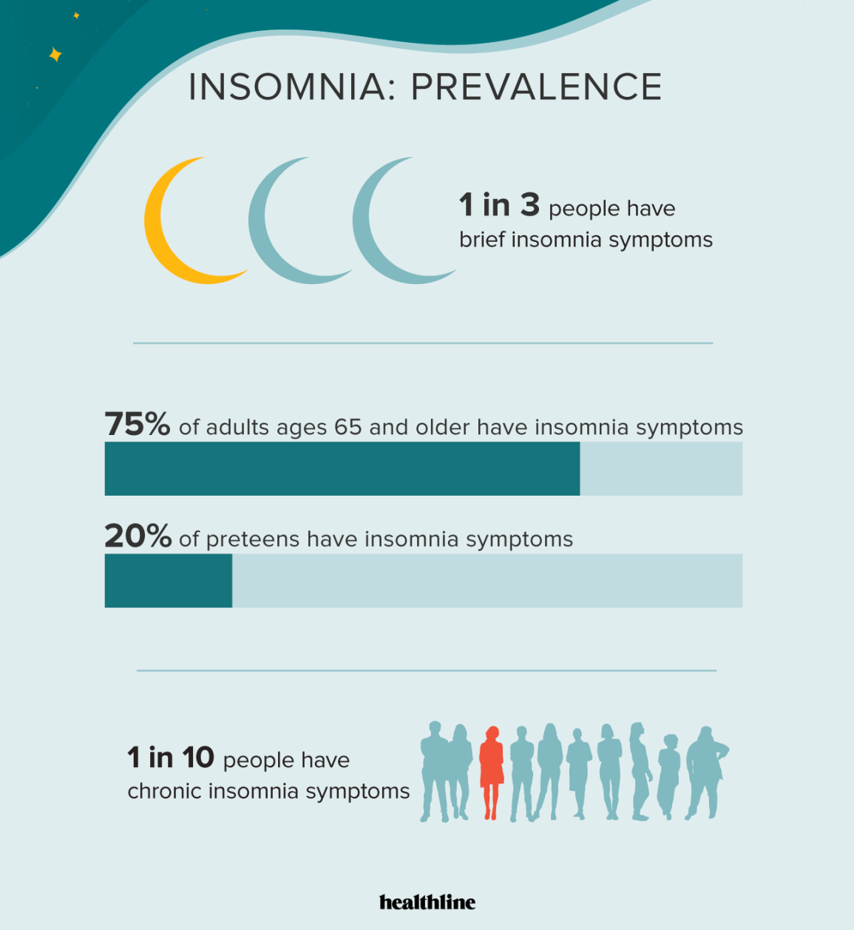

Slide 12
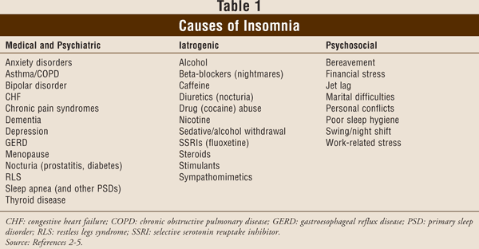
Insomnia Causes

Slide 13
Sleep Disorders: Types
Hypersomnia: prolonged nighttime sleep or excessive daytime drowsiness, even after long periods of sleep
Narcolepsy: irresistible daytime drowsiness with sudden sleeping episodes lasting from a few seconds to half an hour
Parasomnia: abnormal movements, behaviors, emotions, perceptions, and dreams that occur while falling asleep, during sleep, or waking up
  Includes sleepwalking, night terrors, and nightmares
Notes:
Sleep apnea (temporary absence of normal breathing during sleep) is discussed in Chapter 10, titled Respiratory Pathologies, Disorders, and Conditions.

Slide 14
Sleep Disorders: Types
Sleep apnea: temporary absence of normal breathing called apnea
  Obstructive sleep apnea caused by a blocked upper airway is most common type
  Will discuss further in Path 2
Restless leg syndrome: uncontrollable urge to move the legs due to sensations such as itching, crawling, twitching, throbbing, burning, or aching
may be related to changes in dopamine levels
other causes may be magnesium or iron deficiency, peripheral neuropathy (can be B12 deficiency or nerve damage from diabetes), spinal cord lesions/nerve block
Notes:
Obstructive sleep apnea is discussed in Chapter 10.

Slide 15
Anxiety Disorders
Significant or persistent anxiety and fear, or when these feeling are experienced regularly or during inappropriate situations
Anxiety and fear are normal feelings expressed as part of the stress response but can lead to anxiety disorders
  Anxiety is a worry about future events
  Fear is a reaction to current events

Slide 16
Anxiety Disorders: Types
Generalized anxiety disorders
Panic attacks and panic disorders
Specific phobias
Obsessive–compulsive disorders
Acute stress disorders
Posttraumatic stress disorders (PTSD)
  These are somewhat different in behavioral manifestations, but all behaviors strongly influenced by anxiety and fear
Notes:
Anxiety disorders were previously known as neuroses.
Anxiety disorders can coexist with conditions such as pregnancy and during the postpartum period, when separated from loved ones or a social support system, or induced by substance use or medications.

Slide 17
Generalized Anxiety Disorder
Frequent, persistent, unrealistic worry about everyday things leading to feelings of anxiety
  Anxiety persists for at least 6 months
Etiology: Affects about 6% of the population
2x more women than men
Median age of onset is 30
Treatment: exercise, yoga, massage therapy, acupuncture, mindfulness meditation (MBSR)
Psychotherapy
SSRIs & SNRIs such as Prozac, Citalopram, Sertraline
Benzodiazepines such as Valium, Xanax, Lorazepam (Ativan)
Notes:
Physical manifestations include heart palpitations, hypertension, shortness of breath, trembling, profuse sweating, sensation of choking or smothering, nausea, vertigo, fatigue, feelings of terror, and irritability.
The person may startle easily and have insomnia. Nightmares are common. The person often experiences sustained muscular tension, with or without headaches. Some people are prone to panic attacks (see later entry).

Slide 18
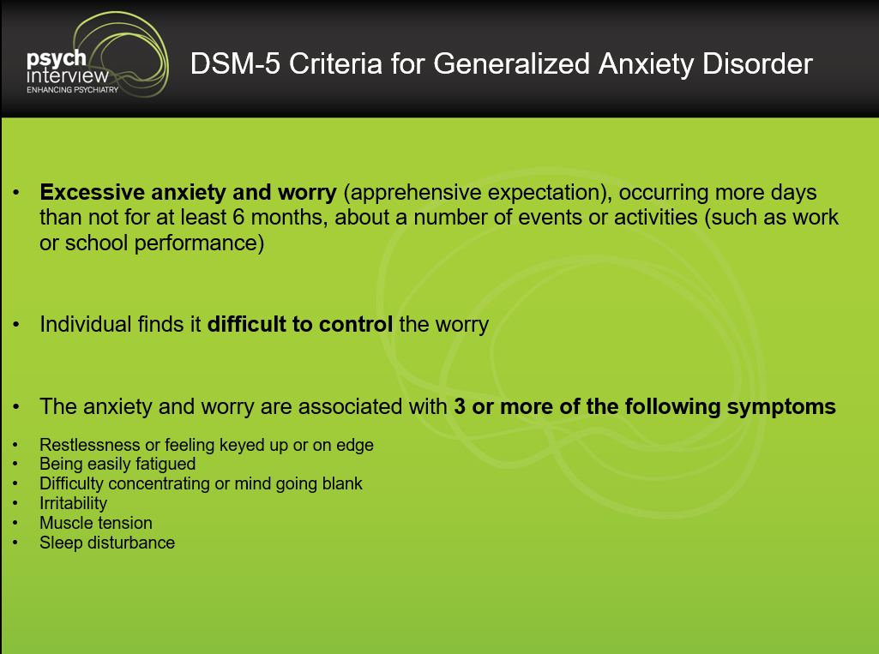
GAD Diagnosis

Slide 19
Panic Attack
Sudden brief episode of intense overwhelming fear and anxiety when there is no real danger or apparent cause
Often begins without warning
S/S
  Racing heartbeat
  Shortness of breath
  Nausea

Slide 20
Panic Disorders
Recurrent unexpected panic attacks
Types include
  Agoraphobia: individual become fearful of being in an open or enclosed space, in crowds, being away from home, or situations which escape might be difficult
  Social anxiety disorder: fear of situations involving interactions with other people because the person might embarrass themselves, offend others, or be scrutinized, judged, or rejected

Slide 21
Panic Attacks During Massage
Assist client into a sitting position
Redirect client's focus
  Encourage slow, deep breaths and focus on the process of breathing
  Ask questions requiring simple answers & grounding in the present - what color is the chair? Name 3 things that are green in the room. Is it windy outside?
When the attack resolves, ask if massage should continue or end for that day without judgement - allow client to lead the response

Slide 22
Panic Attack, Hypoglycemic Event, and Heart Attack: How to Differentiate
Panic attacks: intensity decreases once the person is distracted
Hypoglycemia: resolves quickly after ingesting a sugar source such as juice
Heart attack: S/S increase after measures are taken to resolve hypoglycemia or a panic attack
  If the client is having a heart attack, call 911
Notes:
Chapter 7 has more information about hypoglycemia.
Chapter 8 has more information about first aid measures for a heart attack and cardiac arrest.

Slide 23


Specific Phobias
Overwhelming and irrational fear of an object or situation that poses no real danger, but produces fear, anxiety, and avoidance behaviors
  Examples are fear of spiders, snakes, needles, heights, flying, or public speaking
Notes:
A list of common specific phobias are listed in this chapter.
See Figure 15.3.

Slide 24
Massage and Specific Phobias
Use recommendations for GAD
Claustrophobic client?
  Move to a supine position if prone
  Uncover arms

Slide 25
Obsessive–Compulsive Disorder
Persistent upsetting or irrational thoughts called obsessions and uncontrollable urges or repetitive behaviors called compulsions used to relieve the anxiety these thoughts produce
Notes:
See Figure 15.4.

Slide 26
Massage and Obsessive–Compulsive Disorder
Use recommendations for GAD
Be consistent with appointments and massage sequence
  Changes may promote anxiety
Have sanitizing agents handy or easy access to sink and soap
  Clients may be reluctant to touch items and surfaces in the office and want to sanitize hands often

Slide 27
Acute Stress Disorder
Severe anxiety, intense fear, helplessness, or horror felt immediately after or within 1 month of experiencing or witnessing a terrifying or traumatic event
Notes:
Only after ASD symptoms have been present for longer than a month can diagnosis of PTSD can be determined. But, unlike ASD, symptoms of PTSD may develop months or even years after the original traumatic event. PTSD may follow ASD, but it also may develop much later even if ASD never occurred initially.

Slide 28
Posttraumatic Stress Disorder
Later-stage disorder characterized by distress and difficulty coping with the aftermath of trauma
  Person may experience flash-backs and dissociations
  Often accompanied by depression and substance use
Notes:
See Figure 15.5.

Slide 29
Flash-backs and Dissociation
Flash-backs: sudden and disturbing vivid memories of past events that produces extreme anxiety or panic attacks
Dissociation: coping strategy which allows a person to deal with psychological stress and continue to function after the traumatic event
  Types are depersonalization, derealization and compartmentalization

Slide 30
Dissociation: Types
Depersonalization: disconnection from one's own body, thoughts, or emotions
  May produce an out-of-body experience
Derealization: disconnection from one's surroundings
  World feels surreal, foggy, distorted, and the person may think the traumatic event was a dream
Compartmentalization: suppression of memories because they produce anxiety from conflicting personal values and beliefs
  Ex: act of shooting if they shot enemy soldier
Notes:
Several studies have indicated between 15% and 30% of military veterans diagnosed with PTSD reported symptoms of depersonalization and derealization.

Slide 31
Massage and ASD/PTSD
(1 of 2)
Use recommendations for GAD minus low lighting
Client may want to see what you are doing, which may require raised lighting and avoiding the prone position or face rest to expand vision
Let clients control the massage
  Disrobing, client positioning, areas worked on or avoided, and depth of pressure
Notes:
Read “Massage and Panic Attacks/Panic Disorders” for suggestions in case your client has a panic attack.

Slide 32
Massage and ASD/PTSD
(2 of 2)
Identify/avoid triggers that may cause hyperarousal
Offer choice practitioner gender
Consider using a technique that does not require disrobing
If client does not want an area massaged, honor this even if prior consent was given
Give option of having a trusted friend or family member in the treatment room, having the door ajar, or both
Notes:
Be sure to read the research section for this pathology.

Slide 33
Nine Principles of Sensitive Practice
(1 of 3)
Respect. Acknowledge inherent value of each individual with empathy and compassion while suspending judgement
Take time. Be fully present, unrushed, and less task-oriented
Develop rapport. Develop and maintain a demeanor that conveys genuine caring and balances professionalism with warmth and friendliness
Notes:
Schachter et al (2009) recommend nine principles of sensitive practice to help foster feeling of safety specifically for PTSD cases resulting from sexual abuse.
These are suitable for all clients.

Slide 34
Nine Principles of Sensitive Practice
(2 of 3)
Share information. Tell client what you are doing and why
Share control. Enable client to be active participant rather than passive recipient by sharing control
Respect boundaries. Have healthy boundaries to validate and reinforce the client’s inherit worth and autonomy
  Sexual abuse is blatant disregard of boundaries

Slide 35
Nine Principles of Sensitive Practice
(3 of 3)
Foster mutual learning. Encourage clients to question and speak up when uncomfortable
Understand nonlinear healing. Check in with clients each session and with the session, making adjusts according to the client’s comments
Demonstrate awareness of interpersonal violence. Have pamphlets available from local organizations
Notes:
The degree to which a client is able to tolerate or participate in treatment varies from session-to-session and from one moment to the next within a session.
Number 9 may help clients overcome their hesitancy in disclosing the issue with their massage practitioners.

Slide 36
Additional Suicide Risk Factors
Serious or chronic physical disorder
Family history of mental disorders, violence, or suicide
Possessing a gun
Previous self-harm
Knowing, identifying, or being associated with someone who has committed suicide
Lack of a partner
Starting antidepressants or when dosage changes

Slide 37
Terminology
Suicidal ideations: thinking about, considering, or planning suicide
Suicide attempt: nonfatal, self-directed, potentially injurious behavior with an intent to die as a result of the behavior that may or may not result in injury
Suicide: death caused by self-directed injurious behavior with the intent to die as a result of that behavior
Notes:
About 50 to 90% of all suicides are committed by people who have a diagnosable mental disorder.

Slide 38
QPR Model
Respond immediately to suicidal ideations by using QPR model
  Q: Question
  P: Persuade
  R: Refer
Three-fourths of people who commit suicide gave some warning of their intentions to someone they knew

Slide 39
Q: Question
If you have a client communicating suicidal ideations, ask if they are considering suicide or if they have a plan or particular method in mind
  Talking about thoughts of suicide does not increase the risk of suicide attempts or success
Use direct and indirect questions
  “Do you have thoughts of suicide?”
  If yes, “Do you have a suicide plan in mind? Can you tell me about your plan?”

Slide 40
P: Persuade
Persuade the person to get help
Let them know you care
Communicate that depression can be treated
Do not succumb to temptation of offering reasons for living such as “You have so much to live for,” “You have come so far to throw your life away,” or “Your suicide will hurt your family, think about them.”

Slide 41
R: Refer
Offer to help by making a referral or accompany the person to get help
This can be client's
  Primary healthcare provider
  Mental health counselor
  Minister, rabbi, counselor, priest, tribal leader
  Call 1-800-SUICIDE (1-800-784-2433) for assistance in finding local agencies or services in your area
  In an acute crisis, do not leave the client alone - stay with them and call 911
Notes:
In an acute crisis, do not leave the client alone. Examples of acute crisis are someone in immediate danger to harm himself or herself or to harm others, and this person is despondent and will not consider your suggestions to get help. In these situations, call 911. Remove all objects that could potentially be used for suicide. While waiting for emergency personnel to arrive, call a suicide resource center such as 800-SUICIDE (800-784-2433) or 800-273-TALK (800-273-8255) and follow their recommendations.

Slide 42
Mood Disorders
Emotional disturbances consisting of prolonged periods of excessive sadness and emptiness (depressed), excessive happiness and elation (mania), or both
These significantly impair a person’s capacity to function. Depression is the 2nd leading cause of disability (after heart disease)
  Mood disorders include major depressive disorder, SAD, Bipolar I & II, & postpartum depression.
  Mood disorders affect about 10% of the population in any given year.
https://youtu.be/ZwMlHkWKDwM
Notes:
Mood disorders can coexist with conditions such as premenstrual syndrome (called premenstrual dysphoric disorder), or induced by substance use or medications.
Approximately 20.9 million people in the United States have a mood disorder in a given year (10% of the population age 18 and older).

Slide 43
Major Depressive Disorder
Occurs when excessive sadness interferes with a person's ability to work, sleep, study, eat, and enjoy once-pleasurable activities
Affects more women than men but…
Traditionally, men are more reluctant to seek treatment for mood disorders
  MDD is also called clinical depression and unipolar depression
Notes:
Women are twice as likely to be diagnosed and treated for depression. However, men may have depression to a larger extent than data indicate because men are less likely to seek help.
Depression is commonly seen in individuals with chronic and debilitating diseases, including cancer, heart disease, diabetes mellitus, seizure disorders, multiple sclerosis, stroke, Alzheimer disease, Parkinson disease, rheumatoid arthritis, lupus, and HIV infection.

Slide 44
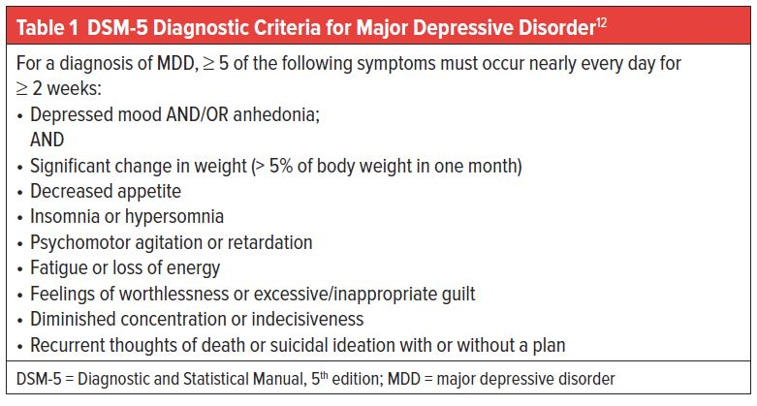
MDD Diagnosis (FYI)

Slide 45
Persistent Depressive Disorder
Chronic form of MDD
Continues for 2 years or longer
Often less severe than MDD
May begin in childhood or during adolescence
Also called dysthymia
Notes:
See Figure 15.6.
See Figure 15.7.

Slide 46
MDD
Etiology: Can be complex and multifactorial
May be idiopathic or linked to trauma or tough life circumstances
Biological components - imbalance of neurotransmitters, genetic susceptibilities, hormonal changes, nutritional status
Average age of onset is 32. Onset age may reflect different causes, as well as be predictive for a worse disease course.
Treatments: Address comorbidities/life circumstances
Exercise, Mindfulness meditation, Massage therapy
Psychotherapy/Counselling
Medications, primarily SSRIs
ECT (Shock treatments)
Exercise: Search PubMed for research articles on Massage therapy & depression. Share your findings with the class (15 min)

Slide 47
Massage and Crying
Crying is a universal human experience and tool to communicate emotions
People who are depressed are more prone to spontaneous and uncontrollable crying, and they may not know why they are crying
Changes in hormones, stress, and sleep deprivation linked to increased crying spells
Crying varies across genders and cultures

Slide 48
Massage and Crying
When the client begins to cry, pause the massage and do not break physical contact
Could use statements such as, “Crying is normal,” “You are in a safe place,” “I am comfortable with your tears.”
  It may be appropriate to rest a hand on the client’s shoulder as a gesture of empathy
Ask client if he or she wants to continue with massage, take a break from massage, or stop massage before scheduled time
    Regardless of which option is chosen, be calm and accepting, and avoid encouraging or discouraging a particular response

Slide 49
Seasonal Affective Disorder
Depressive mood disorder that occurs seasonally, usually fall and winter in geographic locations that have limited sunlight exposure
Affect: personal reactions or emotional expressions
Etiology: Thought to be related to hormone & neurotransmitter changes that occur with disruptions to the circadian rhythm.
Affects 4x as many women
Average age of onset is 23.
Treatment: Exposure to full-spectrum lighting, esp. in the morning, assess Vit D, other treatments for depression

Slide 50
Bipolar Disorder
Mood disorder in which person experiences episodes of both depression and mania. Formerly known as Manic Depession.
  One phase usually predominates with the opposing phase beginning and ending abruptly
  These can last a few days to several months
Mania: Person exhibits symptoms of elation, excitement, and lack of inhibition. They may make reckless choices such as overspending, not sleeping or hypersexuality. Worst case scenario is hallucinations and/or psychosis.
Hypomania: A milder version of mania.

Slide 51
Bipolar Disorder: Types
Bipolar I: manic episodes 7+ days, or manic symptoms so severe it triggers psychosis and requires hospitalization
Bipolar II: patterned depressive and hypomanic episodes, but manic episodes less severe than bipolar I disorder
Cyclothymic disorder (cyclothymia): mild form with depressive and hypomania lasting at least 2 years in adults or 1 year in children/adolescents

Slide 52
Bipolar Disorder
Etiology: Often runs in families, so there is a genetic component.
Often occurs with other mental health disorders like depression, anxiety, eating disorders, ADHD & substance abuse.
Can also be triggered by traumatic events, poor lifestyle choices (lack of sleep, poor nutrition)
Treatment: Mood stabilizers such as Lithium,
Antidepressants, exercise, stability of schedule

Slide 53
Prenatal and Postpartum Depression
Prenatal depression: depressive mood disorder that occurs during pregnancy
Postpartum depression: depressive mood disorder that begins after childbirth and lasts beyond 2 weeks
  Most cases are short lived, but they can last several months
Etiology: Similar to other types of depression, but the main trigger is the pregnancy & all of the changes associated
Treatment: SImilar to MDD

Slide 54
Eating Disorders
Abnormal eating habits related thoughts and emotions that can affect health and wellbeing
Types include
  Anorexia nervosa
  Bulimia nervosa
  Binge eating disorder
Affects about 2x more women than men
More common in developed countries
Etiology seems to be primarily psychosocial and cultural factors.
About 40% of eating disorder patients also have OCD

Slide 55
Anorexia Nervosa
Abnormal low weight for the person’s age and height
Body Dysmorphia: person does not see an accurate representation of their body & spends an excessive amount of time worrying about their body
Employ various methods to prevent weight gain
  Self-starvation (primary method)
  Exercise
  Diet aids
  Laxatives
  Diuretics
  Enemas
Notes:
See Figure 15.9.

Slide 56
Massage and Anorexia Nervosa
Use recommendations for GAD
Cold intolerance: use blanket, table warmer, raise room temp, or a combination
Be prepared to work through clothing
Abdominal massage may relieve constipation
Orthostatic Hypotension: client should arise in 3 1-minute stages
  Sit up on table
  Sit on side of table with legs dangling
  Stand with care, holding onto edge of table or other non-movable object
Notes:
Be sure to read the research section for this pathology.

Slide 57
Bulimia Nervosa
Binge eating—consuming large amounts of food—followed by unhealthy behaviors to rid body of calories and prevent weight gain
  Self-induced vomiting called purging is primary method
Can use other methods
  Similar to AN

Slide 58
Binge Eating Disorder
Characterized by binge eating (usually large amounts of food in a short amount of time) followed by significant distress from bingeing
Pattern similar to BN, but people with BED do not regularly engage in behaviors to prevent weight gain

Slide 59
Substance Use Disorder
Persistent use of one or more substances despite associated adverse consequences
  Can cause physical and mental health problems, and failure to meet major responsibilities at work, school, or home
  Also called drug addiction
Drug addiction: uncontrollable craving for a drug (including alcohol) that leads to compulsive drug-seeking behaviors and uncontrollable drug use
Notes:
Drug use becomes a priority for the addict, and he or she may engage in destructive behaviors to get and use the drug, regardless of the harm these behaviors cause themselves or others.

Slide 60
Substance Use Disorder: Types
Nicotine
Alcohol
Recreational/illegal drugs
Prescription drugs
  Disorders related to tobacco, alcohol, or recreational drugs can start with experimental use in social settings
  Disorders related to prescription drugs can start with use for physical or mental disorder, or from a friend/family member who was prescribed the drug

Slide 61
Massage and Substance Use Disorders
Use recommendations for GAD
Massage can help clients cope with a substance use disorder and is recommended by the Addiction Help Center as part of the recovery process
If your client reports use of substances during the intake or massage, consider asking if this has discussed with his or her primary healthcare provider
  If no, encourage the client to have this discussion soon
Notes:
Respond immediately to suicidal ideations by implementing the Question–Persuade–Refer (QPR) model listed under “Acute Stress Disorder and Posttraumatic Stress Disorder.”
Research related to substance use and addiction are located in this chapter.

Slide 62
Schizophrenia
Etiology: Affects less than 1% of the population
- strong familial/genetic connection
- affects males & females equally, but affects males at a younger age - late teens to mid 20s
- excessive cannabis use linked to male development
- increased dopamine activity may be a factor
Signs & Symptoms: - disorganized thinking
disorganized or abnormal motor behaviour
delusions: false beliefs despite evidence to the contrary
hallucinations: experience of seeing, hearing or feeling things that are not there

Slide 63
Schizophrenia
Treatment:
Ist generation “typical” antipsychotics: Includes Haldol.
May cause side effects of muscle spasms and tardive dyskinesia.
Caution with deep work and stretching with these clients.
These meds may also interfere with body temperature control so caution with hydrotherapy.Systemic hydro is contraindicated.
2nd generation “atypical” antipsychotics: Includes Seroquel and Abilify.
May cause orthostatic hypotension, so caution with getting up from from massage

Slide 64
Schizoaffective Disorder
Has symptoms of schizophrenia and bipolar disorder.
Affects only about 0.3% of the population. Most cases diagnosed between ages 25-35 & affects more women.
3 types: manic, depressive & mixed
Has a genetic predisposition. Childhood trauma and high stress levels can also be causative factors.
Treatments include antipsychotics, mood stabilizers & antidepressants.

Slide 65


