Slide 1
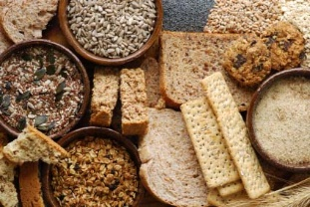
Carbohydrates

Slide 2
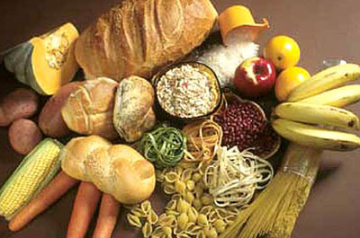
Carbohydrates
Ideal nutrients to meet body’s energy needs, feed brain & nervous system
Digestible carbs (with fats and proteins) add bulk to foods and provide energy
Indigestible carbs (most fibres in foods) - no energy but have other benefits

Slide 3
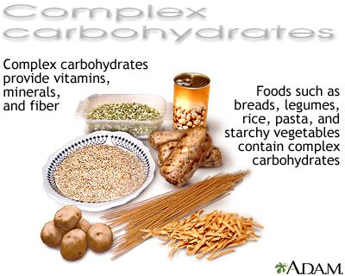
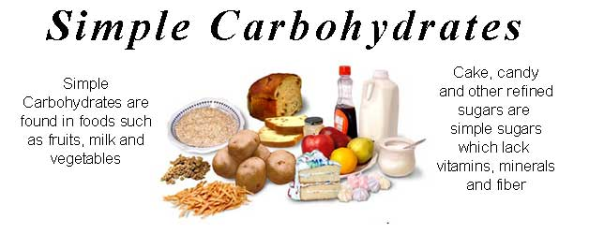
Not all Carbohydrates are equal in terms of nutrition

Slide 4
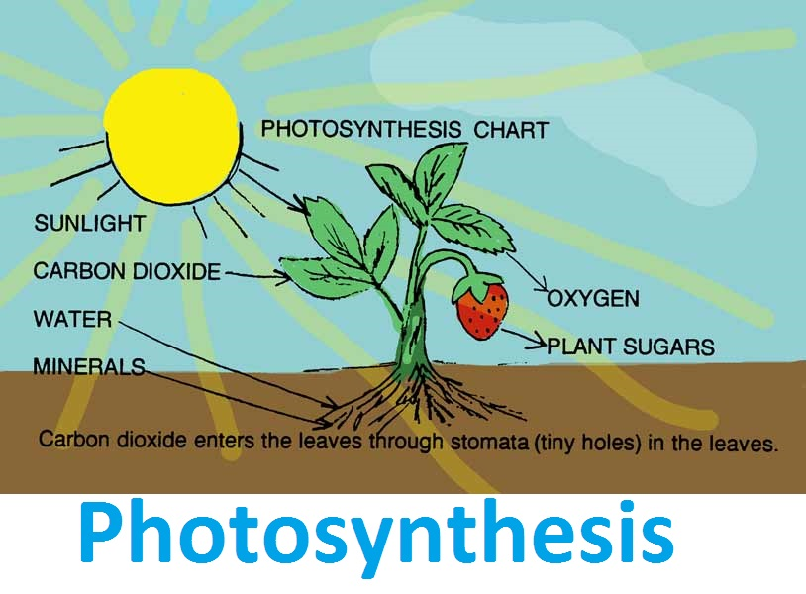
Carbohydrates contain the sun’s energy
Green plants make carbohydrates through photosynthesis
CO2 and H20 combine to make glucose
Carbohydrate is made of C, H and O held together by energy- containing bonds

Slide 5
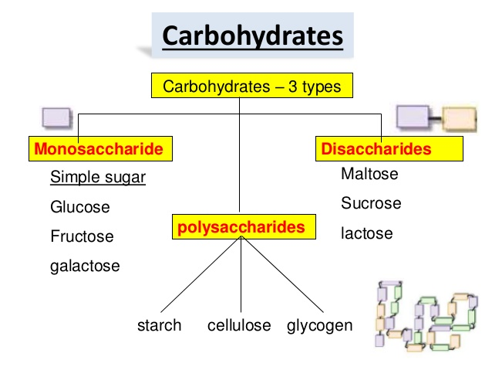

Slide 6
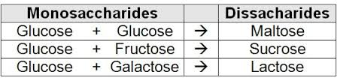
Six sugar molecules important in nutrition
3 single sugars (monosaccharides): fructose, glucose, galactose
3 double sugars (disaccharides): sucrose (table sugar), maltose, lactose

Slide 7
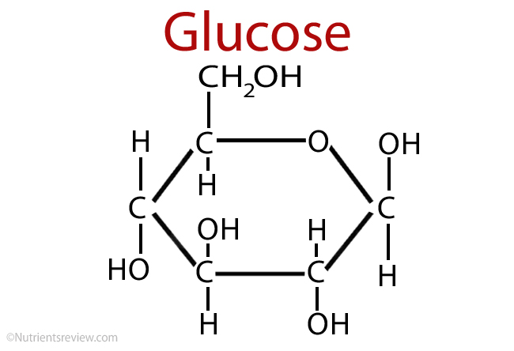
Glucose
The most important monosaccharide in body
Most other monosaccharides and disaccharides become glucose in the body

Slide 8
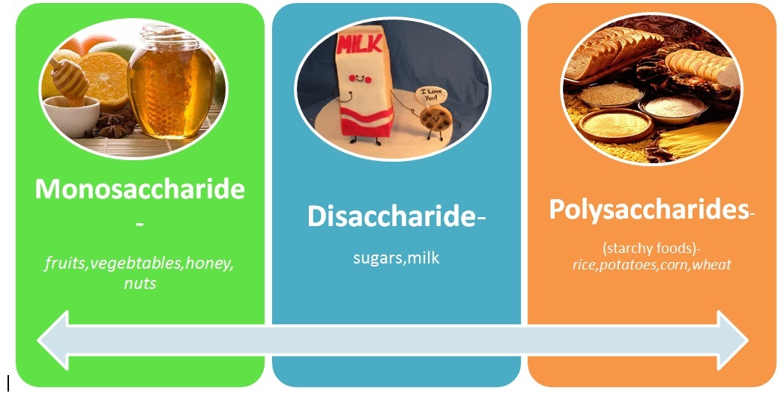
Polysaccharides
Long strands of hundreds to thousands of glucose units: starch, glycogen, fibre

Slide 9
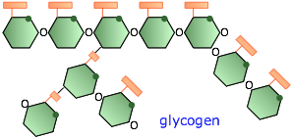
Polysaccharides
Starch – storage of glucose in plants, humans can break them down to provide energy
Glycogen – storage form of glucose in animals and humans
Fibre (i.e., Cellulose) – Glucose chains that are linked in such a way that human enzymes cannot digest them.

Slide 10



Fibres
Soluble fibres: dissolve in water, form gels (viscous), easily digested by bacteria in human colon. Present in oats, barley, legumes, fruits, vegetables
Insoluble fibres: do not dissolve in water, less readily fermented (cellulose, outer layers of whole grains aka bran), strings of celery, hulls of seeds, skins of corn kernels. They aid digestive system by easing elimination

Slide 11
Soluble Fibre
Soluble, viscous, fermentable fibres
Add thickness to food
Readily dissolve in water
Cannot be digested by enzymes to produce energy but may be broken down to absorbable products by bacteria in the digestive tract
Beta-glucan – a type of soluble fiber that has been extensively studied for its health benefits including heart health, healthy cholesterol levels, stabilizing blood sugar and boosting immunity. Highest food sources include: oats, barley, mushrooms & nutritional yeast

Slide 12
Insoluble Fibre
Tough, fibrous structures of fruits, vegetables, and grains
Do not dissolve in water
Indigestible
Aid in elimination through the bowels

Slide 13
Why do nutrition experts recommend fibre-rich foods?
Non viscous, insoluble, less fermentable fibre (from brown rice, fruit, legumes, seeds, vegetable, wheat bran, whole grains):
Alleviate constipation
Lower risks of diverticulosis, hemorrhoids, appendicitis
Weight management
Beneficial prebiotic (support growth of beneficial bacteria)
Soluble, viscous, more fermentable fibre (pectins, psyllium, etc. from barley, oats, bran, rye, fruit, legumes, seeds):
normalize blood cholesterol
Viscous fibre: normalize blood glucose (lower risk of diabetes)
Lower risk of heart disease & diabetes
Lower bad cholesterol
Help with weight management

Slide 14
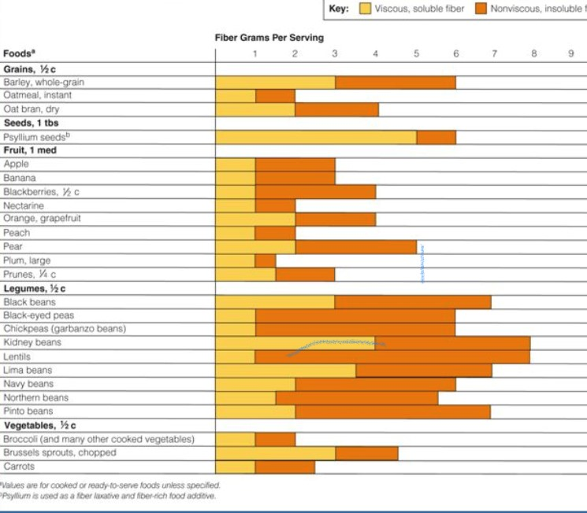
DRI for fibre -
Men 19 - 50 38g/day
Men 50+ 30g/day
Women 19 - 50 25g/day
Women 50+ 21g/day
OR 14g/1000 kcal/day
(USDA)

Slide 15
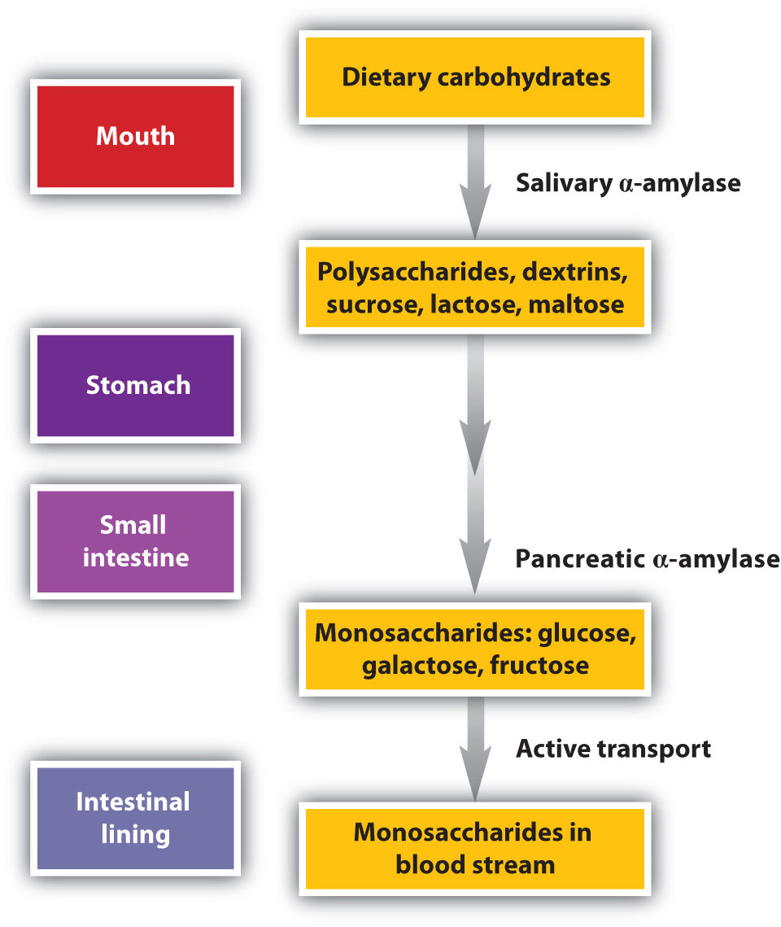
Digestion of Carbohydrates

Slide 16
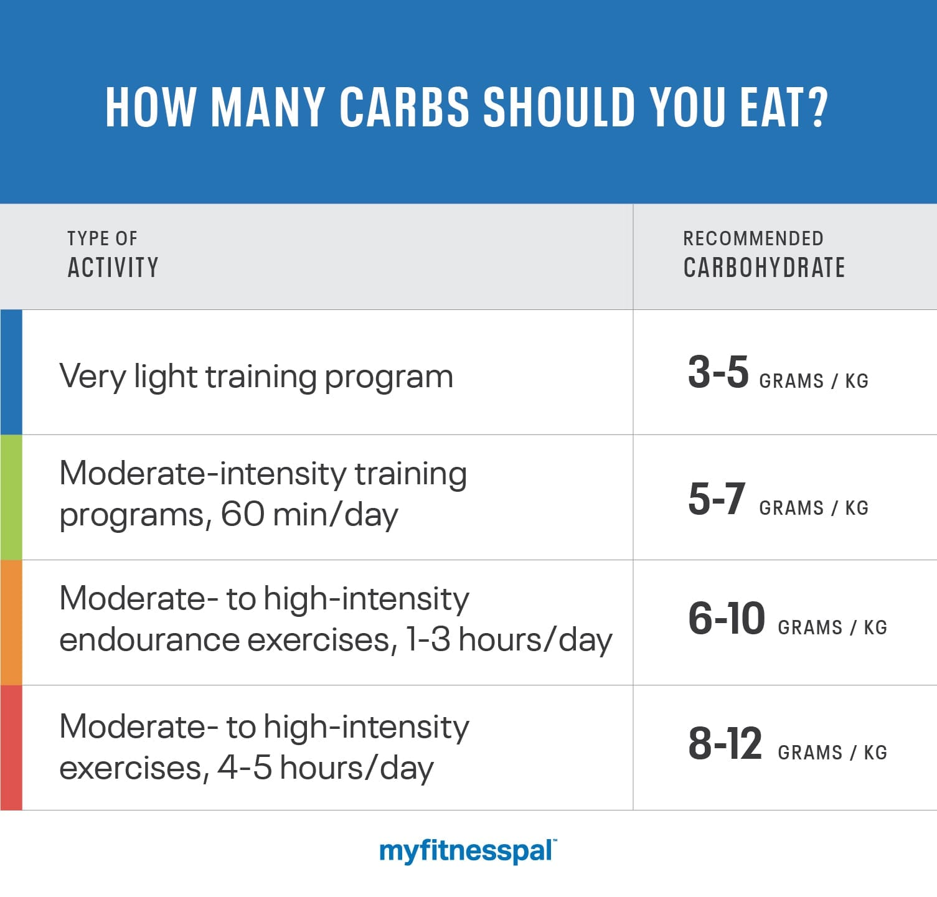
Carbohydrate and Nutrition
-4 calories per gram
USDA recommends 45-65% of your total calorie intake come from carbohydrates

Slide 17
Question: If an individual is consuming a 2000 kcal/day diet and they want 65% of their diet to be carbohydrate, how many grams of carbohydrates will that person need to consume?
The Math:
2000 cal/day * 0.65 = 1300 kcal of carbs
1300 cal / 4 cal per gram = 325 g
Health Canada does not recommend a certain percentage of carbs but does use 300g as their Daily Value for food labeling
Consider: Keto diets generally recommend less than 30g carbohydrate per day, low carb can mean under 50, 75 or 100g/day
When would it be appropriate to follow a low carb – keto dietary plan?
Recall that Inuit & other Northern traditional peoples survived on a very low carbohydrate diet
The controversy over carbohydrate recommendations continues & is a major topic of interest in nutritional science

Slide 18
If I want to lose weight and stay healthy, should I avoid carbohydrates?
Better to consume balanced diet based on foods high in complex carbs
Avoid refined sugars – Why?
400 calories of refined sugars (sucrose, fructose) contain no other nutrients (protein, vitamins, minerals, fibre) VS
400 calories of vegetables or whole grains: proteins, vitamins, minerals, phytochemicals, fibre
OK to choose the refined sugar IF you have met all of your nutrient needs for the day and still have calories to spend

Slide 19
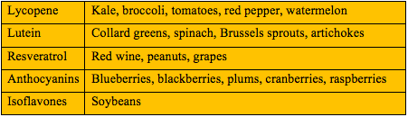
Phytochemicals
Definition: Any chemical compound produced by plants, generally for their own protection. Many are beneficial to human health while some are poisonous.
https://youtu.be/Hja0SLs2kus

Slide 20
Blood Glucose Regulation
Glucose fuels the work of most of our body’s cells. Glucose generates energy through the processes of glycolysis, Krebs cycle and the Electron Transport chain.
When blood glucose rises, the pancreatic hormone insulin stimulates the body cells take take in more glucose. Cells of the muscles and liver will turn this excess glucose into the highly branched polysaccharide, glycogen.
Glucose that exceeds the amount required for energy and glycogen formation will be converted into fatty acids, which will be stored as triglycerides in the adipose tissue.

Slide 21
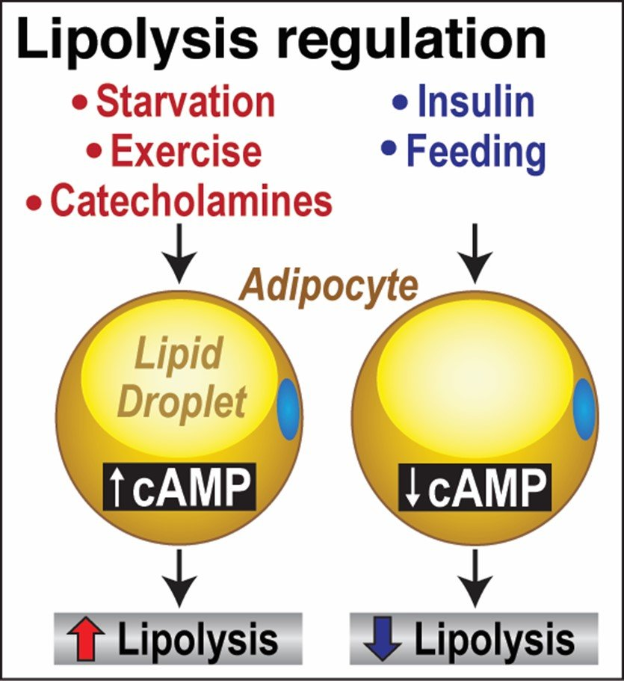
Blood Glucose Regulation
When Blood glucose is low, the pancreatic hormone glucagon triggers the breakdown of liver glycogen to free glucose, through the process of gluconeogenesis.
Glucagon (and other hormones like epinephrine and norepinephrine and catecholamines) will also stimulate lipolysis, which breaks down triglycerides to obtain energy from the fatty acids.

Slide 22
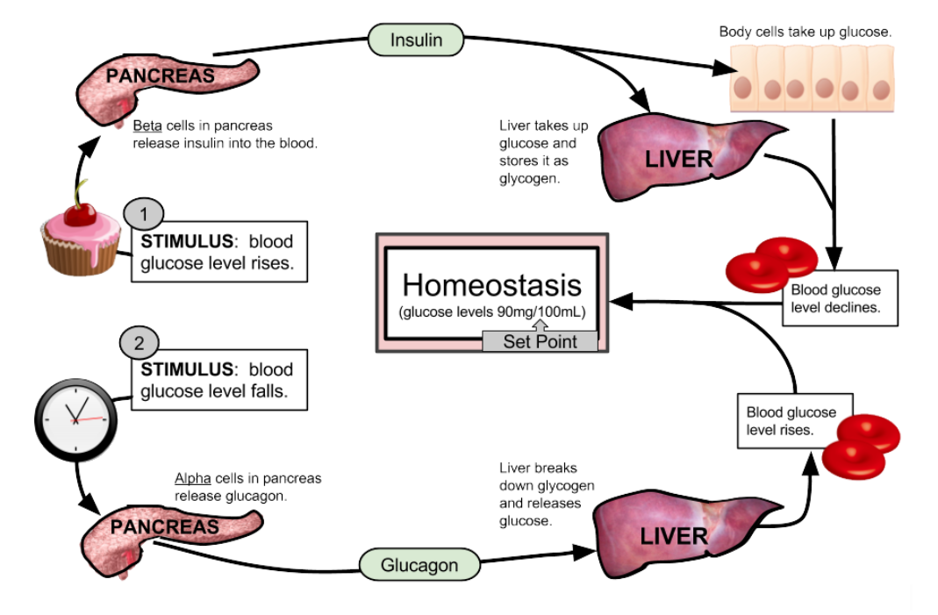
Normal blood glucose: 6 - 10 mmol/L

Slide 23
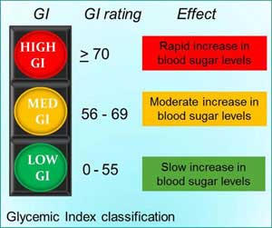
The Glycemic response
Glycemic index (GI): food potential to raise blood glucose relative to a standard (glucose or white bread) https://youtu.be/wxzc_2c6GMg

Slide 24
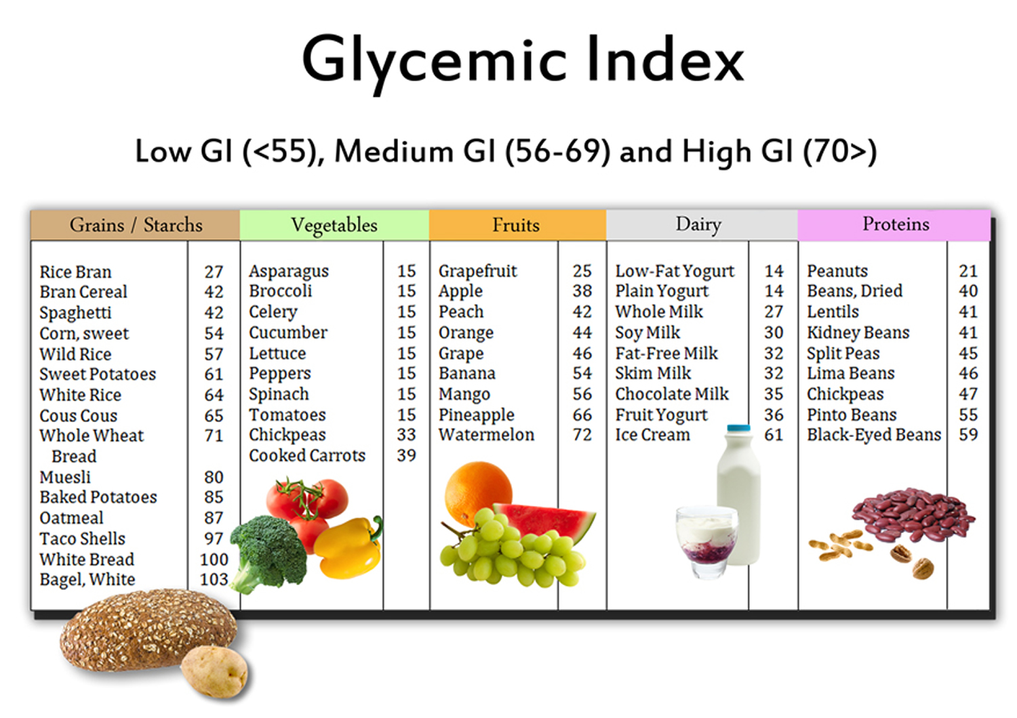
Glycemic Index of Foods

Slide 25
The dietary monosaccharides include
Sucrose, glucose, and lactose
Fructose, glucose, and galactose
Galactose, maltose, and glucose
Glycogen, starch and fibre

Slide 26
The polysaccharide that helps form the supporting structures of plants is
Cellulose
Maltose
Glycogen
Sucrose

Slide 27
Digestible carbohydrates are absorbed as _____through the small intestinal wall and are delivered to the liver, where they are converted to _____
disaccharides; sucrose
glucose; glycogen
monosaccharides; glucose
galactose; cellulose

Slide 28
When blood glucose concentration rises, the pancreas secretes ____, and when blood glucose levels fall, the pancreas secretes _____
glycogen; insulin
insulin; glucagon
glucagon; glycogen
insulin; fructose

Slide 29
Foods rich in fibre can lower blood cholesterol
T
F

Slide 30
Key Points
Body tissues use carbohydrates for energy
The brain and nerve tissues prefer carbohydrate as fuel
Fibres can reduce blood sugars and cholesterol levels
Fibres are a critical fuel source for the bacteria in our guts
Recommendation is that a diet based on foods rich in complex carbohydrates and fibre is good general dietary advice.
But the best dietary advice is very individual! Research is ongoing https://youtu.be/0z03xkwFbw4

