Slide 1
Lecture 2
Digestion, absorption and metabolism

Slide 2
Digestive system – some facts
When your body needs food, your brain and hormones alert your mind to the sensation of hunger (high levels of ghrelin promote food intake)
When you eat, taste buds guide you in finding food acceptable or not
4 basic chemical tastes: sweet, sour, bitter, and salty
Aroma, texture, temperature can also affect flavour
Human ability to detect a food’s aroma is 1,000 x as sensitive as our sense of taste

Slide 3
Preference for sugar, fat and salt: inborn?
Sweet, salty and fatty foods: universally desired
Enjoyment of eating sugar: energy to the brain
Fats: energy and essential nutrients to body tissues
Minerals: salt and chloride important for muscles, neurons, blood pressure, blood pH
Bitter and sour: most people have aversions to them (many toxins are bitter)

Slide 4
Digestive Tract
Once you have eaten, your brain and hormones direct organs of digestive system to digest and absorb the complex mixture of chewed and swallowed food

Slide 5
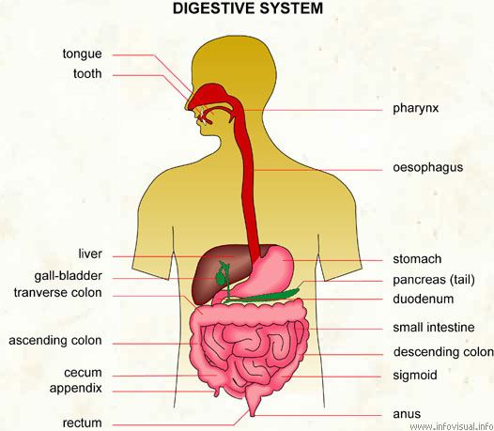
Flexible, muscular tube, digests foods and absorbs its nutrients and some non-nutrients
Digestive organs aid digestion
When you swallow something, it is not inside your body, but inside the tube
Only when nutrient passes through the wall of digestive tract it enters the body’s tissues
2 levels: mechanical digestion and chemical digestion

Slide 6
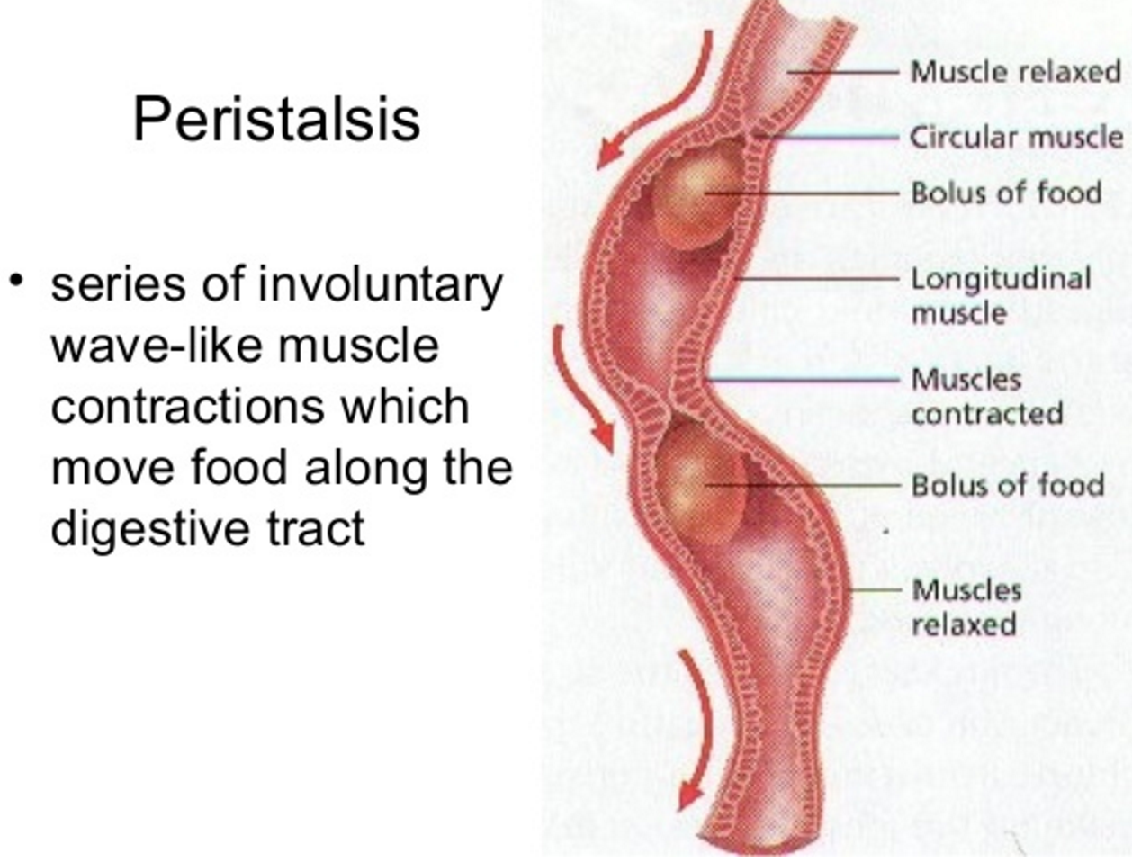
Mechanical aspect of digestion - peristalsis
Chewing, mixing by stomach, adding fluid, moving tract’s contents by peristalsis.
After digestion and absorption, wastes are excreted

Slide 7
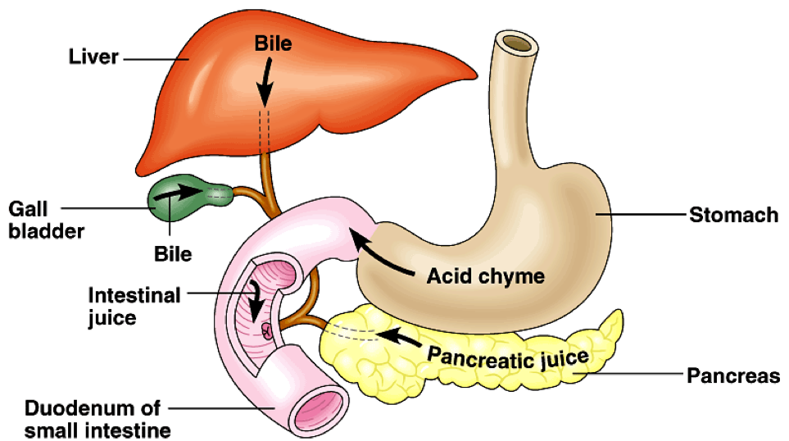
Chemical aspect of digestion – digestive juices
Mouth: Salivary amylase breaks starch and lingual lipase starts digestion of fat Stomach: gastric juice (HCl, water, enzymes) activates pepsin
Mucus protects stomach and digestive tract from being digested
Bile: emulsifier
Pancreatic enzymes, bicarbonate (neutralizes pH)

Slide 8
Stomach Digestive Functions
Mucous cells – secrete mucus to protect the lining of the stomach from stomach acid
Parietal cells – produce intrinsic factor (needed for the absorption of vitamin B12) and hydrochloric acid (HCl)
Hydrochloric acid – decreases stomach pH for denaturation of proteins to take place and converts pepsinogen into pepsin
Peptic cells – secrete pepsinogen (pepsin) and gastric lipase
Pepsin – breaks proteins down into amino acids
Gastric lipase – breaks down triglycerides into fatty acids and monoglycerides

Slide 9
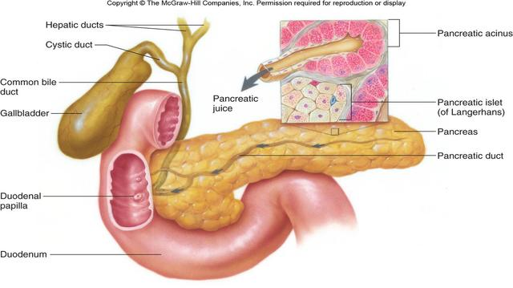
Pancreas: endocrine and exocrine gland
Endocrine:
Insulin
Glucagon
Somatostatin
Exocrine:
Digestive enzymes
to small intestine
Notes:
Endocrine gland: cells in Langerhans islets secrete hormones directly into blood
Exocrine gland: enzymes are secreted to the small intestine through ducts

Slide 10
Pancreatic Enzymes
Secreted along with other components in pancreatic juice
1-1.5Litres secreted daily
Pancreatic juice: sodium bicarbonate, water, some salts, and enzymes
Pancreatic amylase - breaks down carbohydrates
Trypsin - Protein digestion
Chymotrypsin - Protein digestion
Carboxypeptidase - protein digestion
Elastase - protein digestion
Pancreatic lipase - lipid digestion
Ribonuclease (RNAse)
Deoxyribonuclease (DNAse)

Slide 11
Liver and Gallbladder
Hepatocytes (liver cells) secrete bile
Bile: water, bile salts, cholesterol, lecithin, bile pigments, and ions
Bile salts – emulsify fats so they can be more readily digested by pancreatic lipase
Cholesterol is secreted in the bile as well – it can either be reabsorbed in the colon or, with the help of fibre binding to the cholesterol, can be excreted from the body in feces
Gallbladder – storage for bile (constantly produced in liver)

Slide 12
Intestinal Juice and Brush Border
Intestinal Digestive Juice – 1-2 Litres secreted daily
  Water and mucous – slightly alkaline
  Role – to aid the absorption of digested macronutrients along with pancreatic secretions
Brush Border – the fuzzy layer of the small intestine made up of microvilli
  Digestive enzymes secreted to finalize digestion before absorption occurs
    Brush border enzymes – carbohydrate and protein digestion primarily
      Alpha-dextrinase, maltase, sucrase, and lactase
      Peptidases (aminopeptidase, dipeptidase)
      Nucleosidase and phosphatase
Notes:
Protein digestion

Slide 13
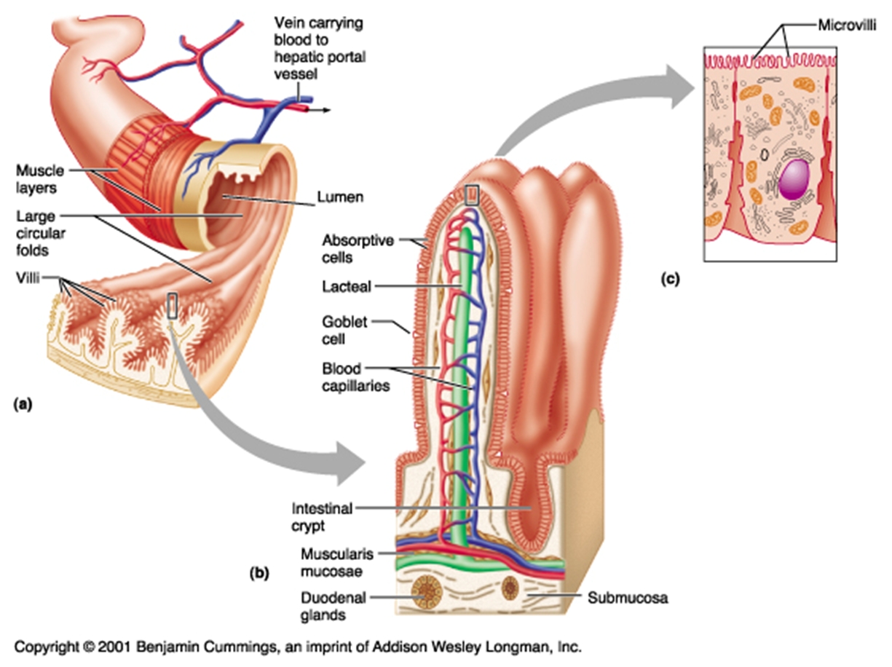

Slide 14
Digestive Tract
Remarkable efficiency:
Within 24 to 48 hrs of eating, a healthy body digests and absorbs about 90% of carbohydrates, fat and protein in a meal
https://www.youtube.com/watch?v=goSC-1YvHVk (~ 16 min)

Slide 15
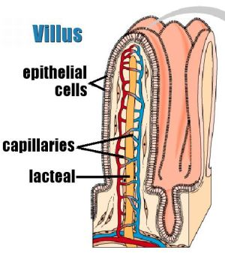
Absorption and transportation of nutrients
Nutrient molecules must traverse one of the cells of the intestinal lining
Cells absorb nutrients from mixture within intestine and deposit them in blood and lymph
Villi: finger-shaped projections in intestinal tract, with microvilli (hairlike projections) that can trap nutrient particles.
Each villus has its own capillary network and lymph vessel so nutrients can be easily transported
https://www.youtube.com/watch?v=-Zyk0H1HmjA (~ 5:30 min)
https://www.youtube.com/watch?v=_A2BW_UnX5c (~ 23:14 min)

Slide 16
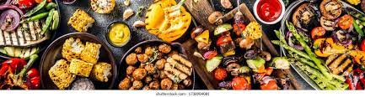
When I eat more than my body needs, what happens to the extra nutrients?
Excess energy-containing nutrients mainly stored in 2 forms:
1. Glycogen (carbohydrate) in muscle and liver
2. Fat (triglycerides) in fat cells

Slide 17
Chemical digestion of all nutrients mainly occurs in which organ?
Mouth
Stomach
Small intestine
Large intestine

Slide 18
Which chemical substance released by the pancreas neutralizes stomach acid that has reached the small intestine?
Mucus
Enzymes
Bicarbonate
Bile

Slide 19
Which chemical substance released by the pancreas neutralizes stomach acid that has reached the small intestine?
Mucus
Enzymes
Bicarbonate
Bile

Slide 20
Bile starts the process of protein digestion in the stomach
TRUE FALSE

