Slide 1
Disorders of Digestion, Absorption, and Metabolism

Slide 2
Disorders of Digestion – Food Allergy vs Intolerance vs Sensitivities
FOOD ALLERGY- Only affects 2-5% of the population.
IgE antibodies react to a protein component of a food as if it were a pathogen
Reaction starts to occur within maximum 20 minutes of consuming the food so usually easy to identify culprit
Symptoms can include: tingling or itching in the mouth, swelling of lips, face, tongue or throat, abdominal pain, diarrhea or vomiting, dizziness, hives, itching or eczema
Can progress to ANAPHALAXIS – severe dyspnea, rapid pulse, shock
Most common food triggers in children: peanuts, soy, tree nuts, eggs, cow’s milk (whey or casein or other protein), wheat
In adults: peanuts, tree nuts, shellfish, fish
Children may out grow their allergies

Slide 3
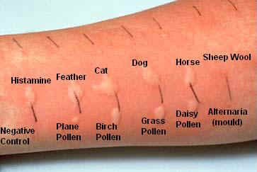
Food Allergies cont.
How are food allergies diagnosed? Skin prick test is the most common method. Skin is
Scratched & allergens are
Placed on the open skin.
Or allergens may be
injected just under the
skin. A red, swollen reaction confirms allergy.
Treatments: antihistamines, Epipen, allergy shots (small amounts of allergen in hopes of desensitizing – used more in environmental allergies), most often life-long food allergen avoidance

Slide 4
Oral Allergy Syndrome or Pollen-Food Allergy
Proteins in certain fruits, vegetables, nuts & spices are similar to proteins in pollens that are commonly involved in allergies.
Ragweed pollen- bananas, cucumber, melons, zucchini
Grasses- cucumber, kiwi, melons, orange, peanut, tomato, potato, zucchini
Birch- almond, apple, apricot, carrot, celery, cherry, stone fruits, potato, soy, many spices
Mugwort- apples, peppers, garlic, onion, broccoli, cabbage, some spices
Symptoms are similar to food allergy & often involve tingling, swelling, itching of the mouth.
Cooking these foods tends to reduce symptoms by denaturing the proteins.

Slide 5
Food Intolerances
More common than true food allergy, intolerances affect 15-20% of the population.
NOT an immune system reaction, intolerances involve trouble digesting foods for various reasons. Eg. A deficiency of an enzyme, a structural digestive problem such as diverticulosis etc.
Often associated with functional GI disease such as IBS
Symptoms: bloating, excessive gas, stomach pain/heartburn, headache/migraine, chronic runny nose/sinusitis
Common intolerances are: lactose, gluten, Food colourings/preservatives, sulfites, salicylates, Histamine & FODMAPS

Slide 6
Food Intolerances
Complex Carbohydrate intolerance
Trouble digesting beans, cereals, nuts & seeds
  Symptoms:
    Diarrhea, flatulence, abdominal cramps
  Mechanism
    Increased number of particles in the intestine draws water into the intestine which activates the peristaltic (wave-like) motion of the intestine and induces frequent passing of watery stools
    Bacteria in the colon ferment undigested carbohydrates to short chain fatty acids, gases, and irritating compounds
    Treatment: avoidance and or supplemental digestive enzymes such as bromelain, papain, amylase, Beano

Slide 7
Food Intolerances
  Lactose Intolerance – deficiency of the enzyme lactase, which breaks down the disaccharide lactose
  https://youtu.be/_i2ccIGYPx0
  Age and genetics (lactase persistence in Northern European ancestry & some others)
  Primary cause of lactose intolerance is low lactase activity after weaning.
  Secondary cause are diseases that affect the villi and brush border of the intestine and inflammation or infection of the GI tract
  Rarely can be congenital & baby will have trouble digesting breast milk or cows milk formulas
  Can supplement with the lactase enzyme, eat no/low lactose dairy products, or eat plant-based dairy substitutes such as almond milk, cashew cheese etc.

Slide 8
Histamine Intolerance
You naturally produce Histamine as well as DAO – the enzyme that breaks down histamine.
Eating a lot of histamine rich foods and/or a DAO deficiency can cause high Histamine levels and Histamine intolerance. Some things that can reduce DAO are: certain medications, inflammatory bowel disease, bacterial overgrowth, as well as chronic allergies.
Symptoms: digestive disturbances, hives/itching/flushed skin, headaches/dizziness, tachycardia
Treatment: Avoidance of high histamine foods including: alcohol, fermented foods, dried fruits, processed/smoked meats, shellfish & aged cheese.
https://youtu.be/fbm3gZgxWGx

Slide 9
FODMAPs
Monash University (Australia) discovered a connection between IBS and some types of carbohydrates – Fermentable oligosaccharides, disaccharides, monosaccharides & Polyols.
Symptoms after eating high FODMAP foods in some people are: cramping, diarrhea, constipation, bloating, gas
Treatment: Elimination – Challenge diet of the various categories of high FODMAP foods

Slide 10
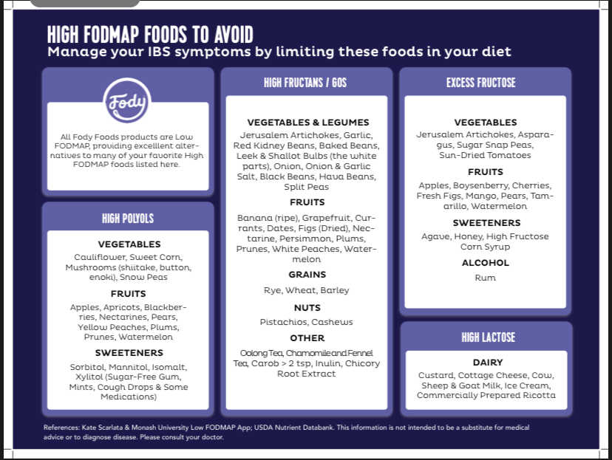

Slide 11

Food Sensitivities/ Delayed Allergy
Reactions to foods that do not develop within 20 mins. Thought to be mediated by IgG antibodies to the protein components of food.
Diagnosis: Elimination- Reintroduction Diet, Blood test for IgG antibodies (some controversy over its usefulness)
Symptoms seem to worsen with increased exposure – both dose & frequency
Symptoms can include: headache/migraine, GI symptoms from GERD to diarrhea, IBS, obesity, autoimmune conditions, joint & muscle pains, skin conditions such as eczema, acne, chronic rash, chronic sinusitis, lowered immunity
Most commonly reactive: Dairy, Gluten
& gluten-containing grains, egg, corn, soy, peanut, tree nuts, pea,
Nightshade vegetables (tomato, potato, peppers)

Slide 12
Disorders of Absorption
Intrinsic Factor Deficiency
Irritable Bowel Syndrome
Inflammatory Bowel Disease – Crohn’s, Ulcerative Colitis
Celiac Disease

Slide 13
Disorders of Absorption
Intrinsic Factor Deficiency
  Intrinsic factor is secreted in the stomach and binds to vitamin B12
  IF is necessary to absorb vitamin B12
  Genetic deficiency can cause low levels of vitamin B12 in the body
  Low stomach acid (hypochlorhydria) also causes IF to decrease and subsequently causes low vitamin B12 levels.
  Symptoms of low B12:
    Fatigue, depression, sore tongue, pins and needles sensation, diarrhea or constipation, rapid heartrate, panic attacks, paranoia, memory loss
  Symptoms of low stomach acid:
    Feeling excessively full after eating, constipation, bloating, gas/flatulence, brittle nails, hypothyroidism, difficulty digesting protein
    https://youtu.be/aww5NiahRb8

Slide 14
Disorders of Absorption
Irritable Bowel Syndrome
  Symptoms: abdominal pain, bloating, gas, abnormal bowel movements (alternating constipation and diarrhea)
  IBS is usually a symptom of something else that has not been determined medically. It is known as a diagnosis of exclusion.
  One theory is that food sensitivities (such as a FODMAP sensitivity), especially to carbohydrate containing foods, may cause the symptoms of IBS.
  Caffeine, stress, medications, antibiotics, GI illness, lack of sleep, lack of rest, and lack of fluid intake worsen symptoms
  10-20% of adults may have this syndrome

Slide 15
Disorders of Absorption
Inflammatory Bowel Disease – Crohn’s, Ulcerative Colitis
Signs & Symptoms: diarrhea, bleeding in BM, general illness –fatigue, fever
  Ulcerative Colitis – generally affects rectum & low colon
  Crohn’s disease – often affects ileocecal area, can be throughout the entire intestinal tract. Often presents with “skip lesions”. Affects more females.
https://youtu.be/iefghc2g91M

Slide 16
Disorders of Absorption
Celiac Disease
  Caused by an immune system response to the protein gliadin or gluten
  What is gluten? https://youtu.be/zDEcvSc2UKA
  Gluten is present in wheat, rye, barley, & other grains
  In celiac disease, Gluten must be avoided strictly for life
  The immune response destroys the small intestine villi
    Leads to decreased surface area for nutrient absorption, reduced amount and activity of brush border enzymes, and reduced ability to absorb nutrients
  Symptoms:
    May be symptom free
    Significant GI distress, malabsorption and malnutrition

Slide 17
Disorders of Absorption
Celiac Disease
  Symptoms continued:
    In children 3 months – 3 years: diarrhea, growth failure, vomiting, bloated abdomen, and abnormal stools, increased cavities, fatigue and mood disturbance
    In adults: weight loss or gain, weakness and fatigue, malnutrition, anemia, low bone density (osteopenia), muscle weakness, peripheral neuropathy, joint pain, etc.
    Why do so many people think they have a problem with gluten?
    https://youtu.be/uEM2iDT-VAk

Slide 18
Disorders of Absorption
Cystic Fibrosis- An inherited, life-threatening disease that affects many organs.
  Glands that make sweat & mucus are affected
  In the GI system, CF affects the pancreas. The secretions become too thick & can clog the ducts.
  The person with CF can then have trouble absorbing proteins, fats & the fat-soluble vitamins.
  Over time, the endocrine function of the pancreas can also become damaged, leading to CF Related Diabetes, which is a unique type of insulin dependent diabetes
  Digestive Symptoms may include: greasy stool, bloody diarrhea, stomach pain & rectal prolapse
  https://youtu.be/GoLgsrbMbCQ

Slide 19
Disorders of Eating
Anorexia nervosa- body dysmorphia leads to a significantly low body weight
- Results in multiple nutrient deficiencies over time
- one of the most serious & potentially fatal psychiatric disorders
Bulimia nervosa- recurrent binge-purge cycles
results in imbalances of the electrolyte ions – sodium, potassium, magnesium, calcium etc. This leads to GI and Cardiovascular symptoms. Often present with edema.
Orthexia nervosa- An unhealthy focus on eating in a healthy way. Person imposes overly strict dietary rules. Can be related to OCD.
Treatments involve counselling, nutrition/dietician support, nutritional supports such as supplements, IV nutrition
https://youtu.be/2aWgUILtn7Q

Slide 20
Disorders of Metabolism
Disorders of Carbohydrate Metabolism
  Diabetes
Disorders of Lipid Metabolism
  Cardiovascular Disease
  Atherosclerosis
Disorders of Protein
  Marasmus
  Kwashiorkor
  Protein Excess

Slide 21
Disorders of Metabolism
Disorders of Blood Sugar Regulation – On the road to diabetes
Postprandial (after eating) carbohydrate metabolism
  Blood glucose levels rise after eating and the amount of increase reflects
    The amount of CHO consumed
    Rate of digestion and rate of glucose entry into the bloodstream
    Rate of glucose uptake by the body’s cells
    Normal blood glucose levels: fasting or before meals 4.0 – 7.0 mmol/L
                2 hours after a meal 5.0 – 10.0 mmol/L
    Hemoglobin A1C: Normal < 5.7%, prediabetes 5.7 – 6.4%, diabetes >6.4%
    https:youtu.be/llyMmg5e2qi

Slide 22
Disorders of Metabolism
Glycemic effect of food
  Extent to which foods elevate blood glucose compared to a glucose solution or white bread
  Low glycemic number is best: legumes, peas, beans
  High number: white bread, potatoes, juice, sugar
  Factors that affect the G.I.:
    Type of food (eg. An apple is lower than apple juice)
    Cooking method (eg. A baked potato is lower than mashed)
    How it is eaten (eg. Eaten alone or in combination with other foods)
    Glycemic Index Chart

Slide 23
Disorders of Metabolism
Glucose metabolism
  Transported into cells via the hormone insulin. The exception to this being the brain, nerves, red blood cells which do not require insulin; glucose can enter all the time.
Class Activity (10 min) What are the symptoms of low and high blood glucose levels?
High:
Low:

Slide 24
Disorders of Metabolism
Diabetes
  Type 1 diabetes – less than 10% of diabetes is type 1
    Auto-immune destruction of the pancreatic cells that release insulin
    Insulin injections are required to make sure the body gets enough glucose into the cells for energy and proper functioning.
  Type 2 diabetes – 90% of cases
    Risk factors include obesity, weight gain, genetics, smoking, high blood pressure, gestational diabetes, ethnic background
    Pancreas produces lots of insulin but body cells respond poorly
    Increase risk for CVD, Kidney disease, cataracts/blindness, amputations due to gangrene

Slide 25
Disorders of Metabolism
Warning signs of pre-diabetes:
Feeling weak, shaky or hangry when going without food for a few hours
Developing many skin tags
Development of areas of dark, velvety skin – Acanthis Nigricans
Warning signs of diabetes:
  Increased urine and thirst (excessive)
  Glucose in the urine (can test with a urine dipstick)
  Weight loss, nausea, weakness, irritability
  Craving for food and sweets
  Drowsiness
  Vision disturbances
  Frequent infections (skin and itching) and slow healing
  Pain in legs, feet, or fingers

Slide 26
Disorders of Metabolism
Disorders of Lipid Metabolism
  Cardiovascular Disease and Atherosclerosis

Slide 27
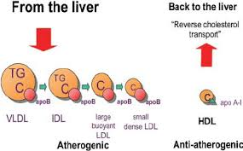
Disorders of Metabolism
High Cholesterol
  May increase risk for heart disease and cardiovascular disease and stroke
  Normal Blood levels:
    Total cholesterol ideal is <5.2 mmol/L; high is > 6.2 mmol/L
    HDL > 0.9 mmol/L is desired
    LDL <3.5 mmol/L ideal; > 4.0 mmol/L is high
    Triglycerides Normal < 1.7, high is >2.2

Slide 28
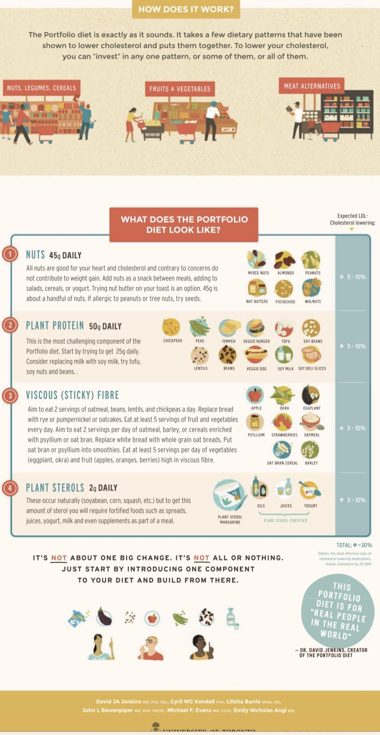
Cholestrol continued
    How much of a risk factor for atherosclerosis is high blood cholesterol?
    https://youtu.be/AuhW4e-Ych0
    Lowering cholesterol through diet: The Portfolio Diet
    https://www.albertahealthservices.ca/assets/info/nutrition/if-nfs-portfolio-eating-pattern-form.pdf

Slide 29
Disorders of Metabolism
Atherosclerosis
  Most common form of heart disease
  Plaque development in the artery walls leads to hardening and narrowing of the arteries
  Narrowing leads to high blood pressure and increased risk for a blood clot to become trapped and cause a heart attack or stroke

Slide 30
Disorders of Metabolism
Disorders of Protein
  Marasmus
  Kwashiorkor
  Protein Excess

Slide 31
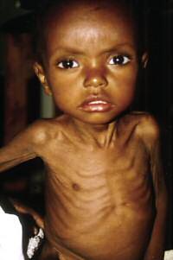
Disorders of Metabolism
Marasmus
  Less than 2 years of age
  Total diet deficiency
  Malabsorption
  Slow, chronic progression
  Severe weight loss
  Muscle and fat loss
  No edema
  <60% weight for age normal
  No fatty liver
  Anxiety, apathy
  Appetite high or low or normal
  Hair, skin problems

Slide 32

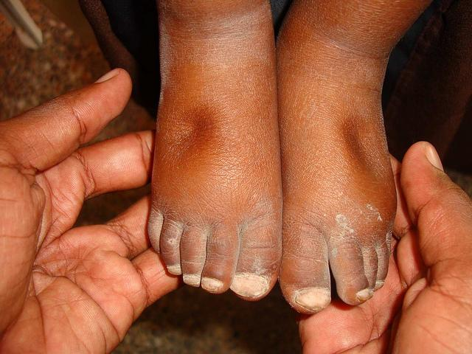
Disorders of Metabolism
Kwashiorkor
  1-3 years of age
  Protein deficiency only
  Rapid onset, acute
  Some weight loss
  Some muscle loss
  60-80% weight for age
  Edema
  Fatty liver
  Apathy, irritability
  Loss of appetite
  Hair, skin problems

Slide 33
Disorders of Metabolism
Protein Excess
  Associated with obesity
  Leads to kidney and liver problems
  Can lead to bone mineral loss with high intake of purified protein (increased calcium lost in the urine) (not much evidence for meat protein causing low calcium levels)
  Kidney disease – due to increased work of the kidneys to excrete nitrogen wastes (recall ammonia and urea are wastes of protein metabolism in the body)
  OR DOES IT? https:/youtu.be/d94aU-LbH94

