Slide 1
Proteins and Amino Acids

Slide 2
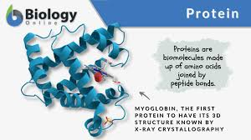
Protein
Proteins are arranged as strands or chains of amino acids
Amino acids – the building blocks of proteins – all types consist of the same basic structure however the side chain changes. 20 different kinds.
Essential amino acids – cannot be synthesized by the body or cannot be synthesized in quantities sufficient to meet body needs. Must be obtained through dietary sources.
Peptide bonds – how amino acids are linked in order to create proteins
Collagen – a type of protein in the body – tendons, ligaments, scars, etc. Connective tissue

Slide 3
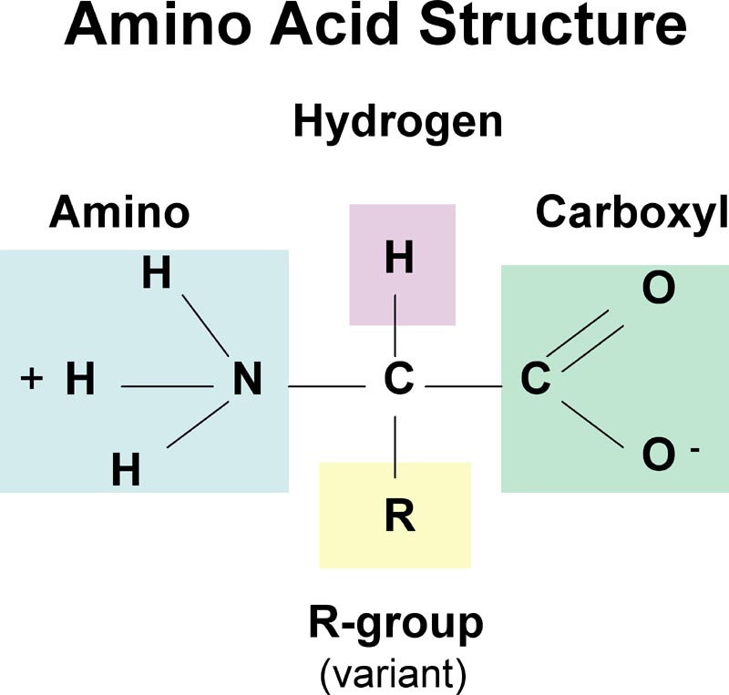
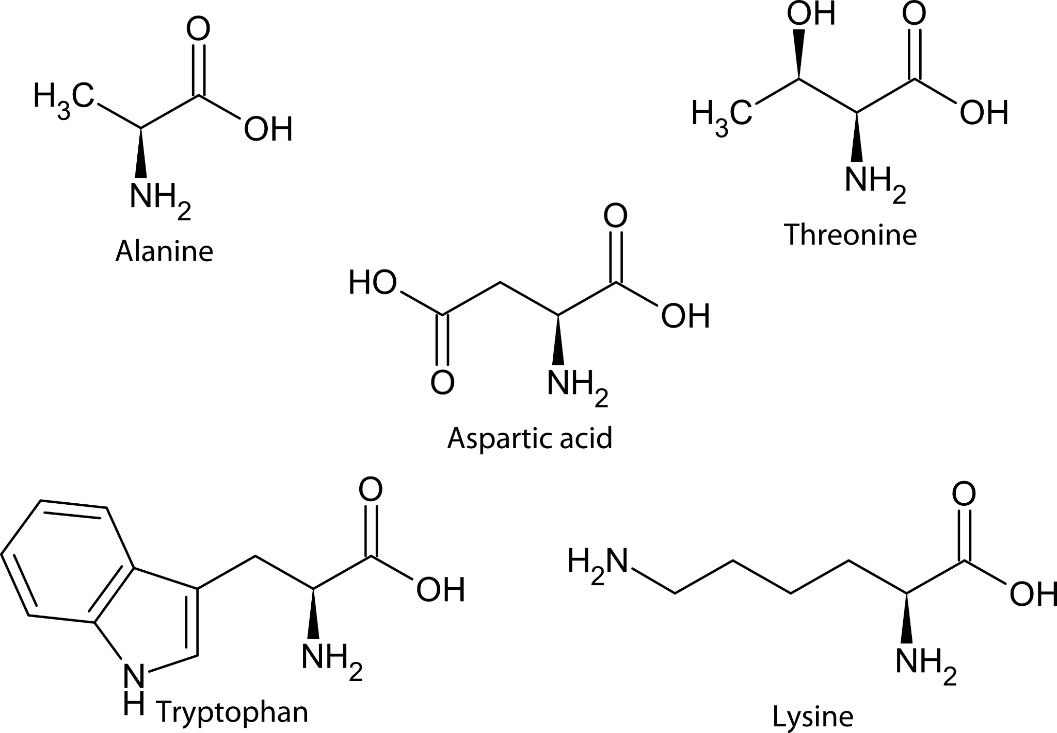
Amino Acid Structure

Slide 4
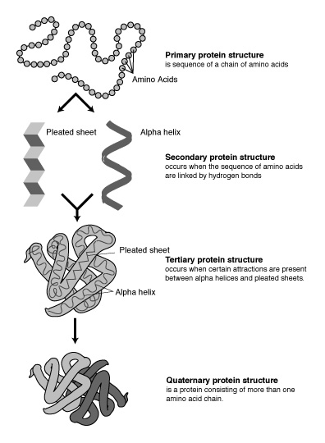
Protein Structures
Primary - chains of amino acids such as in Insulin
Secondary - Interactions between atoms in the backbone of the polypeptide (does not involve R groups) Produces most often a helix or pleated sheet shape.
Tertiary - 3D structure of the protein. Due to interactions between the R groups.
Quaternary - Only some proteins have this shape, when subgroups join together. One example is Hemoglobin, which has four subgroups.
Denaturation - When a protein loses its 3D shaping, & is reduced to its primary structure. Usually makes the protein non-functional. Can sometimes be reversed but often not - think of an egg white which becomes solid & opaque after heating and will not become clear again once cooled.

Slide 5
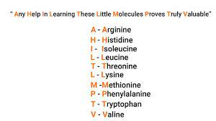
Essential Amino Acids
PVT TIM HALL (acronym)
  Phenylalanine
  Valine
  Tryptophan
  Threonine
  Isoleucine
  Methionine
  Histidine
  Arginine
  Leucine
  Lysine

Slide 6
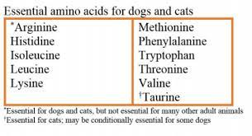
Non-Essential Amino Acids
Alanine
Asparagine
Aspartic Acid
Cysteine
Glutamic Acid
Glutamine
Glycine
Proline
Serine
Tyrosine
FYI - Essential amino acids varies by species

Slide 7
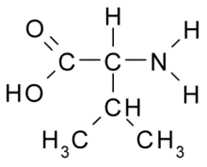
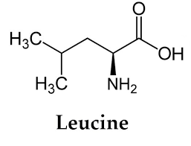
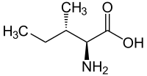
What about BCAAs?
BCAAs or Branched Chain Amino Acids are the essential amino acids leucine, isoleucine & valine. They are present in high concentrations in muscle tissues. Initial studies have shown some benefits to supplementing BCAAs before, during or after exercise to increase muscle growth, decrease post-workout soreness & reduce exercise fatigue. BCAAs have also shown some promise in treating liver disease.

Slide 8
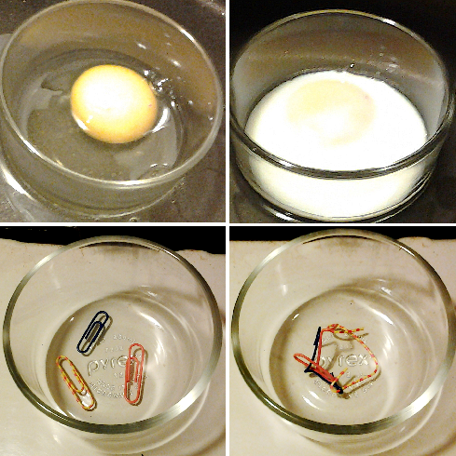
Protein Digestion
Proteins must be broken down into amino acids prior to absorption
Denaturation – the irreversible change in a protein’s shape brought about by heat, acids, bases, alcohol, salts of heavy metals, etc.
Acid-tolerant proteins (enzymes)
Stomach – hydrochloric acid, pepsin
Small intestine – proteases (from pancreas)
Brush Border – peptidases
From proteins → polypeptides
Polypeptides → di and tri-peptides
Di and Tri-peptides → amino acids
Notes:
Isn’t the stomach lining made of proteins too? Yes, but mucous protects these proteins from being denatured by acid. If the mucous barrier is disrupted, an ulcer can form.

Slide 9
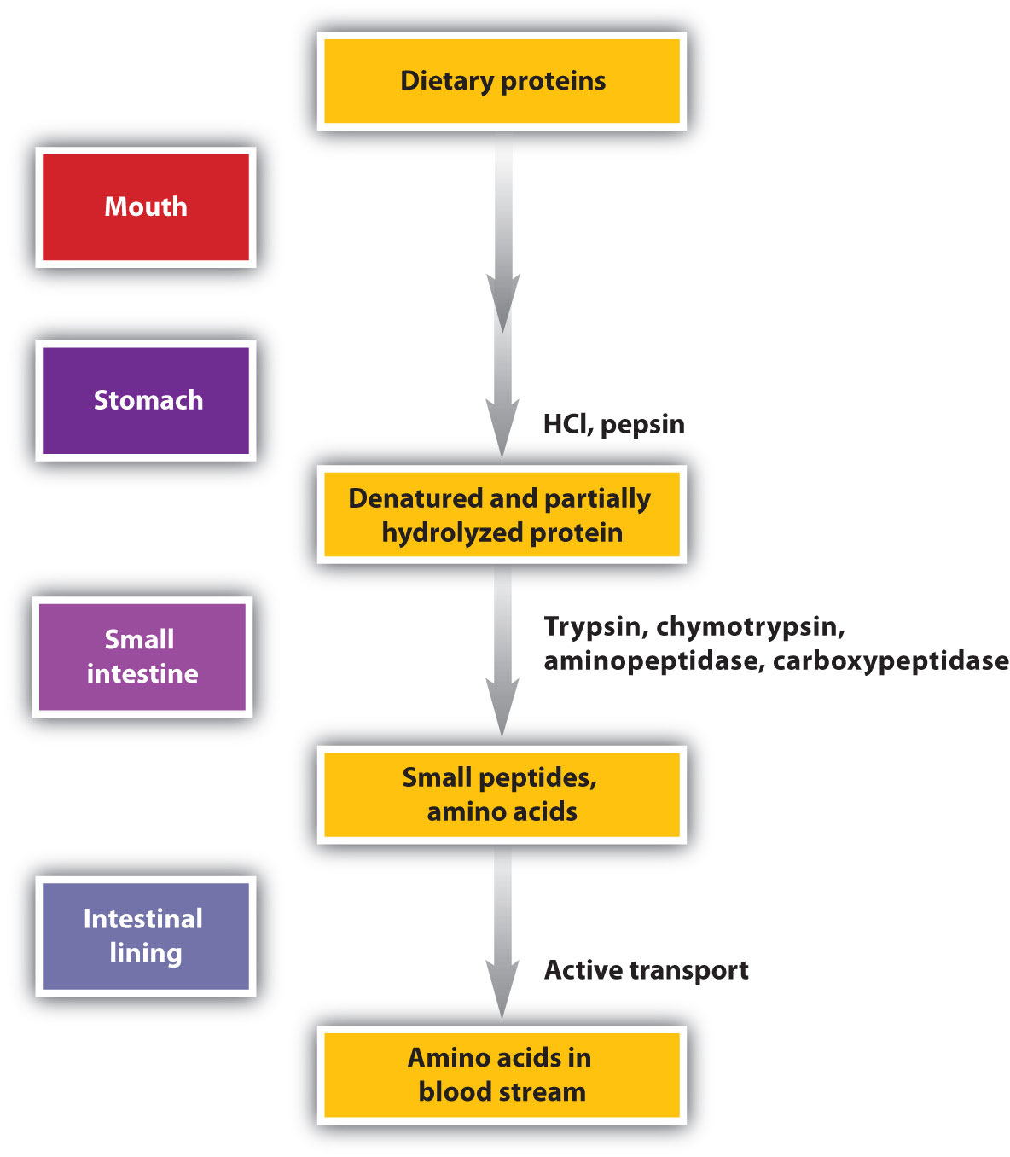

Slide 10
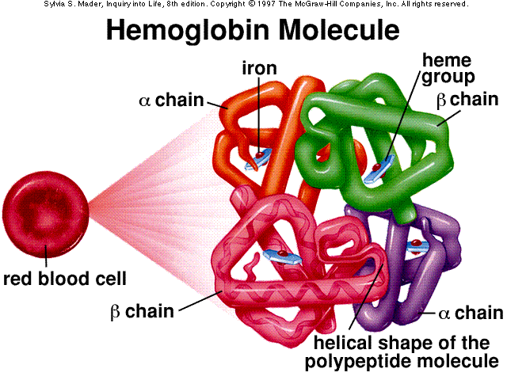
Important Body Proteins
Every cell in the body contains protein.
Structural Components:
Actin & Myosin
Collagen
Transport &/or Storage:
Hemoglobin
Ferritin
Messenger / Hormones:
Growth Hormone
Insulin
Antibodies

Slide 11
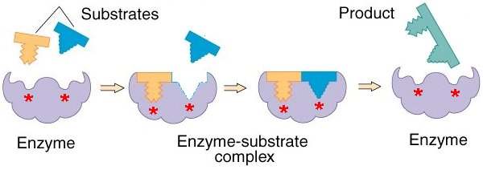
Important Body Proteins
Enzymes - There are many enzymes in the human body that carry out thousands of chemical reactions.
https://youtu.be/V_E7mq8bv4g
https://youtu.be/7gK-5tLFM50
Notes:
Every:
3 days – every cell in the gastrointestinal tract replaced
3-4 months – new red blood cells (5L of blood in body approximately)

Slide 12
Important Body Proteins
Growth and Maintenance
  Muscles
  Blood
  Embryo
  Growing child
  Scar tissue after injury or surgery
  Hair and nails
Protein turnover – the continuous breakdown and synthesis of body proteins involving the recycling of amino acids
  Daily approximately ¼ of all available amino acids are irretrievably used for other uses (eg. Fuel) – why we need proteins from food every day
Notes:
Every:
3 days – every cell in the gastrointestinal tract replaced
3-4 months – new red blood cells (5L of blood in body approximately)

Slide 13
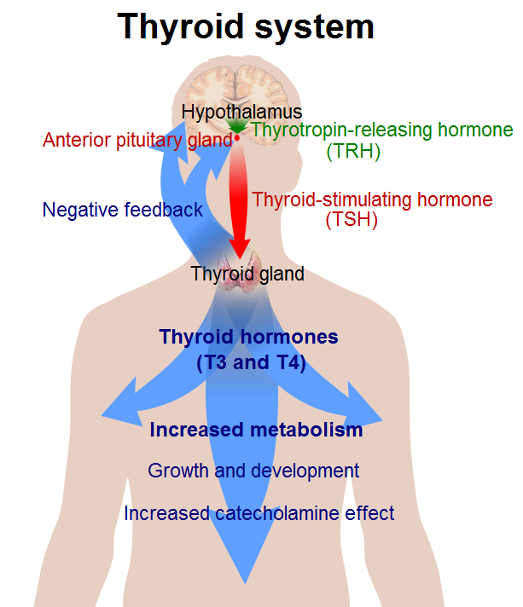
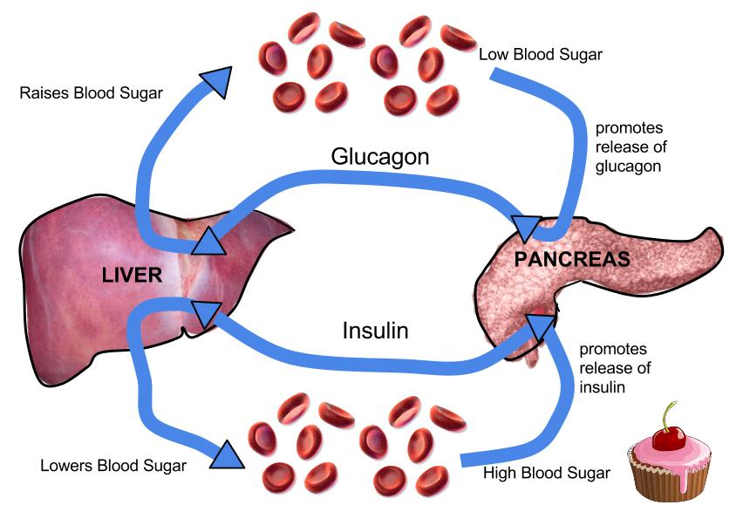
Important Body Proteins
Hormones (recall some hormones are made from lipids)
  Eg: Thyroid hormone, insulin, glucagon
Notes:
Every:
3 days – every cell in the gastrointestinal tract replaced
3-4 months – new red blood cells (5L of blood in body approximately)

Slide 14
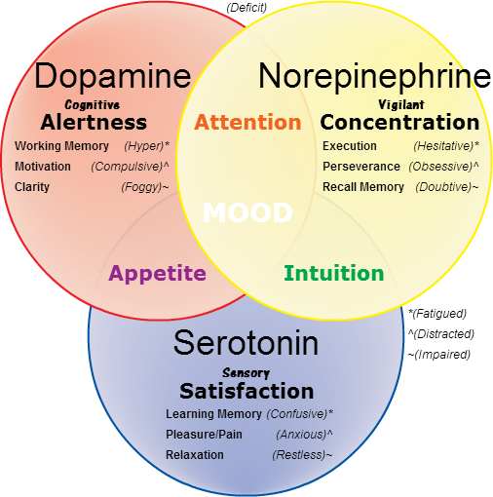
Important Body Proteins
Skin, hair, eye colour – melanin is a protein
Neurotransmitters
  Serotonin – “feel good” chemical in the brain – anti-depressant medications increase serotonin levels in the brain.
    Made from tryptophan
    Cashews also increase serotonin
Notes:
Every:
3 days – every cell in the gastrointestinal tract replaced
3-4 months – new red blood cells (5L of blood in body approximately)

Slide 15
Important Body Proteins
Antibodies
  Recognize every protein that belongs within the human body and leaves these alone
  Identifies foreign proteins that invade the body and attack them (bacteria, virus, toxin)
    Hyperactive response – allergies develop (trees, grasses, molds, dust, animals, foods)
    Autoimmune diseases – body begins to attack proteins that are “normal” within the body – this is an abnormal process
Notes:
Every:
3 days – every cell in the gastrointestinal tract replaced
3-4 months – new red blood cells (5L of blood in body approximately)

Slide 16
Important Body Proteins
Acid/base balance
Blood Clotting
Energy
Fluid and electrolyte balance
Transportation
Notes:
Every:
3 days – every cell in the gastrointestinal tract replaced
3-4 months – new red blood cells (5L of blood in body approximately)

Slide 17
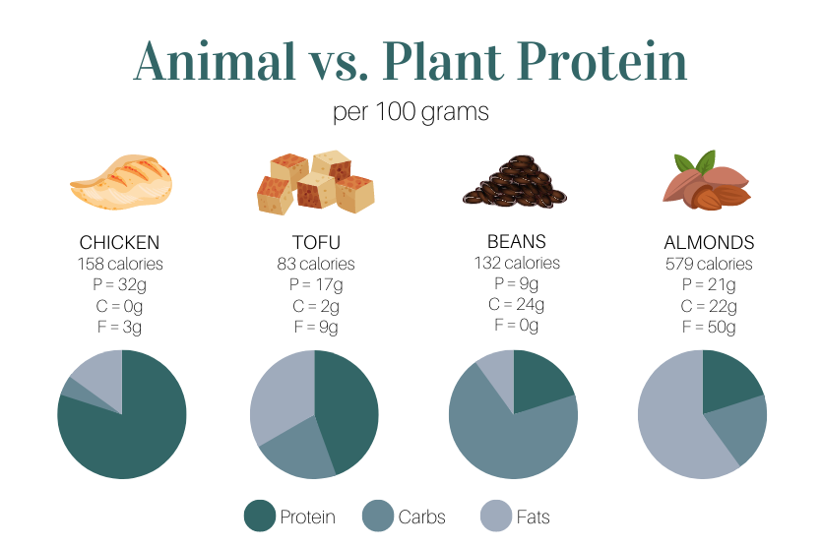
Food Sources of Protein
Digestibility
  Animal protein is highest
  Legumes (beans/lentils) – 80-90%
  Grain and other plant sources – 70-90%
  Cooking with moist heat increases
  Dry heat decreases

Slide 18
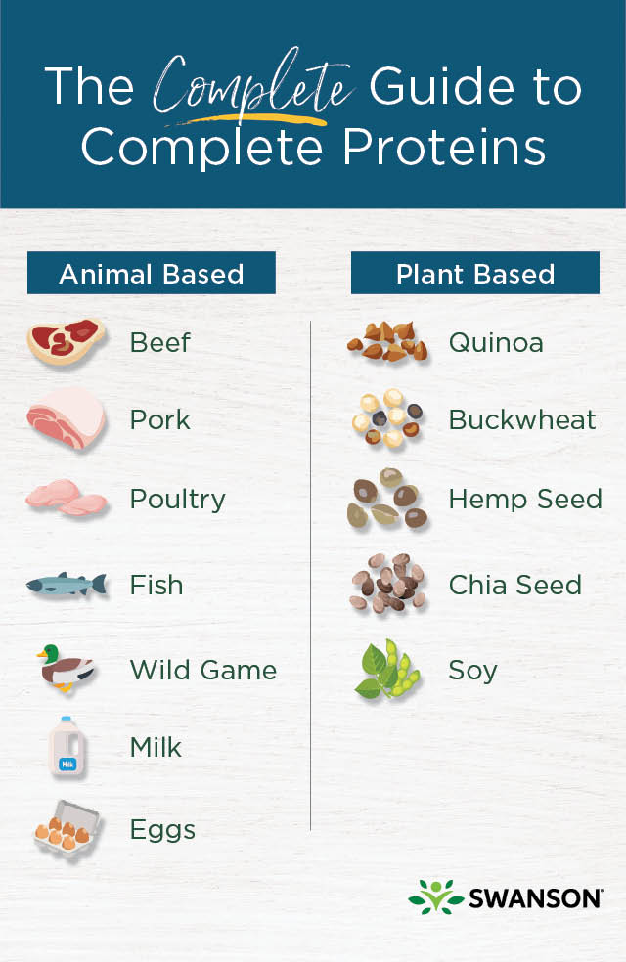
Complete vs Incomplete Proteins
A food that contains all 9 essential amino acids is called a complete protein.
In general, proteins from an animal source such as meat and dairy are usually complete proteins, while many plant proteins can be lacking one or more essential amino acids.
This is one reason why vegan protein powders are usually composed of a blend of plant sources.

Slide 19
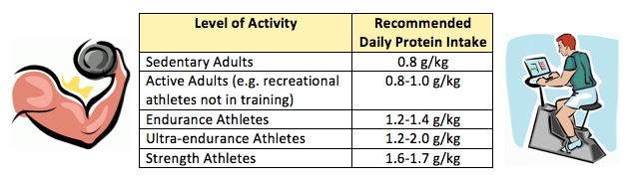
Protein Requirements
EAR -0.6g/kg body weight
DRI – 0.8g/kg of body weight
AMDR - 10- 35% of total calories (1.05 - 3.67g/kg body weight)

Slide 20
Too much protein is toxic?
For many years, eating too much protein was considered potentially dangerous, especially regarding kidney function. In recent years, research is showing no correlation between kidney stone formation & kidney function in those consuming 20 -30 % of their calories from protein sources without pre-existing kidney disease.. Many nutrition scientists are now recommending eating protein levels above the DRI level & replacing nutrient poor carbohydrates & saturated fats with increased proteins.
https://www.ncbi.nlm.nih.gov/pmc/articles/PMC5347101/#:~:text=The%20Acceptable%20Macronutrient%20Distribution%20Range%20(AMDR)%20(10%E2%80%9335,than%20that%20of%20the%20RDA.
https://brighterworld.mcmaster.ca/articles/myth-busted-researchers-show-that-a-high-protein-diet-does-not-affect-kidney-function/

Slide 21
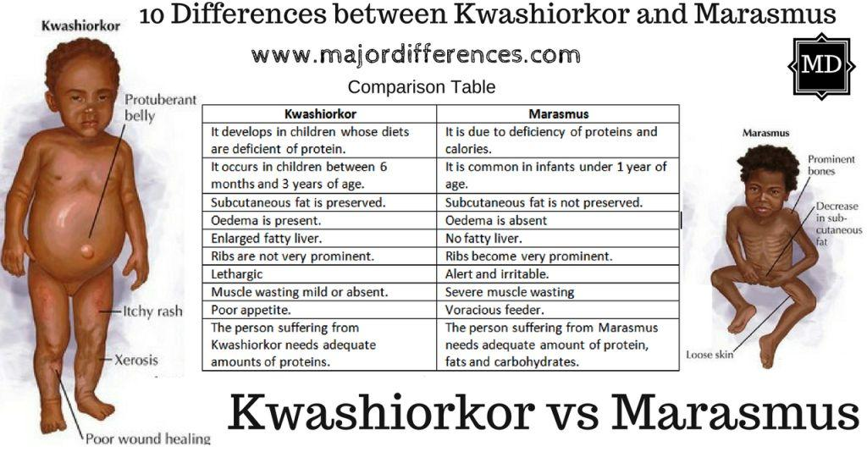
Protein Deficiency diseases = Kwashiorkor and Marasmus

Slide 22
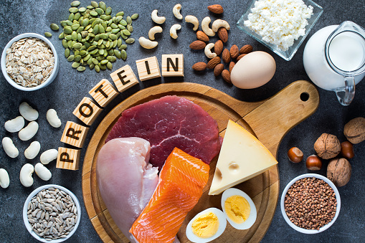
Protein Roundup
https://youtu.be/HSCUAjZQhXI

Slide 23
Dietary Macronutrient Review
Carbohydrates - Composed of C,H & O elements. Includes Fibre, starch and sugars.
RDA of 130g/day based on brain’s need but can survive on <20 g per day (Brain will get energy from ketone bodies instead)
AI for Fibre is 21 - 38 g/day for adults, varying according to age and sex.
AMDR (Acceptable macronutrient distribution range) is 45- 65% of total calories.

Slide 24
Dietary Macronutrient Review
Fats/Lipids - Composed of C & H elements.
Includes polyunsaturated, unsaturated & saturated fats.
Adequate Intakes are only established for Linolenic Acid (Omega 6) of 11 - 17g/day and Linoleic Acid (Omega 3) of 1.1- 1.6g/day, depending on sex and age.
AMDR for percentage of calories from fat is 20 - 35%.

Slide 25
Dietary Macronutrient Review
Protein - Composed of C, H, O & N elements
RDA is 0.8 g /kg body weight for the majority of adults.
AMDR is 10 - 35% of total calories.
Deficiency of protein specifically is called Kwashiorkor.
No Upper Limits (UL)s are defined for any macronutrients.

Slide 26
Macronutrient Ratios for Specific Goals
Tracking your macros can be an effective way to work towards specific goals. Some specific ratios, based upon nutritional science are:
For weight/fat loss: 50% C:35%P:15% fat Or
10% C: 20% P: 70% F (keto)
Muscle building: 30%C: 30% F: 40% P
For cutting: 25%C: 40% F: 35% P

