Slide 1
Cranial Nerves & Spinal Nerves
https://www.youtube.com/watch?v=qPix_X-9t7E
CRASH COURSE

Slide 2
Peripheral and Central Nervous System
Peripheral nervous system – includes all the nerves that lie outside the spinal cord and the brain
  The PNS Carry information to and from the central nervous system
Central Nervous System – Consists of nerves and nervous tissue within the Brain and Spinal Cord

Slide 3
Sensory Nerves
Sensory Nerve - a nerve that passes impulses from receptors toward or to the central nervous system. AKA an Afferent Nerve.
  Individual nerve fibers vary widely in diameter and also may be myelinated or unmyelinated. Myelin in the peripheral nervous system derives from Schwann cells, and the distance between nodes of Ranvier determines the conduction rate

Slide 4
Sensory Nerves Continued
Sensory neurons are somewhat unique, having an axon that extends to the periphery and another axon that extends into the central nervous system via the dorsal root . The cell body of this neuron is located in the dorsal root ganglion or one of the sensory ganglia of sensory cranial nerves

Slide 5
Sensory Nerves Continued
Before a sensory signal can be relayed to the nervous system it must be transduced into an electrical signal in a nerve fiber. This involves a process of opening ion channels in the membrane in response to mechanical deformation, temperature or, in the case of nociceptive fibers, signals released from damaged tissue. Many receptors become less sensitive with continued stimuli and this is termed adaptation. This adaptation may be rapid or slow, with rapidly adapting receptors being specialized for detecting changing signals.

Slide 6
Sensory Nerves Continued
There are several structural types of receptors in the skin. These fall into the category of encapsulated or non-encapsulated receptors. The non-encapsulated endings include free nerve endings, which are simply the peripheral end of the sensory axon. These mostly respond to noxious (pain) and thermal stimuli. There are some specialized free nerve endings around hairs that respond to very light touch and also free nerve endings that contact special skin cells, called Merkle's cells. These Merckle's cells (discs) are specialized cells that release transmitter onto peripheral sensory nerve terminals. The encapsulated endings include Meisner's corpuscles, Pacinian corpuscles and Ruffini endings. The capsules that surround encapsulated endings change the response characteristics of the nerves. Most encapsulated receptors are for touch, but the Pacinian corpuscles are very rapidly adapting and therefore are specialized to detect vibration. Ultimately, the intensity of the stimulus is encoded by the relative frequency of action potential generation in the sensory axon

Slide 7
Motor Nerves
There are three types of motor nerves.
Somatic motor nerves control skeletal muscles, which cause movement.
Special visceral motor nerves control muscles in the face and neck.
General visceral motor nerves control the smooth muscles that lack voluntary control, such as the heart. Another term for a motor nerve is "motor neuron." Motor nerves work by sending chemicals, known as neurotransmitters, across a gap between the nerve and the muscle. The neurotransmitters bind to receptors in the muscle fiber and trigger movement. AKA Efferent Nerves

Slide 8
Mixed Nerves
Mixed nerves contain both afferent and efferent axons, and thus conduct both incoming sensory information and outgoing muscle commands in the same bundle

Slide 9
Classifications of Peripheral nerves
Peripheral nerve fibers are grouped based on the diameter, signal conduction velocity, and myelination state of the axons. These classifications apply to both sensory and motor fibers. Fibers of the A group have a large diameter, high conduction velocity, and are myelinated.
The A group is further subdivided into four types (A-alpha, A-beta, A-delta, and A-gamma fibers) based on the information carried by the fibers and the tissues they innervate.

Slide 10
A Fibers
A-alpha fibers are the primary receptors of the muscle spindle and golgi tendonorgan.
A-beta fibers act as secondary receptors of the muscle spindle and contribute to cutaneous mechanoreceptors.
A-delta fibers are free nerve endings that conduct painful stimuli related to pressure and temperature.
A-gamma fibers are typically motor neurons that control the intrinsic activation of the muscle spindle.

Slide 11
B and C Fibers
Fibers of the B group are myelinated with a small diameter and have a low conduction velocity. The primary role of B fibers is to transmit autonomic information
Fibers of the C group are unmyelinated, have a small diameter, and low conduction velocity. The lack of myelination in the C group is the primary cause of their slow conduction velocity.

Slide 12
C Fibers Continued
C fiber axons are grouped together into what is known as Remak bundles. These occur when an unmyelinated Schwann cell bundles the axons close together by surrounding them. The Schwann cell keeps them from touching each other by squeezing its cytoplasm between the axons.
C fibers are considered polymodal because they can often respond to combinations of thermal, mechanical, and chemical stimuli.

Slide 13
Pain Sensation
A-delta and C fibers both contribute to the detection of diverse painful stimuli. Because of their higher conduction velocity, A-delta fibers are responsible for the sensation of a sharp, initial pain and respond to a weaker intensity of stimulus.
These nerve fibers are associated with acute pain and therefore constitute the afferent portion of the reflex arc that results in pulling away from noxious stimuli. An example is the retraction or your hand from a hot stove. Slowly conducting, unmyelinated C fibers, by contrast, carry slow, longer-lasting pain sensations.

Slide 14
Crash course Nervous system Videos
https://youtu.be/QY9NTVh-Awo 3
https://youtu.be/qPix_X-9t7E 1
https://youtu.be/OZG8M_ldA1M 2

Slide 15
Cranial Nerves
Number | Name | Type of Nerve
I | Olfactory | Sensory
II | Optic | Sensory
III | Oculomotor | motor
IV | Trochlear | Motor
V | Trigeminal | Mixed
VI | Abducens | Motor
VII | Facial | Mixed
VIII | Vestibulocochlear | Sensory
IX | Glossopharyngeal | mixed
X | Vagus | mixed
XI | Accesory | motor
XII | Hypoglossal | motor

Slide 16
How to remember Cranial Nerves
Oh, Oh, Oh, To Touch And Feel Very Green Velvet, AH
Olfactory, Optic, Oculomotor, Trochlear, Trigeminal, Abducens, Facial, vestibulocochlear, Glossopharyngeal, Vagus, Accessory, Hypoglossal

Slide 17
CN I Olfactory Nerve
sensory for smell
bundles of axons of olfactory receptors extend through the olfactory foramina within the cribriform plate
they end as the olfactory bulbs
here the axons synapse with new neurons that run through the olfactory tracts
these end in the temporal lobe (olfactory cortex)
Emerges from the nose

Slide 18
CN II Optic Nerve
sensory
rods and cones in the eye convey visual signals to optic nerves
the optic nerves pass through the optic foramen and then merge to form the optic chiasm within the chiasm, axons from the medial portion of each eye cross over axons from the lateral portion of each eye remain ipsilateral these axons terminate in the occipital lobe. Emerges from the Eyes

Slide 19
CN III Oculomotor
Motor
Passes through the superior orbital fissure into the orbit supplies some of the mm that move the eyeball and the mm of the upper eyelid also supplies parasympathetic innervation to the eyeball for pupil constriction & lens adjustment
  PNS – Pupil constriction
  SNS – Pupil dilation
Emerges from the Brain Stem

Slide 20
CN IV Trochlear
Motor
Smallest of the cranial nerves. Passes through the superior orbital fissure. Innervates a mm that moves the eyeball (superior oblique mm)
Emerges from the Brain Stem

Slide 21
CN V Trigeminal
Mixed, largest cranial nerve
Has 3 large branches (TRI-geminal)
  Opthalmic(V1) – enters the orbit through the superior orbital fissure
    sensory axons from skin over the upper eyelid; eyeball; lacrimal gland; upper part of nasal cavity; side of nose, forehead and anterior scalp
  Maxillary (V2)– exits the foramen rotundum
    sensory axons from nose, palate, pharynx, upper teeth and lip, lower eyelid
  Mandibular (V3)– exits the foramen ovale
    sensory axons from the anterior tongue (not taste); cheek, lower teeth and lip, skin over the mandible
    also has motor fibres and innervates the mm of mastication
Emerges from the Brain Stem

Slide 22
CN VI Abducens
motor
enters the orbit through the superior orbital fissure. Supplies a muscle that moves the eyeball (lateral rectus mm). Causes lateral rotation of the eye (or abduction)
Emerges from Brain Stem

Slide 23
CN VII Facial
Mixed
Sensory axons extend from taste buds and from proprioception in mm of the face and scalp
Motor neurons pass through the temporal bone to innervate the mm of facial expression; also supplies parasympathetic to the lacrimal glands, nasal glands, palatine glands, and sublingual and submandibular glands
Emerges from the Brain stem

Slide 24
CN VIII Vestibulocochlear
sensory nerve with 2 branches: vestibular and cochlear (balance and hearing)
Emerges from the inner ear

Slide 25
CN IX Glossopharyngeal
mixed
sensory axons from the posterior taste buds of the tongue and from proprioceptors in swallowing mm
motor neurons exit through the jugular foramen and innervate stylopharyngeus mm
parasympathetic info to the parotid gland
Emerges from the Brain Stem

Slide 26
CN X Vagus Nerve
Mixed
travels from head and neck into the thorax and abdomen
sensory axons from the skin of the external ear, some taste buds in the epiglottis and proprioceptors in mm of neck and throat. Also from baroreceptors, chemoreceptors, sensory receptors for most organs of the thorax and abdomen
somatic motor neurons supply mm of the pharynx, larynx, and soft palate
parasympathetic innervation to the glands of the GI tract and to smooth mm of the respiratory pathways, esophagus, stomach, gallbladder, small intestine, and large intestine
Emerges from the Brain Stem

Slide 27
CN XI Acessory Nerve
Motor
motor neurons to SCM and trapezius
Emerges from Spinal Cord

Slide 28
CN XII Hypoglossal Nerve
motor
passes through the hypoglossal canal to supply mm of the tongue
helps with speech and swallowing
Emerges from the Brain Stem

Slide 29
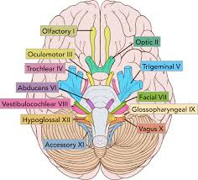
Cranial Nerves

Slide 30
Spinal Nerves
https://www.youtube.com/watch?v=6XtPzcXAqBc

Slide 31
Spinal Cord
The spinal cord comes off the base of the brain, runs throughout the cervical and thoracic spine, and ends at the lower part of the thoracic spine.
The spinal cord does not run through the lumbar spine. After the spinal cord stops in the lower thoracic spine, the nerve roots from the lumbar and sacral levels come off the bottom of the cord like a "horse's tail" (cauda equina) and exit the spine

Slide 32
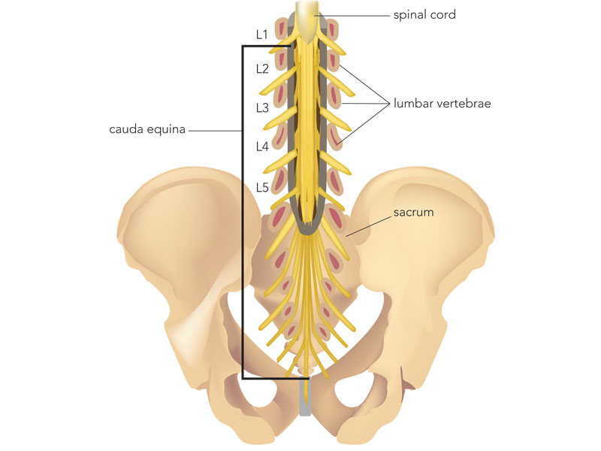
Cauda Equina

Slide 33
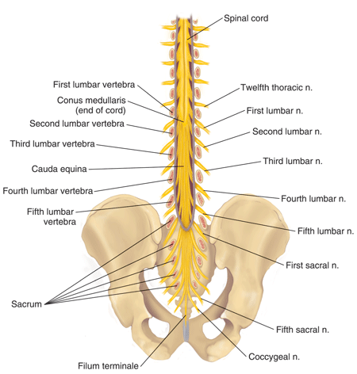
Spinal Cord

Slide 34
Spinal Nerves
The spinal cord can be divided into segments according to the nerve roots that branch off of it.
Spinal nerves are part of your Peripheral Nervous System and are responsible for voluntary movement and sensation.
Nerves along the cord consists of 8 cervical nerves, 12 thoracic nerves, 5 lumbar nerves, 5 sacral nerves, and 1 coccygeal nerve.
The nerve roots run through the bony canal, and at each level a pair of nerve roots exits from the spine.

Slide 35
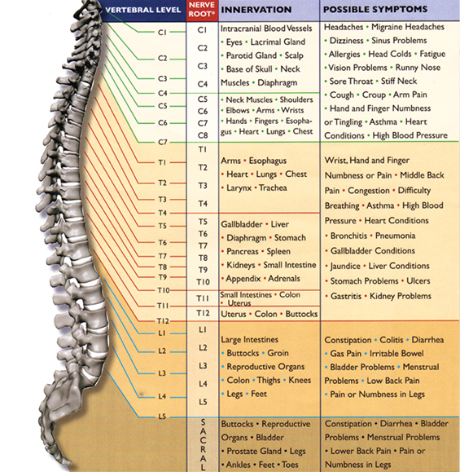

Slide 36
Autonomic Nervous System
Your Peripheral Nervous System also contains autonomic nerves and these are responsible for involuntary functions of the body. Autonomic nerves assist with the functioning of organs such as your heart, intestines, bladder, bowel and sexual organs.
The autonomic nerves are made up of parasympathetic and sympathetic. They work together to keep the body functions in balance. Sympathetic response increases activity and parasympathetic response decreases activity (for example heart rate up and down). The diagram below shows which areas contain autonomic nerves.

Slide 37
Autonomic Nervous System
The autonomic nervous system plays an essential role in keeping the body's internal environment (temperature, salt concentration, blood sugar, oxygen and carbon dioxide level in blood, etc) in proper balance, a condition called homeostasis. The autonomic nervous system also plays a major part in emotional experience and expression. When you are emotionally excited, the body shows many changes: blood pressure and heart beat increase, mouth is often dry, stomach has "butterflies" in it. These and other body actions are controlled by the autonomic nervous system.

Slide 38
Autonomic Nervous System
The autonomic nervous system controls the insides of the body: the viscera or gut. It carries information about the inside of the body to the CNS and controls the action of internal organs, including the gut, the heart, the secretion of epinephrine (adrenalin) and norepinephrine (noradrenalin) from the medulla (middle part) of the adrenal gland, etc.

Slide 39
Autonomic Nerves
Because there are many spinal and autonomic nerves in the end of your spinal cord, it is called a major reflex centre. Reflex (unconscious) activity takes place between your spinal cord and skeletal muscles, as well as your bladder, bowel and sexual organs.

Slide 40
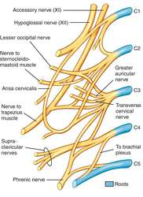
Cervical Plexus Review

Slide 41
Continued
The cervical plexus is a network of nerve fibres that supplies innervation to some of the structures in the neck and trunk.
It is located in the posterior triangle of the neck, halfway up the sternocleidomastoid muscle, and within the prevertebral layer of cervical fascia. The plexus is formed by the anterior rami (divisions) of cervical spinal nerves C1-C4.

Slide 42
Continued
The spinal nerves C1 – C4 form the basis of the cervical plexus.
At each vertebral level, paired spinal nerves leave the spinal cord via the intervertebral foramina of the vertebral column.
Each nerve then divides into anterior and posterior nerve fibres. The cervical plexus begins as the anterior fibres of the spinal nerves C1, C2, C3 and C4.

Slide 43
Continued
The cervical plexus gives rise to numerous branches which supply structures in the head and neck. They can broadly be divided into two groups – muscular branches and sensory branches.
Phrenic Nerve- The phrenic nerve arises from the anterior rami of C3-C5. It provides motor innervation to the diaphragm.
The C1 spinal nerve gives rise to nerves to the geniohyoid (moves the hyoid bone anteriorly and upwards, expanding the airway) and the thyrohyoid (which depresses the hyoid bone and elevates the larynx) These nerves travel with the hypoglossal nerve to reach their respective muscles

Slide 44
Continued
The ansa cervicalis (goose’s neck) is a loop of nerves, formed by nerve roots C1-C3. It gives off four muscular branches – superior and inferior omohyoid, sternohyoid and sternothyroid
Several other minor branches arise from the nerve roots to supply muscles of the neck and back:
  C1-C2: Rectus capitis anterior and lateralis
  C1-C3: Longus capitis
  C2-C3: Prevertebral muscles and sternocleidomastoid
  C3-C4: Levator scapulae, trapezius and scalenus medius
  The middle and anterior scalenus muscles also receive innervation directly from the cervical plexus.

Slide 45
Continued
Sensory Branches
  Greater Auricular Nerve
  Transverse cervical Nerve
  Lesser Occipital Nerve
  Supraclavicular nerve

Slide 46
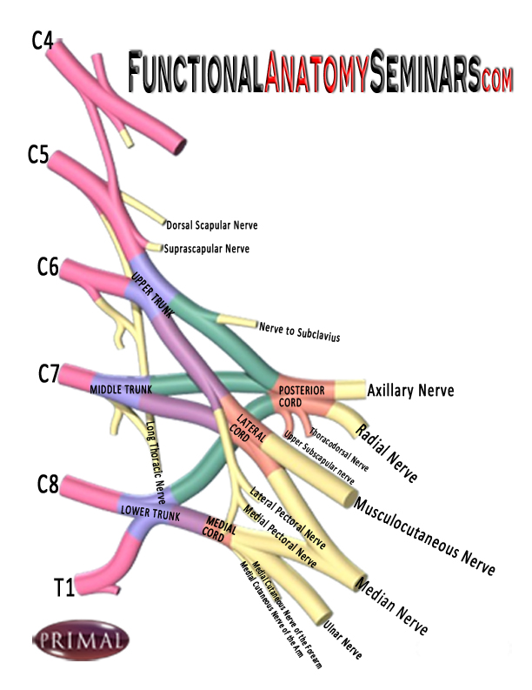
Brachial Plexus Review

Slide 47
Continued
The Brachial Plexus is a network of nerve fibers that run from the spine, passing through the cervico-axillary canal to reach axilla. It is formed by the ventral rami of the lower four cervical and first thoracic nerve roots (C5-C8, T1)
The brachial plexus is responsible for cutaneous and muscular innervation of the entire upper limb, with two exceptions: the trapezius muscle innervated by the spinal accessory nerve (CN XI) and an area of skin near the axilla innervated by the intercostobrachial nerve

Slide 48
The brachial plexus is divided into Roots, Trunks, Divisions, Cords, and Branches. There are five "terminal" branches and numerous other "pre-terminal" or "collateral" branches that leave the plexus at various points along its length.
The five Roots are the five anterior rami of the of the lower four cervical and first thoracic nerve roots (C5-C8, T1), after they have given off their segmental supply to the muscles of the neck. These Roots merge to form three Trunks:
Upper Trunk (C5-C6)
Middle Trunk (C7)
Lower Trunk (C8, T1)

Slide 49
Each Trunk then splits into anterior and posterior divisions, to form six Divisions. The anterior/ posterior divisions innervate flexor groups versus extensor groups:
anterior divisions of the upper, middle, and lower trunks
posterior divisions of the upper, middle, and lower trunks
These six Divisions will regroup to become the three Cords. The Cords are named by their position with respect to the axillary artery.
The Posterior Cord is formed from the three posterior divisions of the trunks (C5-C8,T1)
The Lateral Cord is the anterior divisions from the upper and middle trunks (C5-C7)
The Medial Cord is simply a continuation of the anterior division of the lower trunk (C8,T1)
Specific Branches [1][3]
The branches are listed below. Most branch from the cords, but a few branch (indicated in italics) directly from earlier structures.

Slide 50
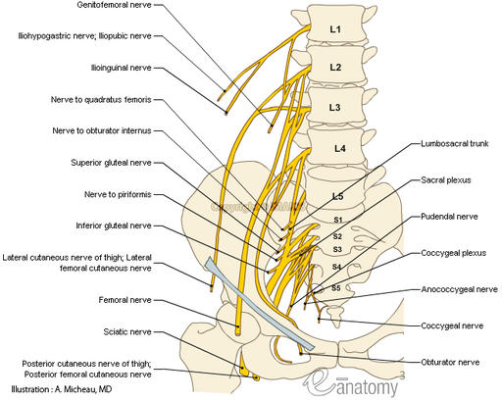
Lumbosacral Plexus Review

Slide 51
Continued
The lumbar plexus is a web of nerves in the lumbar region of the body which forms part of the larger lumbosacral plexus. It is formed by the divisions of the first four lumbar nerves (L1-L4) and from contributions of the subcostal nerve (T12), which is the last thoracic nerve.

Slide 52
Lumbar plexus Continued
The lumbar plexus begins as the anterior fibres of the spinal nerves L1, L2, L3, and L4.
The anterior rami of the L1-L4 spinal roots divide into several cords. These cords then combine together to form the six major peripheral nerves of the lumbar plexus. These nerves then descend down the posterior abdominal wall to reach the lower limb, where they innervate their target structures.

Slide 53
Nerves of the lumbar Plexus
The iliohypogastric nerve is the first major branch of the lumbar plexus. It runs to the iliac crest, across the quadratus lumborum muscle of the posterior abdominal wall. It then perforates the transversus abdominis, and divides into its terminal branches.
Roots: L1 (with contributions from T12).
Motor Functions: Innervates the internal oblique and transversus abdominis.
Sensory Functions: Innervates the posterolateral gluteal skin in the pubic region

Slide 54
Lumbar Plexus Nerves Continued
The ilioinguinal nerve follows the same anatomical course as the larger iliohypogastric nerve. After innervating the muscles of the anterior abdominal wall, it passes through the superficial inguinal ring to innervate the skin of the genitalia and middle thigh.
Roots: L1.
Motor Functions: Innervates the internal oblique and transversus abdominis.
Sensory Functions: Innervates the skin on the upper middle thigh. In males, it also supplies the skin over the root of the penis and anterior scrotum. In females, it supplies the skin over mons pubis and labia majora.

Slide 55
Lumbar Plexus Nerves Continued
After leaving the psoas major muscle, the genitofemoral nerve quickly divides into a genital branch, and a femoral branch.
Roots: L1, L2.
Motor Functions: The genital branch innervates the cremasteric muscle.
Sensory Functions: The genital branch innervates the skin of the anterior scrotum (in males) or the skin over mons pubis and labia majora (in females). The femoral branch innervates the skin on the upper anterior thigh.

Slide 56
Lumbar Plexus Nerves Continued
The Lateral Cutaneous Nerve of the Thigh has a purely sensory function. It enters the thigh at the lateral aspect of the inguinal ligament, where it provides cutaneous innervation to the skin there.
Roots: L2, L3
Motor Functions: None.
Sensory Functions: Innervates the anterior and lateral thigh down to the level of the knee.

Slide 57
Lumbar Plexus Nerves Continued
The Obturator Nerve
Roots: L2, L3, L4.
Motor Functions: Innervates the muscles: obturator externus, pectineus, adductor longus, adductor brevis, adductor magnus, gracilis.
Sensory Functions: Innervates the skin over the medial thigh.

Slide 58
Lumbar Plexus Nerves Continued
The Femoral Nerve
Roots: L2, L3, L4.
Motor Functions: Innervates the muscles: Illiacus, pectineus, sartorius, all the muscles of quadriceps femoris.
Sensory Functions: Innervates the skin on the anterior thigh and the medial leg.

Slide 59
Sacral Plexus
The sacral plexus is a nerve plexus that provides motor and sensory nerves for the posterior thigh, most of the lower leg, the entire foot, and part of the pelvis. The sacral plexus is derived from the anterior rami of spinal nerves L4, L5, S1, S2, S3, and S4.

Slide 60
Sacral Plexus Spinal Nerves
The spinal nerves S1 – S4 form the basis of the sacral plexus.
Each nerve then divides into anterior and posterior nerve fibres. The sacral plexus begins as the anterior fibres of the spinal nerves S1, S2, S3, and S4. They are joined by the 4th and 5th lumbar roots, which combine to form the lumbosacral trunk. This descends into the pelvis to meet the sacral roots as they emerge from the spinal cord.

Slide 61
Sacral Plexus Spinal Nerves
The anterior rami of the S1-S4 spinal roots (and the lumbosacral trunk) divide into several cords. These cords then combine together to form the five major peripheral nerves of the sacral plexus.
These nerves then descend down the posterior pelvic wall. They have two main destinations:
Leave the pelvis via the greater sciatic foramen – these nerves enter the gluteal region of the lower limb, innervating the structures there.
Remain in the pelvis – these nerves innervate the pelvic muscles, organs and perineum.

Slide 62
Sacral Plexus Spinal Nerves
he superior gluteal nerve leaves the pelvis via the greater sciatic foramen, entering the gluteal region superiorly to the piriformis muscle. It is accompanied by the superior gluteal artery and vein for much of its course.
Roots: L4, L5, S1.
Motor Functions: Innervates the gluteus minimus, gluteus medius and tensor fascia lata.
Sensory Functions: None.

Slide 63
Sacral Nerves Spinal Nerves
The inferior gluteal nerve leaves the pelvis via the greater sciatic foramen, entering the gluteal region inferiorly to the piriformis muscle.
It is accompanied by the inferior gluteal artery and vein for much of its course.
Roots: L5, S1, S2.
Motor Functions: Innervates gluteus maximus.
Sensory Functions: None.
© 2015-2017 TeachMeAnatomy.com [CC-BY-NC-ND 4.0]

Slide 64
Sacral Plexus - Sciatic Nerve
Roots: L4, L5, S1, S2, S3
Motor Functions:
Tibial Portion – Innervates all of the muscles in the posterior compartment of the thigh, including the hamstring portion of adductor magnus, apart from the short head of the biceps femoris. All muscles in the posterior compartment of the leg. All muscles in the sole of the foot.
Common Fibular Portion – Short head of biceps femoris, all muscles in the anterior and lateral compartments of the leg and extensor digitorum brevis.

Slide 65
Sacral Plexus – Sciatic Nerve
Sensory Functions:
Tibial Portion: Innervates the skin on the posterolateral and medial surfaces of the foot as well as the sole of the foot.
Common Fibular Portion: Innervates the skin on the anterolateral surface of the leg and the dorsal aspect of the foot

Slide 66
Sacral Plexus Nerves Continued
The posterior cutaneous nerve of thigh leaves the pelvis via the greater sciatic foramen, entering the gluteal region inferiorly to the piriformis muscle. It descends deep to the gluteus maximus and runs down the back of the thigh to the knee.
Roots: S1, S2, S3
Motor Functions: None
Sensory Functions: Innervates the skin on the posterior surface of the thigh and leg. Also innervates the skin of the perineum.

Slide 67
Sacral Plexus Nerve Continued
The Pudendal Nerveleaves the pelvis via the greater sciatic foramen, then re-enters via the lesser sciatic foramen. It moves anterosuperiorly along the lateral wall of the ischiorectal fossa, and terminates by dividing into several branches.
Roots: S2, S3, S4
Motor Functions: Innervates the skeletal muscles in the perineum, the external urethral sphincter, the external anal sphincter, levator ani.
Sensory Functions: Innervates the penis and the clitoris and most of the skin of the perineum.

Slide 68
Sacral Nerve Plexus Continued
Other Branches
In addition to the five major nerves of the sacral plexus, there are a number of smaller branches. These tend to be nerves that directly supplying muscles (with the exception of the perforating cutaneous nerve, which supplies the skin over the inferior gluteal region and the pelvic splanchnic nerves, which innervate the abdominal viscera):
Nerve to piriformis
Nerve to obturator internus
Nerve to quadratus femoris

Slide 69
Dermatomes
Each of the spinal nerves exits the spinal canal between two of the vertebra. Each then goes to a particular area of the body. The area of skin served by each of these nerves is called its dermatome.

Slide 70
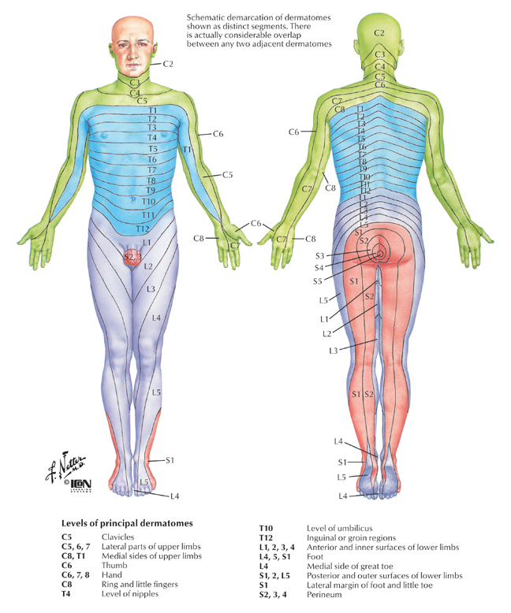
Dermatome Map of the Body

Slide 71
Main Dermatome Levels
C5 Clavicles
C5, 6 Lateral sides of upper limbs
C8, T1 Medial Sides of Upper Limbs
C6 Thumb
C6, 7 and 8 Hand
C8 Ring and Little Finger
T4 Level of Nipples
T10 Level of umbilicus

Slide 72
Conitnued
L1 Inguinal region
L1, 2, 3, 5 Anterior and inner surfaces of lower limbs
L4, 5, S1 Foot
L4 Medial side of the Great Toe
L5, S1, 2 Lateral and posterior side of lower limbs
S1 Lateral margin of Foot and Baby toe
S2, 3, 4 Perinum

Slide 73
What is a Dermatome Test
There are two types
  Pain sensations (pin prick) Test
  Light touch Sensation (cotton wool) Test
    Cotton wool = Cotton Ball
The pin prick test involves touching the clients skin with the sharp or blunt part of a needle and asking what the feel
The Light Touch test involves lightly touching the clients skin with the cotton wool

Slide 74
Procedure
Used when there is an abnormal feeling in the skin
Test patient with pin and cotton
Test should be shown to client prior to performing
The Client will then close their eyes as the examiner performs the tests. The patient will supply information about what they feel

Slide 75
Continued
Test should be performed in a specific dermatome and completed bilaterally
Should be Tested distally moving proximally

Slide 76
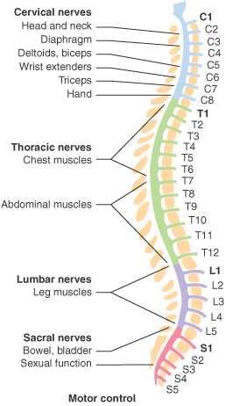
Myotomes

Slide 77
Myotomes
What are they?
  Myotomes correspond to muscles that are controlled by a specific nerve root from the spinal cord

Slide 78
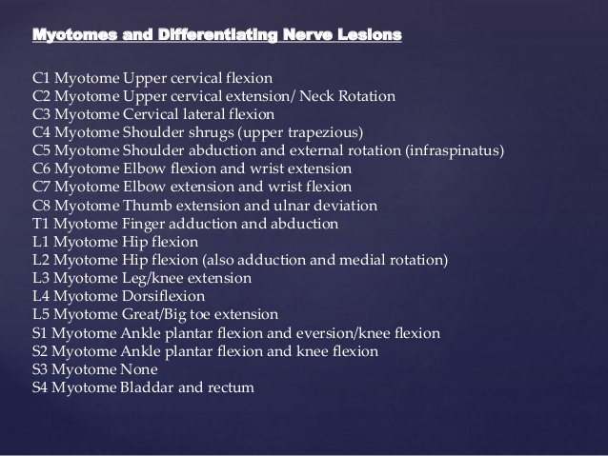

Slide 79
Plexuses Summary
Cervical Plexus
  C1 – C4 Nerve roots innervate diaphragm, shoulder and neck
Brachial Plexus
  C5 – T1 Nerve roots innervate the upper limbs
Lumboscaral Plexus
  L1 – L5, S2 Nerve roots innervate the lower limb

Slide 80
When to use Myotome Testing
Note the position the client asssumes, often paralysis or weakness shows when the client takes on abnormal positions
Appearance of musculature – signs of muscle wasting or atrophy
Feel of muscle tone
These are all signs we may want to perform a myotome test

Slide 81
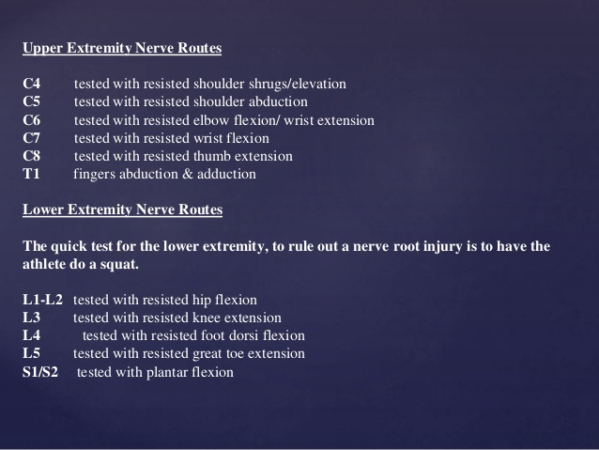
Myotome Tests

