Slide 1
Pathology 2
Spinal and Nervous System Pathologies

Slide 2
Introduction
Disorders of the spine including herniated disk, spinal stenosis, osteoarthritis, degenerative disc disease, vertebral fracture can result in complications affecting the nerve roots or the spinal cord
Nerve root compressions are characterized by:
  Radicular pain
  Reduced range of motion in the spine
  Motor loss, accompanied by sensory or reflex loss

Slide 3
Spinal Stenosis
can result in:
  Pseudoclaudication/neurogenic claudication-painful muscle cramps not related to peripheral vascular disease, but due to spinal, neurological or orthopedic conditions
  Chronic radicular pain and/or paresthesia, weakness, fatigue, heaviness
  Inability to ambulate effectively
  Symptoms can be unilateral or bilateral
Symptoms tend to increase with spinal extension and decrease with flexion, therefore patients will report lessened pain with side lying (where lumbar flexion can occur) more so than lying in supine. In contrast to those with vascular claudication, sitting but not standing will relieve symptoms, walking uphill will be better tolerated than downhill walking, and exercise on a stationary bicycle in a seated flexed position will be better tolerated than walking in the erect position.

Slide 4
Spinal Stenosis
Two types: lumbar stenosis and cervical stenosis
Lumbar spinal is more common, cervical spinal stenosis is often more dangerous
In lumbar stenosis, the spinal nerve roots in the lower back are compressed, or impinged, and this can produce symptoms of sciatica -- tingling, weakness or numbness that radiates from the low back and into the buttocks and legs - especially with activity.
Cervical spinal stenosis can be far more dangerous due to the compression of the upper levels of the spinal cord. Spinal cord stenosis may lead to serious symptoms, such as major body weakness or even paralysis
Severe spinal stenosis symptoms are virtually impossible in the lumbar spine as the spinal cord is not present in the lumbar segments.

Slide 5
Cauda Equina Syndrome
The cauda equina refers to the sac of nerve roots with a common covering, close to the end of the spinal cord, in the lumbar region
Cauda equina syndrome most commonly results from a massive disc herniation in the lumbar region. Cauda equina syndrome is caused by compression of the nerve roots.

Slide 6
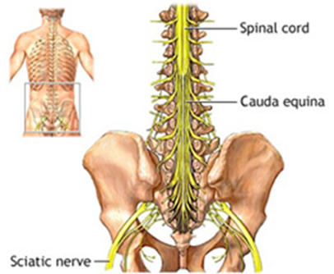

Slide 7
Symptoms
Urinary Incontinence or retention
Saddle anesthesia
Anal sphincter tone decreased or fecal incontinence
Bilateral lower extremity weakness or numbness
Progressive neurologic deficit

Slide 8
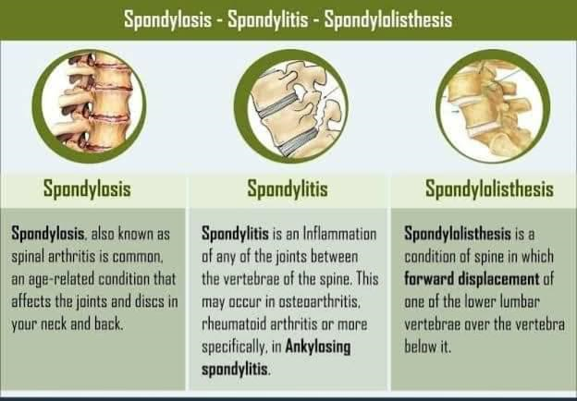
Degenerative Disc Disease
Over time, all vertebral discs will start to lose volume, narrow and may be able to breakdown.
After a patient reaches 60, some level of disc degeneration is a normal finding on an MRI scan, rather than the exception.
Associated with other degenerative changes to the spine such as spondylosis, spondylitis, & spondylolisthesis.

Slide 9
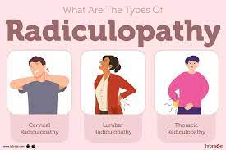
Degenerative Disc Disease
May be asymptomatic
May be associated with Radiculopathy - symptoms associated with spinal nerve root compression and/or inflammation.
Radiculopathy can include: pain, decreased reflexes, paresthesias, numbness, muscle weakness.

Slide 10
Bulging and Herniated Discs
Bulging Disc AKA Slipped Disc
Less serious version then herniated disc. Centre of the disc bulges but remains within an intact disc wall.
Herniated Disc - AKA Ruptured disc
Soft centre of the disc protrudes out through tears in the outer ring.
Spinal ligaments are often sprained as well.
Bulging and Herniated discs occur most often in the lumbar region, followed by cervical. They are rare in the thoracic region.
Causes: Degenerative disc disease, direct trauma, and/or cumulative trauma such as from poor posture.

Slide 11
Bulging & Herniated Discs
Symptoms: Radiculopathy & Radicular Pain
Paresthesias
Peripheral Neuropathy
Muscle Spasms
Pain may be worse with sitting, lifting, twisting or bending
Treatments: Physical therapies
Strengthening of back & core muscles
Medications (NSAIDs, Muscle relaxers, Corticosteroids, Anti Inflammatories)
Surgeries - Laminectomy (removal of part of the vertebra)
Discectomy (removal of damaged disc)
Fusion (welding 2 or more vertebrae together)

Slide 12
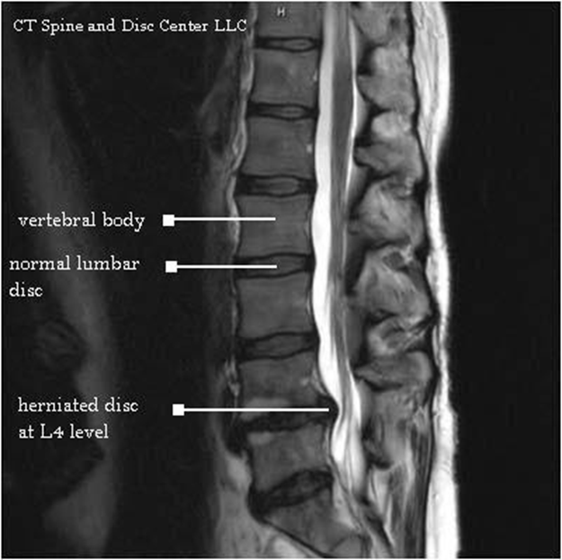

Slide 13
Testing for disc involvement
Bakody Sign (Shoulder Abduction)- Patient abducts their arm & rests hand or forearm on the crown of their head. Reduction of pain & symptoms after 30 sec suggests cervical radiculopathy.
Spurling Test - Practitioner places gentle downward pressure on the crown of seated patient’s head. Pain or paresthesia suggests cervical radiculopathy. If no pain, second level of testing is putting the clients neck into extension and lateral flexion towards the affected side. Again, gentle downward pressure eliciting pain/paresthesias suggest cervical radiculopathy.
Straight Leg Test - Passively lift the leg while keeping knee in extension. Eliciting pain & paresthesias in the non - lifted leg at 35 - 70 degrees of hip flexion suggests lumbar radiculopathy.

Slide 14
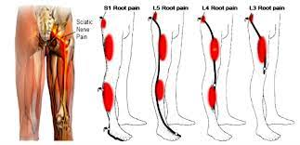
Sciatica
Pain radiating down the path of the sciatic nerve
Causes: Lumbar radiculopathy
Piriformis Syndrome
Tight QL muscles
Spinal tumours
Treatments: Depend upon cause - similar to herniated discs

Slide 15
Spinal Infection
Signs and symptoms:
  Persistent fever (temperature over 100.4 F), chills and shakes
  Unexplained weight loss
  Nighttime pain that is worse than daytime pain, pain that increases with rest
Predisposing factors for acquiring an infection of the spine include:
  History of intravenous drug abuse
  Recent bacterial infection
  Recent urologic procedure
  Elderly or those who are immune compromised

Slide 16
Spinal Tumour
A spinal tumor is malignant or benign growth that develops within or near the spinal cord or within the bones of the spine
Back pain is the most common symptom of a spinal tumor, however most back pain is not cancer
A spinal tumor or a growth of any kind can affect nerves in the area of the tumor, leading to pain, neurological problems and sometimes paralysis. Whether cancerous or not, a spinal tumor can threaten life and cause permanent disability. Cancer is most likely to occur in populations under 17 years old and over 50.
Treatment for a spinal tumor may include surgery, radiation therapy, chemotherapy or other medications.
Signs and symptoms of cancer:
  Unexplained weight loss >10 kg (20 pounds) within 6 months
  Night pain or pain at rest
  Pain persists for more than 4 to 6 weeks,.
  Failure to improve with therapy

Slide 17
Vertebral Fractures
Risk factors include:
  Prolonged use of Steroids
  Mild trauma over age 50 years
  Age greater than 70 years
  History of Osteoporosis
  Recent significant trauma at any age
  Ejection from motor vehicle
  Fall from substantial height
Because osteoporosis is a "silent" disease, it is not uncommon for someone with back pain to be unaware of the fact that he or she has actually fractured a vertebra in their spine.

Slide 18
Symptoms
typically include one or a combination of the following symptoms:
  Sudden onset of back pain
  Standing or walking will usually make the pain worse
  Lying on one's back makes the pain less intense
  Limited spinal mobility
  Height loss
  Deformity and disability
Compression fracture should be suspected in any patient over the age of 50 with acute onset of back pain. For women, especially those with risk factors for osteoporosis, many physicians believe that a vertebral fracture should be suspected in any women over age 45 with sudden onset of back pain.

Slide 19
Ankylosing Spondylitis
Type of inflammatory arthritis and an autoimmune disease.
Joints in the spine are the target of the immune attack, resulting in pain and stiffness and inflammation in the back.
Affects between 150,000 and 300,000 Canadians, men three times more than women;
Appears b/w ages of 15 and 30.
starts at the SI joints, can spread upwards to involve other parts of the spine and, can involve the entire spine.
As the inflammation continues, new bone forms as the body tries to repair itself. As a result, the bones of the spine begin to fuse, Even though new bone has formed, the existing bone may become thin, which increases the risk of fractures.
can also cause pain and stiffness hips and shoulders, as well as inflammation of the tendons surrounding the joints., called enthesitis. Common spots include Achilles Tendon, plantar fascia, trochanteric bursitis, and costochondritis
Universal symptom is chronic low back pain that seems to come and go for no apparent reason. Generally worse in the morning when rising from bed and improves with stretching and exercise.

Slide 20
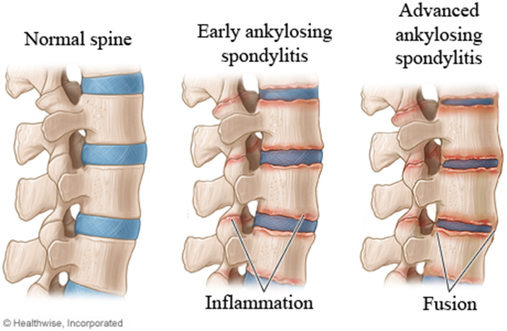

Slide 21
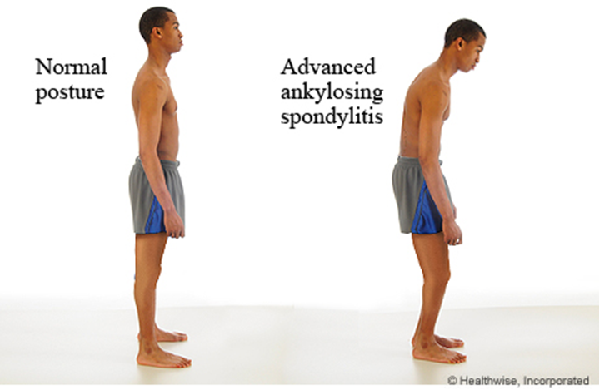

Slide 22
Ossification of the posterior longitudinal ligament (OPLL)
Important cause of cervical myelopathy results from bony ossification of the cervical or thoracic posterior longitudinal ligament
25% of patients with cervical myelopathy will have features of OPLL.
Commonly mid-40s or 50s with clinical evidence of myelopathy
areas of ossification that commonly come together behind the cervical vertebral bodies, leading to direct ventral compression of the cord.
Surgical alternatives include anterior, posterior, or circumferential decompression and/or stabilization.
primarily cervical vertebra, most often C4-C5, then the thoracic spine, lumbar spine least frequently
2 x more common in males, higher prevalence in Asian population, especially Japanese people.
Most who are symptomatic present with spinal stenosis or myelopathy. The majority of patients have no symptoms, however cervical myelopathy is the most common presentation (numbness, neck pain, and weakness)

Slide 23
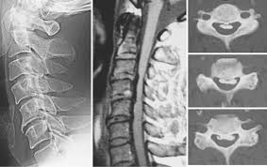

Slide 24
Spinal Deviations- Scoliosis
causes an abnormal curvature of the spine
develop additional curves to either side, and the bones of the spine twist on each other, forming a "C" or an "S" shape in the spine.
2x more common in females
Most common in those over 10
People with scoliosis are more likely to have children with scoliosis; no correlation between the severities of the curve from one generation to another

Slide 25
Idiopathic Scoliosis
most cases (80%) are idiopathic - described based on the age when scoliosis develops
  less than 3 years = infantile idiopathic scoliosis.
  3 and 10 years = juvenile idiopathic scoliosis
  over 10 years = adolescent idiopathic scoliosis.
Alterations of normal spinal curves can lead to back pain, stiffness, and an altered gait or walking pattern.

Slide 26
3 Other causes of scoliosis
Functional: the spine is normal, but an abnormal curve develops because of a problem somewhere else in the body, Ex - short leg, by muscle spasms in the back
Neuromuscular: there is a problem when the bones of the spine are formed. Either the bones of the spine fail to form completely or they fail to separate from each other during fetal development. This type of scoliosis develops in people with other disorders, including birth defects, muscular dystrophy, or cerebral palsy. People with these conditions often develop a long C-shaped curve and have weak muscles that are unable to hold them up straight. If the curve is present at birth, it is called congenital. This type of scoliosis is often much more severe and needs more aggressive treatment than other forms of scoliosis.
Degenerative: occurs in older adults, caused by changes in the spine due to spondylosis. Weakening of the normal ligaments and other soft tissues of the spine combined with abnormal bone spurs can lead to an abnormal curvature of the spine. The spine can also be affected by osteoporosis, vertebral compression fractures, and disc degeneration.

Slide 27
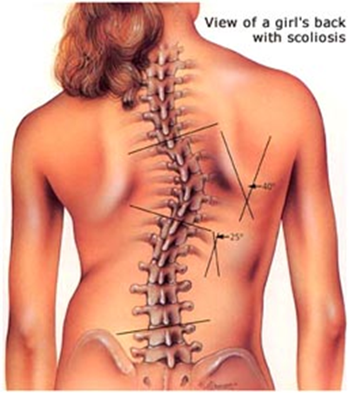

Slide 28
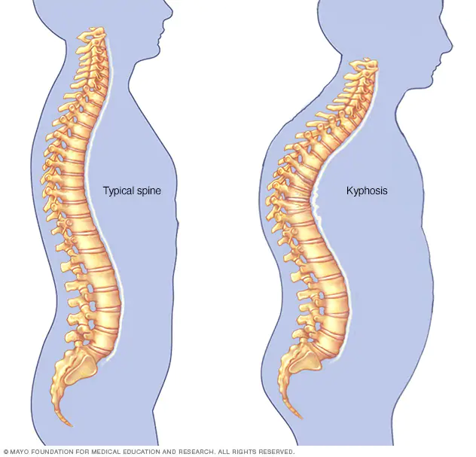
Kyphosis
Exaggerated, forward rounding of the upper back.
Causes:Most kyphosis occurs in older adults due to Degenerative disc disease, Osteoporosis & vertebral fractures.
Scheuermann’s disease is cause of kyphosis that affects kids around puberty.
Kids can also develop kyphosis from
birth defects or conditions like
Osgood-Schlatter disease.
Mild - moderate kyphosis can develop
from poor posture
Treatments: postural exercises, physical
therapy, bracing, surgery
Complications: Persistent back pain,
respiratory problems, paresthesias, loss of
bladder control, balance problems

Slide 29
Soft Tissue Trauma
Many spinal disorders are known to result from soft tissue injury. Injury to these tissues can be caused by unnecessary stress to the spine.
Lying flat on the back, very little pressure is exerted on the spine. As a person stands upright the pressure increases three times and while sitting four times. Forces affecting the lower back can rise five times when a medium weight box is lifted.

Slide 30
Continued
What happens when poor posture is combined with faulty body mechanics? For example, bending at the waist instead of at the knees to pick something lightweight up off the floor? This movement may cause as much as 10 times the amount of unnecessary stress to the spine. Micro-trauma or mini-injuries to soft tissue may result from improper movement especially when repetitive. It is not surprising why so many people suffer from back and neck pain.
Sprains and strains affect soft tissue. By definition both conditions mean something has stretched beyond normal, and possibly torn. Consider a person who has not shoveled snow since last winter and has decided to take care of his driveway after the first big storm. More than likely his back and neck muscles will become strained causing pain, tenderness, and stiffness. Why? He forced his muscles to perform beyond what he does on a routine basis.

Slide 31
Continued
Muscle tissue may become strained when forced to exceed its ability to work. Regular exercise helps to strengthen muscles, allowing them to work harder longer. Muscles are the spine's workhorses. Besides muscle tissue, excessive load can affect a ligament or tendon. Ligaments attach bone to bone and tendons attach muscle to bone. A sprained ankle is an example of a sprained ligament.
The bulk of the back is muscle. Extreme force may injure muscle. During a motor vehicle accident the body may be suddenly thrown forward, backward, and sideways. These movements can cause hyperextension (excessive forward movement) and hyperflexion (excessive backward movement), which can cause muscles, ligaments, and tendons to tear.
The symptoms of sprain and strain include sudden, sharp, and persistent pain at the injury site followed by swelling.

Slide 32
Spinal Trauma
Spinal trauma results in bruising (contusion), partial tearing, or a complete tear to the spinal cord. Because the spinal cord is the central carrier of signals throughout the body, damage to the spinal cord can have serious consequences.
A spinal cord injury, depending on its location and severity, may result in a partial or total loss of movement, sensation, and organ function. There is a wide range of severity in spinal cord injuries. A mild contusion of the spinal cord may cause the loss of only some function below the site of the injury. A complete transection is a total and permanent loss of sensation and movement below the site of the transection. Patients with spinal trauma also are likely to develop secondary infections of the bladder, lungs, and skin.

Slide 33
Continued
Causes: The primary causes of spinal cord injury are motor vehicle accidents, violence, falls, and sports.
Symptoms: The initial symptom of spinal cord injury often is spinal shock, which can cause a loss of feeling and movement below the site of the injury. Lasting from a few hours to a few weeks, spinal shock may subside over time to reveal the true extent of the injury. Other immediate symptoms may include muscle spasticity, difficulty breathing, heart rate and blood pressure problems, and loss of bladder and bowel function.
Long-term effects of spinal trauma vary depending on the location and severity of the injury. The body below the site of the injury is affected, so the higher the injury occurs in the spinal column the more severe the symptoms usually are. For example, an injury in the cervical spine will affect all of the limbs as well as the muscles that control breathing and other essential functions. An injury in the lumbar spine, however, will affect the lower extremities and bowel and bladder function, but usually will not damage other organs or systems. Complete injuries high in the neck, and trauma complicated by other serious injuries may result in death or require total care for the rest of the patient’s life.

Slide 34
Cervical Spondylosis
Cervical spondylosis: is a general term for age-related wear and tear affecting the spinal disks in the neck. As the disks dehydrate and shrink, bone spurs and other signs of osteoarthritis develop. Cervical spondylosis is very common and worsens with age. There also appears to be a genetic component involved because some families will have more of these changes over time, while other families will develop less.
More than 90 percent of people older than age 65 have evidence of cervical spondylosis and osteoarthritis that can be seen on neck X-rays. Most of these people experience no symptoms from these problems. When symptoms do occur, nonsurgical treatments often are effective. They typically affect only the neck causing pain and stiffness.

Slide 35
continued
Sometimes may result in spinal stenosis, symptoms can include
  Tingling, numbness and weakness in the arms, hands, legs or feet
  Lack of coordination and difficulty walking
  Loss of bladder or bowel control
With age, the bones and cartilage gradually develop wear and tear. These changes may include:
  Dehydrated discs. By the age of 40, most people's spinal disks begin drying out and shrinking, which allows more bone-on-bone contact between the vertebrae.
  Herniated discs. Age also affects the exterior of the spinal disks. Cracks often appear, leading to bulging or herniated disks which sometimes can press on the spinal cord and nerve roots.
  Bone spurs. Disk degeneration often results in the spine producing extra amounts of bone, These can sometimes pinch the spinal cord and nerve roots.
  Stiff ligaments. Increasing age can make spinal ligaments stiffen and calcify.

Slide 36
Continued
Risk factors:
  Age
  Occupation. Certain jobs may place extra stress on the neck. This may include repetitive neck motions, awkward positioning or a lot of overhead work.
  Neck injuries
  Genetic factors

Slide 37
Cervical Rib – Thoracic Outlet Syndrome
1 in 200 people are born with a cervical rib
1 in 10 people who have a cervical rib develop thoracic outlet syndrome.
The brachial plexus and the subclavian artery and vein pass through the thoracic outlet.
Occurs when one or more of these structures are compressed in the thoracic outlet. A cervical rib can sometimes cause this compression. Compression of the brachial plexus nerves is most common. Sometimes, a combination of both nerves and blood vessels may be compressed
Symptoms
  pain and pins and needles in the arm on the affected side
TX can include painkillers, physiotherapy, massage therapy and sometimes surgery to relieve the compression
A cervical rib can be present unilateral or bilateral

Slide 38
Thoracic Outlet Syndrome
There are a number of different things that can cause compression of the nerves or blood vessels in thoracic outlet syndrome.
  Other congenital causes: Some people are born with an extra band of tissue underneath their skin around the thoracic outlet area, called a fibrous band. some people are born with an enlarged or elongated part of a vertebra in their neck which can cause compression in their thoracic outlet.
  A recent accident: whiplash following a car accident. Trauma during an accident can cause structures in the neck and chest wall to move slightly and narrow the thoracic outlet
  A job that involves repetitive movements
  Poor posture

Slide 39
Continued
In rare cases when the subclavian vein is compressed, the arm may become swollen and may sometimes appear a blue color. The swelling may lead to pins and needles
If a blood clot develops in the subclavian vein it causes blockage of the vein, these symptoms will become constant and urgent treatment is needed.

Slide 40
Symptoms
Symptoms include neck, shoulder, and arm pain, numbness, or impaired circulation and flushed sensations to the extremities (causing discoloration). Often symptoms are reproduced when the arm is positioned above the shoulder or extended. Patients can have a wide spectrum of symptoms from mild and intermittent to severe and constant. Pains can extend to the fingers and hands, causing weakness.
Most people with thoracic outlet syndrome can have complete resolution of symptoms with conservative measures, including exercises specific for thoracic outlet syndrome, physical therapy, and avoiding stressing the tissues of the thoracic outlet. It can be helpful to avoid sleeping with the arms extended above the head. Rarely, surgical intervention can be necessary to take pressure off of involved nerves and blood vessels.

Slide 41
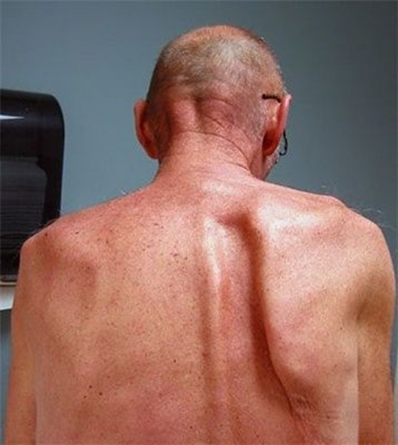
Shoulder Deformity

Slide 42
Causes
The following medical conditions are some of the possible causes of a shoulder deformity.
  Shoulder dislocation
  Scapula fracture
  Clavicular fracture
  Fracture of the shoulder girdle
  Congenital malformations
  Paralysis of the muscles attached to the clavicle

Slide 43
Common Shoulder Problems
Dislocation: The shoulder joint is the most frequently dislocated major joint of the body - often caused by a significant force that separates the head of the humerus away from the glenoid fossa.
Separation: The shoulder becomes separated when the ligaments attached to the clavicle are torn, or partially torn, away from the scapula. Shoulder separation may be caused by a sudden, forceful blow to the shoulder, or as a result of a fall.
Bursitis: often occurs when tendonitis and impingement syndrome cause inflammation of the bursa sacs that protect the shoulder.

Slide 44
Continued
Impingement syndrome: Impingement syndrome is caused by the excessive squeezing or rubbing of the rotator cuff and scapula. The pain associated with the syndrome is a result of an inflamed bursa (lubricating sac) over the rotator cuff, and/or inflammation of the rotator cuff tendons, and/or calcium deposits in tendons due to wear and tear. Shoulder impingement syndrome can lead to a torn rotator cuff.
Tendonitis: is caused when the rotator cuff and/or biceps tendon become inflamed, usually as a result of being pinched by surrounding structures. The injury may vary from mild inflammation to involvement of most of the rotator cuff. When the rotator cuff tendon becomes inflamed and thickened, it may become trapped under the acromion.

Slide 45
Continued
Rotator cuff tear: a rotator cuff tear involves one or more rotator cuff tendons become inflamed from overuse, aging, a fall on an outstretched hand, or a collision.
Adhesive capsulitis (frozen shoulder): Frozen shoulder is a severely restrictive condition frequently caused by injury that, in turn, leads to lack of use due to pain. Intermittent periods of use may cause inflammation and adhesions to grow between the joint surfaces, thus restricting motion. There is also a lack of synovial fluid to lubricate the gap between the arm bone and socket that normally helps the shoulder joint to move. This restricted space between the capsule and ball of the humerus distinguishes adhesive capsulitis from the less complicated condition known as stiff shoulder
Fracture; a fracture is a partial or total crack or break through a bone that usually occurs due to an impact injury.

Slide 46
Common Upper Extremity Problems
In the hand: Carpal Tunnel Syndrome, Tenosynovitis, Dupuytren's Disease, and Arthritis of the Hand.
In the Wrist: Wrist Sprain, De Quervain's Tendinitis, Arthritis, Ganglion Cysts
In the forearm and elbow: Bursitis of the Elbow, Triceps Tendon Inflammation and Rupture, Biceps Tendon Rupture, Biceps Tendonitis, Tennis Elbow,
Osteoarthritis of the Elbow, Rheumatoid Arthritis of the Elbow.

Slide 47
Spina Bifida
Type of malformation that occurs during early fetal development. It's known as a type of neural tube defect (NTD), in which either the brain and spine or only the spine fails to develop properly in the uterus.
3 types of spina bifida
  myelomeningocele: the most severe form; both the spinal cord and its lining (the meninges) protrude from an opening in the spine
  meningocele: only the meninges protrudes
  spina bifida occulta: the mildest form; there is a breach in the spinal vertebrae but it's covered by skin
These malformations are in the lower back or at the level of the hips.
In Canada, about 1 out of every 2,500 babies have some type of spina bifida

Slide 48
Continued
Exact cause of is still unknown.
  Women who have low levels of folic acid are more likely to give birth to children with NTD. The assumption is that when the genes of the fetus give the order to construct the spine, the necessary chemical building blocks are missing.
  There's almost certainly no single spina bifida gene, and it can occur in any pregnancy,
  Women with a family history of NTD are at increased risk of giving birth to a baby with such a defect. Couples who already have one child with spina bifida have a slightly higher risk of having another baby with NTD
  Obesity
  uncontrolled diabetes.
Most people with spina bifida have some degree of paralysis, usually in the lower body,
The nature of the paralysis depends on the location and severity of the lesion in the spine
Many with mild spina bifida occulta experience no physical problems at all. There may well be people with this condition who have never been diagnosed and will never suffer any ill effects.

Slide 49
Continued
Paralysis is common and often begins in the uterus. Babies may already have suffered complications of long-term paralysis at the time of birth. This includes
  having a spine that's too curved at the base, which prevents an infant from lying normal
  vertebrae or other joints may become locked in position, typically in a flexion position
  Clubfoot and dislocated hips are other common malformations seen at birth.
Nerves that control the bowel and bladder are often damaged in spina bifida,
  Can result severe constipation or incontinence and frequent infections. can put a massive strain on the kidneys, potentially leading to kidney failure and death.

Slide 50
Spina bifida
Most people with spina bifida also have malformations high in the spinal cord or brain that lead to a dangerous buildup of cerebrospinal fluid (CSF) in the ventricles inside the brain. This is called hydrocephalus. A large percentage of people with spina bifida develop this condition at some point. In an infant, it can cause the skull to grow out of proportion to the body.
People with spina bifida are of normal intelligence, but for unknown reasons they are more likely than the general population to have learning disabilities such as dyslexia, difficulty paying attention, and problems with learning math.
Babies that are born with meningocele or myelomeningocele are at risk of developing meningitis, newborns with these types of spina bifida often undergo surgery to close their spinal lesion in the first few days after birth.

Slide 51
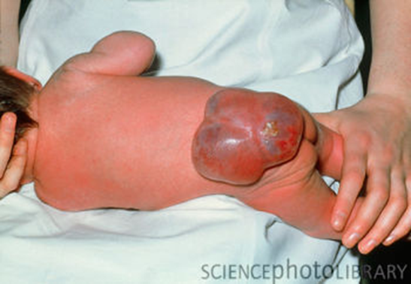
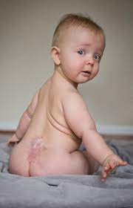
Myelomenigocele
Spina Bifida Occulta
May be “hidden” or present with a tuft of hair, dimple or enlarged mass like a lipoma over the affected area

Slide 52
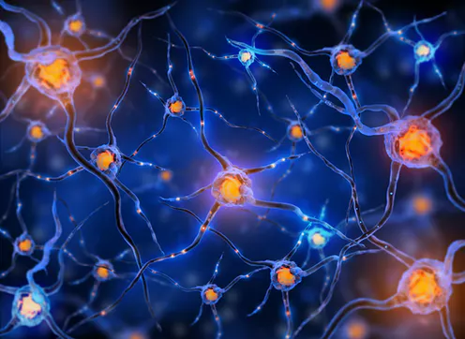
Nervous System Pathologies

Slide 53
Neurovascular Pathologies
Diseases of the Circulatory System that affect the Nerves

Slide 54
Claudication AKA
Intermittent Claudication
Pain caused by too little blood flow during exercise
Generally affects the blood vessels in the legs, but can affect the arms
It is a tight, aching, or squeezing pain that occurs during exercise
pain usually occurs after the same amount of exercise and is relieved by rest.

Slide 55
Symptoms
Pain when exercising - feet, calves, thighs, hips or buttocks depending on where artery narrowing or damage is occurring
Intermittent pain
Pain when at rest as the condition progresses
Discolored skin or ulcerations. If blood flow is severely reduced, the toes or fingers may look bluish or feel cold to the touch. Sores may develop on the lower legs, feet, toes, arms or fingers.
Other possible symptoms include: aching or burning feeling or weakness

Slide 56
Claudication cont.
In extreme cases, the circulation in the legs or arms can be so limited that the person feels pain even when he isn't exercising, and the legs or arms might feel cool to the touch. Severe peripheral artery disease can lead to poor healing of skin injuries and ulcers. These cuts and ulcers can develop gangrene and require limb amputation.

Slide 57
Causes
Claudication is most often a symptom of peripheral artery disease. In peripheral artery disease, the arteries that supply blood to the limbs are damaged, usually as a result of atherosclerosis. Atherosclerosis can develop in any artery. When atherosclerosis affects the arms and legs, it's called peripheral artery disease.
Atherosclerosis makes arteries hard and narrow. That's because the arteries get clogged with clumps of fat, cholesterol and other material, called atherosclerotic plaques. These plaques can make arteries so narrow that less blood can flow through them. Pain occurs because leg muscles are not getting enough oxygenated blood. Oxygen is the fuel that muscles need to contract.

Slide 58
Risk Factors
claudication
The risk factors for claudication are the same as those for developing atherosclerosis, including:
Smoking
High cholesterol
High blood pressure
Obesity (a body mass index over 30)
Diabetes
Age older than 70 years
Age older than 50 years if person also smokes or has diabetes
African American descent
A family history of atherosclerosis, peripheral artery disease or claudication
Heart disease

Slide 59
Healthy Habits to Encourage
Decrease/quit smoking. Smoking is the most significant risk factor for the development and worsening of peripheral artery disease. Smoking increases the chance that patient may eventually require an amputation or even die of the disease. Patients should avoid secondhand smoke as well.
Exercise. How can exercise can be helpful if it's what brings on the claudication pain? Exercise helps condition the muscles so that they use oxygen more efficiently. So even if the muscles are getting less oxygen, they can use what they do get, more effectively. That can eventually mean less pain during exertion.
Control cholesterol levels. By healthy diet and medication if necessary. Combined with exercise, a healthy diet can help control the blood pressure and cholesterol levels, both of which can contribute to atherosclerosis.

Slide 60
Continued
Avoid certain medications. Don't use drugs that cause blood vessels to constrict. Many sinus and cold medications sold over-the-counter contain pseudoephedrine, which is known to constrict blood vessels.
Avoid injury to the feet and legs. Reduced blood flow increases risk of complications from injuries.
Keep the legs below the heart. Doing so can help improve the circulation to the feet. To keep the blood flowing well to the legs and feet at night, it helps to raise the head of the bed by 4 to 6 inches.

Slide 61
The neurological manifestations of stroke
A stroke occurs when the blood supply to your brain is interrupted or reduced.it may be caused by a blocked artery (ischemic stroke) or a leaking or burst blood vessel (hemorrhagic stroke). Some people may experience a temporary disruption of blood flow through their brain (transient ischemic attack, or TIA).

Slide 62
Ischemic Stroke
About 85 percent of strokes are ischemic strokes. Ischemic strokes occur when the arteries to the brain become narrowed or blocked, causing severely reduced blood flow (ischemia). The most common ischemic strokes include:
  Thrombotic stroke - artery blocked by a blood clot
  Embolic stroke- artery blocked by any other type of embolus (fat, air, debris, infection etc)

Slide 63
Hemorrhagic Stroke
Hemorrhagic stroke occurs when a blood vessel in the brain leaks or ruptures. Brain hemorrhages can result from many conditions that affect the blood vessels, including uncontrolled high blood pressure (hypertension) and weak spots in your blood vessel walls (aneurysms).
A less common cause of hemorrhage is the rupture of an abnormal tangle of thin-walled blood vessels (arteriovenous malformation) present at birth.

Slide 64
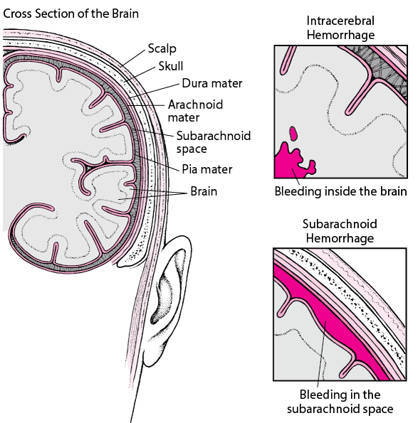
Types of Hemorrhagic Stroke
Types of hemorrhagic stroke include:
  Intracerebral hemorrhage - within the brain
  Subarachnoid hemorrhage - within the subarachnoid space, where CSF is located

Slide 65
Transient Ischemic Attack
(TIA) — also called a mini stroke — is a brief period of symptoms similar to those in a stroke. A temporary decrease in blood supply to part of the brain causes TIAs, which often last less than five minutes.
Like an ischemic stroke, a TIA occurs when a clot or debris blocks blood flow to part of your brain. A TIA doesn't leave lasting symptoms because the blockage is temporary.
Symptoms of brain stroke
  Trouble with walking
  Trouble with speaking and understanding
  Paralysis or numbness of the face, arm or leg
  Trouble with seeing in one or both eyes
  Headache

Slide 66
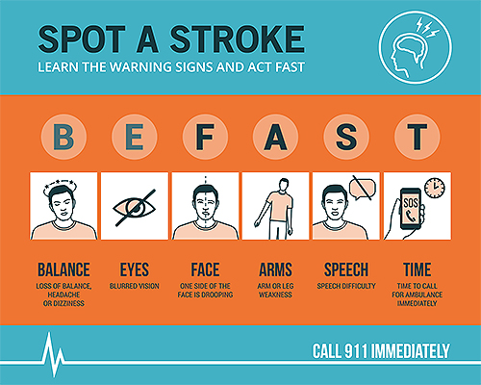
Stroke/TIA Symptoms

Slide 67
Compartment Syndromes
Compartment syndrome occurs when excessive pressure builds up inside an enclosed space in the body. Compartment syndrome usually results from bleeding or swelling after an injury. The dangerously high pressure in compartment syndrome impedes the flow of blood to and from the affected tissues. It can be an emergency, requiring surgery to prevent permanent injury.

Slide 68
What happens
Groups of organs or muscles are organized into areas called compartments. Strong webs of connective tissue called fascia form the walls of these compartments.
After an injury, blood or edema (fluid resulting from inflammation or injury) may accumulate in the compartment. The tough walls of fascia cannot easily expand, and compartment pressure rises, preventing adequate blood flow to tissues inside the compartment. Severe tissue damage can result, with loss of body function or even death.
The legs, arms, and abdomen are most prone to developing compartment syndrome.

Slide 69
Causes
Acute compartment syndrome is the most common type of compartment syndrome. About three-quarters of the time, acute compartment syndrome is caused by a broken leg or arm. Acute compartment syndrome develops rapidly over hours or days.
Compartment syndrome can develop from the fracture itself, due to pressure from bleeding and edema. Or compartment syndrome may occur later, as a result of treatment for the fracture (such as surgery or casting).

Slide 70
Causes
Acute compartment syndrome can also occur after injuries without bone fractures, including:
  Crush injuries
  Burns
  Overly tight bandaging
  Prolonged compression of a limb during a period of unconsciousness
  Surgery to blood vessels of an arm or leg
  A blood clot in a blood vessel in an arm or leg
  Extremely vigorous exercise, especially eccentric movements (extension under pressure)
Taking anabolic steroids can also contribute to developing compartment syndrome.

Slide 71
Chronic Exertional Compartment syndrome
Another form of compartment syndrome, called chronic exertional compartment syndrome (CECS), develops over days or weeks. Also called exertional compartment syndrome, it may be caused by regular, vigorous exercise. The lower leg, buttock, or thigh is usually involved.

Slide 72
Abdominal Compart Syndrome
Abdominal compartment syndrome almost always develops after a severe injury, surgery, or during critical illness. Some conditions associated with abdominal compartment syndrome include:
  Trauma, especially when it results in shock
  Abdominal surgery, particularly liver transplant
  Burns
  Sepsis (an infection causing inflammation throughout the body)
  Severe ascites or abdominal bleeding
  Vigorous overtraining utilizing eccentric abdominal exercises
As the pressure in the abdominal compartment rises, blood flow to and from the abdominal organs is reduced. The liver, bowels, kidneys, and other organs may be injured or permanently damaged.

Slide 73
Symptoms
Acute compartment syndrome usually develops over a few hours after a serious injury to an arm or leg. Some symptoms of acute compartment syndrome include:
  A new and persistent deep ache in an arm or leg
  Pain that seems greater than expected for the severity of the injury
  Numbness, pins-and-needles, or electricity-like pain in the limb
  Swelling, tightness and bruising

Slide 74
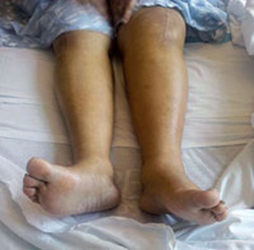
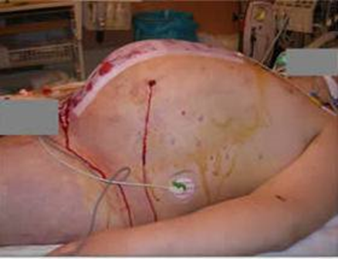

Slide 75
Infections of the CNS

Slide 76
Infections of the CNS
Infection of the central nervous system (CNS) can be viral, bacterial, fungal, or parasitic in origin. Infectious microorganisms most often enter the CNS by direct penetration after trauma or by travelling in the bloodstream. People who are immunocompromised from conditions such as AIDS, cancer, steroid use, diabetes or alcoholism may be at risk for opportunistic infections which would not ordinarily affect persons with normal immune defenses. There are three major categories of CNS infections:
  Encephalitis
  Meningitis
  Brain abscess

Slide 77
Encephalitis
defined as inflammation of the brain due to an infection. This inflammation is commonly the result of a viral infection. Viruses can gain access to the central nervous system (CNS) through the blood or by traveling within nerve cells (neurons). In the United States the most common cause of acute viral encephalitis is the herpes simplex virus. There are approximately 20,000 cases of encephalitis in America each year. Herpes Simplex Encephalitis is clinically characterized by headaches and fever in its early stages. Seizures are commonly present in the early stages of the disease. In addition, because of the viruses' localization to the temporal lobe of the brain, hallucinations, behavioral abnormalities, and personality changes are present in 90% of patients early on. Among other clinical manifestations are: memory impairment, an inability to understand words or to speak fluently (aphasia), and loss of movement most commonly occurring in the face or arm.

Slide 78
Continued
With progression of the disease the fronto-temporal region of the brain (that area between the frontal and temporal lobes) can swell with fluid, a condition known as cerebral edema. This edema can cause a dangerous increase in the pressure within the skull (increased intracranial pressure). Antiviral therapy is critical to affect a favorable prognosis for Herpes Simplex Encephalitis. In the absence of such therapy the mortality rate is 70%. Delayed treatment, an age of the patient over 30, and coma are all associated with a poorer prognosis.

Slide 79
Meningitis
is an inflammation of the meninges due to infection. It occurs when a foreign pathogen invades the subarachnoid space and populates the CSF. The foreign microorganisms can either be bacteria or viruses. Accordingly, meningitis can be classified as either bacterial or viral. Generally, bacterial meningitis is more dangerous than the viral form and can constitute a medical emergency. Two of the major forms of bacteria which cause bacterial meningitis are Streptococcus pneumoniae and Neisseria meningitidis. Therefore, bacterial meningitis usually occurs in either a pneumococcal or a meningococcal form. Pneumococcal meningitis is typically observed in adults. It can arise following brain trauma, and is predisposed by sickle cell anemia, alcoholism, and diabetes. Meningococcal meningitis most often occurs in children, adolescents, and young adults. Whatever the type of meningitis, a critical tool for diagnosis of the disease is lumbar puncture (or spinal tap). The CSF sample is required both to establish a diagnosis of bacterial meningitis and to determine the identity of the invading bacteria, a determination that is essential in treating the disease.

Slide 80
Bacterial Meningitis
Bacterial meningitis presents as an acute disease. Three main features characterize it: headache, high persistent fever, and neck stiffness (an inability to bow the head, known as nuchal rigidity). It can also be accompanied by a variety of other symptoms including rashes, nausea, lethargy, and general malaise. In addition, seizures occur in about 20% of patients and coma occurs in 5-10% of patients. The latter development is associated with a particularly poor prognosis.

Slide 81
Complications of Bacterial Meningitis
Patients with meningococcal meningitis can experience extremely low blood pressure resulting in shock, a condition known as the Waterhouse-Friderichsen syndrome. In addition, bacterial pathogens can increase the amount of fluid leaving blood vessels to enter the tissue of the brain. This condition destroys the so-called blood-brain barrier and results in a swelling of the brain with fluid, a condition known as cerebral edema. This can translate into a dangerous increase in the pressure within the skull (the intracranial pressure or ICP). Both of these complications are life-threatening and mandate treatment in an intensive care unit.

Slide 82
Brian Abscess
a circumscribed region of infection within the substance of the brain. The abscess is initially characterized by an area of necrotic (dead) brain tissue surrounded by a zone of cerebritis (local inflammation of brain cells). As the abscess develops the necrotic area becomes filled with pus and a ring of cells surrounds the area. A mature abscess is characterized by a necrotic puss-filled region of brain tissue, surrounded by an area of cerebritis.

Slide 83
Causes
A brain abscess forms as the result of the spread into brain tissue of an infection elsewhere. There are three possible origins of this infection:
  1. An abscess most commonly arises via the direct extension into the skull of a local infection in the paranasal sinuses or in the middle ear.
  2.Microorganisms can also be spread by the blood during a systemic infection. In this case bacteria are carried to the site of abscess from a distant source, typically the skin, lungs, mouth, or heart valves. Under these circumstances there is not a solitary abscess but rather multiple abscesses in the brain.
  3.Lastly, a brain abscess can result from head trauma. An infection can arise from a wound penetrating the skull. In this case inoculation with bacteria occurs from infected bone fragments or debris from the penetrating instrument.

Slide 84
Symptoms
Symptoms resulting from a brain abscess depend on the size and the location of the infection. Only 50% of patients with a brain abscess present with a fever and, when present, fever is often low-grade. A brain abscess can also present with symptoms typical of any space-occupying mass within the substance of the brain (a focal neurological deficit. The commonly observed deficits include weakness on one side of the body (hemiparesis), impaired speech production (dysphasia), visual field deficits, and an inability to smoothly coordinate muscle movements, such as during walking (ataxia).

Slide 85
Disorders of the CNS

Slide 86
Causes of Injury to the CNS
Any injury to the head may cause traumatic brain injury (TBI). There are two major types of TBI:
Penetrating Injuries: In these injuries, a foreign object (e.g., a bullet) enters the brain and causes damage to specific brain parts. This focal, or localized, damage occurs along the route the object has traveled in the brain. Symptoms vary depending on the part of the brain that is damaged.
Closed Head Injuries: Closed head injuries result from a blow to the head as occurs, for example, in a car accident when the head strikes the windshield or dashboard.

Slide 87
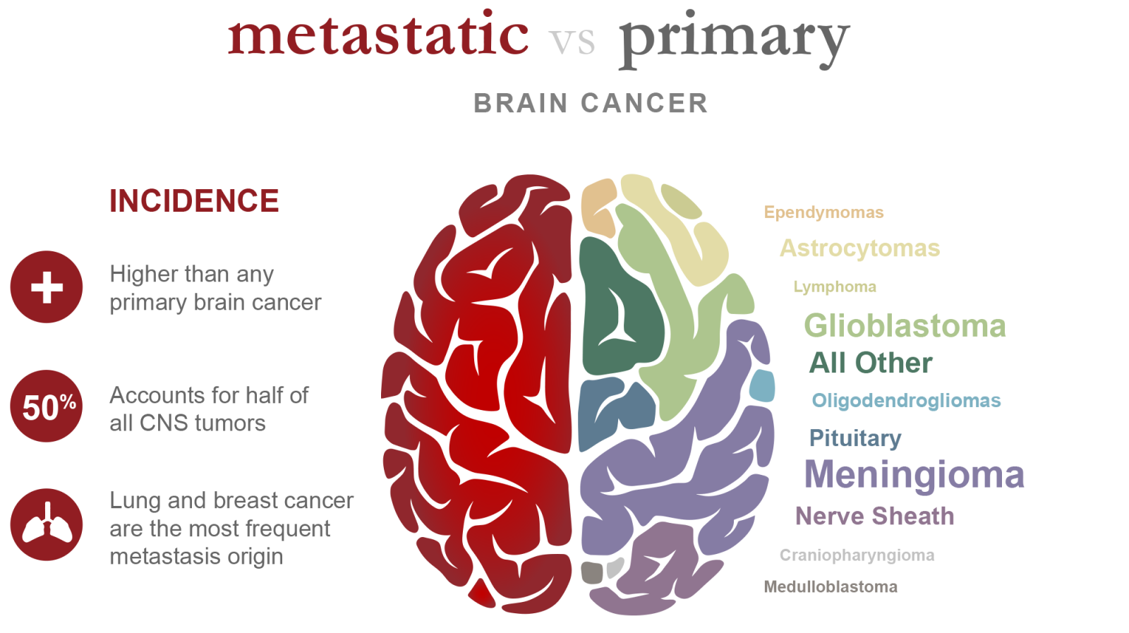
Neoplasms of the Brain
Brain tumors may originate from neural elements within the brain, or they may represent spread of distant cancers. Gliomas, metastases, meningiomas, pituitary adenomas, and acoustic neuromas account for 95% of all brain tumors.

Slide 88
Symptoms
Presenting complaints of patients with an intracranial neoplasm tend to be similar for primary brain tumors and intracranial metastases. The onset of symptoms usually is insidious, but an acute episode may occur with bleeding into the tumor, or when an intraventricular tumor suddenly occludes the third ventricle. Manifestations may be nonspecific and include the following:
  Headache
  Altered mental status
  Ataxia
  Nausea
  Vomiting
  Weakness
  Gait disturbance

Slide 89
Continued
CNS neoplasms also may manifest as follows:
  Focal seizures
  Fixed visual changes
  Speech deficits
  Focal sensory abnormalities

Slide 90
Risk Factors
Being overweight or obese
Physical inactivity
Heavy or binge drinking
Use of illicit drugs such as cocaine and methamphetamines
High blood pressure
Cigarette smoking or exposure to secondhand smoke.
High cholesterol
Diabetes.
Obstructive sleep apnea
Cardiovascular disease, including heart failure, heart defects, heart infection or abnormal heart rhythm.
Personal or family history of stroke, heart attack or transient ischemic attack.
Being age 55 or older.
Race — African-Americans have higher risk of stroke than do people of other races.
Gender — Men have a higher risk of stroke than women.

Slide 91
Complications
Paralysis or loss of muscle movement
Difficulty talking or swallowing
Memory loss or thinking difficulties
Emotional problems
Changes in behavior and self-care ability

Slide 92
Other CNS Disorders
Brain herniation: leg weakness, altered level of consciousness, hemiparesis, pupil dilation, visual field loss, and respiratory arrest.
Hydrocephalus: An abnormal increase in CSF volume in any part or all of the ventricular system, Enlargement of the CSF compartment occurs
Cerebral edema: Occurs with conditions that impair the function of the blood-brain barrier and that allow transfer of water and protein from the vascular into the interstitial space or involves an increase in intracellular fluid.

Slide 93
Epilepsy aka Seizure Disorders
A seizure is a change in the electrical activity of the brain. It results in a change of behaviour and possible change in level of consciousness.
Focal seizures - account for about 60% of seizures. The changes in electrical activity are confined to one area of the brain.
Without loss of consciousness- changes in sensory sensations. May also have involuntary movements.
With impaired awareness - A change in level of consciousness or awareness occurs. Can be a blank stare or performing repetitive movements such as hand rubbing, chewing or walking in circles.

Slide 94
Seizures cont.
Generalized seizures - about 30 % of seizures, they involve abnormal electrical activity throughout a greater area of the brain
Absence seizure (petit mal)- brief loss of awareness lasting up to 10 sec. The person has no memory of the seizure.
Tonic-clonic (grand mal)- intermittent contract-relax pattern in muscles and loss of consciousness. Last several minutes & the person has no memory of the seizure.

Slide 95
Seizures cont.
Status epilepticus - medical emergency. When seizures recur without a full return to consciousness in between, or when a single seizure lasts over 30 mins.
Brain damage or death can result due to lack of oxygen.
Epilepsy - term used to describe people with recurrent seizures. Affects 50 million people worldwide at an incidence of 4 - 10 per 1000 people.

Slide 96
Seizures/Epilepsy Cont.
Etiology- 65% idiopathic
Acquired causes include: head trauma, brain tumours, infections, high fever, chemical imbalances, withdrawal from certain drugs or alcohol & acute stress.
Contrasting light/dark patterns and flashing or patterned lights may be seizure triggers. Some aromas including essential oils may also be triggers.
Treatment: Anticonvulsant medications such as Clonazepam and Valproic Acid. Cannabinoid oils and sedatives may also be used.
Acute Tonic-clonic seizure treatment: Stay with the client & try to put them in an environment to minimize injury. Place them in the recovery position after the seizure ends.

Slide 97
Degenerative Diseases of the Brain
Dementia - A group of neurodegenerative disorders that slowly destroy memory, thinking and communicating skills. Alzheimer’s disease is most common, followed by vascular dementia, Lewy Body dementia & Frontotemporal dementia.
Etiology - Dementia is associated with advancing age but many other health and nutritional determinants appear to play a role. There may be some genetic component as well.
Treatment - Support with activities of daily life. Medications such as antidepressants or Antianxiety meds may be helpful.

Slide 98
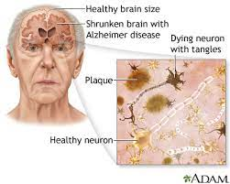
Alzheimer’s Disease
Most common cause of dementia. Characterized by buildup of beta-amyloid and tau proteins, as well as overall shrinkage of the brain.
Etiology- Associated with advanced age. Also associated with poorly controlled diabetes, obesity, sedentary lifestyle, high blood pressure and head traumas.
Incidence: 1 in 9 people aged 65+

Slide 99
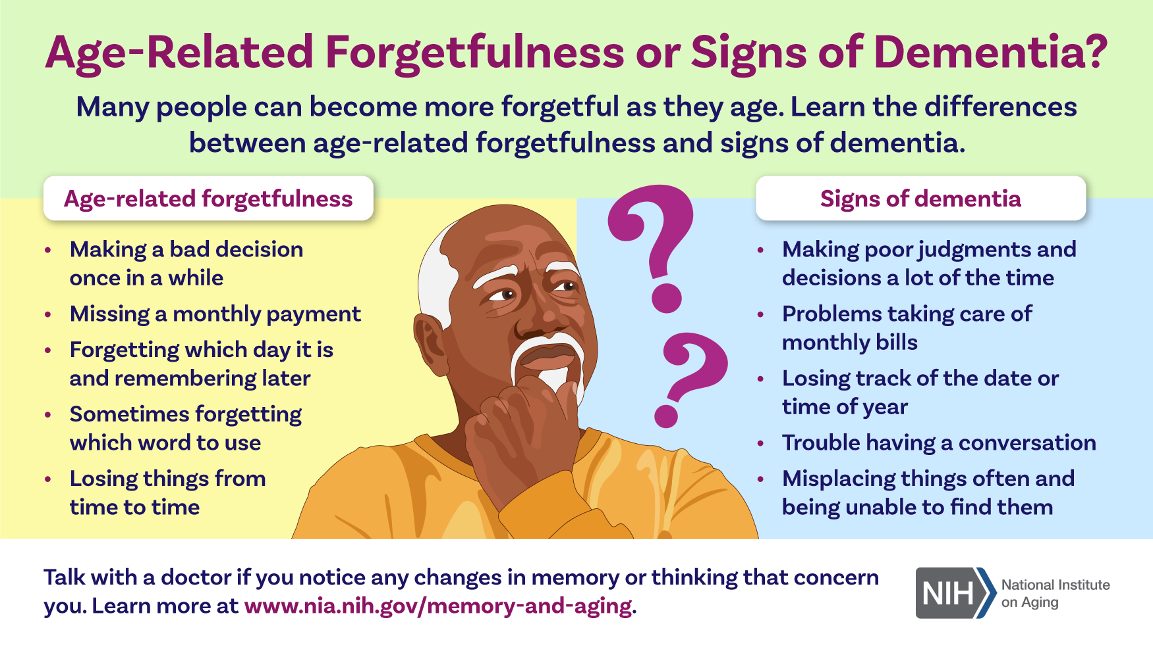
Alzheimers cont.
Signs & Symptoms - Memory problems are typically one of the first signs of the disease. Decline in non-memory aspects of cognition, such as finding the right word, trouble understanding visual images and spatial relationships, and impaired reasoning or judgment. Confabulation

Slide 100
Alzheimer’s Cont.
Pathogenesis - progressive memory and neurocognitive function, ultimately requiring supportive care to perform the basic tasks of life.
Time from diagnosis to death is on average 8 years.
Treatment: No treatment has been found to be effective yet. Antidepressant and antianxiety meds may be helpful as well as supportive nursing care.
Communication strategies include going with the clients into their delusions rather than arguing with them about reality.

Slide 101
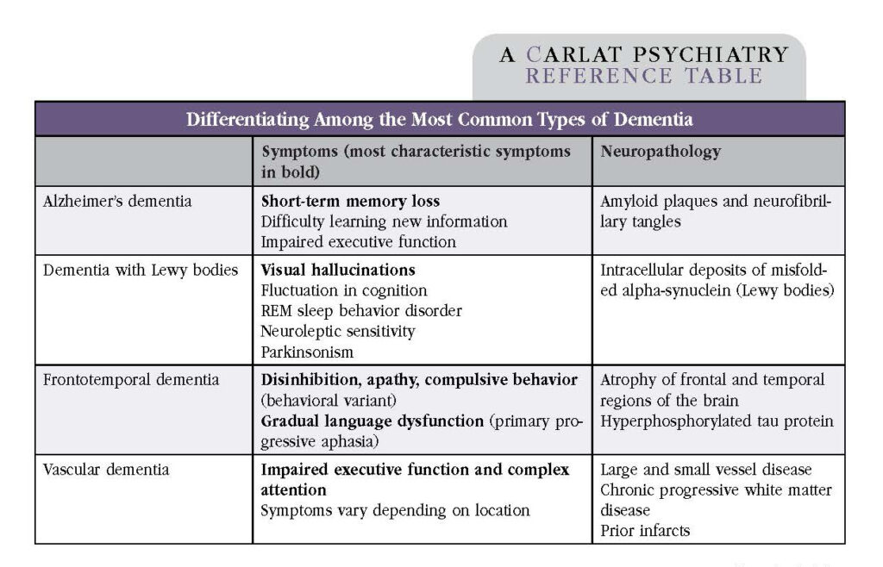
Other Forms of Dementia

Slide 102
Parkinson’s Disease
A neurodegenerative condition that affects the basal ganglia of the midbrain.

Slide 103
Multiple Sclerosis

Slide 104
Motor Neuron Lesions
TIA
The motor neuron diseases (MNDs) are a group of progressive neurological disorders that destroy motor neurons, the cells that control essential voluntary muscle activity such as speaking, walking, breathing, and swallowing. Normally, messages from nerve cells in the brain (called upper motor neurons) are transmitted to nerve cells in the brain stem and spinal cord (called lower motor neurons) and from them to particular muscles. Upper motor neurons direct the lower motor neurons to produce movements such as walking or chewing. Lower motor neurons control movement in the arms, legs, chest, face, throat, and tongue

Slide 105
Continued
When there are disruptions in the signals between the lowest motor neurons and the muscle, the muscles do not work properly; the muscles gradually weaken and may begin wasting away and develop uncontrollable twitching (called fasciculations). When there are disruptions in the signals between the upper motor neurons and the lower motor neurons, the limb muscles develop stiffness (called spasticity), movements become slow and effortful, and tendon reflexes such as knee and ankle jerks become overactive. Over time, the ability to control voluntary movement can be lost.
Some MNDs are inherited, but the causes of most MNDs are not known. In sporadic or non-inherited MNDs, environmental, toxic, viral, or genetic factors may be implicated.
MNDs are classified into: amyotrophic lateral sclerosis (ALS), Primary lateral sclerosis, progressive muscular atrophy, and progressive bulbar palsy

Slide 106
ALS
Amyotrophic lateral sclerosis (ALS): weakness and wasting of the bulbar muscles (muscles that control speech, swallowing, and chewing). Muscle weakness and atrophy occur on both sides of the body. Affected individuals lose strength and the ability to move their arms and legs, and to hold the body upright. Other symptoms include spasticity, spasms, muscle cramps, and fasciculations. Speech can become slurred or nasal.

Slide 107
MND’s Continued
Progressive bulbar palsy: Symptoms include pharyngeal muscle weakness (involved with swallowing), weak jaw and facial muscles, progressive loss of speech, and tongue muscle atrophy
Primary lateral sclerosis: Speech may become slowed and slurred. When affected, the legs and arms become stiff, clumsy, slow and weak, leading to an inability to walk or carry out tasks requiring fine hand coordination. Difficulty with balance may lead to falls
Progressive muscular atrophy: Weakness is typically seen first in the hands and then spreads into the lower body, other symptoms may include muscle wasting, clumsy hand movements, fasciculations, and muscle cramps

Slide 108
Wallerian degeneration
Is the process of antegrade degeneration of the axons and their accompanying myelin sheaths following proximal axonal or neuronal cell body lesions. It may result following neuronal loss due to cerebral infarction, trauma, necrosis, focal demyelination or hemorrhage.

Slide 109
Peripheral Nervous System disorders
Is damage or disease affecting nerves, which may impair sensation, movement, gland or organ function, or other aspects of health, depending on the type of nerve affected. There are many types of peripheral neuropathy, often brought on by diabetes, leprosy, genetic predispositions (hereditary causes), exposure to toxic chemicals, alcoholism, malnutrition, inflammation (infectious or autoimmune), traumatic injury, and nerve compression, vitamin B12 deficiency, and by taking certain medications such as those used to treat cancer and HIV/AIDS.

Slide 110
Continued
Neuropathy affecting just one nerve is called "mononeuropathy" and neuropathy involving multiple nerves in roughly the same areas on both sides of the body is called "symmetrical polyneuropathy" or simply "polyneuropathy." Peripheral neuropathy may be chronic (a long term condition where symptoms begin subtly and progress slowly) or acute (sudden onset, rapid progress and slow resolution). Acute neuropathies demand urgent diagnosis. Motor (that control muscles), sensory nerves, or autonomic nerves (that control automatic functions such as heart rate, body temperature and breathing), may be affected. More than one type of nerve may be affected at the same time. Peripheral neuropathies may be classified according to the type of nerve predominantly involved, or by the underlying cause. Where the cause is unknown it is described as idiopathic neuropathy.

Slide 111
Continued
Neuropathy may cause painful cramps, fasciculations (fine muscle twitching), muscle loss, bone degeneration, and changes in the skin, hair, and nails. Additionally, motor neuropathy may cause impaired balance and coordination or, most commonly, muscle weakness; sensory neuropathy may cause numbness to touch and vibration, reduced position sense causing poorer coordination and balance, reduced sensitivity to temperature change and pain, spontaneous tingling or burning pain; and autonomic neuropathy may produce diverse symptoms, depending on the affected glands and organs, but common symptoms are poor bladder control, abnormal blood pressure or heart rate, and reduced ability to sweat normally

Slide 112
Compression and Tension Neuropathies
When the nervous system is impaired, it can cause excruciating pain or limitations to movement. Because we work so closely with the soft tissues of the body, it is valuable for the massage therapist to understand more about various nervous system pathologies.
The nervous system is a complex network for the transmission of information going in two different directions. We have sensory (afferent) signals moving from the periphery of the body back to the central nervous system and motor (efferent) signals moving from the central nervous system to the periphery. Both types of signals are transmitted along the same nerve tissue. Therefore, if there is an impairment of nerve function, it is likely to affect both sensory and motor signals.

Slide 113
Continued
During the course of normal daily function, the structures of the nervous system are exposed to a variety of different forces. The two forces that cause problems most frequently in the nervous system are compression and tension. When something causes a problem with the proper function of nerve tissue, it is called a neuropathy. Therefore, when speaking of nerve compression and tension injuries, we call them compression or tension neuropathies.
Compression neuropathies are the most common type of nerve injuries. There may be various causes of compression neuropathy. Compression by other structures in a small space (such as an anatomical tunnel) is a common cause. Examples would include compression of the median nerve in the carpal tunnel, the posterior tibial nerve in the tarsal tunnel, or a spinal nerve root as it travels through an intervertebral foramen. Often there is some reason that the tunnel or space through which the nerve travels has narrowed, and the adjacent structures will compress the nerve.

Slide 114
Continued
Sometimes a compression injury will be caused by an outside mechanical force. For example, the radial nerve is often injured in the axillary region from improperly fitted crutches. Prolonged pressure to the axilla from the crutches will compress the radial nerve. Long-distance cyclists often experience a similar problem, termed "handlebar palsy." Handlebar palsy is a compression of the ulnar nerve in the wrist that occurs from long periods of direct pressure on the nerve, when the weight of the upper body is resting on the handlebars.

Slide 115
Continued
Tension neuropathies, while not as common as compression neuropathies, are increasingly viewed as important clinical problems. It has been demonstrated that for the body to move properly, the nervous system must have significant mobility. This is especially true in the extremities, in which the nerves must bend around joints and allow for increases in length as the joints bend at sharp angles. If such mobility is compromised, increased tension on the nervous tissue can cause pathological changes.
Symptoms of compression or tension neuropathies are very similar. In fact, you can't tell the difference in a compression or tension neuropathy simply by the symptoms. In many instances compression and tension neuropathies will exist together. For example, if there is excess compression on the brachial plexus, proper mobility of the nerves of that plexus will be impaired. Therefore these nerves may be subjected to tension neuropathies farther down the arm, because the compression of the brachial plexus has limited the neural mobility.

Slide 116
Symptoms
  Pain (often described as sharp, stabbing or electrical in nature)
  Paresthesia (the sensation of pins and needles)
  Numbness or muscle weakness.
These symptoms will usually be identified with a thorough client interview and detailed physical examination.
The nerves are not only responsible for transmitting afferent and efferent signals along their length; they are also responsible for moving their own nutrient proteins which are essential for optimal function. The movement of these nutrient proteins is accomplished through a special type of cytoplasm within the nerve cell called axoplasm (referring to cytoplasm of the axon). The axoplasm moves freely along the entire length of the nerve. If there is a blockage to the flow of the axoplasm (called axoplasmic flow), the nerve tissue distal to that site of compression is nutritionally deprived and more susceptible to injury.

Slide 117
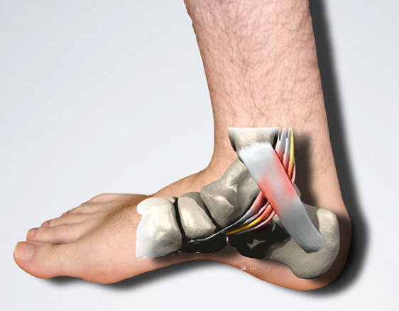
Tarsal Tunnel Syndrome

Slide 118
What is it ?
The tarsal tunnel is a narrow space that lies on the inside of the ankle next to the medial malleolus and talus. The tunnel is covered with a thick ligament (the flexor retinaculum) that protects and maintains the structures contained within the tunnel—arteries, veins, tendons, and nerves. One of these structures is the posterior tibial nerve, which is the focus of tarsal tunnel syndrome.
Tarsal tunnel syndrome is compression, or squeezing, on the posterior tibial nerve that produces symptoms, anywhere along the path of the nerve, from the inside of the ankle into the foot.

Slide 119
Symptoms
  Tingling, burning, or a sensation similar to an electrical shock
  Numbness
  Pain, including shooting pain
Symptoms are typically felt on the inside of the ankle and/or on the bottom of the foot. In some people, a symptom may be isolated and occur in just one spot. In others, it may extend to the heel, arch, toes, and even the calf.
Sometimes the symptoms of the syndrome appear suddenly. Often they are brought on or aggravated by overuse of the foot, such as in prolonged standing, walking, exercising, or beginning a new exercise program.

Slide 120
Causes
The syndrome is caused by anything that produces compression on the posterior tibial nerve, such as:
A person with flat feet is at risk for developing tarsal tunnel syndrome, because the outward tilting of the heel that occurs with “fallen” arches can produce strain and compression on the nerve.
An enlarged or abnormal structure that occupies space within the tunnel can compress the nerve. Some examples include a varicose vein, ganglion cyst, swollen tendon, and arthritic bone spur.
An injury, such as an ankle sprain, may produce inflammation and swelling in or near the tunnel, resulting in compression of the nerve.
Systemic diseases such as diabetes or arthritis can cause swelling, thus compressing the nerve.

Slide 121
Treatment
If left untreated, the condition progresses and may result in permanent nerve damage. A variety of treatment options, often used in combination, are available to treat tarsal tunnel syndrome. These include:
  Rest. Staying off the foot prevents further injury and encourages healing.
  Ice. Apply an ice pack to the affected area, placing a thin towel between the ice and the skin. Use ice for 20 minutes and then wait at least 40 minutes before icing again.
  Oral medications. Non-steroidal anti-inflammatory drugs (NSAIDs), such as ibuprofen, help reduce the pain and inflammation.

Slide 122
Continued
Immobilization. Restricting movement of the foot by wearing a cast is sometimes necessary to enable the nerve and surrounding tissue to heal.
Physical therapy. Ultrasound therapy, exercises, and other physical therapy modalities may be prescribed to reduce symptoms.
Injection therapy. Injections of a local anesthetic provides pain relief, and an injected corticosteroid may be useful in treating the inflammation.
Orthotic devices. Custom shoe inserts may be prescribed to help maintain the arch and limit excessive motion that can cause compression of the nerve.
Shoes. Supportive shoes may be recommended.
Bracing. Patients with flat foot or those with severe symptoms and nerve damage may be fitted with a brace to reduce the amount of pressure on the foot.

Slide 123
Carpal Tunnel Syndrome
The wrist is surrounded by a band of fibrous tissue that normally functions as a support for the joint. The tight space between this fibrous band and the wrist bone is called the carpal tunnel. The median nerve passes through the carpal tunnel to receive sensations from the thumb, index, and middle fingers of the hand. Any condition that causes swelling or a change in position of the tissue within the carpal tunnel can squeeze and irritate the median nerve. Irritation of the median nerve in this manner causes tingling and numbness of the thumb, index, and the middle fingers -- a condition known as "carpal tunnel syndrome."

Slide 124
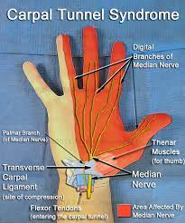
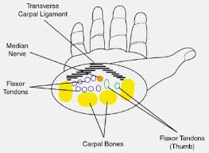
Carpal Tunnel Syndrome

Slide 125
Causes
For most patients, the cause of their carpal tunnel syndrome is unknown. Any condition that exerts pressure on the median nerve at the wrist can cause carpal tunnel syndrome. Common conditions that can lead to carpal tunnel syndrome include obesity, pregnancy, hypothyroidism, arthritis, diabetes, and trauma. Tendon inflammation resulting from repetitive work, such as uninterrupted typing, can also cause carpal tunnel symptoms. Some rare diseases can cause deposition of abnormal substances in and around the carpal tunnel, leading to nerve irritation. These diseases include amyloidosis, sarcoidosis, multiple myeloma, and leukemia

Slide 126
Symptoms
People with carpal tunnel syndrome initially feel numbness and tingling of the hand in the distribution of the median nerve (the thumb, index, middle, and thumb side of the ring fingers). These sensations are often more pronounced at night and can awaken people from sleep. The reason symptoms are worse at night may be related to the flexed-wrist sleeping position and/or fluid accumulating around the wrist and hand while lying flat. Carpal tunnel syndrome may be a temporary condition that completely resolves or it can persist and progress.
As the disease progresses, patients can develop a burning sensation, and/or cramping and weakness of the hand. Decreased grip strength can lead to frequent dropping of objects from the hand. Occasionally, sharp shooting pains can be felt in the forearm. Chronic carpal tunnel syndrome can also lead to wasting (atrophy) of the hand muscles, particularly those near the base of the thumb in the palm of the hand.

Slide 127
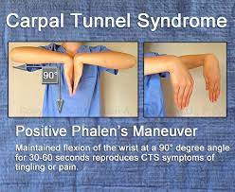
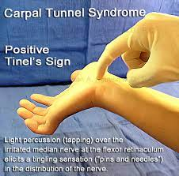
Carpal Tunnel Tests

Slide 128
Treatments
Initial treatments usually include: rest, immobilization of the wrist in a splint, and occasionally ice application. Those whose occupations are aggravating the symptoms should modify their activities. For example, computer keyboards and chair height may need to be adjusted to optimize comfort. These measures, as well as periodic resting and range of motion stretching exercise of the wrists can frequently prevent the symptoms of carpal tunnel syndrome that are caused by repetitive overuse. Underlying conditions or diseases are treated individually. Fractures can require orthopedic management. Obese individuals will be advised regarding weight reduction. Rheumatoid disease is treated with measures directed against the underlying arthritis.

Slide 129
Continued
Wrist swelling that can be associated with pregnancy resolves in time after delivery of the baby. Several types of medications have been used in the treatment of carpal tunnel syndrome. Vitamin B6 (pyridoxine) has been reported to relieve some symptoms of carpal tunnel syndrome, although it is not known how this medication works. Nonsteroidal anti-inflammatory drugs can also be helpful in decreasing inflammation and reducing pain.
In order to avoid serious and permanent nerve and muscle consequences of carpal tunnel syndrome, surgical treatment is considered. Surgery involves severing the band of tissue around the wrist to reduce pressure on the median nerve. This surgical procedure is called "carpal tunnel release." It can now be performed with a small diameter viewing tube, called an arthroscope, or by open wrist procedure. After carpal tunnel release, patients often undergo exercise rehabilitation. Though it is uncommon, symptoms can recur.

Slide 130
References
Lippincott Williams & Wilkins
www.mayoclinic.org www.healthlinkbc.ca
www.medicinenet.com www.webmd.com
www.massagetoday.com www.foothealthfacts.org
www.medicinenet.com www.rightdiagnosis.com
http://uhealthsystem.com www.drevancollins.com
www.arthritis.ca http://columbianeuroicu.org
www.asha.org http://emedicine.medscape.com
www.ninds.nih.gov

