Slide 1
Skull and Facial Anatomy

Slide 2
The Skull
The skull (cranium) has 22 bones
These are grouped into 2 categories:
  Cranial bones and facial bones
8 cranial bones form the cranial cavity which house and protect the brain
14 facial bones form the face

Slide 3
Cranial Bones
Frontal (forehead)
2 Parietal
2 Temporal
Occipital
Sphenoid
Ethmoid

Slide 4
Facial Bones
2 Nasal
2 Maxillae
2 Zygomatic
Mandible
2 Lacrimal (tear duct)
2 Palatine (Hard palate)
2 Inferior nasal conchae
Vomer (forms nasal septum)

Slide 5
Functions of the Skull
Functions of the skull include:
  Protecting the brain
  Forming the nasal cavity and orbits
  Containing cavities called paranasal sinuses and cavities to house structures for hearing and balance
  Provides areas for muscle attachments
  Form the framework for the face and provides the portals of entry to digestion and respiratory system
  Protects the delicate special sense organs

Slide 6
Frontal Bones
Forms the forehead, the roof of the orbits and most of the anterior cranial floor
The left and right halves of the frontal bone unite soon after birth at the metopic suture
This suture has disappeared by age 8

Slide 7
Landmarks of the Frontal Bones
Frontal squama – Plate of bone anteriorly forming the forehead
Supraorbital margins – A hole within the supraorbital margin for nerves and vessels
  Sometimes the foramen is not complete and is called the supraorbital notch
Frontal sinuses – Cavities between the orbits

Slide 8
Sinuses
Called paranasal sinuses
These are cavities lined with mucous membranes
They are found within different skull bones and all have openings into the nasal cavity
https://www.youtube.com/watch?v=oqTzrgzv3-8

Slide 9
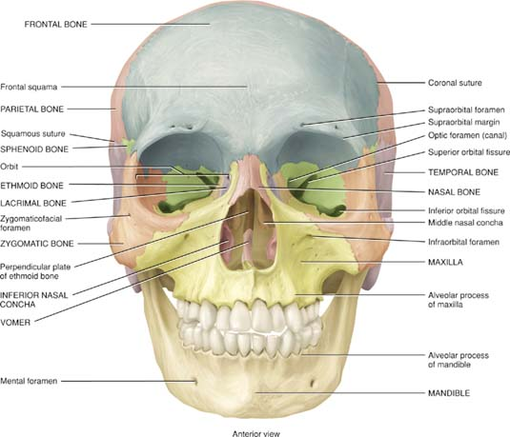
Anterior View

Slide 10
Parietal and Temporal Bones
PARIETAL BONES
  The 2 parietal bones form most of the sides of the cranium
  Inside you can see many protrusions and depressions – indicative of blood vessles
TEMPORAL BONES
  The temporal bones form the inferior lateral portions of the cranium and part of the cranial floor

Slide 11
Landmarks of the Temporal Bones
Temporal squama – Thin plate of bone at the temples
Zygomatic process – A projection from the squama that articulates with the temporal process of the zygomatic bone
  Together these two processes form the zygomatic arch
Mandibular fossa – A socket for the mandible
Mastoid portion of the bone – Posterior and inferior to the external auditory meatus (ear canal)
Styloid process – A pointed projection for muscle attachment
Stylomastoid foramen – Between the 2 processes
Internal auditory meatus – openings for the cranial nerves responsible for hearing and balance
Petrous portion of the bone – on the floor of the cranial cavity houses the internal and middle ear structures
Carotid foramen – for the carotid artery
Jugular foramen – for the jugular vein

Slide 12
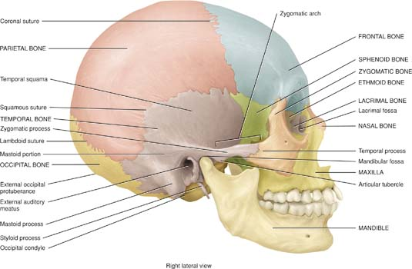
Right Lateral View

Slide 13
Occipital Bone
The occipital bone forms the posterior and most of the base of the cranium
It is best seen from an inferior view

Slide 14
Landmarks of the Occipital Bone
Foramen magnum – A large hole in the base of the skull for the spinal cord
Occipital condyles – Articulating processes for the atlanto –occipital joint
Hypoglossal canal - a small foramen for the hypoglossal nerve (hypoglossal nerve = cranial nerve XII (12))
External occipital protuberance – A prominent midline projection just above the foramen magnum
Superior nuchal lines – extend laterally from the external occipital protuberance
Inferior nuchal lines – Found below the superior nuchal lines
Both sets of lines serve as areas for muscle attachments

Slide 15
Sphenoid Bone
The sphenoid bone is found in the middle of the base of the skull
It is known as the keystone because it articulates with all other cranial bones ( and helps hold them together)
It forms part of the floor, side walls and rear wall of the orbit

Slide 16
Landmarks of the Sphenoid Bone
Resembles a butterfly with a body and 2 sets of wings
Body – A hollow cube like portion
  Space inside is the sphenoidal sinus
Sella turcica – A saddle shaped structure on the superior surface of the body
  Tuberculum sellae and dorsum sellae ridges flank the middle depression known as the hypophyseal fossa – this houses the pituitary gland
Greater wings – Project laterally from the body and from the anterolateral floor of the cranium
  They can be viewed externally between the temporal bone and zygomatic bone
Lesser wings – Smaller form the posterior part of the orbit
Optic foramen – Between the body and lesser wing for the optic nerves and vessels
(optic nerve = CNII)

Slide 17
Continued
Superior orbital fissure – Between greater and lesser wings for vessels and nerves
Pterygoid processes – Project inferiorly and form the posterolateral region of the nasal cavity
  Also serve as sites for muscle attachments
There are 3 other foramen
  Lacerum
  Rotundum
  Ovale
  Spinosum

Slide 18
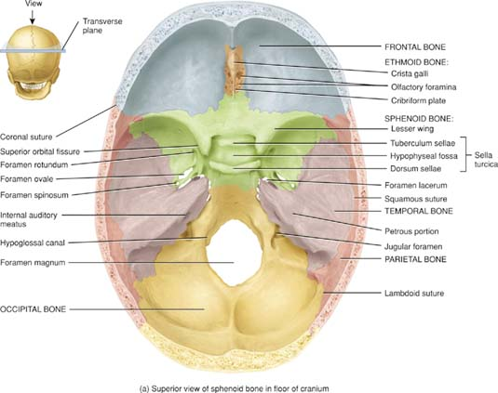
Floor of Cranium

Slide 19
Ethmoid Bone
Sponge like, found between the orbits
Anterior to the sphenoid and posterior to the nasal bones
Forms:
  Part of the anterior cranial floor
  The medial wall of the orbits
  Superior portion of the nasal septum
  Most of the superior sidewalls of the nasal cavity

Slide 20
Landmarks of Ethmoid Bones
Cribriform plate – forms the roof of the nasal cavity
Olfactory foramina – (smell) Holes in the cribriform plate for olfactory nerves (olfactory nerve I)
Crista galli – As superior projection from the cribriform plate for the attachment of the dura mater
Perpendicular plate – an inferior projection that forms the superior portion of the nasal septum
Lateral masses – separate the nasal cavity from the orbits
Ethmoidal air cells – spaces found within the lateral masses
  Together we call these the ethmoidal sinuses
Superior and middle nasal conchae – Scroll-like medial projections of the lateral masses that churn incoming air (warm, humidify)

Slide 21
Facial Bones - Nasal Bones
NASAL BONES
There are 2 nasal bones that meet in the midline
They form the bridge of the nose

Slide 22
Maxillae Bones
There are 2 maxillae, they unite in the midline to form the upper jaw bone
They articulate with all facial bones except for the mandible
They help to form part of the floor of the orbit, part of the lateral walls and floor of the nasal cavity and most of the hard palate

Slide 23
Landmarks of the Maxillae
Maxillary sinus – A large cavity that drains into the nasal cavity
Alveolar process – Contains sockets for the upper teeth
Palatine process – A projection that forms the anterior portion of the hard palate
Infraorbital fissure – Seen through the orbit
Incisive foramen – A foramen just posterior to the incisor teeth for passage of nerves and vessels

Slide 24
Zygomatic and Lacrimal Bones
ZYGOMATIC BONES
  There are 2 zygomatic bones, these are often called the cheek bones
  The temporal process of the zygomatic bone articulates with the zygomatic process of the temporal bone to form the zygomatic arch
LACRIMAL BONES
  Lacrimal means teardrops
  Roughly the size and shape of a fingernail
  Smallest bones of the face
  Found posterior and lateral to the nasal bones and help form part of the medial walls of the orbits
  Each bone contains a lacrimal fossa that gathers tears and passes them into the nasal cavity

Slide 25
Palatine Bones and Inferior Nasal Conchae
PALATINE BONES
There are 2 L-shaped palatine bones
These form the posterior portion of the hard palate
  Specifically it is the horizontal plates of the palatine bones that form the palate
INFERIOR NASAL CONCHAE
These are separate bones (not a part of the ethmoid)
Scroll-shaped bones that form the inferior lateral wall of the nasal cavity
Help to churn incoming air to warm it and humidify it

Slide 26
Vomer Bone
A triangular bone on the floor of the nasal cavity
Helps to form the nasal septum
Articulates with the perpendicular plate of the ethmoid bone and with the maxilla and palatine bones at the midline

Slide 27
Mandible
Largest, strongest facial bone
Only facial bone that moves
Consists of a body and 2 rami
  The angle is where ramus meets body
Each ramus has a posterior condylar process and an anterior coronoid process
  Condylar process articulates with the mandibular fossa of the temperal fossa to form the temperomandibular joint
  Coronoid process is a site for muscle attachement
Depression between the two processes is the mandibular notch
The alveolar process holds the teeth
On the medial side of the ramus (inside) there is a mandibular foramen. This opens into a mandibular canal. Nerves and vessels pass through the foramen and canal and then pass out of the bone through the mental (chin) foramen

Slide 28
Nasal Septum
The nasal septum functions to divide the nasal cavity into left and right halves
The nasal septum is composed of 3 structures:
  Vomer
  Septal cartilage
  Perpendicular plate of the ethmoid bone

Slide 29
Orbits
There are 7 bones that help to form the orbits:
  Roof – frontal and sphenoid bones
  Lateral wall – zygomatic and sphenoid bones
  Floor – maxilla, zygomatic and palatine bones
  Medial wall – maxilla, lacrimal, ethmoid and sphenoid bones
  Posterior wall – mostly sphenoid bone

Slide 30
Openings in the Orbits
The optic foramen (canal) is at the junction of the roof and medial wall
The superior orbital fissure is at the superior lateral angle of the apex
The inferior orbital fissure is at the junction of the lateral wall and floor
The supraorbital foramen is on the medial side of the supraorbital margin of the frontal bone
The lacrimal fossa is in the lacrimal bone

Slide 31
Foramina of the skull
Print and distribute foramin table

Slide 32
Skull Sutures
There are 4 skull sutures:
  Coronal (1) –Between frontal and parietal bones (hairband)
  Sagittal (1) –Between left and right parietal bones
  Lambdoid (1) – Between parietal bones and occipital bone
Squamous (2) – Between parietal bone and temporal bone

Slide 33
Paranasal Sinuses
There are 4 para-nasal sinuses
These are cavities within bones that lie close to the nasal cavity
They are lined with mucous membranes and are open to the nasal cavities
Skull bones containing the para-nasal sinuses are the frontal, sphenoid, ethmoid and maxillary

Slide 34
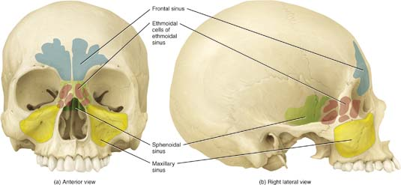
Paranasal Sinuses

Slide 35
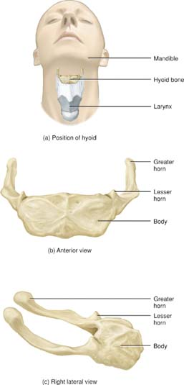
Hyoid Bone
Does not articulate with any other bone
It is suspended from the styloid processes (temporal bone) by ligaments and muscles
It is located between the mandible and larynx
It functions to support the tongue by providing muscle attachment sites
Also helps to keep the larynx open at all times
Consists of a body, greater horns and lesser horns

Slide 36
Muscles of the Face
Also known as the muscles of facial expression

Slide 37
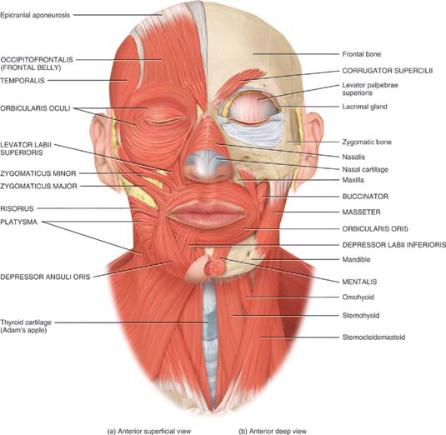
Facial Muscles

Slide 38
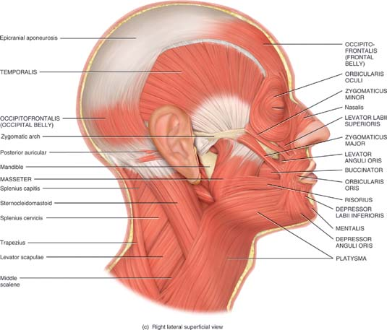
Facial Muscles – Side View

Slide 39
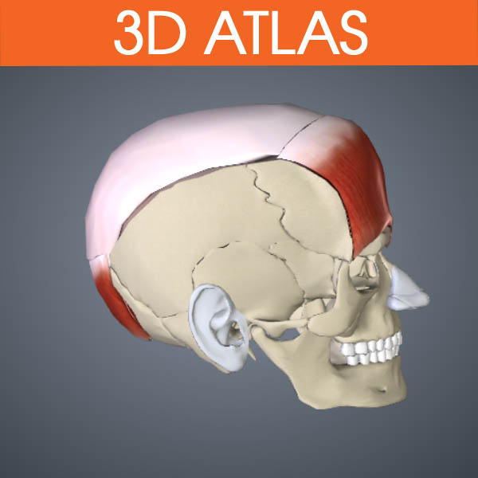
Scalp
Occipitofrontalis
Origin – occipitalis - Occipital & Temporal Bone; frontalis- Galea Aponuerosis
Insertion - occipitalis – Galea Aponeurosis; Frontalis – Fascia & skin overlying the Frontal bone
Action – Draws scalp posteriorly
Nerve – Facial Nerve

Slide 40
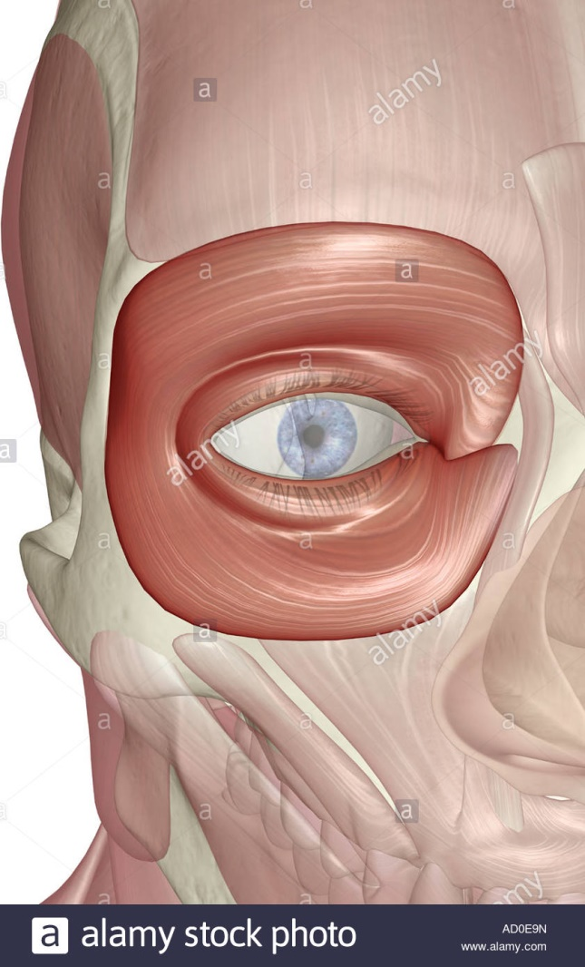
Eye
Orbicularis Oculi
Origin – Medial side of eye
Insertion – Medial side of eye (encircles the eye)
Action – Closes and squints the eye
Nerve – Facial Nerve

Slide 41
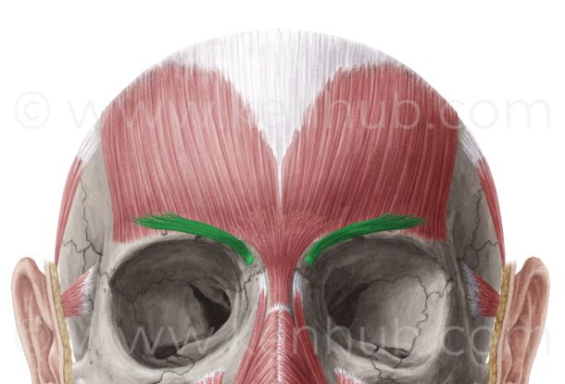
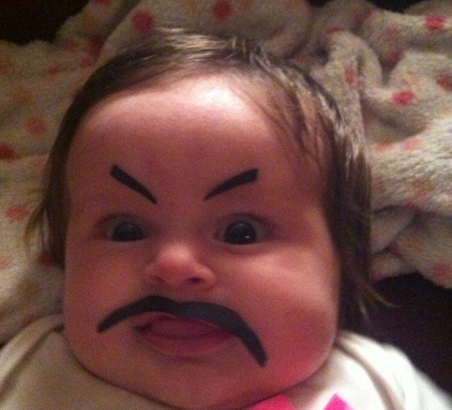
Corrugator Supercilii
Origin – Inferior frontal bone
Insertion – Fascia and deep skin of the eyebrow
Action – Draws eyebrow inferomedially
Nerve – Facial Nerve

Slide 42
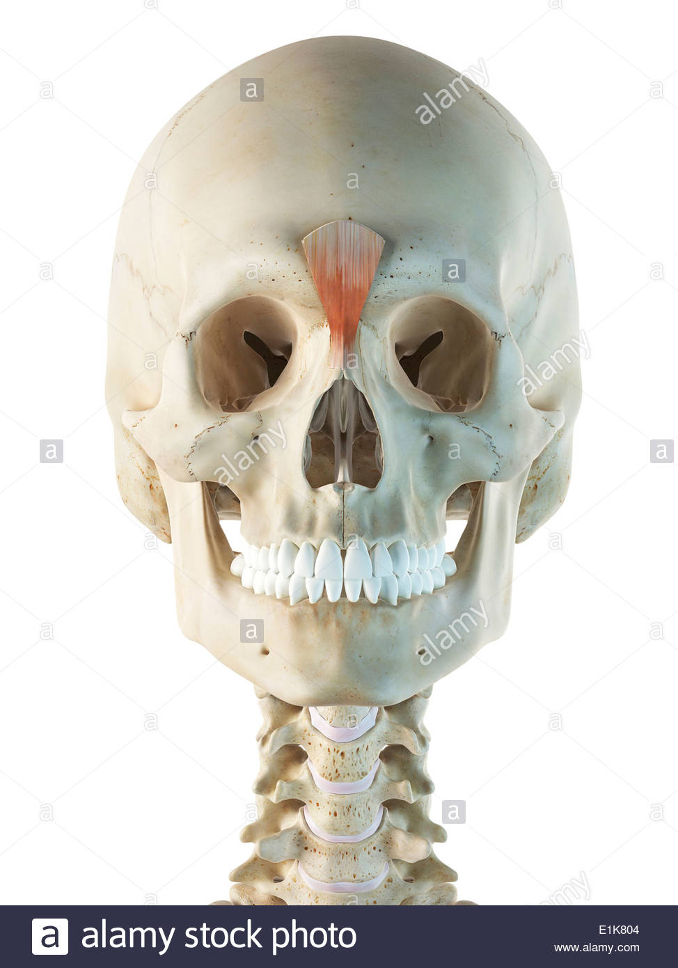

Nose
Procerus
Origin – Fascia and skin over the nasal bone
Insertion- Fascia and skin medial to the eyebrow
Action- Wrinkles the skin of the nose upward, Draws down the medial eyebrow
Nerve - Facial Nerve

Slide 43
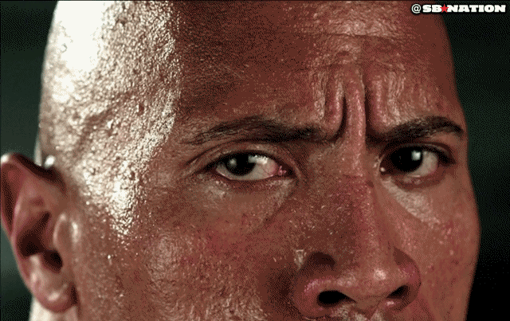
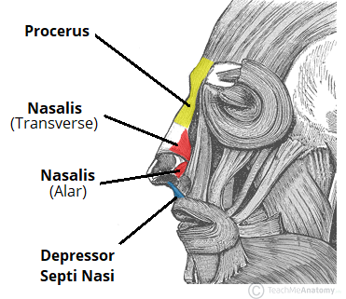
Nasalis
Origin – Maxilla
Insertion – Cartilage of nose and opposite side Nasalis muscle
Action – Flares the nostril, constricts the nostril
Nerve- Facial

Slide 44
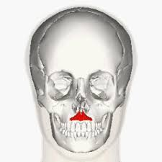
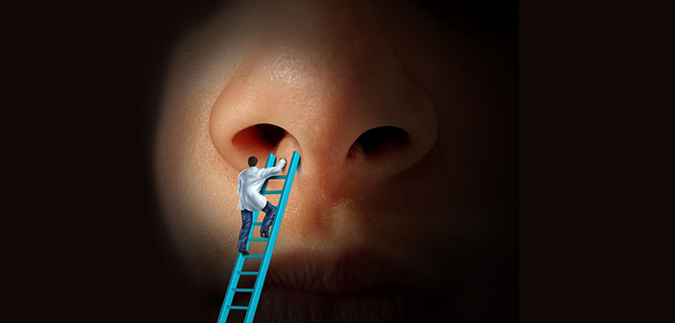
Depressor Septi Nasi
Origin – Maxilla
Insertion – Cartilage of the nose
Action – Constricts the nostrils
Nerve - Facial nerve

Slide 45
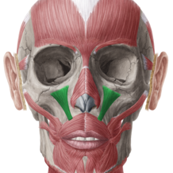
Mouth
Levator labii Superioris
Origin – Maxilla
Insertion- Upper Lip
Action – Elevates upper lip
Nerve - Facial Nerve

Slide 46
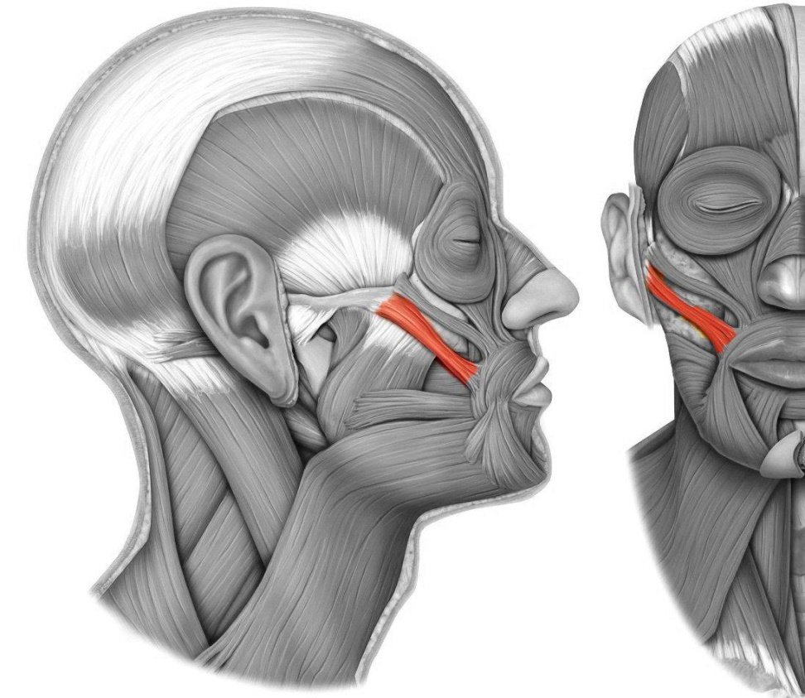
Zygomaticus Minor
Origin – Zygomatic Bone
Insertion – Upper lip
Action – Elevates upper lip
Nerve- Facial Nerve

Slide 47
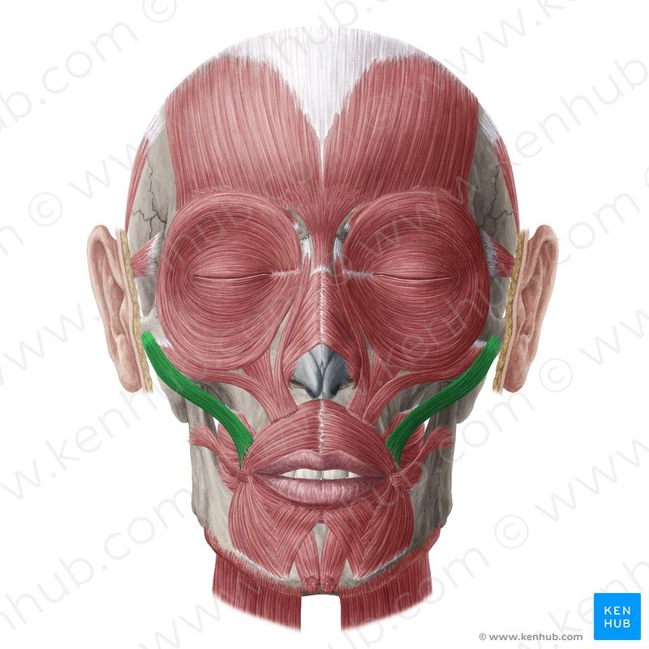
Zygomaticus Major
Origin – Zygomatic bone
Insertion – Angle of mouth
Action – elevates the angle
Nerve – Facial Nerve

Slide 48
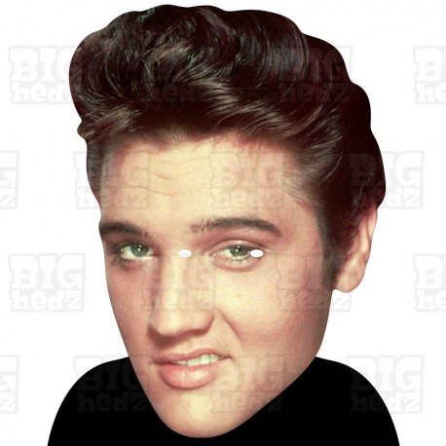
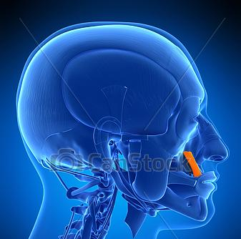
Levator Anguli Oris
Origin – Maxilla
Insertion – Angle of the mouth
Action – Elevates the angle of the mouth
Nerve- Facial Nerve

Slide 49
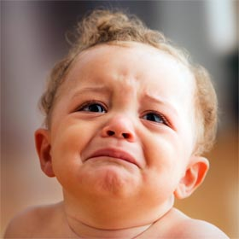
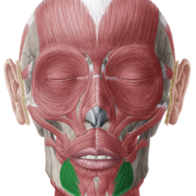
Depressor Anguli Oris
Origin – Mandible
Insertion – Angle of the mouth
Action – Depression of the angle of the mouth
Nerve – Facial Nerve

Slide 50
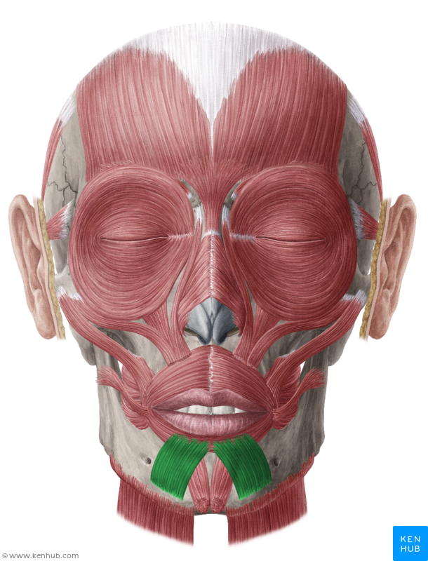
Depressor Labii Inferioris
Origin – Mandible
Insertion –Lower lip
Action – Depress lower lip
Nerve – Facial Nerve

Slide 51
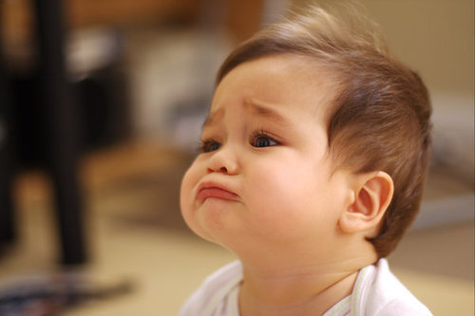
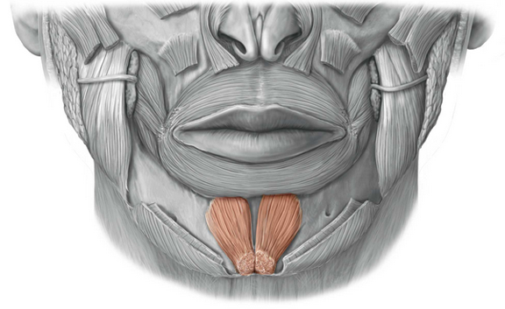
Mentalis
Origin – Mandible
Insertion – Fascia and skin of the chin
Action – Elevates lower lip, Everts and protracts lower lip
Nerve – Facial Nerve

Slide 52

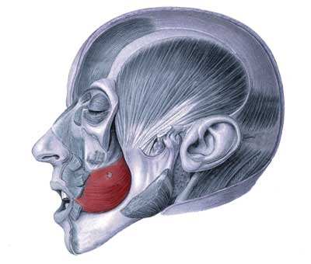
Buccinator
Origin – Maxilla and the Mandible
Insertion – Lips
Action – Compresses cheeks against the teeth
Nerve- Facial Nerve

Slide 53
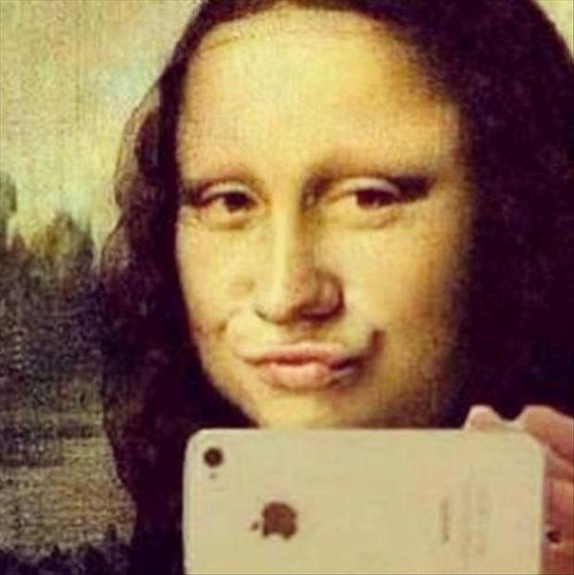
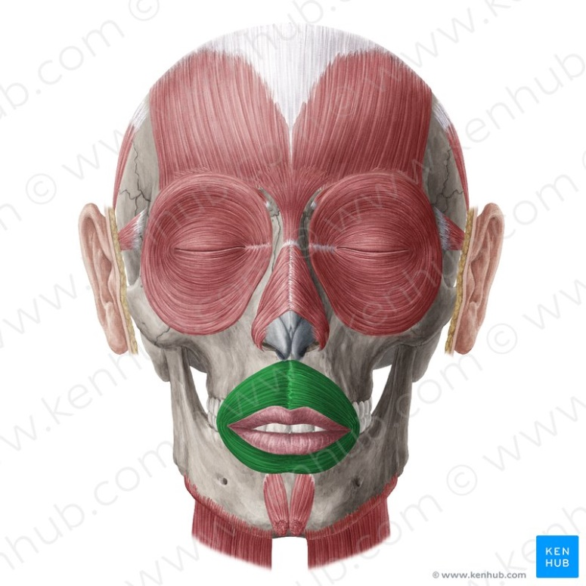
Orbicularis Oris
Origin and insertion – Surrounds the mouth
Action – Closes the mouth, Protracts the lips
Nerve – Facial Nerve

Slide 54
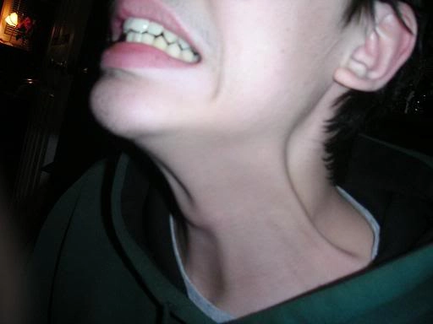
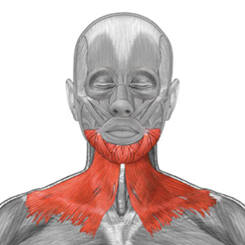
Platysma
Origin – Subcutaneous Fascia of the superior chest
Insertion – Mandible and subcutaneous Fascia of the lower face
Action- Draws up the skin of the superior chest and neck
Nerve – Facial Nerve

Slide 55
TMJ
TMJ is a modified hinge joint (synovial)
Articulation is between the condyle of the mandible and articular tubercle of the temporal bone and the mandibular fossa of the temporal bone
Joint capsule is loose and there are 2 synovial membranes (one superior to the disc and one inferior to the disc)
The articular disc divides the TMJ into 2 separate compartments the disc is attached to the postglenoid tubercle and to the posterior fibres of the lateral pterygoid muscle
Gliding movements of protrusion and retrusion occur in the superior compartment
Hinge movements of depression and elevation occur in the inferior compartment

Slide 56
TMJ Ligaments
There is a lateral thickening of the joint capsule that forms an intrinsic ligament called the lateral ligament
There are 2 extrinsic ligaments that connect the mandible to the cranium:
  Stylomandibular – a thickening of the fibrous capsule of the parotid gland, runs between styloid process and the angle of the mandible
  Sphenomandibular – from the spine of the sphenoid to the lingual of the mandible (Lingual= raised bump around the mandibular foramen)

Slide 57
TMJ Movements
TMJ movements are produced mainly by 4 muscles of mastication:
  Temporalis, Masseter, Medial and Lateral pterygoids
Depression of the mandible is mainly produced by gravity

Slide 58
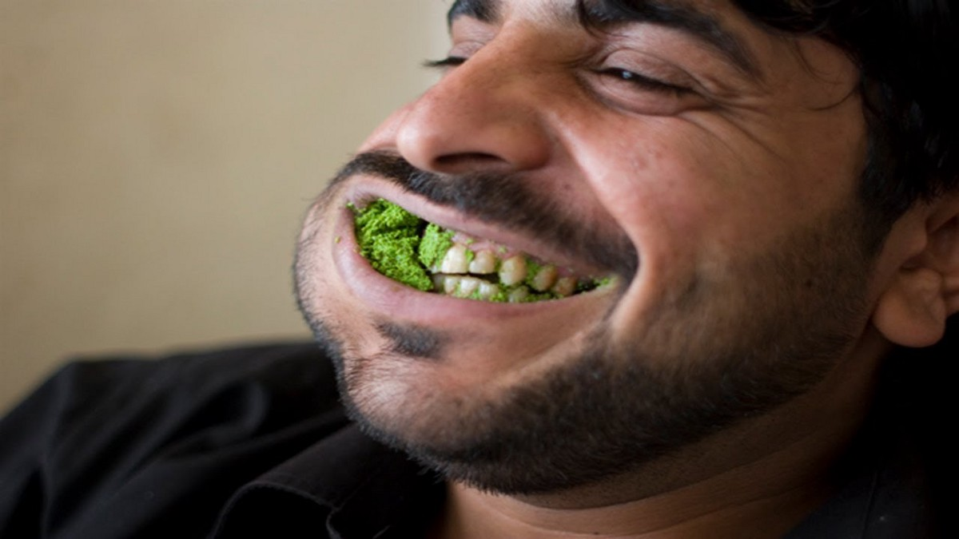
Muscles of Mastication

Slide 59
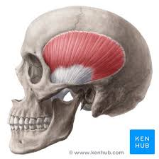
Temporalis
Origin – Temporal Fossa
Insertion – Coronoid Process of the Ramus of the mandible
Action – Elevates Mandible at TMJ
Nerve – Trigeminal Nerve

Slide 60
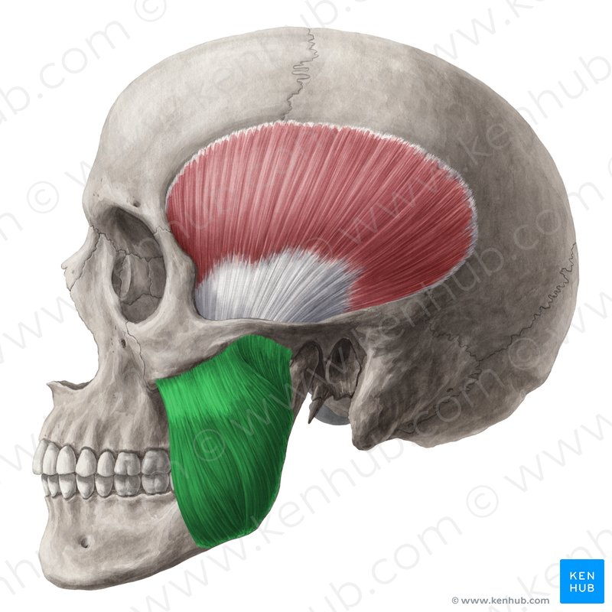
Masseter
Origin – Inferior Margin of zygomatic bone and zygomatic arch
Insertion – angle, ramus and coronoid process of the mandible
Action – Elevates Mandible at TMJ
Nerve- Trigeminal Nerve

Slide 61
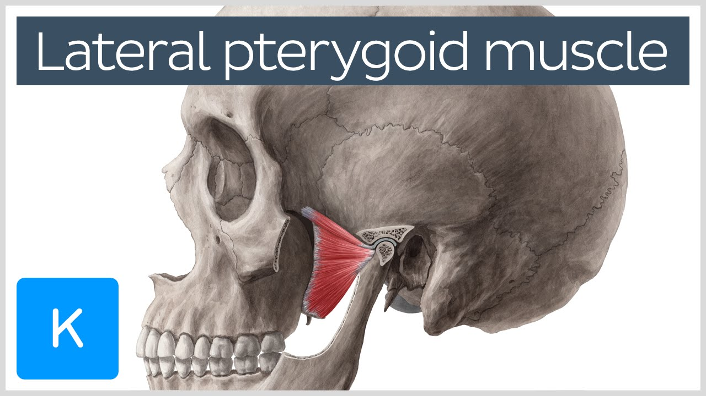
Lateral Pterygoid
Origin – Entire Muscle – Sphenoid Bone
Insertion- Mandible and TMJ
Action – Protraction and contralateral deviation of mandible at TMJ
Nerve – Trigeminal Nerve

Slide 62
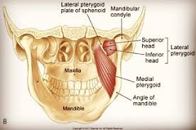
Medial Pterygoid
Origin – Entire Muscle – Sphenoid Bone
Insertion – Internal surface of the Mandible
Action – Elevates, protracts and Contralateral deviation of mandible at TMJ

Slide 63
Hyoid Muscles
Review Hyoids
https://www.youtube.com/watch?v=W032hvnsOBc

