Slide 1

Lecture 3
Food choices and Human Health

Slide 2
Learning Objectives
Discuss how a particular lifestyle choice can impact overall health
Define “Nutrient” and list the 6 major nutrients
Characteristics of a healthy diet and suggestions for using them
Summarize how a particular culture can impact a person’s food choices
List major steps in behaviour change and devise a plan for making successful long-term changes in diet
Recognize misleading nutrition claims in advertisements for dietary supplements and in the popular media

Slide 3
Nutrient:
A substance that provides nourishment for growth or metabolism. Plants absorb nutrients mainly from the soil in the form of minerals and other inorganic compounds, and animals obtain nutrients from ingested foods.

Slide 4
Nutrition profoundly affects health
Examples of chronic diseases connected to poor diet: heart disease, diabetes, some kinds of cancer, dental disease, adult bone loss
Less
nutrition
related
Down Syndrome
Hemophilia
Sickle cell anemia
Osteoporosis
Cancer
Infectious disease
Diabetes
Hypertension
Heart Disease
Iron deficiency
(anemia)
Vitamin deficiency
Mineral deficiency
Toxicities
Poor resistance
to disease
More nutrition
related
Nutrition has little influence on some diseases but strongly affects others

Slide 5
Nutritional Genomics
Choice of diet influences long-term health within a range set by genetic inheritance
Nutritional Genomics: integration of nutrition, genomic science and molecular biology
It studies how nutrients affect genes and vice versa
Pinpoints nutrient needs for growing children, healthy adults, chronic conditions, etc.

Slide 6
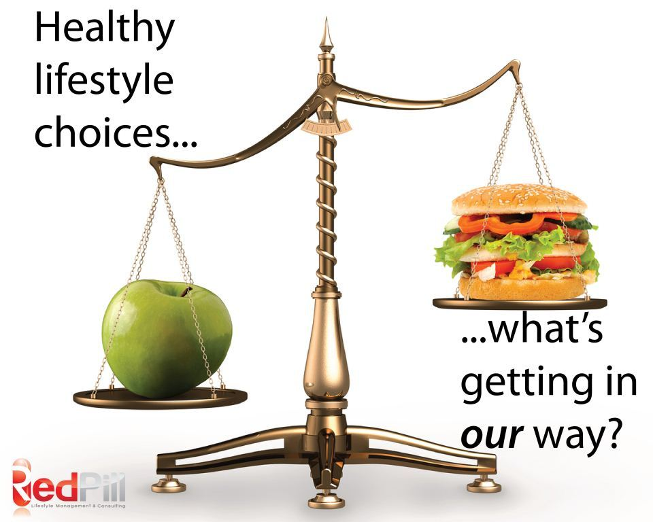
Other lifestyle choices
Tobacco, alcohol and other substance abuse can destroy health
Physical activity, sleep, low stress levels, improved conditions at home and work, quality of air and water, etc. can prevent/reduce severity of some diseases

Slide 7

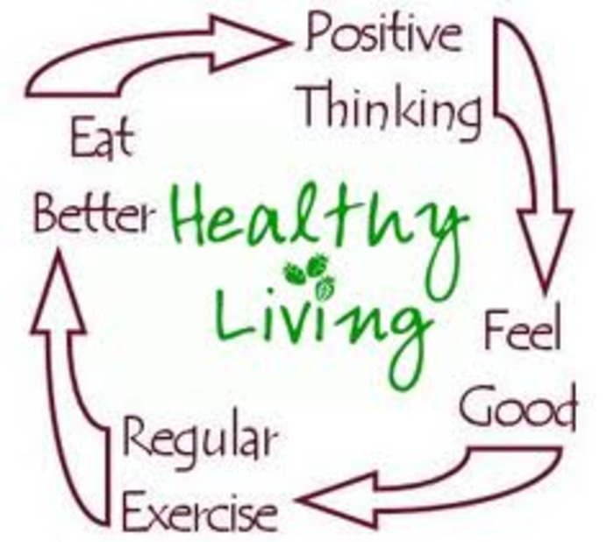
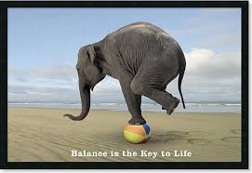
Other lifestyle choices

Slide 8
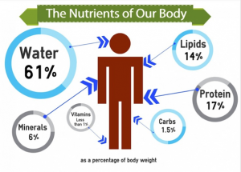
The Six Classes of Nutrients

Slide 9
Six kinds of indispensable molecules:
Water
Carbohydrates*
Lipids (fats)*
Proteins*
Vitamins*
Minerals
(*) organic compounds (contain Carbon)

Slide 10
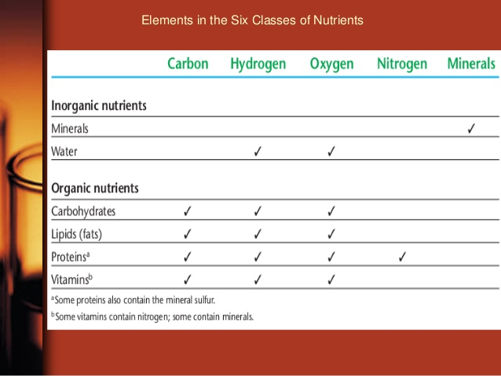
The 6 Classes of Nutrients
http://www.slideshare.net/ehab10f/clinical-nutrition-14806374

Slide 11
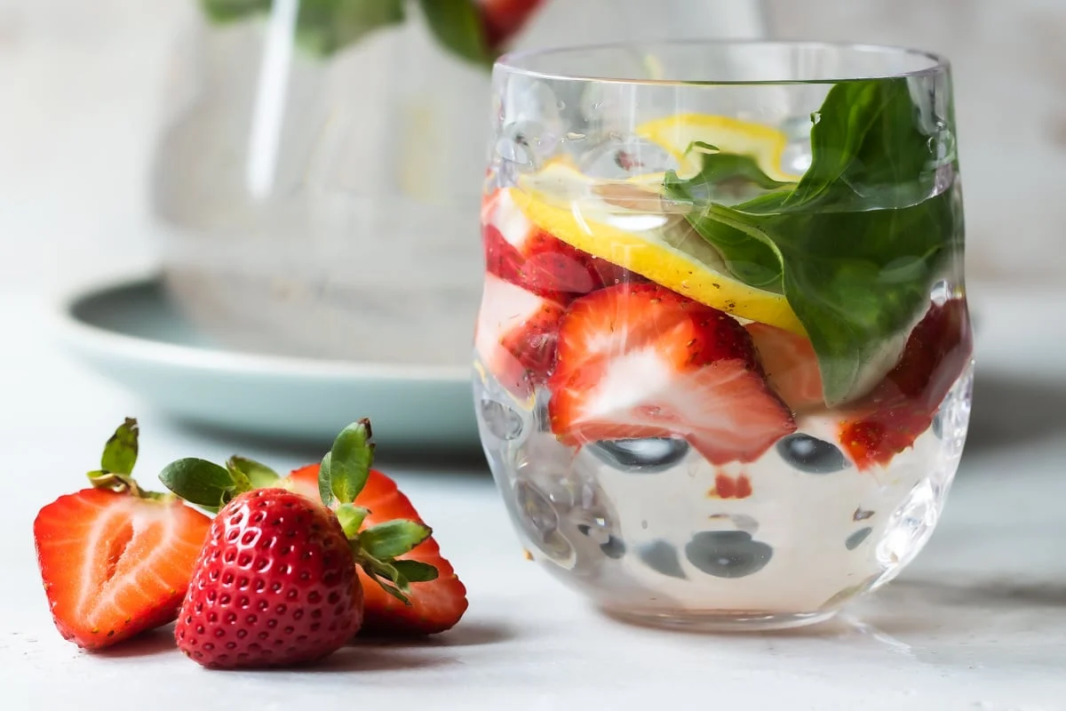
Nutrients in Food
Water: it must constantly be replaced
Energy-yielding nutrients (energy in C-C bonds):
- Carbohydrates (i.e., sugar, starch)
- Lipids (fats) (saturated and unsaturated)
- Proteins (chains of amino acids)
Regulators (assist in body processes):
- Vitamins (i.e. Vitamin C)
- Minerals (i.e. Calcium, Iron)

Slide 12
Nutrients (Cont.)
Essential Nutrient: your body can’t make them so if you don’t ingest them, you will develop deficiencies
Calorie/kilocalorie: unit of energy in food (amount of heat energy to raise the temp of 1 kg (a litre) of water by 1 ºC.
- Lipids (fats) (saturated and unsaturated)
- Proteins (chains of amino acids)
Regulators (assist in body processes):
- Vitamins (i.e. Vitamin C)
- Minerals (i.e. Calcium, Iron)

Slide 13
Energy-yielding nutrients
Body uses energy from C-C bonds from:
Carbohydrates – sugar, starch
Lipids (fats) – saturated and unsaturated
Proteins – (aa) produce energy and structure of body

Slide 14
Calorie values of energy-yielding nutrients
Energy Nutrient | Energy
Carbohydrate | 4 Cal/g
Lipid (fat) | 9 Cal/g
Protein | 4 Cal/g

Slide 15
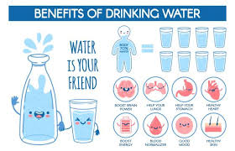
Water
~ 60% of body is water
Important for all the cellular functions
Will go over more in Minerals lecture
https://youtu.be/P8c9DIiAFz8?feature=shared

Slide 16
The challenge of choosing foods
Basic foods (whole foods): milk, milk products, meats, vegetables, grains, fruits
Enriched foods (fortified foods): nutrients have been added
Fast foods: avail within minutes after customers order them, such as hamburgers, French fries, milkshakes, salads (may or may not meet people’s needs)
Functional foods: foods known to possess nutrients or non-nutrients that might help protect against disease
Natural foods: it implies wholesomeness (no legal definition)

Slide 17
And more foods…
Organic foods: nutrients grown without synthetic pesticides or fertilizers. Growers conform to standards set by Canadian Organic Standards or USDA Organics or others.
Partitioned foods: Composed of parts of whole foods (butter, sugar, corn oil). Generally overused, they provide few nutrients with many calories
Processed foods: foods subjected to any process (milling, alteration of texture, addition of additives, etc.). It may or may not be nutritious
Staple foods: foods used frequently or daily (rice, potatoes).

Slide 18
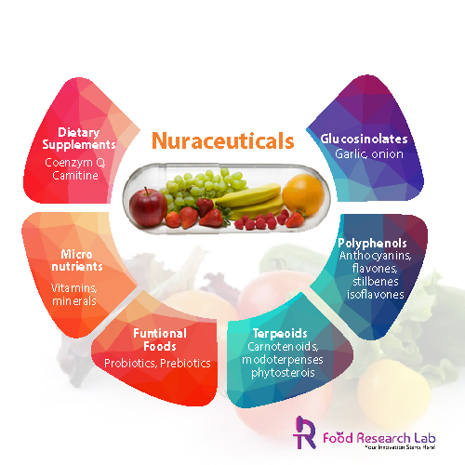
Nutraceuticals
Definition: Any substance that is a food or part of food that provides medical or health benefits.
Eg. Vitamin D, L- Carnitine, Probiotics, Curcumin etc.

Slide 19
Can I live on just supplements/nutraceuticals?
Forming pairs discuss arguments favoring and against the question above

Slide 20
Importance of real food
Elemental diets (precise chemical composition)
Aroma, taste
Digestive organs weaken and grow smaller
Hormones in response to food contribute to health
Physical and emotional comfort
Other chemicals in food may reduce disease risks

Slide 21
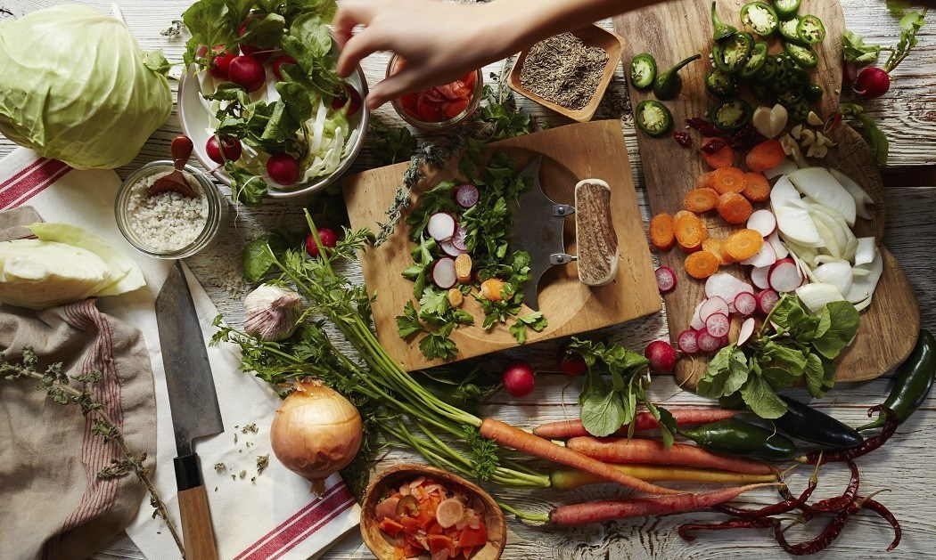
How can I recognize a nutritious diet?
http://daily.jstor.org/plan-get-poor-eat-healthy-food-1890s/

Slide 22
How can I recognize a nutritious diet?
SIX PRINCIPLES OF A HEALTHY & BALANCED DIET
Adequacy: food provides enough of each essential nutrient, fibre and energy
Balance: choices do not overemphasize one nutrient or food type at expense of another
Calorie control: provides amount of energy needed to maintain appropriate weight –not more, not less
Moderation: foods not provide excess fat, salt, sugar, or other unwanted constituents
Variety: foods chosen differ from one day to the next; meals should occur with regular timing throughout the day
Nutrient Density: Choose more foods that are high in nutrient content versus the amount of calories it contains

Slide 23
Key point
A well-planned diet is adequate in nutrients, balanced with regard to food types, offers food energy that matches energy expended in activity, is moderate in unwanted constituents and offers a variety of nutritious foods

Slide 24
Energy-yielding nutrients include all of the following EXCEPT:
Vitamins
Carbohydrates
Fat
Protein

Slide 25
Organic nutrients include all of the following EXCEPT:
minerals
fat
carbohydrates
protein

Slide 26
A characteristic of a nutritious diet is that the diet provides no constituent in excess. This principle of diet planning is called:
adequacy
balance
moderation
variety

Slide 27
Why people choose foods…
Many factors influence food-related choices:
Sharing ethnic food, cherish values and culture
Omnivores, carnivores, vegetarians, vegans
Convenience (time, budget)
Advertising, availability, emotional comfort, habit, personal preference and genetic inheritance, positive associations
Region of the country
Social pressure
Values or beliefs
Weight, nutritional value

Slide 28
Grocery shopping habits around the world
http://prohealthsys.com/site/treatments/nutrition/
Activity: recognize nutritious diet
Select a nutrition habit from the pictures and describe food items. Provide rough estimation of % of nutrients

Slide 29
Can I trust the media to deliver nutrition news?
Forming pairs discuss how you distinguish among dishonest scams, well-meaning but misinformed advice, and honest and helpful ideas and products
Provide an example (from the internet) of a nutrition/health fraud
Present to class

Slide 30
Phytochemicals: what do they promise?
Bioactive compounds found in plants
Provide taste, aroma, texture and colour to food
Examples: burning sensation of hot peppers, aromatic herbs, pungent flavour of onions, garlic, red color of tomatoes…
Antioxidants: protect against disease (heart disease, cancer)
Flavonoid: antioxidants in red wine, grapes, chocolate
Lignans: present in flaxseed, are converted to phytosterols by intestinal bacteria and has possible anticancer properties
Phytoestrogens (in soybeans): may alter women's monthly hormonal cycle in menopause, reducing symptoms

Slide 31
Phytochemicals activity – searching for answers…
Supplements with phytochemicals – benefits?
Scientific evidence concerning their effects?
Phytochemicals in:
chocolate, wine, tea, whole foods, soybeans, flaxseeds, tomatoes, garlic. What do they do?
Tips for consuming phytochemicals?

