Slide 1
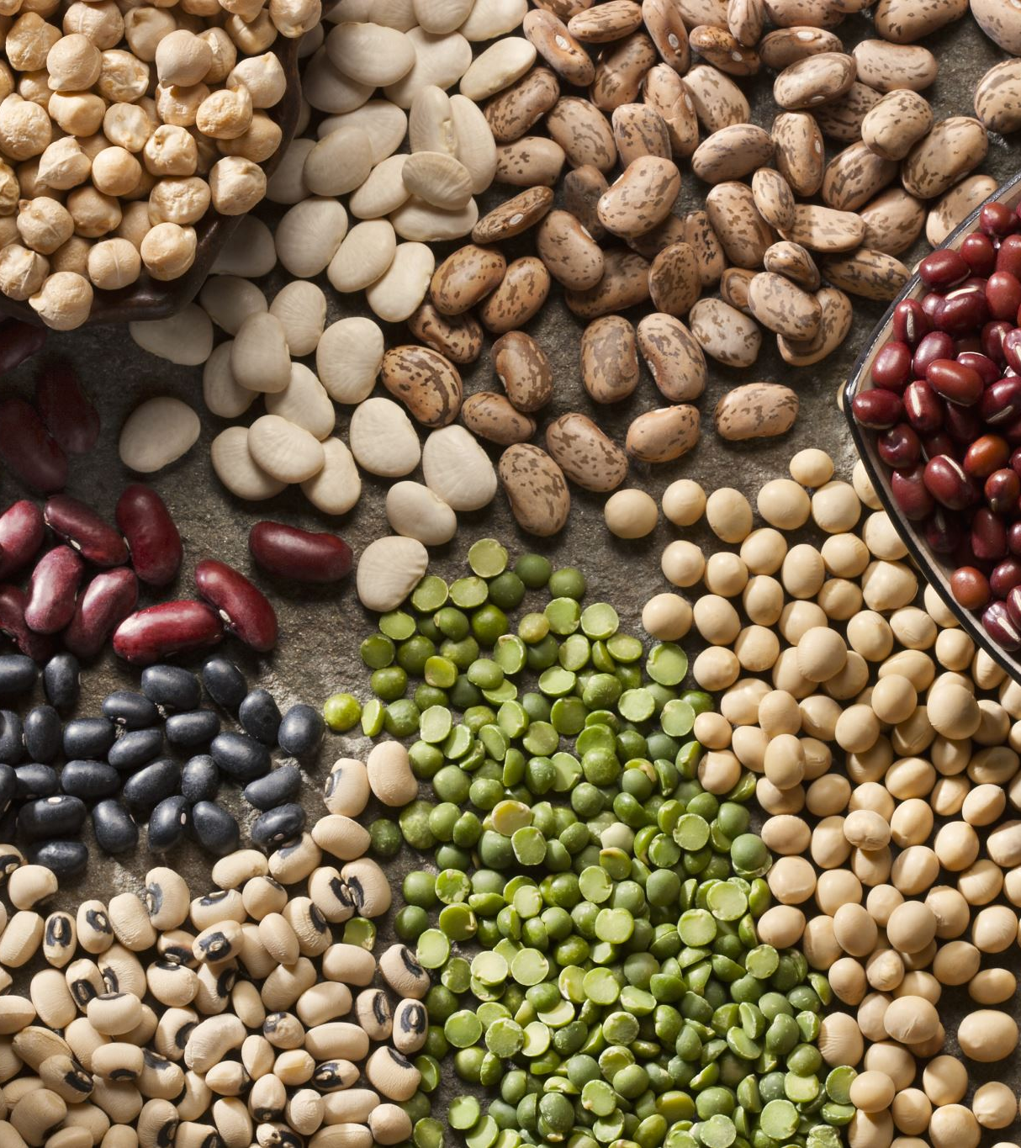
HUMAN DIETARY EXTREMES

Slide 2
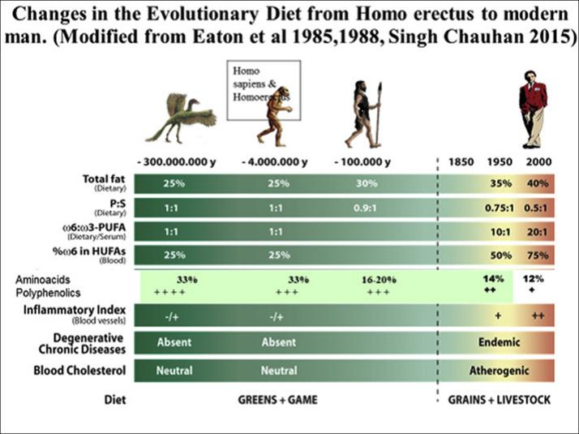
HUMAN DIET THROUGH HISTORY

Slide 3
THE PAST
Until agriculture was developed around 10,000 years ago, all humans got their food by hunting, gathering, and fishing.
Archaeology tells us the earliest humans ate an omnivorous diet similar to chimpanzees- fruits, vegetables, animal products like honey, insects and other animals
Very quickly, early humans began to eat more meat than chimps. Many groups got about 30% of their calories from proteins.
Cooking may have developed anywhere from 2 million to 30,000 years ago. First definitive evidence is earth ovens from 30 000 years ago.

Slide 4
THE AGRICULTURAL REVOLUTION
About 12 – 10, 000 years ago, when the last ice age was coming to an end, evidence can be seen of domesticated crops and animals, starting in the "fertile crescent" in the Middle East & spreading to other places around the world near water
Pros: Allowed humans to stay in one place, more time & socializing to develop culture, more children because less needing to carry them while foraging
Cons: Disease spread from livestock to humans, disease spread more quickly between humans, less variety of diet, dependance on monotonous sources of food sometimes led to deficiencies in certain nutrients, life expectancy decreased at first

Slide 5
VEGETARIANISM IN INDIA
Dating back to our paleolithic ancestors, as hunter gatherers who may not always be successful with the hunt, our ancestors likely survived on plants alone for periods of many days to weeks
First historical references were in Jain and Buddhist followers in India, as early as the 6th century BCE
Jains preached non-violence in general, towards animals as well as humans
In Buddhism, they also wished to abstain from hurting or killing of animals, but they may have accepted and eaten gifts of meat
Later (around 1500 – 500 BCE) many Hindu texts asserted that all creatures manifest the same life force. Many Hindus today follow a vegetarian diet & the killing of a cow is traditionally considered a sin.

Slide 6
VEGETARIANS IN EUROPE
In Ancient Greece of the Classical period (8th century BCE – 6th Century AD), the vegetarian diet was referred to as "Abstinence from beings with a soul". It was not a common practice but some philosophers such as Pythagorus and some subsets of religious orders.
Many early Christians, esp. Monks and hermits, abstained from the meat of four legged animals but fish was never prohibited as Jesus himself had eaten it.

Slide 7
VEGETARIANISM IN ASIA
China – Chinese Buddhism & Taoist monks and nuns eat an egg-free, onion-free vegetarian diet. Some even avoided root vegetables to avoid hurting plants.
It was a fairly common Chinese folk religion or cultural practice for Chinese people to eat vegan on the 1st & 15th of the month.
Many vegetarian/vegan products developed in China as a result of the popularity of these fasts- tofu, seitan & meat alternatives made from seaweeds
In Japan, from 675 – 1872, red meat was banned due to the prevalence of Buddhism and the diet was primarily pescatarian.

Slide 8
VEGETARIANISM CONT.
Vegetarianism or the "Pythagorean Diet" became popular in the Renaissance period (15th & 16th centuries). Leonardo da Vinci was one "celebrity" endorser.
The first vegetarian society was formed in England in 1847.
In the USA, Benjamin Franklin was a vegetarian for a time & introduced tofu to North America.
The American Vegetarian Society was formed in 1850 by the inventor of the Graham cracker, Sylvester Graham.

Slide 9
In the USA, the Seventh Day Adventist Church was founded in 1863. They have advocated a meatless diet from the beginning & many studies comparing their dietary habits to people of other religious traditions have provided solid nutritional information. John Kellogg (founder of the cereal company) formed Sanitariums that promoted vegetarianism for health.
The great Russian author Leo Tolstoy, who died in 1910, was a vegetarian.
Today, the majority of vegetarians live in India & most consume dairy.
In North America, studies from 2005-2010 found <3% of people are vegetarian.

Slide 10

VEGANISM
The word was invented in 1944, at first to describe a non-dairy vegetarian.
It came to mean abstaining from milk, butter & cheese, as well as animals, eggs, gelatin and honey.
Veganism has become much more popular since 2010, with new vegan certifications emblems on grocery products such as:

Slide 11
TYPES OF VEGETARIANS
Lacto-ovo vegetarians: Eat both dairy & eggs
Lacto vegetarians: Eat dairy
Pescatarian: Consume fish
Pollo vegetarian: consume chicken

Slide 12
HEALTH BENEFITS
Studies of Seventh Day Adventists (who also avoid alcohol & caffeine) and other groups of vegetarians seem to indicate the following benefits:
  - lower blood cholesterol - lower blood pressure
  Approx 20% less risk of death from heart disease
  Reduced risk of diabetes
  - reduced risk of certain cancers, such as colorectal & esophageal
  HOWEVER, this depends upon which foods are staples of the diet. Remember that "noodles and coke" is also a vegetarian diet that no one would believe to be health promoting.
  A 2021 review (in Cochrane) found "insufficient information" to draw conclusions about the effects of a vegan diet on CVD risk.

Slide 13
DRAWBACKS
In a strict vegan diet, people are more likely to become deficient in B12, D, Calcium, Iron and Omega 3 fatty acids. A 2014 study found that 80% of vegans became B12 deficient without supplementation.
Lack of Omega 3 fatty acids may contribute to depression
Lack of fats/fat soluble vitamins can contribute to hormone abnormalities – low thyroid, low estrogen/testosterone, etc thereby affecting fertility, energy etc
Low iron can cause anemia
Eating too many packaged foods can cause weight gain

Slide 14
THE CHINA STUDY & CONTROVERSY
T. Colin Campbell looked at the diet of villagers all across China in the 1980s. Some villages ate much more meat than others. One of his conclusions was that eating more meat is associated with higher cancer rates and overall higher incidence of chronic disease.
The book was highly influential when published (2005) & T. Colin Campbell continues to appear in many pro-vegan movies, incl. Forks Over Knives
Some have been critical of his science and statistics, suggesting that he cherry picked the data that supported his hypothesis- See www.deniseminger.com

Slide 15
THE KETO DIET
In contrast to the vegetarian diet, which can be any composition of macronutrients, the Ketogenic diet is defined by its macronutrient ratios.
Usually: 60-70% fat/10 -20% protein/5-10% carbohydrate
Initial ketogenic prescriptions called for a ratio of 4 g of fat to every 1 g of protein & carbohydrates
Some other metrics that people will use are total or net carbohydrates under 30g/40g/50g per day
Recall NET carbohydrates equals
total carbohydrates – ( fiber + sugar alcohols) = net carbohydrates

Slide 16
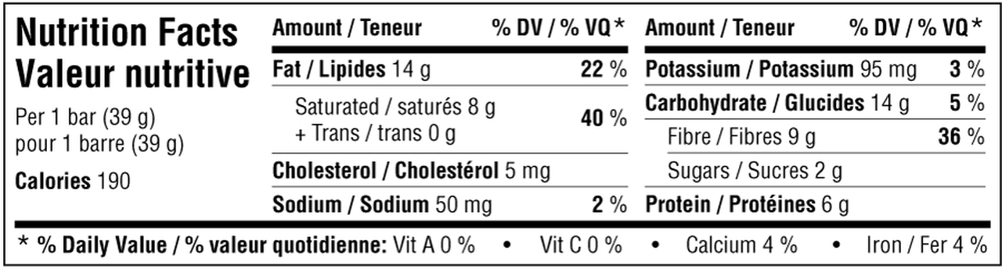
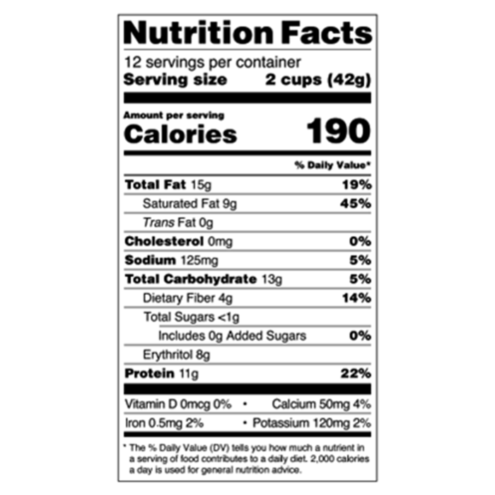
Net Carbohydrates on Food Labels
          Suzie’s Good Fat Bar – Total Carbs (14g) – Fibre (9g) = Net Carbs (5g)
          Quest Peanut Butter Cups
          Total Carbs – (fibre + sugar alcohols/erythritol) = net carbs
          13 g – ( 4g + 8 g) = 1g net carb

Slide 17
HISTORY OF KETO FOR EPILEPSY
Fasting had been described as a treatment for epilepsy since 500 BCE
In the early 1920s, Dr Russell Wilder of the Mayo Clinic began to investigate what part of the fasting process was responsible for the reduction in seizures. He determined that depleting the body of sugars & forcing it to run on ketone bodies instead, from the breakdown of lipids, allowed a similar improvement in epilepsy as total fasting.
This epilepsy treatment regimen continues today throughout the world, see ilae.org for a list of participating centres
Other important organizations are charliefoundation.org & Matthew’s friends
Supplements are often prescribed: Calcium & Vit D, B vitamins, & Selenium
https://youtu.be/X_LnpGuFa6U

Slide 18
MANITOBA’S CONNECTION TO KETO
https://www.atlasobscura.com/articles/all-meat-diet
Read the above article on Gimli, Manitoba’s own Vilhjalmur Stephansson’s extreme ketogenic/carnivorous diet as inspired by the Inuit people.

Slide 19
ATKINS DIET
Dr. Robert Atkins, a cardiologist, published his namesake diet in a book in 1972.
It became enormously popular in the 70s, faded in the fat conscious 80s & 90s & then had a massive resurgence in the early 2000s. In 2004, almost 1 in 10 Americans was on the low carb diet.
Never well accepted by the medical & nutritional science communities who were very focused on cholesterol and saturated fat as dietary problems.
Some researchers such as Dr. Stephen Phinney PhD continued to investigate low carb/ketogenic diets.

Slide 20

THE OPRAH EFFECT
After Oprah lost 67 lbs on a liquid, ketogenic type supplement called Optifast, interest in that dietary plan began to translate to a surge of research in the 1990s.
Quality research is produced in the 2000s – one study showed anti-oxidant and anti-inflammatory genes were activated by one type of ketone body produced when you limit carbs. The authors
suggested that keto may slow the aging process.

Slide 21
BIOHACKERS & PODCASTS
“Biohackers” such as Tim Ferriss & Dave Asprey (Bulletproof Diet) began to popularize research into keto being done by doctors and scientists such as Dom D’Agostino & Peter Attia.
Keto benefits: weight loss without feeling deprived
  Reduction in diabetes medications & possible reversal of disease
  May be beneficial in helping to treat cancers, prevent Alzheimers
  Reduction in metabolic syndrome
  May contribute to increases in longevity
  https://youtu.be/UMhLBPPtlrY

Slide 22
POSSIBLE PROBLEMS WITH KETO DIETS
Can cause low blood pressure
Kidney stones
Constipation (lack of fibre) or diarrhea (if trouble digesting fats)
May be deficient in nutrients such Calcium, Vit D, selenium & B vitamins
May be prone to dehydration & electrolyte imbalances (carbohydrates hold more water in your body)
May affect athletic performance: https://youtu.be/LVSrNEqBkDg

Slide 23
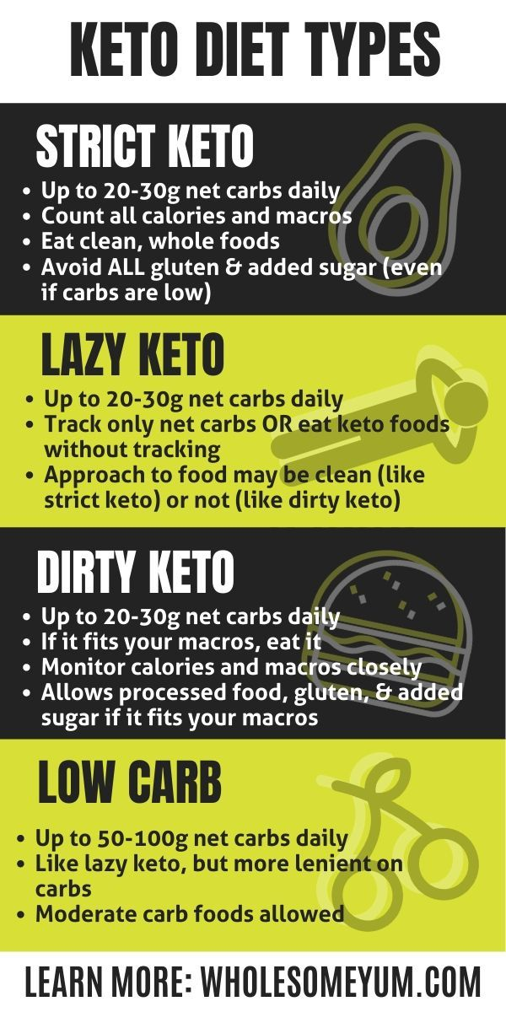
VARIETIES OF KETO DIET

Slide 24
EXAMPLES OF KETO DIET MEALS
Strict Keto: Bulletproof Coffee (coffee with MCT oil or butter &no sweetener OR better sweetener such as stevia, erythritol & monk fruit), steak salad with greens and butter, eggs, cheese in all varieties, “fathead” dough (made with cheese, cream cheese & almond flour) for pizza, buns etc. Keto bars- homemade or brands such as Suzie’s Good Fats, Good to Go
Dirty Keto – All of the above plus convenience products using sweeteners that are considered not as healthy such as sucralose, maltose - like Atkins Diet products or Skinny Syrups, diet pops etc. Relying more on things like Fast-food hamburgers without the buns than home-cooked meals
Vegan Keto – Curried tofu scramble, tomato mushroom spaghetti squash, cauliflower “fried rice”, Thai curry cauliflower soup, guacamole with homemade keto crackers
See http://www.dietdoctor.com for reputable keto & low carb information

Slide 25
Mediterranean Diet-
One Diet to Rule Them All
If you have read any information about a connection between how you eat and your health, you have heard the advice to eat a “Mediterranean Diet”.
This scientific interest in the diet of people living in Greece, Italy, Spain, France & Northern Africa dates back to the 1950s and an observation made by Ansel Keys of the University of Minnesota. He noticed that poor people in remote Italian villages had better cardiovascular health that wealthy residents of New York City. He went on to study the connections between lifestyles, nutrition and cardiovascular disease. The Mediterranean countries had the lowest rates of cardiovascular disease.

