Slide 1

PPT 11 –
Exercise and Physical Activity

Slide 2
Physical inactivity
In Canada at least 51% of adults are physically inactive
  Inactivity increases with age
  Women are less active than men
24 billion dollars spent every year in the US on health care costs related to inactivity
Equally as damaging as obesity or smoking as a risk factor for chronic disease
Physical activity – bodily movement produced by muscle contractions that substantially increase energy expenditure
Exercise – Planned, structured, and repetitive bodily movement that promotes or maintains physical fitness
Training – regular practice of an activity, which leads to physical adaptations of the body with improvement in flexibility, strength, or endurance

Slide 3
Benefits of Physical activity
Moderate physical activity:
  Live longer
  More restful sleep
  Better nutritional health
  Improved body composition
  Improved bone density
  Enhanced resistance to colds and flus and other infectious diseases
  Lower risk of cancer
  Stronger circulation and lung function
  Lower risk of cardiovascular disease
  Lower risk of type 2 diabetes

Slide 4
Benefits of Physical activity
Moderate physical activity:
  Reduced risk of gallbladder disease (in women)
  Lower incidence and severity of anxiety and depression
  Stronger self-image
  Better quality of life, for longer
  …many, many more

Slide 5
Physical Activity/Exercise
How much?
What type?
What intensity?
How often?

Slide 6
How Much Exercise?
Minimum cumulative daily 30 minutes
  However, DRI committee and other national authorities state that 30 minutes is not enough for adults to maintain healthy body composition (which would be important for health benefits)
150 minutes per week
Do not sit in 1 place for longer than 30 minutes at a time
  Blood circulation is maintained through muscular contraction, especially in the legs
  Blood clots – higher risk the longer sitting in 1 place without moving
Canada’s Physical Activity Guide

Slide 7
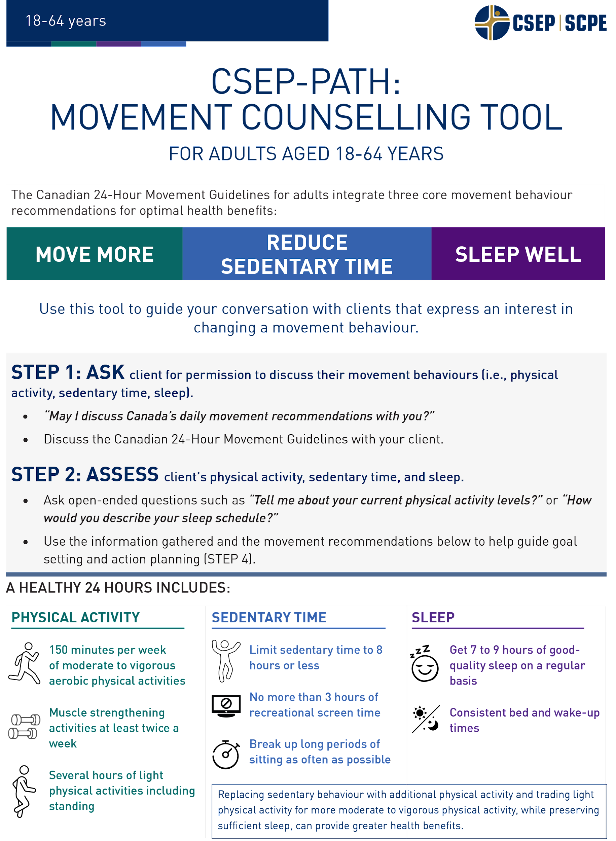
Physical Activity Guidelines for Canadians
https://csepguidelines.ca/
Canadian Society for Exercise Physiology publishes annual physical activity guidelines for Canadians.
Participaction publishes a yearly report card on key markers of health related to physical activity.
https://www.participaction.com/en-ca/resources/adult-report-card

Slide 8
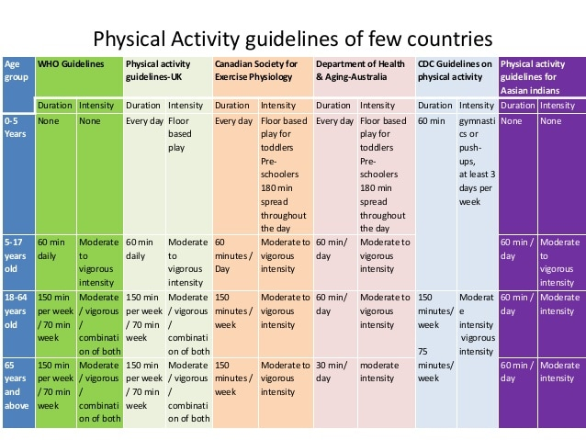
What do other countries recommend?

Slide 9
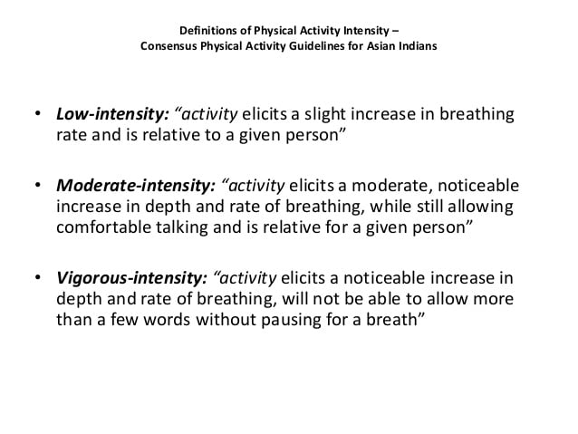
Intensity of Exercise

Slide 10
Another way to gauge intensity - METs
A MET is a ratio of your working metabolic rate relative to your resting metabolic rate.
One MET is approximately 3.5 milliliters of oxygen consumed per kilogram of body weight per minute.
One MET is the energy you spend sitting at rest — your resting or basal metabolic rate. So, an activity with a MET value of 4 means you’re exerting four times the energy than you would if you were sitting still.
The American Heart Association (& many other groups) recommends at least 150 minutes of moderate-intensity aerobic exercise each week for optimal cardiovascular health. That’s equal to about 500 MET minutes per week, according to the Dept. Of Health & Human Services.
Converting METs to calories: The formula to use is: METs x 3.5 x (your body weight in kgs) / 200 = calories burned per minute.
https://youtu.be/9ma8MJXuxMs

Slide 11
Light < 3.0 METs | Moderate 3.0–6.0 METs | Vigorous > 6.0 METs
Sitting at a desk: 1.3 | Housework (cleaning, sweeping): 3.5 | Walking at very brisk pace (4.5 mph): 6.3
Sitting, playing cards: 1.5 | Weight training (lighter weights): 3.5 | Bicycling 12–14 mph (flat terrain): 8
Standing at a desk: 1.8 | Golf (walking, pulling clubs): 4.3 | Circuit training (minimal rest): 8
Strolling at a slow pace: 2.0 | Brisk walking (3.5–4 mph): 5 | Singles tennis: 8
Washing dishes: 2.2 | Weight training (heavier weights): 5 | Shoveling, digging ditches: 8.5
Hatha yoga: 2.5 | Yard work (mowing, moderate effort): 5 | Competitive soccer: 10
Fishing (sitting): 2.5 | Swimming laps (leisurely pace): 6 | Running (7 mph): 11.5

Slide 12
What Type of Exercise?
Endurance
Flexibility
Strength

Slide 13
What Type of Exercise?
Flexibility – the capacity of the joints to move through a full range of motion; the ability to bend and recover without injury
Muscle strength – the ability of the muscles to work against resistance
Muscle endurance – the ability of a muscle to contract repeatedly within a given time without becoming exhausted
Cardiorespiratory endurance – the ability to perform large-muscle dynamic exercise of moderate to high intensity for prolonged periods
Overload – an extra physical demand placed on the body; an increase in the frequency, duration, or intensity of an activity. A principle of training is that for a body system to improve, it must be worked at frequencies, durations, or intensities that increase by increments

Slide 14
What Type of Exercise?
Hypertrophy – an increase in size in response to use (eg. Muscle size)
Atrophy - a decrease in size due to disuse ie. With paralysis, casting etc.
Aerobic – requiring oxygen. Aerobic activity strengthens the heart and lungs by requiring them to work harder than normal to deliver oxygen to the tissues
Myoglobin – the muscles’ iron-containing protein that stores and releases oxygen in response to the muscles’ energy needs
Weight training – the use of free weights or weight machines to provide resistance for developing muscle strength and endurance. A person’s own body weight may also be used to provide resistance as when a person does push-ups, pullups, or situps. Also called resistance training.

Slide 15
What Type of Exercise?
Cardiac output – the volume of blood discharged by the heart each minute
Stroke volume – the amount of oxygenated blood ejected from the heart toward body tissues at each beat
VO2Max – the maximum rate of oxygen consumption by an individual (measured at sea level)
Anaerobic – not requiring oxygen. Anaerobic activity may require strength but does not work the heart and lungs very hard for a sustained period
Lactic acid – a compound produced during the breakdown of glucose in anaerobic metabolism. Causes soreness post-workout in muscles and pain during high intensity exercise
https://youtu.be/8Y_FdjI2v4I

Slide 16
Endurance/Cardiorespiratory Exercise
Aerobic in nature
Body learns to deliver oxygen more efficiently to tissues
Total blood volume and number of red blood cells increase
Heart becomes larger and stronger
Cardiac output increases
Heart stroke volume increases
Resting heart rate decreases
Muscles that inflate and deflate the lungs are strengthened and so breathing becomes more efficient
Blood pressure is maintained in the normal range
HDL increases

Slide 17
Endurance/Cardiorespiratory Exercise
How conditioned is your heart? Take your resting pulse.
  Sit relaxed for 5 minutes before taking your pulse for 15 seconds. Multiply this number by 4. Ideally take this when you wake up in the morning before getting out of bed for the most accuracy.
  Exercise Heart Rate Zones:
Lower-intensity zone: You’re exercising at 50% to 60% of your max heart rate. At this point, 85% of the calories you burn are fat. The downside? You’re burning fewer calories overall than you would if you were exercising at a higher intensity. You’re generally able to sustain this zone the longest amount of time.
Temperate zone: You’re exercising at 60% to 70% of your max heart rate. Roughly 65% of the calories you burn are fat.
Aerobic zone: Working at 70% to 80% of your max heart rate puts you in the aerobic zone. About 45% of the calories you burn are fat. But you’re burning a higher number of overall calories compared to the other heart rate zones. You generally sustain this zone the shortest amount of time.
Maximum Heart Rate: 220 – your age ie. For a 35 year old, 220 – 35 = 185
If you want to be in the temperate zone, you would aim for 185 x 0.70 =130 bpm
https://youtu.be/0on5LV3k26o

Slide 18
Muscle Strength
Muscles increase in strength by responding to an overload of physical activity and gain strength and/or size (called hypertrophy)
Takes a day or two to repair muscle tears and replenish energy stores
Recommended 2-4 times per week
For increased strength, heavier weights, lifted with less repetitions
For increased endurance, lighter weights, lifted with more repetitions
Prevents injury
Prevents limited mobility that accompanies ageing
Increases bone mass and density

Slide 19
Flexibility
Maintains range of motion and functional movement
Prevents injury
Typically, a stretch must be held for about 10 - 30 seconds for benefit
Sitting all day will cause hip flexors to shorten – stretching can help
Decreases joint pain
The latest ACSM stretching and flexibility guidelines include:
Frequency:
Equal to or greater than 2-3 times per week.
Daily stretching is most effective.
Intensity:
Stretch to the point of feeling tightness or slight discomfort.
Time:
Holding a static stretch for 10-30s is recommended for most adults.
In older individuals, holding a stretch for 30-60s may confer greater benefit toward flexibility.
Type:
A series of flexibility exercises for each of the major muscle-tendon units is recommended.

Slide 20
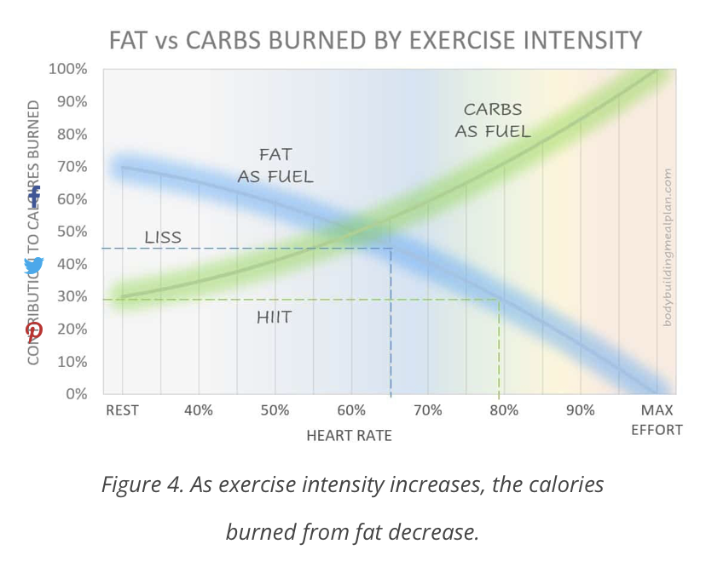
Current Topics in Exercise Physiology
HIIT training
  High intensity interval training: alternating high intensity periods of intense anaerobic exercise with recovery periods.
  No one regime or strategy, often uses a 2:1 ratio, such as 40 sec exertion, 20 sec rest
  Compared to LISS (low intensity steady state), HIIT burns less fat for fuel during exercise

Slide 21
HIIT vs LISS
Post-exercise oxygen consumption (EPOC) increases therefore more fat burn post exercise over a 24 hr period
However, recent meta analyses of research studies seem to show that total calories, & total fat burn are pretty equivalent between the two types of exercise
So why choose HIIT?
  More time efficient 10 min HIIT = 50 min moderate cycling workout
  Greater increases in max heart rate
  Increased insulin sensitivity
  Who should be cautious of HIIT? – Those with cardiovascular conditions
  - “weekend warriors” - people with poor flexibility (increased chance of injury)
  Examples of HIIT workouts: Tabata, full body HIIT, resistance training, interval training on cardio equipment
  Bottom Line: Ideally incorporate both HIIT and LISS (Low Intensity Steady State) workouts

Slide 22
Other Current Topics in Exercise Physiology
asep.org
Wearable Technology
Body Weight Training
Virtual/Online Training
Fitness Programs for Older Adults
Exercise as Medicine
Fasted vs Fed exercise
https://youtu.be/UF0AkfJqq2s

