Slide 1
ANATOMY OF THE BACK
Lumbar Spine

Slide 2
Vertebrae Review
All vertebrae share a basic common structure. They each consist of
  vertebral body
  posterior vertebral arch - refers to the lateral and posterior parts of the vertebrae
  Vertebral foramen – forms vertebral canal
  Pedicle
  Lamina
  Superior and inferior articular facets
  Spinous process

Slide 3
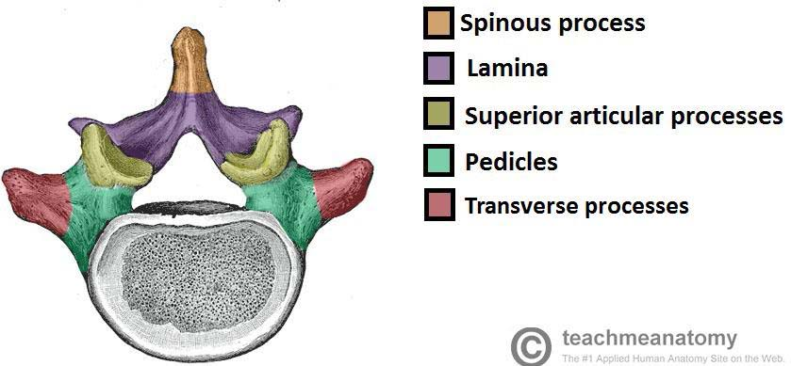
Typical Vertebra

Slide 4
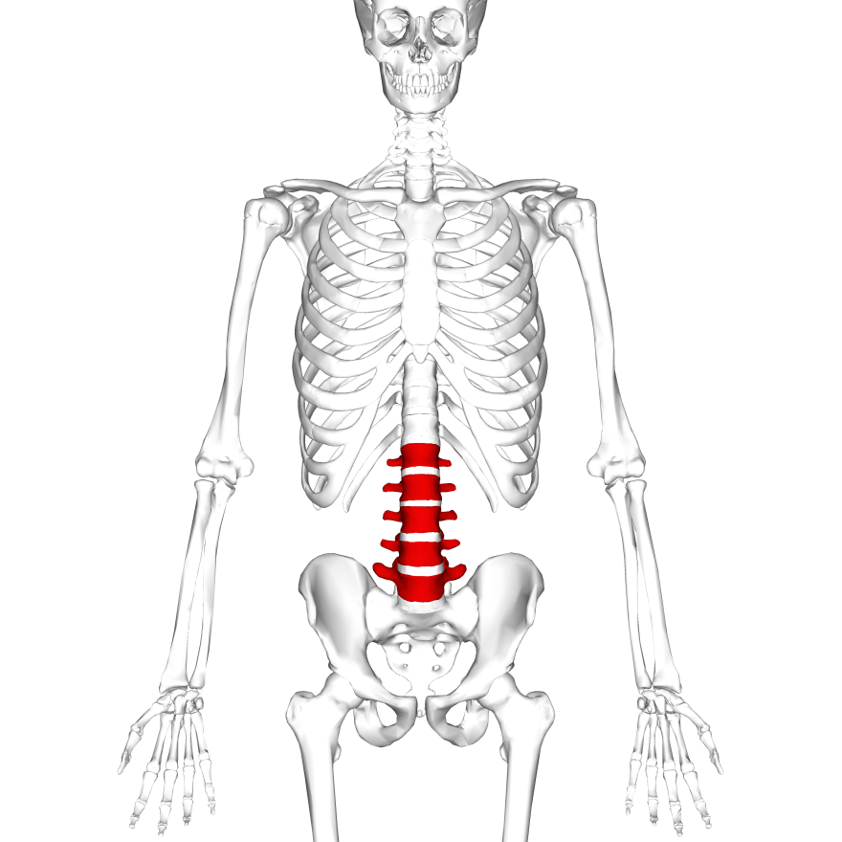
Lumbar Vertebrae
5 Lumbar Vertebrae
Largest of the all the vertebrae
Support the weight of the upper body

Slide 5
Characteristics of Lumbar Vertebrae
Vertebral bodies are large and kidney bean shaped
Vertebral foramen is triangle shaped
Transverse processes are long and slender.
Articular processes have nearly vertical facets.
Spinous processes are short and broad.
Accessory processes can be found on the posterior aspect of the base of each transverse process. They act as sites of attachment for deep back muscles.
Mammillary processes can be found on the posterior surface of each superior articular process. They act as sites of attachment for deep back muscle
  The fifth lumbar vertebrae, L5, has some distinctive characteristics of its own. It has a notably large vertebral body and transverse processes as it carries the weight of the entire upper body

Slide 6
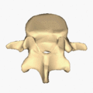
Lumbar vertebra

Slide 7
Thoracic and lumbar vertebra
https://www.youtube.com/watch?v=PM8-C6Lzpso

Slide 8
Joints
There are two types of joint in the lumbar spine. Both of these articulations are not unique to the lumbar vertebrae, and are present throughout the vertebral column.
Between vertebral bodies – adjacent vertebral bodies are joined by intervertebral discs, made of fibrocartilage. This is a type of cartilaginous joint.
articulation of superior and inferior articular processes from adjacent vertebrae. It is a synovial plane type joint.

Slide 9
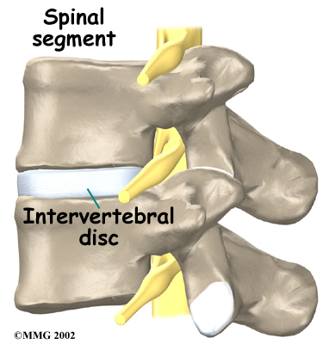
Joints

Slide 10
Spinal Nerves/Spinal Column in the Lumbar spine
The spinal cord starts at the base of the brain, runs throughout the cervical and thoracic spine, and typically ends at the lower part of the thoracic spine.
The spinal cord does not run through the lumbar spine (lower back). After the spinal cord stops in the lower thoracic spine, the nerve roots from the lumbar and sacral levels come off the bottom of the cord like a "horse's tail" (named the cauda equina) and exit the spine.
Because the lumbar spine has no spinal cord and has a large amount of space for the nerve roots, even serious conditions—such as a large disc herniation—do not typically cause paraplegia (loss of motor function in the legs).

Slide 11
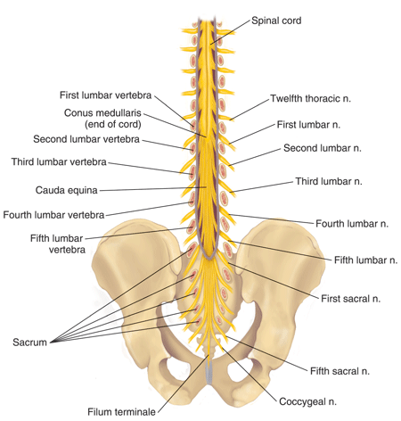
Continued

Slide 12
Plexuses
Review lumbar and sacral plexus from anatomy 2

Slide 13
Lumbar Plexus
The roots (anterior rami) of spinal nerves L1 – L4 from the lumbar plexus
There is not as much intermingling of fibres in the lumbar (compared to brachial plexus)
The plexus is formed anterior to the TVP’s of lumbar vertebrae
It is within the proximal attachment of psoas major (ant,lat bodies of t12-L5 and IVD, ant on tps of L1-L5)
The lumbar plexus supplies the anterolateral abdominal wall the external genitals and part of the lower limbs
Major branches of the lumbar plexus include:
  Femoral nerve
  Obturator nerve
  Lumbosacral trunk

Slide 14
Femoral Nerve
L2,3,4 = “Fem-or-al”
Emerges from lateral border of psoas major and innervates iliacus
Passes deep to inguinal ligament to the anterior thigh – here it divides into many smaller branches
Supplies flexors of hip and extensors of knee
Also supplies skin over anterior and medial thigh and medial leg and foot

Slide 15
Obturator Nerve
L2,3,4 = SAME AS FEMORAL
Emerges from medial border of psoas major and passes into lesser pelvis
Passes through the obturator foramen to supply adductor muscles and skin over medial thigh
No pelvic structures are supplied by the obturator nerve

Slide 16
Lumbosacral Trunk
L4 &L5
Passes over the wing of the sacrum and descends into the pelvis
Here it helps form the sacral plexus with S1-S4

Slide 17
Sacral Plexus
Roots (anterior rami) of L4, L5 and S1 – S4 form the sacral plexus
This is found just anterior to the sacrum (anterior to piriformis muscle)
The sacral plexus supplies the buttocks, perineum and lower limbs
The sciatic nerve is a branch of the sacral plexus

Slide 18
Sciatic nerve
Longest nerve in the body
L4, L5, S1 – S3 nerve roots
Typically passes through the greater sciatic foramen inferior to piriformis
Then descends along the posterior thigh to supply the back of the lower limb

Slide 19
Pudendal Nerve
This is the main nerve of the perineum
It conveys most of the sensory information from the external genitals
S2-S4 roots
Leaves the pelvis through the greater sciatic foramen, hooks around the ischial spine and re-enters the pelvis through the lesser sciatic foramen

Slide 20
Superior Gluteal Nerve
L4-S1 ROOTS
Leaves pelvis through greater sciatic foramen (superior to piriformis)
Supplies gluteus medius, minimus and TFL

Slide 21
Inferior Gluteal Nerve
L5-S2 ROOTS
Leaves pelvis through the greater sciatic foramen (inferior to piriformis)
Lies superficial to sciatic nerve and then supplies gluteus maximus

Slide 22
Videos
Lumbar Plexus
https://www.youtube.com/watch?v=UmIDCHd0Ai4
Sacral Plexus
https://www.youtube.com/watch?v=DZ0IL1tHNxo

Slide 23
Nerves of the thigh
Femoral nerve, Superior gluteal
Deep Gluteal Nerves – inferior gluteal & superior gluteal, Sciatic nerve

Slide 24
Nerves of the thigh
FEMORAL NERVE
The terminal branch of the femoral nerve is the saphenous nerve
The saphenous nerve travels with the femoral vessels through the adductor canal
It emerges between sartorius and gracilis at the level of the adductor hiatus
Supplies the skin on anteromedial knee, leg and foot
SUPERFICIAL GLUTEAL NERVES
Also referred to as the clunial nerves
These innervate the skin over the gluteal region

Slide 25
Cont..
DEEP GLUTEAL NERVES
The superior gluteal nerve runs laterally between gluteus medius and minimus
The inferior gluteal nerve runs on the deep surface of the gluteus maximus
Sciatic nerve rests on the ischium and then passes posterior to obturator internus, quadrates femoris and adductor magnus
The sciatic nerve supplies posterior thigh muscles, all leg and foot muscles and skin of most of the leg and foot
Also supplies joints of the lower limb (Hilton’s law)
The sciatic nerve actually divides into a tibial branch and a como fibular branch
These usually separate about halfway down the thigh

Slide 26
Nerves of the Leg
Saphenous, Tibial, Common Fibular, Superficial Fibular, Deep Fibular
SAPHENOUS
Terminal branch of the femoral nerve
This is a cutaneous nerve that supplies the anteromedial knee, leg, foot
TIBIAL
A branch of the sciatic nerve
The tibial nerve is the medial and larger branch
It passes through the centre of the popliteal fossa
Supplies – soleus, gastrocs, plantaris, popliteus (superficial posterior compartment) and tibialis posterior, flexor digitorum longus, flexor hallucis longus (deep posterior compartment)

Slide 27
Nerves of the legs
COMMON FIBULAR
The lateral smaller branch of the sciatic nerve
Follows the medial border of biceps femoris
Winds around the neck of the fibula and divides into its terminal branches:
  Superficial fibular nerve
  Deep fibular nerve
SUPERFICIAL FIBULAR NERVE
This branch of the common fibular nerve supplies the lateral compartment muscles
This nerve then continues as a cutaneous nerve to supply skin on the distal anterior leg and dorsum of the foot

Slide 28
Nerves of the leg
DEEP FIBULAR NERVE
This branch of the common fibular nerve supplies the anterior compartment muscles
This branch arises between fibularis longus and the neck of the fibula
A lesion of this nerve results in “drop foot” ( inability to dorsiflex)

Slide 29
Nerves of the foot
The following nerves all supply skin and muscles of the foot:
  Saphenous – Medial side of the foot
  Superficial fibular – Skin on dorsum of foot except for region supplied by deep fibular
  Deep fibular – Extensor Digitorum Brevis and skin between 1st and 2nd digits
  Medial plantar – Skin of medial sole of foot, Abductor Hallucis, Flexor Digitorum Brevis and 1st Lumbrical
  Lateral plantar – Skin on lateral sole, quadratus plantae, abductor digiti minimi pedis, flexor digiti minimi, interossei, lateral 3 lumbricals, adductor hallucis
  Sural – Lateral aspect of hind foot and mid foot
  Calcaneal branches – Skin of heel

Slide 30
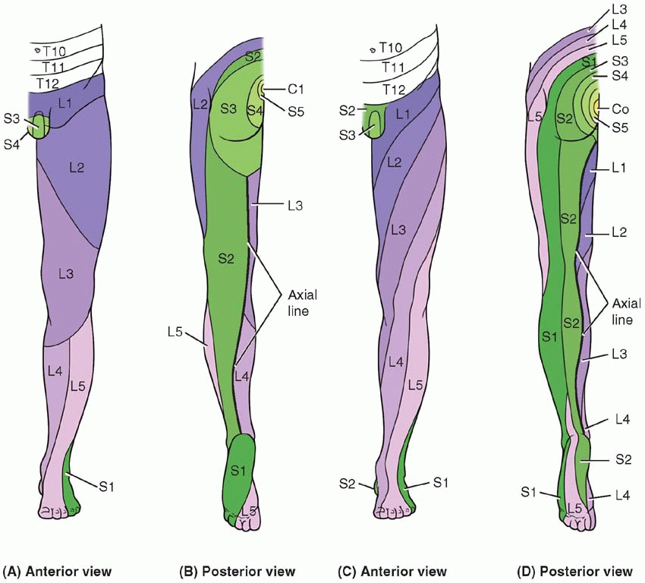
Cutaneous nerve supply

Slide 31
Ligament Review
Supraspinaous Ligament
  Starts at SP of C7 and follows SP to the sacrum, Slightly limits Spinal Flexion
Anterior longitudinal ligament
  Begins at the Occipit bone or Anterior tubercle of the Atlas (C1) and travels to the Sacrum, located on the anterior surface of vertebral bodies but does not attach to the intervertebral discs, limits spinal extension
Posterior longitudinal ligament
  Begins at the occipit bone and runs Posterior surface of vertebral bodies, travels to sacrum. Attaches to intervertbral discs and upper and lower margins of vertebral bodies, limits flexion of the spine and protects the disc

Slide 32
Ligaments Continued
Capsular ligaments (zygoapophyseal ligament)
  Covers joint capsule of each facet, limits gliding motion (opening and closing) of the facets
Ligamentum Flavum
  NON CONTINUOUS ligament that extends from posterior vertebral arch to posterior vertebral arch. Always under tension – even at rest, stretched more during flexion. Plays a role in returning the spinal column to an erect position

Slide 33
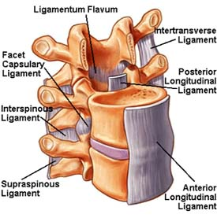
Spinal Ligaments

Slide 34
Pelvic Ligaments
Sacrotuberous Ligament - attached by its broad base to the posterior superior iliac spine, the posterior sacroiliac ligaments (with which it is partly blended), to the lower transverse sacral tubercles and the lateral margins of the lower sacrum and upper coccyx
Sacrospinous Ligament - is a thin ligament attached to the ischial spine (a bone prominence in the lower pelvis) and the lateral (side) regions of the sacrum (at the bottom of the spine) and coccyx, or tailbone

Slide 35
Continued
Posterior Sacroiliac Ligament - is situated in a deep depression between the sacrum and ilium behind; it is strong and forms the chief bond of union between the bones
The upper part (short posterior sacroiliac ligament) is nearly horizontal in direction, and pass from the first and second transverse tubercles on the back of the sacrum to the tuberosity of the ilium.
The lower part (long posterior sacroiliac ligament) is oblique in direction; it is attached by one extremity to the third transverse tubercle of the back of the sacrum, and by the other to the posterior superior spine of the ilium.
Illiolumbar Ligament - is a strong ligament passing from the tip of the transverse process of the fifth lumbar vertebra to the posterior part of the inner lip of the iliac crest

Slide 36
Review hip and thigh muscles
Back muscles
https://youtu.be/-oxY2Duc-0c

Slide 37
Muscles

Slide 38
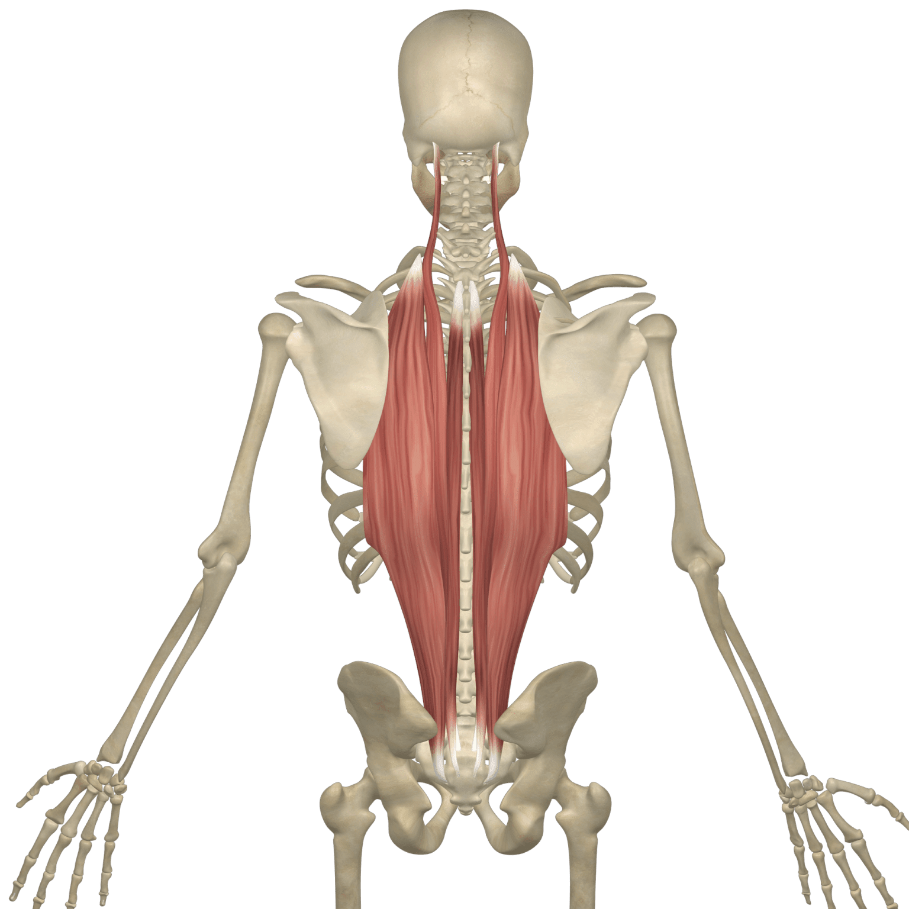
Erector Spinae Muscles
aka: paraspinal muscles
  most superficial of the paraspinal muscles
erector spinae:
  three main muscles:
    Iliocostalis
    Longissimus
    Spinalis

Slide 39
Erector Spinae Muscles
each individual muscle is divided into three different sections
  named based on where they attach along the spinal column
    thoracis → thoracic spine
    cervicis → cervical spine
    Capitis → head
“I LIKE SPAGHETTI”
  spinalis is the most medial along the spinal column

Slide 40
Erector Spinae Muscles
muscle actions:
  bilaterally:
    all contribute to spinal extension & lateral flexion
  unilaterally
    some muscle segments function on their own to create other actions based on their attachment site
  move larger segments of the vertebral column vs. deeper muscles of the back that may only target individual segments

Slide 41
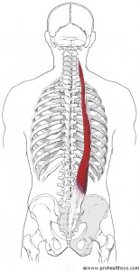
Iliocostalis
Origin
lumborum: medial iliac crest & sacrum
thoracis: angle of ribs 7 -12
cervicis: angle of ribs 3-6
Insertion
lumborum: angle of ribs 7 -12
thoracis: angle of ribs 1-7
cervicis: TPs of C4 - C6
Actions
Extension of the trunk & neck
lateral flexion trunk & neck
Nerve – Spinal Nerve ( Dorsal Rami)
Blood - Muscular branches of Aorta

Slide 42
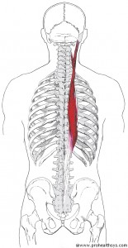
Longissimus
Origin
Thoracis: Medial Iliac crest,
posterior sacrum, TPs L1-L5
Cervicis: TPs of T1-T5
Capitis: TPs C5 – T5
Insertions –
Thoracis: TPs of T1-12 & lower 9 Ribs
Cervicis: TPs C2-C6
Capitis: mastoid process
Actions
extension and lateral flexion of trunk, neck &
head
Nerve- Spinal Nerves Dorsal Rami
Blood- muscular branches of Aorta

Slide 43
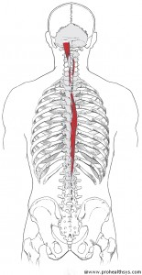
Spinalis
Origins
Thoracis: SPs T11-L2
Cervicis: Inferior Nuchal ligament & SP C7
Capitis: Medial portion of semispinalis
Insertions
Thoracis: SPs of T4 –T8
Cervicis: SP of C2
Capitis: Medial portion of semispinalis
Action
extension and lateral flexion of the trunk
& neck
Nerve – Spinal Nerve (dorsal Rami)
Blood – Muscular branches of Aorta

Slide 44
Transversospinalis Group
Associated with movements of the vertebral column
This muscle group attaches from the transverse process inferiorly to the spinous process superiorly

Slide 45
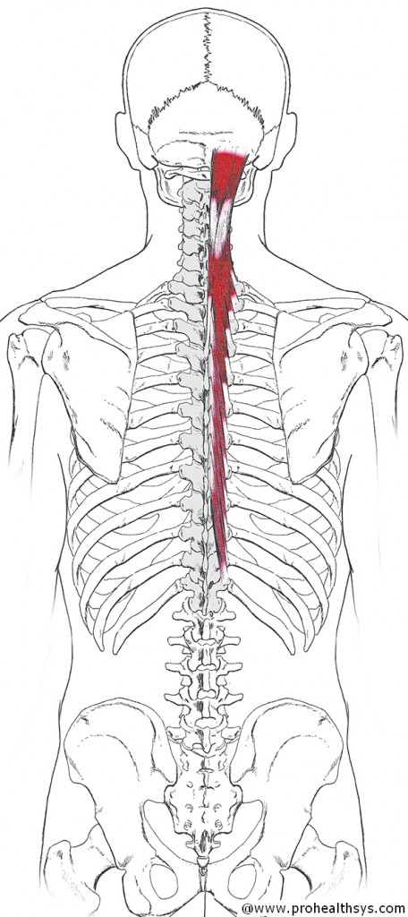
Transversospinalis group –
Semispinalis
Origin - Thoracis: TPs of T6-T10
cervicis: TPs of T1-T5
capitis: TPs of C7-T6 & articular process of C4-C6
Insertion - Thoracis: SPs of C6-T4
Cervicis: SPs of C2-C5
Capitis: occipital bone (below superior nuchal line)
Action – extension & lateral flexion of head, neck & trunk; contralateral rotation of trunk and neck
Nerve – Spinal Nerves (Dorsal Rami)
Blood-Occipital & Posterior intercostal Artery

Slide 46
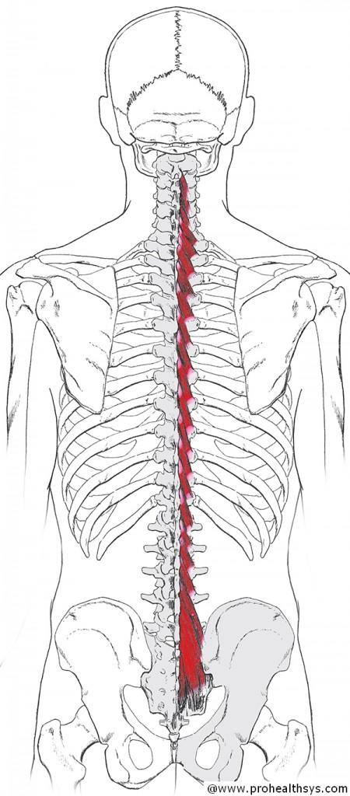
Multifidus
Origin – lumborum – Mamillary processes of L1 – L5; Thoracis – TP T1 –T12; Cervicis – Articular Process C4-C7
Insertion – Sp’s 3-4 segments above origin
Actions – extension & lateral flexion of head, neck & spine; contralateral rotation of trunk and neck
Nerve – Spinal Nerves (Dorsal Rami)
Blood- Posterior intercostal & lumbar artery dorsal branches

Slide 47
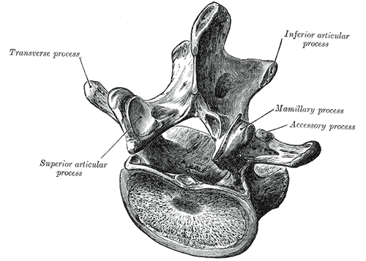

Slide 48
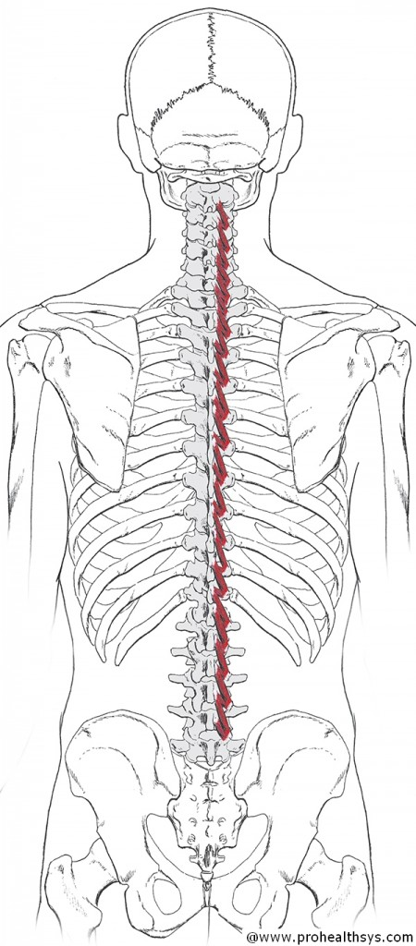
Rotatores
Origin - transverse processes (inferiorly)
Insertion – lamina (superiorly) 1-2 segments above origin
Action – Contralateral rotation, extension and lateral flexion of trunk and neck
Nerve – Spinal Nerves (Dorsal Rami)
Blood- Dorsal branches of Posterior intercostal & lumbar artery

Slide 49
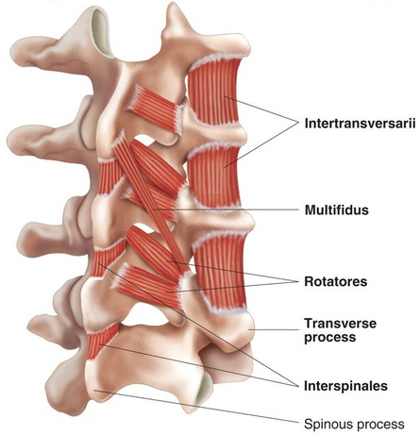
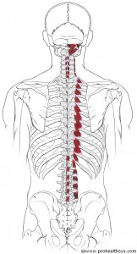
Interspinales
Origin - SP of vertebra below
Insertion - SP of vertebra above
Action - extension of neck & trunk
Nerve – dorsal Rami of Spinal Nerves
Blood- Dorsal Branches of posterior intercostal Arteries

Slide 50
Intertransversarii
Origin - TP of vertebrae below
Insertion - TP of vertebrae above
Action - lateral flexion of neck. lumbar
Nerve – Dorsal Rami of Spinal Nerves
Blood – Dorsal Branches of posterior intercostal Arteries

Slide 51
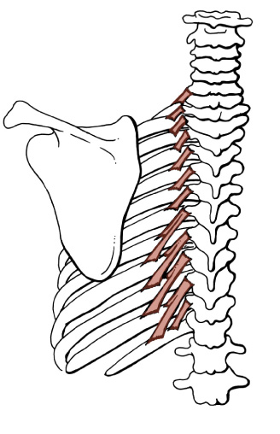
Levator Costarum
Origin - Tip of Transverse Processes of C7 – T11
Insertion – Ribs 1 – 12 inferiorly
Action – Elevates the ribs
Nerve- Dorsal Rami of Spinal Nerves
Blood – Dorsal Branches Posterior Intercostal Arteries

Slide 52
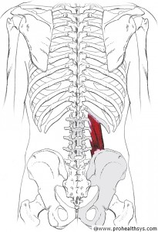
Quadratus Lumborum
Origin – 12th rib and the TP’s of L1 – L4
Insertion – Posterior Iliac Crest
Unilateral – elevates same side pelvis, anterior pelvic tilt
RMA - lateral flexion of trunk, depression of 12th rib, extend trunk at spinal joints
Nerve- Lumbar Plexus (T12 – L3)
Blood – Subcostal, Lumbar, iliolumbar Arteries

Slide 53
Other Information
Deepest anterior muscle of the lumbar, very little rotation – no flexion or extension as both attachments are in the frontal plane
Helps cushion and protect kidneys

Slide 54
Other Information
All thoracic levels have a Levator costarum Brevis - 1 Rib below
Levator costarum Longus occurs from the TPs of T5-T10 and run to Ribs 7 – 12 (2 ribs below)
Takes the place of the intertransversarii in thoracic spine

Slide 55
Muscles to review
These muscles that we have already learned will have an effect on the lumbar spine, pelvis/hip
  Trapezius (most specifically lower fibers)
  Latissimus Dorsi
  Iliacus
  Psoas

Slide 56
Muscle depth of the Posterior back
Deepest layer
  Intertransversarius
  Interspinalis
  Levator Costorum
    In the cervical Region of the back
      Suboccipital muscles
        Rectus Capitis Posterior Major
        Rectus Capitis Posterior Minor
        Obliquus Capitis Superior
        Obliquus Capitis Inferior

Slide 57
Traversospinalis Group
  Rototares
  Multifidi
  Semispinalis (can be considered intermediate muscle)
Intermediate muscles
  Erector Spinae Group
    Spinalis
    Longissimus
    Illiocostalis
Serratus Posterior Inferior and Superior (We will learn during Thoracic spine)

Slide 58
In the cervical Region superficial to the illiocostalis you will find the
  Splenius Cervicis
  Splenius Capitis
Most superficial in the Posterior Lower back
  Trapezius
  Latissimus Dorsi

