Slide 1
Introduction to Research

Slide 2
Goals & Objectives
The student at the end of this course will be able to identify concepts of Scientific Research:
Research literacy
Importance of reading research to stay current on latest developments in massage therapy
Apply scientific research principles to massage therapy
Distinguish qualitative and quantitative research methods
The importance of ethical clinical research
Minimize harm – maximize benefit
Basic concepts in evaluating research
Journal Articles – types and anatomy of
Classification of studies
Statistics
Demonstrate the ability to employ basic concepts of Scientific Research:
Professionalism
Recognize professional misconducts
Locate and critically evaluate research articles
How to form and validate a hypothesis
Clinical application of Evidence-based research

Slide 3
Course Break Down
Test @ 30%
Hand out (final project) @ 25%
Final Project @ 45%

Slide 4
Topic #1
Critical Thinking & Practice

Slide 5
Activity
Notes:
Write down a topic on a piece of paper - something that is culturally relevant right now
Share with the class (write on white board)
each class member thinks about what they know about the topic
how did you know this? where did you get your information? how do the facts/opinions of others make you feel?

Slide 6

What do you know about critical thinking?

Slide 7

What is Critical Thinking?

Slide 8
In a nutshell…
critical thinking can be defined as:
the act of the thinking independently, on purpose & with intention

Slide 9
How do you define yourself as a critical thinker?
What kind of characteristics do you have that fit the definition of a critical thinker?

Slide 10

Characteristics of critical thinkers…
analyzers
assessors/evaluators
self-motivated & independent
curious
continuous learners
self-aware learners
patient
explorers
well-informed
open-minded
reject bias (think rationally)
creative

Slide 11
Benefits of critical thinking
Learning to think for oneself
using skills to reveal & reject beliefs
Form new beliefs
do not passively accept the beliefs of others
Forming principles of thought & action
not swayed by opinions of others & do not mindlessly accept what is presented to them
Open minded
recognize that there is more than one way to do something & uses the more appropriate method

Slide 12
Benefits of critical thinking
Hone a vast skill set
critical thinkers are not limited in one way of doing things
Not easily manipulated
Act with intent
utilize all known & relevant knowledge to inform choices & behaviour
Self-evaluate
can recognize and catch own mistakes

Slide 13
Benefits of critical thinking
Learn how to ask important questions
don’t accept all information as fact, challenge & ask questions & find the answers
Are not lazy in their pursuit of knowledge
“that is my opinion” is lazy thinking, learn how to stand by your perspective using knowledge & fact - this strengthens a person's opinion
Analyze assumptions as biases
assumptions lead us to avoid the evidence - when we avoid evidence this leads to bias
Think rationally
avoid emotional reasoning

Slide 14
Benefits of critical thinking
Learning to tolerate uncertainty
its okay to say “I don’t know” or “It depends”; however need to make an effort to find the answers
Are considerate of other interpretations
thinking empathically - “shoe on other foot”
Enhance communication
Decipher between a fact or an opinion

Slide 15
Critical Thinking in Daily Life
5 tips to improve your critical thinking - Samantha Agoos

Slide 16
What can influence our thinking?
Notes:
Brainstorm on the board

Slide 17
Why is critical thinking important for RMTs?
Notes:
Brainstorm on the board

Slide 18
Critical Thinking & Practice

Slide 19
Scenario
A client comes in to your clinic presenting with elbow pain - points to the outside of the right elbow. Pain has been at about a 6/10 in the last week.
What is your plain of action?

Slide 20
Patient presents with concern (dx, symptoms, etc.)
Challenges our knowledge by asking us questions about identified concern
We ask questions about concern & perform an assessment
We develop a treatment plan & timeline with patient
We implement treatment & support client along the way
We reassess & evaluate effectiveness & make any appropriate adjustments

Slide 21
Enhancing Skills

Slide 22
Communication
Coffee House Chat
Create a character:
Name:
Occupation:
Age/Birthday:
Gender:
Education Level:
Marital Status:
Hobbies:
Create a brief background for your character.
Spend the next 15 minutes doing research on the following topic.
You will then have a “coffee house chat” about this topic based on what you have found & through the lens of your “character”.

Slide 23
The first man to walk on the moon

Slide 24
Visual
Crazy Captions
For the following images you can write some dialogue between characters, a single line caption, or turn the image into a clever meme.
Keep it short & witty!

Slide 25
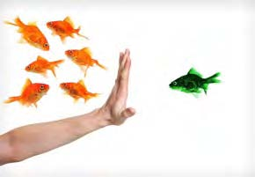
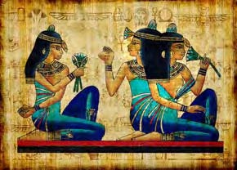

Slide 26
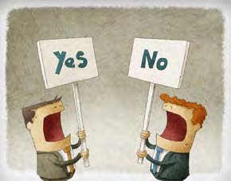
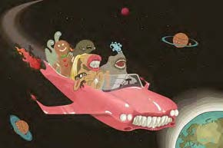

Slide 27
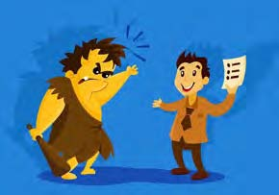
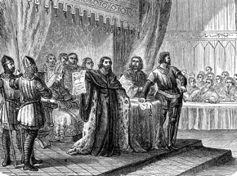

Slide 28
Individual Skills
What would happen…
Answer the following questions as creatively & constructively as you can. Use as much detail as you can!
What would happen if…
There were suddenly no computers, tablets, phones of any kind anywhere on earth?
We had to live in a world without electricity?
You woke up one morning to discover you had changed into a cartoon character?

Slide 29
Individual Skills
What would happen…
Answer the following questions as creatively & constructively as you can. Use as much detail as you can!
What would happen if…
All the animals in the world could suddenly communicate with us in our own language?
You found out your best friend was a super hero?

Slide 30
A strange interview
Listen to the following questions and provide an answer

Slide 31
For next week…
Think of 5 topics within the realm of massage that you are most curious about.
Write them down & bring them to class.

