Slide 1
THE LUMBAR SPINE

Slide 2
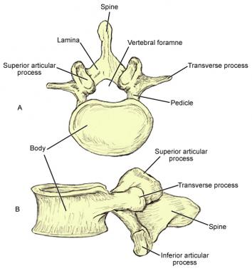

Slide 3
Review of anatomy
The Lumbar spine is made up of 5 vertebrae
Has a Lordotic Curve
Disc are the largest because the support the most weight
Transverse processes and spinous processes at the same level
Ten facet joint in the lumbar spine (five pairs)
Facet joints carry 20-25% of axial load, Unless disc degeneration is present, 70%
Facet joints also provide 40% of torsional/shear strength

Slide 4
Facet joints
Facet joints carry 20-25% of axial load, Unless disc degeneration is present, 70%
Facet joints also provide 40% of torsional/shear strength
Superior facets face medially and backwards
Inferior facets face laterally and forwards
The facet joints limit L/S rotation
    Rotation is accomplished by a shearing force
Transverse processes are at the same level as the spinous processes

Slide 5
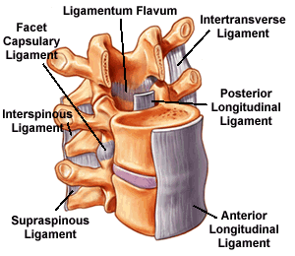
Ligaments
Anterior and posterior longitudinal ligaments
Ligamentum flavum
Supraspinous and interspinous ligament
Intertransverse ligament
Iliolumbar ligament
    Unique to L/S
    Connects L5 TP to ilium and helps prevent anterior displacement of L5

Slide 6
Intervertebral disc anatomy
20-25% length of the L/S, comprised of 85-90% water
    Body becomes less fluid as we age, resulting in a loss of height via shrinking discs
    Adults are 1-2cm taller in the morning compared to the evening
        Implications for excessive flexion in the morning?
Functions:
    Shock absorption
    Distribution of load
    Hold vertebra together
    Allow movement btw the vertebra
    Separate the vertebra to allow free passage of the nerve roots from the spinal cord through the intervertebral foramina
Consists of the annulus fibrosus and nucleus pulposus
Annulus fibrosus increases disc strength and accommodates torsion movements

Slide 7
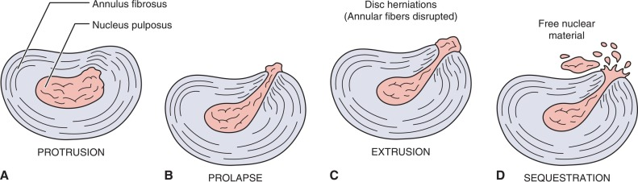
Types of disc herniation

Slide 8
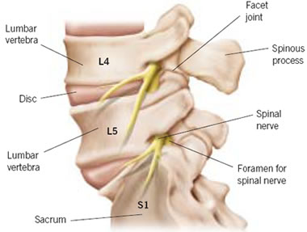
Nerve roots and vertebral segments
Each nerve roots exits below its vertebra (example: L4 nerve root exists between L4-5)
L5-S1 segment is the most common site of problems due to the amount of
load/stress this area takes
and the angle of the joint

Slide 9
Resting position: midway between flexion and extension
Close packed position: full extension
Capsular pattern: side flexion and rotation equally limited, extension

Slide 10
Patient history
Group read starting pg 633
Create a list
23 questions in total.

Slide 11
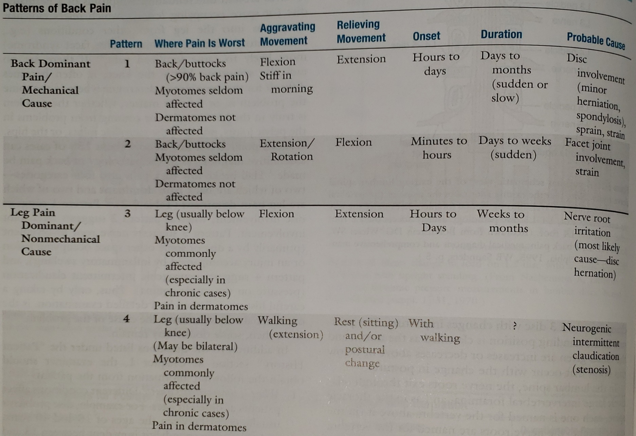
Patterns of back pain pg 635

Slide 12
OBSERVATION

Slide 13
Observation
Body type
Gait
Attitude
Total spinal posture
Markings
Step deformity

Slide 14
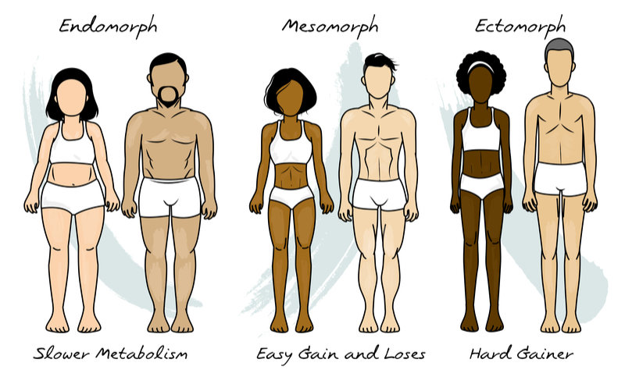
Body type

Slide 15
Gait
Does the gait appear to be normal?
If its altered, is it altered due to a limb or is it altered to relieve symptoms?

Slide 16
Attitude
What is the patient’s appearance?
Are they tense, bored, lethargic, healthy looking, overweight?

Slide 17
Total spinal posture (TSP)
Postural assessment
Positioning of pelvis
  Is the pelvis in a neutral position; if not what is restricting?
  Can they hold the pelvis in a neutral position?
  Can they hold a neutral pelvis during dynamic movement?
Is the body straight according to plumb line?
  Anterior, lateral view
Are there any curves to the spine?
  Anterior, posterior and lateral view.

Slide 18
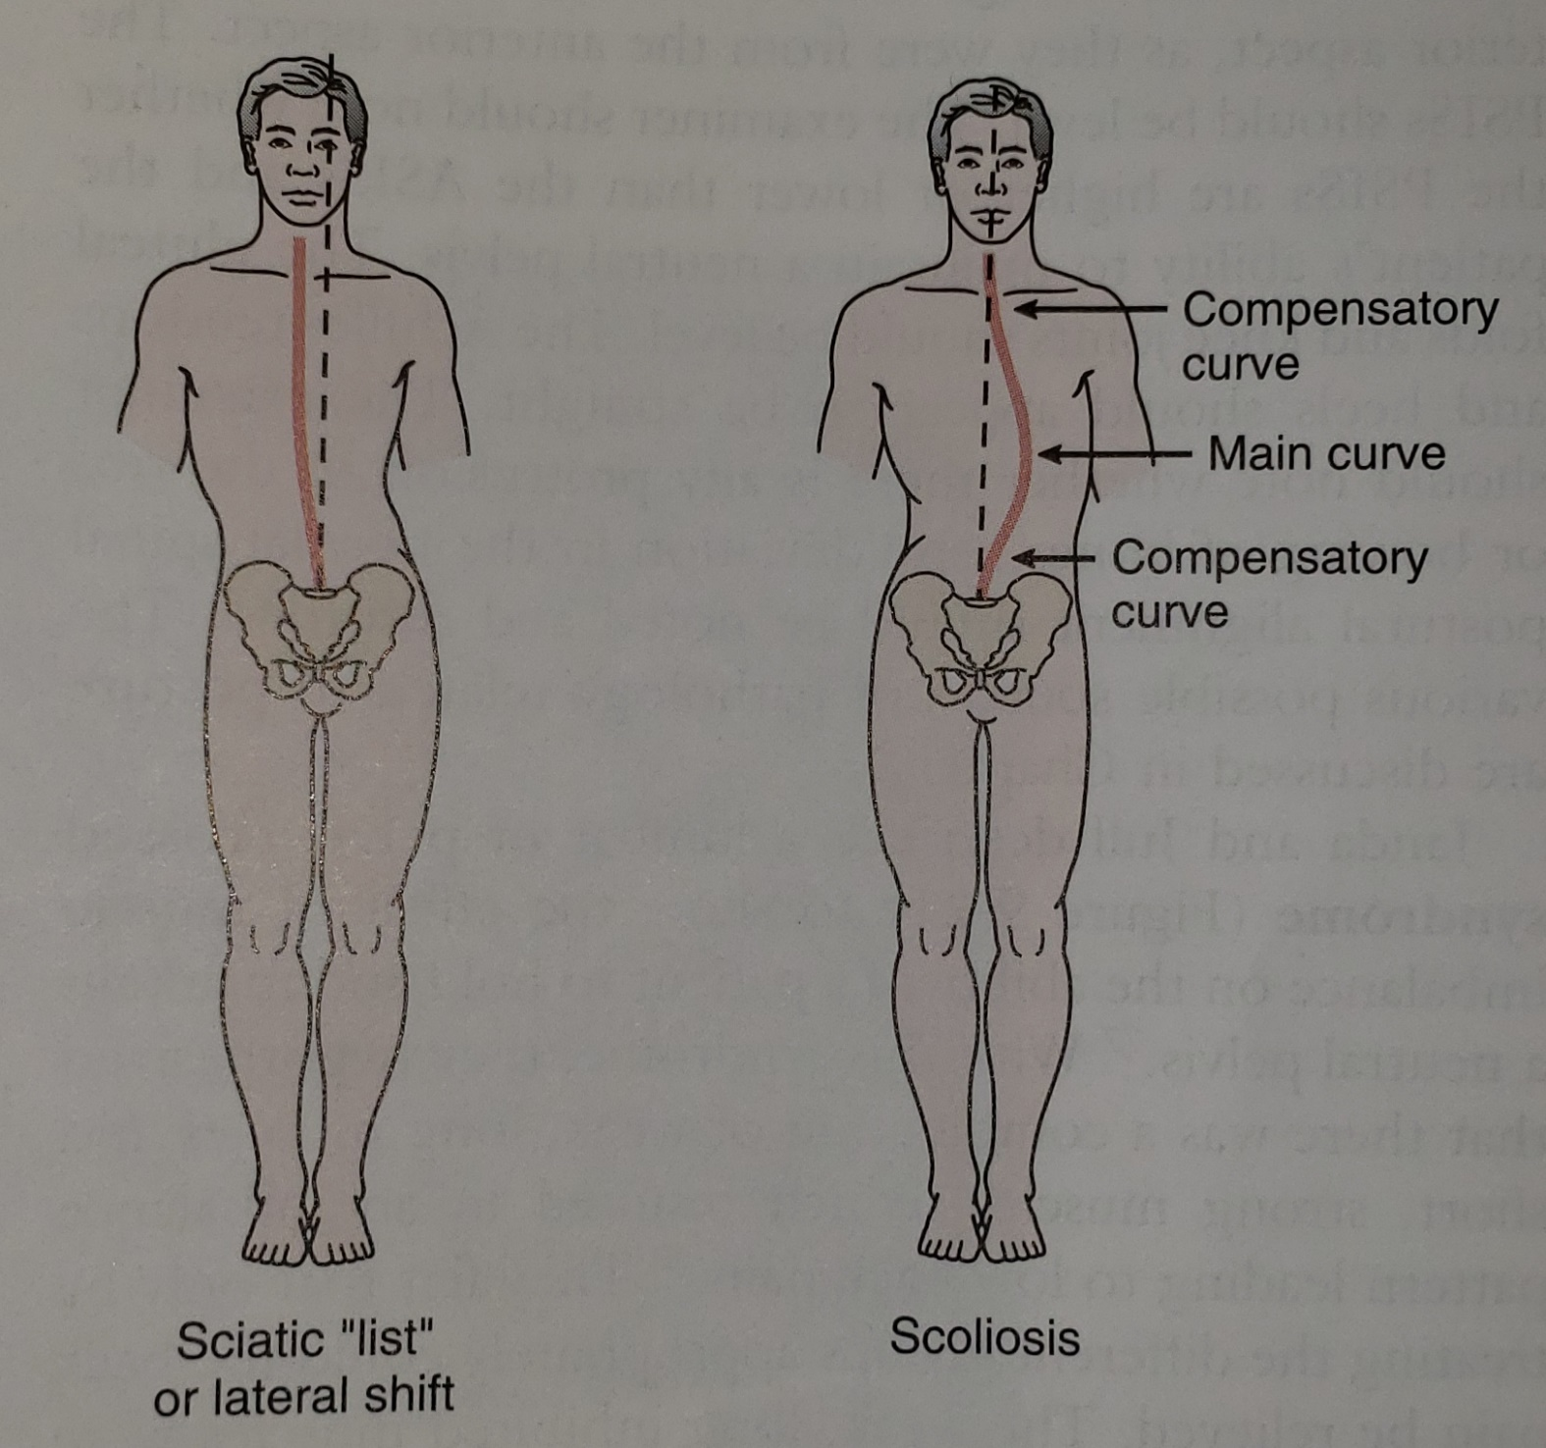

Slide 19
Markings
A faun’s beard may indicate a spina bifida occulta or diastematomyelia
Unusual skin markings or presence of skin lesions at midline may indicate neurological anomalies

Slide 20
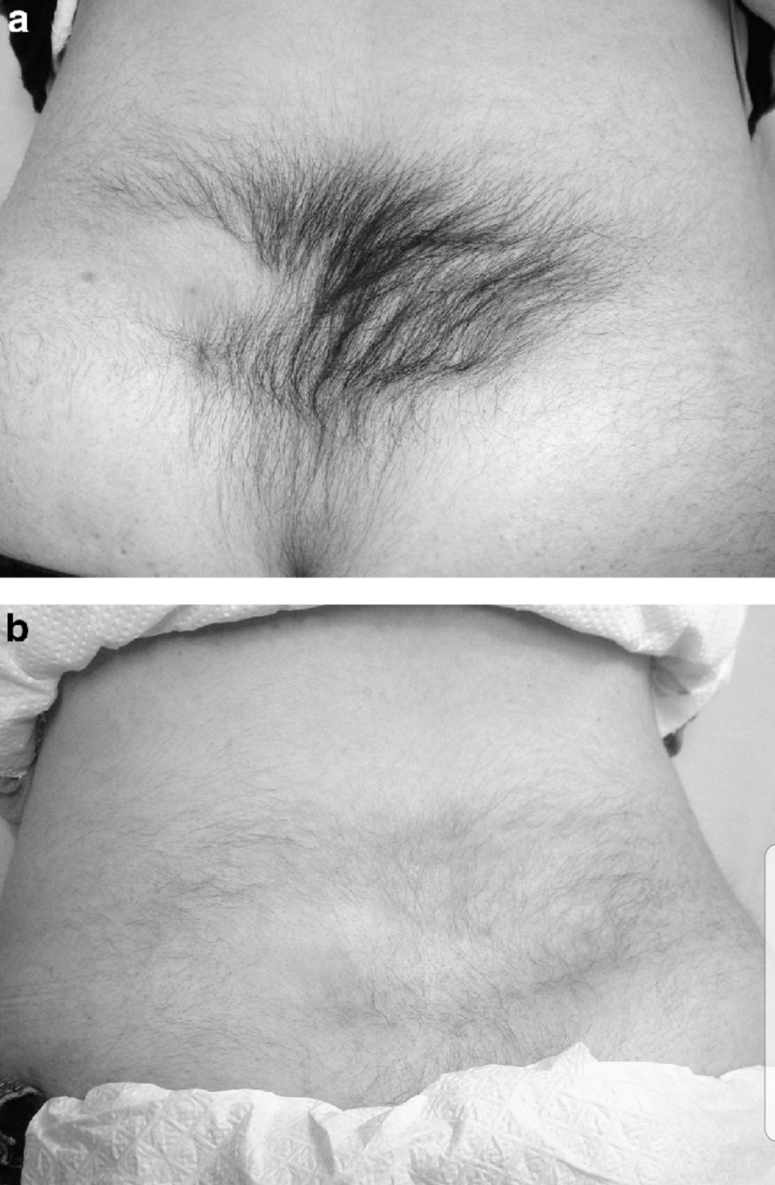
Faun’s beard

Slide 21
Step deformity
The lumbar spine may indicate spondylolisthesis.
The “step” occurs because of the SP of 1 vertebrae becomes prominent when either the vertebrae above or the affected vertebrae slips forward on the one below.

Slide 22
MOVEMENTS

Slide 23
AROM
During all ROM for lumbar spine you will have your clients place their hands behind their head to isolate the lumbar spine
Flexion- 40-60°
Extension- 20-35°
Lateral flexion- 15-20°
Rotation- 3-18°
Sustained postures (if necessary)
Repetitive motions (if necessary)
Combined movements (if necessary)

Slide 24
PROM
Flexion- tissue stretch
Extension- tissue stretch
Lateral flexion- tissue stretch
Rotation- tissue stretch

Slide 25
RIM
Forward flexion
Extension
Lateral flexion
Rotation
Optional
Dynamic abdominal endurance
Double straight leg lower
Dynamic extension endurance
Isotonic horizontal side support
Internal/external abdominal oblique test

Slide 26
Myotomes
L2- hip flexion
L3- knee extension
L4- ankle dorsiflexion
L5- great toe extension
S1- ankle plantar flexion, ankle eversion, hip extension
S2- knee flexion
https://www.youtube.com/watch?v=ACkxtr2emWw

Slide 27
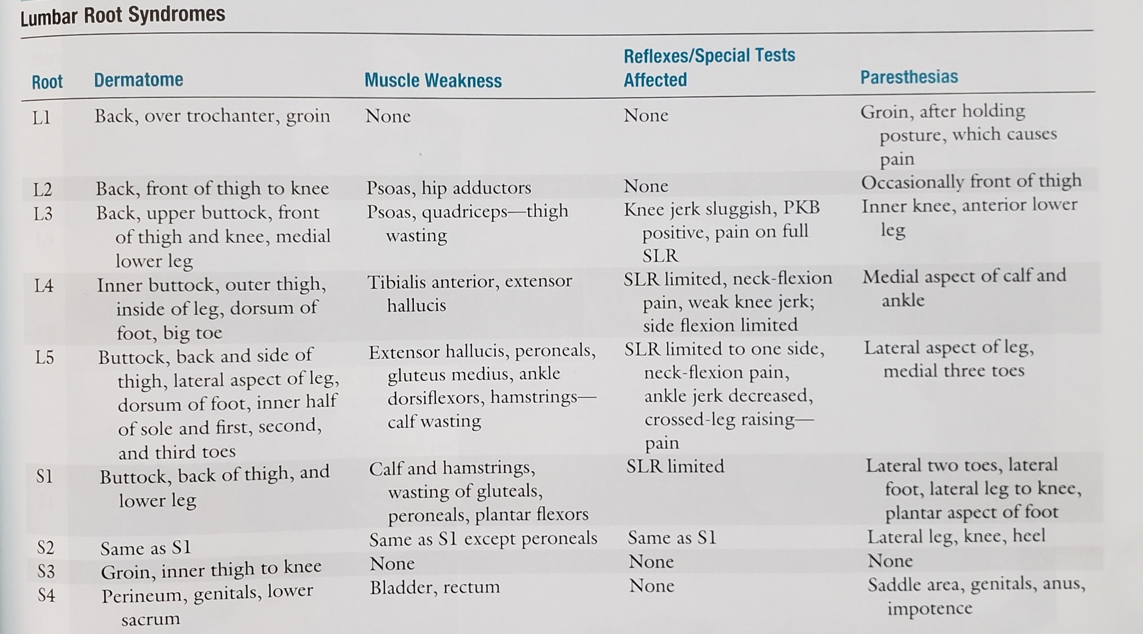

Slide 28
ORTHOPEDIC TESTS

Slide 29
Diagnosis
https://www.youtube.com/watch?v=_jrVkJigWGM
Lumbar Spine Dysfunction Part 2 - YouTube

Slide 30
Neurological dysfunctions
Slump test
Well leg straight leg
Valsalva maneuver

Slide 31
Muscle length test
90-90 straight leg raise test
Ober’s test
Rectus femoris test
Thomas test

Slide 32
Reflexes of the lumbar spine
Patellar L3-L4
Medial hamstring L5-S1
Lateral hamstring S1-S2
Posterior tibia L4-L5
Achillies S1-S2

Slide 33
Referral Pain of Lumbar Spine
Iliocostalis- below T12 ribs lateral to spine down to buttock
Longissimus- beside spine down to gluteal fold
Multifidus- lateral to spine, sacrum to gluteal cleft, posterior leg, and lower abdomen
Abdominals- below xiphisternum and along anterior rib cage down along inguinal ligament to genitals
Serratus posterior inferior- lateral to spine in T9-T12 posterior rib cage

Slide 34
Peripheral nerve injuries
Lumbosacral tunnel syndrome
  Compression of the L5 nerve root as it passes under the iliolumbar canal. Usual cause ifs trauma (inflammation), osteophytes, or a tumor. Symptoms are primarily sensory (L5 dermatome) and pain. minimal to no effect on L5 myotome.

Slide 35
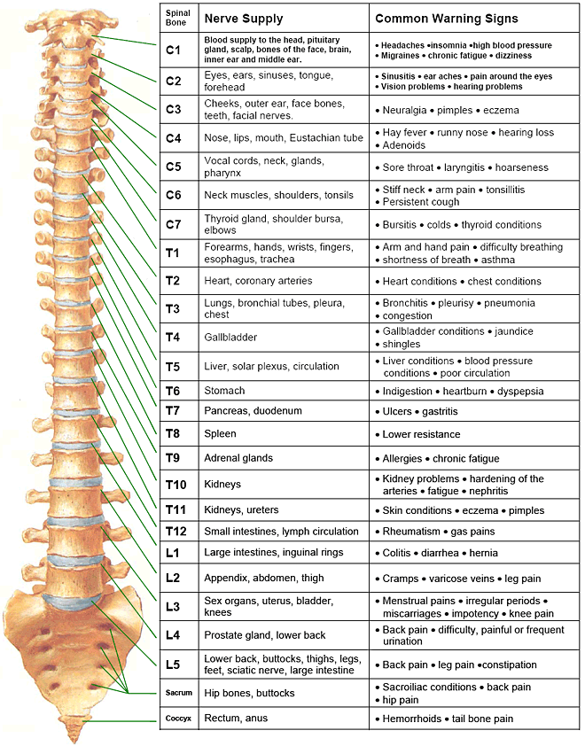

Slide 36
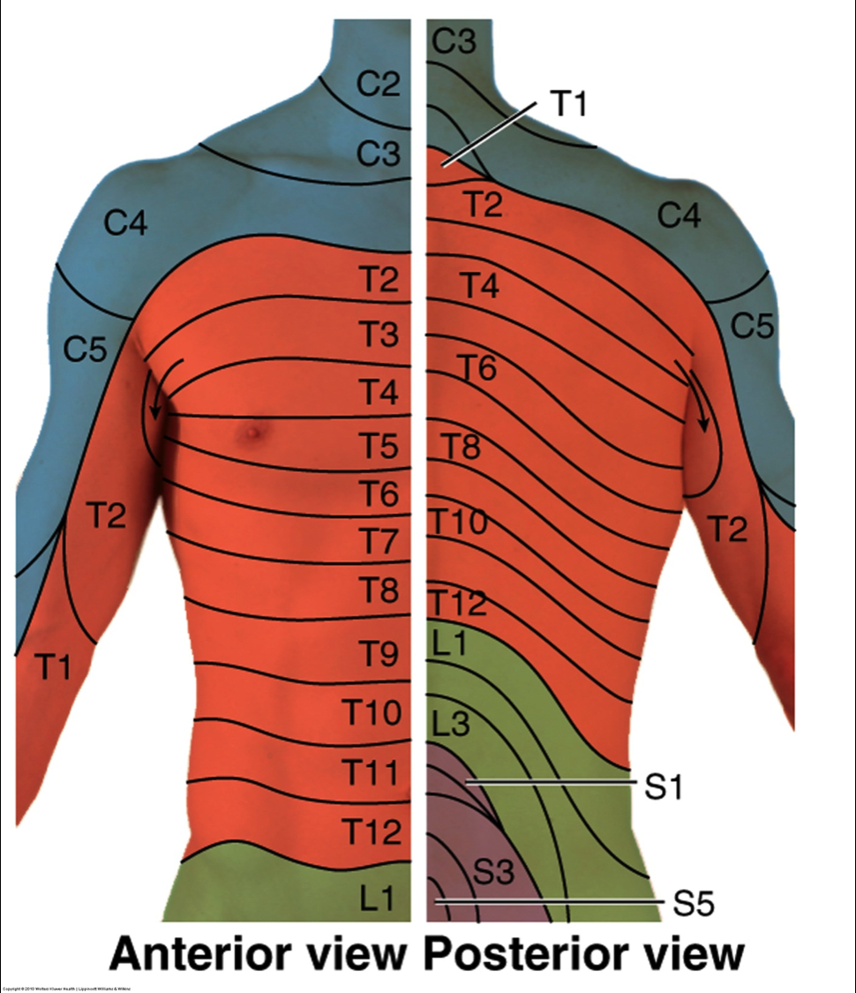
Dermatomes

Slide 37
JOINT PLAY

Slide 38
Flexion, Extension and Side flexion
Patient is sidelying.
Examiner flexes both knees to the patients the chest by flexing the hips.
While palpating between the SP of the Lspine with one hand (finger above and below the SP), passively flex and release the patients hips.
Side flexion and extension are performed in similar manors only substituting flexion for extension or side flexion.

Slide 39
PAUVP, TVP, PACVP
See thoracic notes for method, start L5-L1

