Slide 1
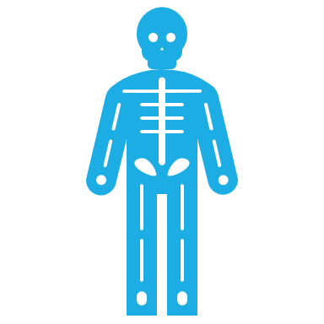
THE HIP AND PELVIS ASSESSMENT
Page 724 & 765

Slide 2
THE HIP JOINT
Largest, Most Stable
Multi Axial Ball and Socket Joint
Resting Position
  30 Degrees of flexion and abduction, and slight lateral rotation
Close packed position
  Full extension, medial rotation and abduction

Slide 3
CAPSULAR PATTERN OF THE HIP
Capsular pattern
  Flexion, abduction and medial rotation
When considering movement be aware whether the pelvis is moving on a stable femur (weightbearing) or femur of the pelvis (non weightbearing)

Slide 4
THE PELVIS ANATOMY
The Pelvis AKA Pelvic Girdle is made up of the two hip (innominate) bones and the sacrum
The innominate bones are made up of three fused bones
The Ilium, Ischium and Pubis
There are five Articulations in the Pelvic Girdle
2 Sacroilliac Joints
2 Coxa articulations
1 pubic joint

Slide 5
JOINTS – SACROILIAC
Synovial and Fibrous diathrodial joint (freely moveable)
The PSIS cover the SI joint completely
Iliosacral motion is when the innominates move on the sacrum
Sacroiliac motion is when the sacrum moves on the innominates
During Iliosacral motion the innominates rotate anterior and posterior during the walking cycle
Sacroiliac motion will be addressed during the Sacrum Lesson

Slide 6
SI JOINT
Resting Position – Neutral
Capsular Pattern – Pain when joints are stressed
Close Pack- Nutation
Open Pack – Counter nutation
https://youtu.be/ycKM-Kw2H2s

Slide 7
JOINT – PUBIC JOINT
AKA Pubic Symphysis
Located anteriorly between pubic bones
Fibrocartilaginous amphiarthrosis Joint held together by the Pubic Ligament
Does allow limited movement
Has an interpubic disc between the joint surfaces
  a cartilage disc which allows compression of the innominates without affecting the axis of the plane of motion
Dysfunction of this joint will affect proper motion of the pelvis

Slide 8
FUNCTIONS OF THE PELVIS
The Pelvis has a couple very important functions in the body
  Supports the weight of the body and transfers that through the femurs are down the body
  Protects the viscera
  Provides attachment sites for muscles travelling up the back and down the leg
  The motions of the pelvis ( and lower back) are important for correct gait
  Transfers impact from the ground to the vertebral column

Slide 9
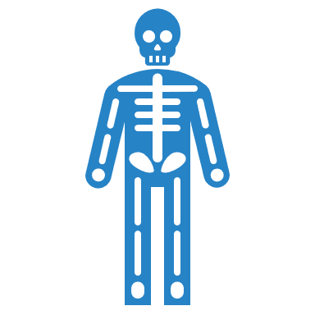

ILIOSACRAL MOTION DURING GAIT
Summary
Factors that affect Gait
The innominate on the opposite side of the forward leg is rotated anteriorly
The innominate on the opposite side of the leg that is posterior is rotated posteriorly
Imbalances of the muscles used in the walking cycle
Imbalances in the pubic symphysis can effect the SI Joint and vice versa

Slide 10
SI JOINT MOTION VIDEOS
SI Motion
https://youtu.be/xxktB0kqIeY
Sacral motion
https://youtu.be/ycKM-Kw2H2s

Slide 11





FORCES ON THE HIP
Standing: 0.3 times the body weight
Standing on one limb: 2.4-2.6 times the body weight
Walking: 1.3-5.8 time the body weight
Walking upstairs: 3 time the body weight
Running: 4.5+ time the body weight

Slide 12
ALL OF THE MUSCLES THAT ATTACH ONTO THE PELVIS
Latissimus Dorsi Psoas Major
Erector Spinae Iliacus
Multifidus Glute Max/Med/Min
External Oblique Obturator In/Ex
Internal Oblique Piriformis
Transverse abdominus Gemellus sup/inf
Rectus Abdominus Pectineus
The semi’s & biceps Sartorius
QL/TFL AD mag/long/brevis
Rectus Femoris Gracilis

Slide 13
HIP LIGAMENTS
Iliofemoral Ligament
  Strongest ligament in the body
  Prevents excessive extension
  Limits IR
  Anterior pelvic tilt slackens inferior/medial bands=increased hip ABD (posterior tilt vice versa)

Slide 14
HIP LIGAMENTS
Ischiofemoral
  Weakest
  Helps stabilize joint in extension
  Limits IR

Slide 15
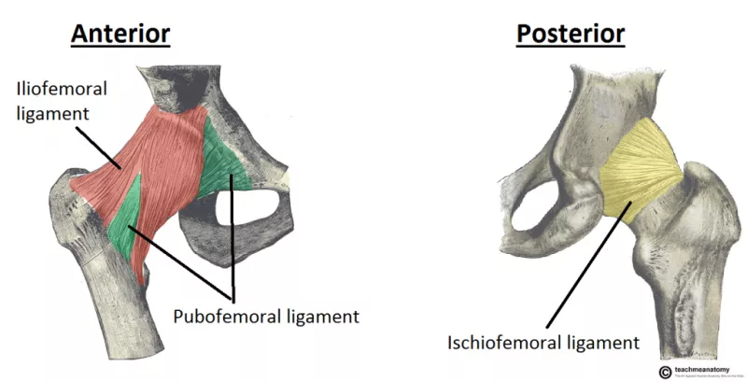
HIP LIGAMENTS
Pubofemoral
  Limits extension and excessive ABD
  Limits Internal rotation

Slide 16
HIP LIGAMENTS
Ligamentum Teres (Ligament to the head of femur)
  Attaches to femoral head within acetebulum
  Provides no stability
  Conduit for secondary blood supply to head of femur via obturator artery

Slide 17




PUTTING IT ALL TOGETHER
Ligaments of the hip provide stability for the hip joint
Most limit extension
Why is this important?
What is the significant of an anterior pelvic tilt?

Slide 18
PELVIC LIGAMENTS
Sacrospinpous Ligament
  Ishial spine to the lateral and anterior aspects of the sacrum and coccyx. Stabilizes the innominate to the sacrum and in that way the spine
Sacrotuberous Ligament
  Ischial Tuberosity to the sacrum. Longer and stronger than the sacrospinous Ligament. Same function as sacrospinous

Slide 19
PELVIC LIGAMENTS
Iliolumbar Ligament
  Transverse process of 4th and 5th lumbar vertabrae and attaches to the illiac crest. Stabilizes the innominate to the spine
Inguinal Ligament
  ASIS to the pubic tubercle. Formed by the inferior margin of the external oblique

Slide 20
PELVIC LIGAMENTS
Superior Pubic Ligament
  Travels on the superior surface of the pubic symphysis and unites the pubic bones. Provides superior stability
Inferior Pubic Ligament
  Travels on the inferior surface of the pubic symphysis and unites the pubic bones. Provides inferior stability
https://youtu.be/pskEkYof95w

Slide 21
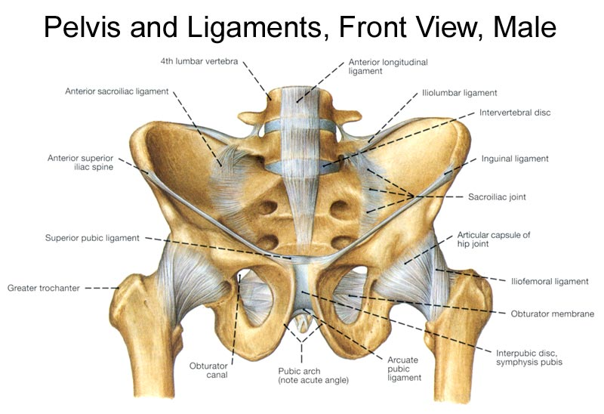

Slide 22
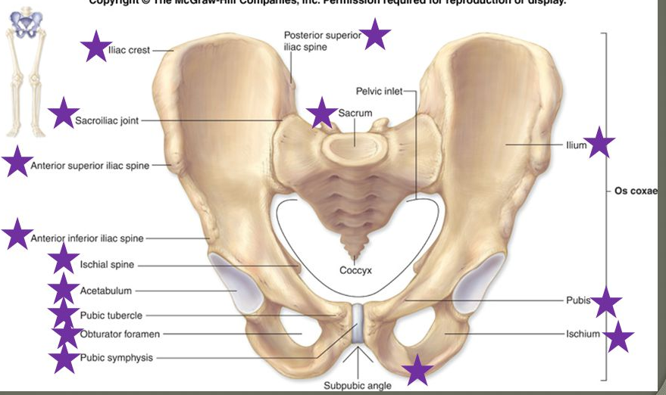
BONY LANDMARKS

Slide 23
AXES OF MOTION IN THE BODY
An axis is an imaginary line that run through the center of an object
In the body Joint motion occur around these Axes
There are 3 Axes in the body
  X aka Transverse Axis
  Y aka Longitudinal Axis
  Z aka Sagittal Axis
Occasionally we use 2 oblique Axis known as Oblique axis which are named from an anterior view Right and Left
Axes occur at right angles to the planes of the body

Slide 24
X AXIS
X axis travel from left to right
Motion occurs around the axis from top to bottom
Or across the axis left to right (or reverse☺)

Slide 25
Y AXIS
The Y Axis travels from top to Bottom
Rotation occurs right to left
Movement can occur up or down the axis

Slide 26
Z AXIS
The Z Axis Travels From front to back
Rotation occurs clockwise or counterclockwise
Movement can occur back to front

Slide 27

PLANES AND AXIS VIDEO
https://youtu.be/yq8cE-EDtuE

Slide 28





SI JOINT AND INTRODUCTION TO ITS AXES
The shape of the SI joint is known as Auricular (ear like)
The Iliac surface is Convex
The Sacral surface is slightly concave
As we age the surfaces have more irregular ridges and depressions
The SI Joint has 3 Transverse axes that run through it which allow for different movements. For now the motion at the inferior transverse axis is our focus for iliosacral motion

Slide 29
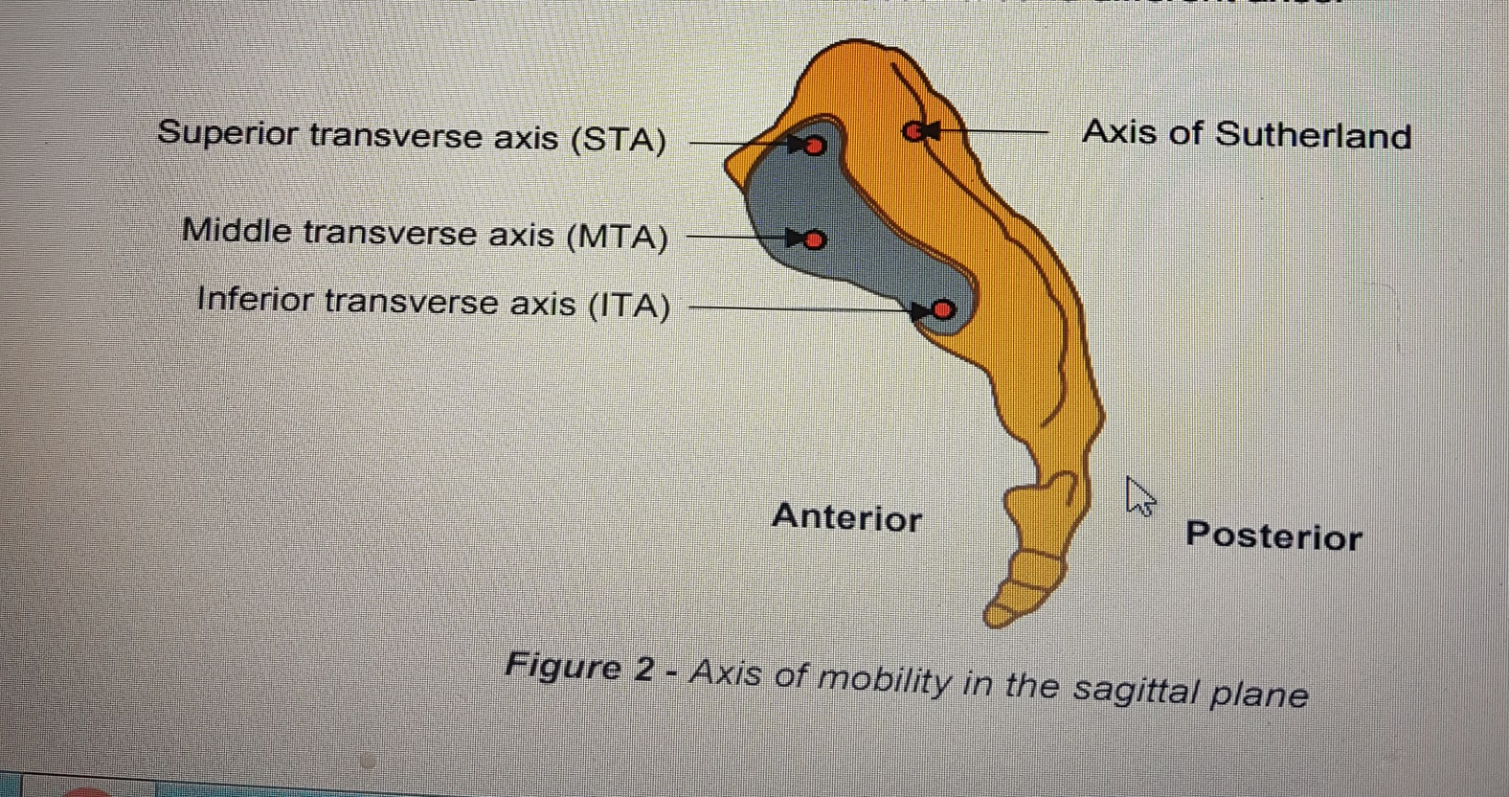
SI JOINT AXIS

Slide 30
ANGLE OF TORSION
The angle between the femoral neck and transverse femoral condyles
8-15 degrees is normal
Anteversion vs. retroversion
  Greater than normal=anteversion (medial femoral torsion)
  Less than normal =retroversion (lateral femoral torsion)
Femoral anteversion is forward torsion of the femoral neck in relation to the coronal plane

Slide 31
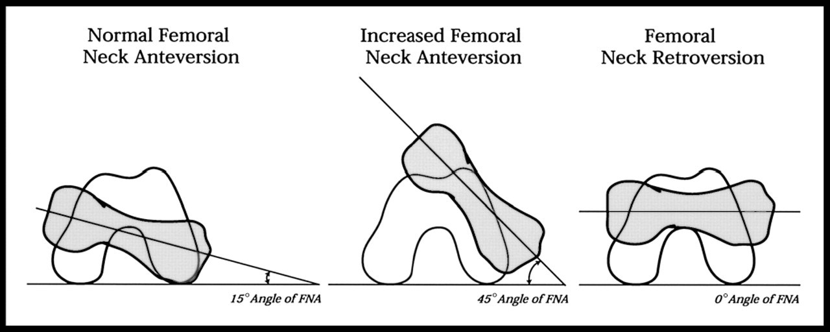
ABNORMAL ANGLES
M. Tannast, In- & out-toeing: a reliable diagnostic sign for femoral malversion?, Hip Symposium 2018 - YouTube

Slide 32
IMPLICATIONS ON LOWER EXTREMITY
Femoral anteversion is characterized by increased anteversion of the femoral neck relative to the femur
compensatory internal rotation of the femur
lower extremity intoeing
Excessive Femoral retroversion
Retroverted femoral head with the foot straight. In this position, the neck of the femur impinges on the front of the acetabulum.
Most patients with hip retroversion compensate by walking with an out-toeing gait to avoid hip impingement and pain.

Slide 33
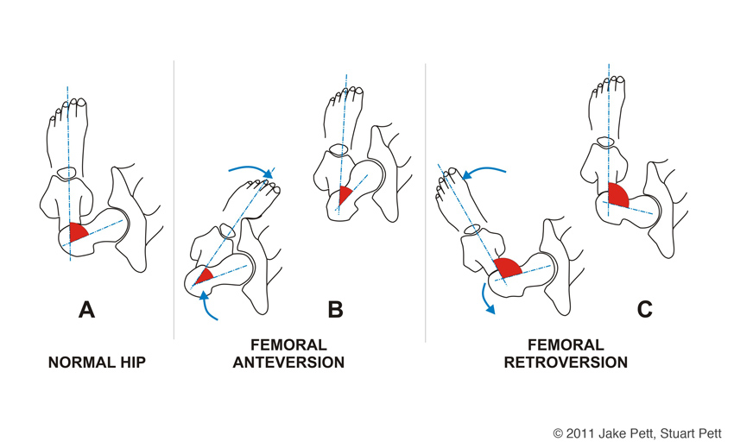
ANTEVERSION, RETROVERSION AND THE LOWER LIMB

Slide 34
FEMORAL ANTEVERSION
https://youtu.be/NHE4kH1RRig

Slide 35
CRAIG’S TEST
Patient prone, knee flexed to 90, examiner palpates the posterior, the hip is then passively rotated medial and lateral until the greater trochanter is parallel with the examiners table or reaches its most lateral position, the degree of anteversion can then be estimated, based on the angle of the lower leg with the vertical
Pg 793
https://www.youtube.com/watch?v=QNtBBV-DcBI

Slide 36
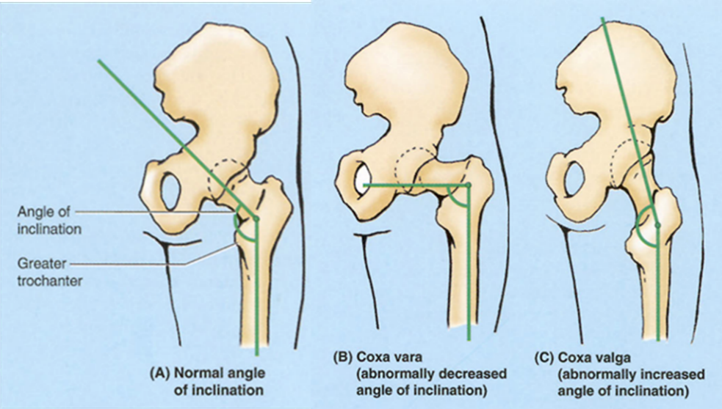
ANGLE OF INCLINATION
Angle between long axis of femoral shaft and the femoral neck

Slide 37
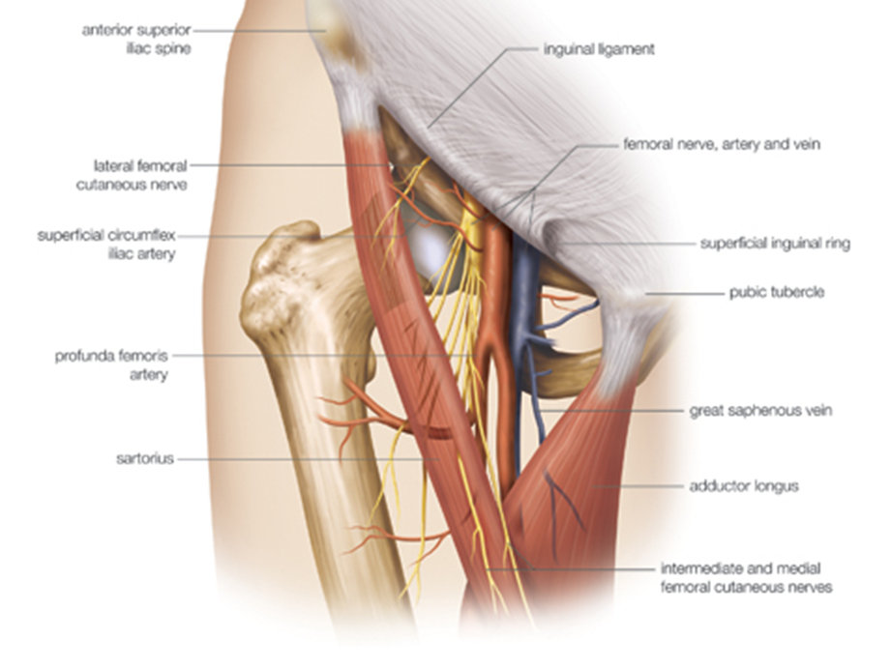
Femoral Triangle

Slide 38
FEMORAL TRIANGLE
The femoral triangle is a hollow area in the anterior thigh. Many large neurovascular structures pass through this area, and can be accessed relatively easily. Thus, it is an area of both anatomical and clinical importance.

Slide 39
BORDERS OF FEMORAL TRAINGLE
As this area is a triangle, it has three borders:
Superior border – Formed by the inguinal ligament, a ligament that runs from the anterior superior iliac spine to the pubic tubercle.
Lateral border – Formed by the medial border of the sartorius muscle.
Medial border – Formed by the medial border of the adductor longus muscle. The rest of this muscle forms part of the floor of the triangle.
Note: Some sources consider the lateral border of the adductor longus to be the medial border of the femoral triangle. However, the majority state that it is the medial border of the adductor longus – and this is definition we have gone with.

Slide 40
CONTINUED
It also has a floor and a roof:
Anteriorly, the roof of the femoral triangle is formed by the fascia lata.
Posteriorly, the base of the femoral triangle is formed by the pectineus, iliopsoas and adductor longus muscles.
The inguinal ligament acts as a flexor retinaculum, supporting the contents of the femoral triangle during flexion at the hip.

Slide 41
CONTENTS
The femoral triangle contains some of the major neurovascular structures of the lower limb. Its contents (lateral to medial) are:
Femoral nerve – Innervates the anterior compartment of the thigh, and provides sensory branches for the leg and foot.
Femoral artery – Responsible for the majority of the arterial supply to the lower limb.
Femoral vein – The great saphenous vein drains into the femoral vein within the triangle.

Slide 42
CONTINUED
  FEMORAL CANAL – A STRUCTURE WHICH CONTAINS DEEP LYMPH NODES AND VESSELS.
  THE FEMORAL ARTERY, VEIN AND CANAL ARE CONTAINED WITHIN A FASCIAL COMPARTMENT – KNOWN AS THE FEMORAL SHEATH.

Slide 43
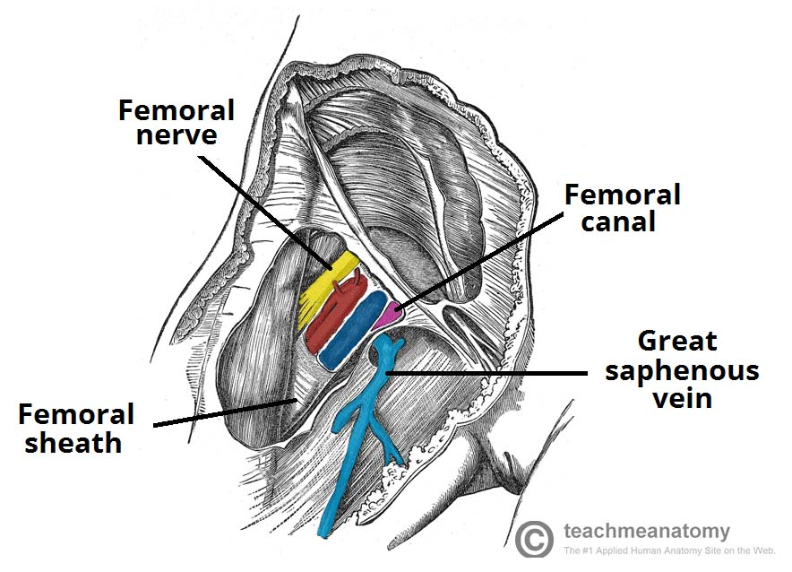

Slide 44
REMEMBER IT!!
A good way of remembering the contents is using the acronym NAVEL:
N: Nerve.
A: Artery.
V: Vein.
E: Empty space (this is important as it allows the veins and lymph vessels to distend, so they can cope with different levels of flow).
L: Lymph canal.
Source – Teach me anatomy

Slide 45
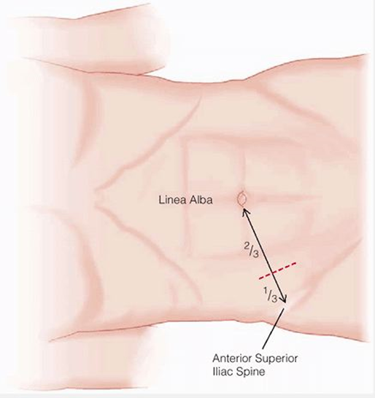
MCBURNEY’S POINT
Line from ASIS to umbilicus, one third of way from ASIS is McBurney’s point
If tender can indicate appendicitis
756

Slide 46
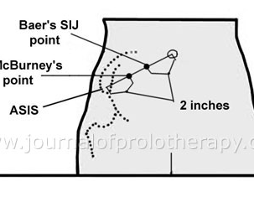
BAER’S POINT
Slightly medial to McBurney’s point
Tender with infection, SI ligament strains, iliacus spasm
756

Slide 47

CLIENT HISTORY
Pg. 729 pelvis
Pg. 769 Hip

Slide 48
Group read
Pg. 729 pelvis
Pg. 769 Hip

Slide 49
ADDITIONAL QUESTIONS
When dealing with hip conditions here are some useful questions that may be helpful to determine possible dysfunction or pathology
  Be aware of clients age – different conditions affect different ages, ROM decreases with age, osteoperosis in elderly, congenital conditions in children
  What is the mechanism of injury if traumatic? (knowing the mechanism often leads to determination of dysfunction)

Slide 50
What are the details of the present pain and other symptoms?
  Hip intra-atricular pain, including labral tears and anterior impingment – felt mainly in the groin and along front and medial side to the knee
  Posterior labral tears, and lumbar problems generally presents as buttock pain
  Adductor pain can be the result of pelvic instablilty or overactive adductors
  Pain in the lateral hip may be referred from the lumbar spine. Further causes of lateral hip pain can be trochanteric bursitis, tear of glut medius tendon, may simulate L4 nerve root pain.
  Sports hernias – come on gradual, unilateral dull aching pain in groin, can be sharp or burning, may radiate into proximal thigh, low back, lower abdominal muscles, perinuem and scrotum. Aggravated by sudden acceleration, cutting or kicking

Slide 51
Is the condition improving, worsening or staying the same?
Does any type of activity ease the pain or make it worse?
  Trochnteric bursitis – poor running mechanics generally cause it
Any movements that feel weak or abnormal?
  Piriformis symdrome traps sciatic nerve weakness occurs in abduction and lateral rotation
What are the patients usual acitivty?
  Repetive or strained positions causing the issue
Past medical, surgery or development issues?

Slide 52
OBSERVATION/ PALPATION
Are the posture or gait normal?
  Counternutation= anterior rotation of the illium
  Nutation= posterior rotation of the illium
Are the ASIS level?
  This will tell you to proceed to specific muscle length tests
Are the PSIS Level?
  If ASIS and PSIS are higher on 1 side this indicates and upslip or short leg
  If ASIS is higher on 1 side and PSIS is lower on the other this indicates an anterior torsion of the sacrum
Are the ischial tuberosities level?
  If one is higher this indicates an upslip on the higher side
Are the sacral sulci equal?
  If one is deeper this indicates a sacral torsion

Slide 53
AROM/PROM DEGREES OF MOTION (HIP)
Flexion- 110-120
Extension- 10 - 15
ABD- 30-50
ADD- 30
ER- 40-60
IR- 30-40
Additionally we would include ROM Testing of lumbar spine

Slide 54
ENDFEELS
Flexion – Tissue Stretch or approximation
Extension – Tissue Stretch
Abduction – Tissue Stretch
Adduction Tissue approximation or stretch
IR/ER – Tissue Stretch

Slide 55
RIM
Flexion
Extension
ABD
ADD
ER
IR
Knee flexion
Knee extension

Slide 56
FUNCTIONAL TESTS OF THE HIP
Squatting
Going up and down stairs one at a time
Figure 4
Going up and down stairs 2 or more at a time
Running straight ahead
Running and decelerating
Running and twisting
One leg hop
jumping

Slide 57
SPECIAL TESTS
SI Joint Tests

Slide 58
INDICATIONS FOR PELVIC ASSESSMENT
Pain in the SI Joint
Leg length difference
Restrictions at the hip
Positive Standing flexion test
Tibial Conditions
Lumbar conditions
Sacral Conditions

Slide 59
TESTS TO RULE OUT SEVERE PATHOLOGY
  Valsalva
  Slump Test
  Well Leg straight leg
  Why and when do we choose to use these?

Slide 60
VALSALVA
Performed to assess for the possibility of disc Pathology
How its done?
  Ask client if the experience the pain reoccur or become more severe while bearing down to have a bowel movement
Positive Sign?
  A positive response to the questioning

Slide 61
SLUMP TEST
How its done?
  Client seated on the edge of the table
  Examiner asks client to flex one hip, extend knee and dorsiflex their foot without bending their knee, then have the client slump forward
Positive Sign
  Recreation of pain (pain, numbness and tingling low back and down leg)
    https://youtu.be/HFGfP84uwEo

Slide 62
WELL LEG/STRAIGHT LEG
The well leg/straight leg test can provide a lot information on a patients condition including
  Hamstring length
  Sciatic nerve
  Lumbar Spine for disc pathology
How its done?
Client supine, legs extended
Next move to the affected leg, grasp ankle and elevate leg to the point where pain is felt again, ease off elevation and then Dorsiflex the foot, if pain returns it indicates Sciatic Condition
Examiner Grasps the ankle of the uninvolved leg. Elevate to the point where pain is felt. If the pain radiates to the opposite leg this indicates Disc Pathology
If Dorsiflexion does not recreate pain then it is indicative of Hamstring Dysfunction

Slide 63
DETERMINING ANATOMICAL SHORT LEG
If a client has a low illiac crest and a corresponding low Greater Trochanter on the same side it is determined that they have an anatomical short leg.
Low Illiac crest and = GT’s indicate possible pelvic imbalance
=Illiac crest and low GT indicate possible pelvic OR Hip imbalance
Low illiac crest on one side and GT on the other indicates Pelvic or Hip imbalance

Slide 64
WEBER-BARSTOW MANEUVER
How its done?
  Stand at pt. feet, palpate the distal aspect of the medial malleoli with your thumbs.
  Pt. lifts hips and the places them back down (resetting the pelvis)
  Passively extend pt. legs and compare the medial malleoli.
  To measure just femoral length do not extend the legs. Look at the heights of the knees when hips and knees are flexed.
Positive Sign
  Medial malleoli higher than other side
  https://www.youtube.com/watch?v=K2VWpuqDQjU
pg 807

Slide 65
STANDING FLEXION TEST
How its done?
  Client standing
  Therapist positioned behind client, eyes level with PSIS, place thumbs on the inferior surface of PSIS
  Have Client flex slowly forward as far as comfortable
  Therapist notes which side travels the greatest distance

Slide 66
SEATED FLEXION TEST
Performed in the same way as standing only client is now seated
Seated flexion helps rule out false positives based on hamstring involvement is now taken out.
RESULTS – If the Test now shows equal movement we know that hamstrings are involved ON THE SIDE THAT HAD THE LEAST MOVEMENT in standing flexion. This is due to tight hamstrings not allowing the innominate to move in the same way as the unaffected side

Slide 67
STANDING/SEATED FLEXION TEST RESULTS CONT.
Possible results include
  +R Standing +R Seated = Right side dysfuction
  +R Standing = Seated = Hamstrings on Left
  +R Standing +L Seated = Possibility of pelvis and sacral dysfunction
  If Hamstrings are indicated proceed next with a passive test of hamstrings

Slide 68
SIJ

Slide 69
GILLET’S TEST
Gillet
  Method:
  client standing, palpate PSIS’s with one hand the other thumb parallel on sacrum.
  Patient asked to stand on one foot while lifting the other to the chest. (they may be close to a wall and face it if needed for stability)
    Normally this cause the innominate to rotate posteriorly thusly the psis would become lower than the thumb on the sacrum
  Positive: PSIS moves superiorly or has no movement
  https://www.youtube.com/watch?v=dvhvKXnXAac
747

Slide 70
GAENSLEN’S TEST
Method:
client side lying on unaffected side and holds unaffected leg flexed to chest
Therapist stabilizes pelvis and extends hip of the upper leg
Positive: Pain or reproduction of symptoms
  Indicates - Ipsilateral joint lesion, hip pathology or L4 nerve root lesion
  https://www.youtube.com/watch?v=aXLig1qoPKo
  746

Slide 71
FABER (PATRICK TEST)
Method: Patient supine, place test ankle over unaffected knee stabilize contralateral hip and lower test knee
Positive: Test leg remains above opposite straight leg indicates: hip pathology, Iliopsoas spasm, or SI Joint pathology
https://www.youtube.com/watch?v=89Qiht82zmg
798

Slide 72
YEOMAN’S TEST
Method
  client prone
  therapist flexes clients knee to 90 degrees and extends hip
Positive?
  Localized pain to SI Joint indicates pathology in the anterior sacroiliac ligaments
  Lumbar pain indicates lumbar involvement
  Anterior thigh pain may indicate femoral nerve stretch
  https://www.youtube.com/watch?v=TFdv7dGweR4
  748

Slide 73
IMPINGEMENT TESTS

Slide 74
ANTEROPOSTERIOR IMPINGEMENT TEST
Tests for hip dysplasia, slipped capital femoral epiphysis, and femoroacetabular impingment
Patient is supine with hips flexed to 90°
Examiner medially rotates and adducts the hip.
+= pain
861

Slide 75
POSTEROINFERIOR IMPINGEMENT TEST
Test for global acetabular over coverage, global femoral neck offset abnormalities and posterior acetabular cartilage damage.
Pt. lies supine with the legs hanging over the edge of the plinth to ensure maximum hip extension.
Examiner laterally rotates hips quickly.
+= deep seated groin or buttocks pain
802

Slide 76
LIGAMENT TESTS

Slide 77
POSTERIOR SIJ LIGAMENT TESTS
Squish Test
  Method: client supine, compress ASIS together
  Positive: LBP, reproduction of symptoms
Approximation
  Method: client side lying, press uppermost iliac crest towards table
  Positive: LBP, reproduction of symptoms
  Video has some discrepancies. We do not do 3 thrust we only do one compression of moderate pressure
  https://www.youtube.com/watch?v=pWjvrhWMR4w

Slide 78
ANTERIOR SIJ LIGAMENT TEST
Gap Test
  Method: client supine, separate ASIS with arms crossed
  Positive: reproduction of symptoms – only positive if unilateral gluteal or posterior leg pain is produced. INDICATES – sprain of Anterior Sacroiliac joint Ligament

Slide 79
LABRAL LESION

Slide 80
ANTERIOR LABRAL TEAR (FADDIR) TEST
Tests for anterior-superior impingement syndrome, anterior labral tear and iliopsoas tendinitis
Pt. in supine position, examiner takes the hip into full flexion, lateral rotation, and full abduction as a staring position.
Examiner then extends the hip, combined with medial rotation and adduction.
+ = production of pain, recreation of symptoms with or without a click, or apprehension.
https://www.youtube.com/watch?v=xyJUIhsL4lg

Slide 81
LUMBAR NERVE ROOT COMPRESSION
TESTS

Slide 82
WELL LEG/STRAIGHT LEG, PRONE KNEE BEND
  Followed after Well leg/straight Leg
Positive: pain in low back or leg
Prone Knee Bend (PKB)
  Method: client prone, flex clients knee to end range
  Positive: anterior thigh/hip pain dysfunctional rectus femoris, LBP L3 nerve compression

Slide 83
HIP PATHOLOGY TESTS

Slide 84
FABER, QUADRENT
TEST (HIP SCOURING TEST)
Fabers
  Positive: hip pain, LBP, reproduction of symptoms – Indicates hip pathology, SI joint pathology or iliopsoas spasm
Quadrant
  Method: Client supine, flex hip to 90 and IR/ER while in adduction and abduction while maintaining the hip in flexion
  Positive: hip pain, clicking, grinding – indicates hip pathology and the approximate location of dysfunction
  https://www.youtube.com/watch?v=MX7hlrS_m3Y

Slide 85
MUSCLE LENGTH TESTS

Slide 86
THOMAS TEST
How its done?
  Client supine, feet on edge of table
  Have client bring one knee to chest and hold
  Observe the extended leg
Positive Sign
  test leg moves into ABD (tight ITB)
  knee does not remain extended(tight quad)
  test hip lifts off table (psoas)
https://youtu.be/NMDd-4NspHs

Slide 87
90/90 STRAIGHT LEG TEST
How its done?
  Client supine hips and knees flexed to 90, clients hands behind their knees
  One at a time have them attempt to extend the knee
Positive Sign
  Client unable to actively extend within 20 degrees of normal knee extension
https://youtu.be/meM4S1vrbpk

Slide 88
TRIPOD SIGN
How its done?
  Client seated knees flexed to 90 over the table
  Examiner passively extends the knee one at a time
Positive Sign
  Client extends or slumps spine to take pressure off the hamstrings
  https://www.youtube.com/watch?v=mRab9U81HSU

Slide 89
PIRIFORMIS TEST
How its done?
  Client side lying
  Affected leg up
  Flex affected hip to 60 knees can be flexed
  Examiner stabilizes hip and presses test knee to the table
Positive sign
  pain in buttock, leg pain
https://youtu.be/zha5jIv4_44

Slide 90
OBER’S TEST
Method: client side lying, stabilize hips while bringing top leg into hip extension with the knee bent, passively lower leg
Positive: leg remains abducted, does not go lower than the table. Indicates ITB Contracture
https://youtu.be/Amjv6FzDeLE

Slide 91
ELY’S TEST
Method: prone knee bend ( passive knee flexion to end range)
Positive: test hip lifts off table as therapist flexes knee
https://www.youtube.com/watch?v=0FgacndWb4Q

Slide 92
MUSCLE WEAKNESS TESTS

Slide 93
TRENDELENBURG SIGN
Tests the Glute Med muscle
How its done?
  Client is standing
  Therapist stands behind client and has them raise one knee. The side being tested is the leg that maintains contact with the floor
Positive sign?
  contralateral hip drops while balancing on ipsilateral leg
    https://youtu.be/0rcczDEWDqU

Slide 94
BARLOW’S TEST
Test for DDH in Newborns- 6 months of age
Infant is supine, legs facing examiner.
Flex hips to 90° and knees are fully flexed
Each hip is evaluated individually, one hand steadies the femur and pelvis.
Middle finger are placed over each GT, thumbs over the inner side of knee and thigh opposite to the LT
Take one hip into abduction, middle finger applies and anterior pressure.
+= if the femoral head slips forward into acetabulum (click clunk or jerk) hip was dislocated
Then examiner thumb to apply a posterior and outward pressure to the inner thigh, if femoral head slips out over the posterior lip of the acetabulum then reduces once the pressure is removed.
This means the hip is unstable. It is not dislocated but it is dislocatable

Slide 95
ORTOLANI’S SIGN
CDH one valid if tested within first few weeks of birth
Infant is supine, legs facing examiner.
Flex hips and grasp the legs so your thumbs are against the inside of the knees and thighs, fingers are along the outside of the thighs to the buttocks.
With gentle traction, the thighs are abducted and pressure is applied against the GT of the femora.
+= if the femoral head slips forward into acetabulum (click clunk or jerk) hip was dislocated

Slide 96
JOINT PLAYS

Slide 97
JOINT PLAY MOVEMENTS OF THE SI JOINT
Cephalad movement of the sacrum with caudal movement of the ilium (left and right)
Caudal movement of the sacrum with cephalad movement of the ilium
Anterior movement of the sacrum on the ilium
Anteroposterior translation ilium on sacrum
Superoinferior translation “ “ “”
Inferoposterior translation
Superoanterior translation

Slide 98
EXPLAINED
Client Prone, heel of hand on iliac crest and heel of hand on apex of sacrum. Apply a superior pressure to sacrum and inferior pressure to Iliac crest
Client prone, heel of hand on ischial tuberosity and heel of other hand on base of sacrum. Apply a superior force on ischial tuberosity and an inferior force at the base of the sacrum

Slide 99
Client prone, heel of one hand over the sacrum and other hand under the ASIS of one side. The hand on the sacrum will apply an anterior pressure while the other hand lifts up, repeat on the other side
Anteroposterior translation of ilium on sacrum – Client supine, One hand placed underneath palpating sacral sulcus to lumbosacral joint. With the other hand apply a posterior pressure through ASIS and iliac crest. Note posterior movement of the ilium end range is when the pelvis is felt to move at L5-S1

Slide 100
Superoinferior translation – client prone, place palpating fingers at sacral sulcus, apply a superior pressure through the ischial tuberosity. End range is when you feel pelvic girdle bend beneath L5 – S1
Inferoposterior translation - Client supine, palpating hand as in scenario 4, with the other hand apply and anterior rotational force to the ipsilateral asis and iliac crest
Superoanterior translation - Client supine palpating hand as above, with the other hand apply posterior rotating force ASIS and Iliac crest

Slide 101
JOINT PLAY MOVEMENTS OF THE HIP
Caudal glide of the femur (long leg traction)
Compression
Lateral distraction
Quadrant test

Slide 102
EXPLAINED
Caudal glide- examiner places both hands around the pt’s leg, slightly above the ankle. Examiner leans back applying a long axis traction/distraction to the entire limb. If knee dysfunction is suspected, place both hand just proximal to the knee and apply traction this way.
Compression- examiner places the pt’s knee in the resting position and the applies a compressive force to the hip through the longitudinal axis of the femur.
Lateral distraction- Examiner applies a lateral force at the hip by placing a wide strap around the leg as high up in the groin as possible. The strap is then wrapped around the examiner's buttocks. The examiner leans back, applying a distraction. The proximal hand is used to palpate the hip or greater trochanter movement, while the distal hand prevents abduction of the leg.

Slide 103
PERIPHERAL NERVE INJURIES

Slide 104
PELVIS
Meralgia Paresthetica
  Result of pressure or entrapment of the lateral femoral cutaneous nerve near ASIS (this nerve passes under the ingiunal ligament)
  May be caused by trauma
    Seat belt in car accident, during delivery
    Tight clothing
    Complication of surgery
  Sensory nerve only so patient experiences sensory alteration or burning pain on lateral thigh

Slide 105
ILIOINGUINAL NERVE
Lies within transverse abdominus, may be compressed by spasm of nerve
Sensory nerve only nerve pain occurs
  Superior aspect of the anterior thigh
  Scrotum or labia
Research shows this nerve may be entrapped with injury to the external oblique (hockey players syndrome)
  Patient feels pain especially on ipsilateral hip extension and contralateral torso rotation
  Pain may radiate into groin, scrotum, hip and back

Slide 106
HIP
Sciatic Nerve
  May be injured anywhere along its path from lumbosacral spine down the back of leg to the knee
  Most COMMONLY injured in the hip
  If injured in pelvis or femur (posterior hip dislocation) – Hamstrings and all muscle below knee results in high steppage gait and inability to stand on heel or toes
  Sensory alteration entire foot minus instep and medial malleolus
  If piriformis is affected pain and weakness on hip abductioni and lateral rotation and stretching pain on medial rotation

Slide 107
SUPERIOR GLUTEAL NERVE
May be compressed as it passes piriformis and inferior border of glute min.
May be injured during hip surgery
Patient complains of
  Acute gluteal pain increases with ambulation
  Hip is often medial rotated
  Weakness of hip abductors = trendelenburg gait
  Tenderness may be palpated lateral to greater sciatic notch

Slide 108
FEMORAL NERVE
Not commonly injured
May be compressed during child birth, anterior dislocation of femur, or during hernia surgery, stripping of varicose veins
Patient not able to flex thigh on trunk or extend the knee, deep tendon reflex is lost, wasting of quad muscles is evident, sensory loss includes medial apsect of the distal thigh and medial aspect of leg and foot

Slide 109
OBTURATOR NERVE
May be compressed as it leaves the pelvis and enters the leg in the obturator tunnel
Injury can be caused by pelvic or hip surgery, pregnancy, fractures or tumors and has been know to be a source of groin pain in athletes
Controls mostly the adductors so adduction will be weak as well as knee flexion (gracilis) and lateral rotation (obturator externus)
Small sensory symptoms involving a small area in the middle medial part of the thigh
Client may also complain of pain form pubic symphysis to medial aspect of the knee

Slide 110
HIP MUSCLES AND REFERRAL OF PAIN

Slide 111
Muscle | Pattern
Iliopsoas | Lateral to Lumbar spine, anterior thigh
Gluteus Maximus | Sacral & Gluteal area to Lateral aspect of pelvis and posterosuperior thigh
Gluteus Medius | Lumbar & sacral gluteal area to lateral aspect of pelvis and upper thigh
Gluteus Minimus | Gluteal area below Iliac crest down lateral aspect of thigh and leg
Piriformis | Sacrum, gluteal area down lateral aspect of thigh and leg
TFL | Lateral thigh
Sartorius | Anteromedial thigh (along the course of the muscle)

Slide 112
Muscle | Pattern
Pectineus | Groin to upper medial thigh
Rectus Femoris | Anterior thigh to knee
Adductor Longus & Brevis | Anterior thigh to middle thigh to anteromedial leg to ankle
Adductor magnus | Groin along medial thigh to above knee
Gracilis | Anteromedial thigh to knee
Hamstrings | Gluteal area along posterior thigh to knee and posteromedial calf

