Slide 1
The Arm and Hand
Stretching and Strengthening

Slide 2
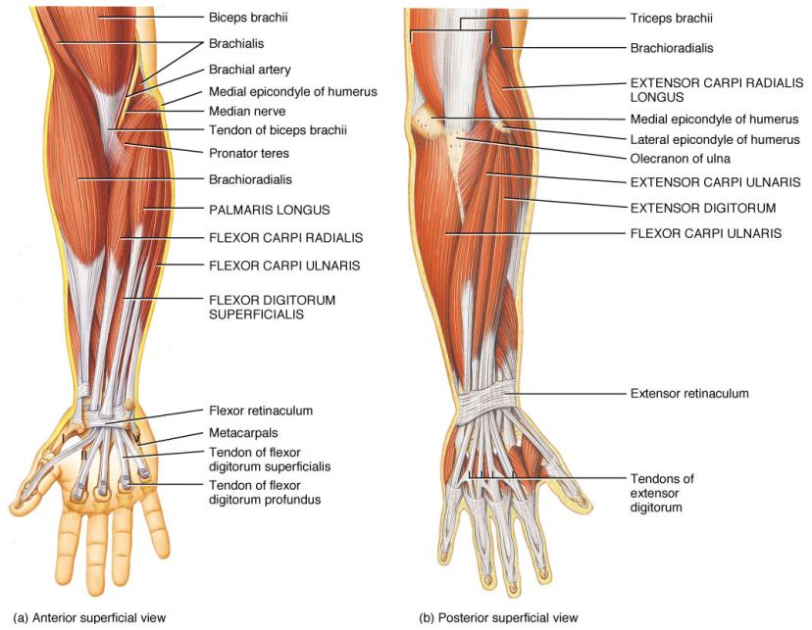

Slide 3
Overuse of Hand & Arm
The most common cause of injury to the hand and arm is Repetitive Strain, (RSI), otherwise known as Occupational Overuse Syndrome (OOS), typically affecting the fingers, hands, wrists and/or elbows. Massage Therapists are an excellent example of a group who are susceptible to this, as are graphic designers, sculptors, gardeners and anyone in a situation where they are working with tools that require gripping and/or sustained positions, as well as tools that are not fitted to their body, cold temps., repetitive movements or work that requires too much speed, without enough recovery breaks.

Slide 4
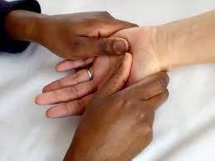

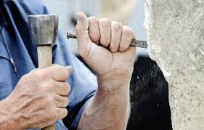
Excessive flexion, extension or gripping seems to be the common factor
in most jobs resulting is RSI.

Slide 5
Symptoms
OOS can result in many different symptoms, including:
Muscle tightness or spasms
Muscle Weakness and/or restricted movement
Swelling, numbness and/or tingling
Muscle discomfort; aches, pains & stiffness
Feelings of hot or cold

Slide 6
If work conditions persist and if left untreated, RSI can lead to:
Carpal Tunnel Syndrome
Tenosynovitis
Epicondylitis
  Lateral Epicondylitis (Tennis Elbow)
  Medial Epicondylitis (Golfer’s Elbow)

Slide 7
Let’s look more closely at these conditions:
Carpal Tunnel: is caused by compression, traction or other forms of irritation of the median nerve, causing swelling of the nerve within the carpal tunnel. This narrowing may result from repetitive use or from conditions such as pregnancy, diabetes, hyperthyroidism or rheumatoid arthritis.
Symptoms: Tingling, numbness, weakness and/or pain in the fingers and hand, possibly even in the forearm.

Slide 8
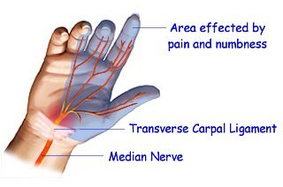

Slide 9
Recommendations:
  Wearing a wrist splint
  Taking frequent breaks from irritating positions
  Cortisone shots
  NSAIDS (Nonsteroidal anti-inflammatory drugs)
  Surgery
  Of course, stretches and exercises are also recommended! Watch this video for 3 great stretches:
  https://www.youtube.com/watch?v=gTxQqu9USC4

Slide 10

You can try the dynamic Spider Stretch….

Slide 11
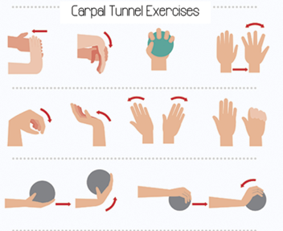
Left-Right:
1. Wrist flexor stretch 2. Wrist Extensor Stretch 3. Ball squeeze
4. Finger spread 5 & 6. Wrist Flexion/extension 7. Waving 8. Finger Curl
9 & 10. Wrist Curls (1-2 lb.
weights.)

Slide 12
Let’s look more closely at these conditions:
Tenosynovitis: Is inflammation of a tendon sheath, or synovium. The most common type of tenosynovitis which affects the hand, is De Quervain’s Disease. The tunnel of the first extensor compartment on the dorsal side of the wrist, (thumb side,) narrows due to thickening of the soft tissues making up the tunnel. This compresses the tendons running through the tunnel. Causes are still up for debate, but overuse may be one of them.
Symptoms: Pain and/or swelling near the base of the thumb, difficulty with grasping or pinching movements, a feeling of “sticking” when moving the thumb.

Slide 13
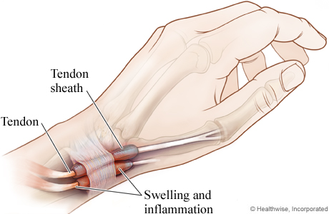

Slide 14
Recommendations:
  Cortisone shots
  NSAIDS
  Splinting
  Surgery to open the tunnel
  Some stretching and/or strengthening techniques

Slide 15
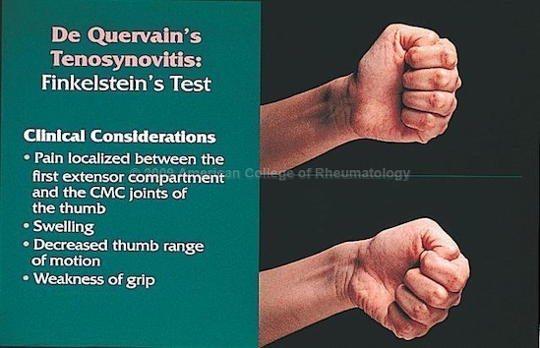
Test for De Quervain’s with Finkelstein’s Test:
-Tuck the thumb inside your fist, hold the fist with the pinky toward the floor and tip the fist forward from the wrist.

Slide 16
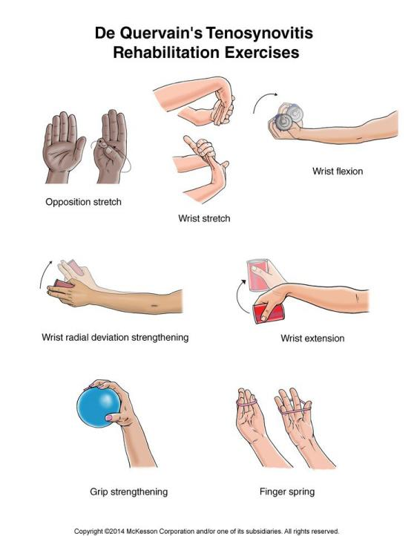

Slide 17
Let’s look more closely at these conditions:
Lateral Epicondylitis (Tennis Elbow): Inflammation of the tendons on the lateral side of the elbow, usually the Extensor Carpi Radialis Brevis. The ECRB extends and abducts the wrist, putting it at risk for repetitive use injury during racquet sports like tennis, or in occupations such as auto mechanic, chef or butcher.
Symptoms: Pain and/or burning on the outside of the elbow, weak grip strength. Symptoms worsen with gripping activities and over time.

Slide 18
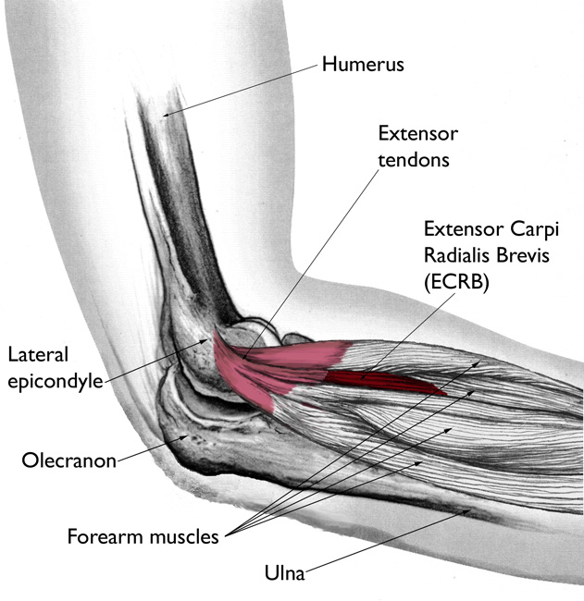

Slide 19
Recommendations:
  Rest
  Physiotherapy/massage/acupuncture
  Forearm brace
  NSAIDs
  Check equipment for proper fit
  Cortisone injections
  Some stretching and/or strengthening techniques

Slide 20
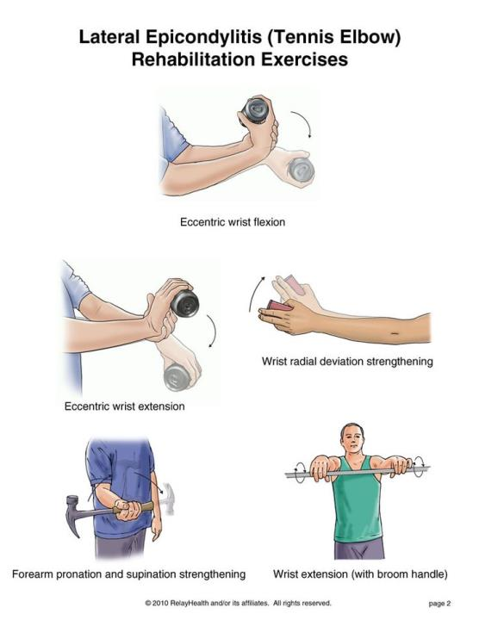

Slide 21
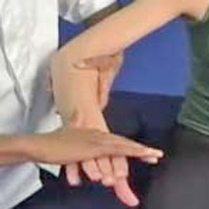
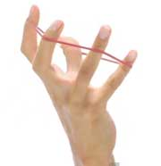
Other Exercises to consider….
Isometric Wrist Extension
Finger Extension with Band

Slide 22
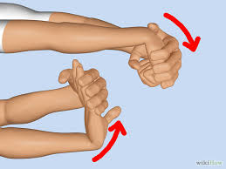
Stretches
Wrist Flexor and Extensor Stretches

Slide 23
Let’s look more closely at these conditions:
Medial Epicondylitis (Golfer’s Elbow): Similar to Tennis Elbow, but on the medial side. Generally a tendinous overload injury that leads to micro-tearing. Pain and inflammation mostly occur at the origin of the wrist flexors on the medial epicondyle of the humerus. Caused by repetitive gripping, carrying, use of a mouse or racket sports.
Symptoms: Pain and/or burning on the ulnar side of the forearm, with pain into the wrist and sometimes the fingers. Grip weakness/pain with gripping. Tightness or weakness of wrist flexors, or tension in the neck are contributing factors as well.

Slide 24
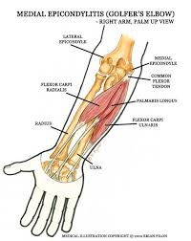

Slide 25
Recommendations:
  Physiotherapy/massage
  Forearm brace
  NSAIDs
  Ice
  Check equipment for proper fit
  Cortisone injections
  Some stretching and/or strengthening techniques

Slide 26
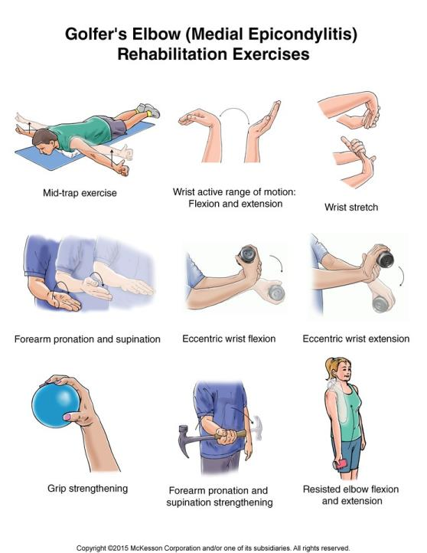

Slide 27
Sources
http://myphysiosa.com.au/golfers-elbow-physiotherapy/
http://www.physio-pedia.com/Medial_Epicondylitis
http://Emedicine.medscape.com/article/2189339-overview
www.assh.org/handcare/hand-arm-conditions/de-quervain-syndrome
www.physioworks.com.au/injuries-conditions-1/golfers-elbow
Orthoinfo.aaos.org
Healthline.com
Physiopedia.com

