Slide 1
EXERCISES OF THE TRUNK
INSTRUCTION GUIDE

Slide 2
BENT KNEE FALL OUT
This exercise is intended to increase pelvic stability while rotating the thighbone in the hip socket.
To do this exercise you will need a mat. Start by lying on your back with your knees bent and your feet planted in the ground. Inhale as you drop one knee to the side rolling onto the side of the foot, and then exhale as you return that knee to its original position. Then repeat the same motion on the other side.
Things to think about
The goal of this exercise is to move the leg without moving the pelvis, so as you drop the leg to the side it is important to use the pelvic floor and lower abdominals. You want to imagine the thighbone rotating in the socket without moving the pelvis. Keep the range of motion as small as necessary. If your inner thighs are tight then you won’t be able to lower the leg very far before the inner thighs overpower the pelvic floor and low abs.https://youtu.be/Uk3Ve2Nsu4U

Slide 3
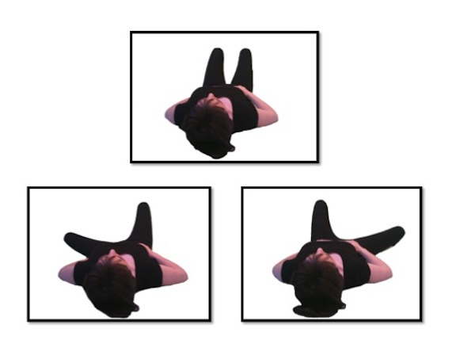
BENT KNEE FALLOUT

Slide 4
HEEL SLIDE
Lie down on the floor or the bed with your leg flat.
Slowly begin to slide your heel toward your buttocks, keeping your heel on the floor or bed. Your knee will begin to bend.
Continue to slide your heel and bend your knee until it becomes a little uncomfortable and you can feel a small amount of pressure inside your knee.
Hold this position for about 6 seconds.
Slide your heel back down until your leg is straight on the floor or bed.
https://youtu.be/38xz_sRgj8Q

Slide 5
BRIDGE
Lie down on your back. It's recommended that you use a yoga mat for this exercise. As you lie down, make sure to keep your knees bent and hip distance apart, and the soles of your feet planted firmly on the floor. Walk your heels back as close to your buttocks as possible. If it is easier, scoot your buttocks toward your heels. You'll need to use the strength of your feet and your glutes to help you lift up. arms at your sides. You can lie with your elbows turned inward and your palms up, just a few inches away from your hips to help stabilize your core. Draw your shoulder blades together to pull your shoulders back toward the floor. Alternately, you can also place your hands and your elbows down.
Lift your hips toward the ceiling. As you do this, make sure to tilt your pelvis and to pull your belly button toward your spine to engage your transverse abdomens. Press your feet into the floor and lift your hips to the ceiling as high as is comfortable. Think of it as lifting your hips to the sky or the ceiling. As you lift, you should squeeze your buttocks to make them more firm, but not harden them too much.
Keep your knees and thighs parallel. Do not let them splay out to the side or you can injure your knees and your back. Keep your shoulders on the floor to protect your neck. Remember to pull your shoulders into the mat as you lift up Hold the pose for 5 full breaths and release back to the start position. Make sure to relax your rib cage as you do this. Gently lower yourself down, doing it slowly so you don't collapse onto your back and neck. Slide your feet down a bit until you are comfortably on the floor

Slide 6
BRIDGE VIDEO
https://youtu.be/_leI4qFfPVw
https://youtu.be/oje869YCAL4

Slide 7
DEAD BUG
Lie flat on your back with your arms held out in front of you pointing to the ceiling. Then bring your legs up so your knees are bent at 90-degree angles. This is your starting position, and it’s vital to get your back as flat against the floor as possible. You shouldn’t be able to get a hand in between your back and the floor, and you need to maintain this position.
Slowly lower your right arm and left leg at the same time, exhaling as you go. Keep going until your arm and leg are just above the floor, being careful not to raise your back off the ground. Then slowly return to the starting position and repeat with the opposite limbs.
https://youtu.be/g_BYB0R-4Ws

Slide 8
AB PREP
Laying on your back in Supine. Pelvis is in neutral, with your ribs connected to the floor and pelvic floor is lifted to engage Transverse. Your arms are straight down by your sides. Make sure your scapula are set in neutral, there is a tendency to depress and protract your shoulders.
INHALE: Nod chin to chest. Think of lengthening the back of the neck to bring it in line with your thoracic spine. This should not be a forced movement, it should be gentle and there should still be space between your chin and your chest.
EXHALE: Flex forward, reaching your hands to your feet and bringing your head forward with your shoulders as 1 unit. Feel the space in your lower back and a sensation of pulling your ribs toward your hips.
INHALE: hold the flexion
EXHALE: lower yourself back down to the floor, feeling a sense of lengthening of the abdominals.
Modification: If your neck strains during this exercise, you may have to support the head by bringing your hands behind your head to help support the neck as you flex forward. Make sure you do not pull with your hands. Elbows should be up so you can see them out of the corner of your eyes.
https://youtu.be/k9zKNDlLk30

Slide 9
CLAM SHELL
Lie on your right side with your feet and hips stacked, your knees bent 90 degrees, and your head resting on your right arm.
Draw your knees in toward your body until your feet are in line with your butt. Place your left hand on your left hip to ensure it doesn’t tilt backward. This is your starting position.
Keeping your abs engaged and your feet together, raise your left knee as far as you can without rotating your hip or lifting your right knee off the floor.
Hold for 1 second, squeezing your glutes at the top of the move, before slowly lowering your left knee to the starting position.
Continue for a total of 20 reps, then repeat on the other side
https://youtu.be/rDLd81bzxwc

Slide 10
SIDE LEG LIFT
Lie down on one side. The arm that's closest to the floor should be extended straight above your head and shoulder while your other arm is bent with your hand on your hip. Your legs should be extended and stacked on top of one another.
Slowly raise your top leg as high as you can. Pause, then return to the starting position.
https://youtu.be/Dha6wZbFLbY

Slide 11
PRONE LEG EXTENSION
Step 1: Lay down on your stomach. Place your hands together on the floor under your chin. Rest your chin on your hands.
Step 2: Spread your knees as far apart as you can on the floor and bring your feet up so that your toes are pointed toward the ceiling.
Step 3: Bring your feet together in the air so that your big toes are touching. This is the starting position.
Step 4: Begin exercise by raising your thighs off the ground.
Step 5: Next, while keeping your thighs up off the ground, extend your feet out so that your legs become straight.
Step 6: Reverse the motion back in so that your toes touch. This completes one rep.
https://youtu.be/m91Q9awbHtE

Slide 12
SWIMMER
Lie on your stomach with the legs straight and together.
Stretch your arms straight overhead, keeping your shoulder blades settled in your back and your shoulders away from your ears,
Pull your abs in so that you lift your belly button away from the floor.
Extend your arms and legs so far in opposite directions that they naturally come up off the floor. At the same time, lengthen your spine so that your head moves up off the mat as an extension of the reach of your spine.
Pump your right arm and left leg up and down in a small pulse, continuing to reach out from your center. Alternate right arm/left leg and left arm/right leg pulses.
Breathe in for a count of 5 kicks and reaches, and out for a count of 5. This should feel like swimming in a pool
https://youtu.be/C2l18H6PX1g

Slide 13
FOUR POINT KNEELING EXERCISES
http://farm3.clik.com/blizard/section821227_334412.html
https://youtu.be/csLWndyvW-0

Slide 14
PLANKS
https://youtu.be/DHvSGdCIZyQ
https://www.pelvicexercises.com.au/plank-exercise/

Slide 15
HIP RAISES
Lie on your back on the floor with your knees bent and your feet flat on the floor.
Place your arms out to your sides at a 45-degree angle.
Brace your core--imagine you're about to be punched in the guts--squeeze your glutes tightly. Then raise your hips so your body forms a straight line from you shoulders to your knees. Pause for fives seconds--as you keep your core braced and continue to squeeze your glutes--then lower body back to the starting position.
Key pointer: Your torso and hips should move as one unit. So the arch in your lower back should remain the same from start to finish. This way, you're primarily doing the work with your glutes, not your lower back and hamstrings.
https://youtu.be/UPcXgTL09lU

Slide 16
REFERENCES
The Pilates Studio
Myhealth.alberta.ca
Wikihow.fitness
Atthebarrelondon.ca
Openfit.com
Msn.com
Exercise.com
Verywellfit.com
Menshealth.com

