Slide 1
Elbow Assessment
Page 431

Slide 2
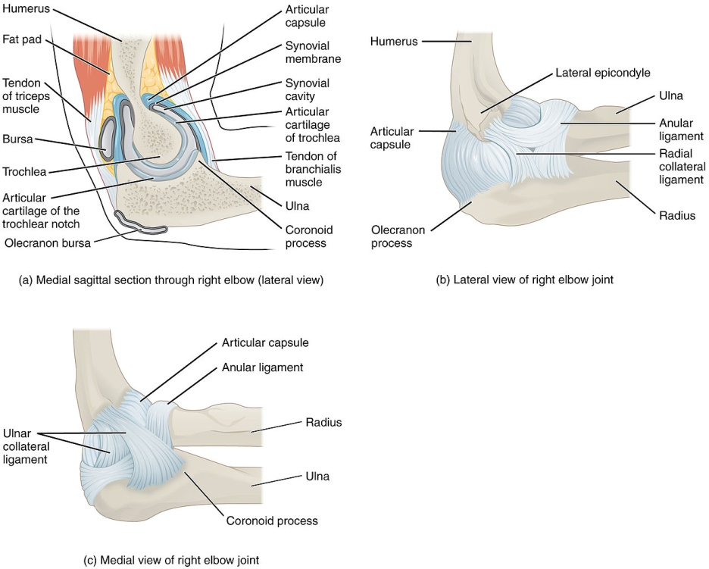
Anatomy Review

Slide 3
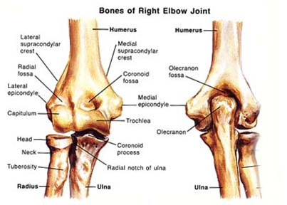
Joints
Within the Joint capsule
  Ulnohumeral Joint (Trochlear Joint)
  Radiohumeral Joint
  Superior Radioulnar Joint

Slide 4
Ulnohumeral Joint
Between trochlea of humerus and trochlear notch of ulna
Uniaxial hinge joint
Resting Position
  70 degrees elbow flexion, 10 degrees supination
Close Packed Position-
  extension with supination
Capsular Pattern
  flexion=extension

Slide 5
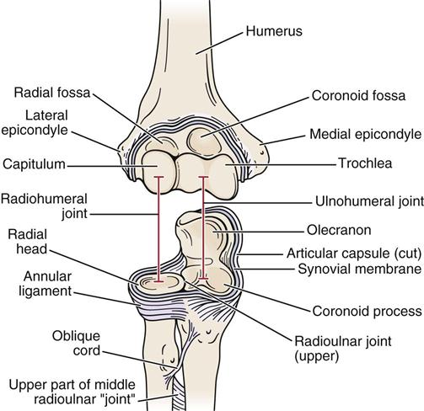

Slide 6
Radiohumeral Joint
Between capitulum of humerus and radial head
Uniaxial hinge joint
Resting Position
  full extension with supination
Close Packed Position
  90 degrees elbow flexion and 5 degrees supination
Capsular Pattern
  flexion, extension, supination, pronation

Slide 8
Superior Radioulnar Joint
Radial head held to ulna and humerus by annular ligament
Uniaxial pivot joint
Resting Position
  35 degrees supination, 70 degrees flexion
Close Packed Position
  5 degrees supination
Capsular Pattern
  supination=pronation

Slide 10
Ligaments
Annular
Ulnar collateral ligaments
Radial collateral ligaments

Slide 11
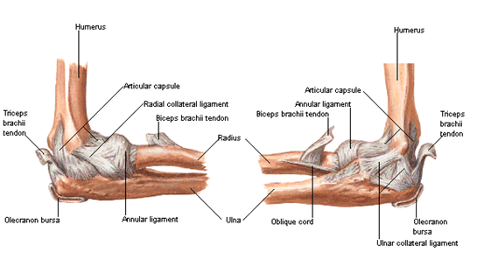

Slide 12
Ulnar Collateral Ligament
Originates from central 2/3 of anteroinferior medial epicondyle
3 bands:
Anterior band inserts into anterior coronoid and trochlear notch
Posterior band- inserts into posterior trochlear notch
Oblique band- variable attachments
Most taught during flexion
Primary restraint to Valgus instability

Slide 13
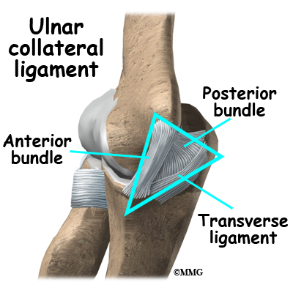

Slide 14
Radial Collateral Ligament
Originates from the anteroinferior lateral epicondyle
Inserts into annular ligament
3 bands (anterior, posterior and middle)
Anterior band taught in extension
Middle band taught in 90 degrees flexion
Posterior band taught in full flexion
Primary restraint to posterolateral instability

Slide 15
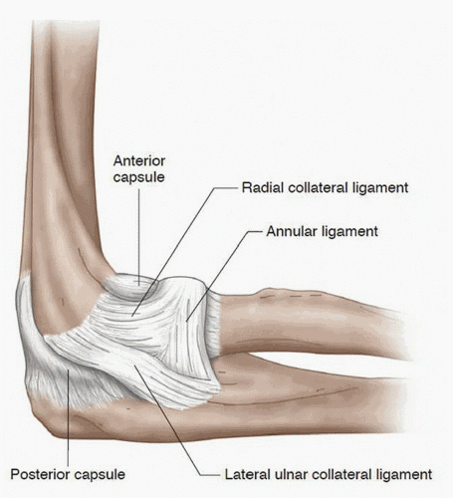

Slide 16
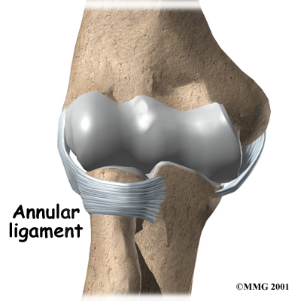
Annular Ligament
Main stabilizer of SRUJ
Encircles radial head and holds SRUJ together
Bound to humerus via RCL
Supinator blends with RCL and annular ligament

Slide 17
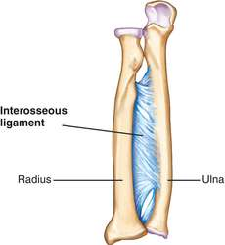
Interosseous Membrane
2 layers of fibers between ulna and radius
Essential for maintaining the length relationship between the radius and ulna and stabilizes the forearm and DRUJ during pronation and supination

Slide 18
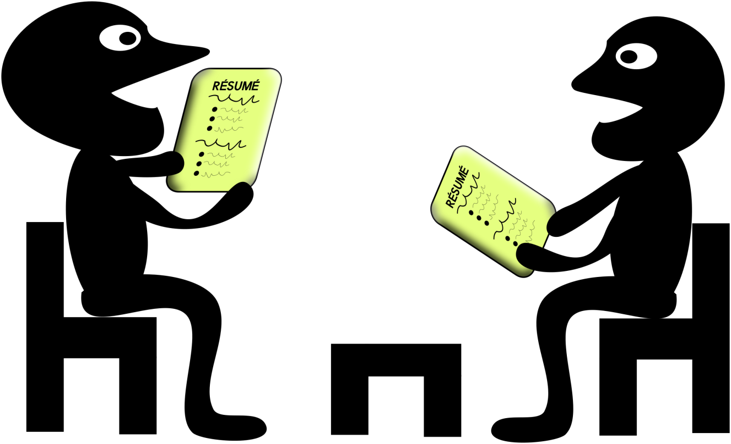
Patient History

Slide 19
Q & A
Age and occupation
  Lateral epicondylitis
    Commonly over 35, great deal of wrist flexion and extension
  Dislocation of radius
    Occurs in young children, complaints of elbow pain, often seen when child recieves a tug on the arm or trips while holding hands
  Osteochondritis dissecans
    Commonly between the ages of 15 -20

Slide 20
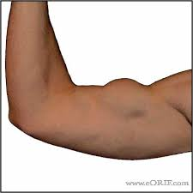
Mechanism of injury
FOOSH, or fall on the tip of the elbow, catching ones self from falling or repetitive overuse in throwing sports
  Severe Valgus force – sprain of ulnar collateral ligament, lateral side compression injury,
Centralized pop and weakness of elbow flexion
  Bicep tendon rupture

Slide 21
Other Questions
How long have they had the problem?
Does the condition come and go?
What are the details of the present pain and other symptoms?
Are there activities that make the pain worse?
Positions that relieve pain?
Any movements impaired?
What is the patient unable to do functionally?
Have current activities been altered?
Any abnormal nerve distribution symptoms?
Previous History?

Slide 22
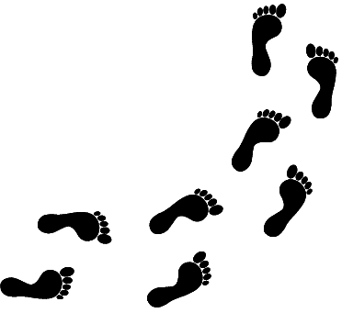

Observation

Slide 23
Observation
Arms should be exposed. Shoulders and cervical regions should observed for possible referral of symptoms especially if a gradual start
Items to note
  Carrying angle
  Color
  Muscle mass
  bruising
  Normal functional position
  Triangle swelling
  Goose egg swelling over olecranon

Slide 24
Carrying Angle
Anatomical position results in a carrying angle in the arm. It is the angle formed by the long axis of the humerus and the long axis of the ulna. Most evident in extension and supination
In adults normal range
  Men ~ 5 – 10 degrees
  Women ~ 10 – 15 degrees
Carrying angle greater than 15 results in Cubitius Valgus
Carrying angle less than 5 results in cubitus varus – see page 393 magee

Slide 25
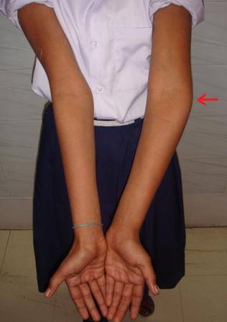
Gun stock deformity
Fracture or epiphyseal injury to the distal humerus and cubitus varus results a gun stock deformity may occur in full extension.

Slide 26
Swelling
If swelling exists all three joints will be affected as they are located in the same joint capsule
Intra articular swelling is most evident in the triangle created by the radial head, tip of the olecranon and the lateral condyle of the humerus
Swelling from olecranon bursitis (Students elbow) appears more like a goose egg over the olecranon. With swelling like this the joint would be held in resting position

Slide 27
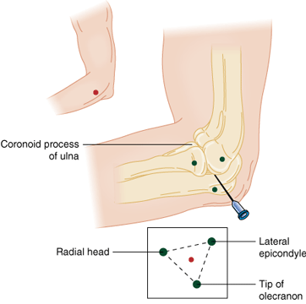

Slide 28
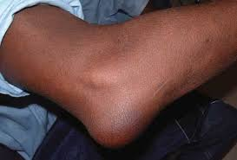

Slide 29
Normal Functional Position
Can the client assume normal functional position of 90 degrees flexion and forearm midway between supination and pronation, or when slightly pronated as in when writing notes for ever and ever and ever. Adding shoulder flexion to this motion and increasing elbow flexion to 120 mimics eating. Supination decreases shoulders ability to flex

Slide 30
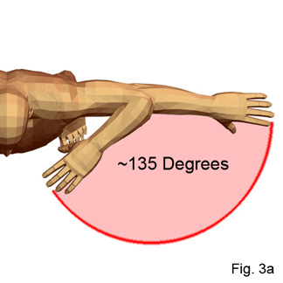
Range of Motion

Slide 31
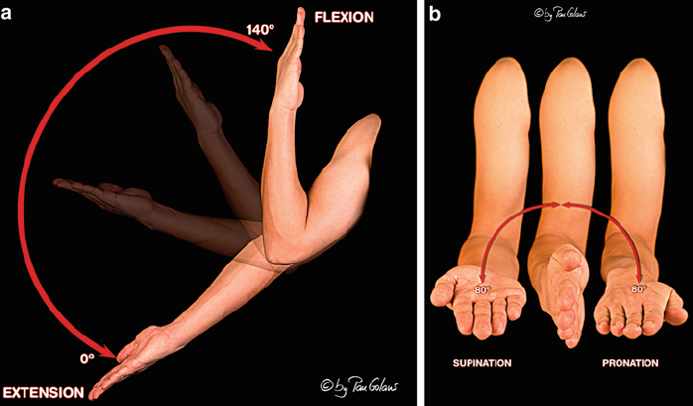
Degrees of Motion
Flexion- 140-150
Extension- 0-10
Supination 90
Pronation 80-90

Slide 32
Active Range of Motion
Done seated
Painful movements last
Compare bilateral/unaffected side first
Hyperextension of elbow is more common in women, normal if equal on both sides
Loss of elbow extension is an indicator or intr-articular patholgy
Shoulder adduction can be a trick movement for supination
Shoulder abduction can be a trick movement for pronation

Slide 33
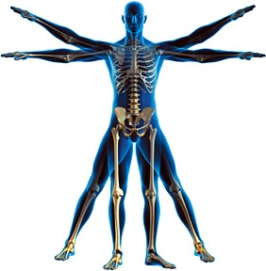
End Feels
Flexion
  tissue approximation
Extension
  Bony (hard)
Supination/pronation
  tissue stretch
The capsular pattern – more
Flexion then extension

Slide 34
Passive Range of Motion
In thin individuals elbow flexion may have a bony end feel
Evolve video

Slide 35
Resisted Isometric Movements
Flexion strongest between 90 and 110
Include Wrist Flexion/Extension because a large number of muscles act over the wrist as well as the elbow
Evolve video

Slide 36
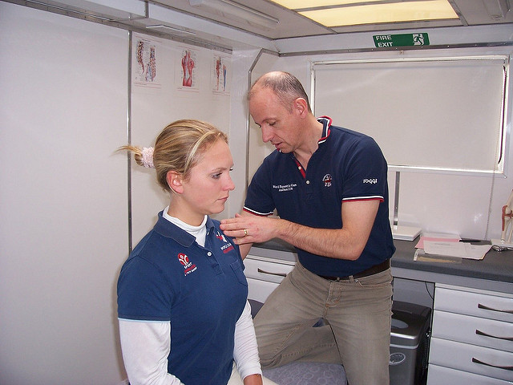
Conditions and Special Tests
Special Tests & Conditions

Slide 37
Ligament Instability
What is it?
  Stretching or Tearing of the ligaments around the elbow, most commonly the Ulnar Collateral Ligament in throwers and golfers
    Grade 1 – Slight Stretch of Ligament
    Grade 2 – Partial tear of Ligament
    Grade 3 – Full Rupture of Ligament
How it happens?
Injury occurs either secondary to a repetitive Stress or a Single Traumatic Event involving a Valgus or Varus Force

Slide 38
Special Test
Ligamentous Valgus Instability Test
  Client standing, therapist stabilizes just above the elbow and wrist. An abduction force is applied to the wrist while ligament is palpated
Positive sign – excessive movement, altered pain when compared to other side

Slide 39
Ligamentous Varus Instability
How its done?
  Client standing, elbow flexed 20 – 30 degrees. Stabilized above wrist and LCL palpated. Adduction force applied to forearm
Positive Sign
  Increased laxity or soft end feel – Injury to ligament
  May indicate posterolateral elbow instability-
    which is the most common in the elbow (displacement of the ulna on the humerus accompanied by the radius) ulna laterally rotates away or off the trochlea)

Slide 40
Moving Valgus Test
Patient supine or standing, arm abducted and fully flexed, while maintaining a valgus force examiner quickly extends the clients elbow
Positive sign – Reproduction of pain between 70 and 120 degrees indicates partial tear of MCL

Slide 41
Lateral Epicondylitis
Also known as – Tennis Elbow
What is it?
  Lateral Elbow pain secondary to tendinosus (Chronic Tendon Injury) or periostitis (inflammation of the periosteum)
How Does it happen?
  Most common occurs with over use that damages the common extensor tendon and Extensor Carpi Radialis Longus. Inflammation leads to micro tears and fibrosus

Slide 42
Risk Factors
Repetitive over use of extension with alternating supination and pronation
Micro tears in the tendon
  Handling tools heavier than 1 KG
  Handling loads of over 20 KG more than 10 times per day
  Repetive movements more than 2 hours per day
    Tennis, typing, hedge trimming, musical instruments

Slide 43
Palpation and Observation
Observation
  Usually no visible swelling or bruising
Palpation
  Localized tenderness to palpation just distal and anterior to lateral epicondyle

Slide 44
Movement
AROM and PROM – Pain with Wrist flexion (due to the stretch occuring at the Extensor Carpi Radialis Brevis)
RROM – Increased pain with resisted extension

Slide 45
Special Tests – Cozen’s Test
How its done?
  Patients elbow stabilized by examiners thumb, which rests on patients lateral epicondyle, patients asked to make a fist, pronate the forearm, radially deviate and extend the wrist while the examiner resists the motion
Positive sign – A sudden severe sharp pain in the area of the lateral epicondyle
  The lateral epicondyle can be palpated to indicate origin of pain

Slide 46
Mill’s Test
How it’s done?
  While palpating lateral epicondyle examiner pronates patients forearm flexes wrist fully and extends the elbow
Positive Sign – pain over lateral epicondyle. Also stresses radial nerve which may cause symptoms similar to tennis elbow. Electrodiagnosis differentiates between the two

Slide 47
Medial Epicondylitis
Also known as Golfer’s elbow
What is it?
  Medial elbow pain secondary to tendinosis
How it happens
  Repetitive use of flexor and pronator forearm muscles can cause micro trauma and inflammation as well as possible micro tears to the common flexor tendon of the forearm

Slide 48
Risk Factors
Repetitive work or sport activity
  Over head throwing
  Racquet sports
  Factory workers
  Manual labourers
  Office employees
  Working with vibrating tools
  Handling loads of 5kg 2 x per minute for a minimum of 2 hours at a time
  High hand grip forces

Slide 49
Health History
Medial elbow pain after activity without direct trauma
Pain increases with flexion or pronation
Occasional tingling sensation that radiates into their fourth and fifth fingers (suggest ulnar nerve involvement)

Slide 50
Observation and Palpation
Observation
  Look for signs of swelling, redness and warmth
Palpation
  Tenderness over medial epicondyle or common flexor tendon

Slide 51
Movement
AROM and PROM – usually normal, possible pain with tendon stretch on PROM
RROM may show weakness or pain with resisted wrist flexion

Slide 52
Special Test – Medial Epicondylitis Test
How it’s done?
  Examiner palpates patients medial epicondyle, patients forearm passively supinated and the examiner extends the elbow and wrist
Positive Sign
  Pain over medial epicondyle of humerus

Slide 53
Cubital Tunnel Syndrome
What is it?
  Increase of pressure on the Ulnar Nerve at the elbow (cubital tunnel). Leads to pain and tingling in the 4th and 5th digits
How it Happens?
  The cubital tunnel is located just distal to the Ulnar groove and is created by the tendinous arch joining the humeral and ulnar heads of the flexor carpi ulnaris. The Ulnar nerve runs through here and compression tension on this nerve causes the symptoms

Slide 54
Risk Factors
Blunt trauma
Consistent pressure on ulnar nerve at the elbow
Prolonged hyperflexion – sleeping
Repetitive elbow flexion and extension
Inflammation of flexor carpri ulnaris

Slide 55
History
Numbness and tingling at 4th and 5th digits and medial hand, may be burning
May not be able to complete ADL due to weakness – dropping objects or weak grip
Prior elbow trauma

Slide 56
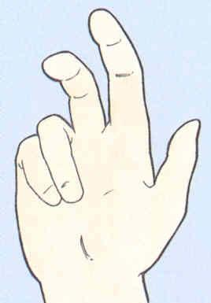
Observation
Observation
  Cubitis Valgus
  When condition has been occuring for a length of time intrinsic hand muscle may be atrophied
  Possible claw hand or bishops hand

Slide 57
Palpation
Direct pressure over the cubital tunnel will increase symptoms
Inflammation of Flexor Carpi Ulnaris compared bilaterally

Slide 58
Special Tests – Elbow Flexion Test
How its done?
  Patient asked to fully flex elbow, extend wrist and depress shoulder, hold position for 3 – 5 minutes
Positive sign
  Tingling or paresthesia in ulnar nerve distribution

Slide 59
Tinnels Sign -Elbow
How it’s done?
  Patient seated, examiner taps 4- 6 times over cubital tunnel (This is the groove that is located between the Olecranon process & medial epicondyle) with the fingers or reflex hammer
Results – Positive sign – Shooting Electrical pain along the medial side of the forearm to the medial Hand Indicates – Ulnar compressive neuropathy
Test indicates the point of regeneration of the sensory fibers of nerve. Most distal point of abnormal sensation indicates the limit of the nerve regeneration
High rate of false positives as this is similar to hitting your funny bone

Slide 60
Pressure Provocation Test
How its done?
  Patient Seated, Standing or Supine elbow flexed to below 80, forearm supinated
  Examiner places finger over ulnar nerve just proximal to the cubital tunnel and hold pressure for 60 seconds or less
Results – Positive Sign – numbness or tingling in the Ulnar nerve distribution Indicates – Cubital Tunnel Syndrome

Slide 61

Peripheral Nerve Injuries

Slide 62
Median Nerve
Can be injured by trauma, systemic disease and compression/traction
Can be compressed or pinched above the elbow by the ligament of struthers (only found in 1% of the population) leading to motor and sensory loss
Also can be compressed between the 2 heads of pronator teres which is called pronator syndrome leading to motor and sensory loss

Slide 63
Anterior Interosseus Nerve
Is a branch of the median nerve is sometime pinched as is passes between the heads of pronator teres, leading to pain and functional impairment which is called anterior interosseus nerve syndrome
This nerve can also be injured with a forearm fracture
No sensory loss; signs and symptoms are related to motor function

Slide 64
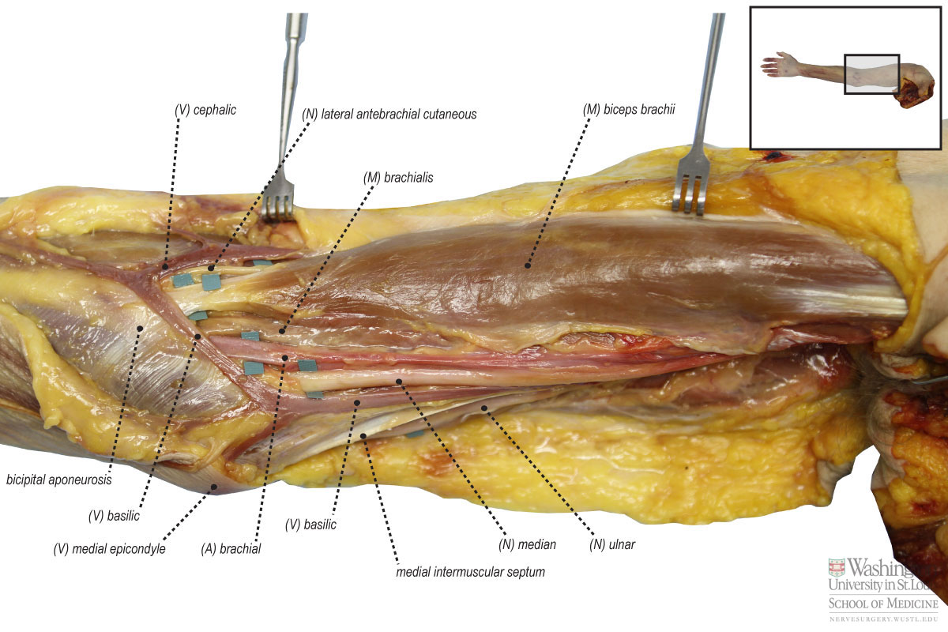
http://nervesurgery.wustl.edu/NerveImages/Anatomy%20and%20Physiology/AP-Median-Nerve---IMG_0527.jpg

Slide 65
Ulnar Nerve
Most likely to be injured in the elbow region
Second only to carpal tunnel
Can be injured or compressed due to swelling, osteophytes, arthritic diseases, trauma or repeated micro trauma
Compression occurs between the 2 heads of flexor carpi ulnaris

Slide 66
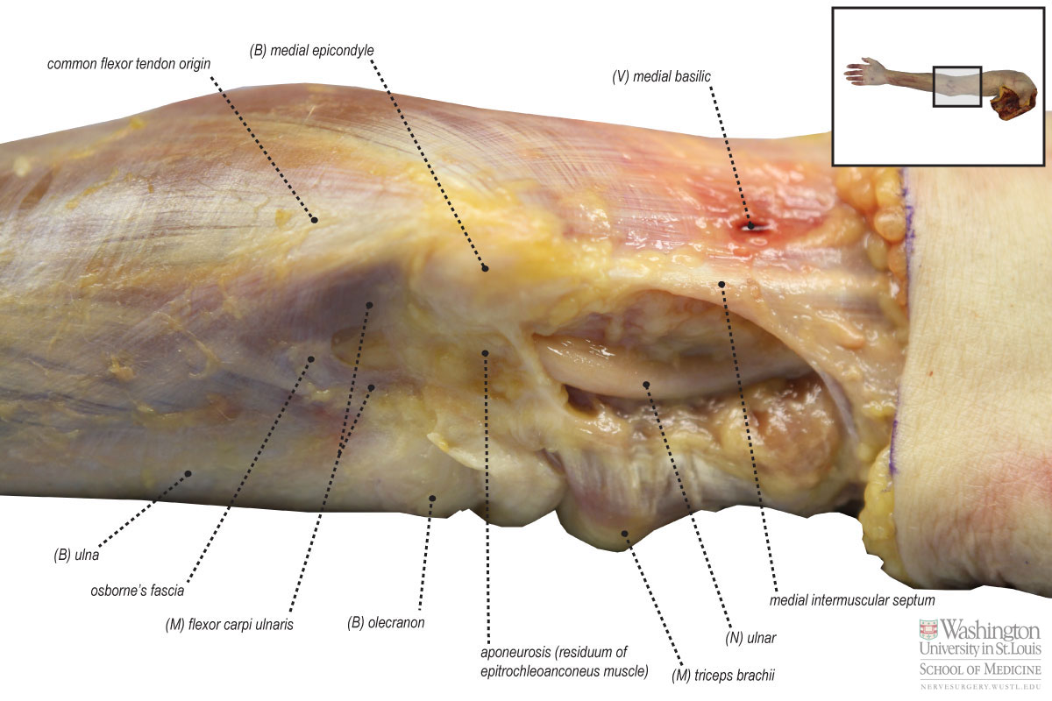
http://nervesurgery.wustl.edu/NerveImages/Anatomy%20and%20Physiology/AP-Ulnar-Nerve---IMG_0480.jpg

Slide 67
Radial Nerve
Can be injured if there is a fracture of the shaft of the humerus (either at time of fracture or during the healing process due to callus formation)
Posterior interosseus nerve, a branch of the radial nerve can be compressed between the 2 heads of supinator
Can also be compressed at the entrance of the tunnel anterior to the head of the radius
Compression can also occur to the superficial branch of the radial nerve as it passes under the tendon on brachioradialis, only leading to sensory loss

Slide 68
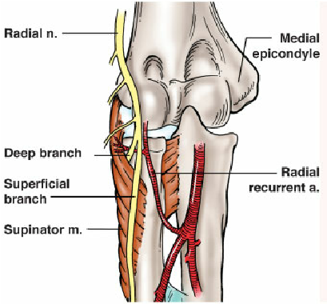

Slide 69
Special Tests for peripheral nerve Injury
Pinch Grip Test
Tests for pathology of the anterior interosseous nerve (branch of median nerve, mainly motor)
  Client is asked to pinch the tips of the index finger and thumb together
  Normally there should be a tip-to-tip pinch
  If the client is unable to pinch tip to tip it is an indication of a pathology of the median nerve specifically the anterior interosseous portion as it passes between the 2 heads of pronator teres

Slide 70
Reflexes
Biceps (C5 C6)
  Therapist places their thumb over the client biceps tendon and then tapping nail with the reflex hammer to elicit the reflex
Brachioradialis (C5 C6)
  Therapist located the brachioradialis tendon and directly taps the tendon to elicit the reflex
Triceps (C7 C8)
  Therapist located the triceps tendon and directly taps the tendon to elicit the reflex

Slide 71
ULTT’s
Review
Name the position of 1 – 4?
What movement is performed last?
What movement of the arm is performed last?

Slide 72
ULTT’s
ULTT 1 (Median Nerve) “Set bird free”
  Shoulder ABD 110 degrees with elbow flexed to 90 degrees
  Extend wrist and fingers
  ER shoulder
  Supinate forearm
  Elbow extension
ULTT 2 (Median Nerve) “Throw it away”
  Shoulder depression
  Elbow extension
  ER shoulder with caudal hand
  Wrist and finger extension
  ABD shoulder 10 degrees
ULTT 3 (Radial Nerve) “Passing the baton”
  Shoulder depression
  Shoulder IR
  Wrist and finger flexion
  Elbow extension
ULTT4 (Ulnar Nerve) “Carrying a tray”
  Wrist and finger extension
  Supinate forearm
  Elbow flexion
  Shoulder ER/ABD

Slide 73
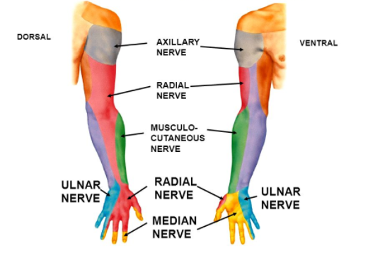
Dermatomes

Slide 74
Cervical Dermatomes
C1- Top of head
C2- Face and upper neck
C3- Anterolateral neck
C4- UFT, ACJ, SCJ, clavicle
C5- Lateral shoulder, brachium, forearm, outcroppers
C6- Biceps, antecupital fossa, digits 1-2
C7- Triceps, wrist extensors, into digits 2-4
C8- Hypothenar eminance, into digits 4-5
T1- Medial aspect of forearm and wrist
Notes:
Pg 183

Slide 75
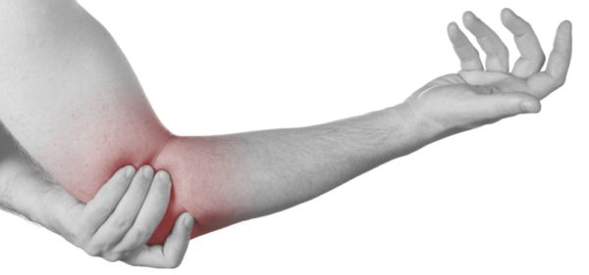
Elbow muscles referral of pain

Slide 76
Biceps – upper shoulder, bicep groove to anterior elbow
Brachialis – anterior arm , elbow the lateral thenar eminence
Triceps – posterior shoulder, arm, elbow, and forearm to medial two finger, medial epicondyle
Brachioradialis – lateral epicondyle and lateral forearm to posterior web space b/w thumb and index finger
Anconeus – Lateral epicondyle area

Slide 77
Continued
Supinator – Lateral epicondyle and posterior web space
Pronator teres – anterior forearm to wrist and part of ant. Thumb
ECU – Medial wrist
ECRB – Posterior forearm to posterior wirst
ECRL – Lateral epicondyle to posterolateral wrist
EI – posterior forearm to Index finger
PL- anterior forearm to palm
FDS – Palm to appropriate digit
FCU & FCR - anteromedial wrist
Remember that pain from the cervical area and upper extremity as well as the wrist can refer to the elbow region

Slide 78
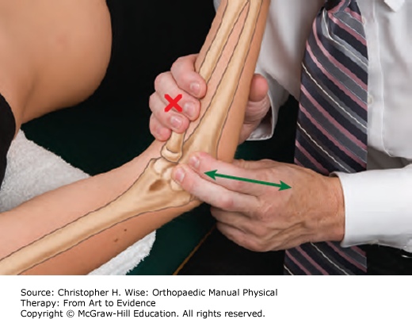
Joint Play

Slide 79
Available Joint play movements of the Elbow complex
Radial deviation of the ulna and radius on the humerus
Ulnar deviation of the ulna and radius on the humerus
Distraction of the Olecranon from the humerus in 90 degree flexion
Anteroposterior glide of the radius on the humerus
https://youtu.be/GxyxvcIEE-E

