Slide 1
Cervical Spine

Slide 2
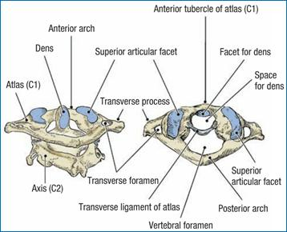
Cervical Spine Anatomy
Consists of several pairs of joints
Atlanto-occipital joint
    Articulations are between the occiput and C1
    Principle motion at this joint is flexion and extension (15 – 20) nodding of head
    Ellipsoid joint
Atlanto-axial joint
    Articulation between C1
    and C2
    Principle motion at this
    joint is rotation
    Pivot joint

Slide 3
Nerve Roots and Vertebral Segments
7 cervical vertebra and 8 cervical nerve roots
    C1 exists btw occiput and C1
    Each nerve root is named by the vertebra below it
Atlanto-occipital and atlanto-axial joints are the most complicated articulation of the axial skeleton
Rotation is the primary movement of the atlanto-axial joint (odontoid process- pivot)
    Talking and chewing produce small movement at C1-2, implications of a still C1-2?
The atlanto-axial joint is stabilized by the transverse ligament (holds dens from C2 onto C1)
    This ligament can weaken and rupture in individuals with Rheumatoid arthritis
The lower C/S (C3-7) is often called the cervicobrachial area b/c pain is often referred to the U/E

Slide 4
Facet Joints
14 facet joints (C1-C7)
T1-2 are often included
Superior facets face upward, backward and medially, the inferior facets face downward, forward and laterally; this facilitates flexion and extension and prevents side flexion and rotation from occurring independent of each other (COUPLED MOVEMENT)
The most mobility occurs between C4-5 and C6-7 (most degeneration occurs here)

Slide 5
Ligaments
Anterior and posterior longitudinal ligaments
Ligamentum flavum
Supraspinous and interspinous ligament
Intertransverse ligament

Slide 6
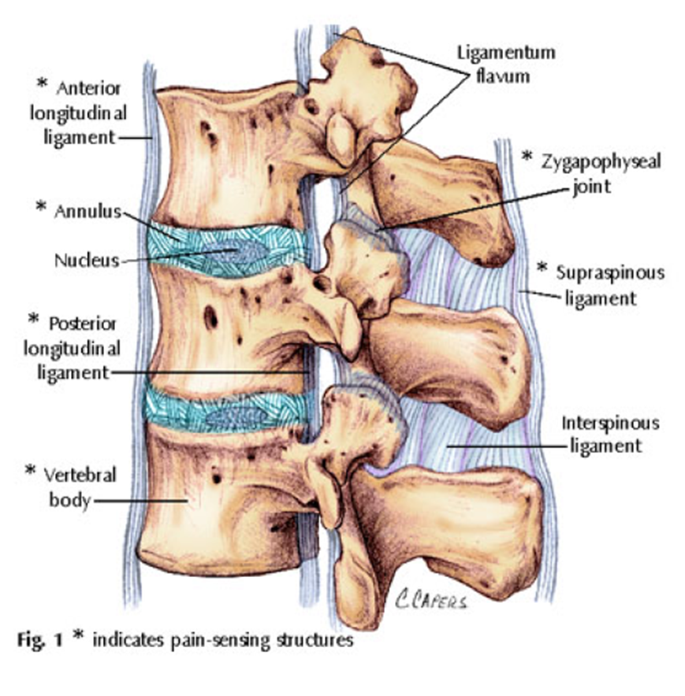

Slide 7
Vertebral Artery
Passes through C/S TP’s at C6
Supplies 20% of the brains blood (along with the internal carotid artery-80%)
Lies close to facet joints, easily compressed with osteophyte formation or injury to the facet joint
Vertebral and carotid arteries are stressed by rotation, extension and traction

Slide 8
The Vertebral Artery Continued…
Most stress on artery occurs at:
    Entrance of C6 transverse process
    Within bony canals of vertebral transverse processes
    Between C1-2
    Between C1 and entry to skull
Vertebral artery insufficiency:
    Dizziness
    Disphagia- difficulty swallowing
    Dysphasia- impairment in understanding language
    Diplopia- double vision
    Drop attacks- falling without fainting
    Dysarthria- difficulty speaking
    Nausea
    Nystagmus
    Positive cranial nerve signs

Slide 9
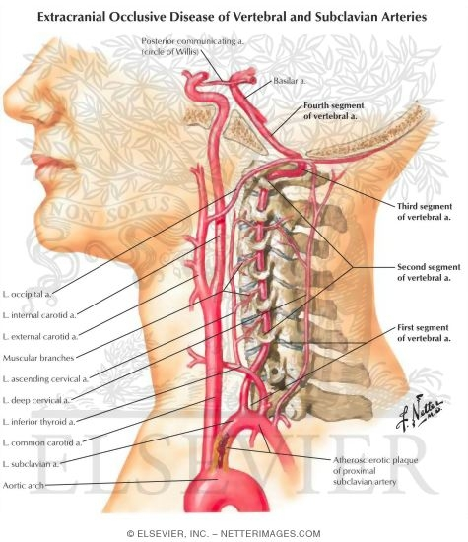

Slide 10
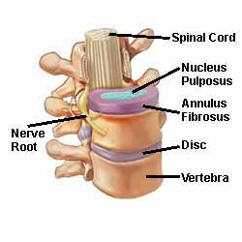
Intervertebral Disc Anatomy
Discs give the C/S the lordotic shape
No disc exits between occiput and atlas (C0-1) or atlas and axis (C1-2)
Consists of the annulus
Fibrosus and nucleus pulposus
Annulus fibrosus withstands
tension in the disc

Slide 11
C/S
Resting position is slight extension
Close packed position is full extension
Capsular pattern is side flexion and rotation equally limited and extension

Slide 12
Client History
MOI, when
Recent/past injuries or health issues
  Heart
  Lung
  Cancer
  Blood disorder
  Skin disorder
  arthritis
MD, PT, RMT, chiro
Medical imaging (xray, MRI..)
Signs/symptoms
  Pain, location, quality
  Sensory (numbness/tingling)
ADL’s, work, leisure, sleep
Medications
Aggravating/alleviating factors
Vertebral artery issues (see slide)

Slide 13
Observation
Forward head posture
Head position
Spinal curves (kyphosis, protracted)
Shoulder levels
Swelling, redness
How the client moves
Soft tissue/bony contours
Muscle symmetry

Slide 14
AROM/PROM
You must clear the U/E
    Consists of AROM/PROM of shoulder, elbow and wrist
Atlanto-occipital joint
    Flexion- 5
    Extension- 10
    Lateral Flexion- 5
    Rotation- negligible
Atlanto-axial joint
    Flexion- 5
    Extension- 10
    Lateral flexion- negligible
    Rotation – 40-45
Intracranial region (C2-7)
    Flexion- 35
    Extension- 70
    Lateral flexion- 35
    Rotation- 45
Total craniocervical region
    Flexion- 45-50
    Extension- 85
    Lateral flexion- 40
    Rotation- 90
Quandrants

Slide 15
PROM
All C/S endfeels are a tissue stretch

Slide 16
RROM
The same movements that were performed in active are done isometrically
The easiest way of performing these motions is by placing the client in a relaxed position and telling them “Don’t let me move you”

Slide 17
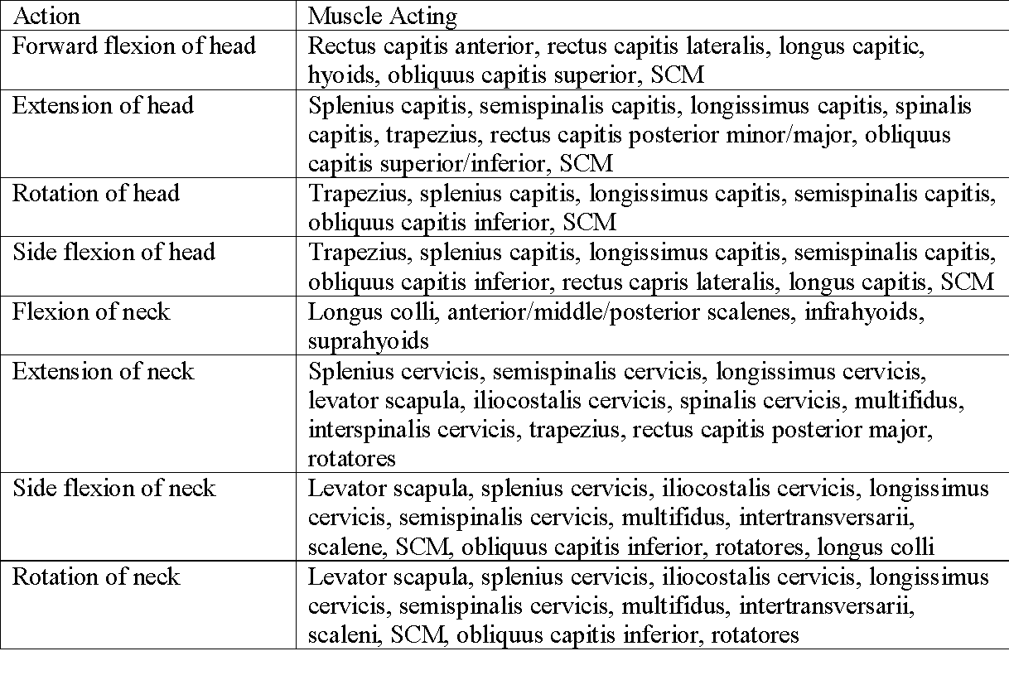

Slide 18
Peripheral Joint Scanning
Used to rule out obvious pathologies in the extremities and to note areas that may need more detailed assessment
Each of the following is scanned bilaterally
Pathology originating in the C/S can refer pain/tingling to the upper extremity

Slide 19
Peripheral Joint Scanning
TMJ
Therapist checks the movement of the joint by placing the index finger anterior to the ear
The client then open and closes the mouth as the therapist feels for equal movement of the condyles, and for clicking or grinding
Note if client experiences pain and with what movements
Therapist observes the client when opening and closing mouth looking for any deviation

Slide 20
Peripheral Joint Scanning
Shoulder
Client is asked to actively abduct, forward flex arm
Then client is asked to medially and laterally rotate while arm is abducted to 90
Lastly the client is asked to perform an apley’s scratch test with both arms
Therapist notes any restrictions, and if client experiences pain

Slide 21
Peripheral Joint Scanning
Elbow
The elbow joint is actively moved through flexion, extension, supination and pronation
Any restrictions or abnormal movements should be noted

Slide 22
Peripheral Joint Scanning
Wrist/Hand
Client actively performs flexion, extension, radial and ulnar deviation of wrist
Active flexion, extension, abduction, adduction and opposition are performed in the hand
Any restrictions or abnormal movements should be noted

Slide 23
Neurological Exam
Myotomes
Dermatomes
Reflexes

Slide 24
Neurological Scan- Dermatomes
NERVE ROOT | DERMATOME | MYOTOME | REFLEX | PARETHESIAS
C1 | Vertex of skull | None | None | None
C2 | Temple, forehead, occiput | Longus colli, sternocleidomastoid, rectus capitis | None | None
C3 | Entire neck, posterior cheek, temporal area, under mandible | Trapezius, splenius capitis | None | Cheek, side of neck
C4 | Shoulder area, clavicle area, under scapular area | Trapezius, levator scapulae | None | Horizontal band along clavicle and upper scapula
C5 | Deltoid area, anterior aspect of entire arm to base of thumb | Supraspinatus, infraspinatus, deltoid, biceps | Biceps, brachioradialis | Thumb and index finger
C6 | Anterior arm, radial side of hand to thumb and index finger | Biceps, supinator, wrist extensors | Biceps, brachioradialis | Thumb and index finger
C7 | Lateral arm and forearm to index, long and ring fingers | Triceps, wrist flexors (rarelt wrist extensors) | Triceps | Index, long and ring fingers
C8 | Medial arm and forearm to long, ring and little fingers | Ulnar deviators, thumb extensors, thumb adductors (rarely triceps) | Triceps | Little finger alone or with 2 adjacent fingers
T1 | Medial side of forearm to base of little finger
T2 | Medial side of upper arm to medial elbow, pectoral and midscapular region
T3 – T12 | T3-T6 – upper thorax T5-T7 – costal margins T8-T12 – abdomen and lumbar region

Slide 25
Myotomes
Myotomes are tested with resisted isometric contraction of each action
Contraction should be held for 5 seconds so that weakness if any can be noted
Where applicable both sides are tested at the same time to provide comparison
To test the motions of the neck it should be placed slightly into the movement to be tested, for example if testing neck flexion the neck should be slightly flexed before the resisted contraction is applied
C1 – C2 neck flexion
C3 neck side flexion
C4 shoulder elevation
C5 shoulder abduction/shoulder lateral rotation
C6 elbow flexion and/or wrist extension
C7 elbow extension and/or wrist flexion
C8 thumb extension and/or ulnar deviation
T1 abduction and/or adduction of hand intrinsics

Slide 26
#2- Neurological Scan- Myotomes
NERVE ROOT | TEST ACTION | MUSCLES | POSITIONING
C1 – C2 | Neck flexion | Rectus lateralis,rectus capitis anterior, longus capitis, longus colli, longus cervicis, sternocleidomastoid | Head should be slightly flexed and pressure directed at the forehead while other hand stabilized between the scapulae
C3 | Neck side flexion | Longus capitis, longus cervicis, trapezius, middle scalenes | Therapists hand applies pressure above the clients ear into side flexion while other hand stabilized at the opposite shoulder
C4 | Shoulder elevation | Diaphragm, trapezius, levator scapulae, anterior scalenes, middle scalenes | Client actively elevates shoulders to about half way, therapist then applies a force in a downward direction on both shoulders while client attempts to hold them in that position
C5 | Shoulder abduction | Rhomboid major/minor, deltoid, supraspinatus, infraspinatus, teres minor, biceps, anterior and middle scalenes | Client elevates arm to about 75˚ with elbows flexed to 90˚ and forearms pronated, therapist applies downward pressure on both humerus while client attempts to hold that position
C6 | Elbow flexion & wrist extension | Serratus anterior, latissimus dorsi, subscapularis, teres major, pectoralis major (clavicular head), biceps, coracobrachialis, brachialis, brachioradialis, supinator, extensor carpi radialis longus, anterior middle and posterior scalenes | Clients arms are at their side with elbows flexed to 90˚ and forearms in neutral, therapist applies a downward force to forearm to test elbow flexors Clients wrist is pronated and therapist applies a downward force to the dorsum of hand to test wrist extensors
C7 | Elbow extension & wrist flexion | Serratus anterior, latissimus dorsi, pectoralis major (sternal head), pectoralis minor, triceps, pronator teres, flexor carpi radialis, flexor digitorum superficialis, extensor carpi radialis longus, extensor carpi radialis brevis, extensor digitorum, extensor digiti minimi, middle and posterior scalenes | Clients arms are at their side with elbows flexed to 90˚ and forearms in neutral, therapist applies an upward force to forearm to test elbow extensors Clients wrist is supinated and therapist applies a downward force to the palmar surface of hand to test wrist flexors
C8 | Thumb extension & ulnar deviation | Pectoralis major (sternal head), pectoralis minor, triceps, flexor digitorum superficialis, flexor digitorum profundus, flexor pollicis longus, pronator quadratus, flexor carpi ulnaris, abductor pollicis longus, extensor pollicis longus/brevis, extensor indicis, abductor pollicis brevis, flexor pollici brevis, opponens pollicis, middle and posterior scalenes | Client extends thumb just short of full range and therapist applies a force to bring thumb into extension Wrist is in neutral position and therapist applies pressure to the medial portion of the hand to test ulnar deviators
T1 | Hand intrinsics | Flexor digitorum profundus, intrinsic muscles of the hand (except extensor pollicis brevis), flexor pollicis brevis, opponens pollicis | To test intrinsics of hand therapist places fingers between those of the client and has them squeeze fingers together
Notes:
Why do we hold it for at least 5 seconds and possibly repeat the movement?

Slide 27
Special Tests
Principles of Special Testing:
Many types of special tests are available for each joint to determine whether a particular type of disease, condition or injury is present
Because a test may yield a negative does not necessarily rule out that condition or disease
When deciding to use a special test the therapist must take the following into consideration …
  It must be a useful diagnostic test that will give reliable data
  Must be valid
  Must be accurate to minimize clients discomfort/
Reliability depends on the cooperation of the client, and could be influenced by client’s ability to relax, pain, apprehension, and sincerity
Under no circumstance should a special test be used in isolation

Slide 28
Special Tests Continued
These tests are used to
  confirm a tentative diagnosis
  to make a differential diagnosis
  to differential between structures
  to understand unusual signs
  to unravel difficult signs and symptoms
Special care should be taken when performing these tests as they could provoke signs and symptoms including pain and apprehension
The tests could be contraindicated in the presence of severe pain, acute or irritable joints, instability, osteoporosis, pathological bone diseases, active disease processes, major neurological signs, and client apprehension

Slide 29
Special Tests
Nerve Root Compression
Distraction Test – used if client has radicular symptoms, used to alleviate
Spurling’s (Foramina compression) Test– assess for nerve root compression
Shoulder Abduction Test – tests for radicular symptoms

Slide 30
Special Tests
Foraminal Compression
Jackson’s Compression – assesses for foraminal compression

Slide 31
Special Tests
Vertebral Artery Pathology/Blood Flow
Vertebral Artery Test – tests for compression of the vertebral artery
Barre’s Test – assess blood flow to the brain

Slide 32
Special Tests
Vertigo/Dizziness
Hautant’ Test – used to differentiate dizziness from vertigo

Slide 33
Special Tests
Brachial Plexus Lesion
Shoulder Depression Test – evaluate brachial plexus lesions

Slide 34
Special Tests
UMN Lesion
Romberg’s Test – tests for upper motor neuron lesion
Babinski
Clonus
**Upper motor neuron- originating from the motor cortex of the brain or brain stem

Slide 35
Palpation
Spinous Process
    C2- first bump at midline
    C6-C7- passively flex and extend clients neck, C6 moves and C7 does not
Transverse Process
    C1- inferior to mastoid process
    C2- at level of mandible angle
Lymph nodes/carortid arteries- along SCM muscle
External occipital protuberance
Mastoid process
TMJ- palpate anterior to external ear, feel condyles move when client open, closes and deviates jaw, movement should be equal bilaterally
First 3 ribs
Supraclavicular fossa

Slide 36
First Rib Mobility
**Why assess if client has neck or shoulder pain?
1) Client supine, palpate bilateral first ribs posterior to clavicle
Apply caudal pressure to assess amount of movement
2) Client supine, palpate first rib and contralaterally side flex head while feeling superior motion of first
Compare superior motion and amount of neck side flexion bilaterally
    What affects first rib motion?

Slide 37
Cervical Ligament Stress Tests
**Why are these important prior to performing a joint mobilization tx?
Transverse Ligament Stress Test
    Index fingers lay in groove between occiput and C2 on C1 neural arch, head and C1 are lifted anteriorly, hold for 10-20 seconds
    Positive= soft endfeel, muscle spasm, dizziness, parathesia of face/lip/limb, nystagmus, lump in throat
Lateral Shear Test
    Shear axis and atlas together
    Normally there should be little motion and no symptoms
Lateral Flexion Test
    Stabilize axis and side flex clients head
    Normally there should be little motion and no symptoms

Slide 38
Special Tests
Upper Limb Tension Tests
ULTT 1 (Median Nerve) “Set bird free”
  Shoulder ABD 110 degrees with elbow flexed to 90 degrees
  Extend wrist and fingers
  ER shoulder
  Supinate forearm
  Elbow extension
ULTT 2 (Median Nerve) “Throw it away”
  Shoulder depression
  Elbow extension
  ER shoulder with caudal hand
  Wrist and finger extension
  ABD shoulder 10 degrees
ULTT 3 (Radial Nerve) “Passing the baton”
  Shoulder depression
  Shoulder IR
  Wrist and finger flexion
  Elbow extension
ULTT4 (Ulnar Nerve) “Carrying a tray”
  Wrist and finger extension
  Supinate forearm
  Elbow flexion
  Shoulder ER/ABD

Slide 39
Conditions
Cervical spine disc herniation
Cervical spine radiculopathy
Stenosis
Cervicogenic dizziness
Suboccipital headaches
Forward head posture
Whiplash

Slide 40
Assignment
Definition of condition
Mechanism of injury
Symptoms
Positive special tests
Structures you would palpate
Structures that could be painful
Treatment options

