Slide 1
Importance of Science & The Scientific Method

Slide 2
The Scientific Method
________________
“A particular way of studying something in order to discover new information about it in order to understand it better.”
__________________

Slide 3
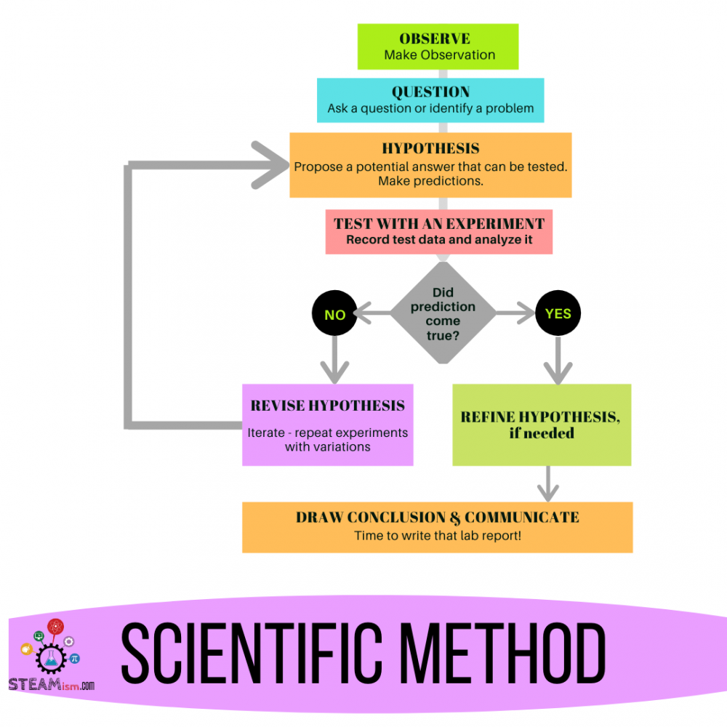

Slide 4

How do we do this in everyday life? As RMTs?
Why do we need to discuss research in massage school?

Slide 5
Makes us better critical thinkers
Ensures we are following best & current evidence based practices
Keeps us current & relevant
Accessing research sets us apart from non-registered massage practitioners
Keeps our clients safe
Enhances our confidence & reduces imposter syndrome
Provides evaluation (of self, treatments)
Informs everything that we do - how do we know what is effective?

Slide 6
Defining Research Literacy
Defined by the World Health Organization as:
______________
“the cognitive and social skills which determine the motivation and ability of individuals to gain access to, understand, and use information in ways which promote and maintain good health.”
______________
(WHO Commission on the Social Determinants of Health 2007).

Slide 7
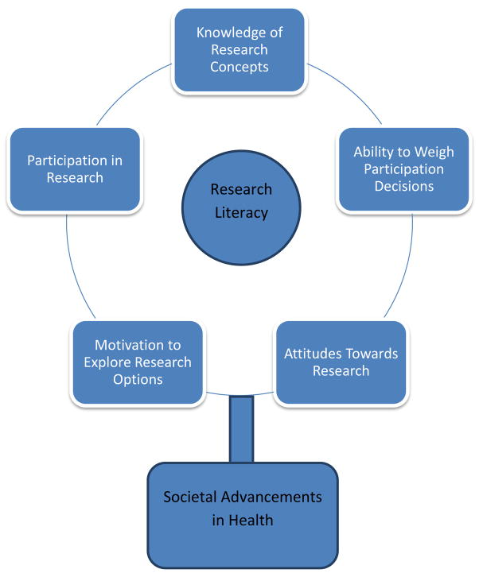
Notes:
J Health Psychol. Author manuscript; available in PMC 2013 Jul 1.
Published in final edited form as:
J Health Psychol. 2012 Jul; 17(5): 724–730.
Published online 2011 Oct 21. doi: 10.1177/1359105311425273

Slide 8
But why does it matter?
Fundamental for conventional health care disciplines (medicine, physical therapy, nursing, etc.)
It helps distinguish useful treatments and practices from those with no benefits
It facilitates acceptance of complementary therapies by conventional health care and public
Cornerstone of evidence-based practice
Notes:
It is a fundamental aspect of each of the conventional health care disciplines
It helps to distinguish useful treatments from those with no benefits or are harmful for patients
It helps facilitate acceptance of complementary therapies
It is fundamental for shifting disciplines towards evidence-based practice

Slide 9
Activity
Topic:
Instrument assisted modalities are better than massage.
Agree or disagree? Defend your answer.
Evidence 1: Social Media
Evidence 2: Journal Articles
Evidence 3: Websites
Take 15-20 minutes & research the above topic.

Slide 10
What is the difference between consuming information via media v/s research?
How do each inform our thinking/understanding of various topics?

Slide 11

Notes:
Science is a way of looking at the world with a spirit of open-minded curiosity and inquiry.
There are other methods of gaining knowledge about the world, such as:
Tradition: a familiar procedure should be performed in a certain manner because it has always been done that way (it might be correct in some situations)
Intuition: sometimes we meet someone to is untrustworthy because we “just know it” and this intuition may prove correct.
Authority: we may have been taught that massage is contraindicated for people with cancer because that is what our massage teacher was taught and passed on to us (base on what he/she learned 15 years ago). In this latter examples, our teacher’s assertion is not a valid knowledge claim based on more recent and accurate information.

Slide 12
Is science important to you?
Define it.
Explain how you have utilized it.

Slide 13
Science as a way of thinking…
Science is a way of looking at the world with a spirit of open-minded curiosity and inquiry
  ask a question & seek an answer…but how?
By gaining knowledge!
Ways to gain knowledge?
Tradition: example?
Intuition: example?
Authority: example?
Notes:
Science is a way of looking at the world with a spirit of open-minded curiosity and inquiry.
There are other methods of gaining knowledge about the world, such as:
Tradition: a familiar procedure should be performed in a certain manner because it has always been done that way (it might be correct in some situations)
Intuition: sometimes we meet someone to is untrustworthy because we “just know it” and this intuition may prove correct.
Authority: we may have been taught that massage is contraindicated for people with cancer because that is what our massage teacher was taught and passed on to us (base on what he/she learned 15 years ago). In this latter examples, our teacher’s assertion is not a valid knowledge claim based on more recent and accurate information.

Slide 14
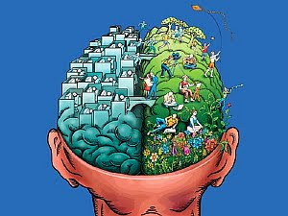
Rationalism vs. Empiricism
Logic, reason,
critical thinking
Observation,
sensory experience
http://thedeconstructionzone.blogspot.ca/2011_08_01_archive.html
Notes:
Two other methods upon which scientific knowledge claims are more likely to be based: Rationalism and Empiricism.
Rationalism is a way of acquiring knowledge through the use of reason or logic and critical thinking.
Empiricism is a way acquiring knowledge through observation and experience.
Problem with logic alone: does not validate assumptions:
All men are mortal
Socrates is a man
Socrates is mortal
The use of rationalism and empiricism allows for the validation of assumptions of rationalism through careful observation assessment and evaluation of empirical information.

Slide 15
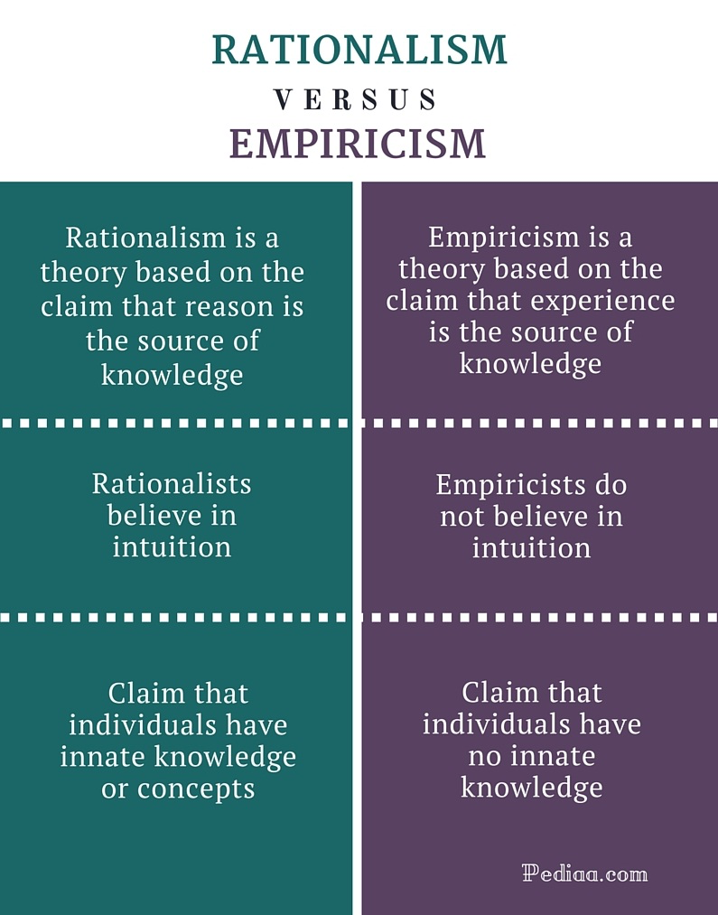

Slide 16
Empiricism
Empiricism is a theory that states that knowledge comes only or primarily from sensory experience
John Locke believed that…the mind is a blank slate as we enter the world & that our experiences shape our thoughts.
Idea: that all knowledge is gained through experience
Do you agree or disagree?
Are there limitations to this belief?

Slide 17
Rationalism
Rationalism is a theory that states knowledge comes through reason, i.e., reason is the source of knowledge and justification.
Innate knowledge – Rationalists argue that we are not born with minds like blind slates, but we have some innate knowledge. That is, even before we experience the world we know some things.
Intuition/deduction – Rationalists can also argue that there are some truths that can be worked out independent of experience of the world, though not known innately. Examples of such truths include logic, mathematics, or ethical truths.
Innate concept – Some philosophers argue that innate knowledge and innate concept are the same whereas some other philosophers are of the view that they are different. Innate concepts are a part of our rational nature and are not based on our experience. The way two children view the same object as ugly and beautiful can be an example of innate concepts.

Slide 18
How do the ideas of Rationalism and Empiricism Apply to RMT’s?
Activity
A client comes in with a shoulder injury explain how we deduct that the issue is a rotator cuff injury using rationalism? Empiricism?

Slide 19
Science Characteristics
Describes & explains relationships between variables
  Essential feature of almost every research question
  Does treatment A work better than treatment B
Systematic: methodical gathering of data
  No information is left out due to personal preference or forgetfulness
Anti-authoritarian: evidence-based
  Not just taking someone's word for it
Assumes that knowledge is always provisional
  Correct in the moment but can be corrected/changed later
Notes:
Essential feature of almost every research question is that it seeks to describe or explain relationships among variables.
Examples: teachers may want to know if different teaching methods can improve reading comprehension, doctors may want to know if treatment A works better than treatment B, etc.
Another aspect of science is that it is systematic: effort to ensure that no critical information is left out, whether for personal preference or forgetfulness. Statistical analysis are used (are any changes between the variables or outcomes and if it possible that these results have occurred due to chance alone).
Anti-authoritarian: does not take someone else`s word for it. Science accepts that an hypothesis is true based on evidence.

Slide 20
1) Falsification and accumulation of knowledge
Science works best when attempting to prove a thing to be false
When hypothesis fails to be demonstrated as false enough times, it becomes part of the accepted knowledge
Knowledge is always provisional: we can never say that: “such and such is certainly true”
Notes:
Essential feature of almost every research question is that it seeks to describe or explain relationships among variables.
Examples: teachers may want to know if different teaching methods can improve reading comprehension, doctors may want to know if treatment A works better than treatment B, etc.
Another aspect of science is that it is systematic: effort to ensure that no critical information is left out, whether for personal preference or forgetfulness. Statistical analysis are used (are any changes between the variables or outcomes and if it possible that these results have occurred due to chance alone).
Anti-authoritarian: does not take someone else`s word for it. Science accepts that an hypothesis is true based on evidence.

Slide 21
Falsification - Karl Popper
Chose to challenge the theory that observation/patterns create a generalized theory (inductive reasoning)
  Moving from specific to broad generalizations
Introduced the idea that you can take a specific idea or prediction and test it through experimentation (deductive reasoning)
  Moving from broad generalizations to a specific outcome
  Idea that if a theory is wrong we can reject it
Ex: white swans (Europeans; inductive - all swans are white) v/ black swans (Australia - deductive - not all swans are white)

Slide 22
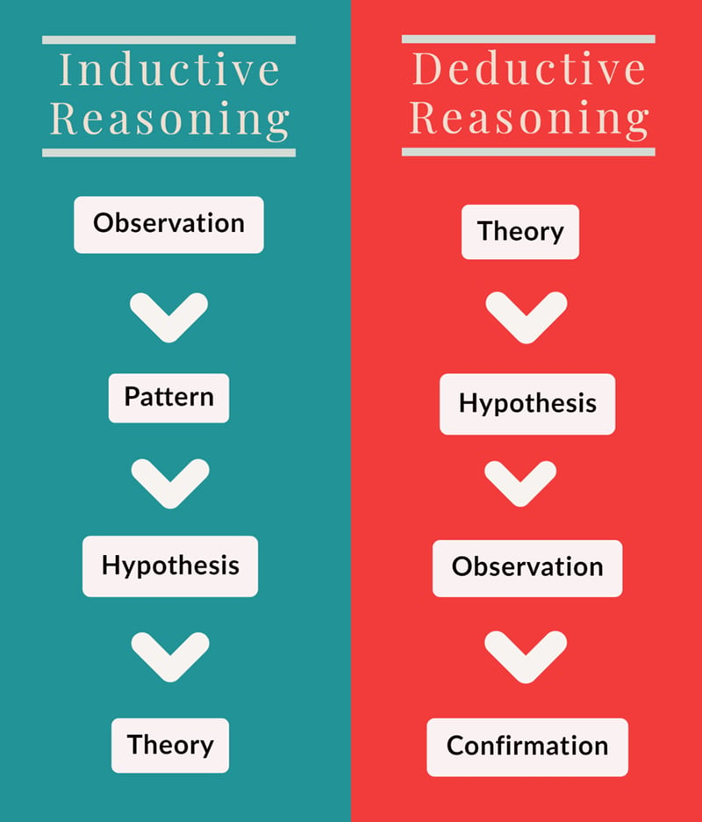
Notes:
https://www.simplypsychology.org/karl-popper.html

Slide 23
Science: proving something to be false rather than proving it to be true
Nothing is certainly true (research question), it is always possible for new information to be discovered.
A hypothesis is tentatively true to date because no evidence has disconfirmed it
It implies that accepted knowledge is always provisional and there are degrees of certainty
Scientific knowledge is always temporary: there are degrees of uncertainty (changes based on new knowledge)
Can you think of any examples related to massage?
Notes:
It is said that it is easier for science to prove something to be false rather than proving it to be true.
The idea of falsification implies that this status is always temporary and that there are degrees of uncertainty.
As new information becomes available, accepted knowledge eventually changes to accommodate and include it

Slide 24
2) Reproducibility of Results
Goal: to prove the consistency of measurements
  obtaining the same result by using the same circumstances (input variables)
  this is the highest standard of validating a hypothesis
Reproducibility v/ Replicability
Reproducibility
  can be defined as obtaining consistent results using the same input variables, methodological and computational steps, and analysis conditions
Replicability
  the process of obtaining consistent results across studies that answered the same scientific inquiry, each of which has obtained its data.
“Method” section in a paper
Notes:
https://www.news-medical.net/life-sciences/What-is-Reproducibility.aspx

Slide 25
Tiers of Reproducibility
Direct replication
  attempts to reproduce a previously observed result by using the same experimental design and conditions as defined in the original study
Analytic replication
  reproducing a series of scientific findings through a re-analysis of the original data set
Systematic replication
  reproducing an experimental finding using different experimental conditions (for example, in a different animal model or cell culture system)
Conceptual replication
  evaluation of data validity using a different set of experimental conditions or methods

Slide 26
Factors Affecting Reproducibility
A lack of access to methodological details, raw data, and research materials.
Use of misidentified, cross-contaminated, or over-passaged cell lines and microorganisms.
Inability to manage complex datasets
Poor research practices and experimental design
Cognitive bias
A competitive culture that rewards novel findings and undervalues negative results
Notes:
https://www.nature.com/articles/d42473-019-00004-y

Slide 27
Ethics in Health Care Research
Code of Ethics applies to research with humans and animals
Goal:
to maximize effort to protect human and animal rights and well-being of study’s participants
Principles:
Full information disclosure of study procedures
  Informed consent
Do everything possible to minimize potential harm to study participants – do no harm
  Make every effort to ensure safety of participants
Notes:
Scientists involved in health care research have a code of ethical principles that must be applied to research involving both human and animal subjects

Slide 28

Hypothesis vs. Theory
Theory:
  well-established principle
  it arises from repeated observation and testing
  incorporates facts, laws, predictions, and tested hypotheses that are widely accepted
  Something that has already been proven multiple times by many researchers
Hypothesis:
  a specific, testable prediction about what you expect to happen in your study.
  Has not yet been proven
Notes:
Methods for investigating research questions (hypotheses) can be qualitative or quantitative
Researcher manipulates the treatment setting and the participants in the study, controlling as much of the environment as possible (laboratory like)

Slide 29
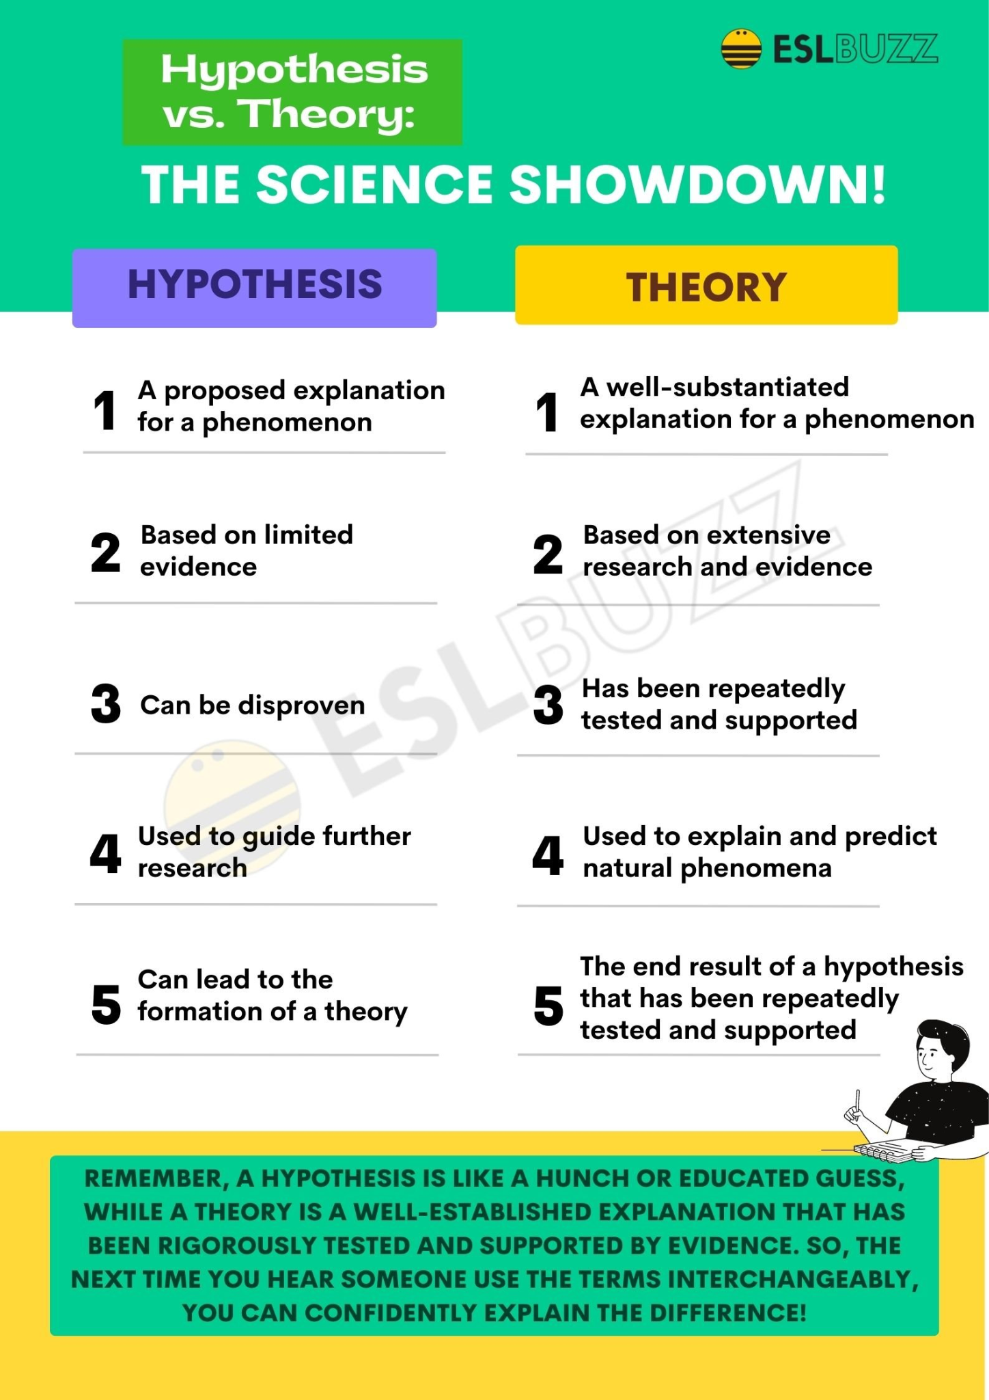
Notes:
https://www.eslbuzz.com/hypothesis-vs-theory/

Slide 30
Characteristics of Hypothesis
Hypotheses have certain characteristics that set them apart from other types of statements. These characteristics include:
Testable:
  A hypothesis must be testable through empirical research. This means that it must be possible to collect data that can either support or refute the hypothesis.
Specific:
  A hypothesis must be specific in its predictions. It should clearly state what is expected to happen and under what conditions.
Falsifiable:
  A hypothesis must be falsifiable, which means that is must be possible to disprove the hypothesis if it is not supported by evidence
Parsimonious
  A hypothesis should be simple and straightforward. IT should not include unnecessary assumptions of variables
Notes:
https://www.eslbuzz.com/hypothesis-vs-theory/

Slide 31
Characteristics of Theory
A theory has several characteristics that distinguish it from other scientific concepts such as hypotheses or laws. Some of the key characteristics of a theory are:
A theory is based on empirical evidence and is supported by multiple lines of evidence.
A theory is constantly evolving and can be modified or refined as new evidence emerges.
A theory is generally accepted as true by the scientific community and is widely used to make predictions and guide research.
A theory is not a guess or a hunch, but a well-substantiated explanation that has been rigorously tested.
Notes:
https://www.eslbuzz.com/hypothesis-vs-theory/

Slide 32
Qualitative vs. Quantitative Research
Quantitative research
collects numerical data and analyzes it using statistical methods
aim is to produce objective, empirical data that can be measured and expressed in numerical terms
quantitative research is often used to test hypotheses, identify patterns, and make predictions.
Qualitative research
collects non-numerical data such as words, images, and sounds
the focus is on exploring subjective experiences, opinions, and attitudes, often through observation and interviews
qualitative research aims to produce rich and detailed descriptions of the phenomenon being studied, and to uncover new insights and meanings.
Notes:
Methods for investigating research questions (hypotheses) can be qualitative or quantitative
Researcher manipulates the treatment setting and the participants in the study, controlling as much of the environment as possible (laboratory like)

Slide 33
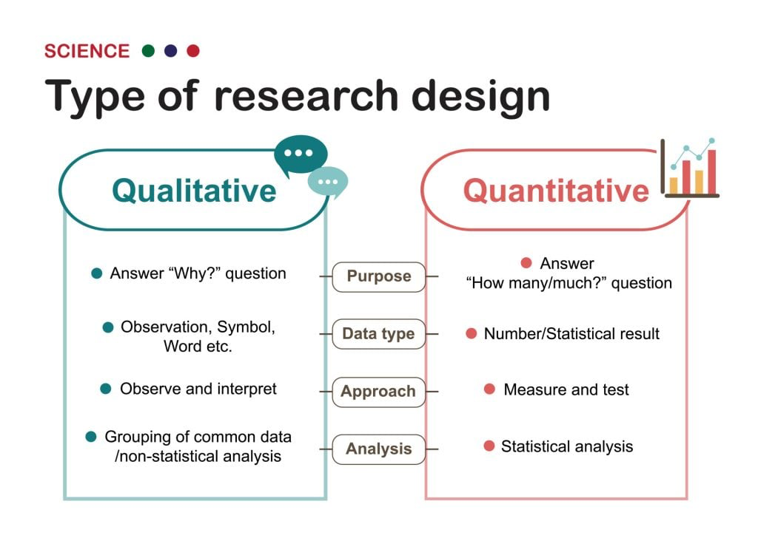

Slide 34
Key Features of Qualitative Research
Qualitative researcher immerses her/himself in the field, in natural surroundings. The contexts of inquiry are not contrived; they are natural. Nothing is predefined or taken for granted.
Qualitative researchers want those who are studied to speak for themselves, to provide their perspectives in words and other actions. Therefore, qualitative research is an interactive process in which the persons studied teach the researcher about their lives.
The qualitative researcher is an integral part of the data; without the active participation of the researcher, no data exists.
The study’s design evolves during the research and can be adjusted or changed as it progresses. For the qualitative researcher, there is no single reality. It is subjective and exists only in reference to the observer.
The theory is data-driven and emerges as part of the research process, evolving from the data as they are collected.

Slide 35
Limitations of Qualitative Research
Because of the time and costs involved, qualitative designs do not generally draw samples from large-scale data sets.
The problem of adequate validity or reliability is a major criticism. Because of the subjective nature of qualitative data and its origin in single contexts, it is difficult to apply conventional standards of reliability and validity. For example, because of the central role played by the researcher in the generation of data, it is not possible to replicate qualitative studies.
Also, contexts, situations, events, conditions, and interactions cannot be replicated to any extent, nor can generalizations be made to a wider context than the one studied with confidence.
The time required for data collection, analysis, and interpretation is lengthy. Analysis of qualitative data is difficult, and expert knowledge of an area is necessary to interpret qualitative data. Great care must be taken when doing so, for example, looking for mental illness symptoms

Slide 36
Advantages of Qualitative Research
Because of close researcher involvement, the researcher gains an insider’s view of the field. This allows the researcher to find issues that are often missed (such as subtleties and complexities) by the scientific, more positivistic inquiries.
Qualitative descriptions can be important in suggesting possible relationships, causes, effects, and dynamic processes.
Qualitative analysis allows for ambiguities/contradictions in the data, which reflect social reality (Denscombe, 2010).
Qualitative research uses a descriptive, narrative style; this research might be of particular benefit to the practitioner as she or he could turn to qualitative reports to examine forms of knowledge that might otherwise be unavailable, thereby gaining new insight.

Slide 37
Key Features of Quantitative Research
Quantitative researchers try to control extraneous variables by conducting their studies in the lab.
The research aims for objectivity (i.e., without bias) and is separated from the data.
The design of the study is determined before it begins.
For the quantitative researcher, the reality is objective, exists separately from the researcher, and can be seen by anyone.
Research is used to test a theory and ultimately support or reject it

Slide 38
Limitations of Quantitative Research
Context: Quantitative experiments do not take place in natural settings. In addition, they do not allow participants to explain their choices or the meaning of the questions they may have for those participants (Carr, 1994).
Researcher expertise: Poor knowledge of the application of statistical analysis may negatively affect analysis and subsequent interpretation (Black, 1999).
Variability of data quantity: Large sample sizes are needed for more accurate analysis. Small-scale quantitative studies may be less reliable because of the low quantity of data (Denscombe, 2010). This also affects the ability to generalize study findings to wider populations.
Confirmation bias: The researcher might miss observing phenomena because of focus on theory or hypothesis testing rather than on the theory of hypothesis generation.

Slide 39
Advantages of Quantitative Research
Scientific objectivity: Quantitative data can be interpreted with statistical analysis, and since statistics are based on the principles of mathematics, the quantitative approach is viewed as scientifically objective and rational
Useful for testing and validating already constructed theories.
Rapid analysis: Sophisticated software removes much of the need for prolonged data analysis, especially with large volumes of data involved (Antonius, 2003).
Replication: Quantitative data is based on measured values and can be checked by others because numerical data is less open to ambiguities of interpretation.
Hypotheses can also be tested because of statistical analysis

Slide 40
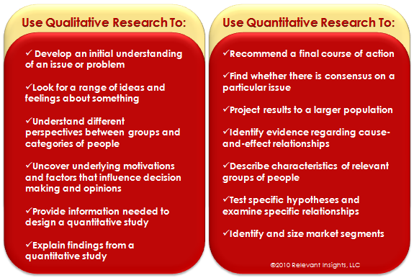

Slide 41


Slide 42
Quantitative & Qualitative
Example 1: Oil painting
Qualitative data:
Yellow/blue color
silver frame
looks old & dated
texture shows brush strokes of oil paint
Appears as a peaceful scene of the country
masterful brush strokes
Quantitative data:
picture is 10" by 14" / with frame 14" by 18"
weighs 8.5 pounds/ surface area of painting is 140 sq. in./ cost $300

Slide 43
Quantitative, Qualitative, or Both?
Quantitative method predominates in health care and medical science
Qualitative method used in sociology, anthropology, psychology, education
Health care: tendency to integrate qualitative and quantitative methods
Both can be used in same study:
Pilot (exploratory) study collects information (survey) enough to make a highly specific and quantifiable hypothesis
Quantitative data may be collected as part of qualitative study (ex: job placement rates before setting up a school program)

Slide 44
Weighing Evidence
When reading a research article, we are assessing the evidence that the authors have presented.
The authors present their findings and their interpretation of those findings
The readers decide whether or not they accept or reject those findings based on the evidence presented.
  Refer to figure 1.1 on page 20

Slide 45
Model 1: Hierarchy of Research Study Designs based on ability to link “cause” and “effect”
Evidence of cause and effect
Kind of study
Systematic review
Meta-analysis
Randomized controlled trial
Cohort study
Before-and-after treatment with control
Case-control study
Cross-sectional study
Before-and-after treatment without control
Evaluate
Groups
Exp.
Designs
Descriptive
Notes:
There are several levels of credibility that different kinds of research studies can provide. Usually is that body of knowledge accumulates, study by study, with different studies, contributing with different kinds of evidence.
Studies from the case report up to the case-control study are considered descriptive or observational (investigator describes what is naturally occurring without interfering in any way and then reporting the observations
The before-and-after treatment with control, cohort study, and randomized control trial are examples of experimental designs. Investigator isi actively intervening, comparing outcomes to outcomes of others and reporting results. Provide stronger link between cause and effect (systematic testing hypotheses).
Meta-analyses and systemic reviews are evaluations of groups of studies on a specific research question. These studies provide strongest evidence between treatment and outcome.

