Slide 1
The Digestive System

Slide 2
The GI Tract
GI = Gastrointestinal
30 ft long – travels mouth to anus
Imperative for long term health, many pathological conditions that can affect it
Functions = Digestion and absorption
The GI tract includes: mouth, esophagus, stomach, small intestine, large intestine (colon), rectum, and terminates at the anus
Liver, gallbladder, pancreas, teeth etc. are accessory structures

Slide 3
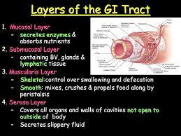
Layers of the GI Tract

Slide 4
Mucosa - Innermost layer
Mucosa: aka mucous membrane.
absorptive and secretory layer.
Composed of three layers:
1) Epithelium: Stratified squamous in the mouth, pharynx, esophagus & anal canal
Simple columnar epithelium with microvilli in the stomach and intestines
Goblet cells are located in the epithelial layer & produce mucus to lubricate the GI tract

Slide 5
Mucosa cont.
2) Lamina propria- contains loose connective tissue and many blood and lymph vessels.
Also has a immune system function, known as MALT - mucosa-associated lymphoid tissue. This is important since we are exposed to many pathogens through the food and drink that we consume.

Slide 6
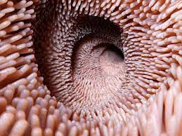
Mucosa cont.
3) Muscularis mucosa - a thin layer of smooth muscle that is in a constant state of tension, pulling the mucosa of the stomach and intestines into many folds or villi which help increase the surface area available for digestion and absorption.

Slide 7
Submucosa
Broad layer of dense connective tissue that connects the mucosa to the muscularis layers
relatively thick, highly vascular, and serves the mucosa.
absorbed elements that pass through the mucosa are picked up from the blood vessels of the submucosa.
also has glands and nerve plexuses.

Slide 8
Muscularis
responsible for segmental contractions and peristaltic movement in the GI tract.
composed of two layers of muscle: an inner circular and outer longitudinal layer of smooth muscle
These muscles cause food to move and mix with digestive enzymes down the GI tract
Mostly smooth muscle, but skeletal muscle in the mouth, pharynx to control swallowing and in the anal sphincter, which controls defecating.

Slide 9
Serosa
AKA Serous membrane
Outermost layer, a protective layer
Only present for the part of the GI tract in the abdominal compartment
composed of avascular connective tissue and simple squamous epithelium.
secretes lubricating serous fluid.
visible layer on the outside of the organs.

Slide 10
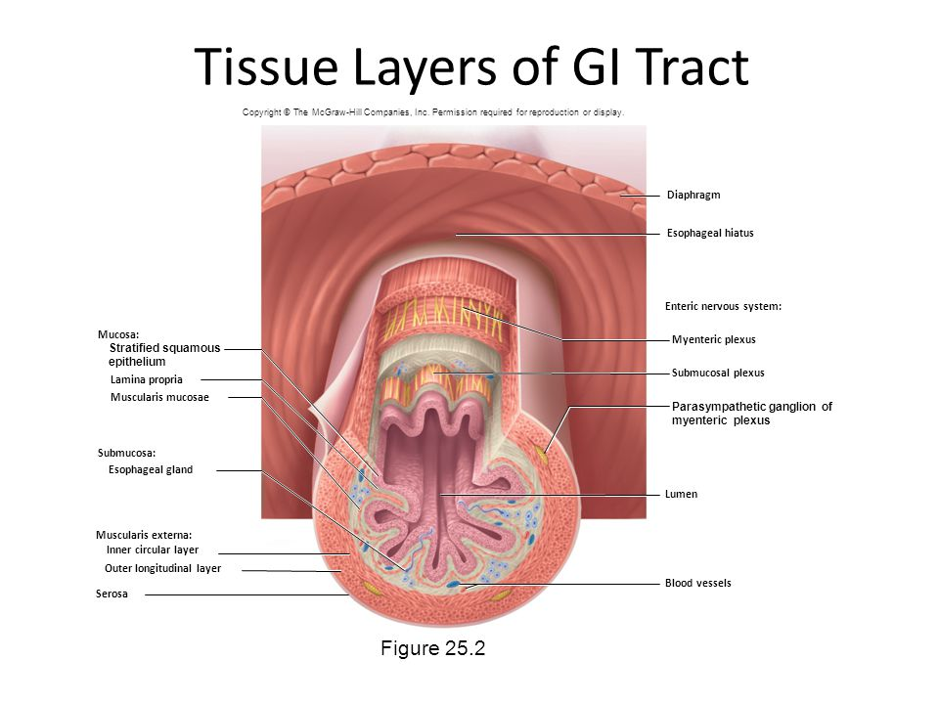

Slide 11
Digestion
Food is the body's source of fuel.
Before food can be used by the individual cells of the body, it has to be broken down into very small absorbable components.
Proteins breakdown into amino acids, Carbohydrates/starches into simple sugars, and
Fats into fatty acids and glycerol.

Slide 12
Digestive System
Made up by the alimentary canal, or the digestive tract, and accessory organs
smooth muscles of the tubular digestive organs move the food efficiently along as it is broken down into absorbable molecules.
During absorption, the nutrients pass through the wall of the small intestine and into the bloodstream and lymph. In this way nutrients can be distributed throughout the rest of the body. In the large intestine there is reabsorption of water and absorption of some minerals as feces are formed.

Slide 13
Processes During Digestion
Mechanical Digestion: larger pieces of food get physically broken down into smaller pieces while being prepared for chemical digestion. Mechanical digestion starts in the mouth with chewing and tongue movements and continues to the stomach.
Chemical Digestion: several different enzymes break down macromolecules into smaller molecules that can be more efficiently absorbed. Chemical digestion starts with saliva and continues into the duodenum.

Slide 14
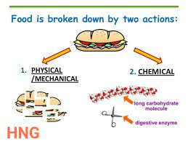

Slide 15
Ingestion and Mastication
Digestion begins in the mouth. Ingestion is the process of putting food and drink into the mouth.
A brain reflex triggers the flow of saliva when we see/think about food.
Saliva moistens the food while the teeth masticate the food (chew it up) and make it easier to swallow. Salivary glands produce an estimated 1-1.5 liters of saliva per day.
Ingestion and mastication are aspects of the mechanical digestion of foods.
Chemical digestion also begins in the mouth, with Amylase enzyme in saliva starting to break down starch into simpler sugars before the food even leaves the mouth.

Slide 16
Swallowing aka Deglutition
happens when the muscles in the tongue and mouth move the food into the pharynx (passageway for food and air, about five inches (5") long.)
Epiglottis closes over the pharynx to prevent food from entering the trachea and thus choking.
For swallowing to happen correctly a combination of 25 muscles must all work together at the same time.
https://youtu.be/Ujr0UAbyPS4?feature=shared
After passing through the throat, the food moves into the esophagus and is pushed down into the stomach by the process of peristalsis

Slide 17
Esophagus
Uses peristaltic action to move swallowed food down to the stomach.
Lined by a stratified squamous epithelium, which serves a protective effect due to the high volume transit of food, saliva, and mucus into the stomach. The lamina propria of the esophagus is sparse.
The muscularis propria of the esophagus consists of striated skeletal muscle in the superior third part of the esophagus. The middle third consists of a combination of smooth muscle and striated skeletal muscle, and the inferior third is only smooth muscle.
The distal end of the esophagus is slightly narrowed because of the thickened circular muscles called the lower esophageal sphincter

Slide 18
Stomach
Thick walled organ located is on the upper left side of the abdominal cavity, just underneath the diaphragm
The stomach is the only part of the digestive system that has 3 layers of muscle.
On the inside of the stomach there are folds of skin called the gastric rugae. Gastric rugae make the stomach very extendable, especially after a very big meal.
The stomach is the location of mechanical digestion from the churning of the three muscle layers AND chemical digestion, especially of proteins.

Slide 19
Stomach
divided into four sections.
  Cardiac region, where the contents of the esophagus empty into the stomach
  Fundus, formed by the upper curvature of the organ
  Body, the main central region
  Pylorus or atrium, the lower section of the organ that facilitates emptying the contents into the small intestine.
Two sphincters, or smooth muscle valves, keep the contents of the stomach contained.
  Cardiac or lower esophageal sphincter - prevents stomach contents from going up into the esophagus
  Pyloric sphincter - dividing the stomach from the small intestine.

Slide 20
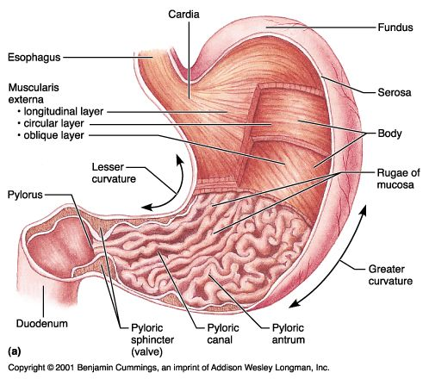

Slide 21
Gastric Juice
Gastric juice - contains an enzyme pepsin (digests proteins,) hydrochloric acid and mucus
We produce about 3L per day
Hydrochloric acid causes the stomach to maintain a pH of about 2 (very acidic), which helps kill off bacteria that comes into the digestive system via food and begins digestion by denaturing proteins (undoes the 3D structure of proteins)
When chewed food mixes with the gastric juice, it becomes a liquid mixture called chyme.
Water, alcohol, salt, and simple sugars can be absorbed directly through the stomach wall. However, most substances in our food need a little more digestion and must travel into the intestines before they can be absorbed.

Slide 22
Gastric Cell Functions
There are many different gastric cells and they secrete many different chemicals.
  Parietal cells secrete hydrochloric acid and intrinsic factor (needed to absorb Vitamin B12)
  Chief cells secrete pepsinogen (the zymogen form of the enzyme pepsin)
  Goblet cells secrete mucus;
  Argentaffin cells secrete serotonin (stimulates peristalsis) and histamine (stimulates production of HCl and pepsin)
  G cells secrete the hormone Gastrin which promotes production of hydrochloric acid and increased motility in the stomach. It is inhibited by pH normally less than 4 (high acid), as well as the hormone somatostatin.

Slide 23
Small Intestine
The small intestine is the site where most of the chemical digestion is carried out, especially of lipids.
The three sections of the small intestine is The Duodenum, The Jejunum, & The Ileum.
Small Intestine is about 20 feet long (3m) and about 1 inch in diameter.
Tiny projections called villi line the small intestine which absorbs digested food into the capillaries. Most of the food absorption takes place in the jejunum and the ileum.

Slide 24
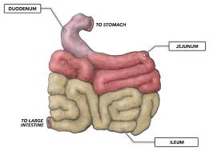

Slide 25
Small Intestine Anatomy & Function - Duodenum
hollow tube connecting the stomach to the jejunum
first and shortest part
almost entirely retroperitoneal (behind the peritoneal membrane)
Where the bile and pancreatic juices enter the intestine at the Ampulla of Vater
Lipids are emulsified here by the presence of bile and chemically digested by the many lipases of pancreatic juice.
Protein and carbohydrate chemical digestion continue in the duodenum.

Slide 26
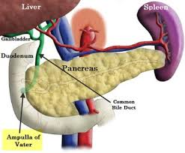
Diagram of the Duodenum & Ampulla of Vater with the Stomach removed.

Slide 27
Duodenal Hormone Production
Cholecystokinin (CCK) stimulates release of pancreatic juice, and also decreases gastric emptying. CCK production is stimulated by high levels of dietary fat in the small intestine.
Secretin,also stimulates pancreatic juice production but will also diminish acid secretion in the stomach.

Slide 28
Small Intestine - Jejunum
Located between the distal end of duodenum and the proximal part of ileum
jejunum and the ileum are suspended by an extensive mesentery (sheet of connective tissue) giving great mobility within the abdomen.
The inner surface is covered in villi, which increase the surface area of tissue available to absorb nutrients
Different from the ileum due to fewer goblet cells and generally lacks Peyer's patches

Slide 29
Small Intestine - Ileum
Primary function is absorption
The wall of the ileum is made up of many folds called villi. The simple columnar epithelial cells which line these villi possess even larger numbers of microvilli.
The terminal ileum absorbs bile salts, and is also crucial in the absorption of fat-soluble vitamins (Vitamin A, D, E and K).
90% of all nutrients from food have been absorbed by the time the chyme leaves the ileum.
Contain Peyer’s patches, oval or round lymphoid follicles (similar to lymph nodes) form an important part of the immune system by monitoring intestinal bacteria populations and preventing the growth of pathogenic bacteria in the intestines
Ileocecal sphincter - regulates the flow of material into the colon.

Slide 30
Colon
AKA Large intestine
End of the ileum to the anus
About 5 feet long. Internal diameter about 2 inches.
It differs from the small intestine by the greater internal diameter, more fixed position, and having a sacculated form.
Functions: absorb water, absorb electrolytes

Slide 31
Colon Continued
Divided into:
  cecum
  Colon
  Rectum
  anal canal
Begins in the right iliac region, with the cecum

Slide 32
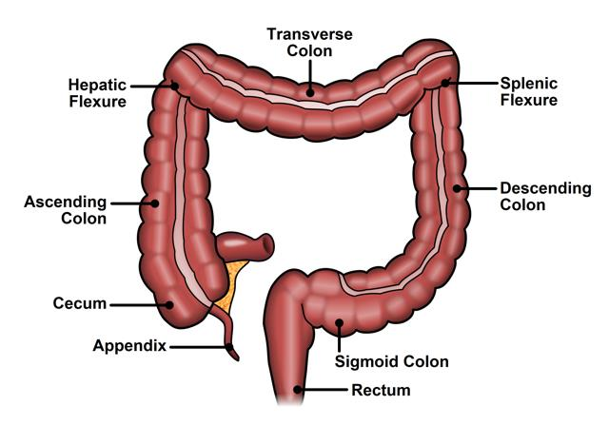

Slide 33
Colon
There are trillions of bacteria, living in our intestines, mostly in the colon.
Over 400 species of probiotic bacteria live in the colon
Helpful organisms synthesize vitamins, like B12, biotin, and vitamin K, stop proliferation of harmful organisms, stimulate the immune system and produce short chain fatty acids that are required for the health of colon cells and to help prevent colon cancer
Most common and important are Lactobacillus Acidophilus

Slide 34
Rectum & Anus
two anal sphincters, one internal, the other external. These hold the anus closed until defecation occurs.
Internal sphincter consists of smooth muscle and its action is involuntary; the external consists of striated muscle and its action is voluntary.
Role of the anus is when the rectum is full, the increase in intra-rectal pressure forces the walls of the anal canal apart allowing the fecal matter to enter the canal. The rectum shortens as material is forced into the anal canal and peristaltic waves propel the feces out of the rectum.

Slide 35
Accessory Organs of Digestion
Salivary glands
  3 sets - Parotid gland, submandibular gland, sublingual gland
  Exocrine gland that produces saliva which begins the process of digestion with amylase
Tongue
  Manipulates food for chewing/swallowing
  Main taste organ, covered in taste buds
Teeth
  For chewing food (mastication)
  32 teeth in adults

Slide 36
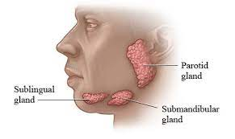

Slide 37
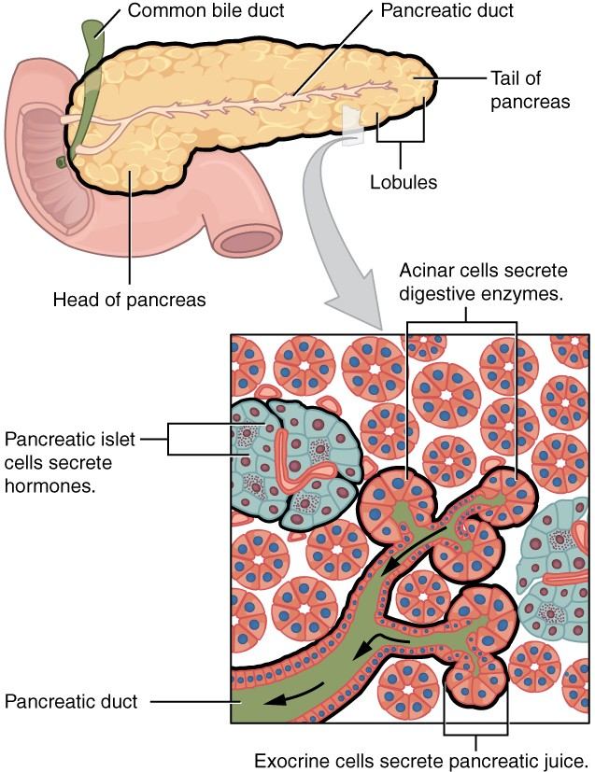
Pancreas

Slide 38
Accessory Organ - Pancreas
located posterior to the stomach and in close association with the duodenum
6-10 inch elongated organ in the abdomen located retroperitoneal (behind the peritoneal membrane)
three regions: a head, body and tail.
pancreatic duct runs the length of the pancreas and empties into the second part of the duodenum at the ampulla of Vater. The common bile duct commonly joins the pancreatic duct at or near this point.

Slide 39
Pancreas
The Pancreas is a unique gland that has both exocrine and endocrine functions.
The exocrine function of the pancreas is to produce enzymes that break down all categories of digestible foods
And the endocrine function is to secrete hormones that affect carbohydrate metabolism - insulin and glucagon.

Slide 40
Exocrine Functions of the pancreas
Exocrine functions: Digestive enzyme secretion. The pancreas secretes many digestive enzymes that help to break down all the macronutrient categories of food.
  Lipase- digests fats.
  Amylase: digests carbohydrates(glycogen and starches)
  Nuclease: digests nucleic acids

Slide 41
Exocrine Pancreas
The Pancreas releases its protein digesting enzymes in an inactive form so they do not damage the organ itself.
Released as zymogens (inactive enzymes) that will be activated when a person eats protein (amino acids).
  Trypsinogen – Trypsin (active enzyme): digests protein.
  Chymotrypsinogen – Chymotrypsin: digests proteins.
Carboxypeptidases: digests proteins.

Slide 42
Exocrine Pancreas
As part of its exocrine gland function, the pancreas produces about 1.5 L per day of the fluid which contains the digestive enzymes.
This fluid contains many bicarbonate ions which helps to neutralize the acidity of the stomach acid, as the two liquids meet at the duodenum of the small intestine.

Slide 43
Pancreas -
Endocrine Functions
Secretes Hormones
  Somatostatin: - inhibits the secretion of pancreatic hormones such as insulin and glucagon as well as pancreatic enzymes
  Glucagon: stimulates the stored glycogen in the liver to convert to glucose when the blood glucose level is low. Effect= raising blood sugar
  Insulin: made in the beta cells of the Islets of Langerhans of the pancreas, helps get glucose into the cells when the blood glucose levels are high. Effect = lowering blood sugar

Slide 44
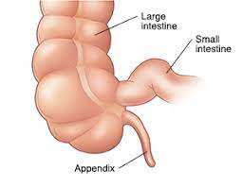
Appendix
The function of the appendix is a bit unclear. People can survive without their appendix.
Some possible functions:
  Immune function (stores many immune cells)
  Helps maintain
gut flora by
storing beneficial
bacteria.

Slide 45
Gallbladder
The gallbladder is a pear shaped organ that stores about 50 ml of bile until the body needs it for digestion. The gallbladder is about 7-10cm and is dark green in appearance due to bile. It is connected to the liver and the duodenum by biliary tract.
Bile exits the liver in the common hepatic duct. This duct joins the cystic duct from the gallbladder to form the common bile duct which dumps into the duodenum at the Ampulla of Vater.

Slide 46
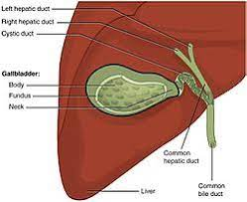

Slide 47
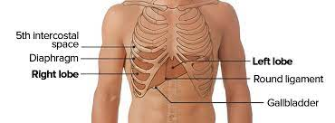
Liver
The liver weighs about 3 lbs. and is a soft, pinkish-brown organ
Largest solid organ (skin is the largest organ) , and the largest gland
Its anatomical position in the body is immediately under the diaphragm on the right side of the upper abdomen, the liver lies on the right side of the stomach and makes a kind of bed for the gallbladder.

Slide 48
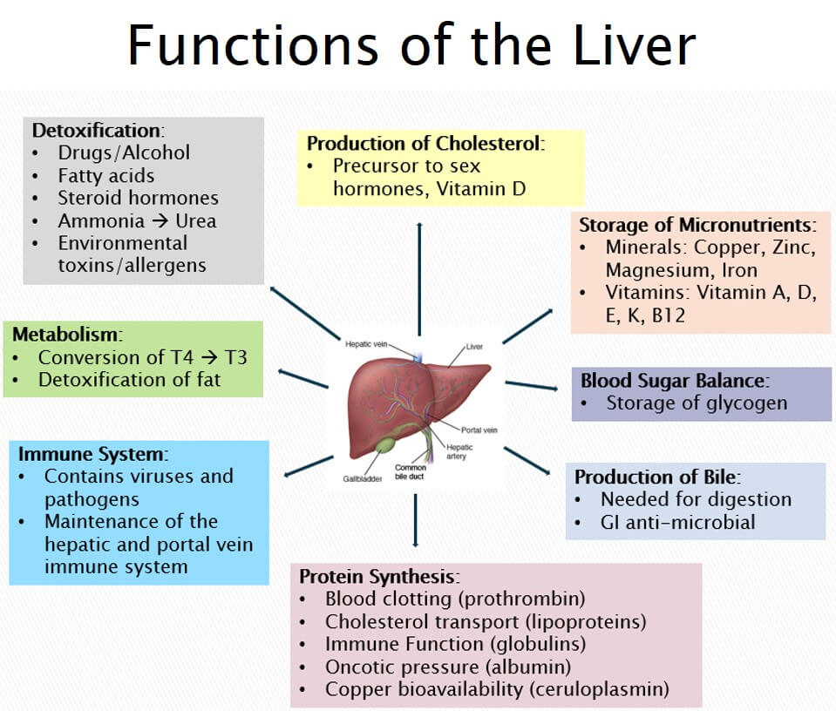
Liver Functions

Slide 49
Functions
Most important function for digestion is bile production.
All hepatocytes (liver cells) produce bile which travels in small channels called canaliculi, which eventually join together to form the common hepatic duct. The bile then leaves the liver and travels either to the gallbladder for storage through the cystic duct OR straight to the duodenum through the common bile duct.

Slide 50
Bile
Bile is a greenish liquid produced by the liver that contains bile salts, cholesterol, bilirubin, phospholipids, electrolytes and water.
Functions:
Alkaline pH that helps neutralize the acidic stomach contents as they enter the duodenum
Emulsify fats. Take large lipids & make many small particles to increase surface area for lipase enzymes to work on.

Slide 51
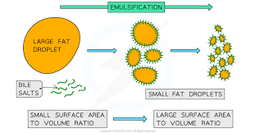

Slide 52
Other Important Liver Functions
Blood sugar balance:
The liver store glycogen & will break it down to glucose when needed through the process of glycogenolysis.
When blood sugar is high, the liver will turn glucose into glycogen through the process of glycogenesis.
Storage: Besides glycogen, the liver also stores Vitamin B12 & fat-soluble vitamins (A,D,E & K)
And the minerals Iron, Copper, Zinc & Magnesium

Slide 53
Important Functions of the Liver
Production: Of Cholesterol (building block of Vitamin D and sex hormones) &
Important proteins that help control bleeding, help carry lipids in the bloodstream, help immune function and more.
Detoxification: of drugs, alcohol, environmental toxins, allergens, steroid hormones etc.
Everything absorbed by the intestines into the bloodstream will go to the liver before anywhere else in the body through the portal vein.

Slide 54
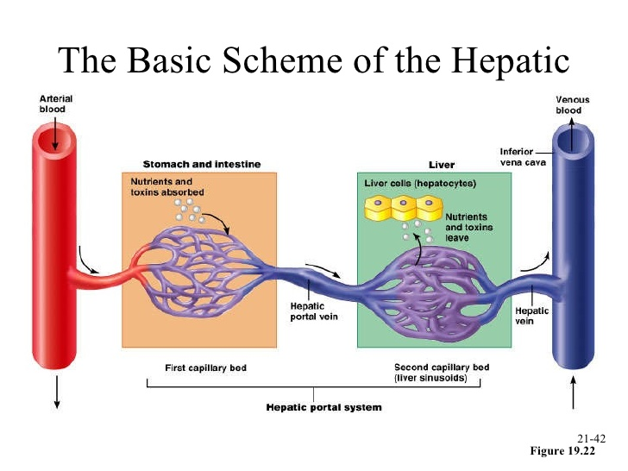
Hepatic Portal Circulation

Slide 55
Other facts about the Liver
Regeneration - The Liver is unique among organs in its ability to regenerate new healthy tissue after removal or damage of up to 75% of its size. This occurs because the hepatocytes retain their stem cell like functions.
Fetal blood supply - In the first two trimesters of pregnancy, the liver is the site of blood cell production. Towards birth, blood cell production will shift to the bone marrow.
https://youtu.be/wbh3SjzydnQ

Slide 56
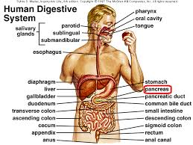
The End

